Slide 1


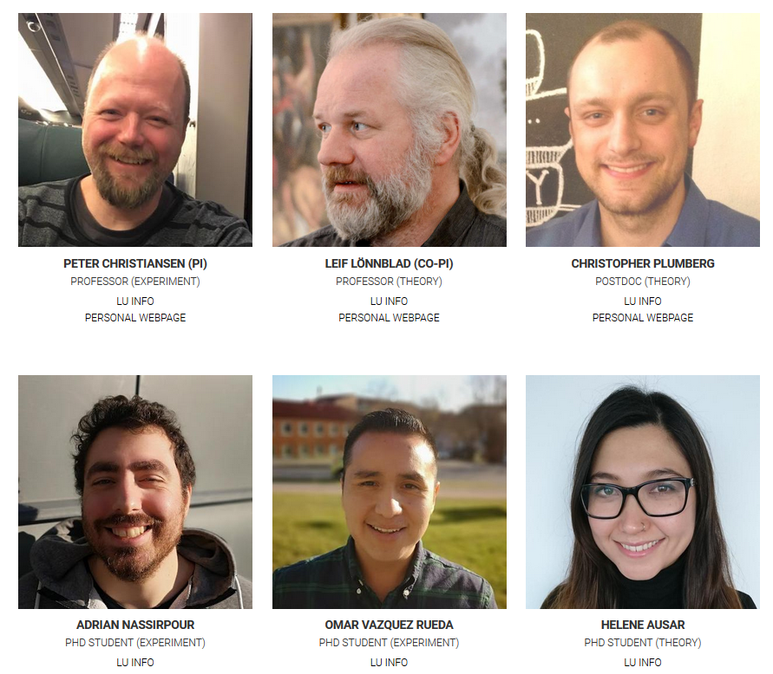
+ several close collaborators and master students
www.hep.lu.se/clash/

Slide 2
How to
pin down the origin of collective effects in small systems:
We want to confront the traditional paradigm for small collisional systems (microscopic models based on quarks and gluons) with the QGP-paradigm originating in large collisional systems (macroscopic models based on relativistic viscous hydrodynamics)

Slide 3
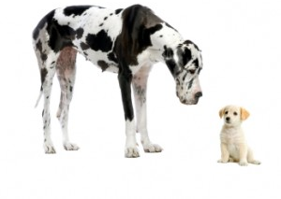
Macroscopic vs microscopic models
Stat. thermal model
Canonical
Grand-canonical
Hydrodynamics
Radial flow
Azimuthal anisotropic
Tunneling of qq̅-pairs
Strings
Ropes
String interactions
Color reconnection
Shoving

Slide 4
The 3 pillars of CLASH
Development of new theoretical models and generators (mainly theory)
Angantyr (covered in this workshop)
Search for jet quenching in small systems (mainly experiment)
Develop new more sensitive experimental measurement methods
Search for the best observables to differentiate between models for QGP-like effects in small systems
Where we CLASH

Slide 5
Best observables: some ideas
Tool to select events with more or less QGP-like effects, e.g., transverse spherocity
Can we prove that strangeness enhancement and flow is correlated (V. Vislavicius, Wednesday)
φ: can this meson with hidden strangeness (S=0) provide insights into the strangeness production (V. Vovchenko, Wednesday)
Hopefully many more to come

Slide 6

But importantly…

Slide 7
For many things
We need help to identify the most sensitive observables to the underlying physics in your model
We need to extend heavy-ion ideas/models to small systems
Very non-trivial as this means to insert mini-jet like physics
We need to develop new more sensitive measurements
We need new fresh ideas

Slide 8
CLASH workshop in August
Continuation of series “International Workshop on QCD Challenges from pp to AA”
August 19-23
Format will be CLASHy
Few or no talks but much interactions
More a Berserk than a Workshop
Goal is to define measurements or calculations needed to make significant progress on a series of open topics

Slide 9

There can be only one!
Thank you!

Slide 10
Backup slides

Slide 11
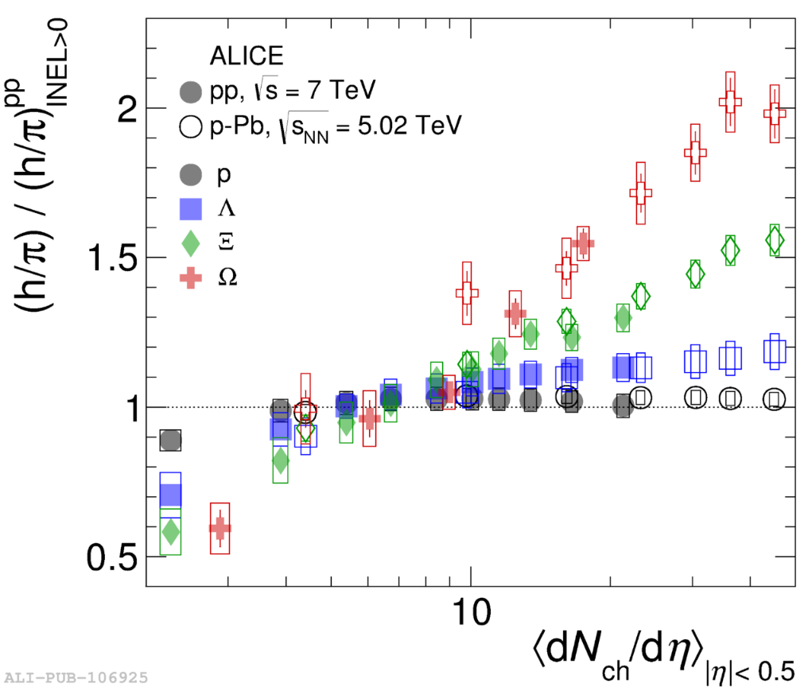
What particle to measure?
“QGPmeter”
My view: we need to establish these methods using bulk particles: π, K, p
And then go to multi-strange hadrons as they are the most sensitive to the QGP-like effects!

Slide 12
φ production in string vs thermal models
φ
s
s̅
q
q̅
s̅
s
String model: Requires 2 string breakings to make a φ
Enhanced with activity in a rope model!
Statistical thermal model: no open strangeness
No canonical suppression (should follow proton)

Slide 13
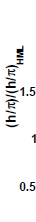
Naïve behavior is more as expected from stronger color field
So it seems that these results would favour a model where the φ production grows with multiplicity, e.g., strings → ropes
https://indico.cern.ch/event/576735/contributions/2566924/

Slide 14
But we should also study correlations for the φ
K+(?)
K-(?)
φ
s
s̅
q
q̅
s̅
s
What to expect?
Strings/ropes (jets): strong φ-K correlations
Stat. thermal model: weak φ-K correlations (there can still be, e.g., intra-jet correlations)
Recombination: weak φ-K correlations ?
My view: if we think there is a change in the hadronization mechanism then we must find a way to probe this change

