Slide 1
Quark-Guon Plasma: the Fastest Rotating Fluid
Michal Šumbera
Nuclear Physics Institute of the CAS, Řež/Prague
Figure from Nature 548, 34–35 (03 August 2017)

Slide 2
Outline
Motivation –subjecting our (hydro) paradigm to scrutiny
Strong magnetic fields and chiral magnetic effect
Fluid vorticity and polarization probes
Barnett- Einstein-de Haas effects / fluid spintronics
Hyperon polarization in Beam Energy Scan I
Extraction of ω & B
broader context & comparison with predictions
Outlook & Summary

Slide 3
The QCD Phase Diagram and BES
Large μ_{B}
FAIR (2025)
NICA (2020)
J-PARC (?)
RHIC(FXT)
Large E
LHC, RHIC
2
RHIC
SPS
2000–2012: RHIC+LHC
Top energy program
Discovery of sQGP
- QCD Critical Point?
- Chiral effects?
2010–2017: RHIC BES-I
7.7, 11.5, 14.5, 19.6, 27, 39, 54.4 GeV
2019–2020: RHIC BES-II
7.7, 9.1, 11.5, 14.5, 19.6 GeV
FXT*: 3.0, 3.5, 3.9, 4.5, 7.7 GeV
2022 – : RHIC+FAIR BES-III
Fixed-target programs
1
3
5000 200 20 2 √s_{NN} (GeV)

Slide 4

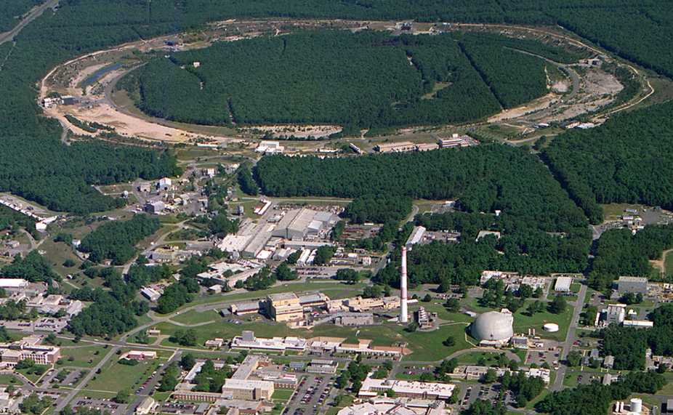
Relativistic Heavy Ion Collider Brookhaven National Laboratory (BNL), Upton, NY
Year | System | √s_{NN} [GeV]
2000 | Au+Au | 130
2001 | Au+Au | 200
2002 | p+p | 200
2003 | d+Au | 200
2004 | Au+Au p+p | 200, 62.4 200
2005 | Cu+Cu | 200, 62.4, 22
2006 | p+p | 62.4, 200, 500
2007 | Au+Au | 200
2008 | d+Au, p+p Au+Au | 200 9.2
2009 | p+p | 200, 500
2010 | Au+Au | 200, 62.4, 39, 11.5, 7.7
2011 | Au+Au p+p | 200,19.6,27 500
2012 | U+U Cu+Au p+p | 193 200 200,510
PHOBOS
BRAHMS
RHIC
PHENIX
STAR
AGS
2013 | p+p | 500
2014 | Au+Au ³He+Au p+p | 200,14.5 200 500
2015 | p+Au, p+Al, p+p | 200
2016 | Au+Au p+p | 54 510
2017 | Au+Au d+Au | 200 200, 62.4, 39, 22
2018 | ⁹⁶Zr+⁹⁶Zr, ⁹⁶Ru+⁹⁶Ru Au+Au | 200 27
TANDEMS
World’s (second) largest operational heavy-ion collider
World’s largest polarized proton collider
Animation M. Lisa

Slide 5
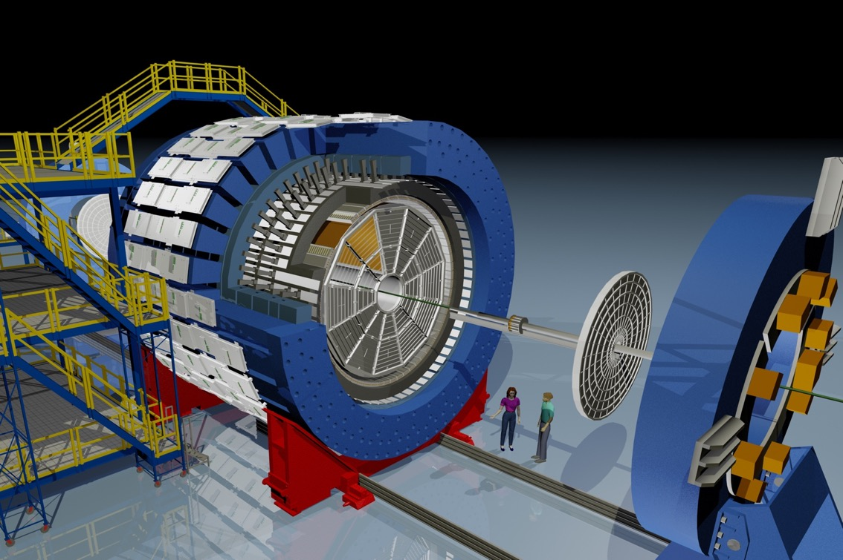

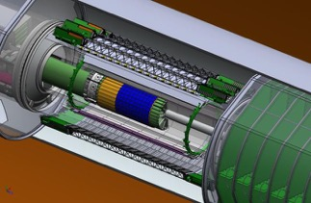
STAR Beam Energy Scan Program
EEMC
Magnet
MTD
BEMC
TPC
TOF
iTPC
EPD
1) Turn-off of sQGP signatures
2) Search for the signals of phase boundary
3) Search for the QCD critical point
- Powerhouse at RHIC
Needs upgrades for
the future of RHIC
http://arxiv.org/abs/1007.2613
HFT

Slide 6
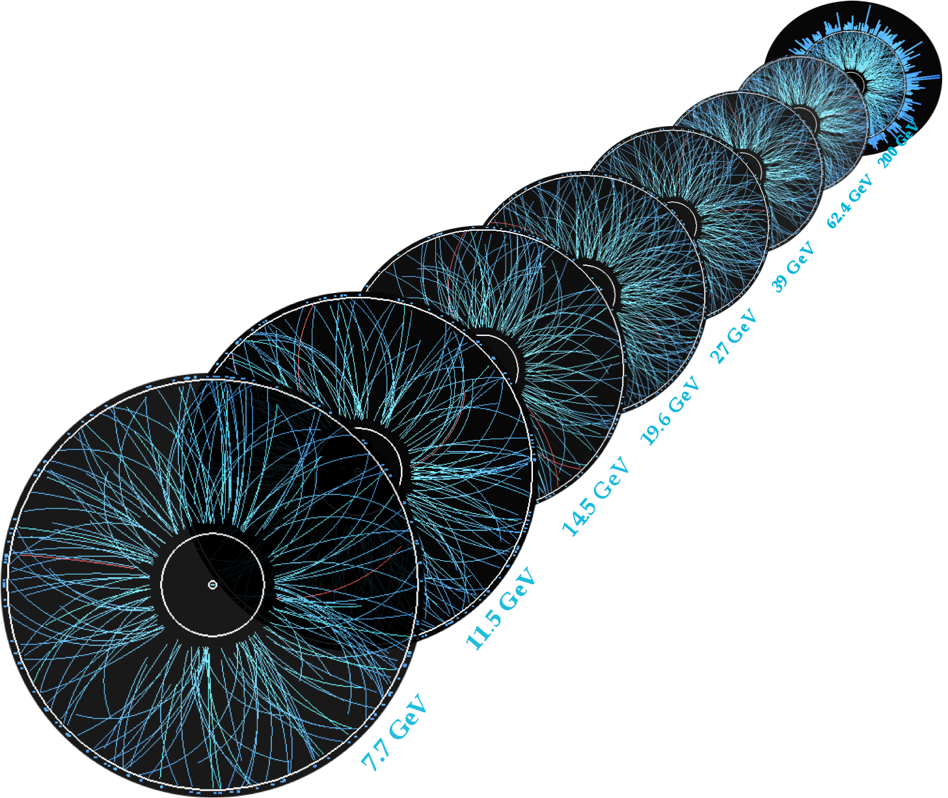
BES-I Au+Au Data Taking
Largest data sets versus collision energy!!!
STAR: Phys.Rev. C 96 (2017) 044904
√s_{NN} [GeV] | events(10⁶) | Year
200 | 350 | 2010
62.4 | 67 | 2010
54.4 | 300 | 2017
39 | 130 | 2010
27 | 70 | 2011
19.6 | 36 | 2011
14.5 | 20 | 2014
11.5 | 12 | 2010
7.7 | 5 | 2010
4.9 (FXT) | 3.4 | 2015
4.5 (FXT) | 1.3 | 2015
7.7 GeV 39 GeV 200 GeV
π
K
p
Geometric acceptance @ collider mode remains the same, track density gets lower.
Detector performance generally improves at lower energies.
Excellent particle identification capabilities. Large and homogeneous acceptance.
Especially important for fluctuation analysis

Slide 7
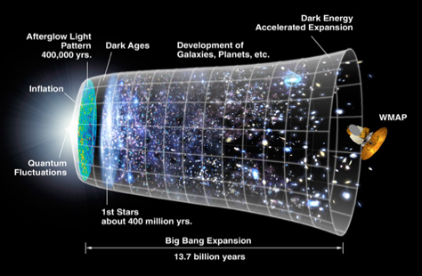
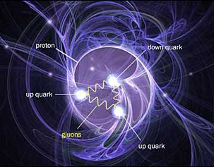

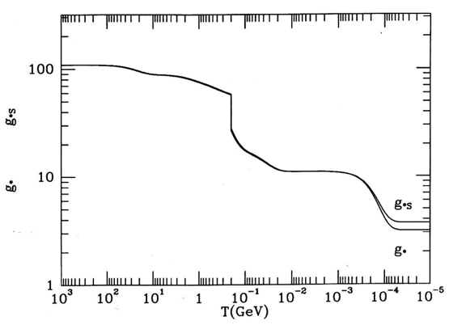
What we’re after*
The Universe
QCD
Higgs
Credit: NASA
Fundamental understanding of the Strong Interaction
confines color
generates ~95% of visible mass
QCD Transition
Thermodynamic degeneracy
*) Many references, including those to the other reviews can be found in R. Pasechnik, M. Šumbera: Phenomenological Review on Quark–Gluon Plasma: Concepts vs. Observations,
Universe 3 (2017) no.1, 7, arXiv:1611.01533
The Early Universe, Kolb & Turner

Slide 8
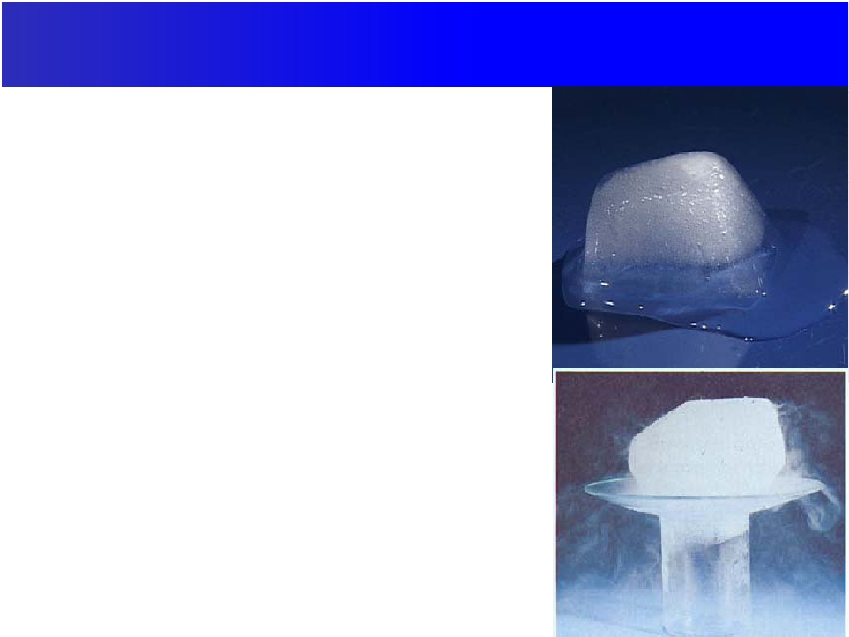
Surviving the tyranny of asymptotic freedom*
The conceptual beauty of asymptotic freedom was (is) hugely prejudicial for the QCD phase transition:
Rather than ice melting to liquid water
Thought it would be like the sublimation of frozen CO₂ to gas, i.e, QCD phase transformation like “sublimation” of (p,n) ➔ (q,g)
*) Slide adapted from Bill Zajc

Slide 9
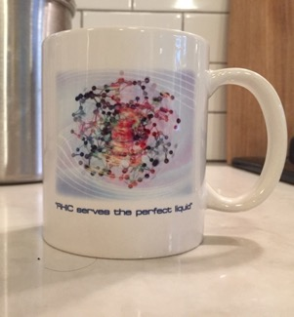
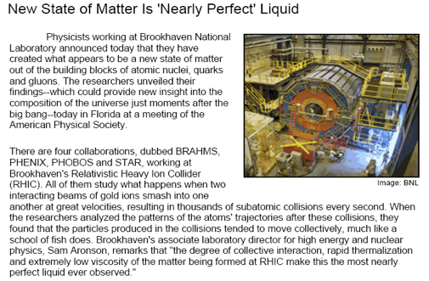
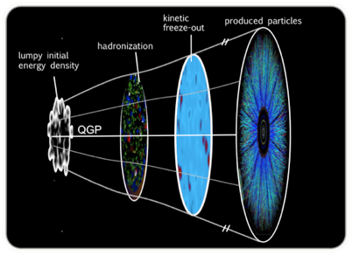
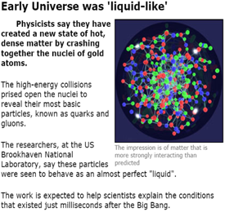
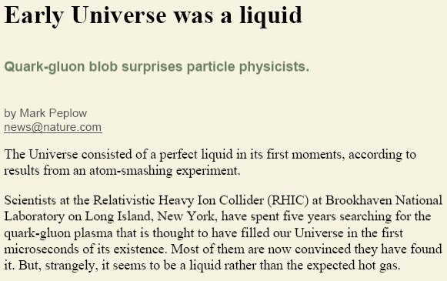
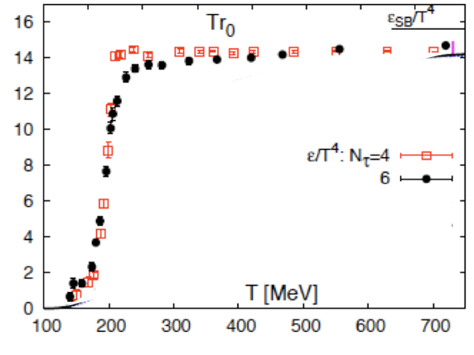

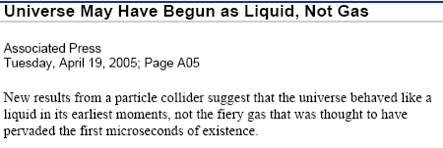
What we found
1) Quenching
All hard hadronic process are strongly quenched
2) Flow
Panta rhei: All soft particles emerge from the common flow field
Lattice QCD:
weakly-interacting parton gas
The lattice calculations were not wrong. Our physical understanding based on them was wrong (weakly vs strongly coupled).
detailed experimental probes dislodged our misconceptions
Hydro treatment is now a crucial element of H.I.C. Standard Model*
Access to Equation of State, transport coefficients, time evolution
We must continue to subject our new paradigm to detailed experimental scrutiny
Even assuming hydro: Do we sufficiently understand the fluid structure?
QCD Transition
~ Thermodynamic degeneracy
F. Karsch, arXiv:0711.0656 [hep-lat]
Thermodynamic degeneracy
ideal non-interacting gas?
Edward Shuryak, Strongly coupled quark-gluon plasma in heavy ion collisions, Rev.Mod.Phys. 89 (2017) 03500
The Early Universe, Kolb & Turner
*) All hard hadronic process are strongly quenched, all soft particles emerge from the common flow field

Slide 10
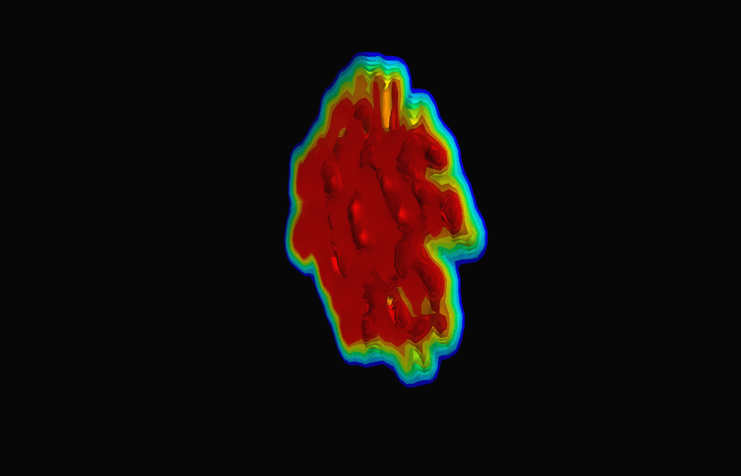
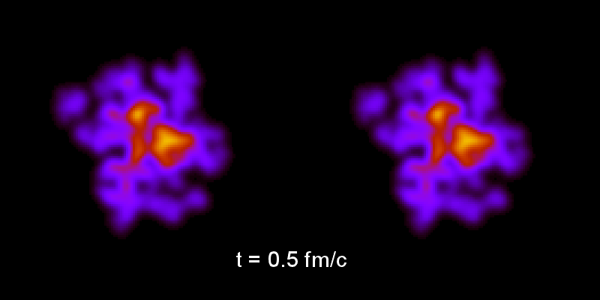


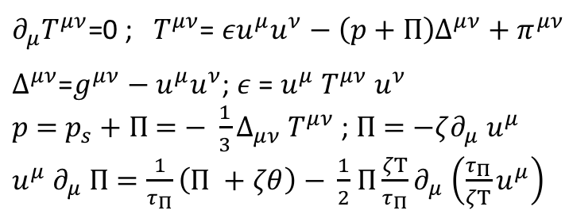
Hydrodynamics – standard paradigm of H.I.C
movies by Bjorn Schenke
Modern approach*:
Fluid dynamics is a long-wavelength
effective theory based on knowledge of the effective degrees of freedom, and the symmetries of the system under consideration.
From a (lumpy) initial state, solve hydro equations:
N.B. For Bjorken flow $u^{μ}$= $x^{μ}$/ $τ:$
$∂_{μ}T^{μν}$=0 ; $T^{μν}$=$εu^{μ}u^{ν}−\left(p+Π\right)Δ^{μν}+π^{μν}$
$∆^{μν}$=$g^{μν}−$ $u^{μ}u^{ν}$; $ε$ = $u^{μ}$ $T^{μν}$ $u^{ν}$
$p$ $=$ $p_{s}+$ $Π$ $=$ $− \frac{1}{3}Δ_{μν}$ $T^{μν}$ ; $Π$ $=$ $−ζ∂_{μ}$ $u^{μ}$
$u^{μ}$ $∂_{μ}$ $Π$ $=\frac{1}{τ_{Π}}\left(Π +ζθ\right)$ $− \frac{1}{2}$ $Π{\frac{ζΤ}{τ_{Π}}∂}_{μ}$ $\left(\frac{τ_{Π}}{ζΤ}u^{μ}\right)$
$\frac{dε}{dτ}$ $=−\frac{ε+p_{s}}{τ}\left(1−\frac{4}{τΤ}\frac{η}{s}−\frac{1}{τΤ}\frac{ζ}{s}\right)$
*) For recent reviews of new theories of relativistic hydrodynamics:
P. Romatschke, U. Romatschke, arXiv:1712.05815
W. Florkowski, M.P. Heller and M. Spalinski, arXiv:1707.02282
P. Romatschke, PRL 120(2018) 012301
& many more terms... (gradient expansion)

Slide 11
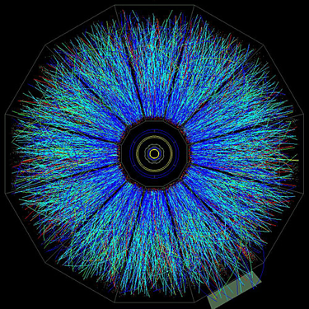
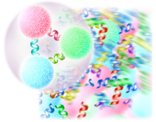
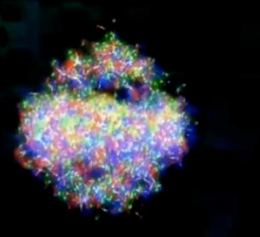

Connection to experiment – freeze-out
movies by Bjorn Schenke
emitted hadron
(color confined)
System cools & expands → Freeze-out
Cooper-Frye prescription* – “physics-free”.
Emitted hadrons reflect properties of their parent hydro cell (chemical potentials, thermal and collective velocities).
*)
fluid cell at
freeze-out
QGP fluid:
colored quarks deconfined

Slide 12
Hydro works for A+A collisions at RHIC and LHC
P. Romatschke, U. Romatschke, arXiv:1712.05815
z
V_{n}=⟨cos[n(φ−Ψ_{RP})]⟩
x
Radial Flow
Elliptic Flow

Slide 13
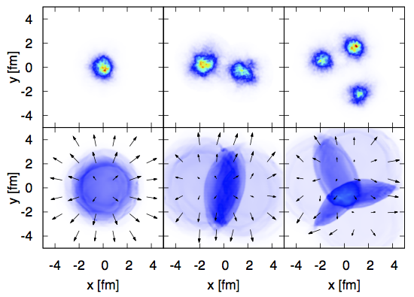
..and for (p,d,³He)+Au at RHIC!!!
B. Schenke, Nucl.Phys. A967(2017)105
PHENIX, arXiv:1710.09736
p+Au
d+Au
³He+Au
PHENIX, Phys.Rev.Lett. 115 (2015)142301
V_{n}=⟨cos[n(φ−Ψ_{RP})]⟩
sQGP ⇒ FSI dominates momentum space correlations ⇒ final state is very sensitive to the initial shape of the collision system.
⇒ Using varying small projectiles (p, d, or ³He) to modify the average geometry one expects modification of the measured ellipticity and triangularity coefficients v₂ and v₃.

Slide 14
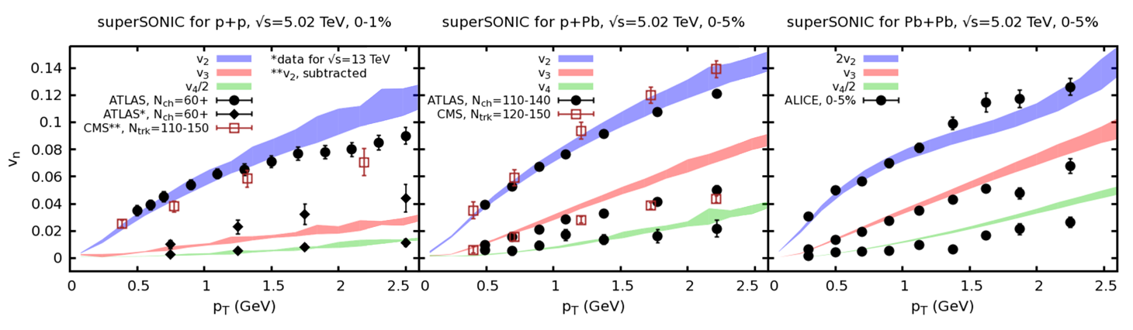
... and even for high-multiplicity p+p events at LHC !!!
R.D. Weller, P. Romatschke, Phys.Lett. B 774 (2017) 351
p+p
p+Pb
Pb+Pb
Using initial conditions that allow for nucleon substructure in the form of three valence quarks all collision systems can be described simultaneously with a single set of fluid parameters.

Slide 15
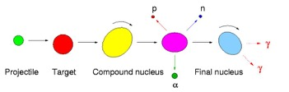
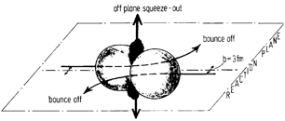
Developing a finer probe/test of hydro
V₂>0: (rotating) compound nucleus formation
V₂>0: strongly interacting matter
V₂>0: in-plane
V₂<0: out-of-plane
V₂<0: shadowing
by spectators
(squeeze-out)
Au+Au, Pb+Au or Pb+Pb
A≈200

Slide 16
Developing a finer probe/test of hydro
Non-central heavy ion collisions: J ~ 10⁵ ħ ≈ N_{part} × (√s_{NN}/2) × b)
N.B. Calculations behind the “perfect fuid” story neglect angular momentum altogether.
Effect on hydrodynamic system?
What is the experimental probe?
P. Carruthers, Nuclear Physic A418 (1984)501c – Proc. Quark Matter II
…note that if the excitations are energized
in a nucleus-nucleus collision, considerable angular momentum is likely to be concentra-ted in vorticle eddies, which could decay as coherent blasts of vector particles …

Slide 17
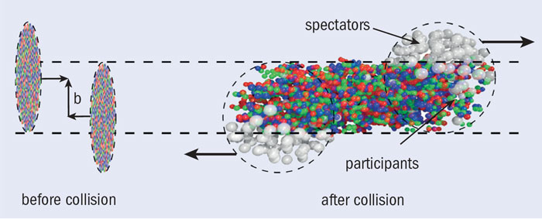
A finer probe?
Non-central collision: J ~ 10⁵ ħ
In a hydrodynamic picture, relevant quantity is vorticity
How would this manifest experimentally?

Slide 18
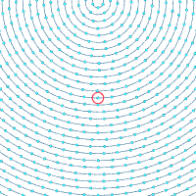
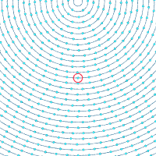
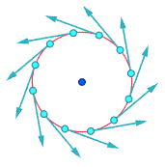
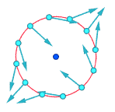
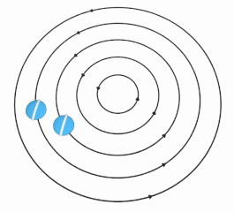
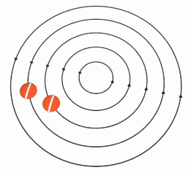
Rotational & irrotational vortices
Rotational Vortex (e.g. rigid body):
Irrotational Vortex (e.g. tub drain):

Slide 19
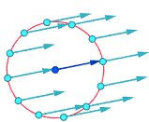
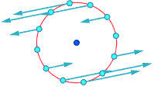
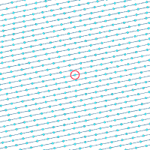
Shear field vorticity
In collision c.m. frame
In local frame of fluid cell
Localized vortex generation via baryon stopping
Viscosity dissipates vorticity to fluid at larger scale
More natural structure for plasma from nuclear collision:

Slide 20
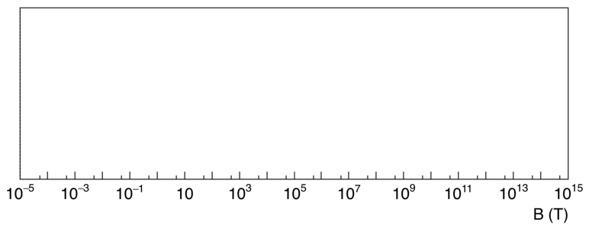
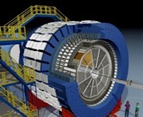
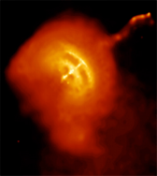
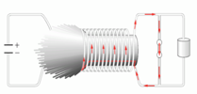
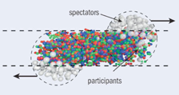

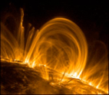

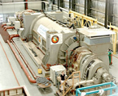
Intermezzo: Magnetic Fields in A+A
with explosive charges
pulsars
QGP ???
sun spot
National High
Magnetic Field Lab
Notes:
Earth (at pole) : 6e-5
Refrigerator magnet .01
STAR magnet 0.5
sunspots 0.5 (surprisingly low!)
strongest sustained fields in the lab (national high magnetic field lab) 45
strongest manmade fields. (By explosive charges – lasted only a few microseconds) 1000
strongest fields ever detected on non-neutron stars (just a few white dwarfs) 1e4
pulsars ~ 5e8
magnetars 5e10
QGP? 6e13

Slide 21
Heavy ion collisions –
source of the strongest magnetic ﬁelds
Biot-Savarat law:
Kharzeev, McLerran, Warringa,
Nucl PhysA803(2008)227
😩
Au+Au collisions at √s_{NN}= 200 GeV

Slide 22
Magnetic field evolution in the presence of QGP medium
The time-evolution and the strength of magnetic field are strongly affected by the electrical conductivity σ(t) of the plasma.
K. Tuchin: Phys.Rev. C93 (2016) no.1, 014905
γ= 100 (RHIC)
γ = 2000 (LHC).
😋
😋
Magnetic field in units of m²_{π}/e . σ = 5.8 MeV, z = 0.2 fm t₀ = 0.2 fm. Solid, dashed and dotted lines stand for B , B_{init} and B_{val}.

Slide 23
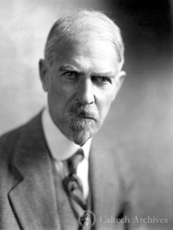
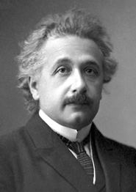
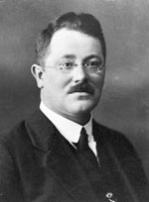
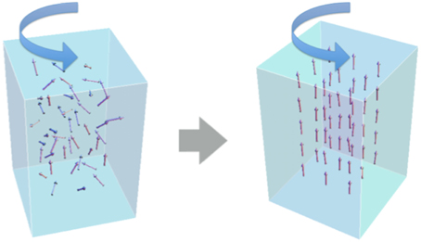
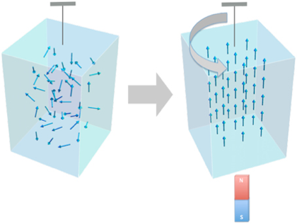

One year, two discoveries
Barnett Effect (1915)
$\vec{B}=\vec{ω}$/$γ$
Einstein-de Haas Effect (1915)
Μ=χω/γ
Μ – magnetization
γ – gyromagnetic ratio
χ – magnetic susceptibility
S. J. Barnett, Rev. Mod. Phys. 7 (1935) 129
uncharged metal object:
mechanical rotation → magnetization
unmagnetized metal object:
introduce B-field → mechanical rotation
spin alignment
spin alignment

Slide 24
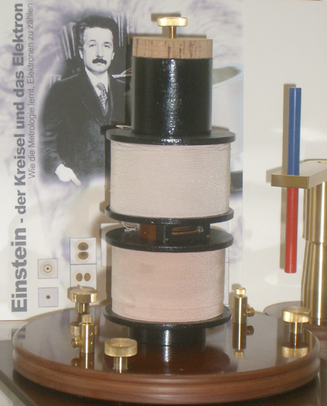
Einstein-de Haas Effect (1915)
This is the only experimental result Einstein published
(* N.B. electron spin discovered in 1925)

Slide 25
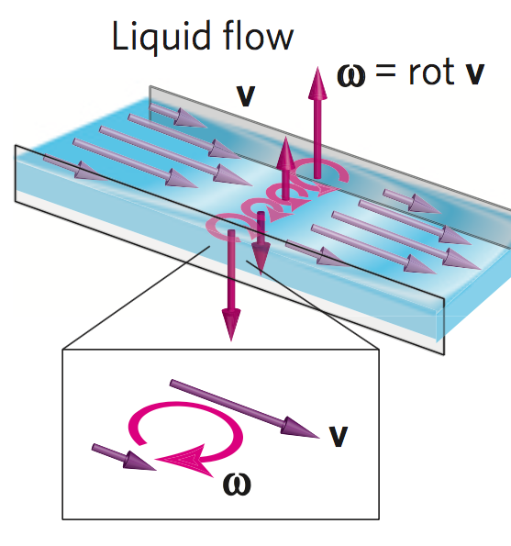
First observation of vorticity-polarization coupling
Takahashi, et al. : Spin hydrodynamic generation, Nature Physics 12, 52–56 (2016)
1
Hg flowing down a channel
viscous forces with walls → fluid vorticity

Slide 26
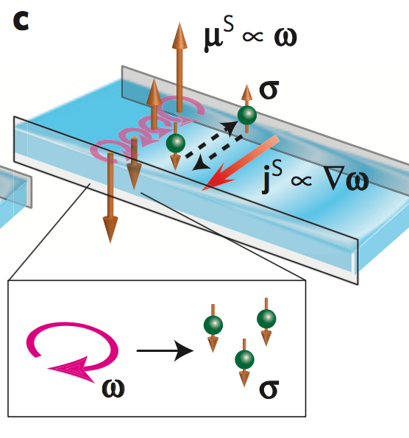
First observation of vorticity-polarization coupling
Takahashi, et al. : Spin hydrodynamic generation, Nature Physics 12, 52–56 (2016)
μ^{S} = spin chemical potential
2
Hg flowing down a channel
viscous forces with walls ⇒ fluid vorticity
mechanical fluid vorticity ⇒ e⁻ polarization

Slide 27

First observation of vorticity-polarization coupling
Takahashi, et al. : Spin hydrodynamic generation, Nature Physics 12, 52–56 (2016)
3
Hg flowing down a channel
viscous forces with walls ⇒ fluid vorticity
Mechanical fluid vorticity ⇒ e⁻ polarization
Gradient across channel ⇒ spin voltage
... can be transformed into electrical voltage, generators, etc. without magnets
“This opens a door to the new field of fluid spintronics”
Notes:
How they measure the spin voltage:
“To detect spin voltage in a fluid, we have used the inverse spin Hall effect (ISHE). The ISHE converts a spin current into an electric field EISHE through the spin–orbit interaction of electrons. “

Slide 28
Local vorticity and polarization
Fine-scale vorticity at the “point” cell is reflected in the spin of emitted particles
first suggested by
Z.-T. Liang and X.-N.Wang, Phys. Rev. Lett. 94(2005), 102301
Betz et al., Phys.Rev. C76 (2007) 044901
Becattini et al., Phys.Rev. C77 (2008) 024906

Slide 29

Subatomic spintronics
Barnett, Einstein-de Haas, Takahashi et al.
straightforward to measure both
Our experimental situation is a little tougher...
How to measure polarization?
What is the direction of the vorticity?
...but we benefit from their validation of the connection

Slide 30

They had the electron, we have Λ*
*) Strategy to measure global polarization of produced quarks using spin alignment of vector mesons
was first suggested in Z.-T. Liang and X.-N. Wang, Phys. Lett. B629 (2005) 20.

Slide 31

They had the electron, we have Λ
Lambdas are “self-analyzing”
reveal polarization by preferentially emitting daughter proton in spin direction of Λ

Slide 32

Global polarization – alignment of with
LS coupling can generate a spin alignment, or polarization, along the direction of the vorticity in the local fluid cell, which, when averaged over the entire system, is parallel to J_{sys}.
Polarization measurements of hadrons emitted from the fluid can be used to determine ω ≡ |𝛚|.

Slide 33




Global polarization

Slide 34

Global polarization
Ν.Β. μ_{Λ} = −0.613 ± 0.04 μ_{Ν}
Both effects may be active

Slide 35




Contributors to Global Polarization
Known effect in p+p collisions [e.g. Bunce et al., PRL 36 (1976) 1113]
Lambda polarization at forward rapidity relative to production plane
p
p
Vortical: Magnetic
Polarization w/ production plane:
No integrated effect at midrapidity for Lambda
no effect at all for AntiLambdas

Slide 36



Slide 37

Lambdas are found topologically using identified protons and pions

Slide 38



Event plane resolution
Event-plane resolution $R_{EP}^{(1)}$
obtained from correlation of two event plane vectors of two random sub-events
best for mid-central collisions
significantly worse at higher energy
errorbars

Slide 39

First global polarization signal
Systematic uncertainty (dominated by combinatorial background) small relative to statistical uncertainty
vortical coupling dominant
tantalizing suggestion (but no claim!) of additional magnetic coupling
Signal falls with energy (large errorbars...)
previous “null” result in line with the trend
STAR Collaboration, Nature 548 62 (2017)

Slide 40
200GeV update
New result at √s_{NN} =200 GeV with 150× larger statistics give P_{H}=0.277±0.040(stat)±0.049(sys) % for 𝛬 and P_{H}=0.240±0.045(stat)±0.065(sys) % for anti-𝛬
Polarization is found to decrease at higher collision energy
Model calculations for primary 𝛬 and all 𝛬 taking into account feed down from 3+1D hydro vHLLE with UrQMD initial condition agree within accuracy with experimental data.
Calculation using Multi-Phase Transport (AMPT) slightly overpredict data but are still in a good agreement within current experimental accuracy.
STAR preliminary
STAR Collaboration, Phys.Rev. C98(2018)014910

Slide 41
Including results from LHC (ALICE)
S. Voloshin @ SQM 2017, Arxiv:1710.08934

Slide 42

Extracting vorticity and magnetic field
Magneto-hydro equilibrium interpretation*
for small
polarization:
vorticity from sum:
B-field from difference:
*)Becattini, Karpenko, Lisa, Upsal, Voloshin Phys. Rev. C95 (2017) 054902

Slide 43

Extracted Physical Parameters
Significant vorticity signal
(probably) falling with collision energy, despite increasing J_{sys}
Magnetic field
positive value would be expected
2σ above zero, averaged over all BES energies
Higher statistics dataset for 27 GeV in run 2018 ⇒ hope for 5σ measurement

Slide 44

Perspective
Ocean surface vorticity (NOAA)
http://sos.noaa.gov/Datasets/dataset.php?id=604
ocean flows: ω ~ 10⁻⁵ s⁻¹
terrestrial atmosphere: ω ~ 10⁻⁴ s⁻¹
Lund
zero
vorticity as of 6:00 UTC 26 Feb 2019
http://tropic.ssec.wisc.edu/real-time/europe/winds/wm7vor.GIF

Slide 45


Perspective
ocean flows: ω ~ 10⁻⁵ s⁻¹
terrestrial atmosphere: ω ~ 10⁻⁴ s⁻¹
core of supercell tornado: ω ~ 10⁻¹ s⁻¹
Doppler radar measurement of supercell tornado system, 21 May 1998, Bridgeport, Nebraska
J. Wurman et al., Mon. Weather Rev. 135, 2392 (2007)

Slide 46



Perspective
ocean flows: ω ~ 10⁻⁵ s⁻¹
terrestrial atmosphere: ω ~ 10⁻⁴ s⁻¹
core of supercell tornado: ω ~ 10⁻¹ s⁻¹
solar subsurface flow: ω ~ 10⁻⁶ s⁻¹
“Collar” of Jupiter’s Great Red Spot: ω ~ 10⁻⁴ s⁻¹
D. Choi et al, Icarus 188 (2007) 35
solar subsurface vorticity, 2002 R. Komm et al., Astrophys. J. 667, 571 (2007)

Slide 47

Perspective
ocean flows: ω ~ 10⁻⁵ s⁻¹
terrestrial atmosphere: ω ~ 10⁻⁴ s⁻¹
core of supercell tornado: ω ~ 10⁻¹ s⁻¹
solar subsurface flow: ω ~ 10⁻⁶ s⁻¹
“Collar” of Jupiter’s Great Red Spot: ω ~ 10⁻⁴ s⁻¹
Heated, rotating soap bubbles: ω ~ 10² s⁻¹
Intensity of vortices: from soap bubbles to hurricanes
T. Meuel, et al, (Nature) Scientific Reports 3 (2013) 3455

Slide 48


World’s record
ocean flows: ω ~ 10⁻⁵ s⁻¹
terrestrial atmosphere: ω ~ 10⁻⁴ s⁻¹
core of supercell tornado: ω ~ 10⁻¹ s⁻¹
solar subsurface flow: ω ~ 10⁻⁶ s⁻¹
“Collar” of Jupiter’s Great Red Spot: ω ~ 10⁻⁴ s⁻¹
Heated, rotating soap bubbles: ω ~ 10² s⁻¹
Max vorticity in bulk superfluid He-II: ω ~ 150 s⁻¹
R. Donnelly, Ann. Rev. Fluid Mech. 25 (1993) 325
Max vorticity in nanodroplets of superfluid He-II: 10⁶ s⁻¹
Gomez et al, Science 345 (2014) 903

Slide 49




Vorticity: theory expectation
Thermal vorticity ω/T = 2-10%
ω = 0.02-0.09 fm⁻¹
Magnitude, √s_{NN}-dep in range of transport &
3D viscous hydro calculations with rotation
Y. Jiang, Z.W. Lin and J. Liao, Phys. Rev.C 94, 044910 (2016)
L. Csernai et al., Phys. Rev. C90, 021904(R) (2014)
T_{assume}=160 MeV

Slide 50

Direct comparison with 3D calculation
UrQMD (lumpy conditions) + hydro
matching & evolution parameters tuned to reproduce dN/dη, dN/dp_{T}, v₂ (but not ω!)
strong dependence on lumpiness of initial conditions given by UrQMD
Becattini, Karpenko, EPJ C77(2017)213

Slide 51
Energy dependence: initial structure + evolution
Single hydro event:
ω distribution on freeze-out hypersurface
I. Karpenko and F. Becattini,
Eur. Phys. J. C77 (2017)213
Baryon stopping: more vorticity
@ η=0
at low √s_{NN}
Longer evolution: vorticity reduced at high √s_{NN}
ω<0 regions
“negative vorticies”

Slide 52
A key take-away
Becattini, Karpenko, EPJ C77(2017)213
This is a stunning success and validation of the hydro paradigm underlying our understanding of heavy ion collisions. The substructure of the prediction is being tested at a much finer level than “just” anisotropy of the momentum distribution.

Slide 53



Magnetic field?
Statistical uncertainties preclude claim
B should change with energy, but...
Highest fields in the known universe!!! Magnetars ~ 10¹⁰-10¹¹ T
McGill Online Magnetar Catalog: ApJS 212 (2014)
http://www.physics.mcgill.ca/~pulsar/magnetar/main.html

Slide 54
Summary
First observation of global polarization by STAR@RHIC
Interpretation in magnetic-vortical model:
clear vortical component of expected sign & magnitude for BES energies
magnetic component consistent with zero, but tantalizing hint that STAR pursues in 2018 & BES-II
stunning success/validation of hydro picture
subjected to unique probe of substructure considerably finer than previously achieved
much more can be done to probe substructure of the substructure
non-central H.I. collisions create most vortical fluid observed to date
generated by early shear viscosity, persists through low viscosity
Vorticity & B-field crucial elements to validate/calibrate high-profile CME & CVE measurements @ RHIC

Slide 55



Mike Lisa, OSU
Isaac Upsal, OSU
The STAR Collaboration
L. Adamczyk1, J. K. Adkins2, G. Agakishiev3, M. M. Aggarwal4, Z. Ahammed5,
N. N. Ajitanand6, I. Alekseev7,8, D. M. Anderson9, R. Aoyama10, A. Aparin3,
D. Arkhipkin11, E. C. Aschenauer11, M. U. Ashraf12, A. Attri4, G. S. Averichev3, X. Bai13, V. Bairathi14, A. Behera6, R. Bellwied15, A. Bhasin16, A. K. Bhati4,P. Bhattarai17, J. Bielcik18, J. Bielcikova19, L. C. Bland11, I. G. Bordyuzhin7,J. Bouchet20, J. D. Brandenburg21, A. V. Brandin8, D. Brown22, I. Bunzarov3,J. Butterworth21, H. Caines23, M. Calder.n de la Barca S.nchez24,J. M. Campbell25, D. Cebra24, I. Chakaberia11, P. Chaloupka18, Z. Chang9,N. Chankova-Bunzarova3, A. Chatterjee5, S. Chattopadhyay5, X. Chen26,J. H. Chen27, X. Chen28, J. Cheng12, M. Cherney29, W. Christie11, G. Contin30,H. J. Crawford31, S. Das13, L. C. De Silva29, R. R. Debbe11, T. G. Dedovich3,J. Deng32, A. A. Derevschikov33, L. Didenko11, C. Dilks34, X. Dong30,J. L. Drachenberg35, J. E. Draper24, L. E. Dunkelberger36, J. C. Dunlop11,L. G. Efimov3, N. Elsey37, J. Engelage31, G. Eppley21, R. Esha36, S. Esumi10,O. Evdokimov38, J. Ewigleben22, O. Eyser11, R. Fatemi2, S. Fazio11, P. Federic19,P. Federicova18, J. Fedorisin3, Z. Feng13, P. Filip3, E. Finch39, Y. Fisyak11, C. E. Flores24, L. Fulek1, C. A. Gagliardi9, D. Garand40, F. Geurts21, A. Gibson41,M. Girard42, D. Grosnick41, D. S. Gunarathne43, Y. Guo20, A. Gupta16, S. Gupta16, W. Guryn11, A. I. Hamad20, A. Hamed9, A. Harlenderova18, J. W. Harris23, L. He40, S. Heppelmann34, S. Heppelmann24, A. Hirsch40, G. W. Hoffmann17, S. Horvat23, T. Huang44, B. Huang38, X. Huang12, H. Z. Huang36, T. J. Humanic25, P. Huo6, G. Igo36, W. W. Jacobs45, A. Jentsch17, J. Jia6,11, K. Jiang26, S. Jowzaee37, E. G. Judd31, S. Kabana20, D. Kalinkin45, K. Kang12, K. Kauder37, H. W. Ke11, D. Keane20, A. Kechechyan, Z. Khan38, D. P. Kikoła42, I. Kisel46, A. Kisiel42, L. Kochenda8, M. Kocmanek19, T. Kollegger46, L. K. Kosarzewski42, A. F. Kraishan43, P. Kravtsov8, K. Krueger47, N. Kulathunga15, L. Kumar4, J. Kvapil18, J. H. Kwasizur45, R. Lacey6, J. M. Landgraf11, K. D. Landry36, J. Lauret11, A. Lebedev11, R. Lednicky3, J. H. Lee11, X. Li26, C. Li26, W. Li27, Y. Li12, J. Lidrych18, T. Lin45, M. A. Lisa25, H. Liu45, P. Liu6, Y. Liu9, F. Liu13, T. Ljubicic11, W. J. Llope37, M. Lomnitz30, R. S. Longacre11, S. Luo38, X. Luo13, G. L. Ma27, L. Ma27, Y. G. Ma27, R. Ma11, N. Magdy6, R. Majka23, D. Mallick14, S. Margetis20, C. Markert17, H. S. Matis30, K. Meehan24, J. C. Mei32, Z. W. Miller38, N. G. Minaev33, S. Mioduszewski9, D. Mishra14, S.
Mizuno30, B. Mohanty14, M. M. Mondal48, D. A. Morozov33, M. K. Mustafa30, Md. Nasim36, T. K. Nayak5, J. M. Nelson31, M. Nie27, G. Nigmatkulov8, T. Niida37, L. V. Nogach33,
T. Nonaka10, S. B. Nurushev33, G. Odyniec30, A. Ogawa11, K. Oh49,
V. A. Okorokov8, D. Olvitt Jr43, B. S. Page11, R. Pak11, Y. Pandit38,
Y. Panebratsev3, B. Pawlik50, H. Pei13, C. Perkins31, P. Pile11, J. Pluta42,
K. Poniatowska42, J. Porter30, M. Posik43, A. M. Poskanzer30, N. K. Pruthi4,
M. Przybycien1, J. Putschke37, H. Qiu40, A. Quintero43, S. Ramachandran2,
R. L. Ray17, R. Reed22, M. J. Rehbein29, H. G. Ritter30, J. B. Roberts21,
O. V. Rogachevskiy3, J. L. Romero24, J. D. Roth29, L. Ruan11, J. Rusnak19,
O. Rusnakova18, N. R. Sahoo9, P. K. Sahu, S. Salur30, J. Sandweiss23, M. Saur19,J. Schambach17, A. M. Schmah30, W. B. Schmidke11, N. Schmitz51,
B. R. Schweid6, J. Seger29, M. Sergeeva36, P. Seyboth51, N. Shah27,
E. Shahaliev3, P. V. Shanmuganathan22, M. Shao26, A. Sharma16,
M. K. Sharma16, W. Q. Shen27, Z. Shi30, S. S. Shi13, Q. Y. Shou27,
E. P. Sichtermann30, R. Sikora1, M. Simko19, S. Singha20, M. J. Skoby45,
N. Smirnov23, D. Smirnov11, W. Solyst45, L. Song15, P. Sorensen11,
H. M. Spinka47, B. Srivastava40, T. D. S. Stanislaus41, M. Strikhanov8,
B. Stringfellow40, T. Sugiura10, M. Sumbera19, B. Summa34, Y. Sun26,
X. M. Sun13, X. Sun13, B. Surrow43, D. N. Svirida7, A. H. Tang11, Z. Tang26,
A. Taranenko8, T. Tarnowsky52, A. Tawfik53, J. Th.der30, J. H. Thomas30,
A. R. Timmins15, D. Tlusty21, T. Todoroki11, M. Tokarev3, S. Trentalange36,
R. E. Tribble9, P. Tribedy11, S. K. Tripathy, B. A. Trzeciak18, O. D. Tsai36,
T. Ullrich11, D. G. Underwood47, I. Upsal25, G. Van Buren11,
G. van Nieuwenhuizen11, A. N. Vasiliev33, F. Videb.k11, S. Vokal3,
S. A. Voloshin37, A. Vossen45, G. Wang36, Y. Wang13, F. Wang40, Y. Wang12,J. C. Webb11, G. Webb11, L. Wen36, G. D. Westfall52, H. Wieman30, S. W. Wissink45, R. Witt54, Y. Wu20, Z. G. Xiao12, W. Xie40, G. Xie26, J. Xu13, N. Xu30, Q. H. Xu32, Y. F. Xu27, Z. Xu11, Y. Yang44, Q. Yang26, C. Yang32, S. Yang11, Z. Ye38, Z. Ye38, L. Yi23, K. Yip11, I. -K. Yoo49, N. Yu13, H. Zbroszczyk42, W. Zha26,Z. Zhang27, X. P. Zhang12, J. B. Zhang13, S. Zhang26, J. Zhang28, Y. Zhang26, J. Zhang30, S. Zhang27, J. Zhao40, C. Zhong27, L. Zhou26, C. Zhou27, X. Zhu12, Z. Zhu32&M. Zyzak46
1AGH University of Science and Technology, FPACS, Cracow 30-059, Poland.2University of Kentucky, Lexington, Kentucky 40506-0055, USA.3Joint Institute for Nuclear Research,Dubna 141 980, Russia.4Panjab University, Chandigarh 160014, India.5Variable Energy Cyclotron Centre, Kolkata 700064, India.6State University of New York, Stony Brook, New York 11794, USA.7Alikhanov Institute for Theoretical and Experimental Physics, Moscow 117218, Russia.8National Research Nuclear University, MEPhI, Moscow 115409, Russia. 9Texas A&M University, College Station, Texas 77843, USA.10University of Tsukuba, Tsukuba,
Ibaraki, Japan.11Brookhaven National Laboratory, Upton, New York 11973, USA.12Tsinghua University, Beijing 100084, China.13Central China Normal University, Wuhan, Hubei 430079, USA.14National Institute of Science Education and Research, Bhubaneswar 751005, India. 15University of Houston, Houston, Texas 77204, USA.16University of Jammu, Jammu 180001, India.17University of Texas, Austin, Texas 78712, USA.18Czech Technical University in Prague, FNSPE, Prague 115 19, Czech Republic.19Nuclear Physics Institute AS CR, Prague 250 68, Czech Republic.20Kent State University, Kent, Ohio 44242, USA.21Rice University, Houston, Texas 77251, USA.22Lehigh University, Bethlehem, Pennsylvania 18015, USA.23Yale University, New Haven, Connecticut 06520, USA.24University of California, Davis, California 95616, USA. 25Ohio State University, Columbus, Ohio 43210, USA.26University of Science and Technology of China, Hefei, Anhui 230026, China.27Shanghai Institute of Applied Physics, Chinese Academy of Sciences, Shanghai 201800, China.28Institute of Modern Physics, Chinese Academy of Sciences, Lanzhou, Gansu 730000, USA.29Creighton University, Omaha, Nebraska 68178, USA.30Lawrence Berkeley National Laboratory, Berkeley, California 94720, USA.31University of California, Berkeley, California 94720, USA.32Shandong University, Jinan, Shandong 250100, China.33Institute of High Energy Physics, Protvino 142281, Russia.34Pennsylvania State University, University Park, Pennsylvania 16802, USA.35Physics Department, Lamar University, Beaumont, Texas 77710, USA.36University of California, Los Angeles, California 90095, USA. 37Wayne State University, Detroit, Michigan 48201, USA.38University of Illinois at Chicago, Chicago, Illinois 60607, USA.39Southern Connecticut State University, New Haven, Connecticut 06515, USA.40Purdue University, West Lafayette, Indiana 47907, USA.41Valparaiso University, Valparaiso, Indiana 46383, USA.42Warsaw University of Technology, Warsaw 00-661, Poland. 43Temple University, Philadelphia, Pennsylvania 19122, USA.44National Cheng Kung University, Tainan 70101, Taiwan.45Indiana University, Bloomington, Indiana 47408, USA.46Frankfurt Institute for Advanced Studies (FIAS), Frankfurt 60438, Germany.47Argonne National Laboratory, Argonne, Illinois 60439, USA.48Institute of Physics, Bhubaneswar 751005, India. 49Pusan National University, Pusan 46241, Korea.50Institute of Nuclear Physics, PAN, Cracow 31-342, Poland.51Max-Planck-Institut fur Physik, Munich 80805, Germany.52Michigan State
University, East Lansing, Michigan 48824, USA.53World Laboratory for Cosmology and Particle Physics (WLCAPP), Cairo 11571, Egypt.54United States Naval Academy, Annapolis, Maryland
Sergei Voloshin, WSU

Slide 56


Thanks for your attention

Slide 57
Event-by-event generation of electromagnetic fields in heavy-ion collisions
Direct calculations of Liénard-Wiechert potentials using coordinates and velocities of incoming protons* from HIJING
Wei-Tian Deng and Xu-Guang Huang, Phys.Rev. C85 (2012) 044907
The electromagnetic fields at t = 0 and r = 0 as functions of the impact parameter b
Due to EbyE fluctuations <|E_{x}|>≈<|E_{x}|>≈<|B_{x}|>≠0
*Contributions from the produced partons to the generation of the EM field is neglected.

Slide 58


Separation of Charge wrt the reaction plane
If a chirally restored bubble is created in a heavy ion collision, the positively charged quarks will go up … then hadronize … and yield an excess of positive pions above the plane
Unfortunately, it could be just the opposite in the next event depending on the topological charge in the bubble
+
+
+
+
+
+
+
The signal is manifestly
parity odd ⇒
x ⇒ -x , p ⇒ -p
but the observable will be even
The charge-flow asymmetry is too small to be seen in a single event but may be observable with correlation techniques
+
+
-
-
-
-
-
-
-
-
-
Notes:
Charge separation is parity odd. Check the finger physics of saying the signal is manifestly odd because p=-p etc. This is true … Parity (in 3D) is reversal of all momentum components. So signal is parity odd … however, if you change the sign of all charges, then the B field changes too so, overall, the signal is charge even

Slide 59
Feed-down complication
Most of our Lambdas are not emitted directly from the plasma.
Significant feed-down from (polarized) parents complicates the picture
Still a linear relationship (for small polarization)
Becattini, Karpenko, Lisa, Upsal, Voloshin PRC95 (2017) 054902
overall, ~15% effect

Slide 60
STAR publications on BES results
Inclusive charged hadron elliptic flow in Au + Au collisions at √s_{NN}= 7.7-62.4 GeV , Phys. Rev. C 86 (2012) 54908
Observation of an energy-dependent difference in elliptic flow between particles and antiparticles in relativistic heavy ion collisions, Phys. Rev. Lett. 110 (2013) 142301
Elliptic flow of identified hadrons in Au+Au collisions at √s_{NN}= 7.7-62.4 GeV , Phys. Rev. C 88 (2013) 14902
Energy Dependence of Moments of Net-proton Multiplicity Distributions at RHIC , Phys.Rev.Lett. 112 (2014) 032302
Beam-Energy Dependence of the Directed Flow of Protons, Antiprotons, and Pions in Au+Au Collisions , Phys.Rev.Lett. 112 (2014) 162301
Beam energy dependence of moments of the net-charge multiplicity distributions in Au+Au collisions at RHIC , Phys.Rev.Lett. 113 (2014) 092301
Beam-energy-dependent two-pion interferometry and the freeze-out eccentricity of pions measured in heavy ion collisions at the STAR detector , Phys.Rev. C 92 (2015) 014904
Energy dependence of acceptance-corrected dielectron excess mass spectrum at mid-rapidity in Au+Au collisions at √s_{NN}= 19.6 and 200 GeV, Phys.Lett. B 750 (2017) 64
Beam-energy dependence of charge separation along the magnetic field in Au+Au collisions at RHIC , Phys.Rev.Lett. 113 (2014) 052302

Slide 61
STAR publications on BES results
Energy Dependence of K/π, p/π, and K/p Fluctuations in Au+Au Collisions from √s_{NN} = 7.7 to 200 GeV , Phys.Rev. C 92 (2015) 021901
Observation of charge asymmetry dependence of pion elliptic flow and the possible chiral magnetic wave in heavy-ion collisions , Phys.Rev.Lett. 114 (2015) 252302
Probing parton dynamics of QCD matter with Ω and ϕ production, Phys.Rev. C 93 (2016) 021903
Beam-energy dependence of charge balance functions from Au + Au collisions at energies available at the BNL Relativistic Heavy Ion Collider , Phys.Rev. C 94 (2016) 024909
Centrality dependence of identified particle elliptic flow in relativistic heavy ion collisions at √s_{NN}=7.7–62.4 GeV , Phys.Rev. C 93 (2016) 014907
Beam Energy Dependence of the Third Harmonic of Azimuthal Correlations in Au+Au Collisions at RHIC , Phys.Rev.Lett. 116 (2016) 112302
Measurement of elliptic flow of light nuclei at √s_{NN}= 200, 62.4, 39, 27, 19.6, 11.5, and 7.7 GeV at the BNL Relativistic Heavy Ion Collider, Phys.Rev. C 94 (2016) 034908
Energy dependence of J/ψ production in Au+Au collisions at √s_{NN}= 39, 62.4 and 200 GeV, Phys.Lett. B 771 (2017) 13
Harmonic decomposition of three-particle azimuthal correlations at RHIC, arXiv:1701.06496

Slide 62
STAR publications on BES results
Global Λ hyperon polarization in nuclear collisions: evidence for the most vortical fluid, Nature 548, 62 (2017)
Bulk Properties of the Medium Produced in Relativistic Heavy-Ion Collisions from the Beam Energy Scan Program, Phys.Rev. C 96 (2017) 044904
Beam Energy Dependence of Jet-Quenching Effects in Au+Au Collisions at √s_{NN} = 7.7, 11.5, 14.5, 19.6, 27, 39, and 62.4 GeV , arXiv:1707.01988
Beam-Energy Dependence of Directed Flow of Λ, antiΛ, K±, K⁰_{s} and ϕ in Au+Au Collisions, Phys.Rev.Lett. 120 (2018) 062301
Collision Energy Dependence of Moments of Net-Kaon Multiplicity Distributions at RHIC, arXiv:1709.00773
+ many conference proceedings…
1 Nature + 9 PRL + 2 PLB + 9 PRC

Slide 63
Bulk Properties at Freeze-out and Statistical Hadronization Models
STAR: Phys.Rev. C 96 (2017) 044904
PRC 73, 034905 (2006) NPA 834, 237c (2010)
PRC 73, 034905 (2006) NPA 834, 237c (2010)

Slide 64




















Slide 65


Hot QCD allows for metastable states … lots of them
Gauge theories with compact symmetry groups possess topologically nontrivial configurations of gauge field.
Dramatic implications for the vacuum structure of QCD at high T*.
Moving from one vacuum state to another results in changing the topological charge Q_{w} of the system.
Q_{w} flips helicity and thus counts the difference between the number of right and left handed quarks.
Q_{w} changing transitions also violate local P and CP conservation.
D.E. Kharzeev et al. Prog. Part. Nucl. Phys. 88 (2016) 1
Ground State
sphalerons
instantons
Kharzeev, McLerran, and Warringa arXiv:0711.0950 and Nucl. Phys. A803 (2008) 227: The consequences and magnitude of these effects are subject to experimental study and verification…
*) N.B. deconfinement transition is accompanied by a rapid change in the rate and nature of topological transitions connecting different topological sectors.
Notes:
Topological charge flips helicity of a quark. From right to left, or vice versa.

Slide 66


How does the B field affect the (massless) quarks
H. Warringa
Notes:
Note that charge motion is balance if the number of right and left handed quarks is the same

Slide 67

Topological charge flips chirality: L to R
Topological Charge fluctuations create an excess of right, or left handed quarks.
Right handed quarks move up or down based on charge.
H. Warringa
Notes:
Note that charge motion is balance if the number of right and left handed quarks is the same

Slide 68


Observing Topological Charge Transitions
Charge separation 7.7-2760 GeV
To observe in the lab
- add massless (chiral) quarks and anti-quarks
- apply a magnetic field
CME task force report: arXiv: 1608.00982
A required set of Extraordinary Phenomena:
QCD Topological Charge + Chiral Symmetry Restoration
+ Strong Magnetic Field ⇒ Chiral Magnetic Effect = QCD anomaly driven chirality imbalance leading to current along B-field
Observable:
Chirally restored quarks separated along magnetic field
STAR: Phys.Rev. Lett. 113 (2014) 052302
Experimental strategy:
Measure 2 particle correlations
(++,--,+-) WRT reaction plane
Necessary but not sufficient condition for the CME. Other explanations (resonances, v₂) not ruled out).
http://www.physics.adelaide.edu.au/theory/staff/leinweber/VisualQCD/QCDvacuum/su3b600s24t36cool30action.gif

Slide 69


Coming up
ω & B : of very high interest to the field
model substructure
dedicated workshops
novel QCD effects (CME, CVE)
Based on this discovery, BNL approved 2 weeks dedicated running in 2018
further exploration in 2019+
STAR upgrade detector – EPD
project led & built by OSU (M. Lisa)
significant improvement on resolution
25.1.2018

Slide 70





Magnetic splitting? 2018 run at 27 GeV
Expect fields ~ 5x10¹³ T (for how long?)
2x BBC RP resolution
BES-I: 67x10⁶ min. bias events with BBC
2018 : 10⁹ events & detector upgrade

Slide 71

Chiral Magnetic Effect: 2018 run at 200 GeV
Expect fields ~ 5x10¹³ T (for how long?)
Zr and Ru same geometry and mass; charge different by 10% (20% signal difference)
5σ effect with 20% (signal)+80% (background)
V. Koch et al., arXiv:1608.00982
Blind analyses of CME studies of Run-18 isobar data:
“Frequent” switching of isobar collision species
Interleave isobar data samples from each species
Respect the time-variation of running conditions

Slide 72
What we expected
The Universe
Lattice QCD:
weakly-interacting parton gas
Credit: NASA
S. Borsanyi, G. Endrodi, Z. Fodor et al., JHEP 1011, 077 (2010)
QCD Transition
~ Thermodynamic degeneracy
Thermodynamic degeneracy
The Early Universe, Kolb & Turner

Slide 73

What we found
Lattice QCD:
weakly-interacting parton gas
S. Borsanyi, G. Endrodi, Z. Fodor et al., JHEP 1011, 077 (2010)
ideal non-interacting gas?
$$\frac{p}{T^{4}}$$

Slide 74


Strong magnetic ﬁelds may produce charge-dependent directed flow
first harmonic coefficient
Pb
Pb
Model predicts opposite v1 for
particles and anti-particles
deflected by the initial EM filed.
Induced v1 depends on balance
between E and B fields
c-quarks produced at 𝛕 ≈ 0.1 fm/c (max. B field)

Slide 75
200GeV: Centrality and charge asymetry
STAR Coll., Phys.Rev. C98(2018)014910
Event charge asymmetry:A_{ch}=⟨N₊ - N₋⟩/ ⟨N₊ + N₋⟩
Difference in the slopes is 1-2𝝈 effect.
May indicate contribution from anomalous chiral effect producing axial current J₅∼e 𝝁_{V}B.
STAR Coll., Phys.Rev. C98(2018)014910
Polarization is larger in more peripheral collisions - expected from an increase in the thermal vorticity.

