Slide 1
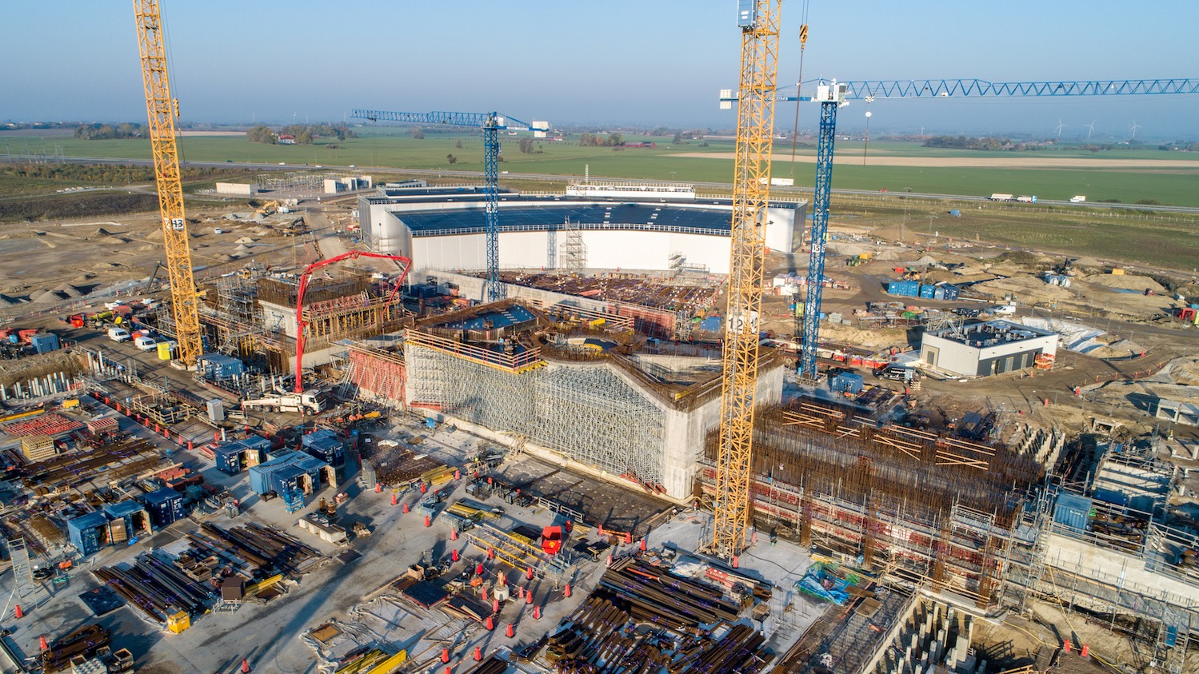

The European Spallation Source
John Womersley, Director General
June 2019

Slide 2
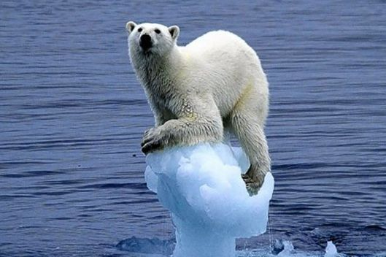
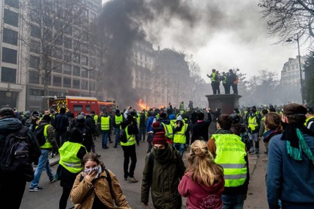
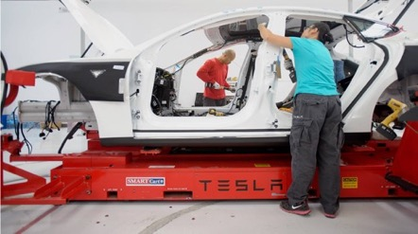
Scientific and technological innovation is essential
global challenges of energy, climate, environment, healthcare
economic and societal challenges of stalled productivity and long term wage stagnation

Slide 3
Materials and molecules
Where are the atoms and what do they do?
New materials, new drugs, new processes, new energy technologies

Slide 4

HEALTH
With neutrons, we are able to study the building blocks of the human body by understanding how proteins, enzymes and other biological material work on the molecular and atomic level.
This includes research on DNA molecules and proteins that control aging and cancer, organs like muscles and teeth, and constructing better medical implants.

Slide 5

ENERGY
Neutrons enable the potential for developing more environmentally friendly products and processes.
Fuel cells driven by hydrogen, materials used for solar power, and telephone batteries are some of the areas that benefit from neutron technology.

Slide 6

FOOD
Consumers deserve safe and healthy food, creating a need for companies to understand the complex structure of food and ingredients.
Neutrons are used to study enzyme structures and what happens during chemical processes. The non-destructive analysis techniques can reveal protein and emulsion structures and reduce energy consumption in food production.

Slide 7

NEW MATERIALS
Mobile phone and computer technology are developing fast while new technologies like LED lighting are emerging. New products full of advanced materials surround us in our everyday life.
Today's materials must be lighter, stronger, cheaper and sustainable. Neutrons help us not only understand the atomic structure of materials, but also their behavior.

Slide 8
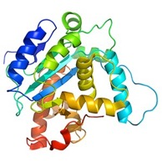
How a spallation neutron source works
instrument
neutrons
moderator
sample
proton accelerator
target
“spallation” is the process that releases neutrons from the target nuclei

Slide 9
ESS Vision: Build and operate the world’s most powerful neutron source
Reactor sources
Accelerator-driven sources
ESS
Effective thermal neutron flux 10¹⁵ n/cm²-s
J-PARC
NIST
ILL
LANSCE
ISIS
FRM-II
SNS
CSNS
Year

Slide 10
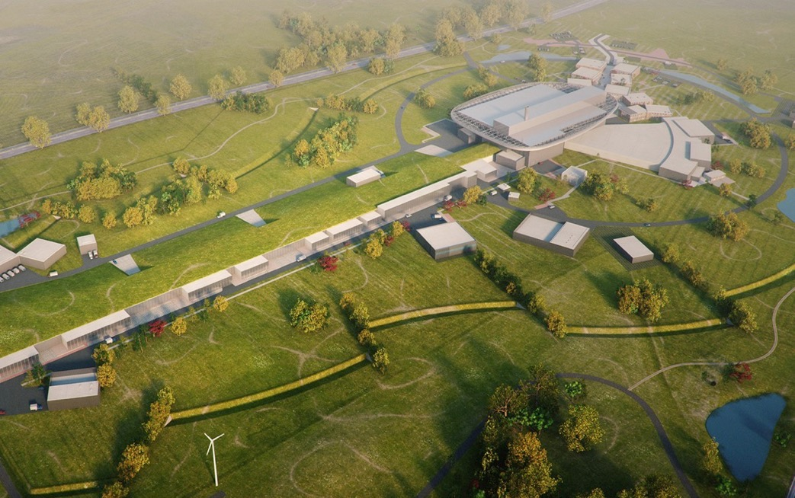
Neutron Production Target
Experiments
Superconducting Proton Accelerator

Slide 11













Some numbers
1843 M€ construction cost
5 MW world’s most powerful particle accelerator
2MW at start of operation
15 experimental stations
20 ⨉ more sensitive on average than today’s best
at 2MW
800 experiments per year
2023 first science for users
13 ERIC member nations

Slide 12











Financing and In-Kind
The European Spallation Source ERIC established in 2015
Host Countries Sweden and Denmark
Construction 47.5% Cash Investment ~ 97%
Operations 15%
Non Host Member Countries
Construction 52.5% In-kind Deliverables ~ 70%
Operations 85%
13 European Member Countries

Slide 13
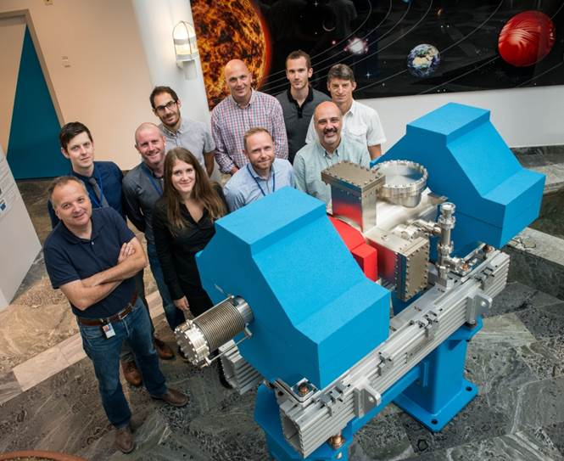
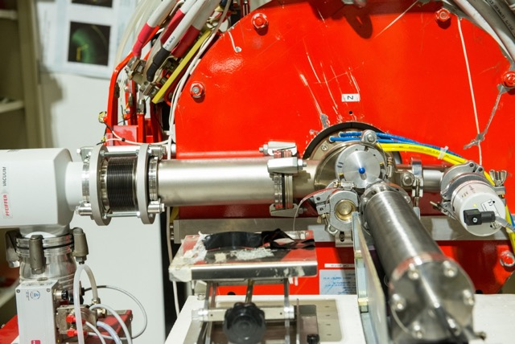
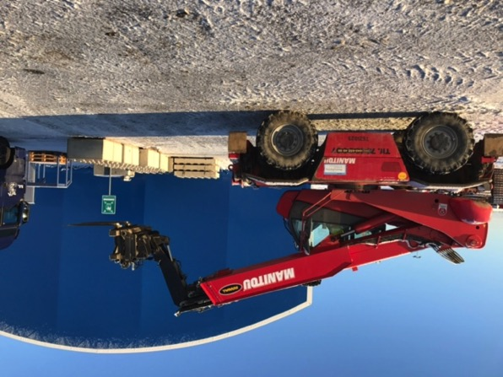
ESS In-kind Partners
Aarhus University
Atomki - Institute for Nuclear Research
Bergen University
CEA Saclay, Paris
Centre for Energy Research, Budapest
Centre for Nuclear Research, Poland, (NCBJ)
CNR, Rome
CNRS Orsay, Paris
Cockcroft Institute, Daresbury
Elettra – Sincrotrone Trieste
ESS Bilbao
Forschungszentrum Jülich
Helmholtz-Zentrum Geesthacht
Huddersfield University
IFJ PAN, Krakow
INFN, Catania
INFN, Legnaro
INFN, Milan
Institute for Energy Research (IFE)
ISIS - Rutherford-Appleton Laboratory, Oxford
Laboratoire Léon Brilouin (LLB)
Lund University
Nuclear Physics Institute of the ASCR
Oslo University
Paul Scherrer Institute (PSI)
Polish Electronic Group (PEG)
Roskilde University
Tallinn Technical University
Technical University of Denmark (DTU)
Technical University Munich (TUM)
Science and Technology Facilities Council
University of Copenhagen (KU)
University of Tartu
Uppsala University
Wigner Research Centre for Physics
Wroclaw University of Technology
Warsaw University of Technology
Zurich University of Applied Sciences (ZHAW)

Slide 14
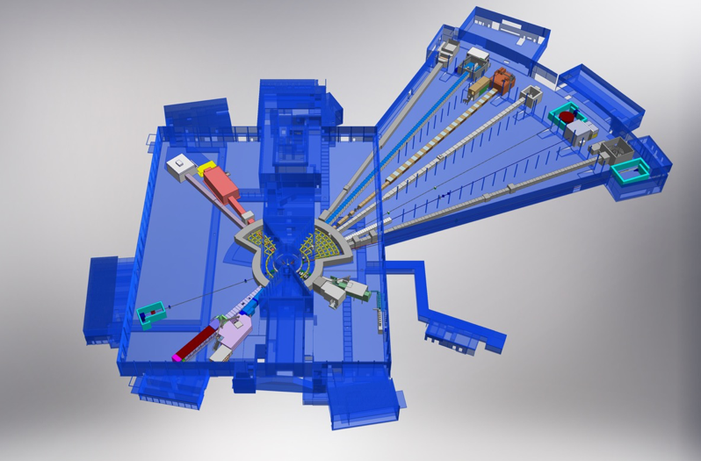













+
Nuclear Physics Institute
BEER
+
NMX
C-SPEC
BIFROST
MIRACLES
MAGIC
ODIN
T-REX
DREAM
HEIMDAL
LoKI
VESPA
FREIA
SKADI
ESTIA
+
15 experimental stations (“instruments”)

Slide 15
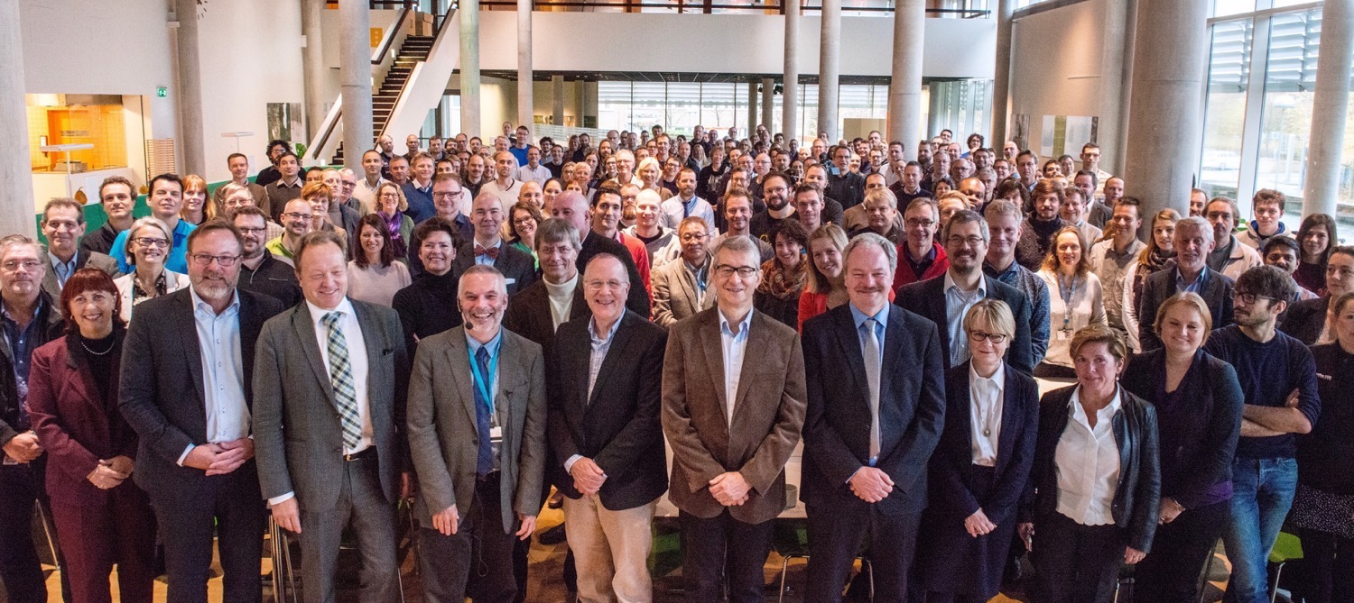


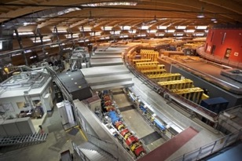
Organisation and People
447
Employees
50
Nationalities
~ 100
Collaborating Institutions
Notes:
Updated September 2017

Slide 16
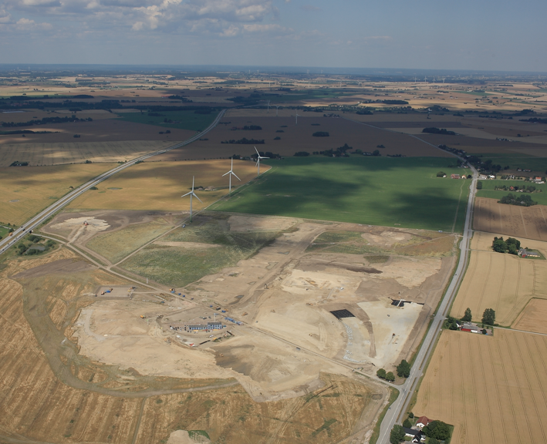
September 2014

Slide 17
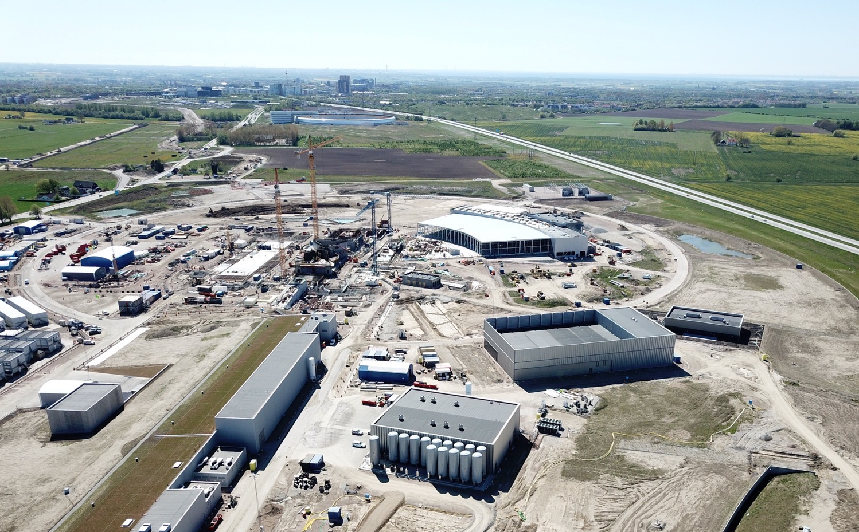

Slide 18
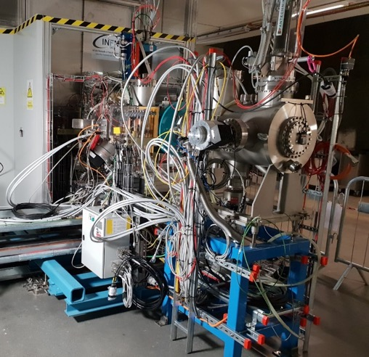
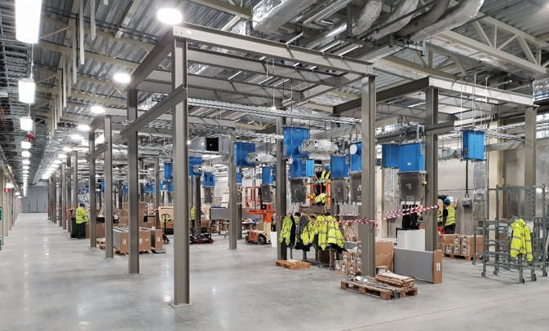
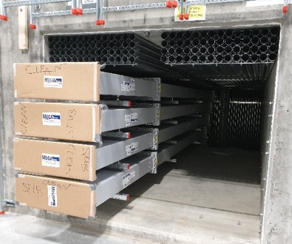
ESS is 58 % complete
Peak of construction activity
Accelerator commissioning started
Instrument hall E01 handover this summer
Working hard to deliver first science in 2023

Slide 19
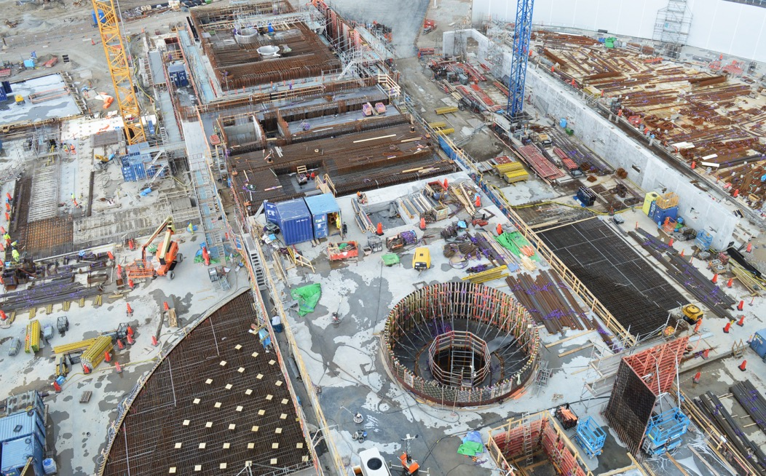
Neutron Target building

Slide 20
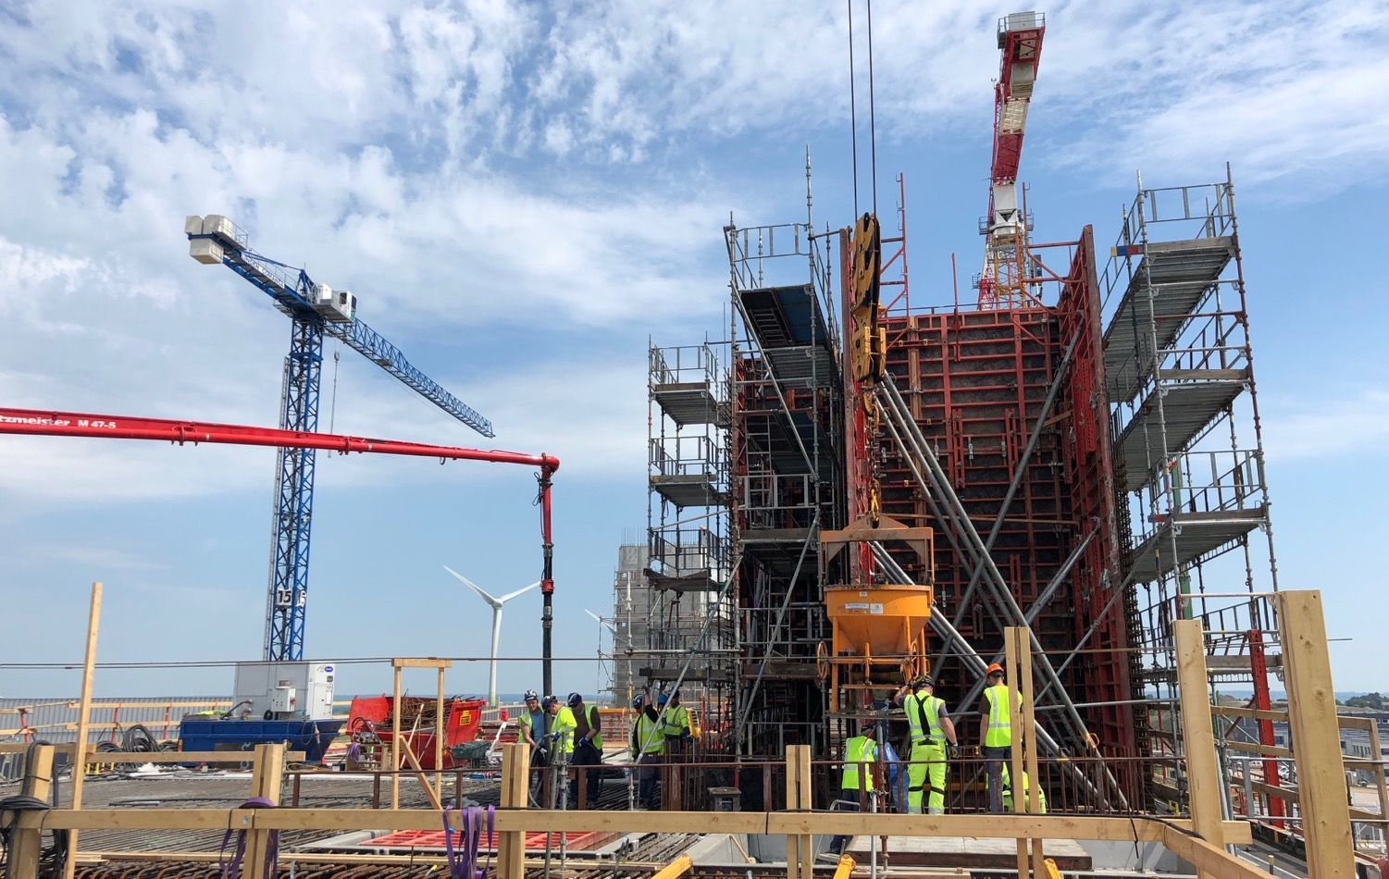
Target Monolith – High Bay
Target high-bay

Slide 21
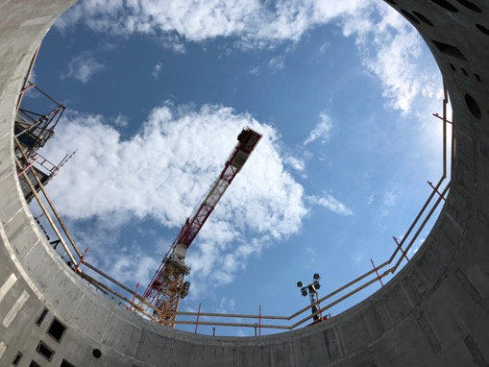
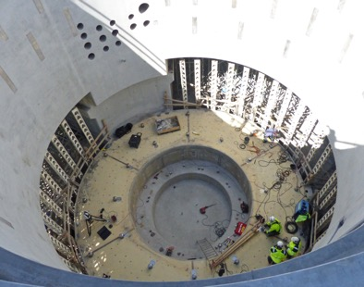
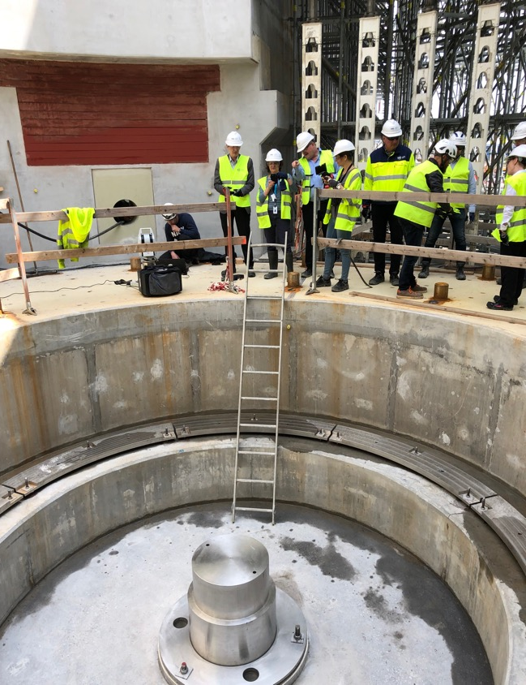
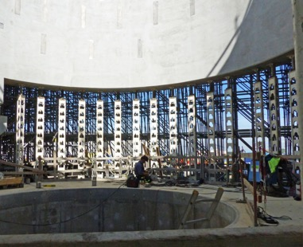
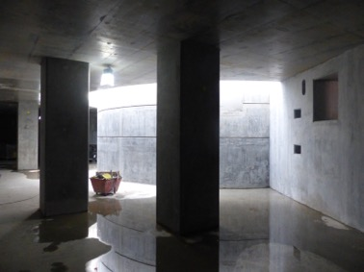
Target Monolith

Slide 22
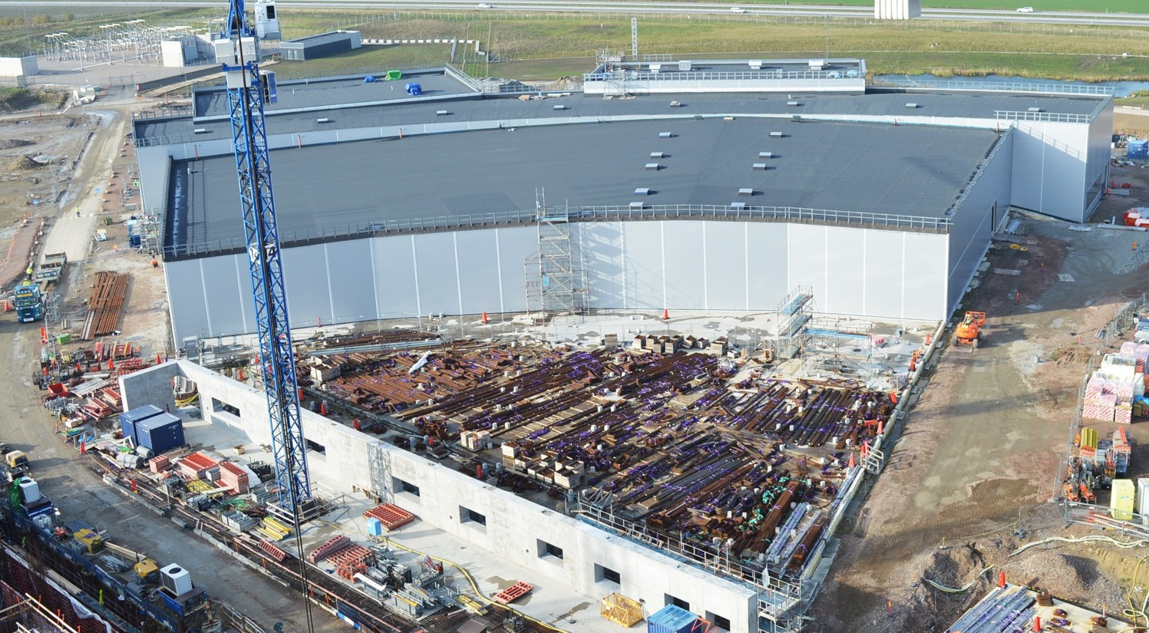
Experimental Hall 3

Slide 23
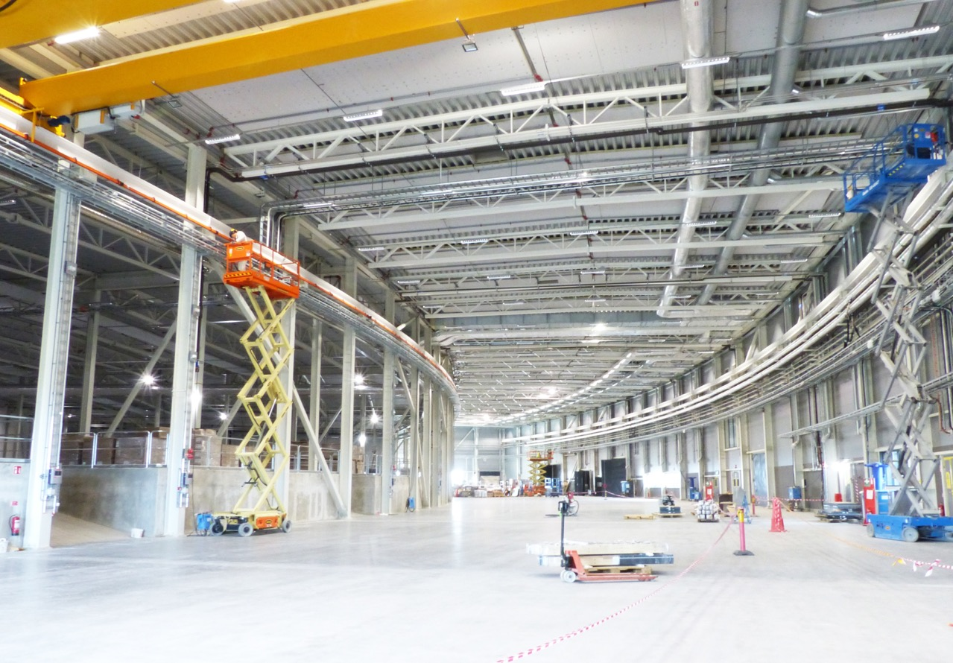
E01 experimental hall
Experimental Hall 3

Slide 24
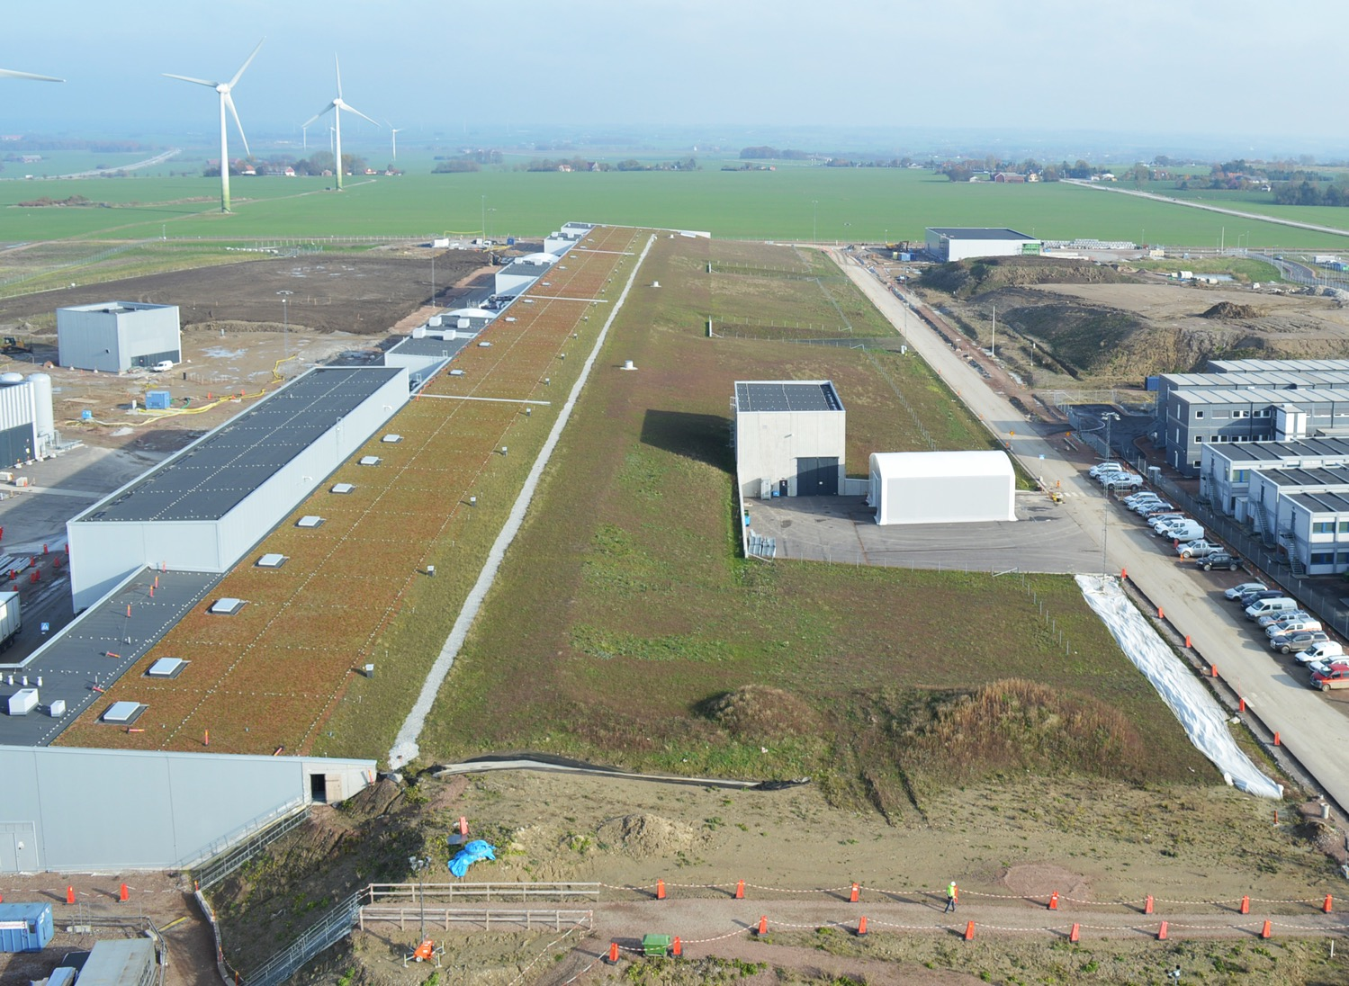
Accelerator and Klystron Gallery

Slide 25
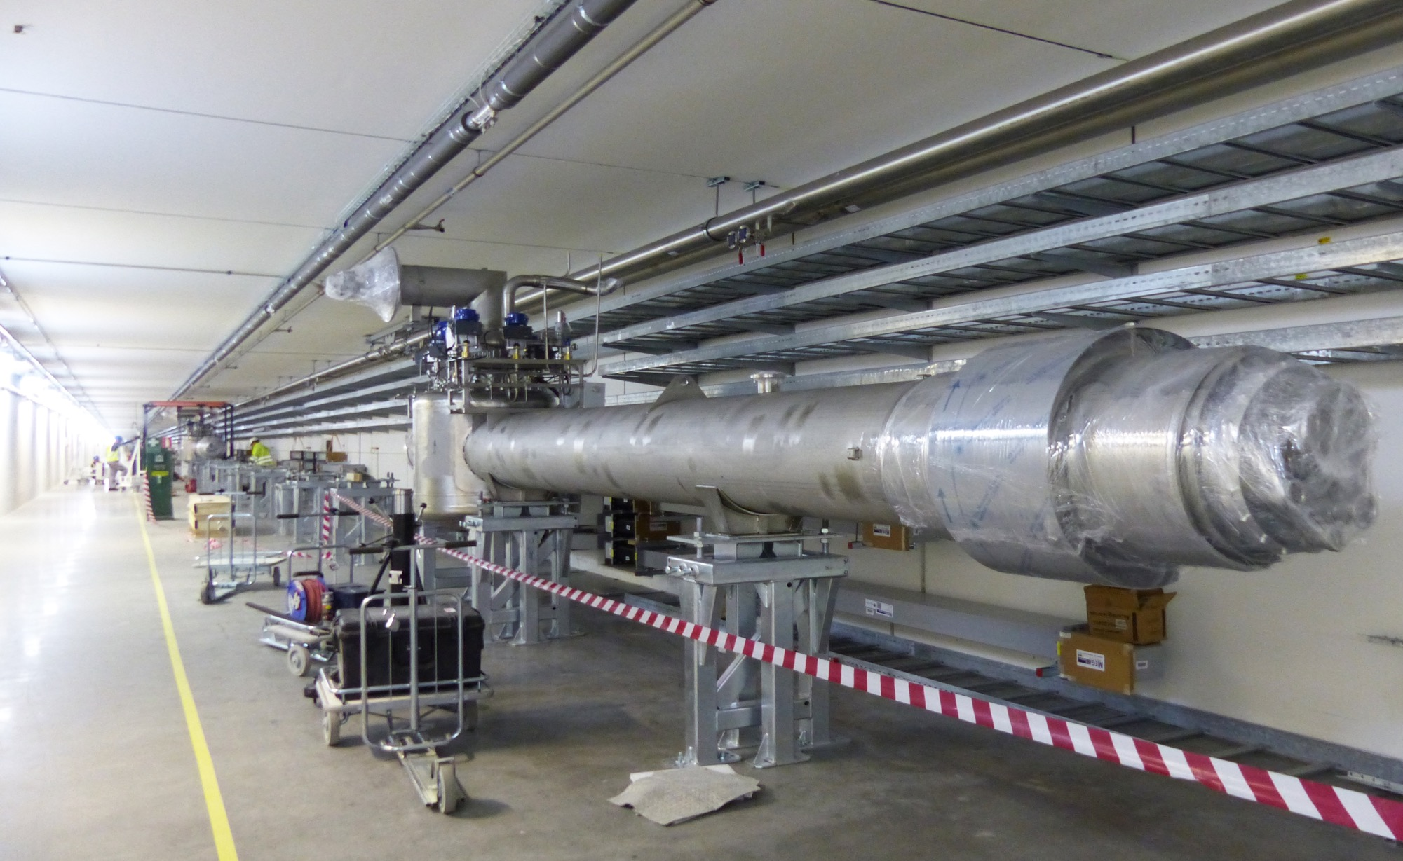
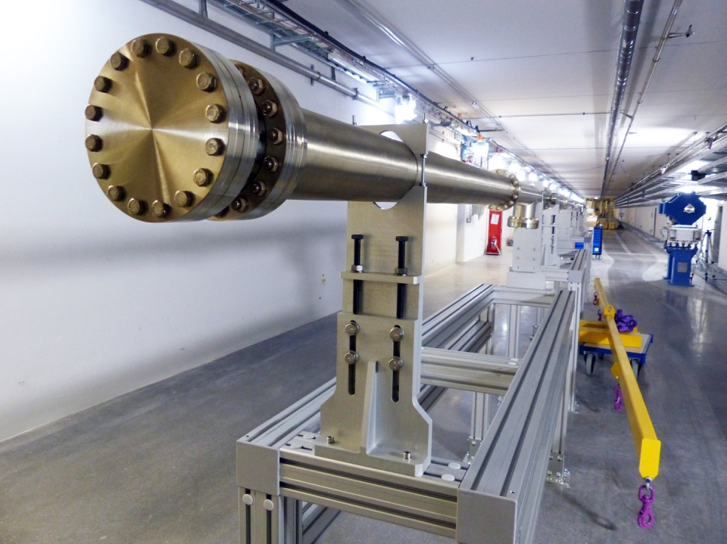
Cryogenic distribution system

Slide 26
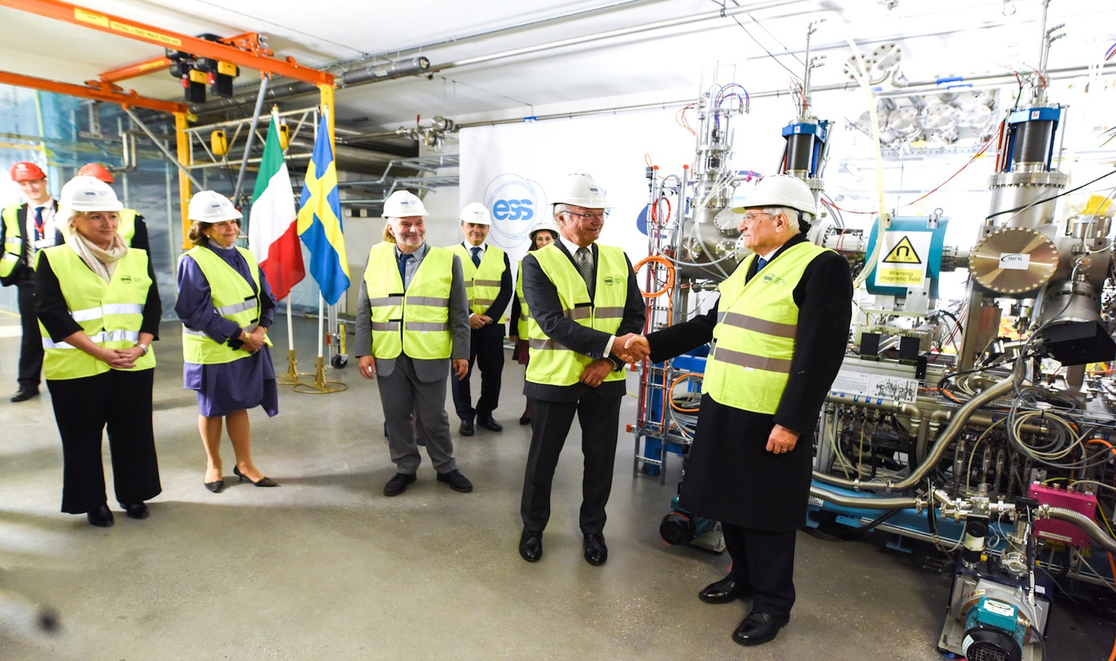
Ion source & LEBT installation
Ion Source inauguration

Slide 27
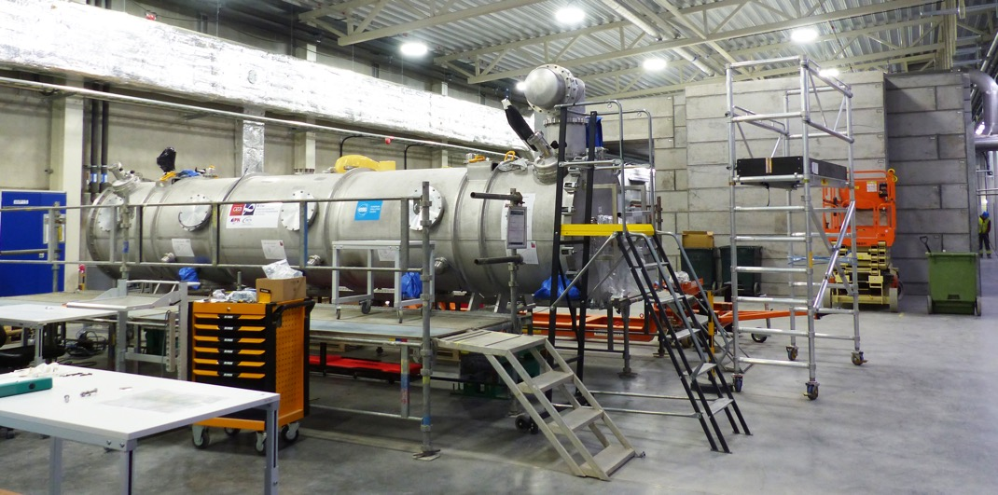
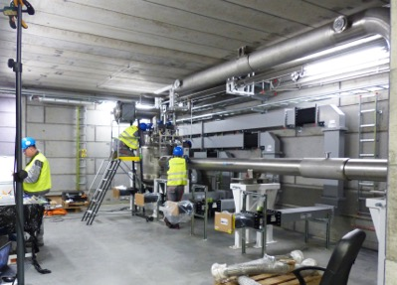
G02
Cryogenic test stand
Test Stand 2 Bunker

Slide 28
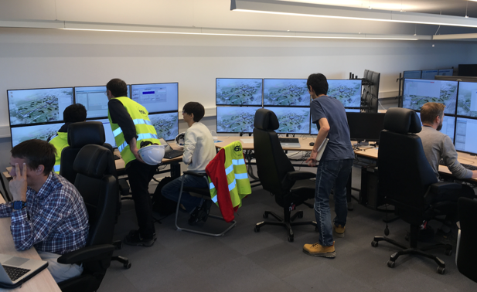
Commissioning activities ongoing
Commissioning shifts are underway

Slide 29
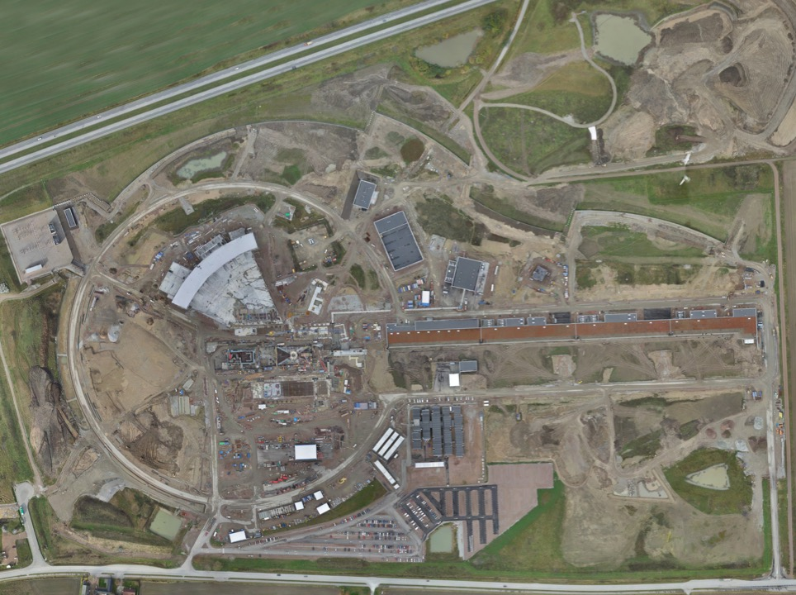
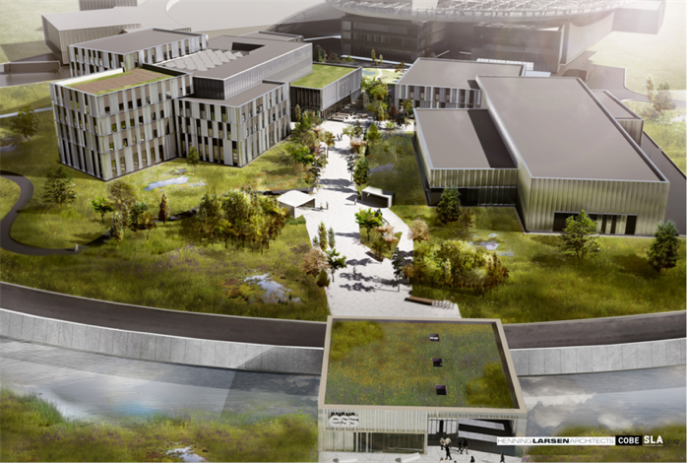
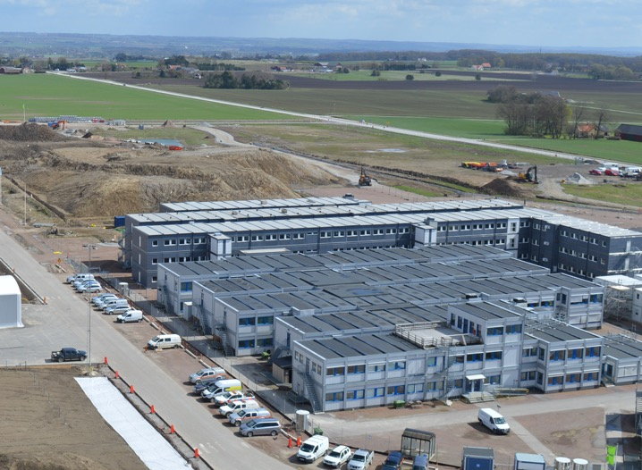
Permanent
Office Campus
2021
Current ESS offices
Bus Stop
Lund Tramway Depot

Slide 30

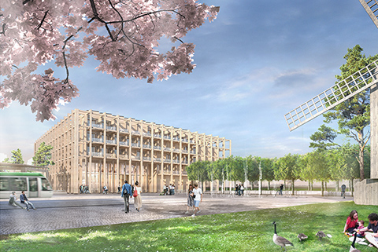
MAX IV
SPACE Building: Reception, exhibition space, guest house for MAX IV and ESS (~100 rooms), office and meeting space, restaurant
Future tram station

Slide 31
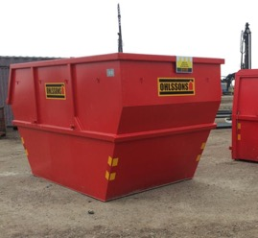
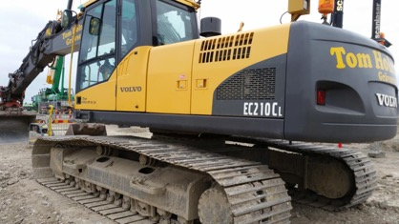

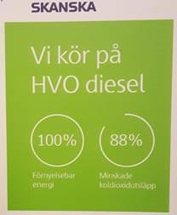
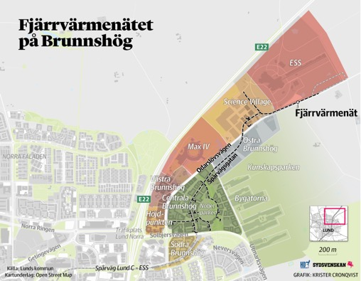
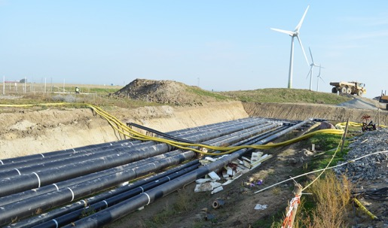
Sustainability is a core value of ESS
Good environmental building standards (BREEAM)
Green construction site
Purchase all electrical power from renewable sources
Waste heat recovery into Lund district heating system
We are confident that the research done at ESS will also go on to have a major impact on the energy sector
ESS
MAX IV

Slide 32



Scientific Computing at ESS
To improve Scientific Efficiency (a TV series analogy)
Move from Post Mortem Analysis to Live Analysis

Slide 33
Where is my Data?
How do I get it?
How do I look at it?
What does it mean?
Is it right?

Slide 34
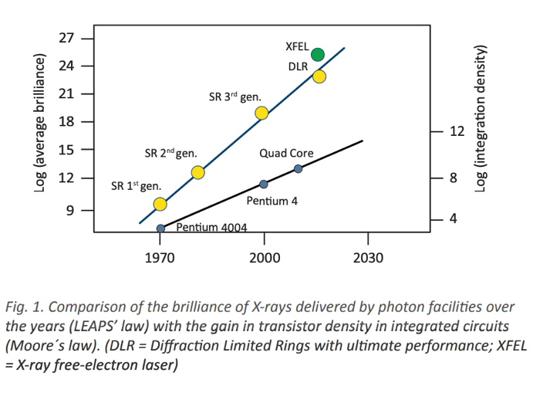
Our core Product is data
Making the data FAIR – Findable, Accessible, Interoperable and Reusable - a real challenge both for facilities and for users
Over 1000 individual experiments (data sets) per year
- Each experiment may have > 200 individual files
Neutron sources produce much more data than ever
ESS at full specification 250TB per day (10GB/Minute/Instrument)
10⁹ Events/s, each event is 32 bit position + 64 bit timestamp
Photon sources generate even larger volumes - up to PB per experiment

Slide 35
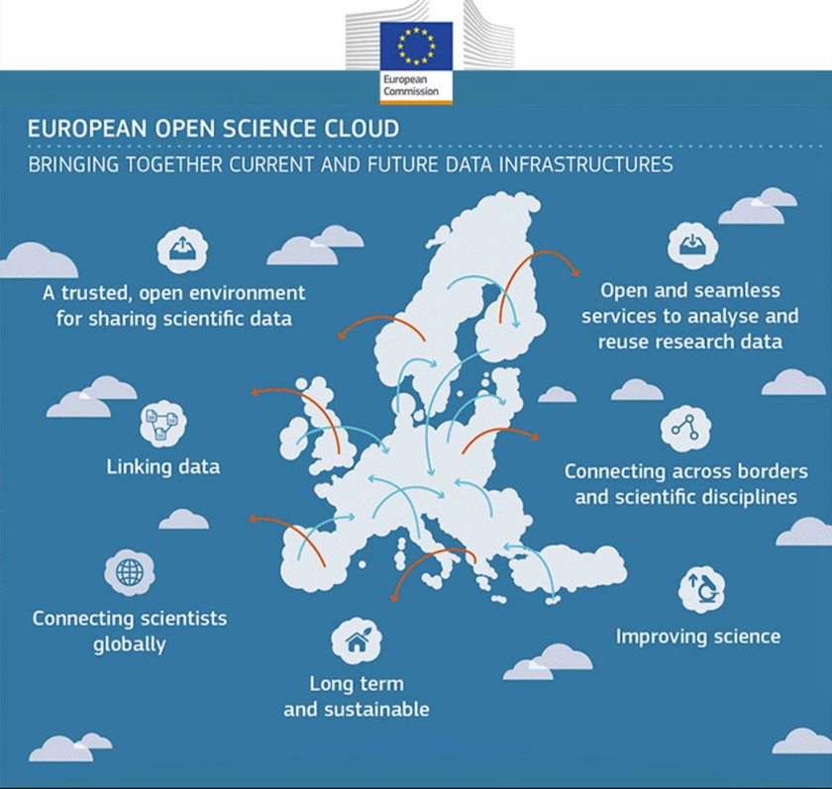
European Open Science Cloud
Photon and Neutron Open Science Cloud project (PaNOSC)
Turning FAIR Data into Reality
Promoting Open Data Use
Trusted
repositories
Workflows
Data services

Slide 36
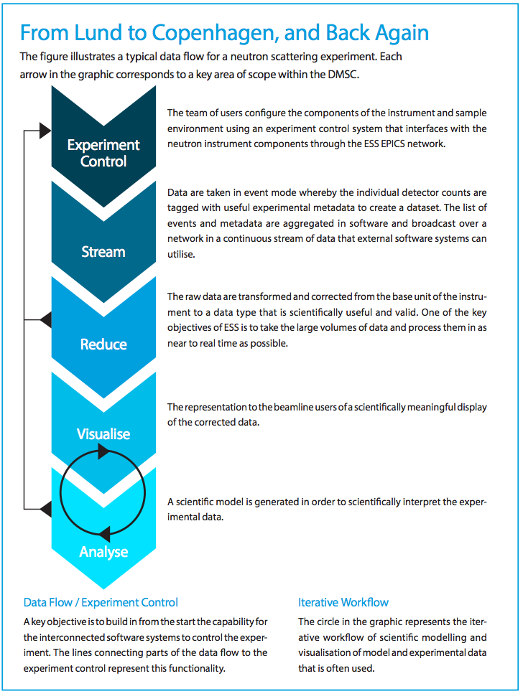
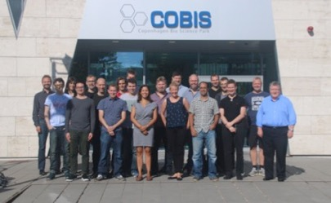
Data Management and Software Centre COBIS, Copenhagen University North Campus
Provide world leading scientific software and scientific computing support for neutron scattering at ESS
Scientific Software
ESS experiment control system, Data acquisition, Data correction software, visualization, and software to model and analyze experimental data sets.
Data center operations
Store and catalogue ESS datasets, provide ESS users remote access to their data, computing for live data correction, and analysis software during and after experiments.
User support
Support ESS users with data treatment and analysis.
Open data model
36

Slide 37
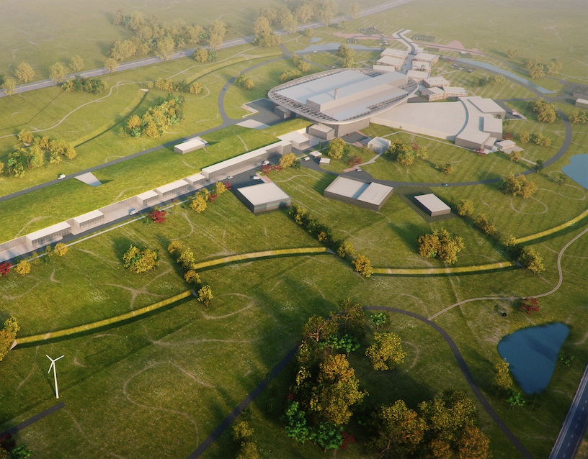
Journey to deliver the world’s leading facility for research using neutrons
2025
ESS Construction Phase Complete
2019
TODAY
2014
Construction Starts on Green Field Site
2023
ESS Starts
User Program
2009
Decision to Site ESS in Lund
2019
Start of Initial Operations Phase
2012
ESS Design Update Phase Complete
2003
European Design of ESS Completed

Slide 38
Thank you!
@johnwomersley @essneutron europeanspallationsource.se

Slide 39

Project planning strategy
NSS (Instrument Program)
EOC
Building
occupancy
In-kind deliveries
SOUP
Beam Comm.
First instruments
Critical Path
CF + Target + NSS (Bunker+TBL) + ICS
BOT
We are focused on keeping the Start of User Programme (SOUP) milestone as close as possible to our original goal in 2023
Target Building
In-kind deliveries
Accelerator + ICS
RBOT
BOD – Beam on Dump
RBOT – Ready for Beam On Target
BOT – Beam On Target
SOUP – Start Of User Program
EOC – End of Construction
TBL – Test Beam Line
In-kind deliveries
BOD

Slide 40
Neutron Facilities
10²⁰
Reactor Sources
Spallation Sources
J-PARC
ESS
HFIR
ILL
LANSCE
ISIS
CSNS
10¹⁵
MTR
HIFAR
MARIA
ORPHEE
IPNS
SALAM
HANARO
SNS
NRX
HFBR
NIST
ZING-P’
Dhruva
CARR
PIK
NRU
SAFARI-1
JRR-3
ETERR-2
FRM-II
OPAL
LVR
RSG
SINQ
IBR-II
HOR
JEEP II
KENS
X-10
WNR
Effective thermal neutron flux n/cm²-s
ZING-P
10¹⁰
CP-2
CP-1
10⁵
Berkeley 37-inch cyclotron
Particle driven pulsed
350 mCi Ra-Be source
Particle driven steady state
Pulsed reactor
Fission reactors
1
Chadwick
1930
1940
1950
1960
1970
1980
1990
2000
2010
2020
2030
Year
(Updated from Neutron Scattering, K. Skold and D. L. Price, eds., Academic Press, 1986)
Notes:
CP-1 Chicago USA
CP-2 Chicago USA
X-10: Oak Ridge, USA
NRX: Chalk River, USA
MTR: Idaho, USA
LVR: Rez, Czech Republic
HIFAR: Sydney Australia
NRU: Chalk River, USA
HOR Delft Netherlands
SAFARI-1 Pretoria South Africa
HFBR: Brookhaven, USA
HFIR: ORNL, Oak Ridge, USA
NIST: National Inst. for Stds and Tech. Gaithersburg, USA
ILL: Grenoble, France
JEEP II Kjeller Norway
MARIA Swierk Poland
ORPHEE LLB Saclay France
Dhruva: Mumbai, India
RSG: serpong, Indonesia
SINQ: PSI, Switzerland
JRR-3: Tokai, Japan
ES-Salam Algiers Algeria
HANARO: Daejon KAERI, South Chorea
ETERR-2 Cairo Egypt
FRM-II: Munich, Germany
OPAL: Sydney, Australia
CARR: Beijing China
PIK: Gatchina, Russia
ZING-P Argonne USA
WNR Los Alamos USA
KENS Tsukuba Japan
IPNS Argonne USA
IBR-II Dubna Russia
LANSCE Los Alamos USA
ISIS Oxfordshire UK
SNS Oak Ridge USA
JPARC Tokai Japan
CSNS Beijing China
ESS Lund Sweden
More reactor sources exist across the world….

Slide 41
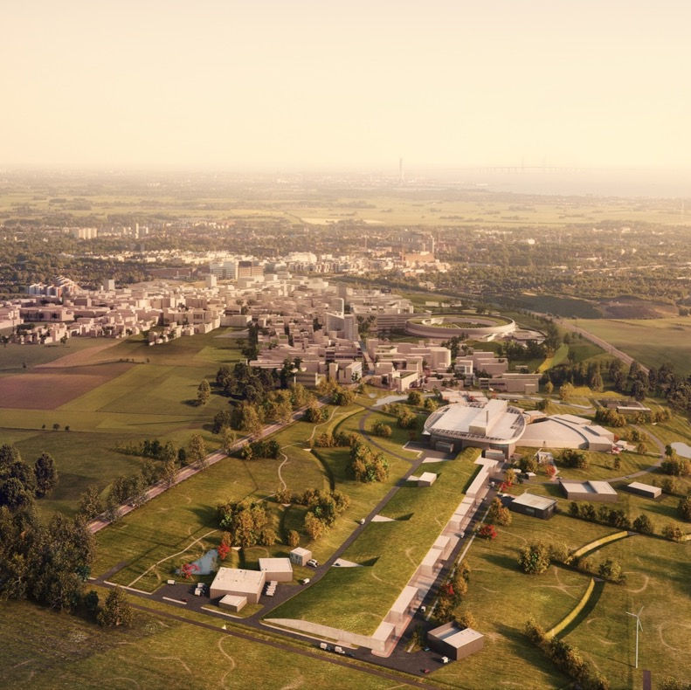
Vision, Mission and Values
ESS Vision
Our vision is to build and operate the world’s most powerful neutron source, enabling scientific breakthroughs in research related to materials, energy, health and the environment, and addressing some of the most important societal challenges of our time.
Mission
To do this, we commit to deliver ESS as a facility that:
Is built safely, on time and on budget
Produces research outputs that are best-in-class both in terms of scientific quality and in terms of socioeconomic impact
Supports and develops its user community, fosters a scientific culture of excellence and acts as an international scientific hub
Operates safely, efficiently and economically, and responds to the needs of its stakeholders, its host states and member states
Develops innovative ways of working, new technologies, and upgrades to capabilities needed to remain at the cutting edge
Core Values
Excellence • Collaboration • Openness • Sustainability

Slide 42
Neutron Facilities
10²⁰
Reactor Sources
Spallation Sources
J-PARC
ESS
HFIR
ILL
LANSCE
ISIS
CSNS
10¹⁵
MTR
HIFAR
MARIA
ORPHEE
IPNS
SALAM
HANARO
SNS
NRX
HFBR
NIST
ZING-P’
Dhruva
CARR
PIK
NRU
SAFARI-1
JRR-3
ETERR-2
FRM-II
OPAL
LVR
RSG
SINQ
IBR-II
HOR
JEEP II
KENS
X-10
WNR
Effective thermal neutron flux n/cm²-s
ZING-P
10¹⁰
CP-2
CP-1
10⁵
Berkeley 37-inch cyclotron
Particle driven pulsed
350 mCi Ra-Be source
Particle driven steady state
Pulsed reactor
Fission reactors
1
Chadwick
1930
1940
1950
1960
1970
1980
1990
2000
2010
2020
2030
Year
(Updated from Neutron Scattering, K. Skold and D. L. Price, eds., Academic Press, 1986)
Notes:
CP-1 Chicago USA
CP-2 Chicago USA
X-10: Oak Ridge, USA
NRX: Chalk River, USA
MTR: Idaho, USA
LVR: Rez, Czech Republic
HIFAR: Sydney Australia
NRU: Chalk River, USA
HOR Delft Netherlands
SAFARI-1 Pretoria South Africa
HFBR: Brookhaven, USA
HFIR: ORNL, Oak Ridge, USA
NIST: National Inst. for Stds and Tech. Gaithersburg, USA
ILL: Grenoble, France
JEEP II Kjeller Norway
MARIA Swierk Poland
ORPHEE LLB Saclay France
Dhruva: Mumbai, India
RSG: serpong, Indonesia
SINQ: PSI, Switzerland
JRR-3: Tokai, Japan
ES-Salam Algiers Algeria
HANARO: Daejon KAERI, South Chorea
ETERR-2 Cairo Egypt
FRM-II: Munich, Germany
OPAL: Sydney, Australia
CARR: Beijing China
PIK: Gatchina, Russia
ZING-P Argonne USA
WNR Los Alamos USA
KENS Tsukuba Japan
IPNS Argonne USA
IBR-II Dubna Russia
LANSCE Los Alamos USA
ISIS Oxfordshire UK
SNS Oak Ridge USA
JPARC Tokai Japan
CSNS Beijing China
ESS Lund Sweden
More reactor sources exist across the world….

Slide 43
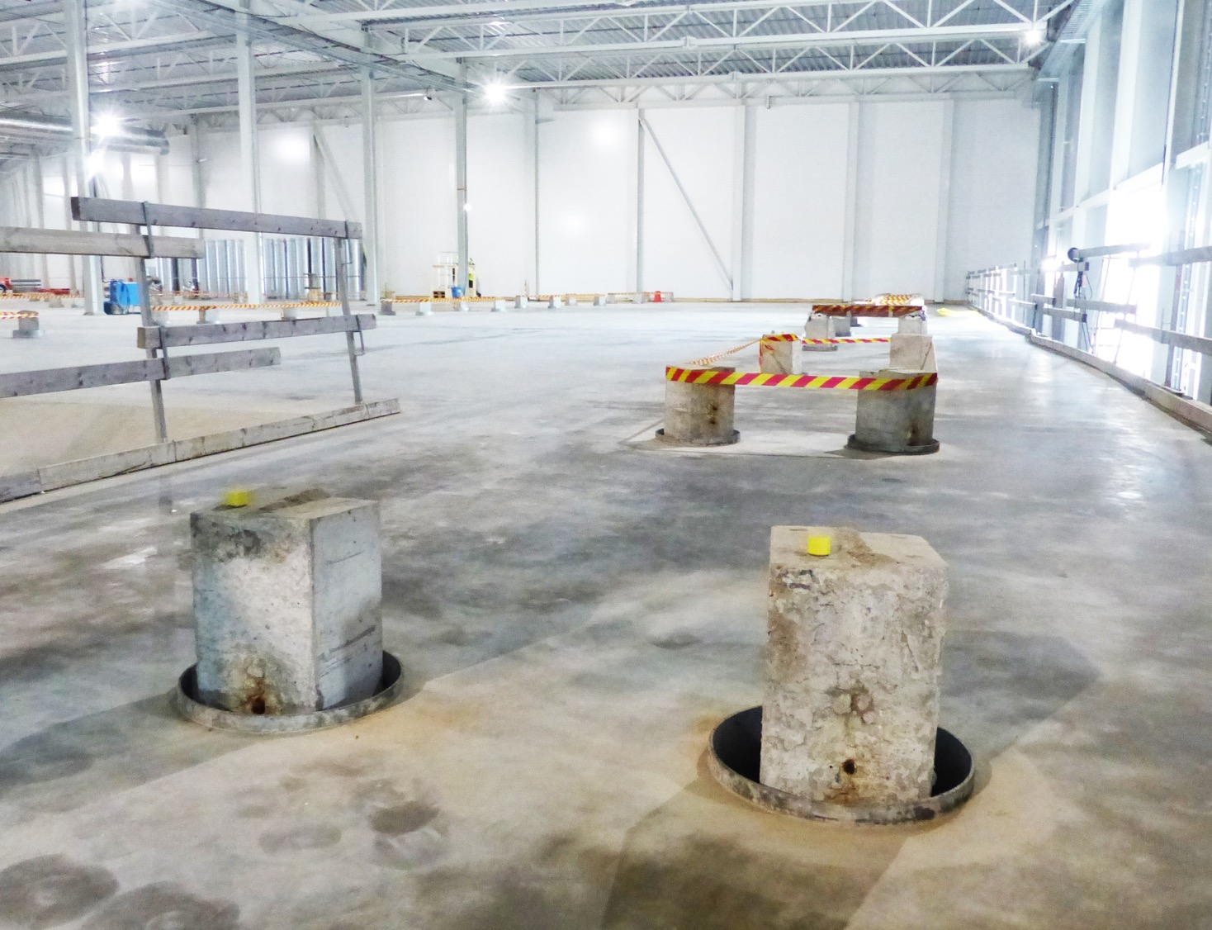
E-buildings E02 Beamline NMX

Slide 44
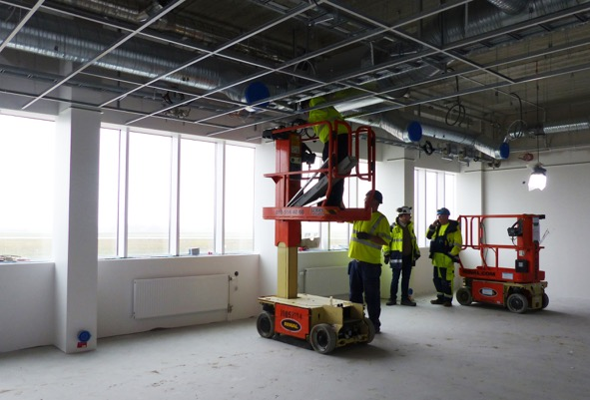


E03/E04 labs interior works

Slide 45

E04 interior works – fan room

Slide 46

Klystron Gallery Racks, waveguide support systems, klystrons

Slide 47


Klystron Gallery Coldbox
ESS is now producing liquid helium

Slide 48


ESS Campus
Office & labs

