Slide 1
ATLAS compute
@UiO

Slide 2
Background
Our Abel HPC cluster is shutting down
3 new national HPC centers: FRAM (operational from Oct 2017 ), SAGA (expected operational late 2019) and B1 (expected operational spring 2020)
Saga (Trondheim)
  10080 cores, high speed interconnect
  200 standard compute nodes: 40 cores and 192 GiB memory each
  28 medium memory compute nodes: w40 cores and 384 GiB of memory each
  8 big memory nodes: 64 cores and 3 TiB memory each
  8 GPU nodes: 4 NVIDIA GPUs and 2 CPUs 24 cores and 384 GiB memory each
  1 PB high metadata performance BeeGFS scratch file system
FRAM (Tromsø)
  Interconnect: Infiniband network
  32256 cores
  Standard compute node: two 16-core chips, 64 GiB memory.
  8 larger memory nodes with 512 GiB RAM
  2 huge memory quad socket nodes with 6 TiB of memory
B1 (name to be decided later, Trondheim)
  172 032 cores, Mellanox Infiniband HDR100, Dragonfly+
  Total memory 372 TB
  AMD Epyc Rome 2,2 GHz – 225W

Slide 3
Directions
ATLAS jobs do not need the expensive HPC interconnect system – jobs are not multinode and not expected to so be very soon
Decision: do not run ATLAS jobs on the new national HPC infrastructure
Two alternative paths seriously considered (plus a third, but ruled so far (commercial cloud) out due to cost)
  Standalone traditional grid cluster
    Pros:
      The Research Infrastructure Team – FI - (me and my colleagues) have full control over the cluster: Freedom to configure and set up as needed and wanted
      Relatively cheap hardware
    Cons:
      FI team has their hands full already with supporting and maintaining the national HPC centers
      The more clusters to maintain and support, the more specific problems to solve
  Allocate resources in the University OpenStack cloud
    Pros:
      A separate OpenStack teams deals with the support and maintenance of the hardware and configuration of the cluster
      Easy to extend cluster if needed
    Cons:
      Not as performant as a regular grid cluster
      Not complete freedom to define the configuration (but the OpenStack team creates an “ATLAS-flavour” dedicated to us, so no lock-down)

Slide 4
OpenStack cluster
Still in commissioning mode – finding the most optimal VM flavour for our needs
Available resources for ATLAS in OpenStack – of which 1/3 is in production at the moment
  2.5TB RAM
  640 VCPU’s (4GB RAM per VCPU)
  9TB Volume storage
  Hyperthreading
Waiting to increase until configuration is settled and optimal
  Cluster may need to be removed and recreated
Will be extended when Epyc Rome is out before the end of the year

Slide 5
Setup on OpenStack
Centos 7 on frontend and workernodes
SLURM batch system
ARC 6.0.0
  Pilot mode right now
  Session directory shared with worker nodes
  Scratchdir 160 GB scratch per worker node
  Cvmfs: 40 GB per worker node
Worker nodes – 8 core – total 24 GB RAM (25 VM’s in production)
HEPSPEC measured recently ~10 kHS06 – very low, sub-optimal settings!
There has been several rounds of issues and tweaks, and we have not reached optimal config yet.
Historical timeline next slide!

Slide 6
Date | Comments /Problems | OpenStack config (flavour configuration) | ARC Cluster config
March | Starting with test cluster – handful of nodes Very slow network – jobs timing out while waiting for input data Network problem was due to faulty the coreunit in their router - solved ca 10.04 Issues with jobs being killed due to memory limitations | Using standard instance flavours with heavy overcommitting on vCPU and RAM | ARC 6 rcX First - no cgroups in SLURM introduced cgroups to handle memory issues better
May 07 | Increased cluster – 20 compute nodes Experienced random shutdown of instances | CPU pinning Thread/CPU policy: Instances have dedicated thread/core pair -> locked into one NUMA node All RAM available for each vCPU (4GB) With this setup the host could get too little memory and the instances were shut down | Cgroups
May 20 | Recreated cluster using new flavours 25 compute nodes Extremely slow jobs – exceeding jobdescription walltime | Removed CPU-pinning and thread policy ¾ RAM available to VM – 3 GB RAM per vCPU Now instances got memory and cores from different NUMA-nodes/CPU sockets No more guarantee that half is cores and half is threads | Turned off timelimits in SLURM – to avoid failures do to exceeded WALLTIME
June 07 | Added 3 nodes to cluster – new flavour | Added cpu-pinning and thread policy again CPU isolation – cpus dedicated fully to the VM’s Hugepages on the hypervisors 496 out of 512 GB memory reserved to instances 3.875 GB of RAM for each vCPU | ARC 6 No cgroups Cronjob to clean /scratch every 12 hours – input-data of failed jobs are not cleaned up by panda it seems Need to get a better setup for cleaning between jobs – cgroups setup to handle memory and job cleaning

Slide 7
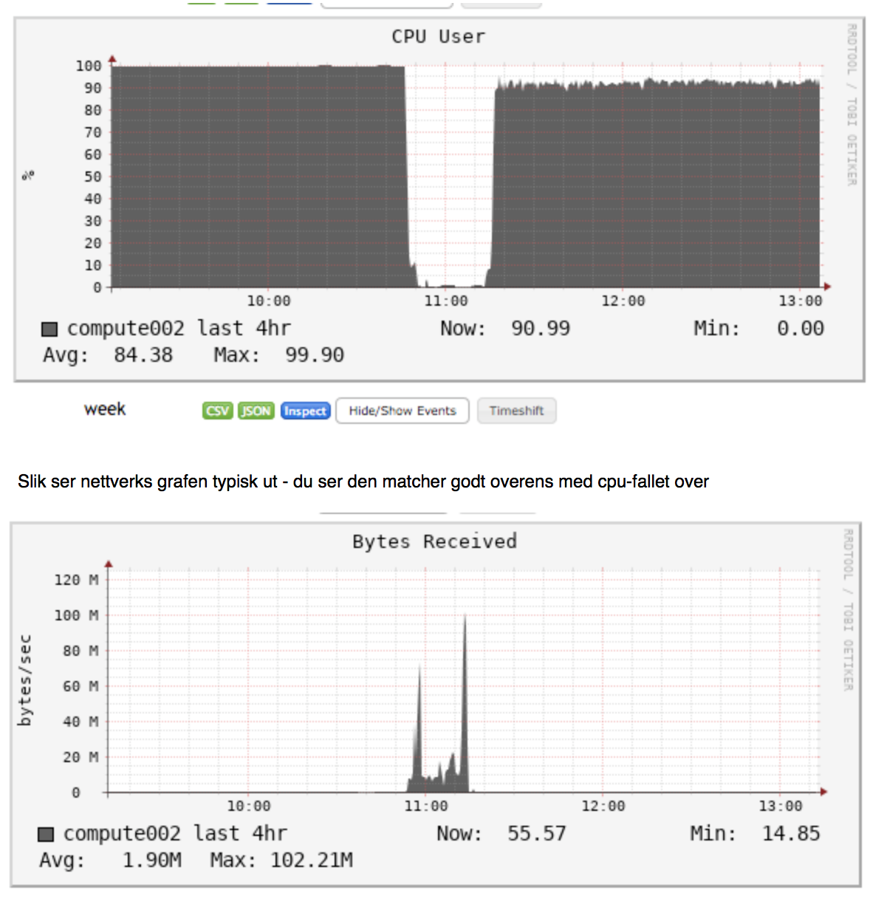
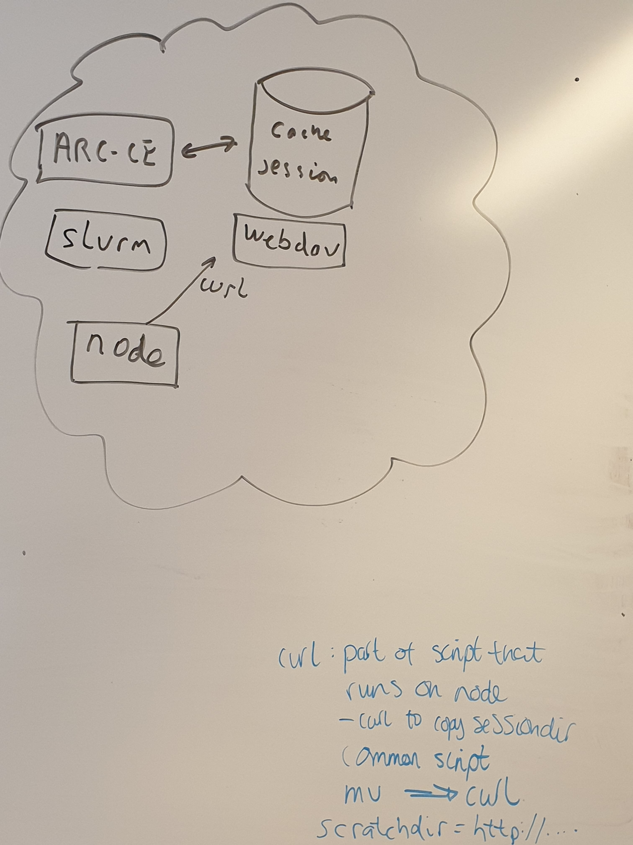
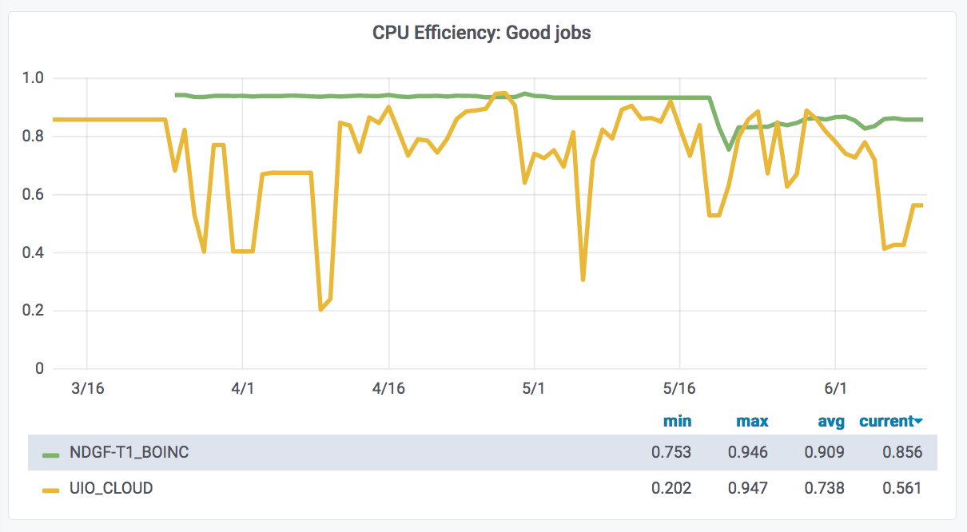
Plans – once OpenStack config more or less stable
Log CPU efficiency and network speed
Add ATLAS@work jobs on worker nodes to increase CPU efficiency
  Interesting exercise for clusters where pilot mode is needed/wanted
Then: set up ARC w/ ARC cache and remove ATLAS@work
  Avoid NFS mounting:

Slide 8
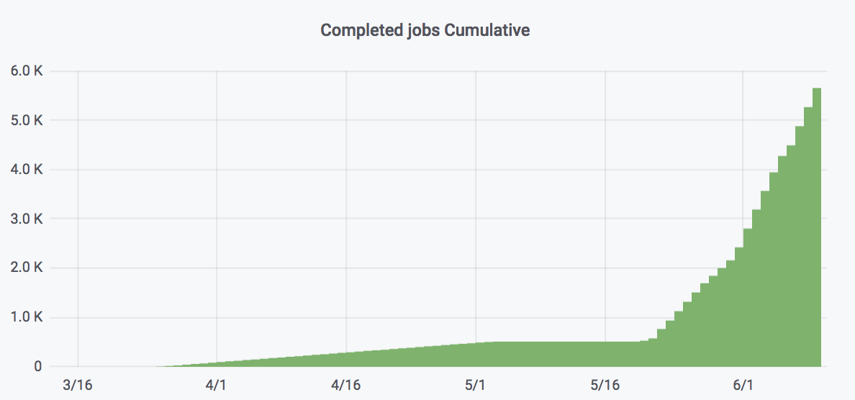
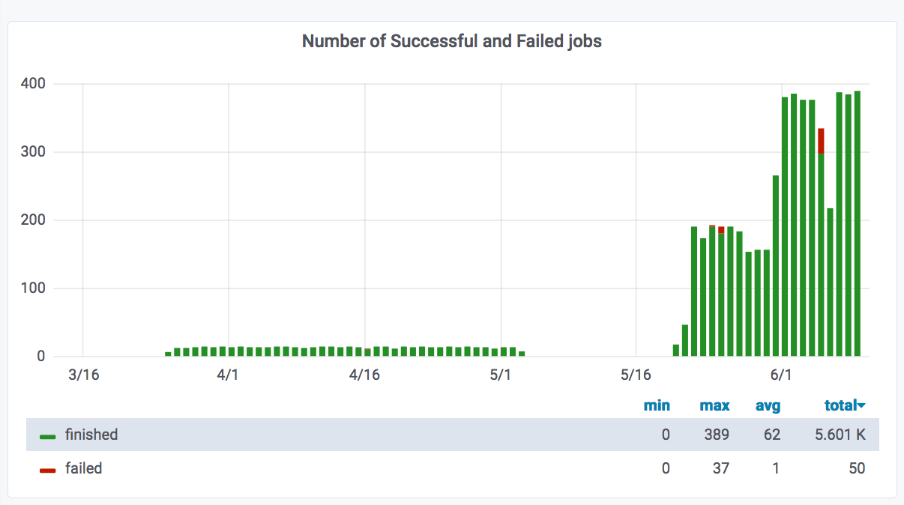
ATLAS on Oracle cloud
The University of Oslo has a license agreement with Oracle and with that comes a bunch of resources
Not used by anyone at the moment
Challenge: how much can ATLAS get out of this?
Have so far set up a handful of compute nodes
Running ATLAS@work
Plan to increase substantially shortly
David helped to set up accounting to SGAS
  NDGF-T1-BOINC Panda queue – in NDGF-T1 site
HEPSPEC: ~24 kHS06
Might set up a regular ARC CE cluster if the resources can be used for a while and we have enough storage to accomplish this – to be confirmed

Slide 9
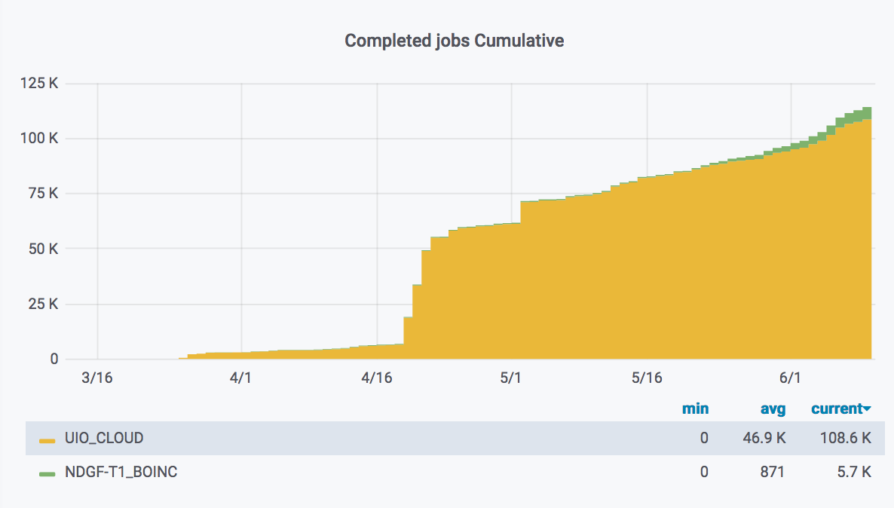
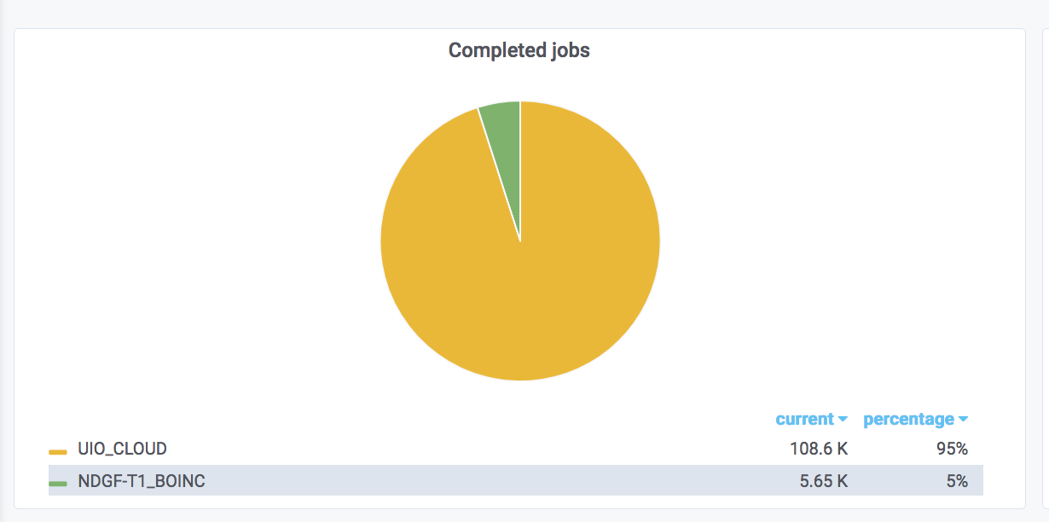
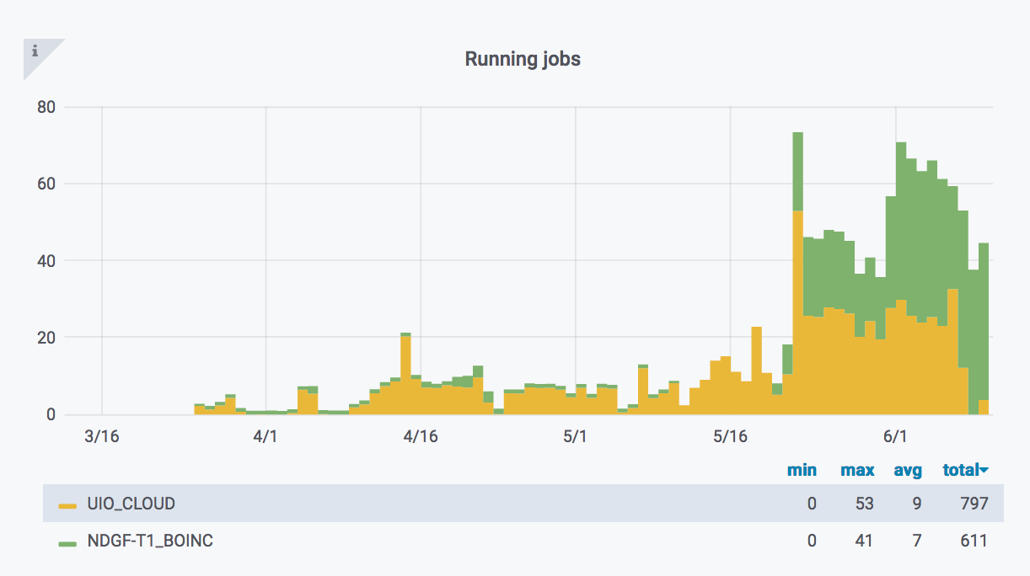
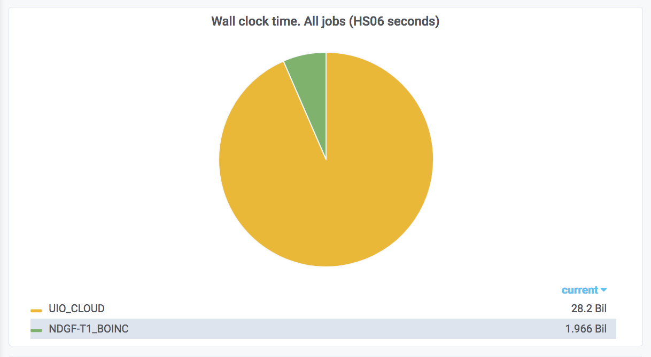
UiO-Openstack (UIO_CLOUD) - UiO-Oracle (NDGF-T1_BOINC)

Slide 10
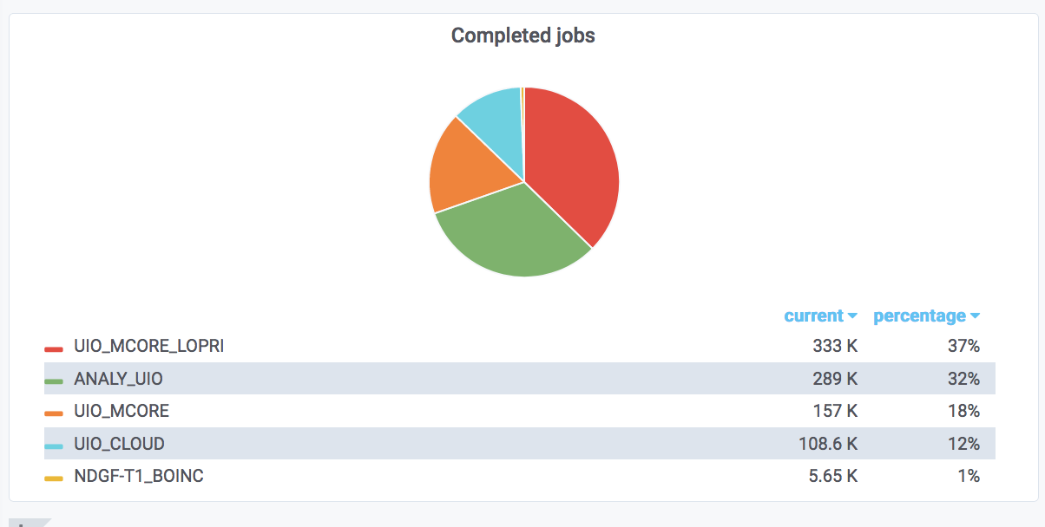
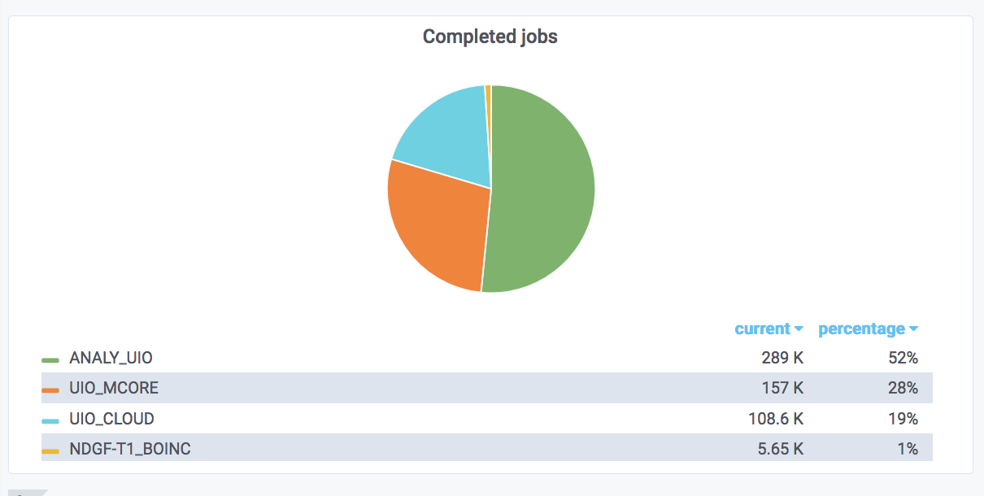
UiO @ Abel HPC (ANALY_UIO + UIO_MCORE + UiO_MCORE_LOPRI )
UIO_CLOUD (OpenStack)
NDGF-T1_BOINC (Oracle)
Completed jobs – Last 90 days

Slide 11
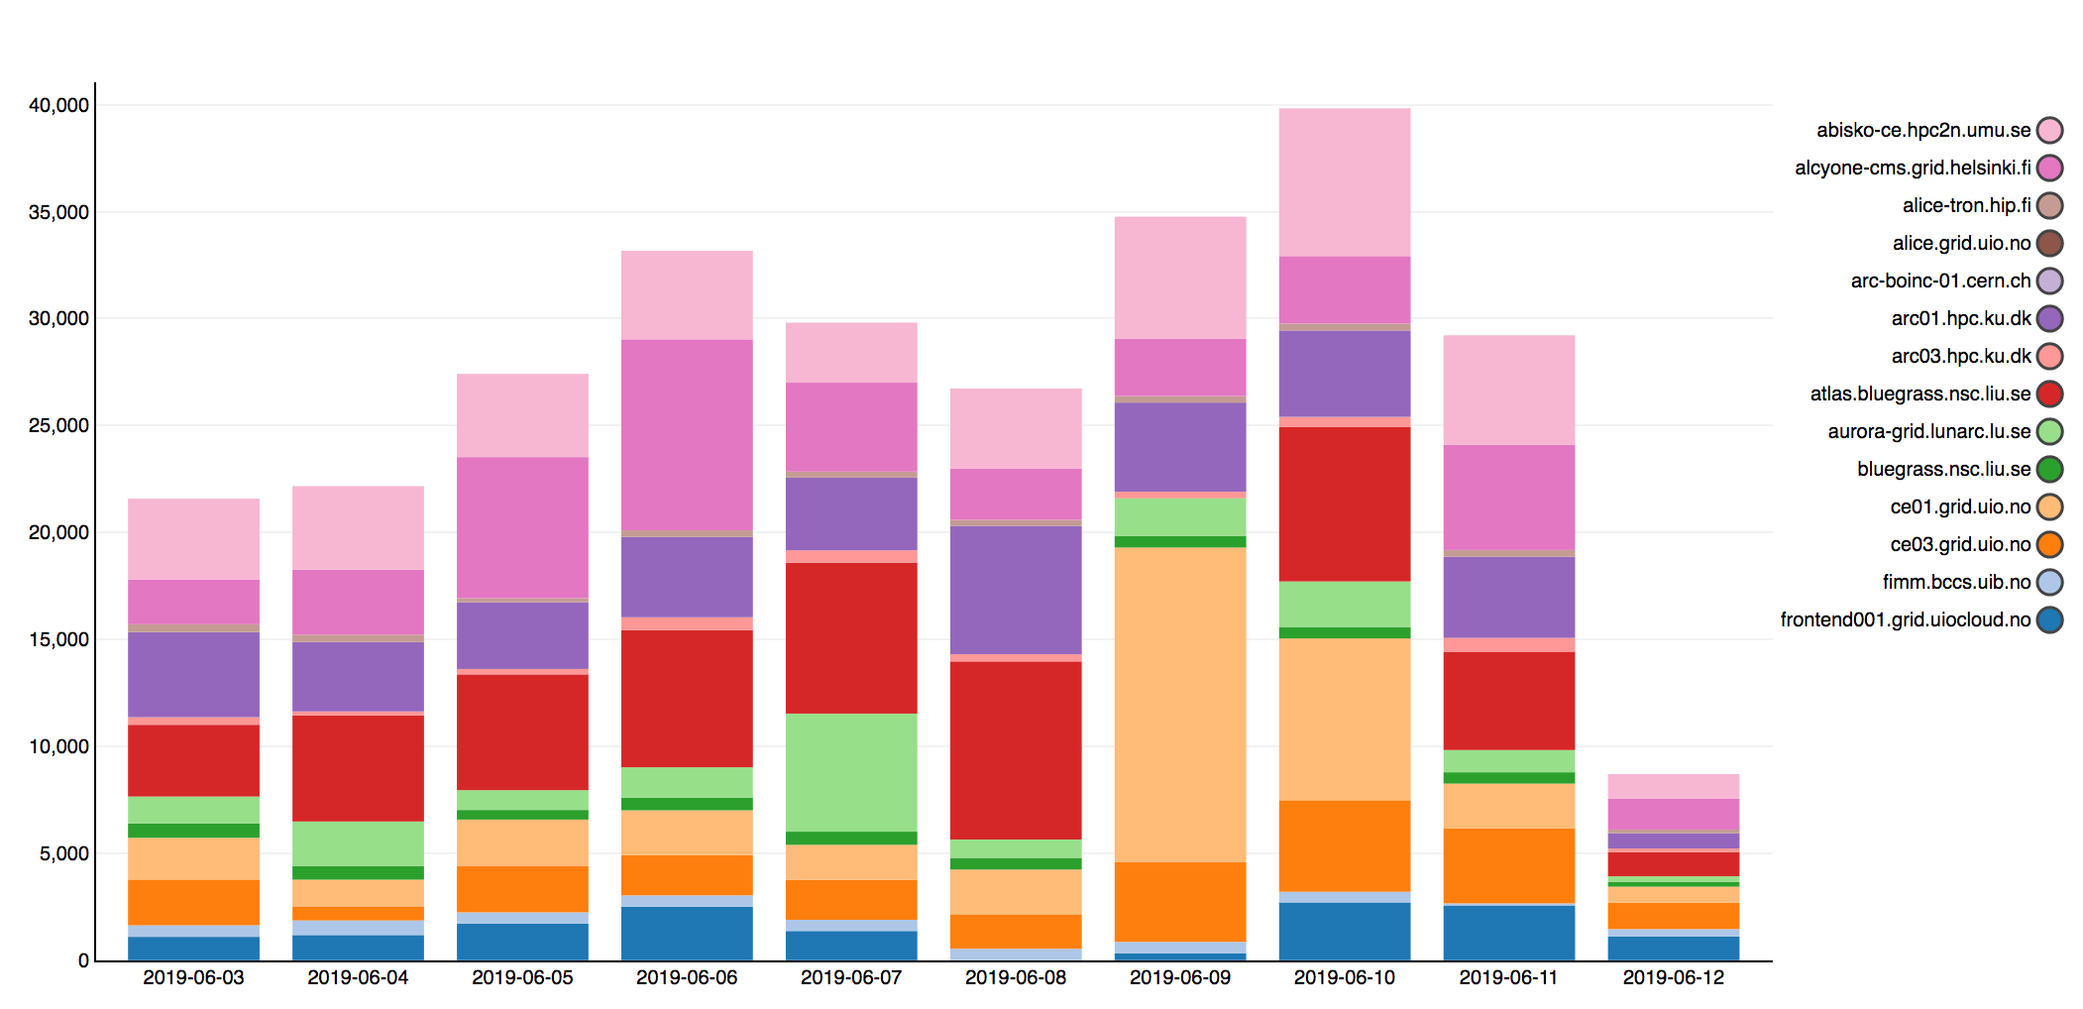
SGAS accounting https://accounting.ndgf.org:6143/sgas/view/custom/machine_registrations

Slide 12
Comments that came up
Block storage – remote/local performance (but the scratch will anyway be on the block storage which is remote I think)
Point of curl versus NFS – performance gain? If not, why? More sustainable? With a web server, you will still need this as a “second layer” and can get issues with running it as you can with NFS
  But interesting still for remote storage
5MB/s per job network speed needed
  2000 cores …

