Slide 1
Elliptical MB SC RF cavity of ESS
Saeid Pirani

Slide 2
Outline
A short overview on ESS
Linac Basics
Ion Source and LEBT
Radio Frequency Quadrapole (RFQ)
Drift Tube Linac (DTL)
Superconducting cavities section
Elliptical MB Cavity
Cavity Design
Cavity Fabrication and Treatment
Cavity Test
Cavity Higher Order Mode Study

Slide 3
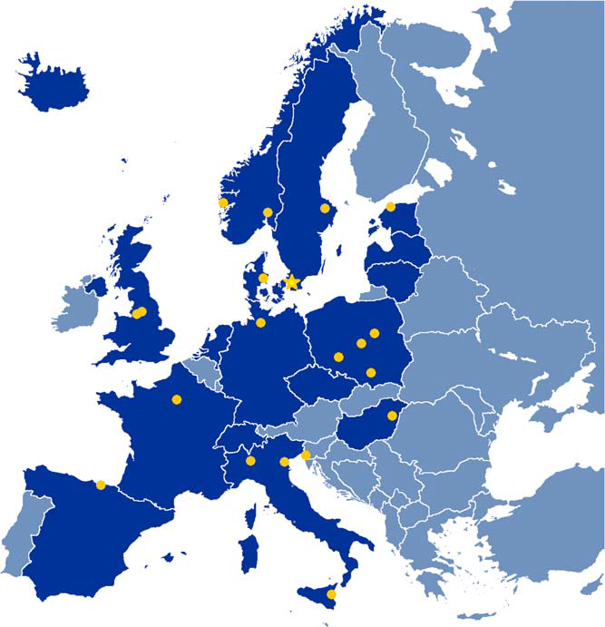
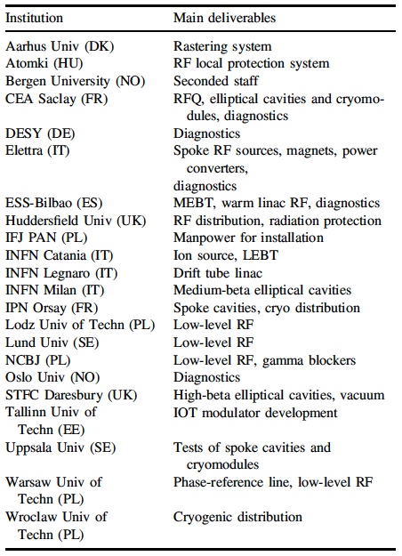
Notes:
The design and construction of the accelerator has largely benefited from state-of-the-art competences all over Europe. More than 20 partner laboratories in eleven European countries are contributing.

Slide 4
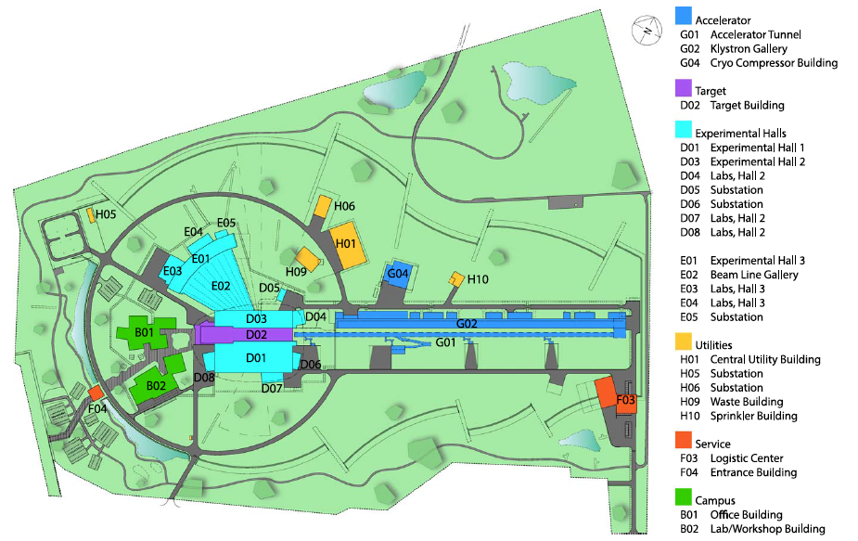
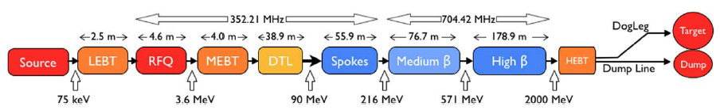
Notes:
The proton linac is designed for high power and high reliability and uses mainly superconducting cavities. RFQ) followed by a DTL section accelerate the ions supplied by the ion source up to a kinetic energy of 90MeV. Cryogenic installation provides the cooling power required to keep the superconducting cavities at a temperature of 2 K. Water cooling is used for the normal conducting structures and all high power equipment (klystrons, RF loads, modulators etc).

Slide 5
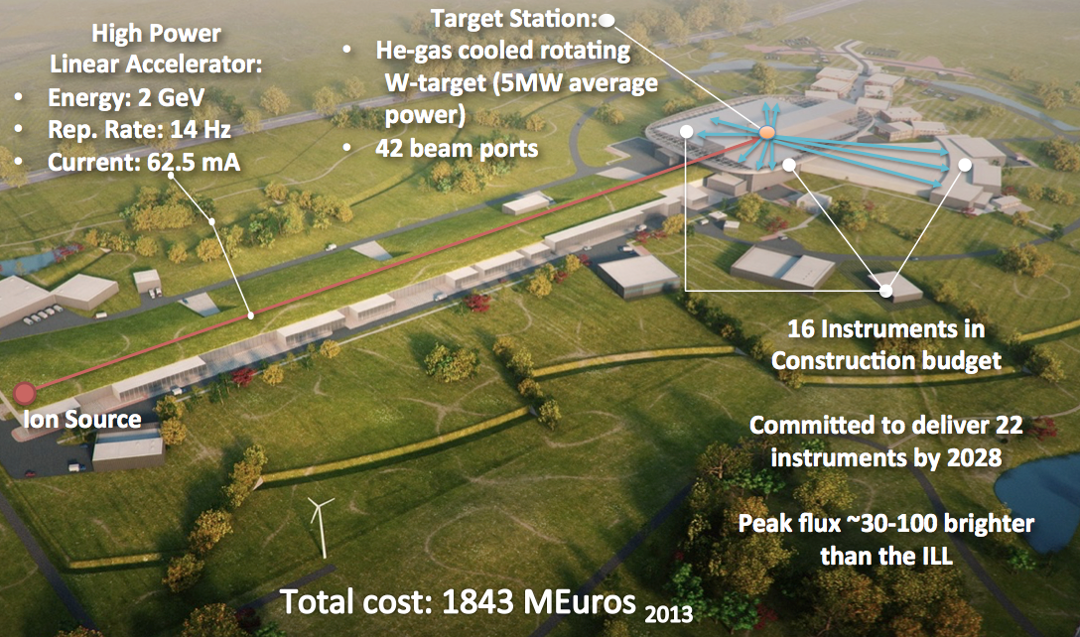
Review on ESS
Picked from Mats slides
Notes:
ESS is well into construction and progressing according to plan towards first beam for science 2023.
In this presentation I will concentrate on the linac section

Slide 6
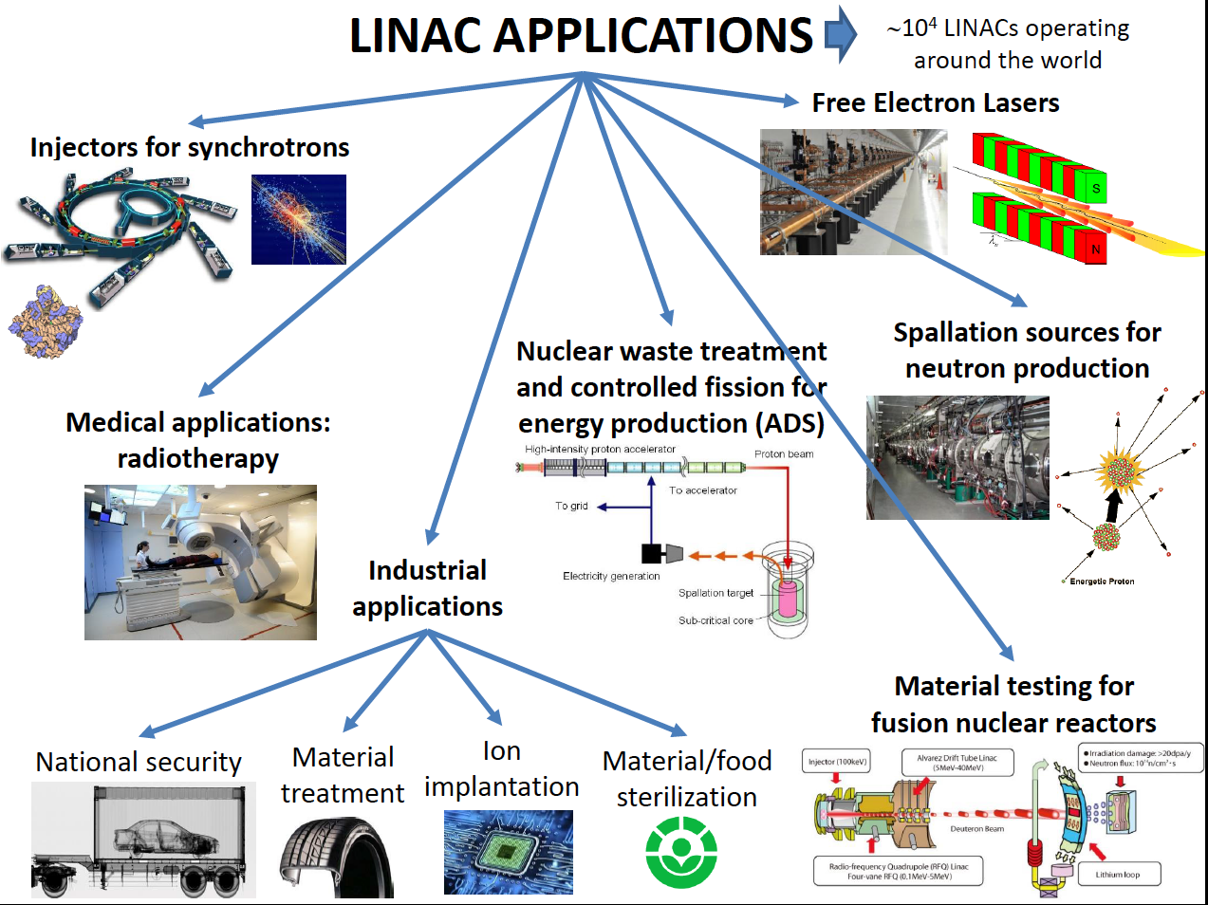
Picked from David Alesini slides-Accelerator Physics CAS 2018
Notes:
Linac or linear accelerator is a system that allows to accelerate charged particles through a linear trajectory by electromagnetic fields.

Slide 7
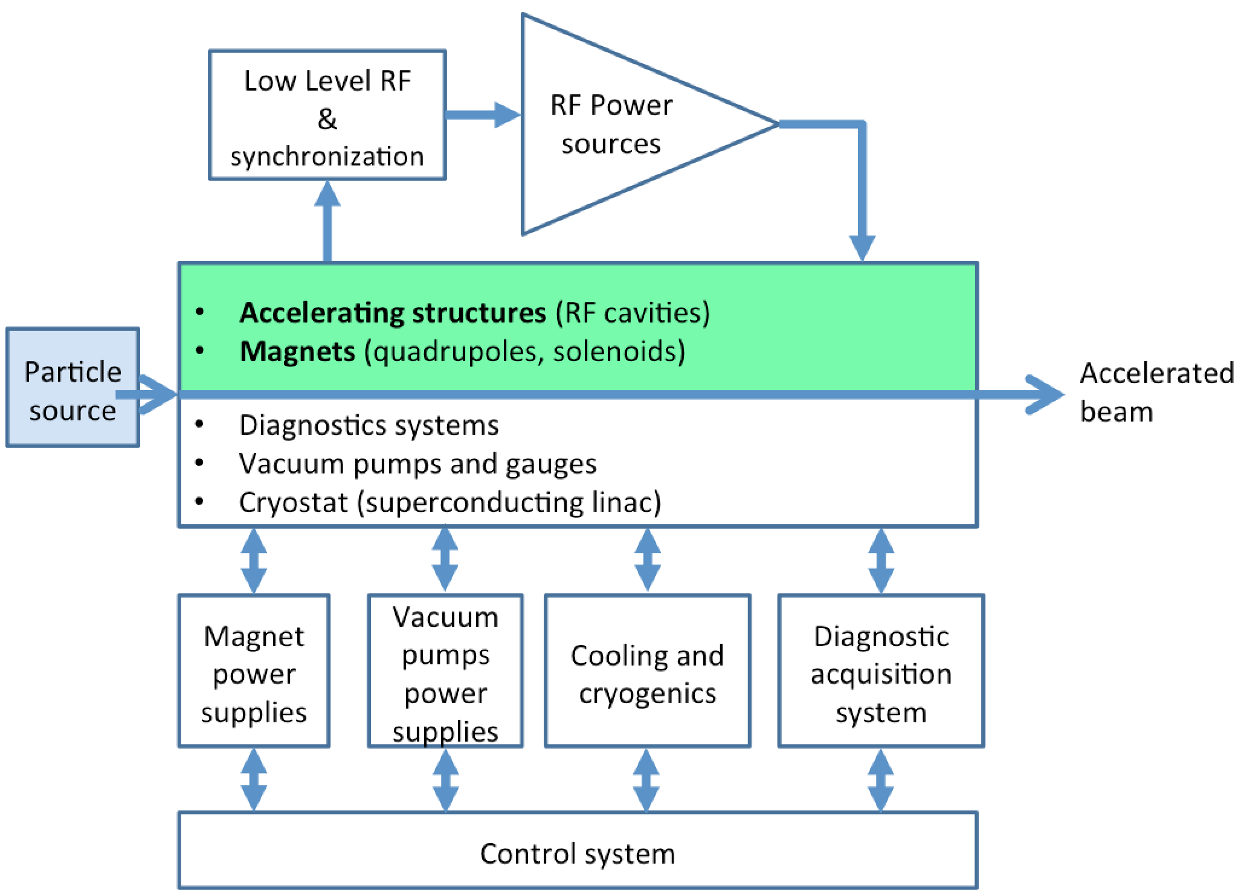
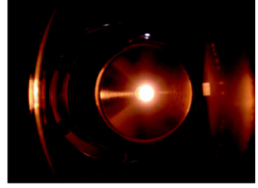
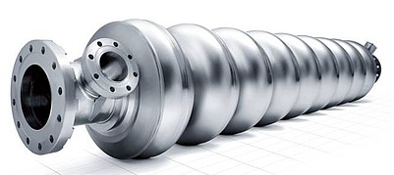
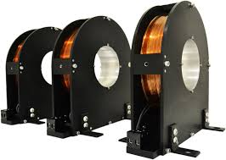
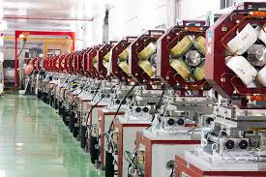
Synchronization of charged particle with RF field
Picked from David Alesini slides-Accelerator Physics CAS 2018
Notes:
In order to accelerate a charged particle through a linear line we need some specific technologies. First of all we need a source to create desired charged particles such as electrons or protons, devices to increase energy of our particles and devices to focus particles and not let our beam to blow up because of forces like space charge.
In a Linac in addition to accelerating (cavity) and magnetic structure there are many other components and parts which are quite essential which are illustrated here and are power supply, vacuum, diagnostic, control and cryogenic system (if we include SC cavities in Linac).

Slide 8
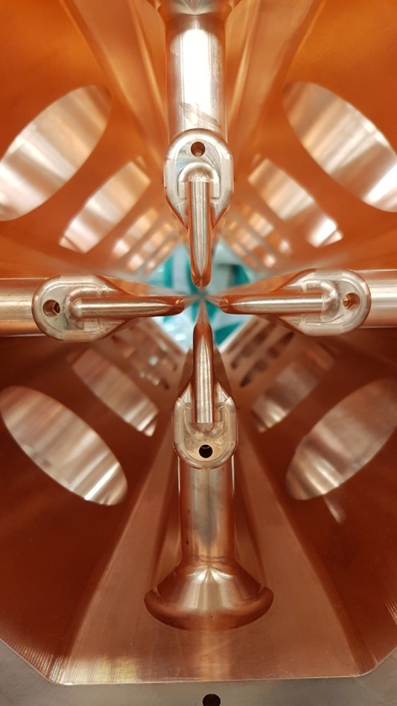
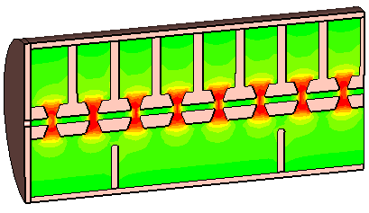
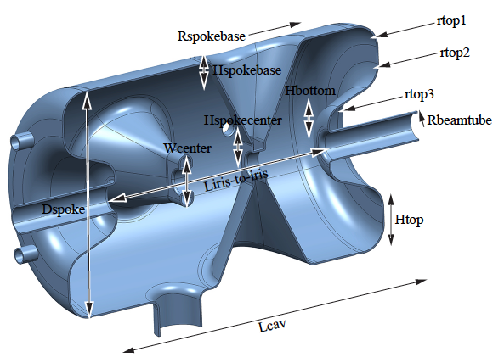
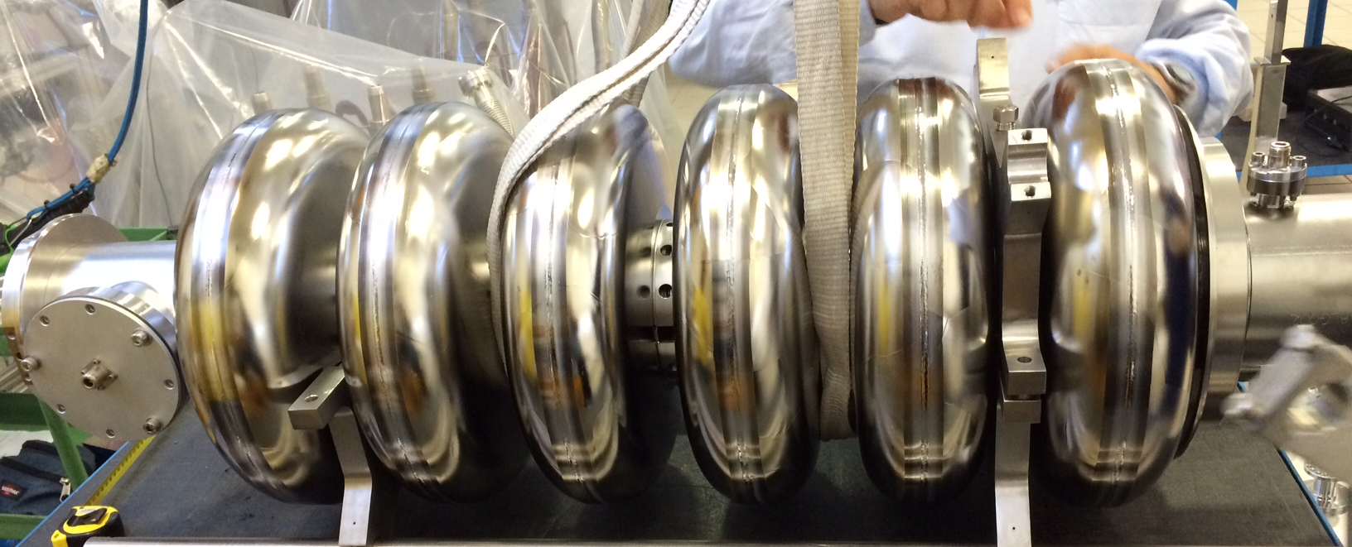
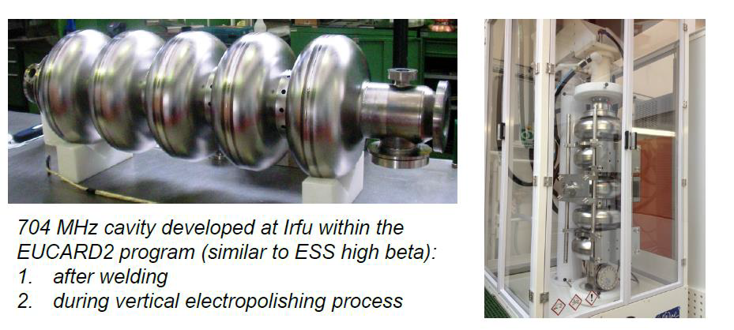
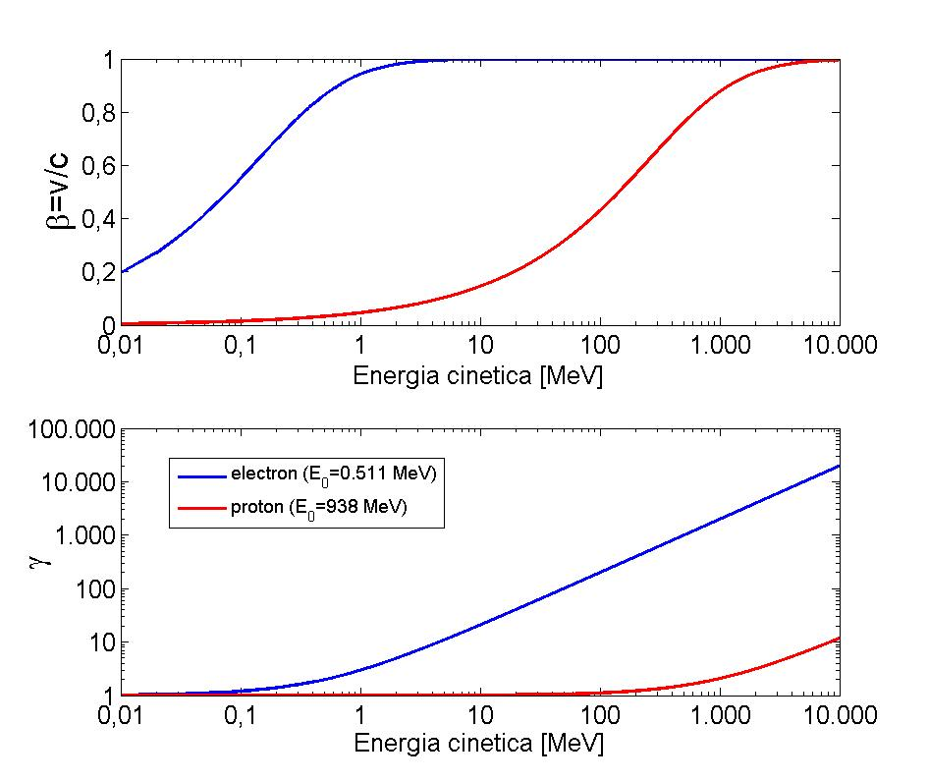
Review on ESS Linac Basics
 | Electron | Proton
Rest mass [Kg] | 9.11E-31 | 1.67E-27
Rest mass [MeV] | 0.511 | 938
V~0.95 c [MeV] | 1.1 | 2000
ratio | 1 | 1836
Why in ESS we use 5 different types of cavities?
Relativistic factors
β=v/c (<1) γ=E/E₀ (≥1)
p⁺
e⁻
Kin. Energy [MeV]
Notes:
The basic equation that describes the acceleration/bending/focusing process is the Lorentz force. Particles are accelerated through E-field and are bended and focused through magnetic field. So based on Lorentz force in order increase momentum it is enough to put several gap voltages in the way of particle pass.
Considering relativistic factors for particle velocity and energy and also this equation which relate particle total energy to particle momentum and rest energy and performance some math we can explain beta as a function of particle kinetic energy. As it is illustrated there is a huge difference between electron and proton in this diagram and it is because of big difference in electron and proton mass.
It is illustrated in the table that an electron and proton reach light velocity by 1.1 MeV and 2000 MeV respectively. So for electron after 1.1 MeV it is reached light velocity and by repeating same gap voltage we can increase particle energy by keeping the synchronization. But in case of proton this synchronization happen after 2 GeV and after that we can repeat accelerating structures.
We use different accelerators to increase acceleration efficiency.

Slide 9
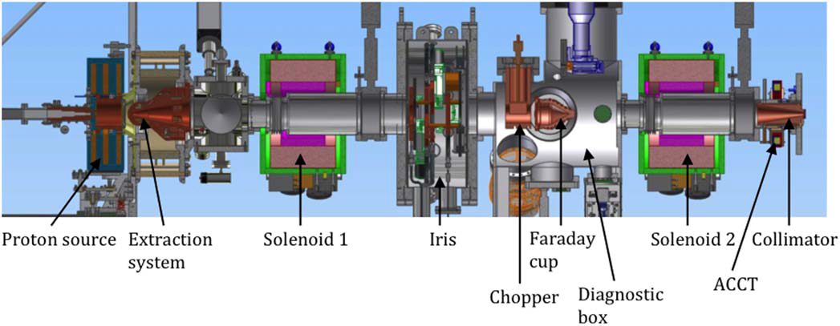
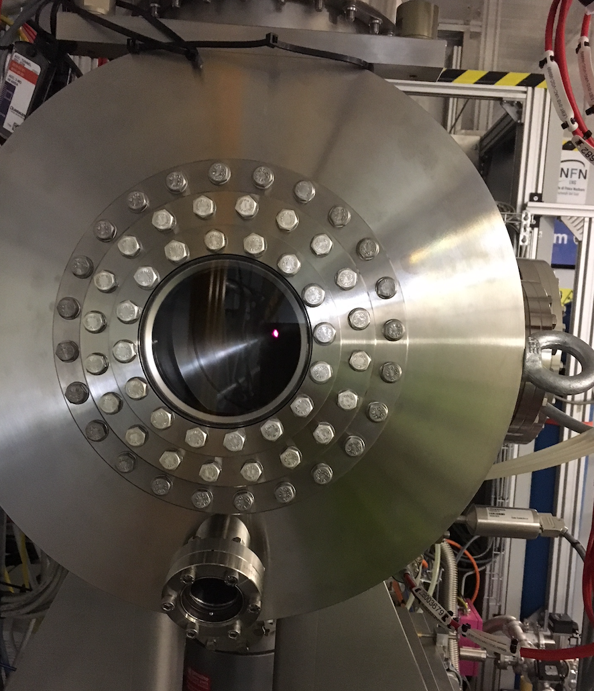
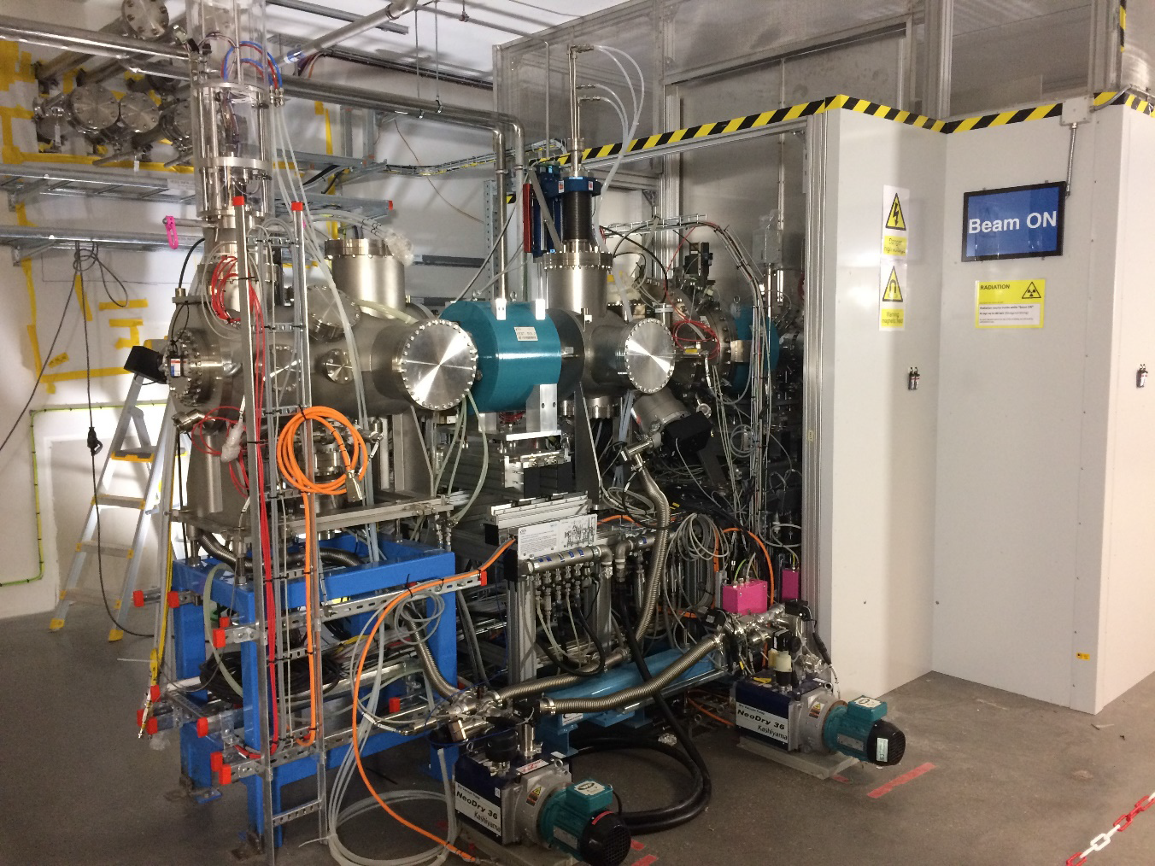
Review on ESS Superconducting cavities section
Plasma in ion source
Notes:
Basic principle: create a plasma and optimize its conditions (heating, confinement and loss mechanisms) to produce the desired ion type. Remove ions from the plasma via an aperture and a strong electric field. Diagram of microwave-discharge ion source ( MDIS) and LEBT
The LEBT matches the ion source beam to the RFQ. It incorporates a chopper system that removes low quality head and tail of the beam, a multi-blade iris to reduce the current and a suite of beam diagnostics that measure the beam properties.

Slide 10
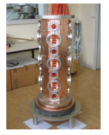
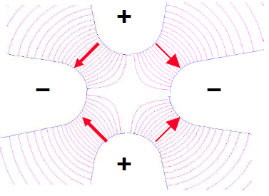
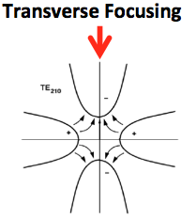
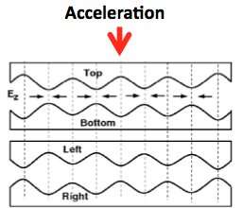
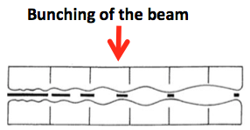
Review on ESS Superconducting cavities section
What is RFQ role in ESS linac?
At low proton energies (β∼0.01), space charge defocusing is high and quadrupole focusing is not very effective. Moreover cell length becomes small and DTL will be very inefficient. At this energies RFQs will be applied.
Notes:
The Radio Frequency Quadrupole is a linear accelerator which focuses, bunches and accelerates a continuous beam of protons with high efficiency and preserving the emittance.
The resonating mode of the cavity (between the four electrodes) is a focusing mode: Quadrupole mode (TE₂₁₀). The alternating voltage on the electrodes produces an alternating focusing channel with the period of the RF (electric focusing does not depend on the velocity and is ideal at low β) - Acceleration: The vanes have a longitudinal modulation with period = βλRF this creates a longitudinal component of the electric field that accelerate the beam (the modulation corresponds exactly to a series of RF gaps). - Bunching: The modulation period (distance between maxima) can be slightly adjusted to change the phase of the beam inside the RFQ cells, and the amplitude of the modulation can be changed to change the accelerating gradient. One can start at -90° phase (linac) with some bunching cells, progressively bunch the beam (adiabatic bunching channel), and only in the last cells switch on the acceleration.

Slide 11
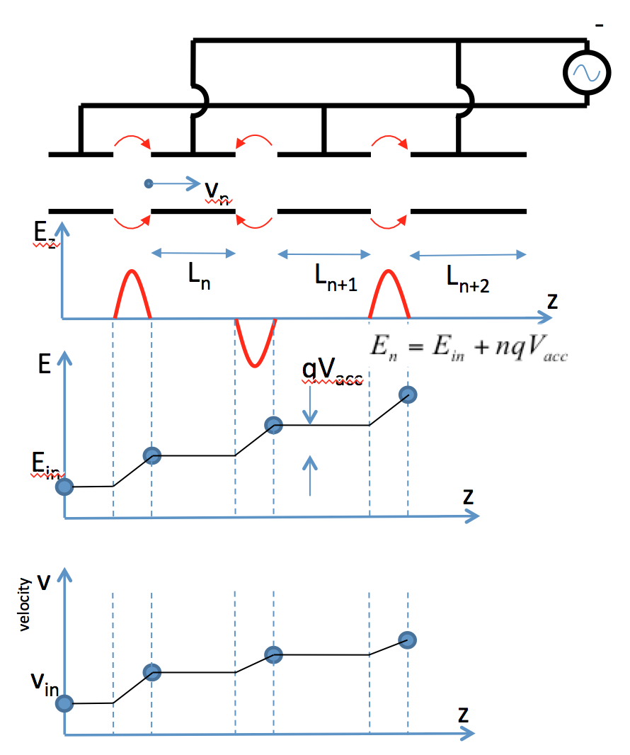
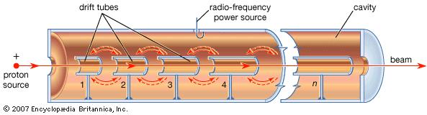

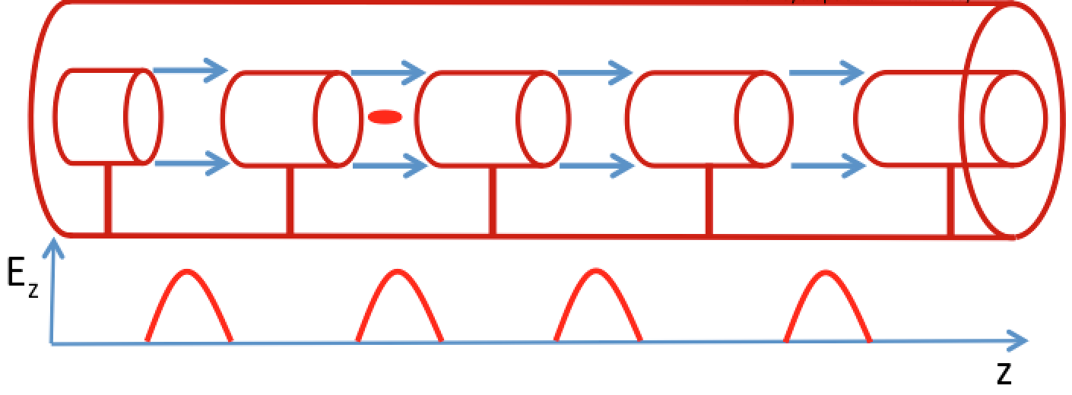
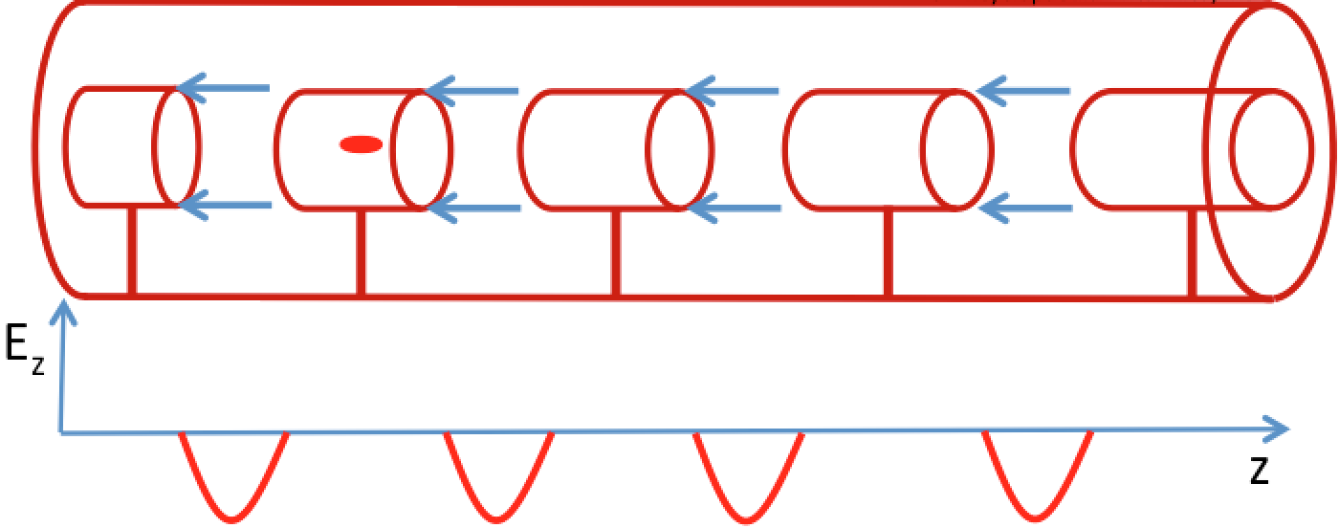
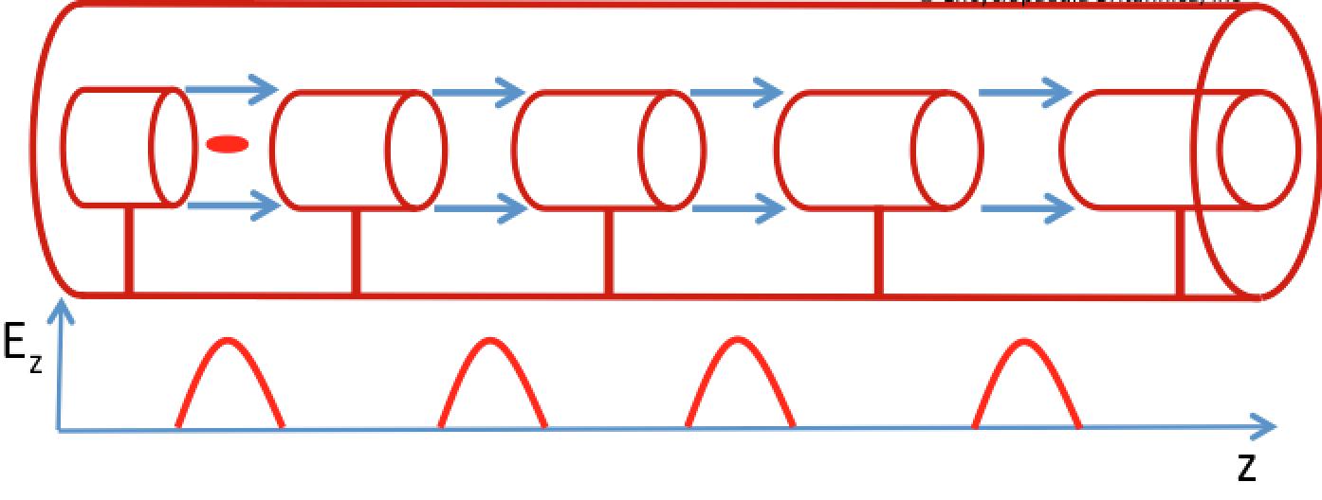
Review on ESS Drift Tube Linac
Widero Drift Tube Linac
Alvarez's DTL structure
Alvarez's structure can be described as a special DTL in which the electrodes are part of a resonant macrostructure.
The DTL operates in 0 mode for protons and ions in the range β=0.05-0.5 (f_{RF}=50-400 MHz)
Picked from David Alesini slides-Accelerator Physics CAS 2018
Notes:
The beam is inside the “drift tubes” when the electric field is decelerating. The electric field is concentrated between gaps;
In order to be synchronous with the accelerating field at each gap the length of the n-th drift tube L_{n} is related to particle velocity relative to speed of light and rf wavelength
It is illustrated that passing of particle through gap voltages lead to continuous increase in energy and velocity of particle. Energy increase is linear but velocity increase is not linear and it will get saturate.

Slide 12
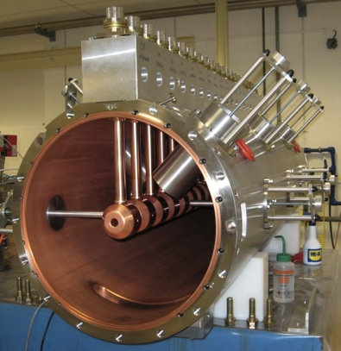
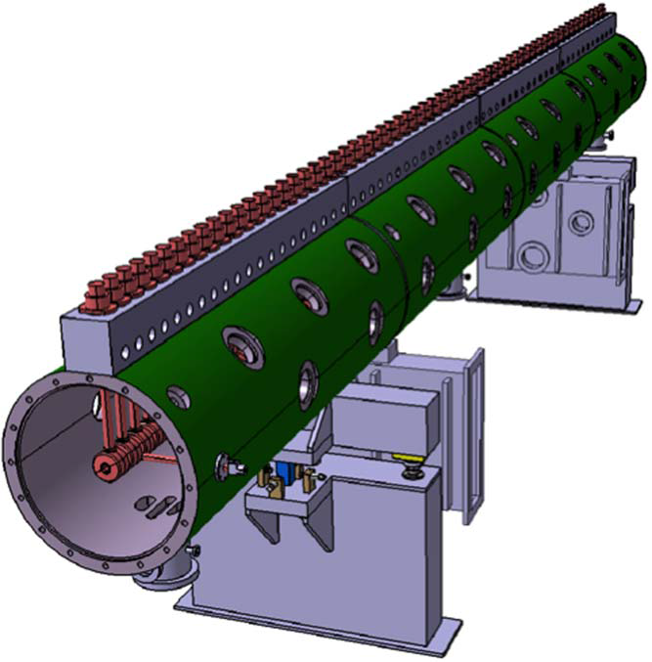
Notes:
For low beta beams we use DTLs, but for beams which their beta is bigger than 0.5 it is not efficient to use DTLs and we need to start using cavities suitable for higher beta beams.

Slide 13
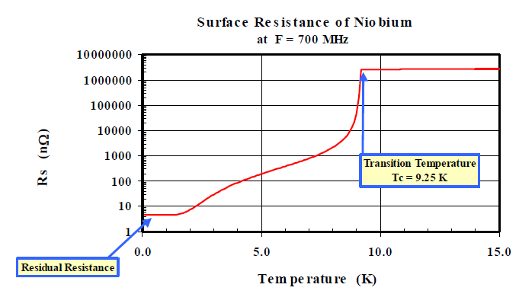
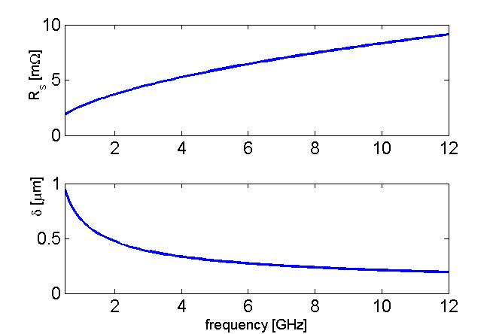
Review on ESS Superconducting cavities section
Why we need superconducting cavities in ESS Linac?
NIOBIUM
COPPER
Between copper and Nb (4K) there is a factor 10⁵-10⁶
In copper cavities almost half of power is dissipated on cavity surface
SC cavities almost deliver all your RF power to the beam
Copper cavities are cheaper and means less complication in your machine
High acceleration gradient and long RF pulse length is not possible with copper cavities
Final decision in using SC or NC is made based on requirements of the machine like pulse width in RF system, gradient we want to have
In ESS because of long pulse width and reducing overall electrical consumption of the machines it is decided to main part of acceleration by SC cavities
Notes:
Cavities can be build of copper (operated in room temperature) and Nb (operated in 2K)

Slide 14
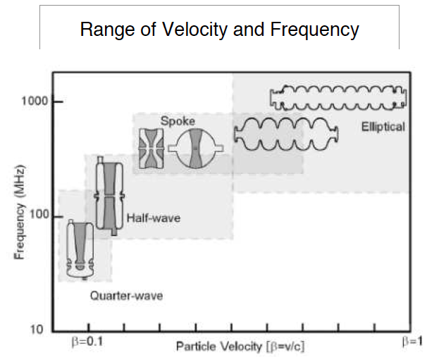
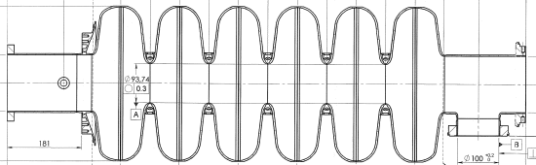
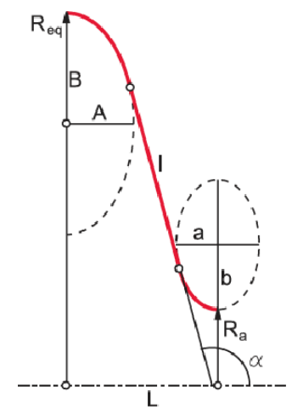
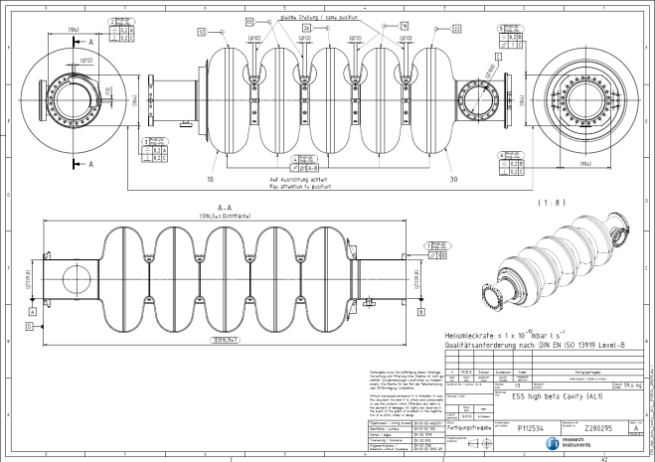
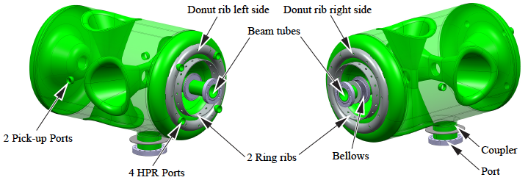
Review on ESS Superconducting cavities section
6 cell elliptical cavity
Spoke cavity
5 cell elliptical cavity

Slide 15
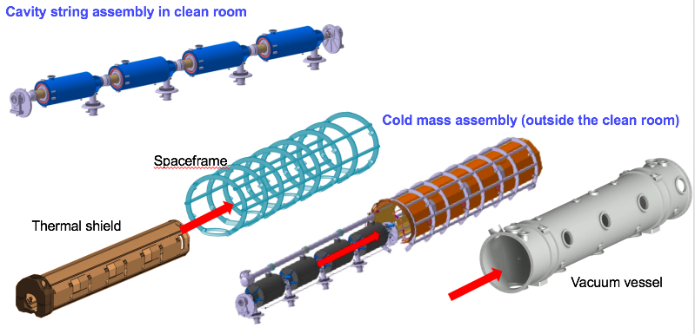
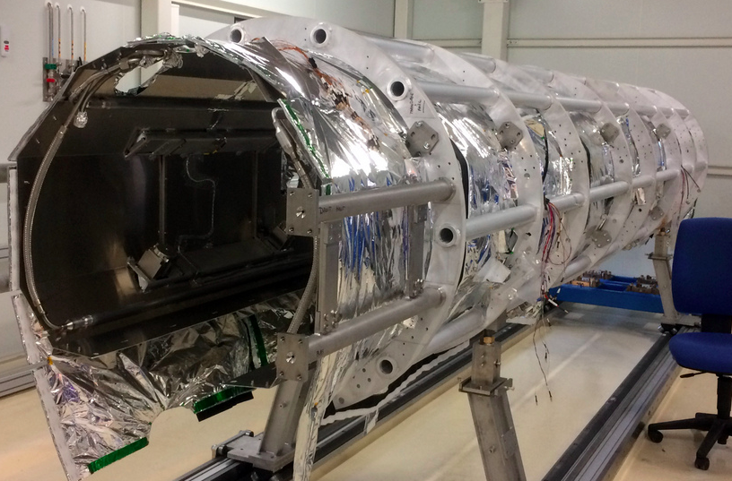
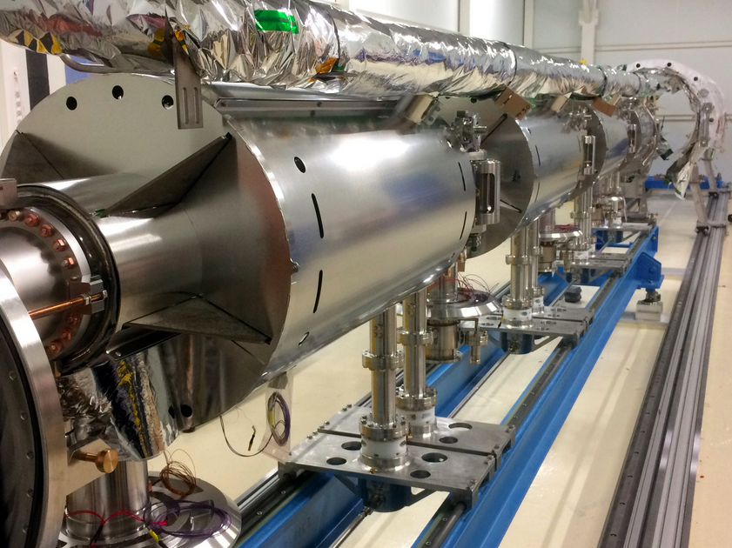

Slide 16
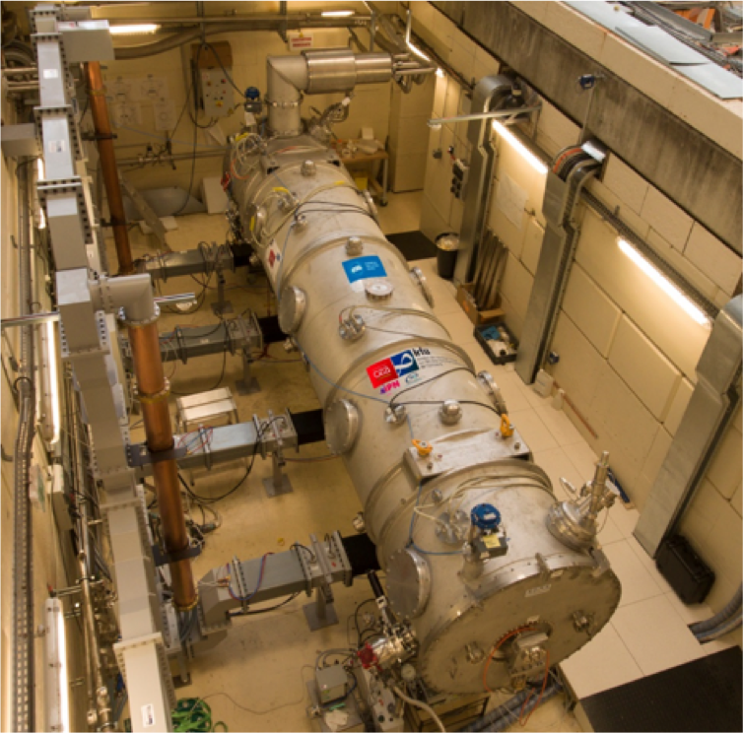
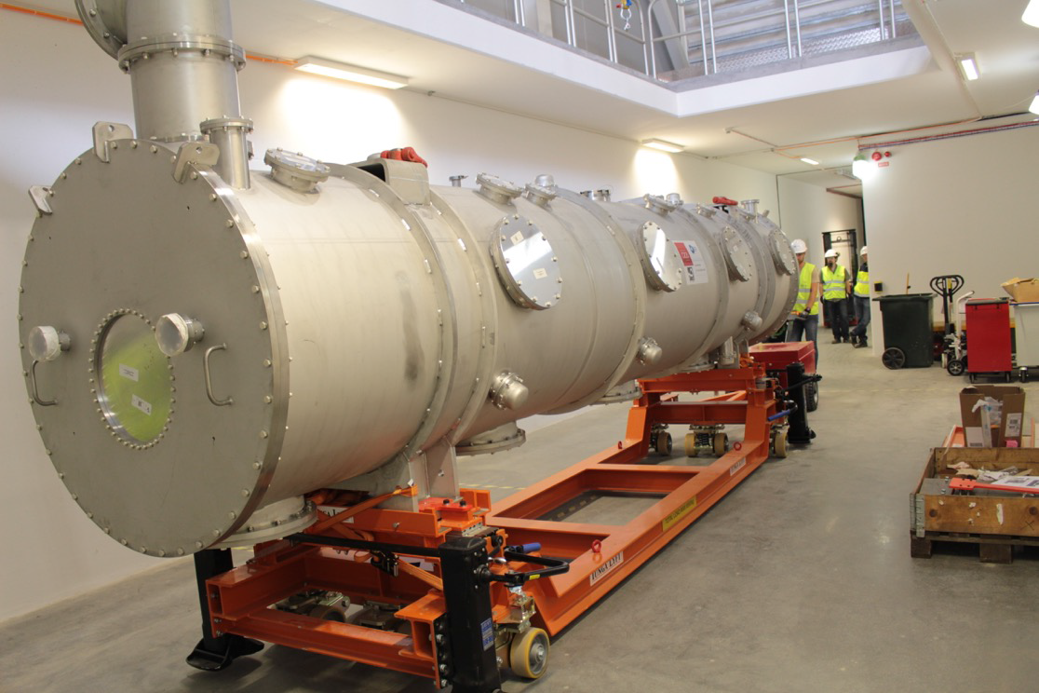
Review on ESS Superconducting cavities section

Slide 17
A short overview on ESS
Ion Source and LEBT
Radio Frequency Quadrapole (RFQ)
Drift Tube Linac (DTL)
Superconducting cavities section
Elliptical MB Cavity
Cavity Design
Cavity Fabrication and Treatment
Cavity Test
Cavity Higher Order Mode Study

Slide 18
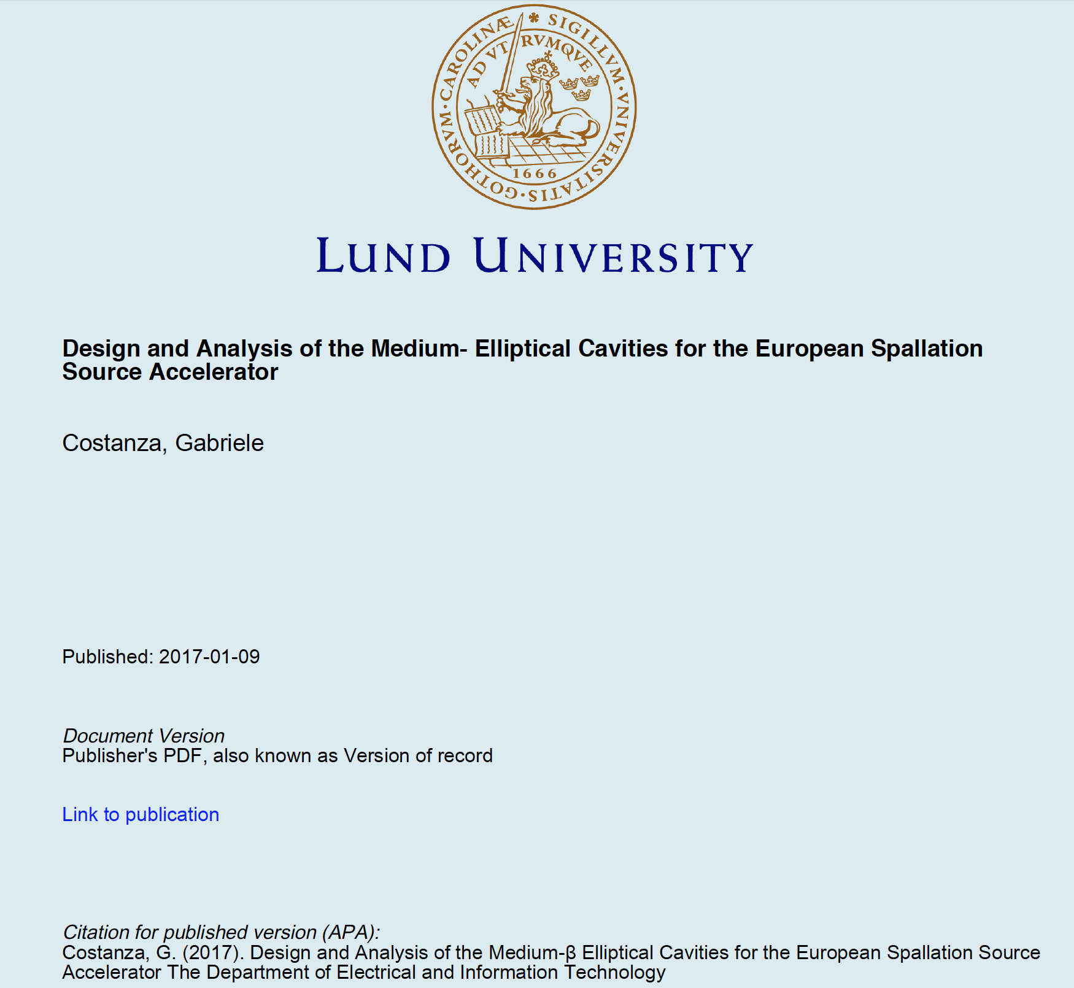
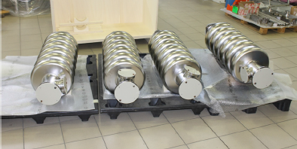
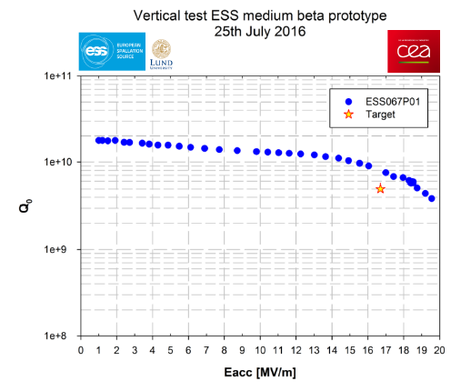
Notes:
Before I start my PhD there was an other PhD student in electrical & IT department who did his PhD in a similar subject to my PhD. His work was done in collaboration with the CEA (French in-kind contributor) and my PhD is in collaboration with INFN-LASA. Reason for this repeat was because CEA finished cryomodule design and MB and HB elliptical cavities and also fabrication of some prototypes they declared ESS that their share of in-kind contribution by fabrication of cryomodule sets of ESS will be done. If they were supposed to be responsible for series production of MB and HB cavities it will not be apart of their in-kind contribution. So ESS gave MB cavity project to INFN-LASA other in-kind contributor and INFN decision was not to use CEA design and I hired as a PhD student to work with them. Also 2 PhD topics are similar but performed job is not similar.

Slide 19
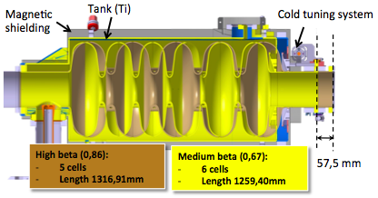
Elliptical MB cavity Cavity Design
Design philosophy:
Compatible to ESS spec.
Boundaries compatible to CEA cryomodule
Practical considerations
To have large cell-to-cell coupling factor, k>1.5%
Considering fabrication, treatment and test specs in geometry design
Parameters | INFN design | ESS spec.
R_{iris} (mm) | 50 | ≥47
Geometrical beta | 0.67 | 0.67
Frequency (MHz) | 704.42 | 704.42
Acc. length (m) | 0.855 | 0.855
Cell to cell coupling k | 1.55%↗(+26%)
π-5π/6 mode sep.(MHz) | 0.70↗(+30%) | >0.45
G (Ω) | 198.8
Optimum beta, β_{opt} | 0.705 | 0.705
Max R/Q at β_{opt} (Ω) | 374 ↘ (-6%)
E_{acc} at β_{opt} (MV/m) | 16.7 | 16.7
E_{peak}/E_{acc} | 2.55 ↗ (+7%)
E_{peak} (MV/m) | 42.6 | < 45
B_{peak}/E_{acc}(mT/MV/m) | 4.95 ↗ (+3%)
Q₀ at nominal gradient | >5×10⁹ | >5×10⁹
Q_{ext} | 7.8×10⁵ | 5.9~8×10⁵
Notes:
In Linac we don’t use single cell cavities but instead we use multi cell cavities. In this we will have a system composed of n coupled oscillating cavities which will be more efficient (occupying space, reduced number of coupler and LLRF) in comparison to a single cell cavity.
In case of MB cavity design philosophy there are 3 main issues to consider: ESS specs – compatibility with CEA cryomodule – practical considerations related to better cavity performance (such as cell to cell coupling factor, lower surface peak E-field, spherical geometry in equator to limit multipacting and avoid side wall angle less than 6 degree to have balance between E-peak and H-peak and chemical treatment considerations.

Slide 20
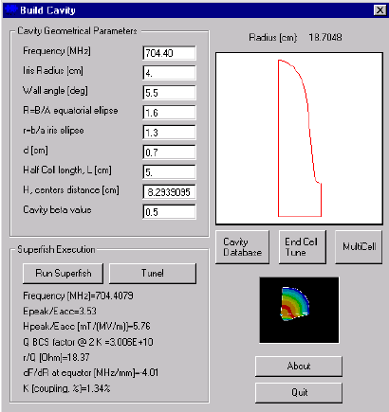
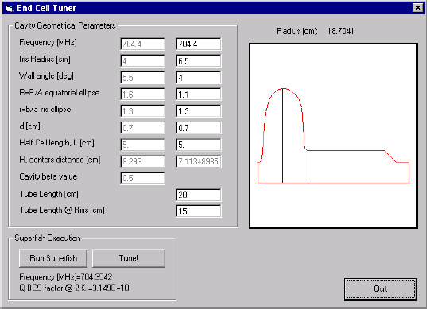




Elliptical MB cavity Cavity Design
Inner half-cell and End half-cell designs are performed by BuildCavity using 7 independent geometrical parameters of elliptical cavities
Geometrical design is a iterative process in order to tune all cavity parameters to optimum value based on defined spec.
Equivalent circuit for a 4 cell cavity with beam pipe
Notes:
Riris = 5 cm, this large Riris gives us a large k, hence large modes seperation (+30%), also a better coupling of HOMs to the outer cells.
Iris ellipse ratio r is chosen to have a minimum Epeak, and also a larger k
L and D are designed considering frequency

Slide 21




Elliptical MB cavity Cavity Design
After cavity 2D design for supplementary calculations such as higher order modes, field emission and external Q factor, cavity 3D simulation is required

Slide 22









Elliptical MB cavity Cavity Fabrication & Treatment
Deep Drawing Die

Slide 23





Elliptical MB cavity Cavity Fabrication & Treatment
Cavity EBW
Pretuning
BCP1_1: 20 μm
Bead Pull in CR
BCP2: 50 - 70 μm
3 x tot: 60 μm
Optical Insp.
Mechanical Check
Mechanical check
Leak test
RF
Each step:
Frequency,
Weight
F. Flatness with bead pull in CR
Weight
RF
F. Flatness with bead pull in CR
Final Check
Accessories installation
Final
BCP: 20 μm
Tuning
Annealing
De Hydrog.
RF (spectrum)
Outcoming insp.
Leak test
RGA
RF
Optical Insp.
Mechanical check
Leak Test
Mechanical check
Acid flow
Picked from Paolo Michelato slides

Slide 24



Elliptical MB cavity Cavity Test

Slide 25



Elliptical MB cavity Cavity Test
Cavity surface resistance variation between 4 K and 2 K
Block diagram of the RF system used to test ESS cavities
Prototype MB cavity vertical test

Slide 26




Elliptical MB cavity Cavity Higher Order Mode Study
What are cavity higher order modes?
Beam loading theory :
How HOMs affect us in accelerators?
Beam instability growth (in both longitudinal and transverse directions)
Extra heating
HOMs decay time in cavity :
Notes:
When a point-like particle of charge, q traverses a cavity at the speed of light, a voltage is induced according to the fundamental theorem of beam loading, The voltage induced is given by;
HOMs in SC cavities are often very long lived (high Q) and can easily be trapped within a cavity.
Transverse modes can deflect the beam from its reference orbit and causes instable beam motion, transverse emittance growth or even beam loss -- Monopole HOMs can lead to energy spread, timing/phase errors also monopole HOM causes longitudinal emittance growth or instability -- HOMs (dominantly monopole modes) also cause extra losses in cavity walls and this is particularly crucial for SRF cavities since power is dissipated in Helium bath (every extra Watt matters)

Slide 27




Elliptical MB cavity Cavity Higher Order Mode Study
HOM analyse for LASA cavity design is performed by Superfish & CST
Performed investigation was up to 1.77GHz
All higher order modes (HOMs) shall be at least 5 MHz away from integer multiples of the beam-bunching frequency (352.21 MHz)
Probable traped modes
SuperFish (MHz) | HFSS (MHz) | Comments
694.332 | 694.323
696.366 | 696.353
699.097 | 699.076
701.797 | 701.737
703.698 | 703.614 | >0.7 MHz, MP
704.420 | 704.311
------ | 1003.84
------ | 1029.659 | >26MHz, DP
------ | 1358.195
------ | 1372.127
------ | 1373.551
------ | 1375.300
------ | 1376.716 | >32MHz, QP
------ | 1651.347
------ | 1656.103
------ | 1661.727
------ | 1666.107
------ | 1689.390
------ | 1704.963
------ | 1705.153
------ | 1705.389
------ | 1705.579
1742.7 | 1742.466 | >17MHz,MP
BeamPipe Radius (mm) | Cut off Frequency (GHz)
 | TE11 | TM01
68 | 1.293 | 1.689
Machine Lines
352.210
704.420
1056.630
1408.840
1761.050
2113.260
2465.470
703.614
MonoPole mode
1376.716
Quadrapole mode
1029.659 Dipole mode
1742.466

Slide 28








Elliptical MB cavity Cavity Higher Order Mode Study
Cavity 3rd Passband Monopole HOM Frequency Shift vs. Errors in Cavity Geometry (kHz/mm)
Considering 0.2 mm shape and length tolerance and adding the numbers in above table, the 1742 MHz mode frequency shift is less than 7 MHz.
HOM measurement result at 2K with tank around 5th machine line.
Notes:
Based on a bad experience during on one of prototype cavities in confluence of HOM with a machine line I did a study to evaluate mechanical tolerances effect on HOMs

Slide 29

Elliptical MB cavity Series production process
Picked from Paolo Michelato slides

Slide 30

Special thanks for my supervisors for their continues support and instructions & for INFN-LASA scientist team for their
friendly-collaborative attitude
Thanks for your attention
Questions??

Slide 31
RF Bunching
Only these particles are accelerated
Gap voltage
ΔE
z
t_{inj}
These particles are not accelerated and basically are lost during the acceleration process
DC acceleration
RF acceleration
charge
charge
Bunched beam (in order to be synchronous with the external AC field, particles have to be gathered in non-uniform temporal structure)
t
RF period
t
Picked from David Alesini slides-Accelerator Physics CAS 2018
Notes:
In RF accelerators always we speak about bunched beam

Slide 32


Backup-RFQ properties
1-Focusing
The resonating mode of the cavity (between the four electrodes) is a focusing mode: Quadrupole mode (TE₂₁₀). The alternating voltage on the electrodes produces an alternating focusing channel with the period of the RF (electric focusing does not depend on the velocity and is ideal at low β)
2-Acceleration
The vanes have a longitudinal modulation with period = βλ_{RF} this creates a longitudinal component of the electric field that accelerate the beam (the modulation corresponds exactly to a series of RF gaps).
3-Bunching
The modulation period (distance between maxima) can be slightly adjusted to change the phase of the beam inside the RFQ cells, and the amplitude of the modulation can be changed to change the accelerating gradient. One can start at -90° phase (linac) with some bunching cells, progressively bunch the beam (adiabatic bunching channel), and only in the last cells switch on the acceleration.

Slide 33
Notes:
DTLs are only suitable for particles which beta<<1 and this mean that rf wavelength much bigger than gap voltage in DTL, other wise acceleration will not be efficient and drift tubes start to act like an antenna. In ESS case 350MHz correspond to 2.8 nm rf wavelength and we can not directly use Widero linac. To solve this problem we need to use rf cavities instead of schematics similar to dc accelerators for acceleration. In this wave we inject an RF EM wave inside the cavity, field will oscillate inside the cavity and will be confined inside the metalic box of cavity.

Slide 34

What is the efficient number of cells?
From the physical point of view it is desired to increase cells as much as possible
Practical issues related to cavity construction and its handling limit us in case of increasing number of cells
Overlap between adjacent modes can be a problem in increasing number of cells (as example the field uniformity due to machining errors is difficult to tune).
HOMs of cavity is a limiting factor in increasing number of cells.

Slide 35


For a N-cell standing-wave structure, sensitivity of the accelerating field amplitude Eacc,i in the i-cell to the cell frequency error Δωi depends on the coupling strength. When a structure operates in π mode, the sensitivity is
is the field flatness factor, which should be small to keep the structure insensitive to random-cell frequency errors coming from the mechanical tolerances for production, chemical treatment, and cooldown–warm-up
cycles.

Slide 36



Neutron and X-ray imaging
Neutrons
X-Rays
From PSI website
Picked from Mamad slides
Notes:
Electromagnetic waves are stopped by metallic parts - Neutrons can show details of plastic elements

