Slide 1

https://kraftly.com/product/thoughts-in-progress-a5-notebook-1461826391siv

Slide 2
First quote: the high level question
“The theoretical picture of collective effects in heavy ion collisions is vastly different from the picture known from proton–proton (pp). Due to the very different geometry of the two system types, interactions in the final state of the collision become dominant in heavy ion collisions, while nearly absent in pp collisions.” (C. Bierlich)
One thing we CLASH about!

Slide 3
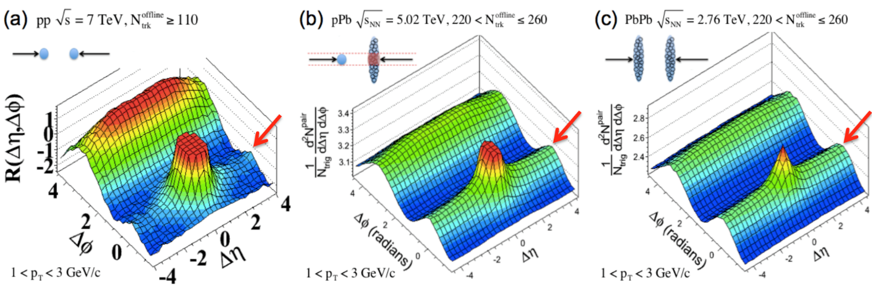
How to understand the ridge variation across systems?
pp
p-Pb
Pb-Pb
The ridge slowly emerges from final state interactions
Ridge disappears in very small systems and is not fully formed in small systems Vs
The ridge is hidden because it scales differently from mini-jet correlations
Minijet correlations scales roughly as 1/Multiplicity
Flow correlations are independent of Multiplicity

Slide 4
Second quote: the low level question
“If collectivity in small systems is due to final state interactions, it should be possible to also measure its effect on jets.” (C. Bierlich)
Common assumption, but is it really true that hydrodynamic collective behavior implies significant jet quenching or could one expect a more complex relation?
Goal today: explore this
In what way does a QGP interact?

Slide 5
First comment
There are signs of other final state interactions in small systems
The strangeness enhancement is a clear indication for violation of jet universality implying final state interactions

Slide 6
Final state interactions in small systems
Plenty of ideas:
”QCD” inspired: parton-parton
Angantyr: Color Reconnection/Ropes, Shoving
But isn’t even a string an interaction?
QGP: hydro, jet quenching, stat model interactions
Note also that even all systems are made of quarks and gluons the relevant degrees of freedom are quite different/unknown
Could a better understanding of final state interactions be the key to differentiate between different paradigms?

Slide 7
First model: kinetic theory
A model where collectivity requires jet quenching/modifications
Kinetic theory primer: https://indico.cern.ch/event/353906/contributions/2223197/attachments/1330331/1998920/kurkela.pdf
Weakly coupled!
Classical (QM/QFT via cross sections)
Partonic (hard modes)
Advantage: can be applied out of equilibrium so it can bridge CGC to hydro (thermalization/hydrodynamization)

Slide 8
Kinetic theory: flow in small systems
https://arxiv.org/abs/1803.02072
Caption: “Free-streaming particles move along the directions of their momentum vectors leading to local momentum anisotropies. In the central region where most collisions take place, there is an excess of particles moving horizontally compared to vertically moving ones. The interactions in the center region tend to isotropize the distribution function, and thus they reduce the number of horizontal movers and they add vertical movers.”
Abstract: “Here, we demonstrate within the framework of transport theory that even the mildest interaction correction to a picture of free-streaming particle distributions, namely the inclusion of one perturbatively weak interaction (“one-hit dynamics”), will generically give rise to all observed linear and non-linear structures. … As a non-vanishing mean free path is indicative of non-minimal dissipation, this challenges the perfect fluid paradigm of ultra-relativistic nucleus-nucleus and hadron-nucleus collisions.”

Slide 9
What does this model predict? What are its signatures?
Difficult because it is not quantitative (only collective effects) so these are my guesses!
Mini jet quenching
In particular when comparing near and away side jet!
Must be huge effect in larger systems
Entropy production
Needed for bottom-up thermalization
Clear if we want to average out fluctuations → must generate entropy

Slide 10
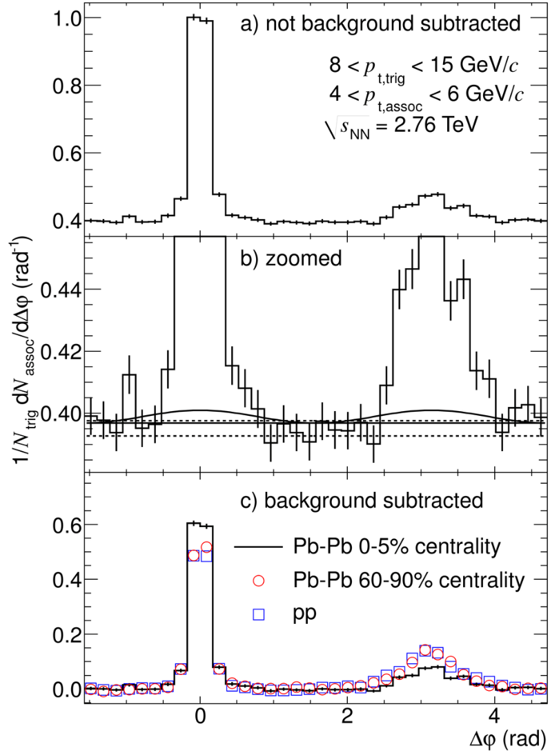
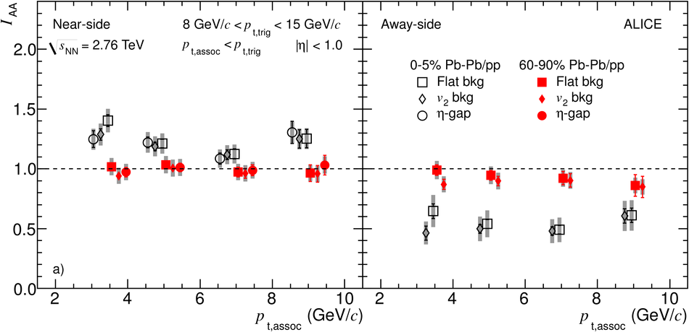
What do we know? I_{AA}
Phys. Rev. Lett. 108 (2012) 092301
Not any evidence that there are significant jet modifications in peripheral Pb-Pb collisions.
In particular the back-to-back structure is the same!

Slide 11
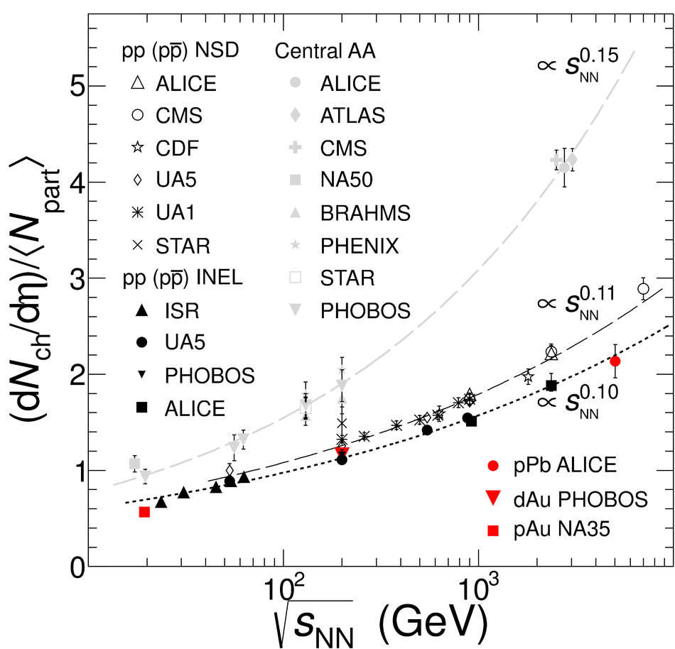
What do we know? dN/dη
Phys. Rev. Lett. 108 (2012) 092301
“The average value at midrapidity is measured to be 16.81±0.71 (syst.), which corresponds to 2.14±0.17 (syst.) per participating nucleon.”
Not any evidence that there are significant enhanced production in MB p-Pb collisions (~4 times MB pp collision).

Slide 12
Kinetic theory conclusion
Large effect → obvious mechanism
Small effect → obscure mechanism
My conclusion: Before kinetic theory can be considered as a serious candidate for non-equilibrium physics quantitative transparent estimates of (mini-)jet quenching and entropy production must be done in a way that it can be compared to experimental data

Slide 13
Second model: Angantyr
Angantyr can be used to study many interesting questions:
Is flow and jet quenching related?
Is flow a MPI effect?
How small a system can flow
Study 1 MPI system!
No classical geometry but there are 2 strings and radiation

Slide 14

Angantyr warning
PYTHIA 8.240
Main101 (ridge example) works
Main102 (strangeness enhancement example) does not work (no mult dependence)
Got a fix from Christian Bierlich
In general: I can so far get ridge or strangeness enhancement but not both at the same time

Slide 15
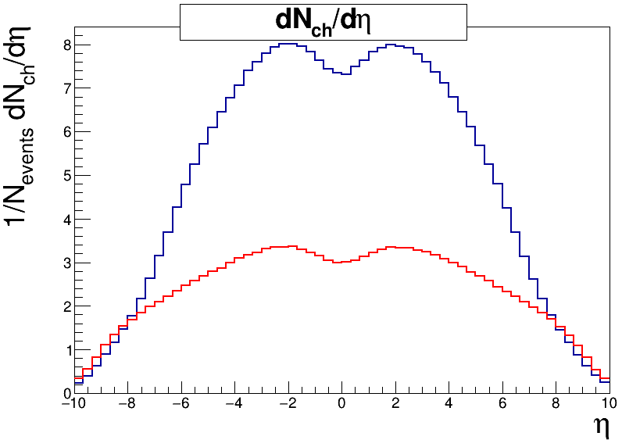
dN/dη (ND √s=13 TeV)
Main101
Main101 1 MPI
Notes:
15

Slide 16
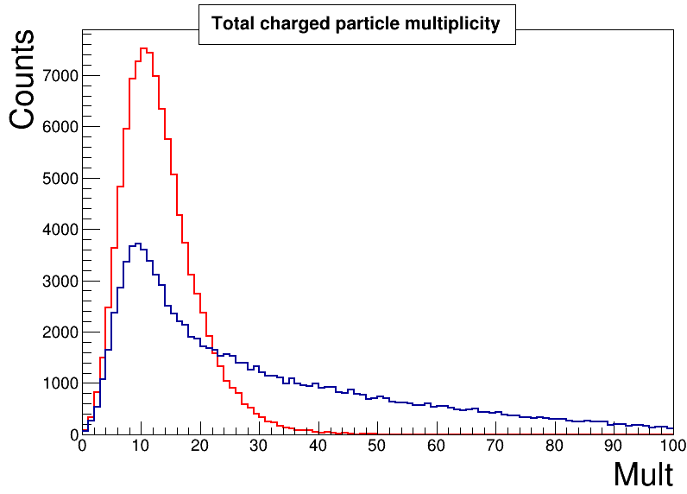
Multiplicity (ND √s=13 TeV)
Main101
Main101 1 MPI
Notes:
16

Slide 17
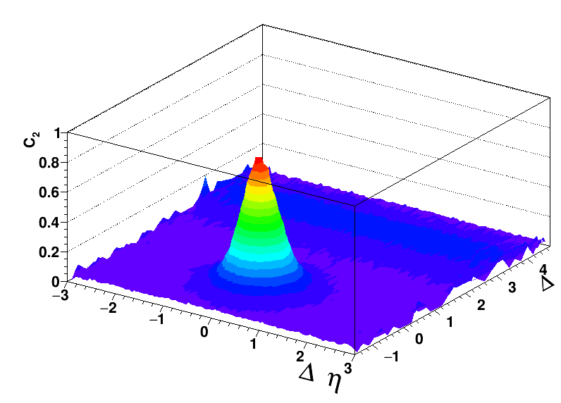
PYTHIA 8.240 default ND √s=13 TeV 1MPI
2 < p_{T,trigger} < 4 GeV/c
1 < p_{T,assoc} < 2 GeV/c
ϕ
Notes:
17

Slide 18

Angantyr (Main101) ND √s=13 TeV 1MPI
2 < p_{T,trigger} < 4 GeV/c
1 < p_{T,assoc} < 2 GeV/c
ϕ
NB! I do not observe any strangeness enhancement for 1 MPI events!
Notes:
18

Slide 19
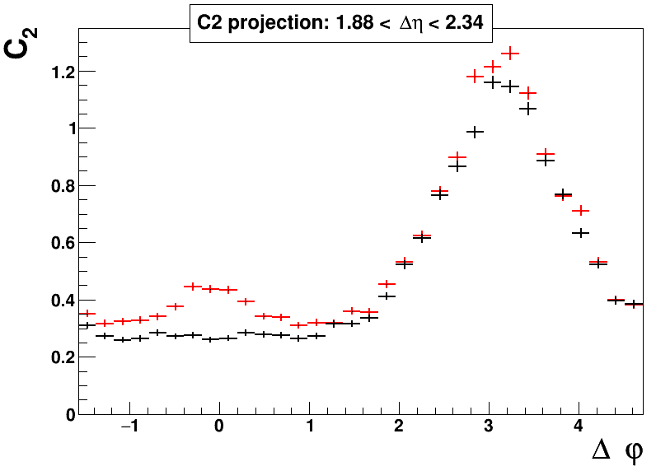
Bulk: Angantyr vs PYTHIA
I get a ridge without changing the away side structure significantly
Notes:
19

Slide 20
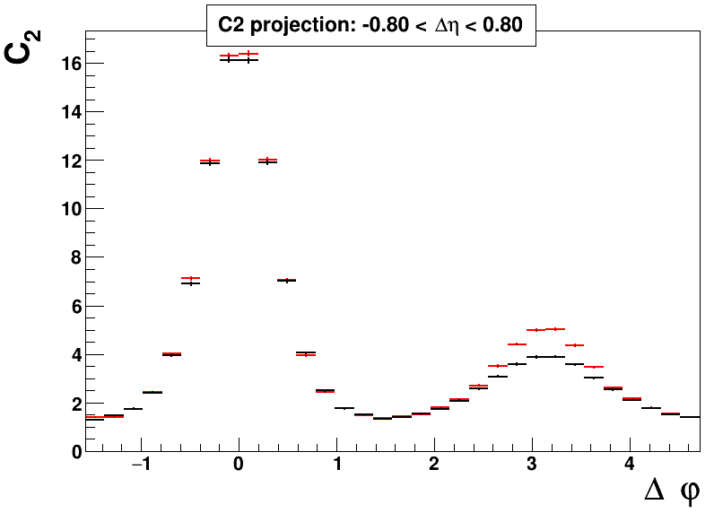
Jet: Angantyr vs PYTHIA
Also the jet structure is not changed significantly
Notes:
20

Slide 21
Angantyr vs kinetic theory
And first then it hadronizes!

Slide 22
Angantyr conclusion
There is a small effect BUT WE ALSO UNDERSTAND WHY IT IS A SMALL EFFECT
It is in some sense a prediction of Angantyr! Because the strings/ropes are only boosted by the shoving the direct correlations are minimally affected
And the effect is more a jet modification rather than jet quenching effect
And what is the reference for observing this if it is also present in 1 MPI events?
Notes:
22

Slide 23
What does that imply for Hydro?

Slide 24
Slight detour: Hydro “paradox” (1/2)
QGP hydro =
Perfect
No diffusion or dissipation
No entropy generation
+ Small viscous correction (η/s)
Diffusion/dissipation ∝ η/s
Strength of interaction ∝ s/η

Slide 25
Slight detour: Hydro “paradox” (2/2)
Best guess: Thermalization ∝ s/η, so perfect liquid thermalizes as fast as possible
But any hot spot will “flow” forever when η/s → 0, so hot spots do not thermalize
Well known: this is what allows us to map out initial stage fluctuations
Solution:
local thermalization is as fast as possible
Global thermalization is much slower
Is this hydrodynamization?

Slide 26
What does this have to do with Angantyr? (weak statement)
Local fast thermalized physics degrees of freedom are the strings/ropes
Global thermalizaton proceeds slowly via shoving (~reversible)
So it seems likely that for this type of studies, the results Angantyr and QGP models would be similar

Slide 27
What does this have to do with Angantyr? (strong statement)
Fast local thermalization = strings/ropes
Slow global thermalization = shoving
What is important is that we have two different mechanisms/interactions
And that while they seem to me a bit ad hoc in Angantyr, perfect hydro suggests that they are fundamental aspects of the same property of the final state matter!

Slide 28
Are final state interactions absent in pp collisions?
They could be there
The perfect liquid nature (as small dissipation as possible) explains why they are hard to observe
Angantyr picture: the strings/ropes are shoved but they hadronize the same way
IMO: the Angantyr/perfect liquid is much more useful than the vanilla PYTHIA one

Slide 29
Conclusions
Weak (firm)
Large ridge signals does not imply significant jet quenching (even in hydro-like models)
The “guessable” signatures of kinetic theory seems at odds with what we know experimentally
Strong (suggestive)
The perfect liquid nature of the QGP suggests that
Jet quenching in small systems will be a small effect in agreement with experimental observations
Wild postulate: Jet quenching in general will be as small as possible
Kinetic theory seems at odds with the perfect liquid paradigm
Notes:
29

Slide 30
Backup

Slide 31
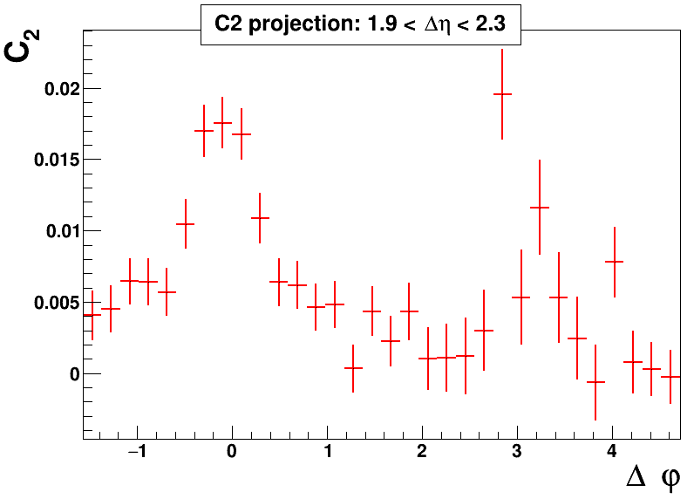
BULK: Angantyr minus PYTHIA
Notes:
31

Slide 32
3 paradigms for collectivity in small systems
pp + corrections
Example: Angantyr
Mixed phases: QGP + pp
Example: EPOS
QGP + ”direct” correlations
Excample: no realistic models for small systems
Idea 1:
This is the outlier
Idea 2:
Difference is the description of the system in terms of interactions
Paradigm 1 and 3 are unified descriptions!

Slide 33
How to accommodate a unified picture (1/2)
Final state in hadronic collisions initially reflects the subcollisions (partonic or color glass or ?)
Final hadron production contains two types of correlations
Direct, e.g., correlated via same subcollision or same string or same rope
Correlations typically scales as 1/Nsubcollisions
Indirect: e.g., string-string interactions, rope as a density indicator
Typically scales with systemsize
Classic example is Fwd-Bck correlations which reflects that strings are extended in rapidity
New examples are flow and strangeness enhancement

Slide 34
How to accommodate a unified picture (2/2)
P(direct) if we check 2 hadrons
pp
p-Pb
Pb-Pb
Fully pp/QGP Paradigm: we see different aspects at different multiplicities but underlying physics is the same!
Different from mixed paradigm a la EPOS

Slide 35
Hydro puzzle that has bothered me
QGP hydro is special: perfect (no diffusion/dissipation) + small viscous correction (smallest η/s)
η/s in some sense measures the strenght of the hydro
η/s -> 0 is strongest => fastest thermalization (hydrodynamization)
BUT η/s -> 0 also means that fluctuations lives longer (no global thermalization)

Slide 36
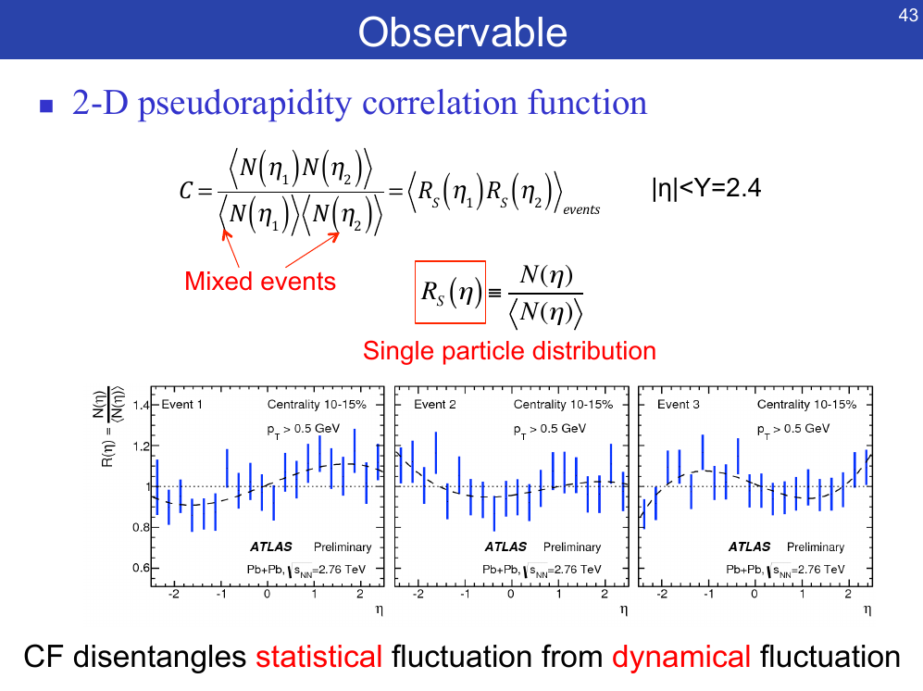
ATLAS studies of pseudorapidity correlations (1/3)
https://indico.cern.ch/ event/442430/
Is this just a superposition of similar independent sources?

Slide 37
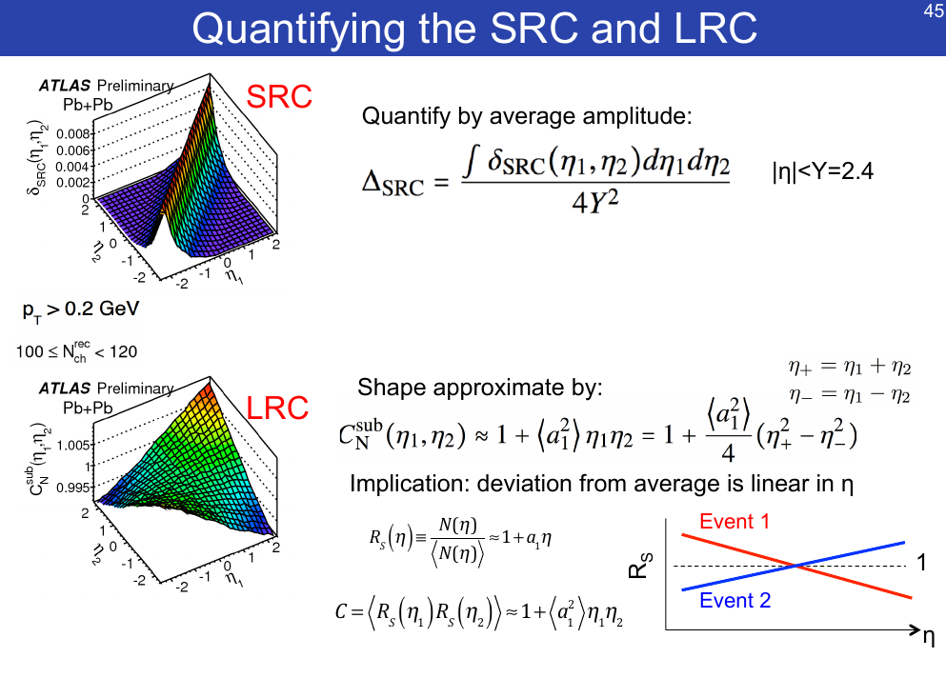
ATLAS studies of pseudorapidity correlations (2/3)
This is a way to remove the hard component

Slide 38
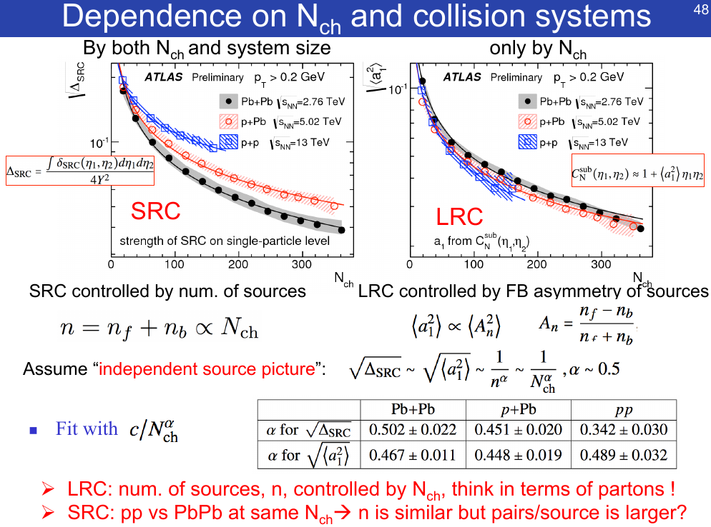
ATLAS studies of pseudorapidity correlations (3/3)
“HARD”
“SOFT”

Slide 39
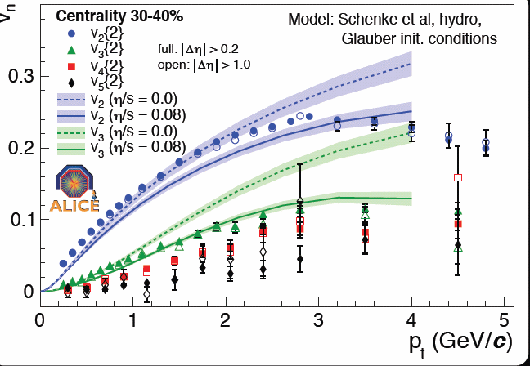
But IMO we expect the same from QGP hydro
The effect of η/s is exactly to smear out the flow on more particles

Slide 40
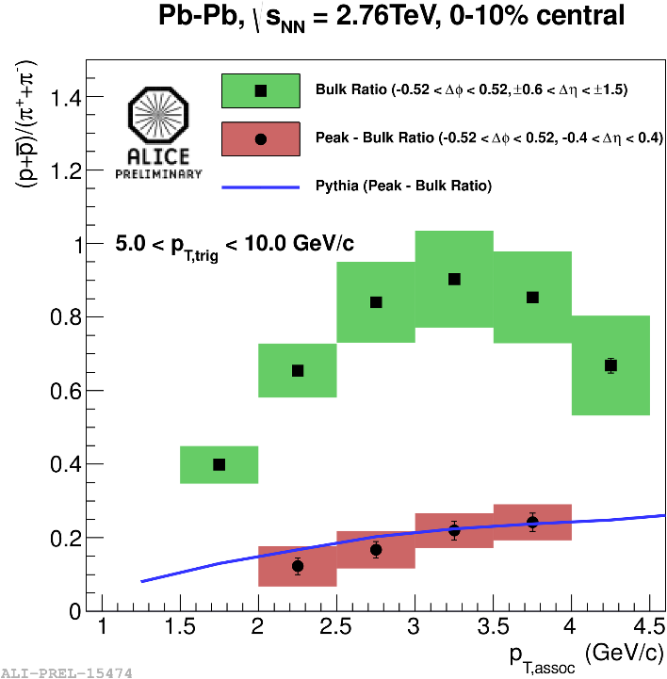
Statement
It is possible to have very strong interactions like shoving without expecting strong mini jet quenching

