Slide 1

Jet quenching in small systems
Discussion Group 3
8/23/2019
Lund Ping Aug 2019
<number>

Slide 2
Reminder of issues: poster I
8/23/2019
Lund Ping Aug 2019
<number>
Notes:
<number>

Slide 3
Reminder of issues: poster II
Inclusive and coincidence measurements do not give consistent picture of quenching
Coincidence preferred due to issues with <TpA>
Is 400 MeV (90% CL) a significant constraint?
8/23/2019
Lund Ping Aug 2019
<number>

Slide 4
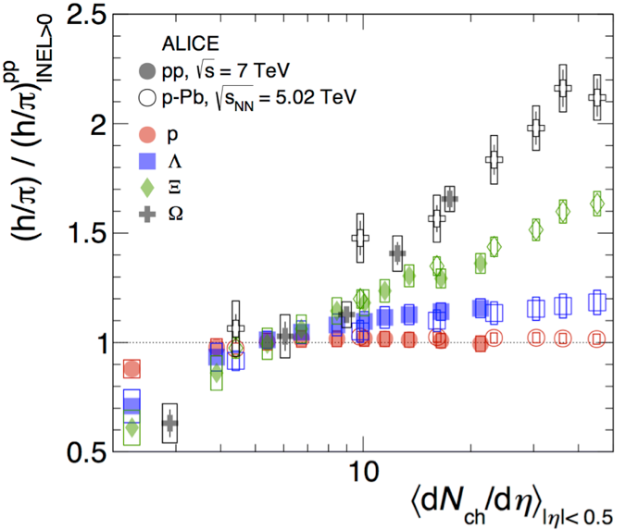
What is a small system?
Is there a continuum pp -> pA -> AA?
pp -> pA : increase density but not size
pA -> AA : increase both size and density
cannot turn effects "on and off” : physics lies in how things change
systematic check: regions of common EA in different systems
Scaling quantities:
Large systems:
Small systems
Other observables: forward ET
8/23/2019
Lund Ping Aug 2019
<number>

Slide 5
What are the theoretical expectations for jet quenching in small systems?
No detailed calculations to date, only parametric projections:
scaling by multiplicity ; assumes continuum large AA →small systems
BDMPS approach:
soft induced radiation occurs early
Signatures: soft, large-angle radiation; softening of fragmentation at low-z
Relative effects largest for lowest p_{T}^{jet}
(b) Monte Carlo approach (e.g. JEWEL):
Small systems do not present any special barrier: thin medium can be accommodated
needs a medium: hydro, transport; both are discretized
Model of medium needs to be calibrated/tuned on soft observables
(c) Angantyr: jet-medium interaction via shoving mechanism
No external model of medium
Deep connection to flow: same physical mechanism
8/23/2019
Lund Ping Aug 2019
<number>

Slide 6
What generates high multiplicity in small systems? How can data check models?
EA bias in p+Pb: how does high-Q^2 process in central region change the distribution?
High p_{T} track in central barrel
Forward multiplicity
\
“Trigger track” in p_{T} interval
(e.g. 6<p_{T}<7 GeV/c)
Mechanisms:
Ncoll bias (geometry)
QCD correlations (color flow)
p+p also interesting: TBD
”central”
”peripheral”
8/23/2019
Lund Ping Aug 2019
<number>

Slide 7
p+Pb hard process bias: Angantyr vs. ALICE data
Excellent agreement of model with data
Use model to explore the nature of the bias. Possible contributions:
Ncoll weighting (geometric bias)
Color correlations (strings connect central and forward)
Energy-momentum convservation (unlikely at LHC but let’s see…)
8/23/2019
Lund Ping Aug 2019
<number>

Slide 8
Angantyr: bias in impact parameter distribution due to central hard process
Forward mult: strong impact param bias
Central hard process: no additional bias (!)
→forward/central are largely decoupled
8/23/2019
Lund Ping Aug 2019
<number>

Slide 9
New prediction: forward mult bias in pp
p+Pb: model and data agree
p+p: not yet measured!
Predict much larger bias in pp than p+Pb
what is underlying mechanism?
This prediction is a great outcome of this workshop
8/23/2019
Lund Ping Aug 2019
<number>

Slide 10
Forward neutron tagging in d+Au @ RHIC
Additional test of control over geometry in p/d+A
Use neutron in ZDC and Hulthen wavefn of the deuteron to tag “peripheral” p+Au events
Unfortunately not achievable at LHC due to injection system
STAR 2003
8/23/2019
Lund Ping Aug 2019
<number>

Slide 11
Summary: jet quenching in small systems
Effects expected to be small
Correlation of EA and geometry is challenging: inclusive suppression (RAA) will always have limited systematic precision
Most precise measurements utilize coincidences (and potentially substructure)
Are current limits significant? Need calculations
Status of calculations:
String approach: First results from Angantyr
MC: JEWEL in progress, needs models of medium; no known show-stoppers
What do we talk about when we talk about high multiplicity in small systems?
Are there correlations forward mult ⟺ central hard? Angantyr: No!
This is an extremely important (and new) result: justifies usage for forward mult as independent characterization of events
predictions for pp…
We now have a clear path forward to explore jet quenching in small systems in both experiment and theory, and know how to compare them
8/23/2019
Lund Ping Aug 2019
<number>

