Slide 1
Heavy Flavor in Nuclear Collisions -- Part I: Focus on Open Heavy Flavor
Anton Andronic (Münster), Hendrik van Hees (Frankfurt),
Andrea Rossi (Padova), David Silvermyr (Lund),
Ralf Rapp (Texas A&M)
Third International ϸing on QCD Challenges from pp to AA
Lund University (Sweden), Aug 19-23, 2019

Slide 2
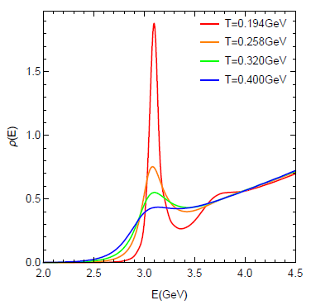
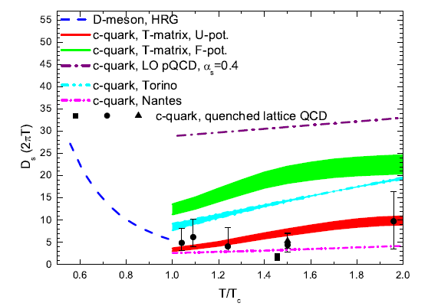
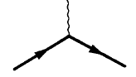
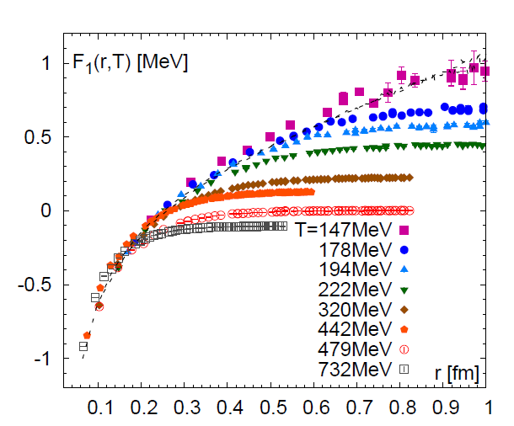
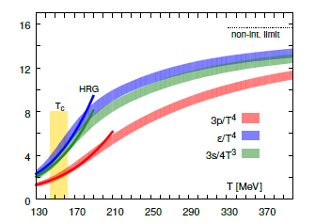
1.) Heavy Quarks and in-Medium QCD Force
Hard-produced probes with unique access to soft-medium properties
Quarkonia Heavy-Quark Diffusion
QGP
_
D_{s} (2pT)
Q
Q
How do heavy-flavor spectral + transport
properties emerge from in-medium QCD force?
T/T_{c}
E_{B}(T) , G_{Y}(p,T)
Non-perturbative
[GeV]

Slide 3
Outline
1.) Introduction
2.) The pA Puzzle
• D-meson R_{AA} vs. v₂
• Bottom(onium) vs. Charm(onium)
3.) Charm-Baryon Chemistry
• Excited States in pp
• Improved Control in AA
4.) Conclusions

Slide 4
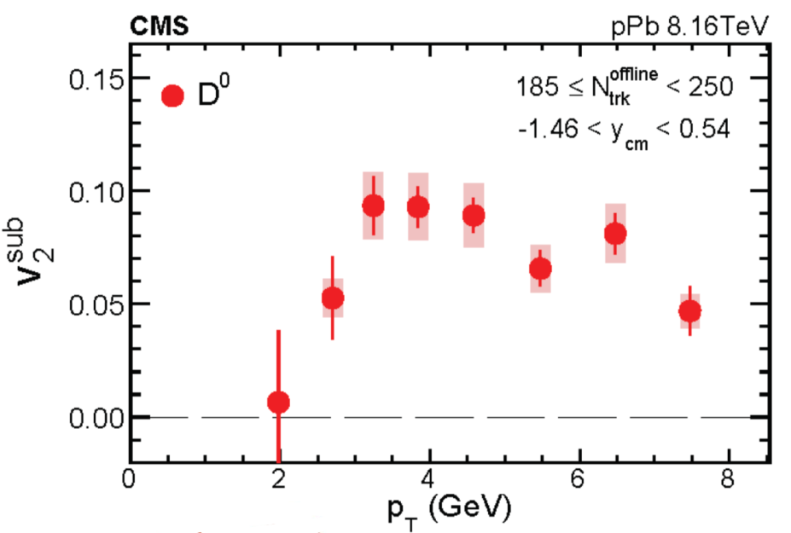
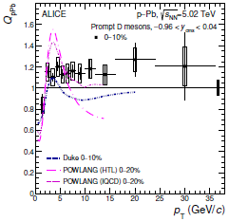
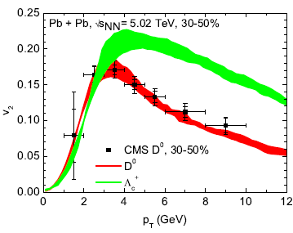
2.) The pA Puzzle: HF Version
Re-evaluation of HF transport
results in kinetic (rather than hydro)
bulk medium warranted, including
“escape” effects
Precise (low-) p_{T} shape
comparisons potentially useful

Slide 5
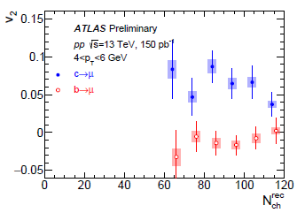
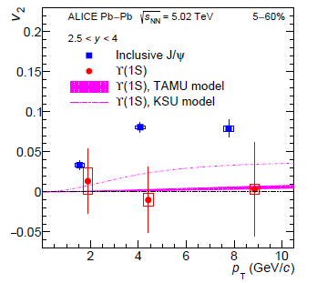
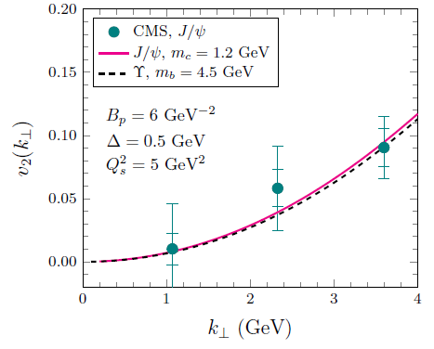
2.2 Bottom(onium) vs. Charm(onium) Sector
HF Muons in pp
Quarkonia in AA
v₂~0 for bottom, v₂>0 for charm
v₂~0 for ϒ, v₂>0 for J/y
CGC Prediction for pA:
Large J/y and ϒ v₂ from initial-state effects [Zhang et al ‘19]
⇒ discriminatory measurement!

Slide 6
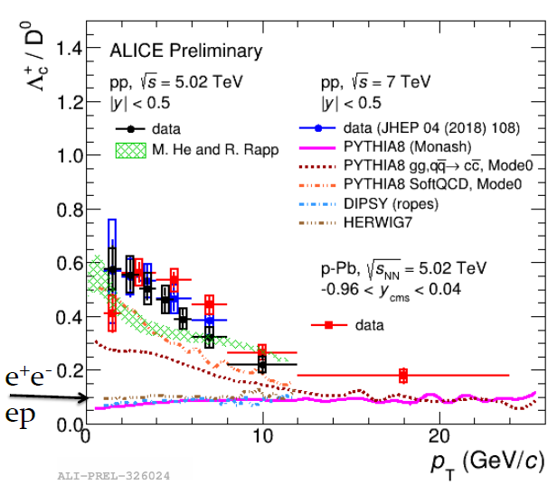
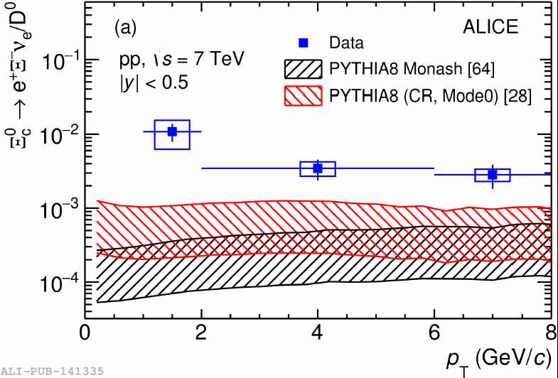
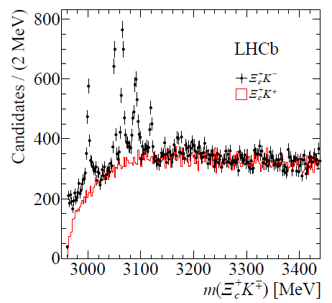
3.) Heavy-Flavor Hadro-Chemistry: pp + pA
Direct probe of hadronization
Rich for baryons in hadronic collisions (+ different from ee, ep)
Compelling measurement of excited states:
test hadronization models + feeddown systematics
(incl. multiplicity dependence)

Slide 7
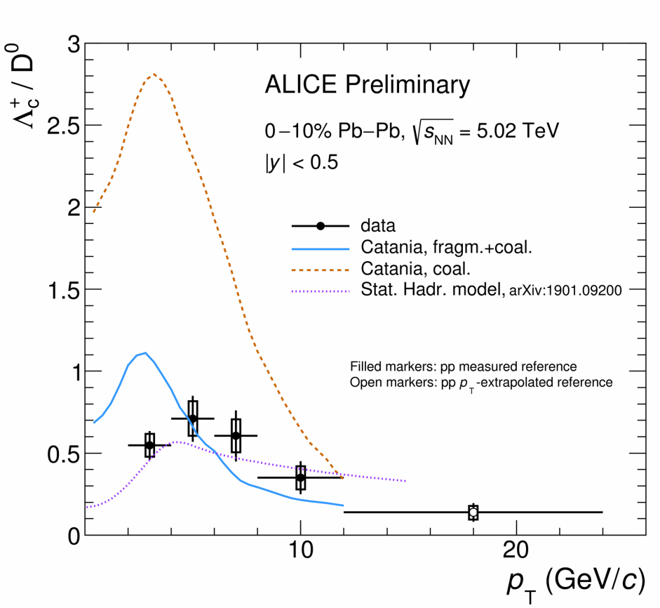
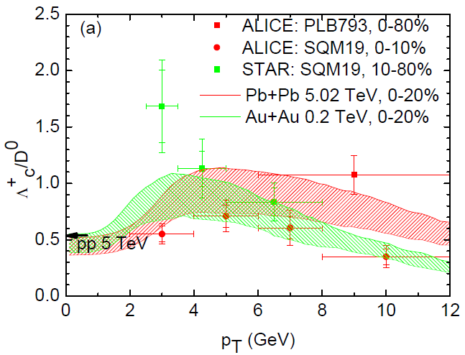
3.2 Hadro-Chemistry in AA
He+RR ‘19]
Need to better scrutinize + benchmark
string/fragmentation/coalescence/recombination/stat-hadronization models
Differences between RHIC and LHC data?

Slide 8
4.) Summary
Interesting measurements: -- low-p_{T} D⁰ v₂ in pA
-- ϒ v₂ in pA
-- HF baryon resonances
Desirable theory: -- HQ transport in kinetic bulk medium for pA
-- reduce spread in hadronization models in AA

Slide 9
2.) Open Heavy-Flavor Transport in URHICs
0 0.5 5 10
| | | |
τ [fm/c]
D
c
initial cond.
(nPDFs, …),
pre-equil. fields
c-quark diffusion
in QGP liquid
c-quark
hadronization
D-meson
diffusion in
hadron liquid
no principle difference between diffusion + hadronization interactions
resonances near T_{c} → HQ kinetics + hadro-chemistry closely related
need to know equilibrium limits (2. law of thermodynamics)

Slide 10
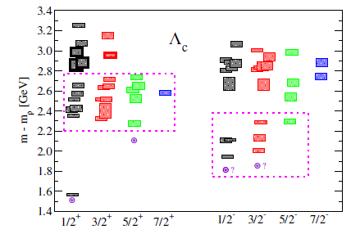
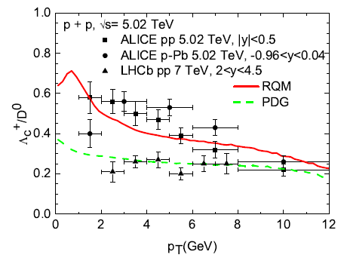
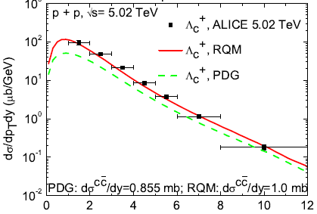
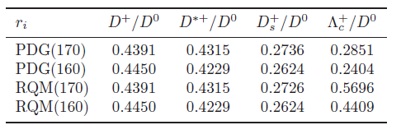
2.1.2 Augmented SHM
Previous SHM calculations based
on PDG states only
many more baryons expected from
latQCD (spectrum + susceptibilities)
+ relativistic quark model (RQM)
⇒ Implement into SHM

