Slide 1
Searching for (Non-)Resonant Signals with ATLAS
Trine Poulsen

Slide 2

Outline
Dijet angular analysis
  Intro on whiteboard
  Ratio analysis
Ttbar resonance search
  Intro on whiteboard
  Fitting a m_{jj} spectrum
Other projects
Recommendations

Slide 3
Dijet Angular Analysis - Whiteboard Intro

Slide 4
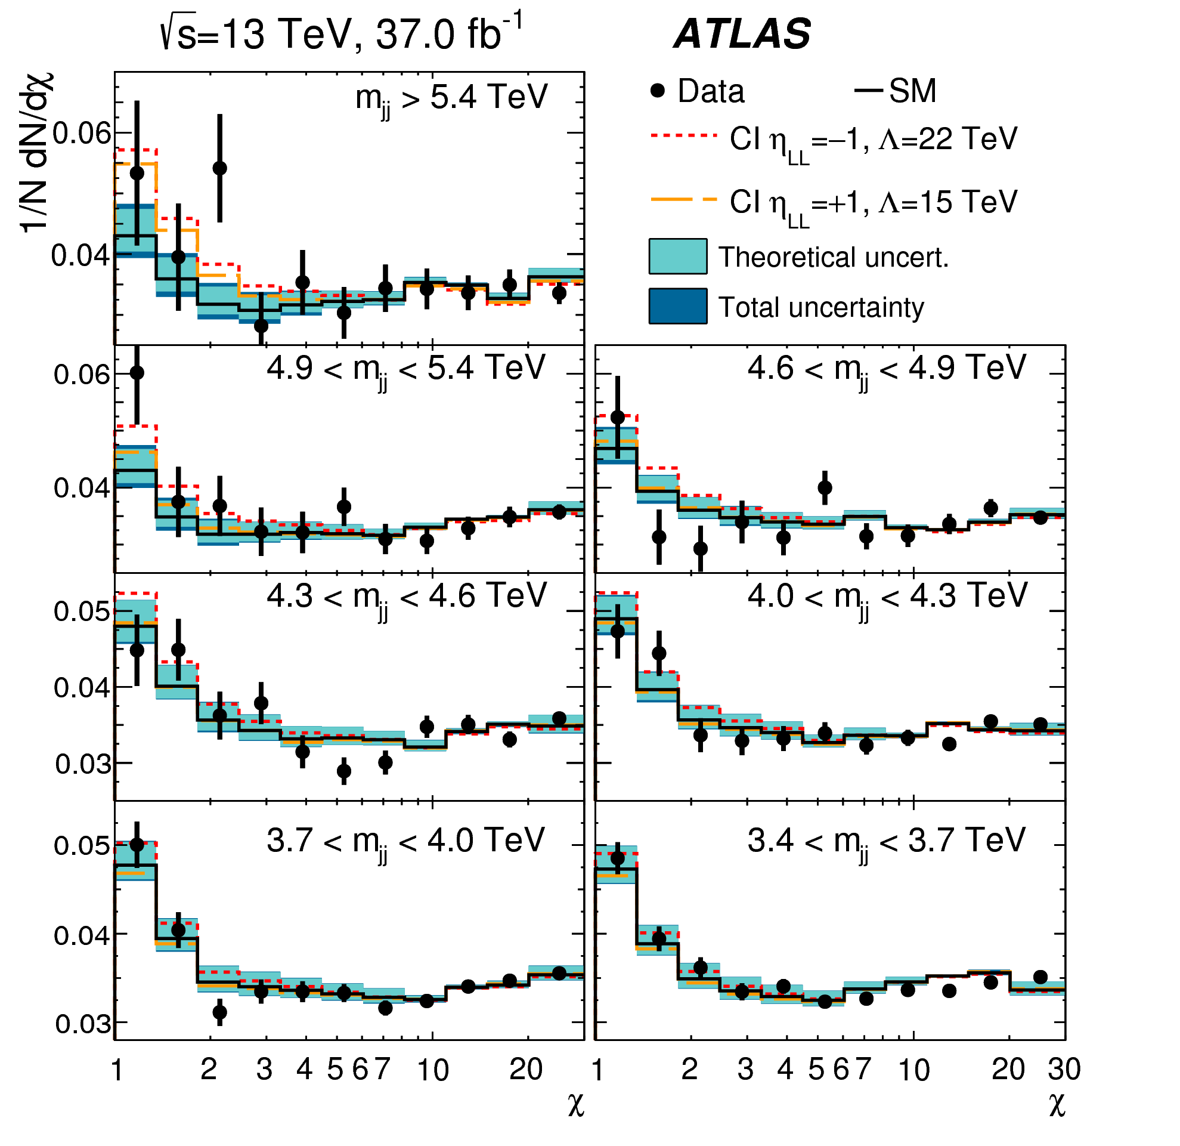
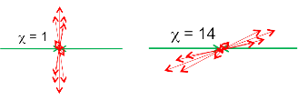
Traditional Dijet Angular Analysis
The angular distribution of the dijets is given by 𝜒=e^{|y1-y2|}
Divided into different mjj-bins.
The data is compared to PYTHIA with next-to-leading order QCD and EW corrections
Combined fit over all mjj-bins
EXOT-2016-21
Notes:
The systematic uncertainties include JES, PDF, tune and scale uncertainty, which are shown as a band around the simulated distribution.
How can we get chi =1 (y* = 0) show more examples. Are central jets more common than forward one?
Circle things that I’m explaining or gray out stuff
Describe plot in detail! Last published angular search in ATLAS, why are 22 and 15 shown, because of limit.
Note that the theory uncertainty is big

Slide 5
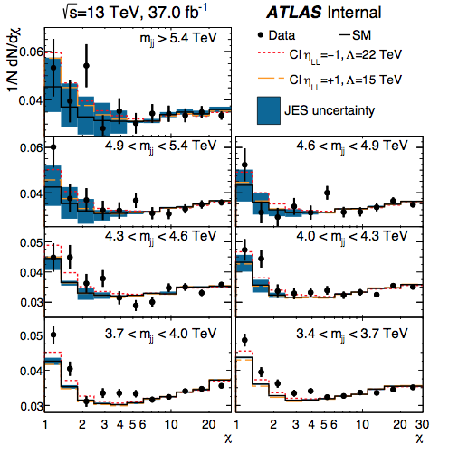
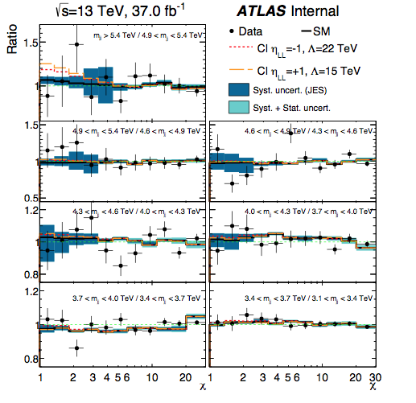
Dijet Angular Analysis Idea- Ratios
Original method (pre-fit)
Ratio method
Notes:
Plots only include JES uncertainty
MC/data discrepancy gone and uncertainty reduced, but so is signal.
Technical problems for limit setting
Ratio histograms can’t be fed directly into HistFactory
It expects bins with number of events (Poisson statistics)
Ratio information can be implemented as a ShapeFactor

Slide 6

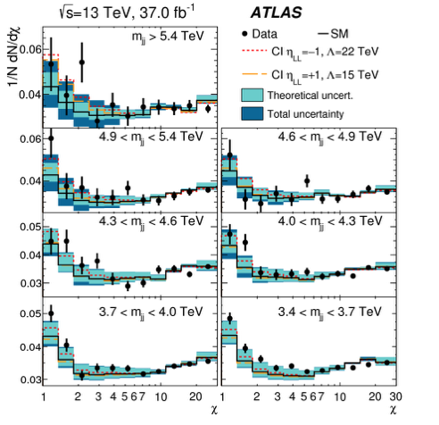
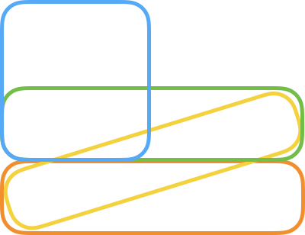


Dijet Angular Analysis Idea - Chained Correlations
Instead of having one nuisance parameter for each uncertainty for all mjj bins
Make several which are connected in a chain
  Each nuisance parameter affect only two bins
This way the low-mjj region will not overconstrain the high-mjj (signal) region
Idea from Alex Read
Notes:
Why do we or do we not believe the NP are correlated?
JES uncertainty is not fully correlated for different pT

Slide 7
Ttbar Resonance Search - Whiteboard Intro

Slide 8
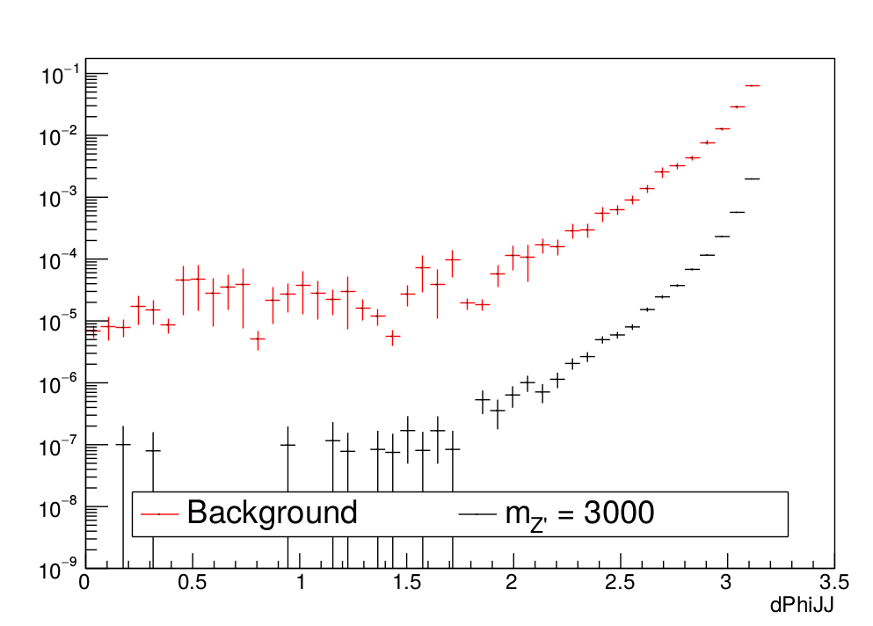
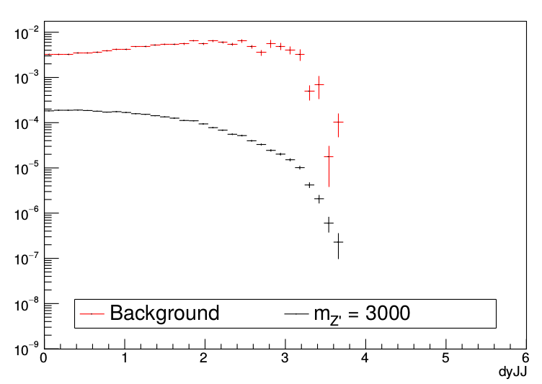
Ttbar Resonance Search
All-hadronic ttbar resonance search: X → tt → bqq+bqq
  Looking for bumps in the m(ttbar) spectrum at high mass
Kinematic selection
  Back-to-back jets: dphi(J1,J2) > 1.6
  s-channel resonances: dy(J1,J2) < 1.8

Slide 9
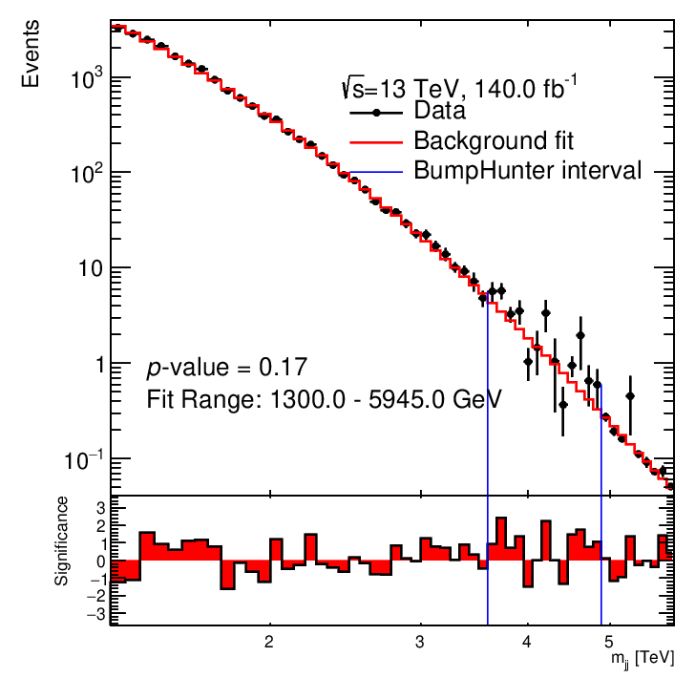
Ttbar Resonance Search - Background Fit
Instead of comparing data to MC
  Fit smoothly falling m_{jj} distribution with
First find baseline function by fitting datalike histograms made from MC
Then validate on background control region
  Inverse cut: dy(J1,J2) > 1.8

Slide 10
Other Projects
Theory paper with Johan Rathsman
Combined Performance paper with Millie McDonald
Heavy Resonance Combination of ATLAS analyses
Top tagger development with Robin Newhouse (August)
Angular ttbar analysis (Future)

Slide 11
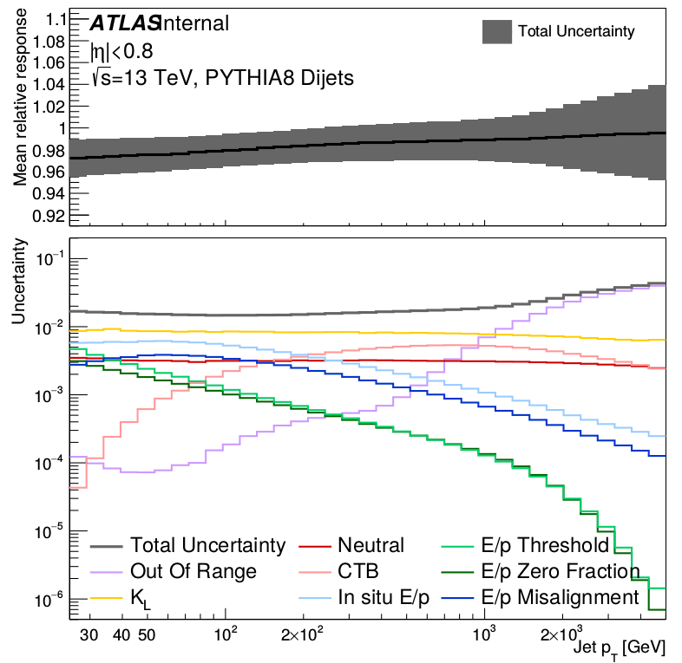
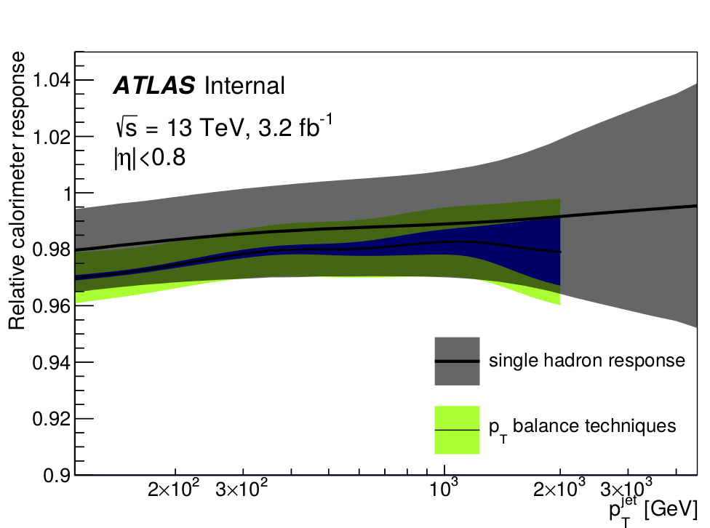
High-Pt Jet Energy Scale Uncertainty from E/p Measurements
Intro on whiteboard

Slide 12
Recommendations
Schools/Courses:
  CTEQ/MCnet School
  Nordic Winter School
  Terascale Statistics School
  Dark Matter school
  Introduction to High Performance Computing
  Learning and Teaching in Higher Education
  Particle Physics Phenomenology
  CERN School of Computing

Slide 13
BACKUP

Slide 14
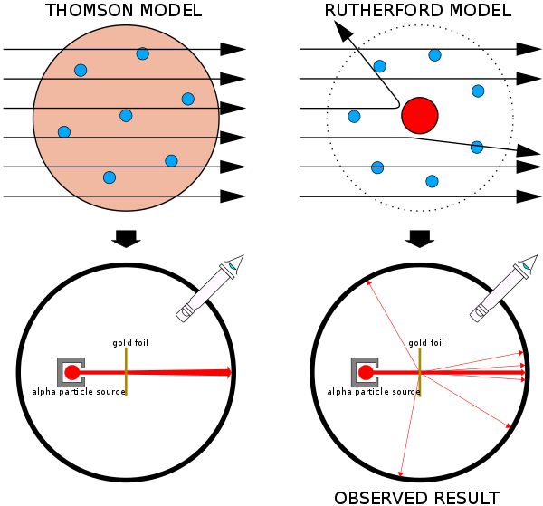
Introduction to Angular Analysis
What is an angular analysis?
  Looking at the angle between two outgoing objects after a collision
  In ATLAS we look at the rapidity difference between two leading objects
Why do an angular analysis?
  Rutherford gold foil experiment
  Signal has a lower rapidity difference than SM interactions
θ
Notes:
Rutherford experiment also called the Geiger-Marsden experiment
Why is signal expected at low chi - kinematics, derived in Lene’s thesis. New signal is expected to be isotropic -> peaks at low chi
Expected result (Thomson) vs observed (Rutherford)

Slide 15
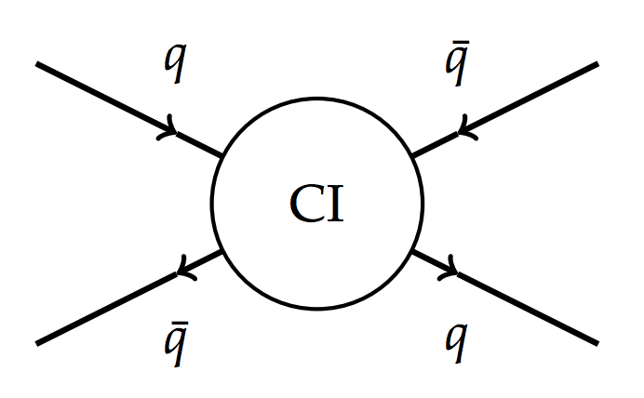
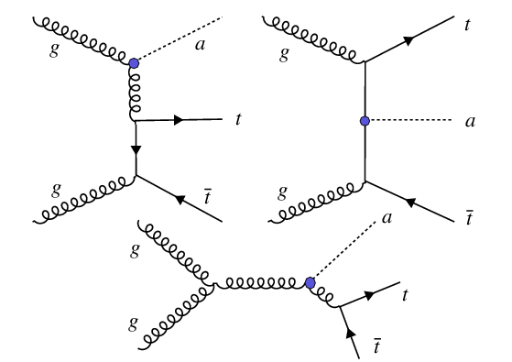
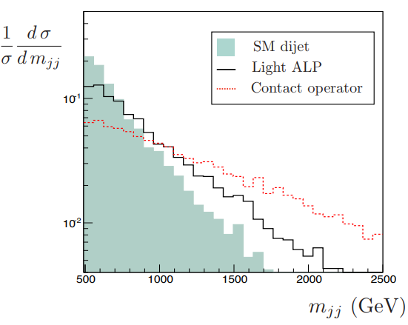
Possible signal
Non-resonant signal
  Contact Interaction (CI)
    Fermion compositeness
    Introducing scale Λ
  Axion-like Particles (ALP)
    Pseudo Nambu Goldstone bosons
    New Probes for Axion-like Particles at Hadron Colliders
    Non-Resonant Searches for Axion-Like Particles at the LHC
Resonances
  Narrow: Complementary to bump hunting
  Broad: Difficult to do model-independent bump hunting (Eric’s talk)
Notes:
ALP paper: CMS dijet angular search used, ttbar proposed as good channel
Resonances: Can be used to give valuable information if a bump is observed in mjj spectrum

Slide 16
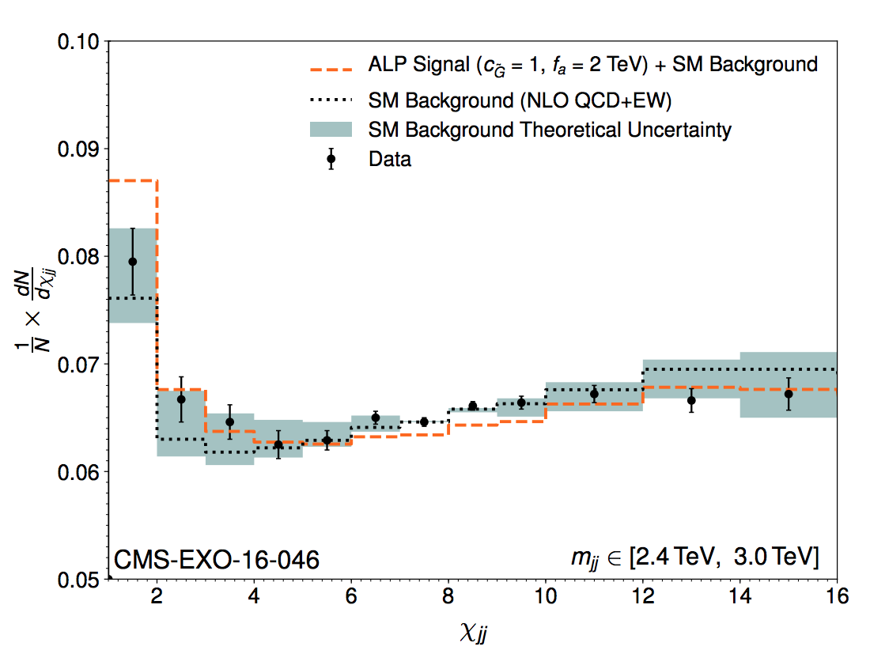
ALP signal compared to CMS angular dijet

Slide 17
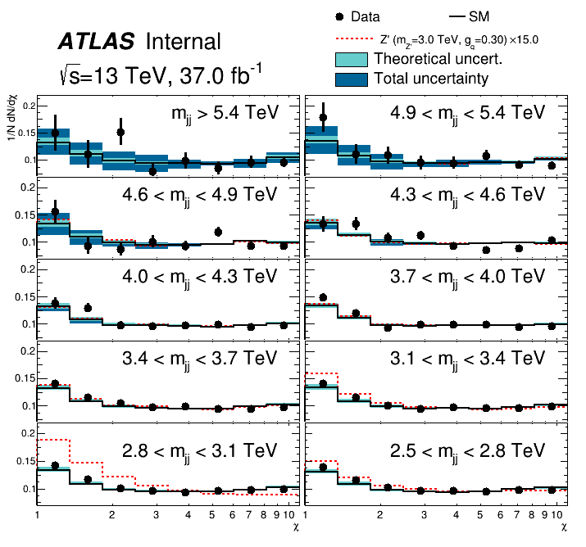
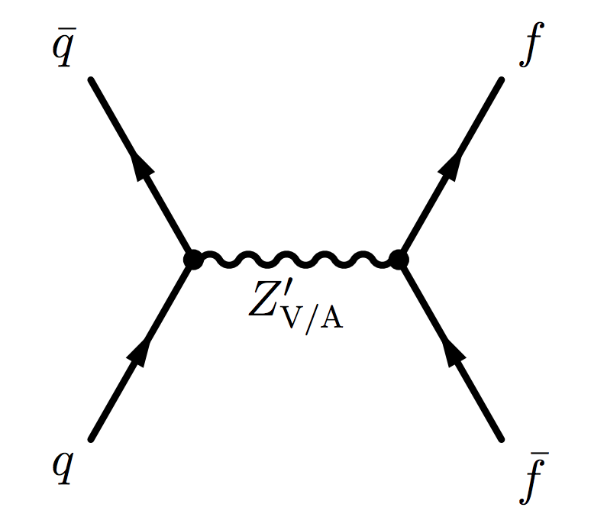
Dijet Angular Analysis - Recast for DM
The mjj threshold was lowered to study Dark Matter Z’ model
The 𝜒 range was reduced to avoid tensions due to
  discrepancy in high stat. bins (low mjj)
  assuming correlation over whole mjj range
Notes:
Say that chi range is reduced to less than 10.?

Slide 18
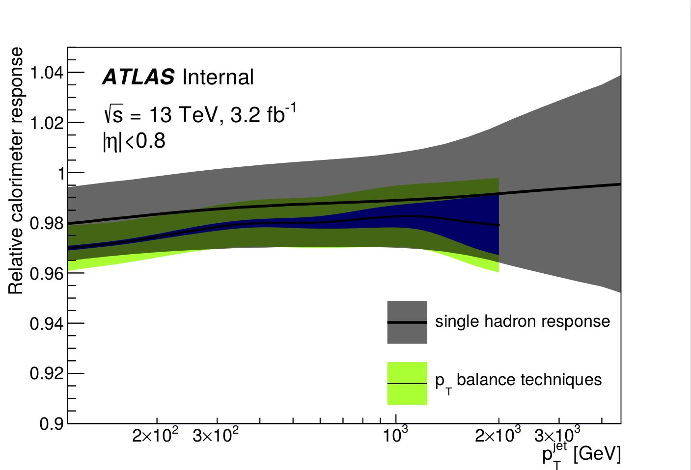
Other Ideas For Dijet Angular Analysis
Use NLO PowhegPythia samples
  Include PowhegPythia weights for pdf/scales/tune systematic variations
Performance work
  Include high-pt single particle term in combination
Use ratio information as a ShapeFactor in HistFactory
Unfold angular distributions
Data driven approach
Notes:
Why should PowhegPythia be better than what we already have?
Why are we interested in unfolding
If including the performance work thing - need to explain much better
Remove ratio information point and data driven

Slide 19
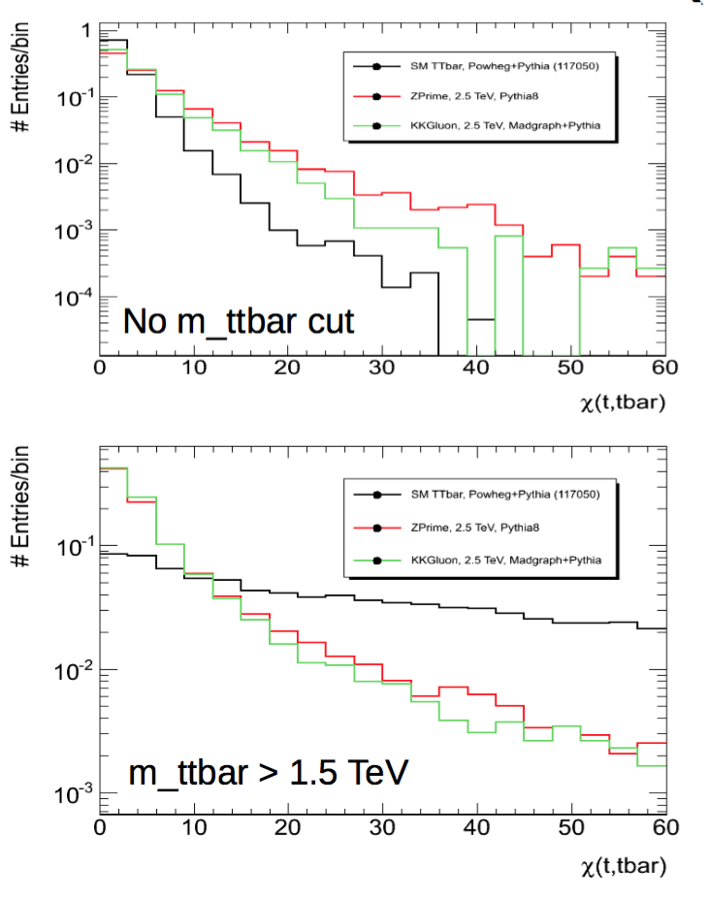
Ttbar Angular Analysis
Apply methods from dijet angular analysis to ttbar events
8 TeV study by Katharina Behr
  Only feasible when looking at high mass resonances (>3TeV)
    SM ttbar t-channel dominated
Need to redo study with full Run 2 dataset

Slide 20
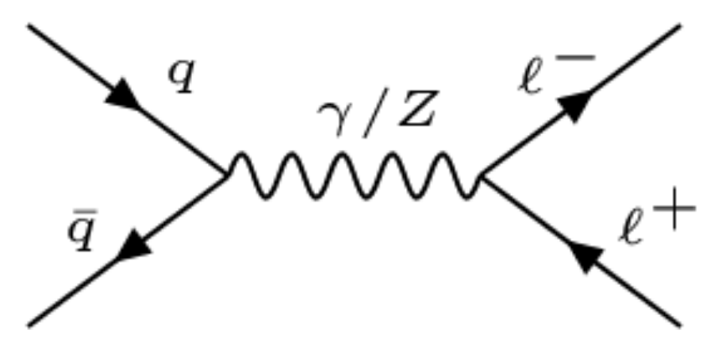
Other Angular Analyses
Di-lepton
  LPX wants to see if angular di-lepton analysis can help the Contact Interaction search
  No dedicated study in Run 2 so far
  Different from dijet search since all backgrounds come from s-channel (large t-channel contribution in dijets)
Dibjet
  B-tagging improve sensitivity for resonances
  Never investigated
Di-tau
Notes:
Include Feynman diagrams for s and t channel (maybe first slide?) as well as for di-lepton CI
Wrong that b-tagging is always possible? Yes I think so
Signal mostly present at low 𝜒 so b-tagging possible is not a true statement

Slide 21
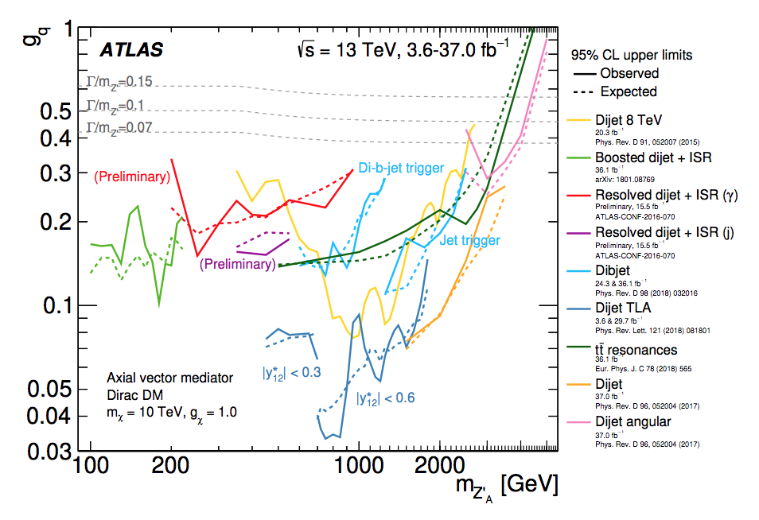
DM summary paper

Slide 22
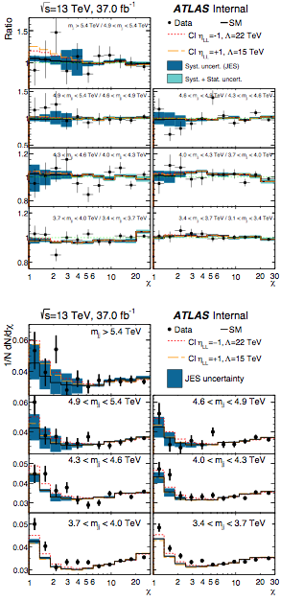
“By-hand” calculations
Calculate expected significance in each bin
  Signal / Total uncertainty
    Total uncertainty is the quadrature sum of the statistical uncertainty on the data and the JES uncertainty (symmetrized)
    Correlation between different bins is not accounted for
  Result for two highest mjj bins:
    Original: 1.25σ (compared to 1.22σ (HistFactory))
    Ratio: 1.08σ
  Result for all mjj bins:
    Original: 2.52σ
    Ratio: 1.18σ
Further tests: Include all uncertainties

Slide 23
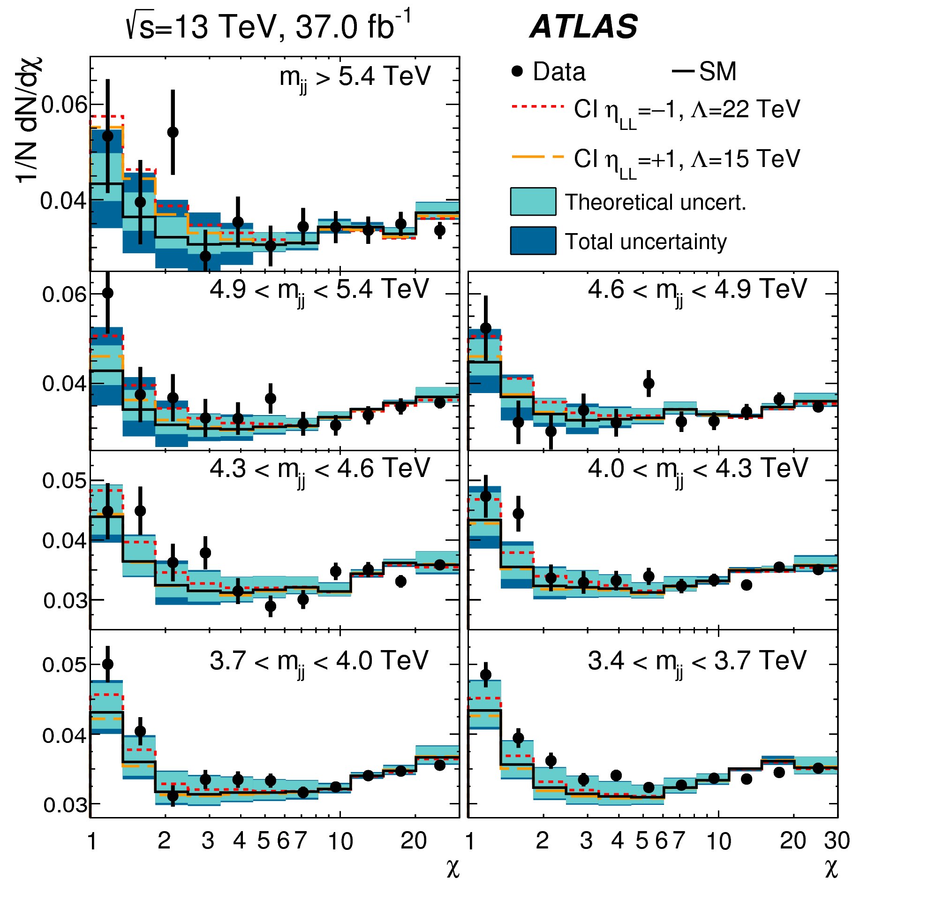
Pre-fit vs Post-fit

