Slide 1
Topic 5: Heavy Flavor Summary
Interesting measurements: -- low-p_{T} D⁰ v₂ in pA
-- ϒ v₂ in pA
-- HF baryon resonances
Desirable theory: -- HQ transport in kinetic bulk medium in pA
-- reduce spread in hadronization models in AA

Slide 2
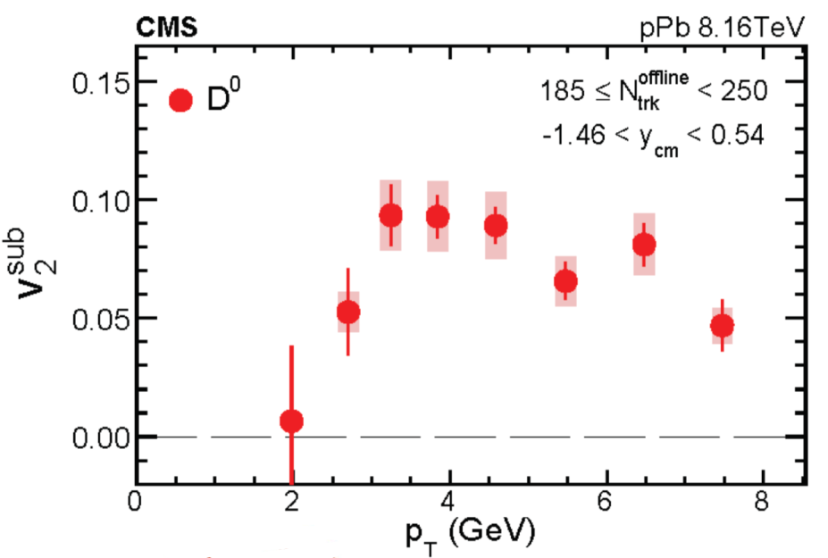
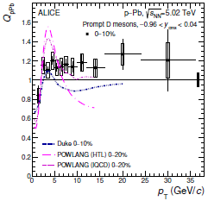
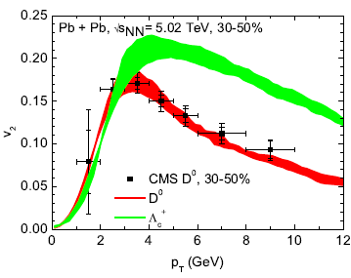
The pA Puzzle: HF Version
Re-evaluation of HF transport
results in kinetic (rather than hydro)
bulk medium warranted, including
“escape” effects
Precise (low-) p_{T} shape
comparisons potentially useful

Slide 3
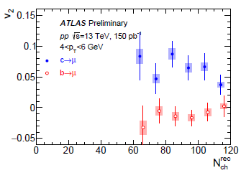
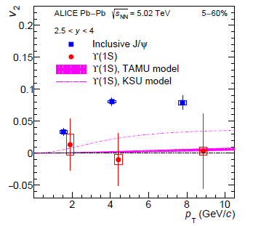
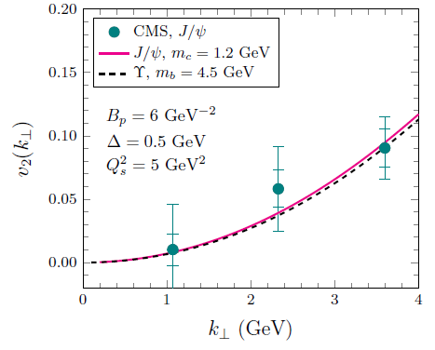
Bottom(onium) vs. Charm(onium) Sector
HF Muons in pp
Quarkonia in AA
v₂~0 for bottom, v₂>0 for charm
v₂~0 for ϒ, v₂>0 for J/y
CGC Prediction for pA:
Large J/y and ϒ v₂ from initial-state effects
⇒ discriminatory measurement!

Slide 4
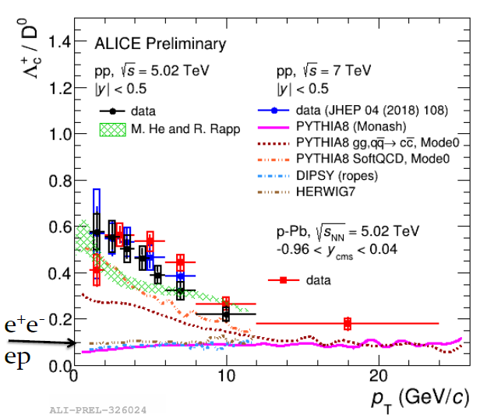
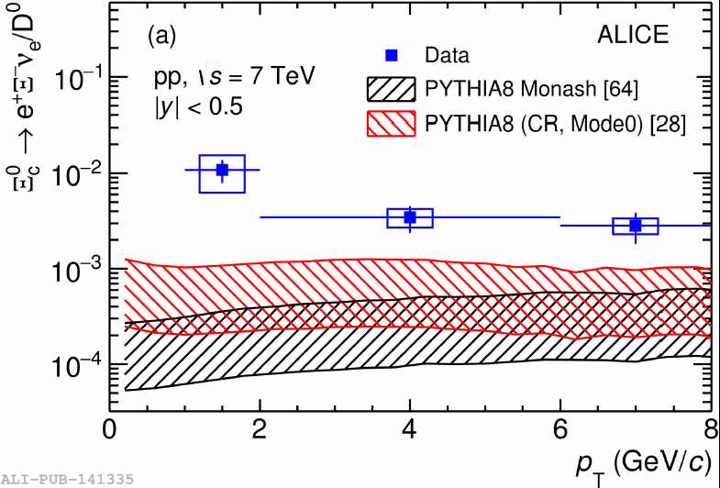
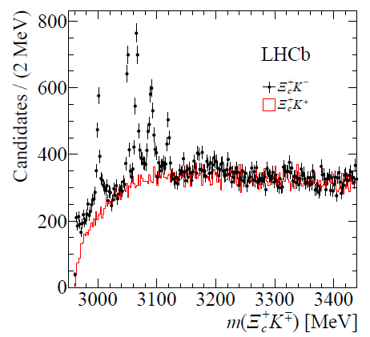
Heavy-Flavor Hadro-Chemistry: pp + pA
Direct probe of hadronization
Rich for baryons in hadronic collisions (+ different from ee,ep)
Compelling measurement of excited states:
test hadronization models + feeddown systematics;
including multiplicity dependence

Slide 5
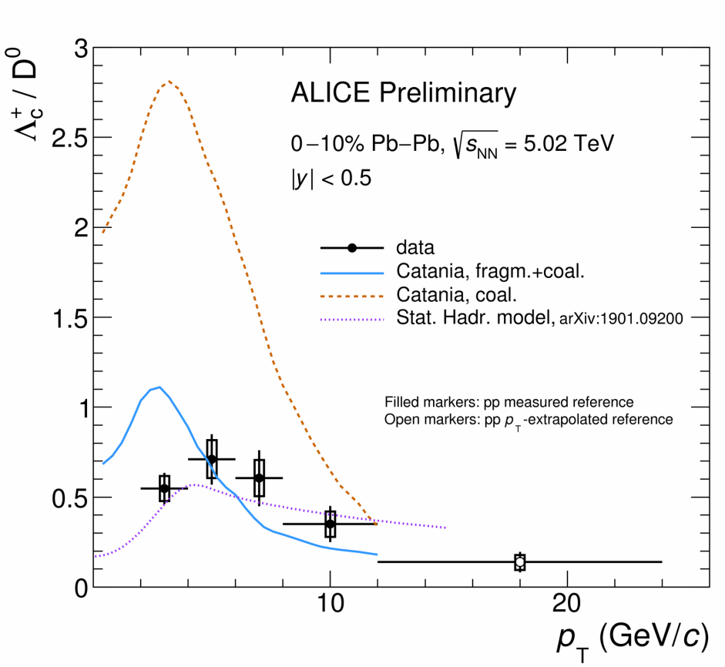
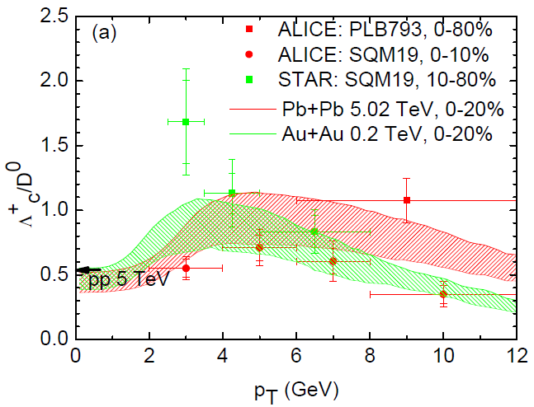
Hadro-Chemistry in AA
Need to better scrutinize + benchmark
string/fragmentation/coalescence/recombination/stat-hadronization models
Differences in RHIC and LHC data?

Slide 6
Heavy Flavor in Nuclear Collisions
Anton Andronic (Münster), Hendrik van Hees (Frankfurt),
Andrea Rossi (Padova), David Silvermyr (Lund),
Ralf Rapp (College Station)
Third International ϸing on QCD Challenges from pp to AA
Lund University (Sweden), Aug 19-23 , 2019

