Slide 1
Doktoranddager
Experimental Particle Physics
Andrew Lifson

Slide 2
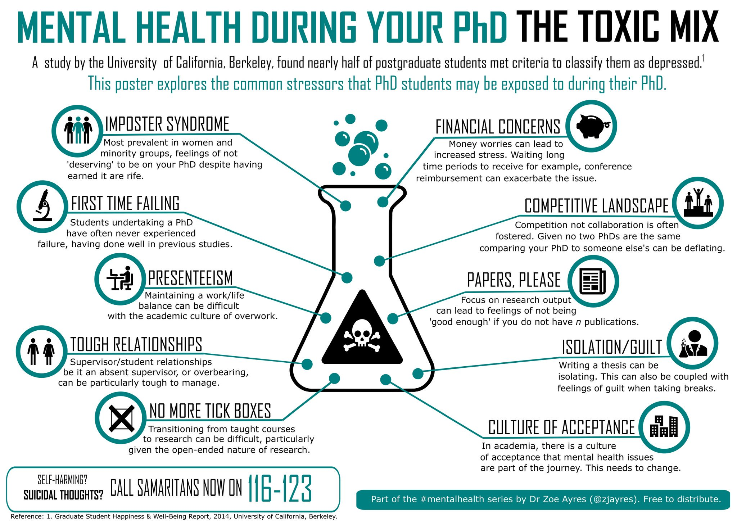

Slide 3

Mental Health: The reality for PhD students
You have your supervisor
You have your colleagues
You have other PhD students
You have student organisations
You have rights
If you need help see occupational health service https://www.staff.lu.se/employment/work-environment-and-health/health-and-wellness/occupational-health-service

Slide 4
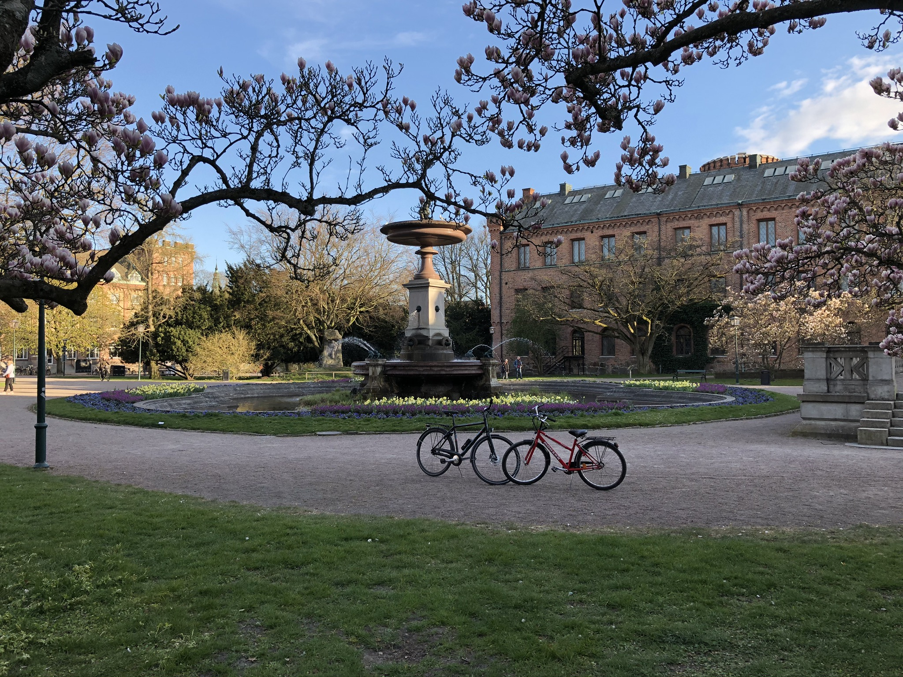
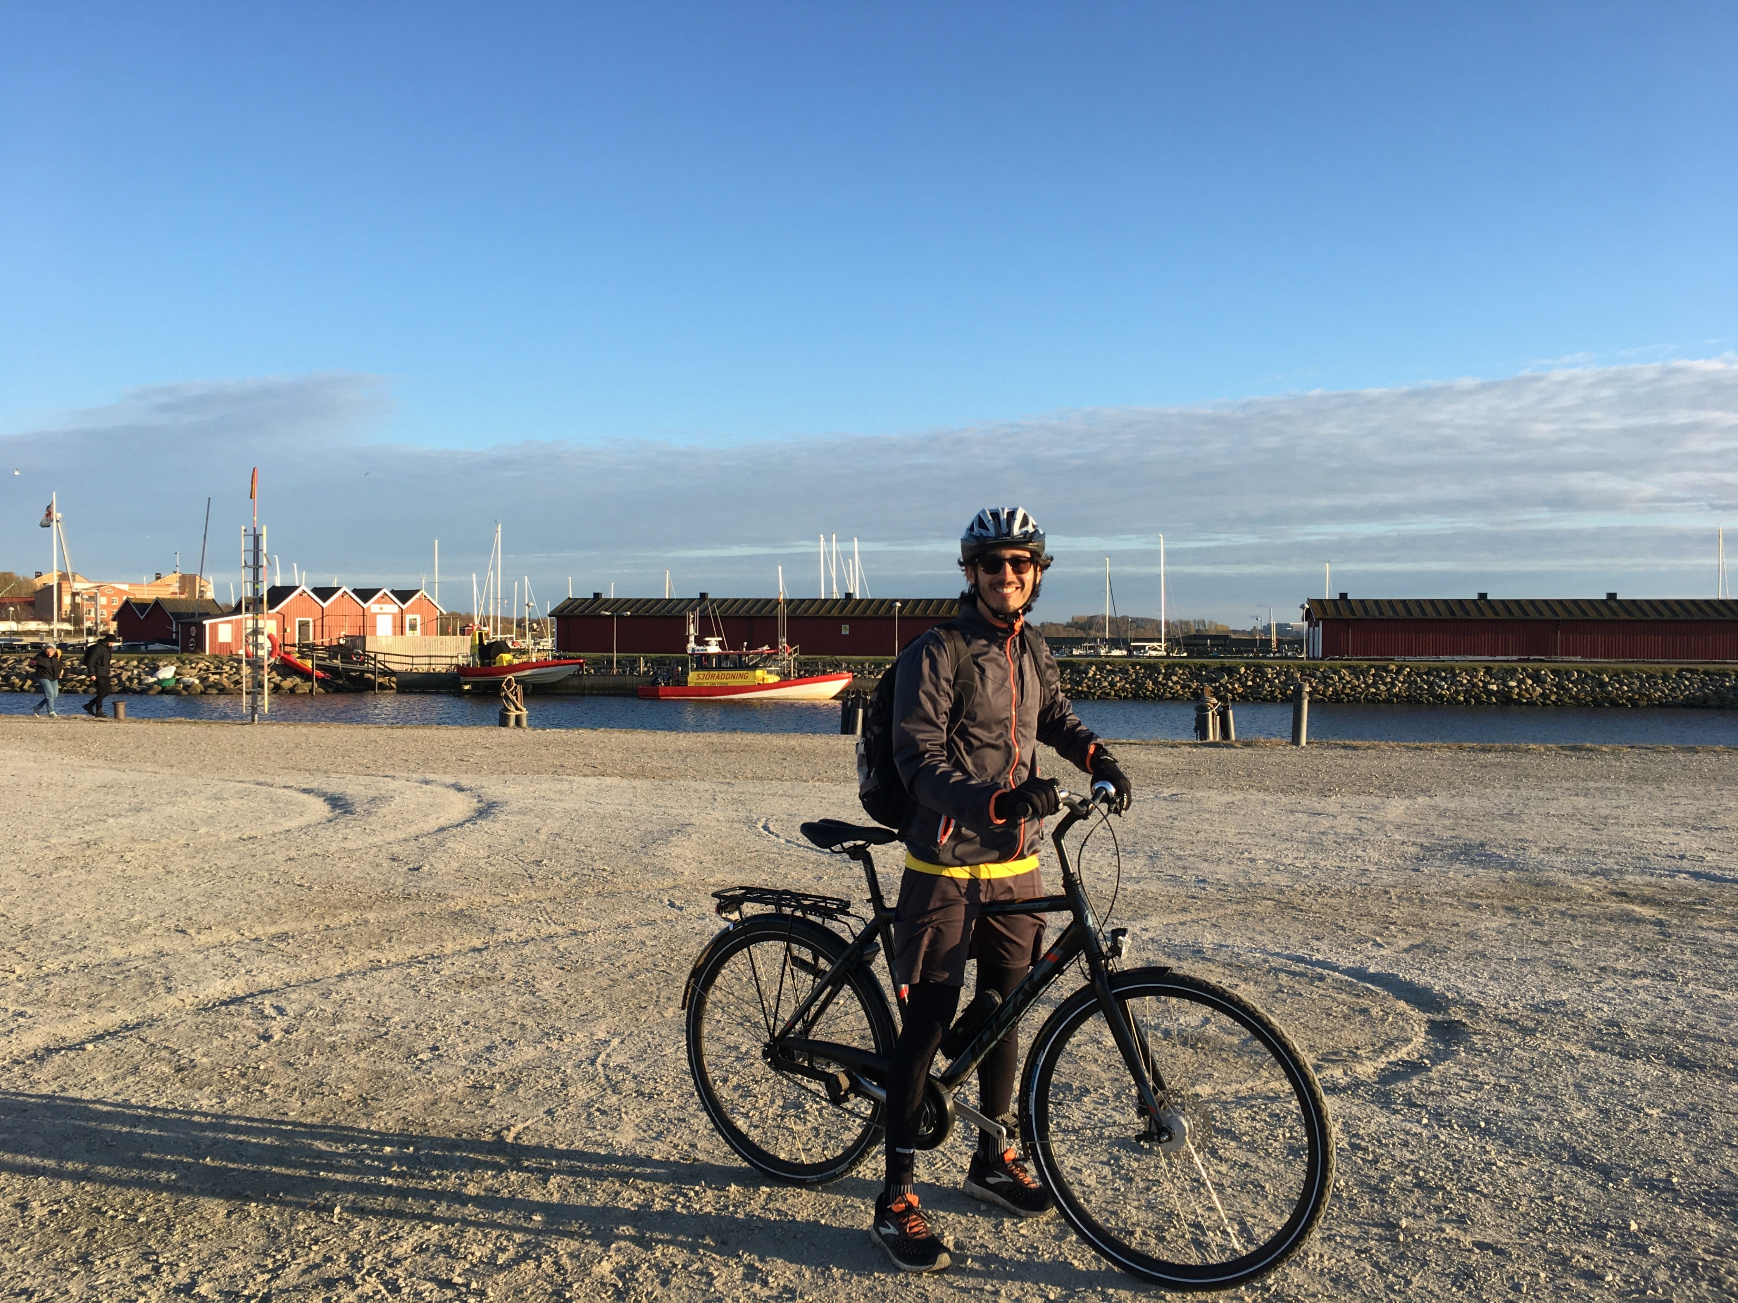
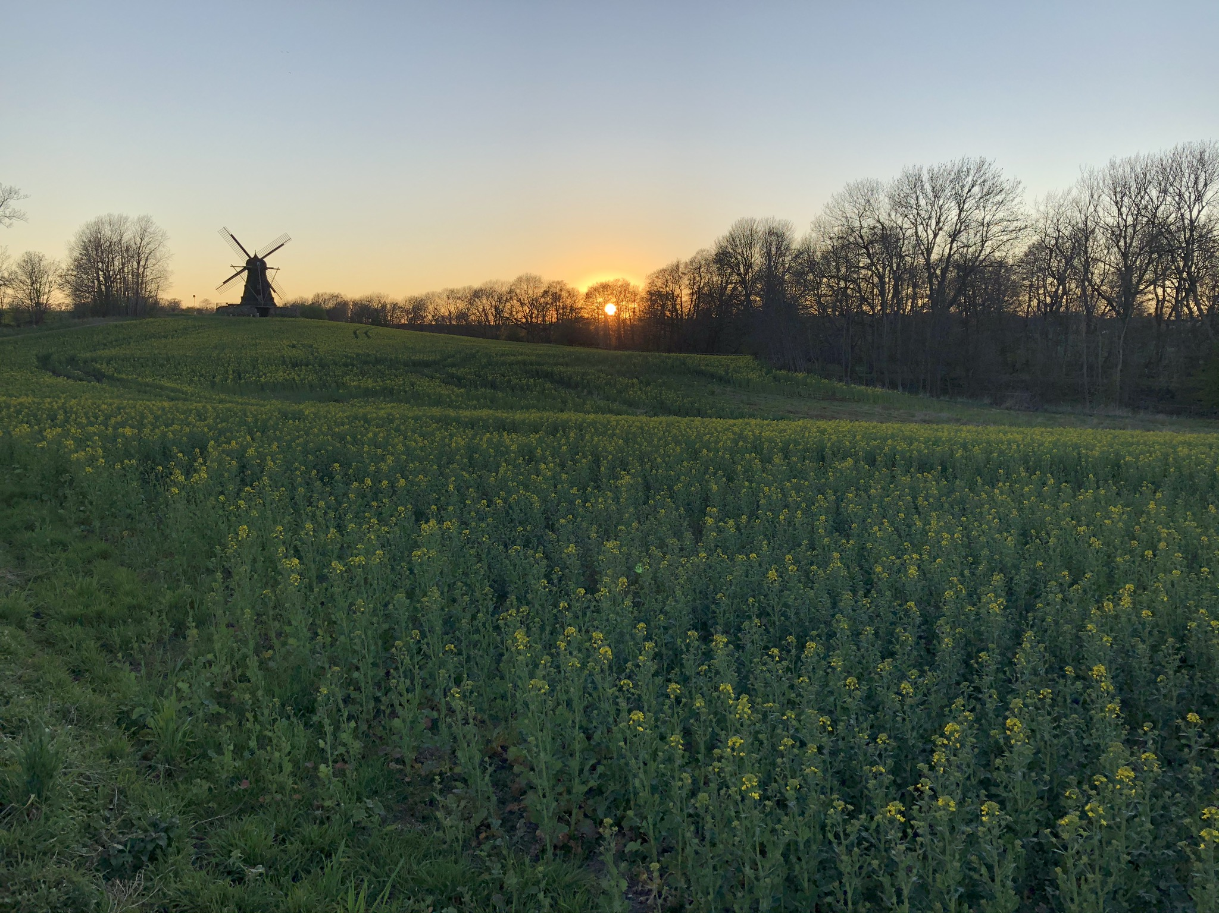
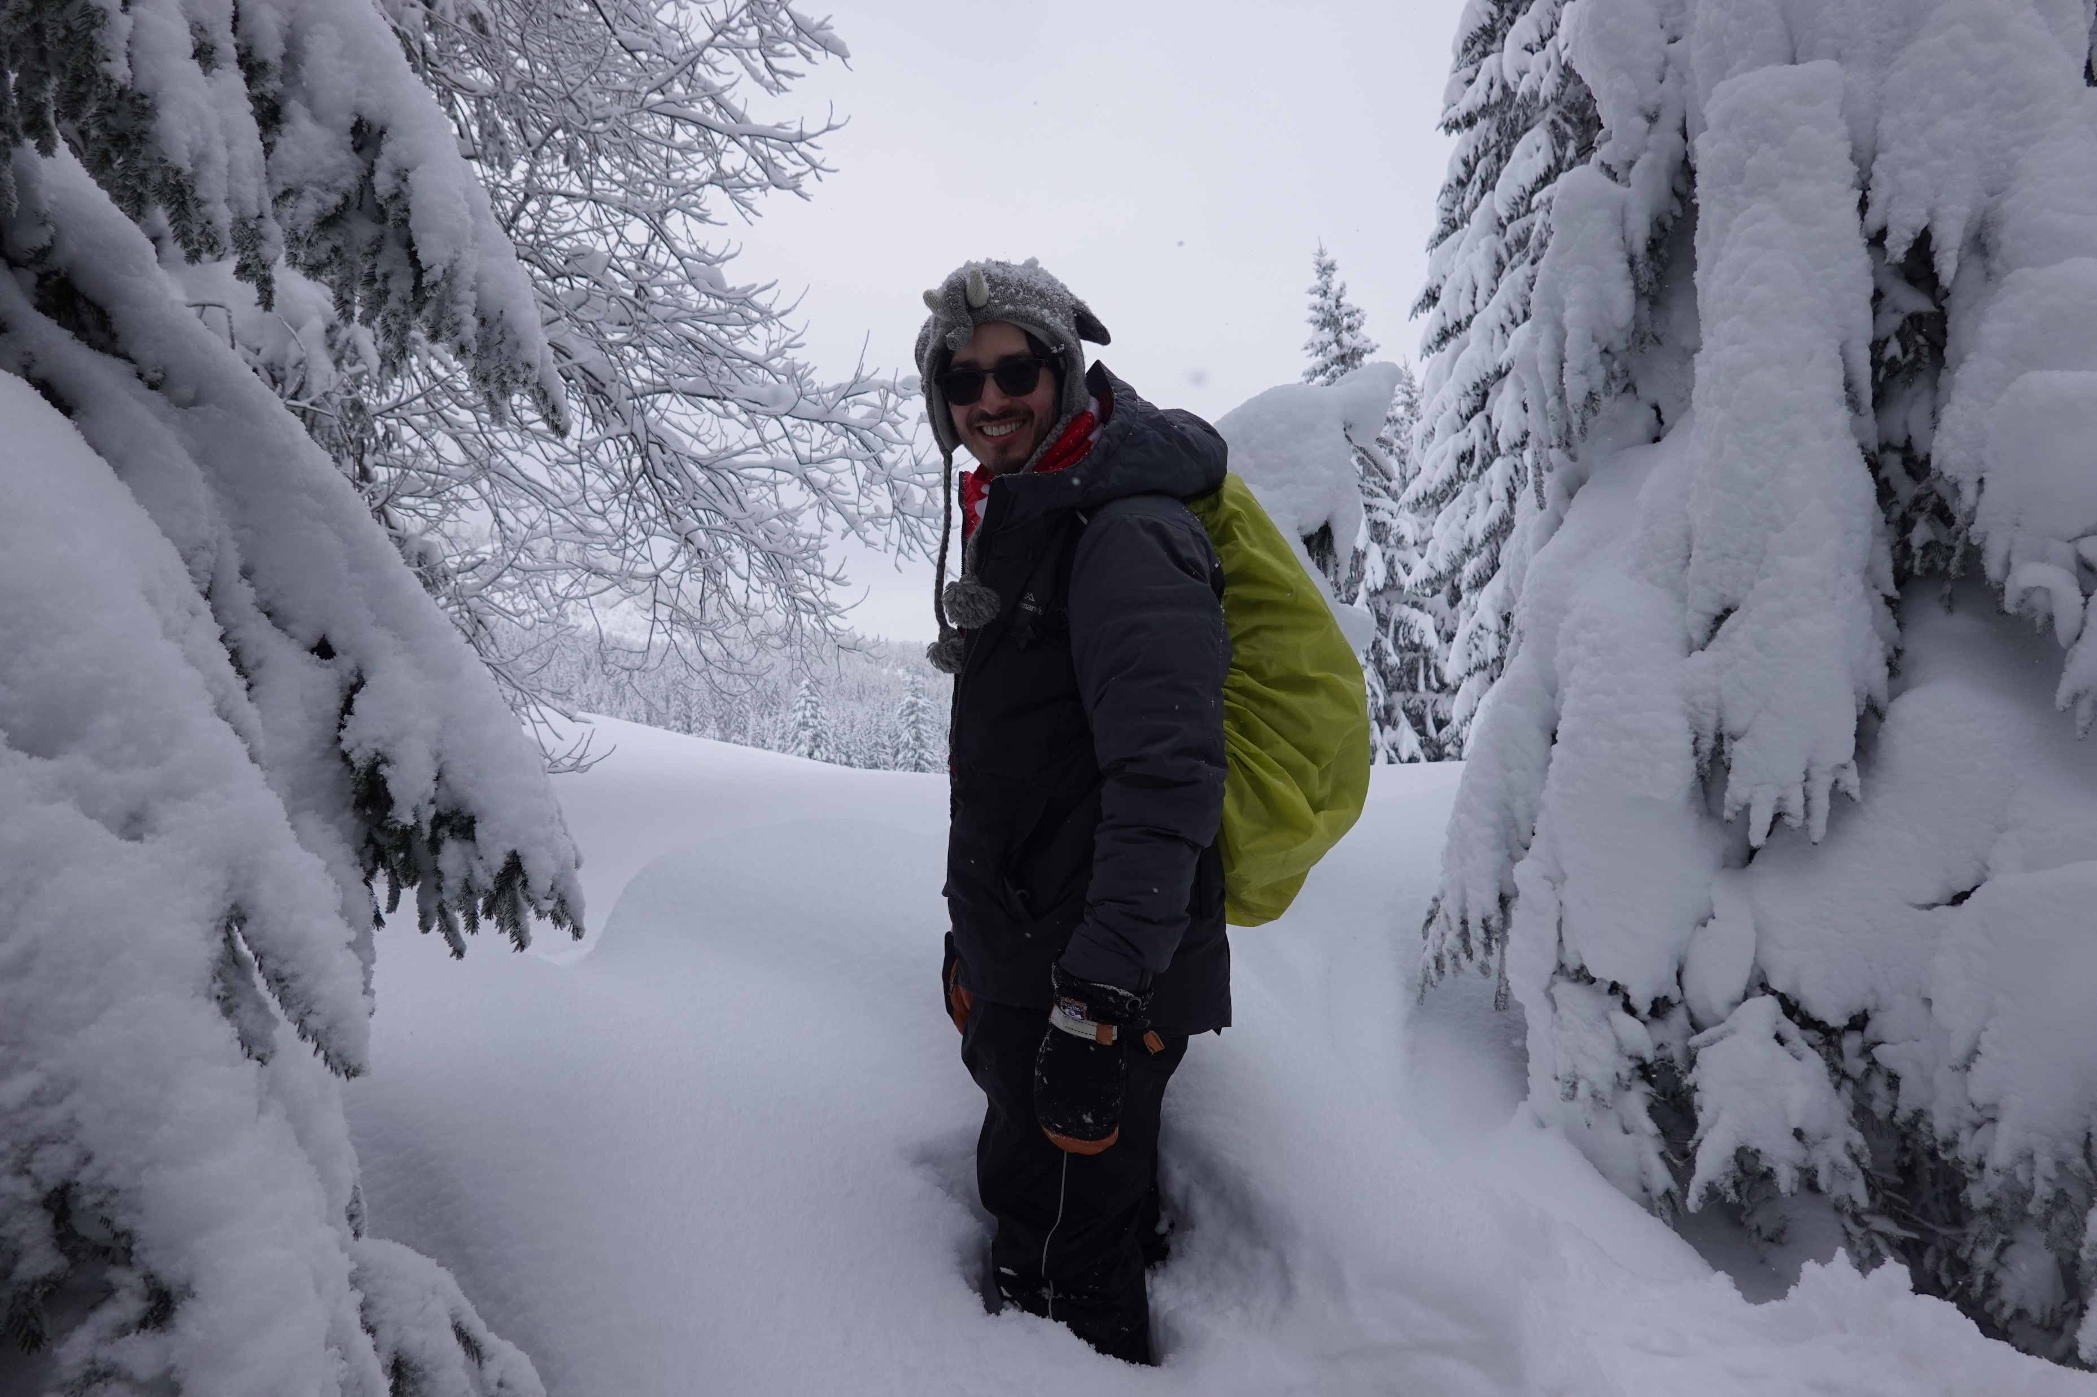
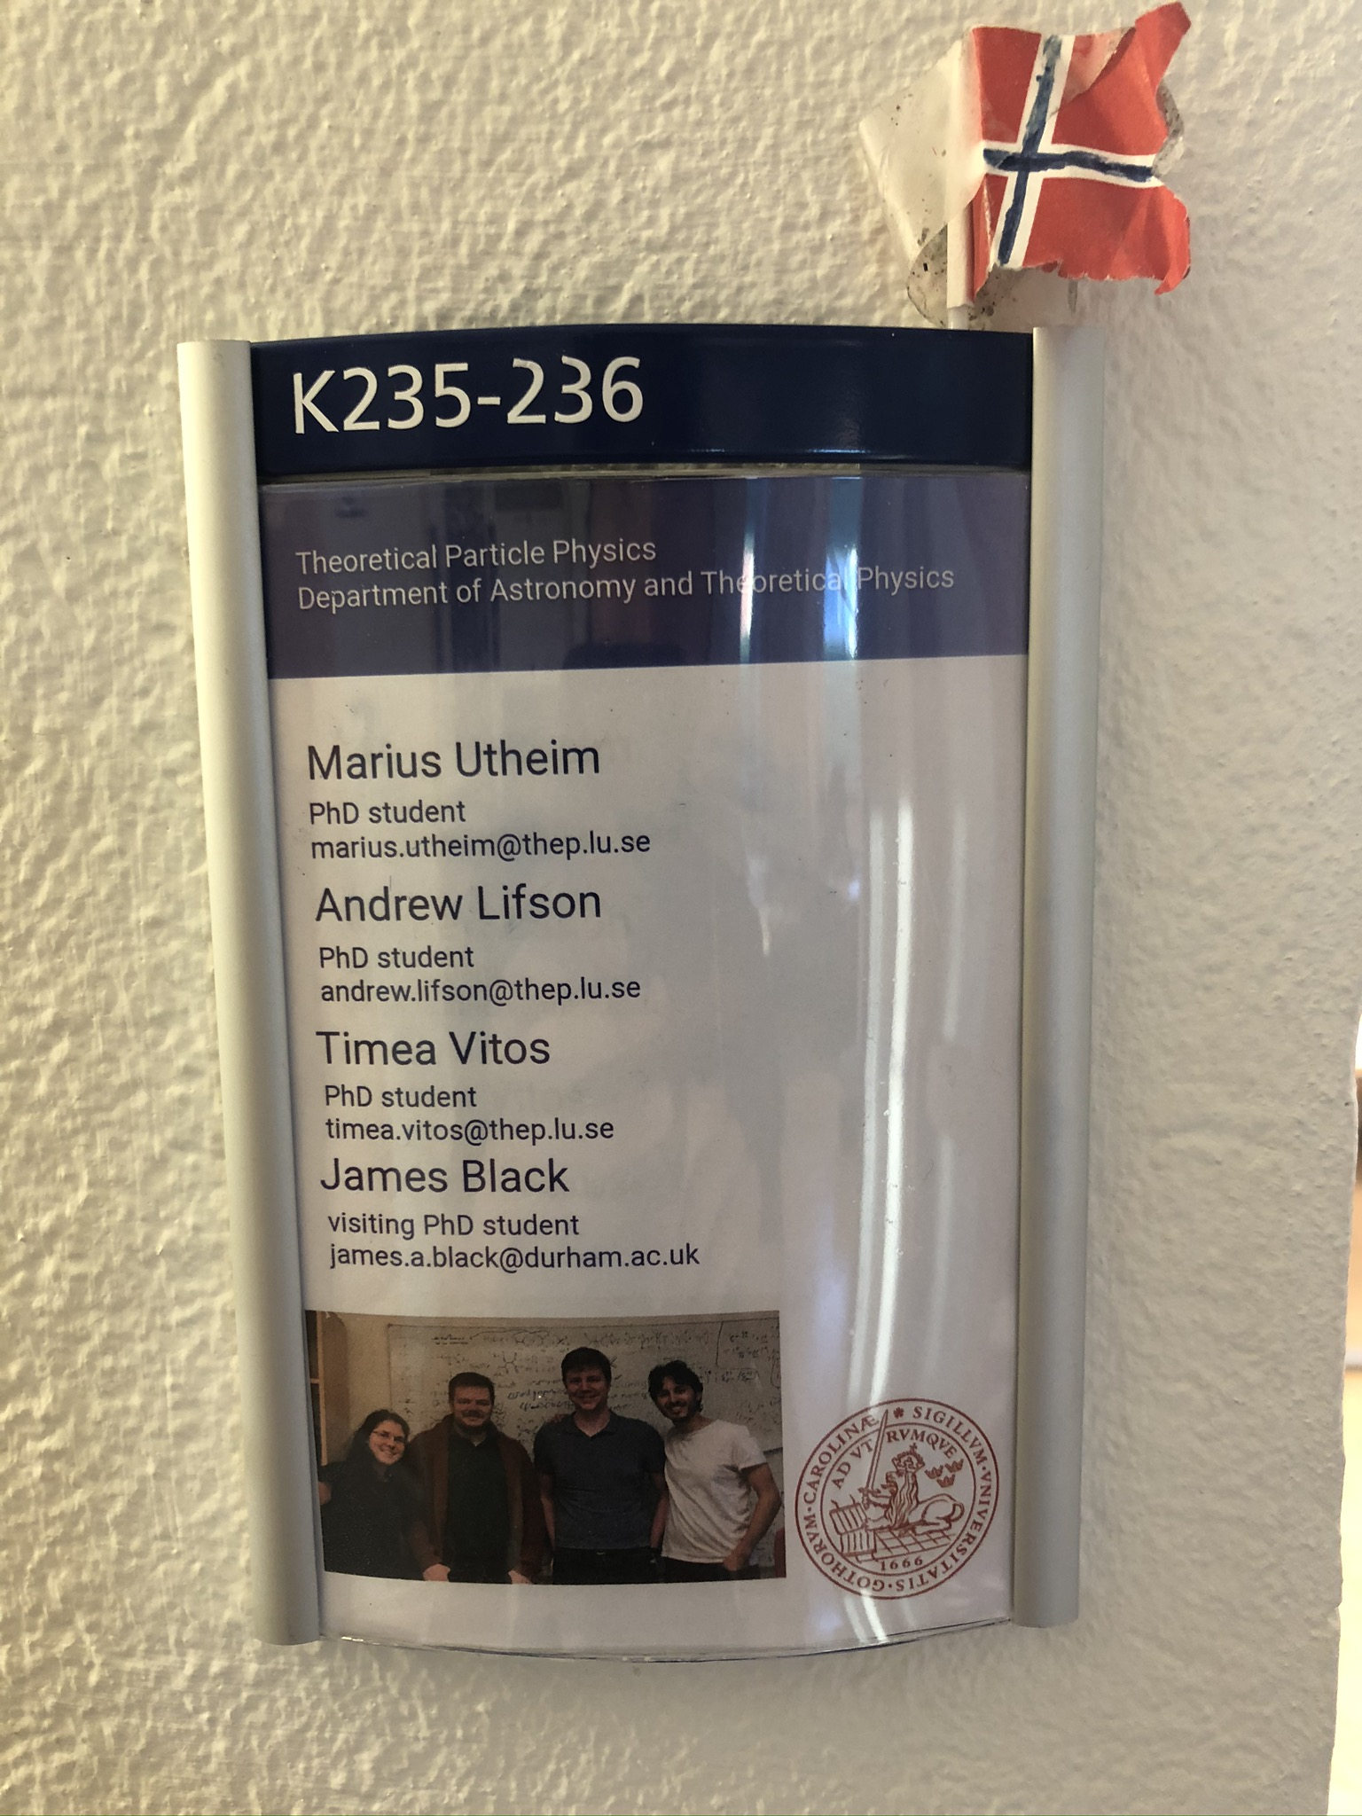
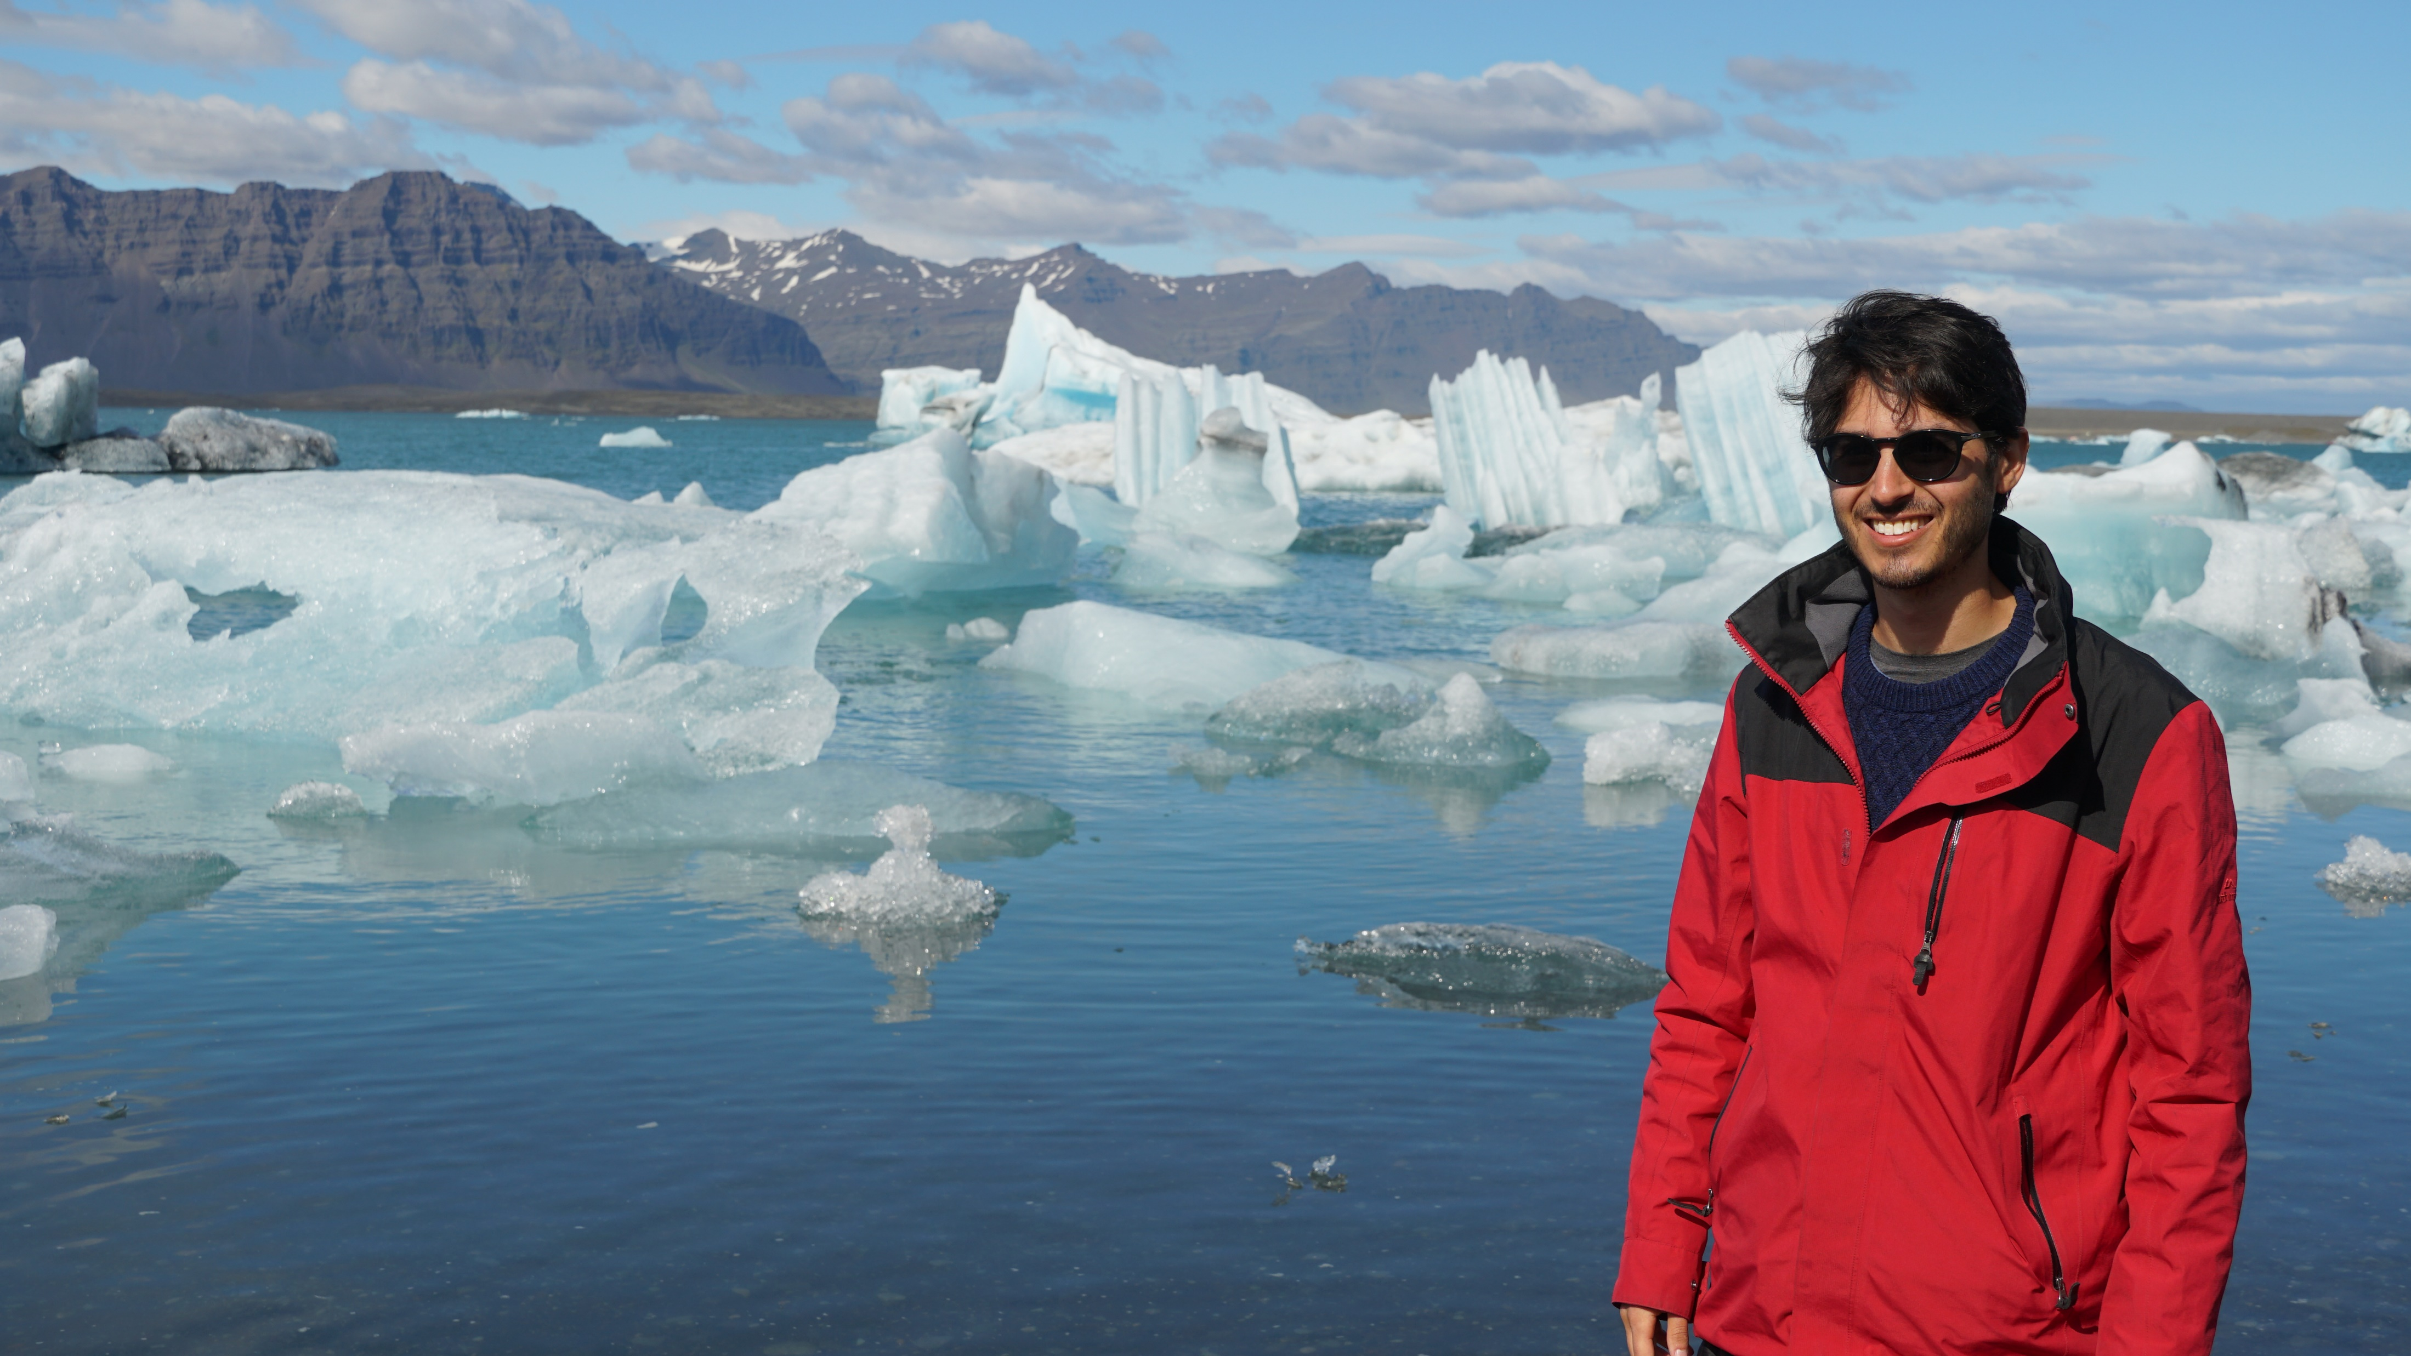
Work-Life Balance

Slide 5
2017/18 NDR Produced Survey of Workplace
Lots of data to sift through
Unfortunately lots of noise
Statistics people never finished its work…
I’ll summarise the positive and negative aspects of our workplace

Slide 6
Any positive comments on the working climate in your work place: Some actual results
People respect each other and are happy to give feedback or advice, even if you don't work closely together, which makes it a very creative work place.
There is a lot of interaction and you are generally encouraged to speak to people and go to fikas. People are mostly nice to each other.
- very relaxed atmosphere and everybody dares to ask for help, and everyone is willing to help
Many friendly people, positive atmosphere
Lots of social events, very little competition but working together though.
Everyone's friendly and there are evening activities sometimes with the PhDs
You tend to hang out with more people than just your group members and the atmosphere in the lunch room is generally friendly. The other phDs, postdocs and project students in my group are nice, we work well together and can talk about many things.
For the people that I talk to, there is a friendly atmosphere, my supervisors give me a lot of freedom to perceive my own goals and interests, which is crucial when it comes to career development.
Everyone is taken seriously. Heads of divison listen to all layers of employees
Regular break activities togehter. Nice and helpful people.
I have an office that I only share with one person, who is not here everyday, this gives me a quiet and calm working environment. Besides this I have I lab that I am responsible for and the lab is well suited for my purpose and I do only need to share it with others in rare occasions.
It is very free and totally awesome.
My colleagues are friendly and supportive. There are no conflicts which I am aware of at the division. When it comes to work within my division, I have nothing negative to say.
People are nice. We have fika at 10 and 15 every day and there is cake on Fridays. The safety in the lab is taken serously and overall it's a nice place to work on.
A social environment with regular coffee breaks where one can socalize with the other employees. An open environment where colleagues are happy to help each other with work-related problems. Seminars are given on a regular basis, where all are encouraged to participate.
Also some private activities in my working group.
spacious and comfortable work office
Events are run to get the department together regularly, which helps people to get to know each other better.
Realistic expectations on workload most of the time.
There is support from others in the group.
Many activities :)
Flexible working hour distribution.
good kitchen facilities, office is well equipped and not cramped. All the necessary items to perform my role comfortably are provided.
supervisor, co-supervisors, working environment, co-workers, and friends are nice.
Everyone is very helpful and friendly towards each other, is interested what I'm working on and willing to give feedback.
Great support from main supervisor. Open and welcoming climate in the group.

Slide 7
Summary of Positive Comments
People are social, including outside workplace
People respect your views and opinions
Lots of fika breaks, e.g. at 10:00 and 15:00 each day
Flexible working hours
Support from supervisor
Support from colleagues, without conflicts

Slide 8
Any negative comments on the working climate in your work place: Some actual results
My co-supervisor is from another department, and he wants me to be there sometimes, even though it is totally pointless because I don't "belong" to that place
There are occasionally too many people in our office.
The working climate in general is good, however, sometimes I feel that there's no any kind of communication with other people/groups. I find all very cold, but I think thats maybe something of the nordic culture
The mentality of "a hard-working PhD is a good working PhD" seems to be stuck with a lot of senior faculty even if in a more comedic sense. I just think it's a dangerous thing to joke about.
A work-a-holic attitude is more or less assumed of everyone.
It is a good, collaborative, environment - but only if your work fits with the central themes of the department. I feel like I am left outside, and given very little help and guidance in my work compared to other PhD students. This is not recognised. The offices for PhD students are not optimal - it is hard to concentrate
Lack of information from the department's leaders, from the department's board and from the administrative office. A major lack of information on all levels when I think about it
I would prefer more team-oriented activities.
Lack of mmetings, journal clubs
Maybe tables and furniture could be more adapted to our needs.
It's not very social during an average work day.
There is an underlying sense of not-trust in the others. Everyone smiles and celebrates, but at least at the PI level, they don't count on each other. There is no real collaboration. I often hear comments about how silly or not serious is the research of others, from PIs in he group.
Our supervisor is a good scientist, but not a good supervisor, which can cause unnecessary stress and tension.
I feel alone most of the time. I do not always get to have the discussions that I need, which leads to I am mostly sitting around waiting for things to happen. Another thing is that my workplace is generally divided. There is not much interaction between various fields, which leads to less cooperation between research fields.
A bit quiet and dull sometimes. Office spaces not great.
Sometimes departmental activites are planned with very short notice.
A significant proportion of my work is carried out in collaboration with people from other institutes. One of the people I have worked with recently has been anything but friendly towards me and has given me a lot of negative criticism, seemingly for no reason, or maybe because he feels like I am stepping into his domain. I am glad I do not have to work with him in my everyday life, but nonetheless this should not be tolerated.
For a long time I felt alone with my research project since I did not have my office close to my co-supervisor which does most of the supervision. It took me years of complaining to finally be able to move closer and eventually it was only solved by me moving into his office due to lack of available office space. However, not all PhD students were allowed to move and now the students in our department are split between different buildings and are given different possibilities to be part of a research group. I have complained about this a lot and there is an understanding among the supervisors, but none of them have the power to decide over office spaces. So in the allocation of office spaces other groups are prioritized and the PhD students will continue to be split between buildings in the future.
Way too stressed. Seniors and head of department are always busy and always complaining. No time for supervision. Things get done last minute. Teaching is not prioritized. Courses are not prioritized. Seniors often eat out and there's little exchange of ideas in the lunch room. No overview of work done. Too little exchange with other departments.
Some communications with should be in English (as they are applicable to all employees) are provided in Swedish but we have a large international cohort in the department.
Lots of depression and a lot of people are feeling alone.

Slide 9
Any negative comments on the working climate in your work place: Some more actual results
Too many departmental activities, although with good intentions they do compete with time put in my own research.
The I don't speak Swedish yet so it can be difficult to be part of conversation.
miscommunication in the department power fights
Facility's work is prioritized but its always possible to find a solution...
The rules and regulations, regarding e.g. my ISP are blatantly disregarded more often than not. It seems that this is common practice, as several other PhD students have voiced the same opinion, albeit in a private setting. One never knows what to expect in regard to e.g. extra teaching duties, which courses one "may" attend, as a PhD student is often considered work-force, rather than an individual, and a student. As such, decisions regarding teaching are taken, and ratified, by the PIs, and the PhD student is expected to do as told, despite a conflicting ISP.
Lack of individual salary and salary negotiation meetings for PhD student employes.
We are colleagues not friends, but a bit more friendlier atmosphere would help all I think.
Not enough other PhD students working in a similar field. Not enough contact with those who do not work in the same field. Most non-PhD personnel is older and shows little interest, for example by talking in Swedish even when I'm around.
no
They are too nice to tell something not good on mine?
People are so focused on their own work, not much interactions. A bit cold place, especially to foreigner colleagues.
The environment feels a bit unpersonal.
It feels like you are supposed to work more than full time. Even though it is not expressed that you have to work late nights and on the weekend the feeling is that it is expected.
The ventilation rarely works in half the building at Geocentrum. It is a well-known problem, but Akademiska Hus does not seem to have any interest in fixing it. There is a big divide between research groups, not in a hostile way, just general lack of interest in your colleagues' work.
Quite crowded at times. And only people in my group, very few from other groupd
People try to be friendly to each other, thus, it is harder to get an independent feedback on your research/presentation/talk etc. Even if it was really very bad and you personally feel that you could have done better, in most cases you would still get a positive feedback.
Very little social interaction. safe/dry storage for bicycles would be appreciated.
There is not much interaction between coworkers, I am mostly alone all the time.
The division leadership feels apathetic and stagnant.

Slide 10
Summary of Negative Comments
People are NOT social, including outside workplace
  People feel alone
People say they’re being worked too hard
Swedish spoken around international researchers (PhD and Postdocs)
  Also Swedish communication when intended for all employees at department
Crowded PhD offices

Slide 11
Covid-19 Survey
Survey undertaken by LDK (Lund’s doctoral student union)
  Initiated by NDR (and much of the work done by Brian Thorsbro and Smita Chakraborty)
Results from 30th March – 17th April
  Still from state of great change
Results from all faculties

Slide 12
Work Environment During Covid-19
Almost everyone affected by transition to home working
Issues include:
  Distractions from children
  Lack of proper desk, chair, poor internet
  Less communication with supervisor
  Teaching workload increased, but not compensated for

Slide 13
Mental Health During Covid-19
Majority face reduced motivation due to reduced contact/stimuli
Social contact attempted online, but not quite the same
Uncertainty to obtain data, equipment etc.
Some worried about general state of world, lose focus
Not in report, but many of previous positive aspects of workplace no longer possible

Slide 14
Summary of LDK Report
PhD students argue that they need prolongation to have a fair chance at meeting the learning outcomes of their education. In particular, mental health and work motivation problems are common. A quantitative follow-up study on this aspect is needed.
It is imperative that all PhD students discuss their situation with their supervisor(s) and other stakeholders of their education, and document any delay of their education in their individual study plans (ISPs).
It is important that the work environment allows for full-time work. However, if the home work environment is not conducive to this, solutions have to be found with the head of department. Example solutions could be alternate work locations, improvements to home work environment or recognition of not being able to work full-time. PhD students with children are particularly challenged.
The university should make a statement verifying that consequences incurred due to the corona pandemic with respect to documented delays to the PhD education, qualify as valid reasons for prolongation.

Slide 15
Some Covid-19 Ideas from THEP
Meet in park for bring-your-own picnic lunch
Daily fika via zoom
Mini exercise breaks via zoom
Weekly lunch catchups to discuss how PhD work is going

