Slide 1
Vega EuroHPC & ARC
Andrej Filipcic

Slide 2


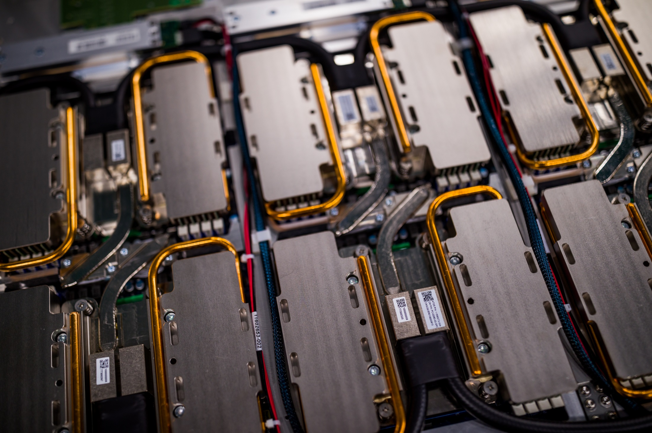
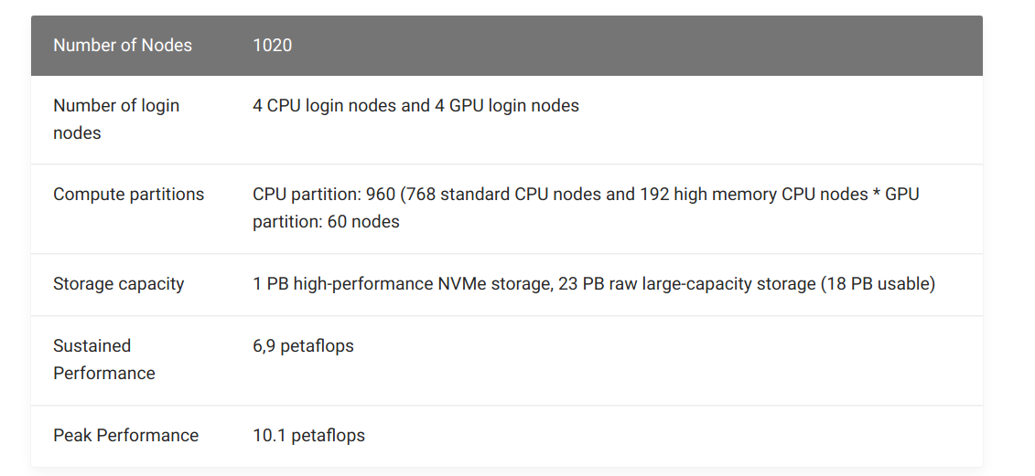

Vega/EuroHPC - IZUM, Maribor, Slovenia

Slide 3
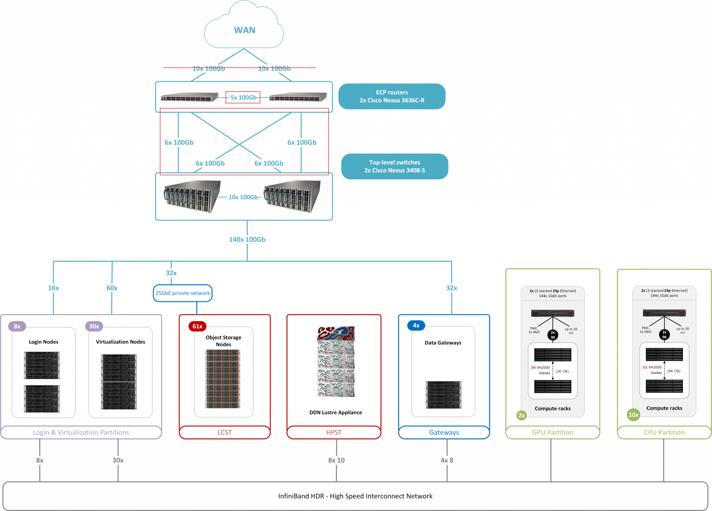
Network
Infiniband:
Compute, Lustre
Ethernet:
Ceph
IB Gateway:
4x Mellanox Skyway, 3.2Tb/s
WAN plan: 5x 100Gb/s
200Gb/s to ARNES for now
100Gb/s to Geant/LHCONE

Slide 4
Performance
122.880 AMD 7H12 2.6GHz cores, HS06: 14.75/HT, 3.8 MHS06 total, more than ATLAS pledge, 2 and (¼) 8GB/core
+ 60 GPU nodes, 4xA100
DDN Lustre, 1PB, >400 GB/s
Ceph: pacific, 23PB HDD + 700TB nvme
61 servers: 2x 6TB nvme, 24x 16TB HDD, 2x25Gb/s NIC layer3+4 bond
Up to 200 GB/s
Erasure coding: 16+3, 32MB block size
CephFS, RBD, RGW

Slide 5
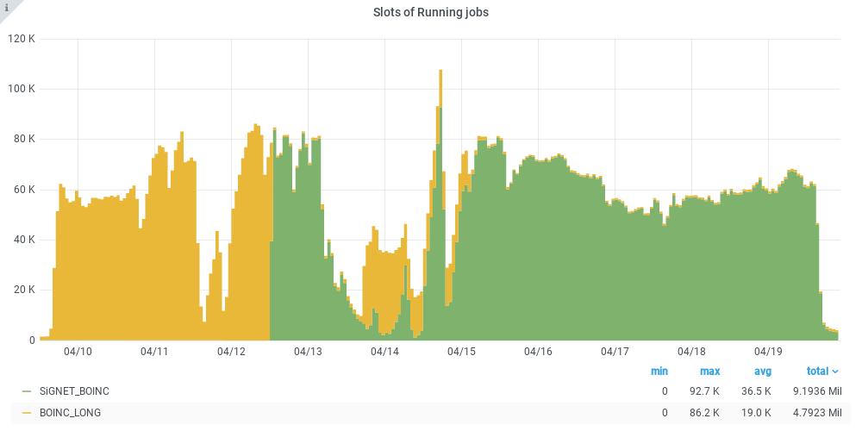
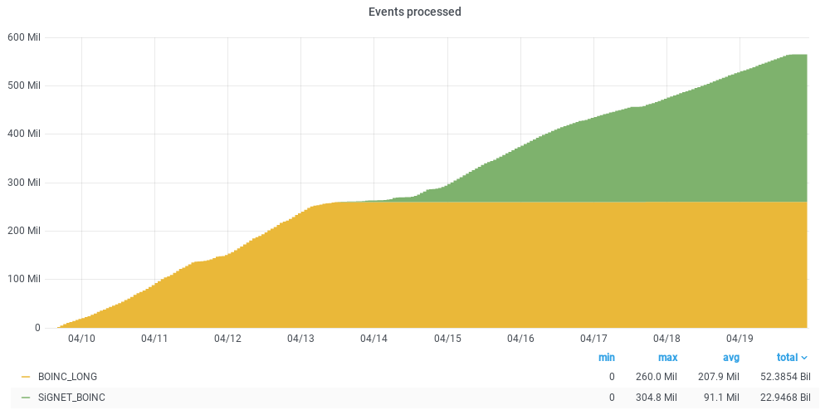
BOINC_LONG (SiGNET_BOINC) - pre-production
BOINC_LONG
SiGNET_BOINC relabeled
~200k cores (boinc does not show it correctly
~550M G4 events in 10 days
Vega is 3.8M HS06 (~15/HT) on CPU partition
10Gb/s flat HITS output, 1.2kHz event output when 120k cores active (240k HT)

Slide 6
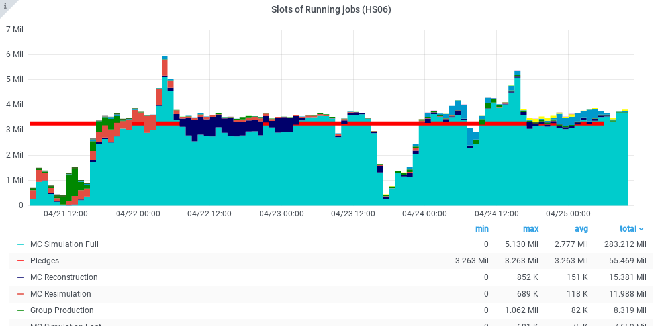
Vega/EuroHPC ATLAS production
960 CPU nodes 128-core/256-HT used by ATLAS
Details on https://doc.vega.izum.si/
Pre-Production
No other users
Some instabilities
~20 nodes off
Some glitches while tuning SLURM
Some spikes due to delayed completion
2 Panda queues:
Vega - 64-core, everything
Vega_MCORE - 64-core G4 only
CVMFS, NAT for outbound
aCT/ARC-CE
Standard integration

Slide 7
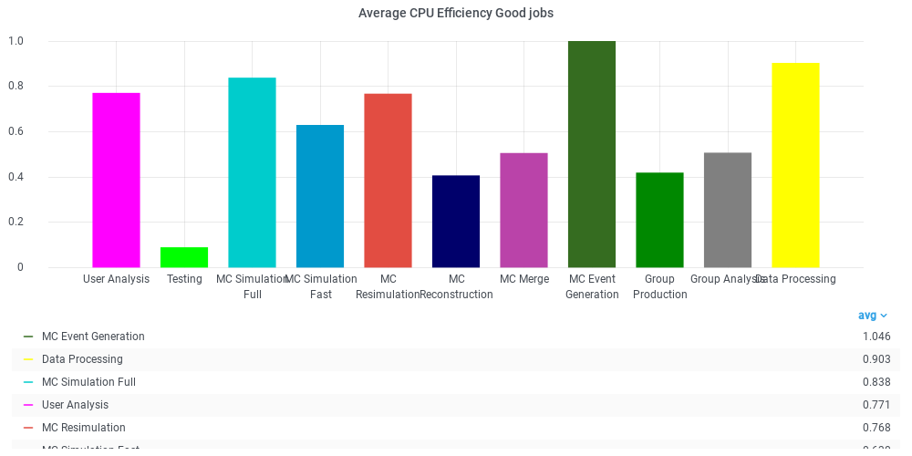
CPU Efficiency
~70-80 % for 64-core jobs
Too short (1-2h)
Some workflows are bad
No infrastructure bottlenecks
100Gb/s IB
3GB/s NVMe
256-core jobs - far too short
AthenaMP scales well, MT not yet
Further SW optimizations are needed

Slide 8
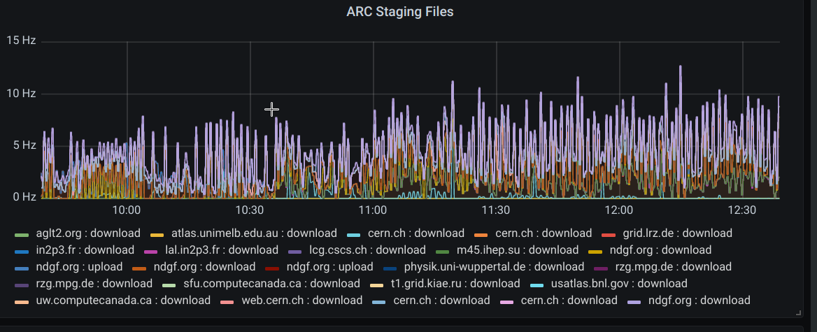
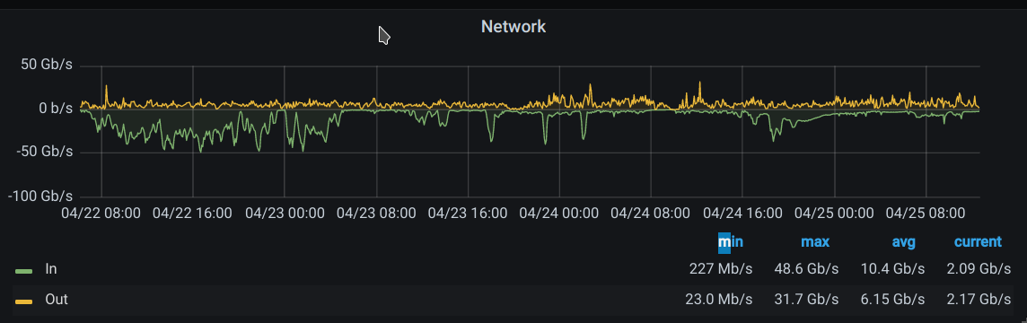
Data staging
ARC-CE cache
NDGF T1 for input
+ CERN-PROD for G4 input
100Gb/s WAN on LHCONE, 500Gb/s this year
22.4. Start with all Jobs, up to 50Gb/s
20Gb/s SiGNET WAN is bottleneck (NDGF dCache pools)

Slide 9
Current setup
HA management
Slurmctld
Virt partition:
2 ARC-CEs
6 ARC delivery (including ARC-CE)
6 squids - all full for heavy workloads (eg heavy ion overlay etc…), in WLCG monitor
Queues:
Cpu, max 2 days
Longcpu, max 4 days (limited resources)
Largemem (1TB/node)
gpu

Slide 10
Issues
Skyway gw no HA support yet, coming in June
Till then 4 groups of nodes with different gws and ip aliases
NAT on one server for outbound
Skyway: no ipv6 support yet, in discussion
ipv6 NAT for outbound
RH 4.18 kernel - very unstable with cgroups memory OOM
Mitigate: 5.10.34 vanilla kernel + Mellanox drivers (supported) + Lustre drivers (git master + AF fixes)
Further optimizations needed for grid jobs (ATLAS)
In general: HPC world is VERY different, it took a lot of discussions with the vendor to adapt for general purpose machine

Slide 11
Resource allocations
35% EuroHPC, 65% Slovenia, independent calls for allocations
Community allocations foreseen for both
ATLAS, Belle-2, LCST, CTA etc. - resource pledges
Eg ATLAS: ~10k cores, 2PB, to be decided later
To be discussed, proposed, when the Ministry defines the access policies
Any EU organization can apply for EuroHPC share
CERN HPC application (beam simulations)
One company R&D (research access)
KTH will apply
Relatively easy to get benchmarking and development access
Slovenian share:
Slovenian research, international collaborations, projects where Slovenia participates,...

Slide 12
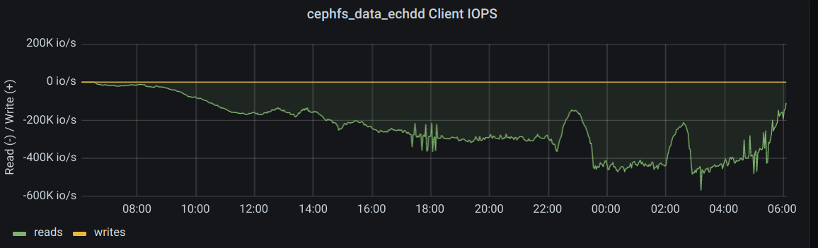
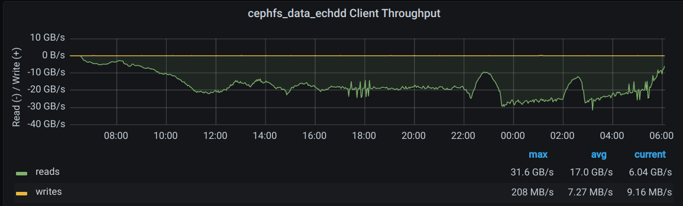
Heavy jobs
Digit jobs on ceph
(hdd 16+3)
https://bigpanda.cern.ch/task/25445935/#plots

Slide 13
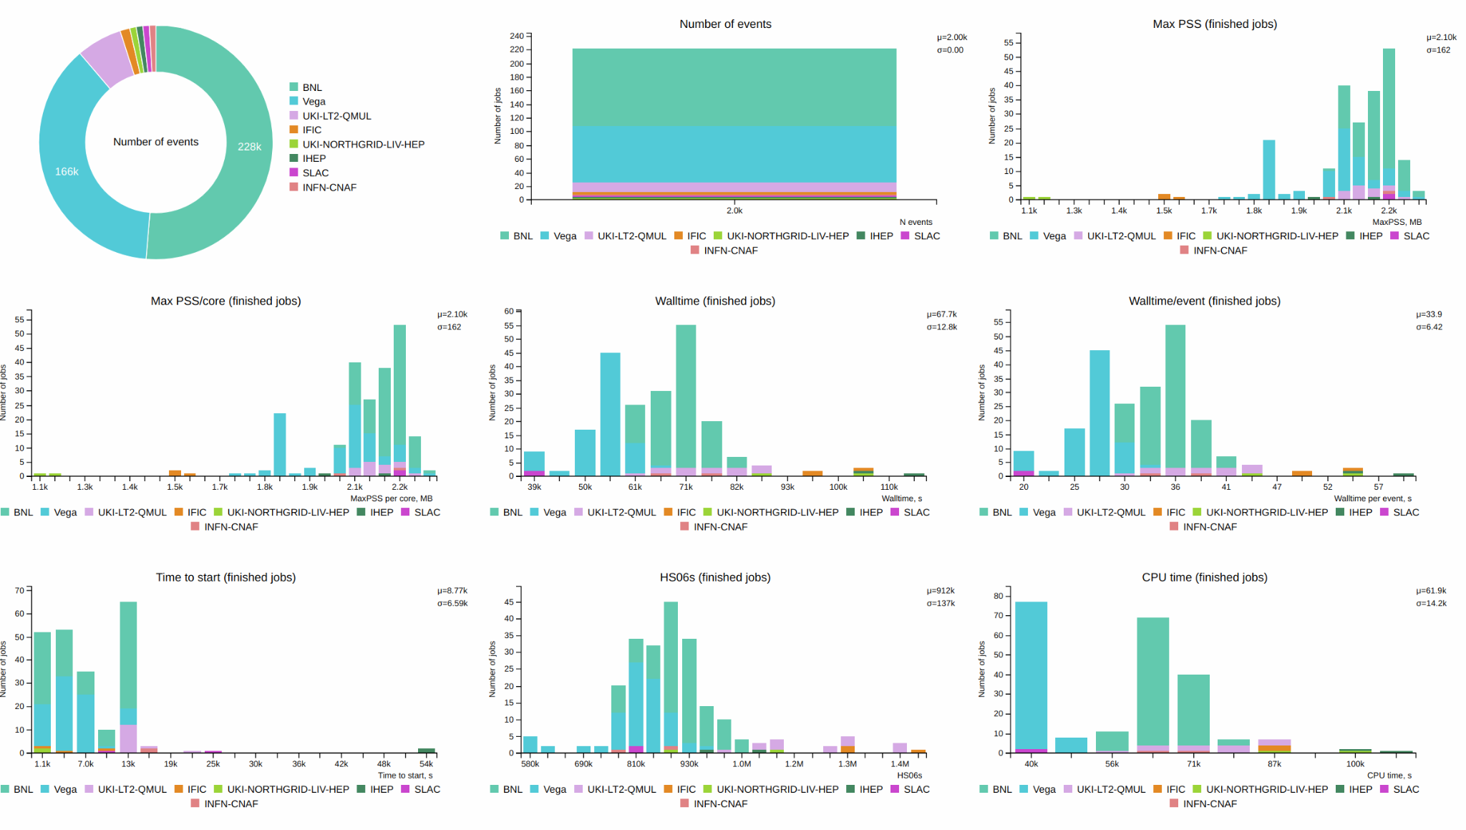
Digit killer jobs -score
Still, pretty fast, faster than most of the grid sites

Slide 14
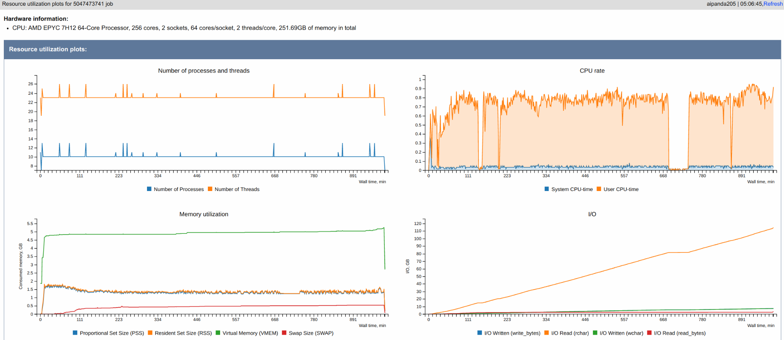
Digit profile

Slide 15
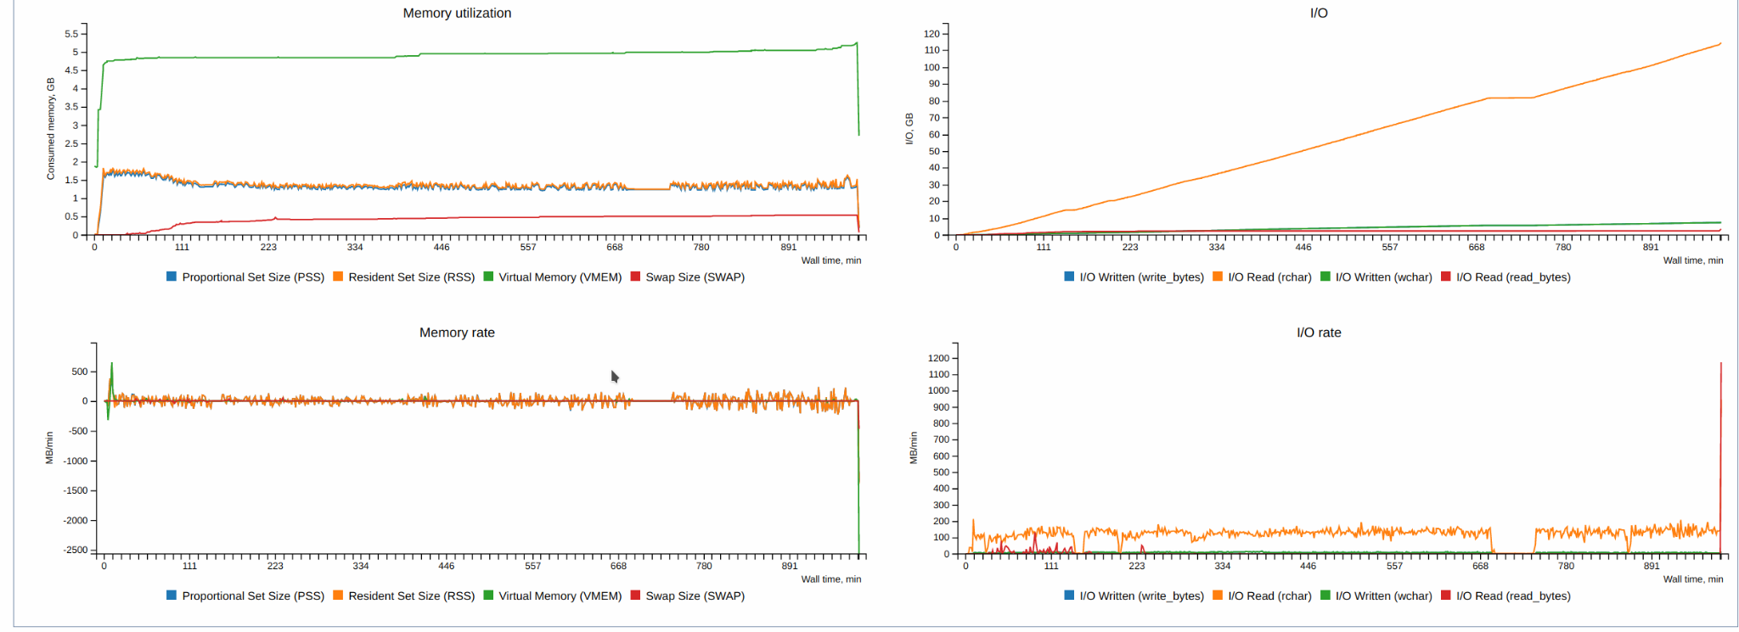
Digit memory

Slide 16
Future
ATLAS could use most of resources up to know, much less in the future, not clear yet on the exact numbers
ATLAS can quickly fill unused resources (especially with large jobs)
backfill/preemptive jobs not planned for now - ExclusiveUser node policy
Payload optimizations should target >90% cpu efficiency for all jobs
Likely, part of the SiGNET pledge will move to Vega, including storage

Slide 17
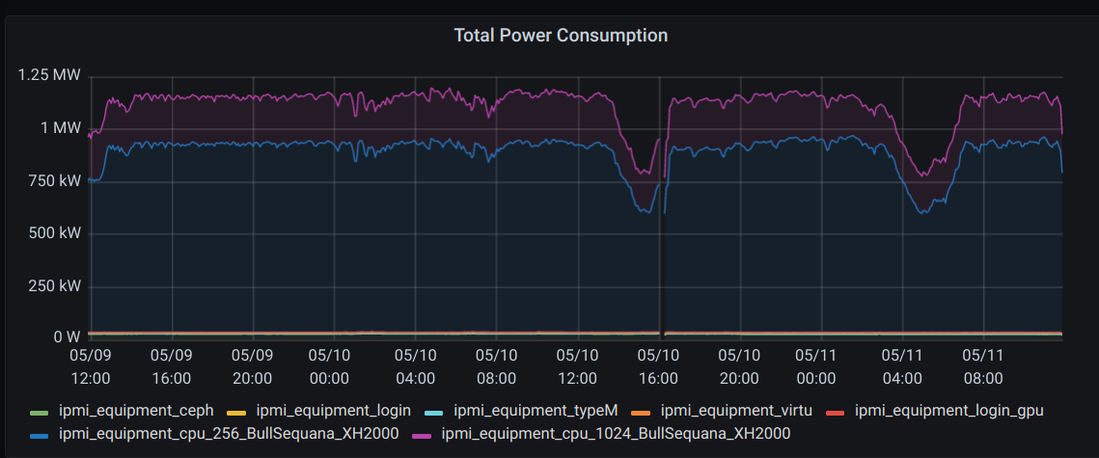
Power consumption

Slide 18
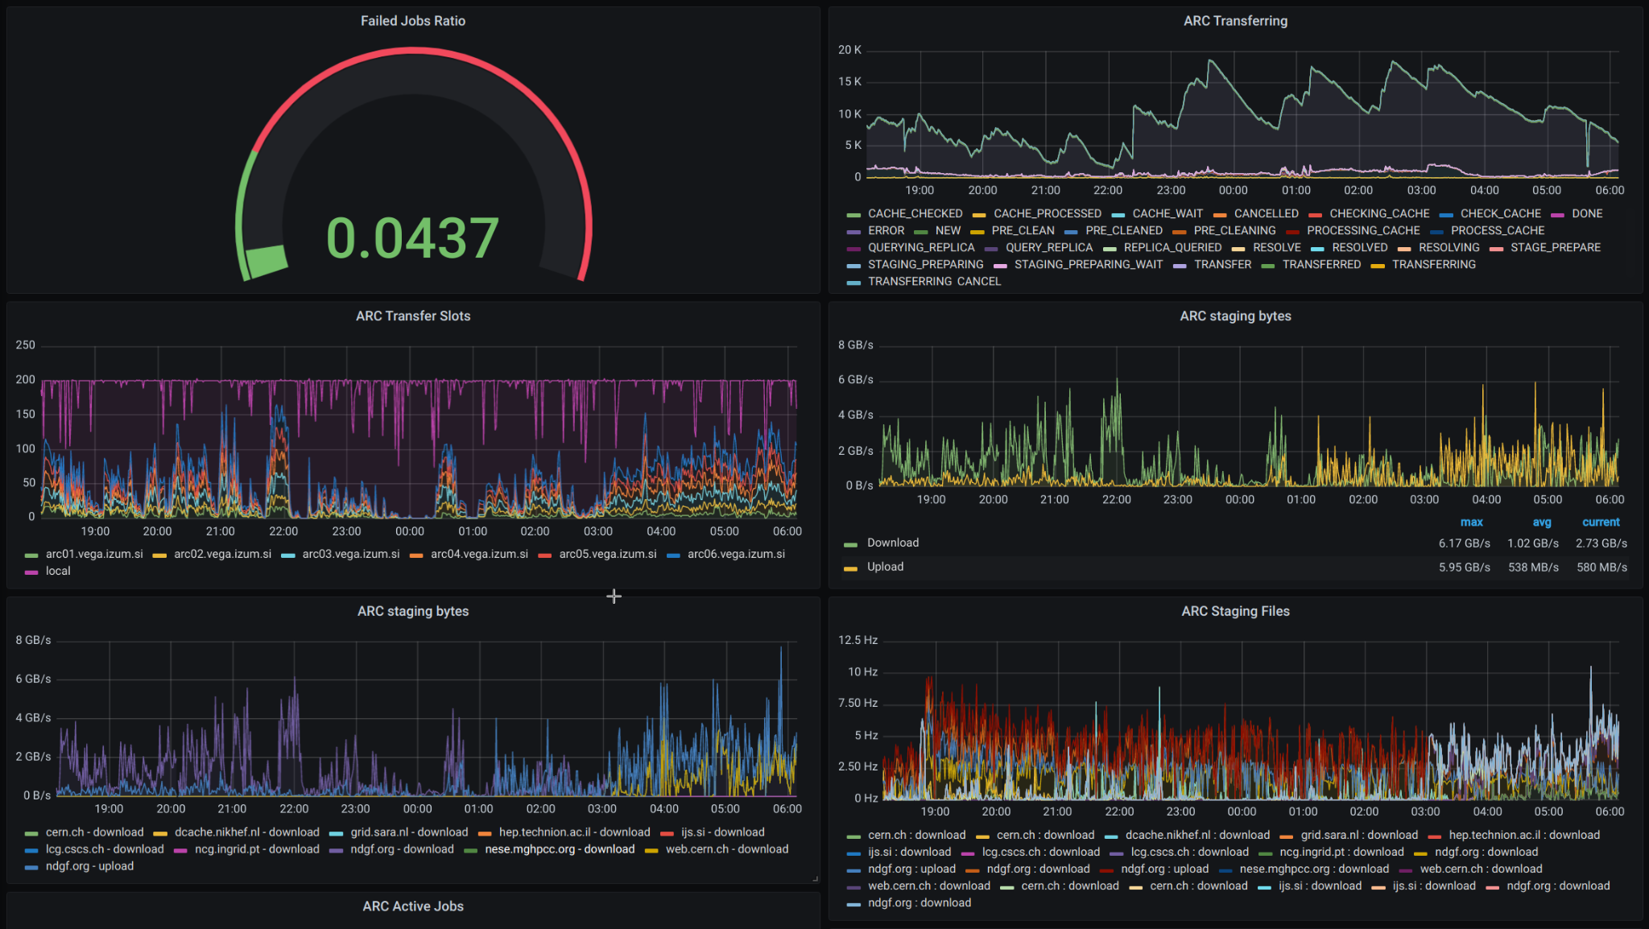
ARC-CE Dashboard

Slide 19
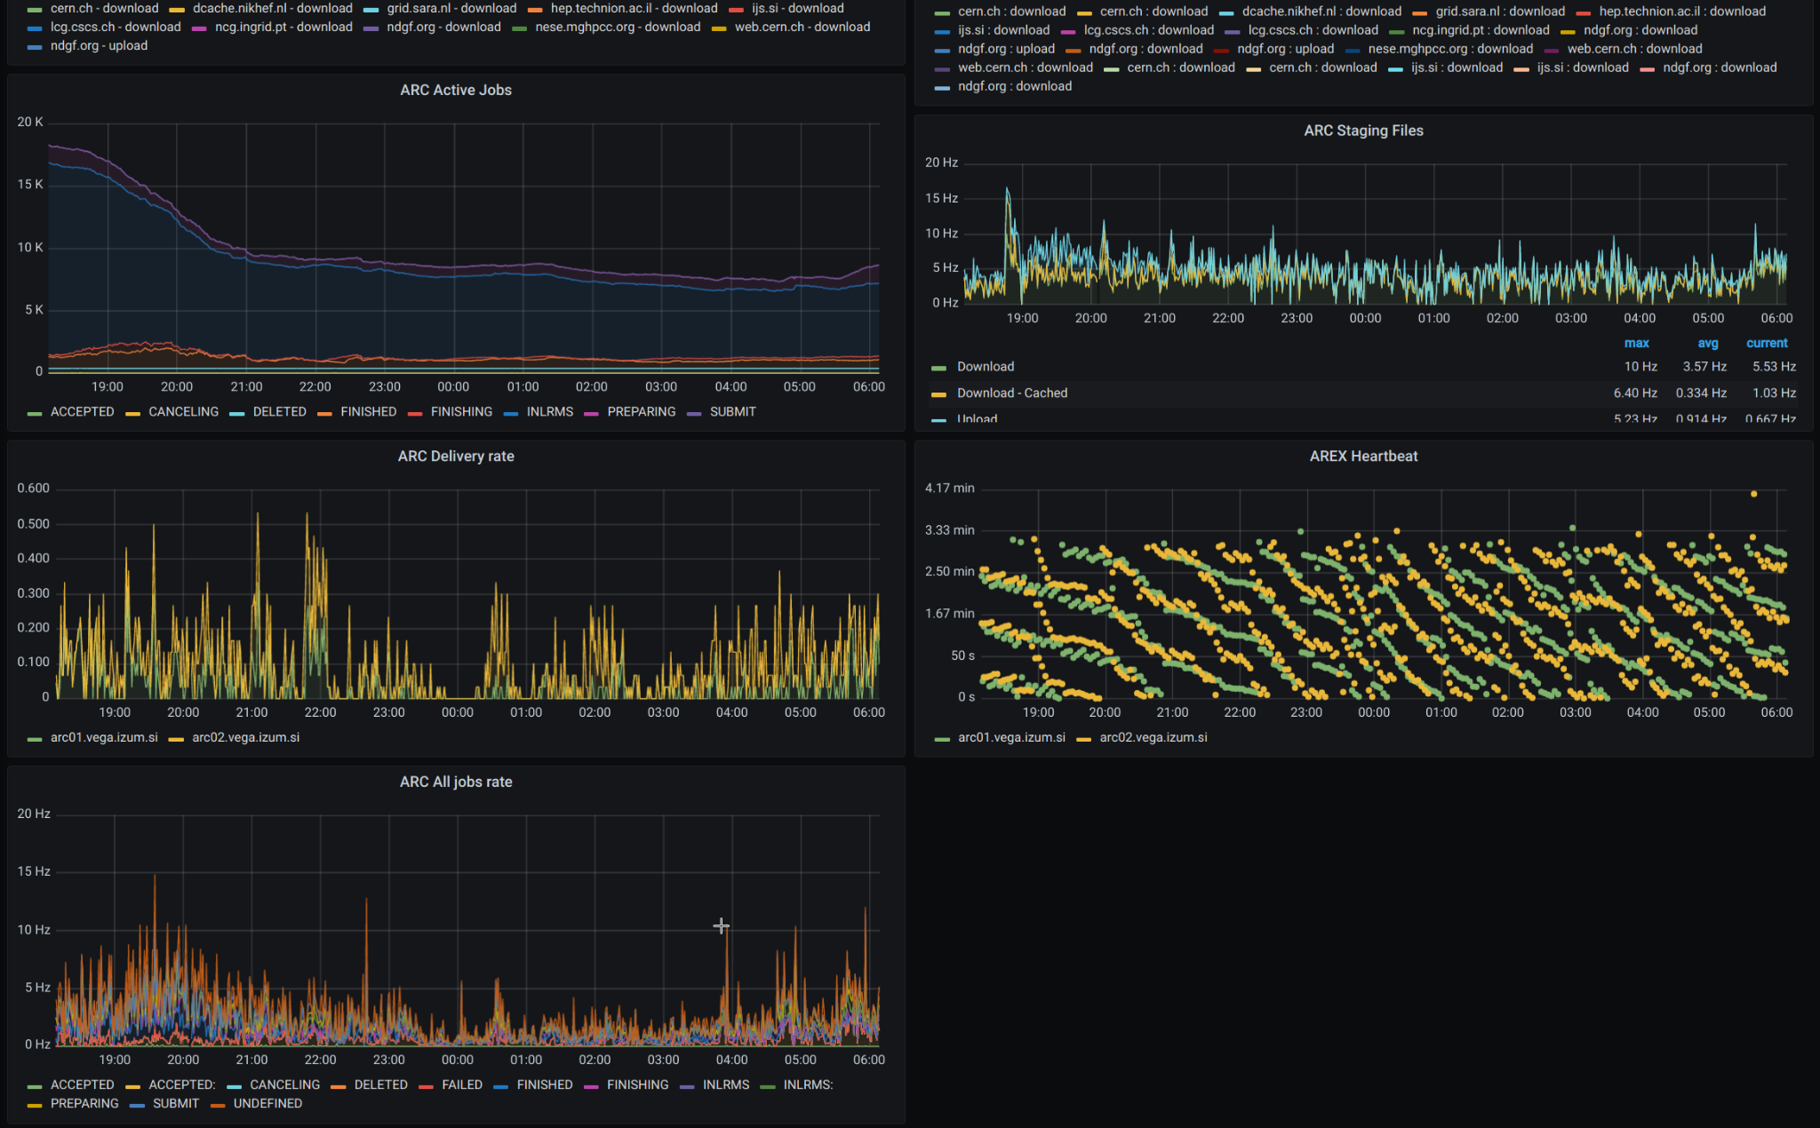
ARC-CE Dashboard

Slide 20
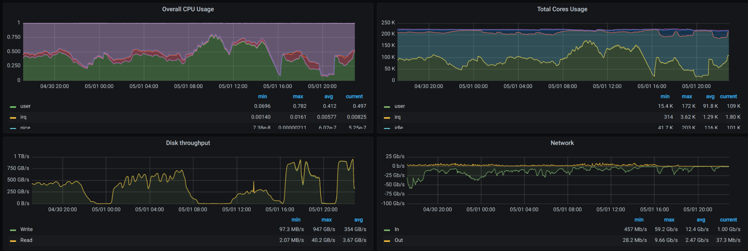
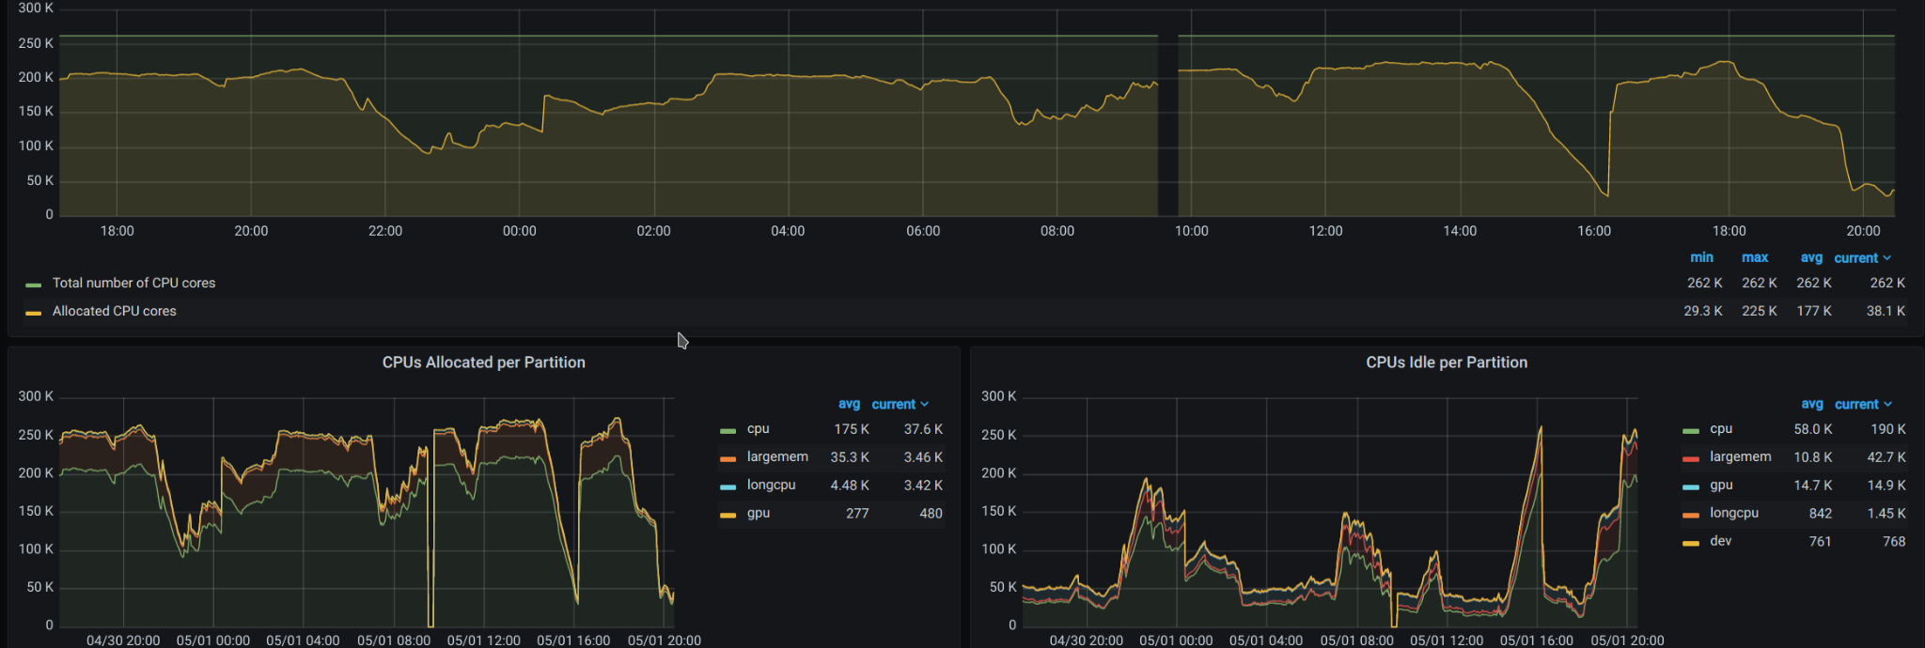
CPU, Network, I/O Profiles

Slide 21
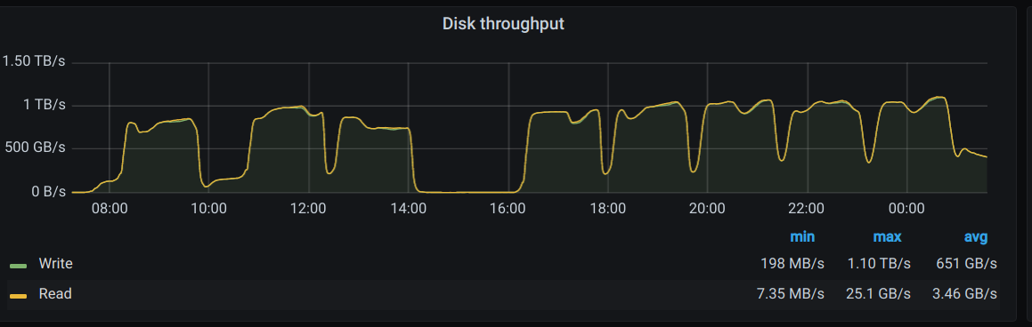
Local nvme disk throughput
400-node jobs, reduced lifetime for 1% in 5 days :( (ML modeling, non atlas)

Slide 22
Optimizations
256-core(thread)/node
Too much for AthenaMP, using 64-core, efficiency not too good
Memory:
1GB/core - quite a limiting factor
4 reco jobs do not fit too well, ~0.9-1.1 GB/core - instabilities without swap
Local 2TB nvme - add 50GB swap, maybe not possible on other HPCs

Slide 23
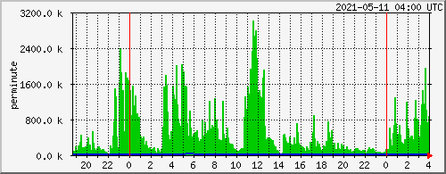
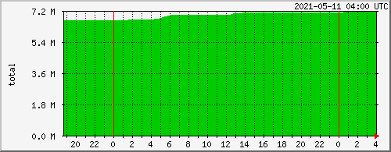
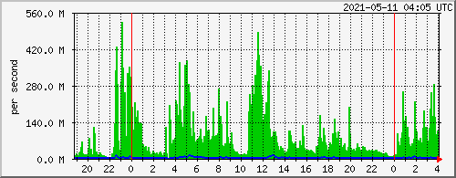
Squids (6)
req/fetch
in/out
Object count

Slide 24
ARC issues
Fast servers: 0.5TB RAM, 64-cores, SSDs, 200Gb/s Eth, 100Gb/s IB
2 CEs + 4 delivery
Hard to get high file-transfer rate
CPU usage: 300-400%, slow job processing
EMI-ES used for most (ATLAS)
Maximum running jobs - 35k yesterday
BOINC: scaled well on 2 CEs&CERN, Boinc servers had to be upgraded
Simple jobs, only 64-core
All ATLAS job types:
Too much fragmentation on resources, 3 Panda Queues
Explicit use of Slurm partitions
Pilot jobs, xrootd inputs -to bee seen, but NAT will be a bottleneck
ARC clients, very limited in (default) scope

Slide 25
Cache organization
Storage:
Local NVME on nodes (BeeGFS on demand in future)
Lustre: job and short term storage
Ceph: nvme + HDD
Several storage partitions - limited cache configuration
Tiering? Eg slow -> fast -> local
Currently: ceph hdd readonly, lustre normal cache (before Ceph only)
For ATLAS:
Huge input transfers initially, ~5GB/s for few days
With ~500TB cached - much less (NDGF T1 ~ 10PB) - common inputs, frequently used inputs
For other experiments, eg Belle-2, not clear yet how to use storage, nodes cannot spend time in transfers
>100core nodes will be more frequent in the future, cannot continue with 1-core or 8-core job model

