Slide 1
DARK PHASES OF MULTISCALAR MODELS
Pedro Ferreira
ISEL and CFTC, UL
Lisbon, Portugal
Lund, 21/10/2021
I. Engeln, P.M. Ferreira, M. Mühlleitner, R. Santos, J. Wittbrodt, JHEP 08 (2020) 085
D. Azevedo, P.M. Ferreira, M.M. Muhleitner , S. Patel, R. Santos, JHEP 1811 (2018) 091

Slide 2

INTERLUDE:
The Inert Doublet Model (IDM)

Slide 3

The Two-Higgs Doublet potential
Most general SU(2) × U(1) scalar potential:
m²₁₂, λ₅, λ₆ and λ₇ complex - seemingly 14 independent real parameters
Most frequently studied model: softly broken theory with a Z₂ symmetry,
Φ₁ → - Φ₁ and Φ₂ → Φ₂, meaning λ₆, λ₇ = 0.
It avoids potentially large flavour-changing neutral currents

Slide 4
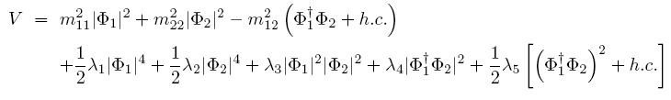
Inert vacua – preserve Z₂ symmetry
The INERT minimum,
Since only Φ₁ has Yukawa couplings, fermions are massive – “OUR” minimum.
WHY BOTHER?
In the inert minimum, the second doublet originates perfect Dark Matter candidates – the Z₂ quantum number of “darkness” is preserved and scalrs from the second doublet can only be produced in pairs.
Inert neutral scalars do not couple to fermions or have triple vertices with gauge bosons. Only possible with EXACT Z₂ symmetry – m₁₂ term must be zero.

Slide 5
Model has very interesting phenomenology.
Presence of inert charged scalar could impact the diphoton width of the observed 125 GeV scalar.
Scalar dark sector can yield good matter candidates.
Current constraints from dark matter searches (Planck, Xenon1T, ...) can be reproduced by the model...
... But the available parameter space is quite constrained (not many parameters to “adjust” to comply with different observables) and even a little fine-tuned.
Absolutely no possibility of CP violation in the scalar sector of the IDM, the Z₂ symmetry prevents it.
To get larger parameter spaces and more interesting phenomenologies (e.g. CP violation with Dark Matter as well) we need to go to higher field contents – the N2HDM, for instance.

Slide 6
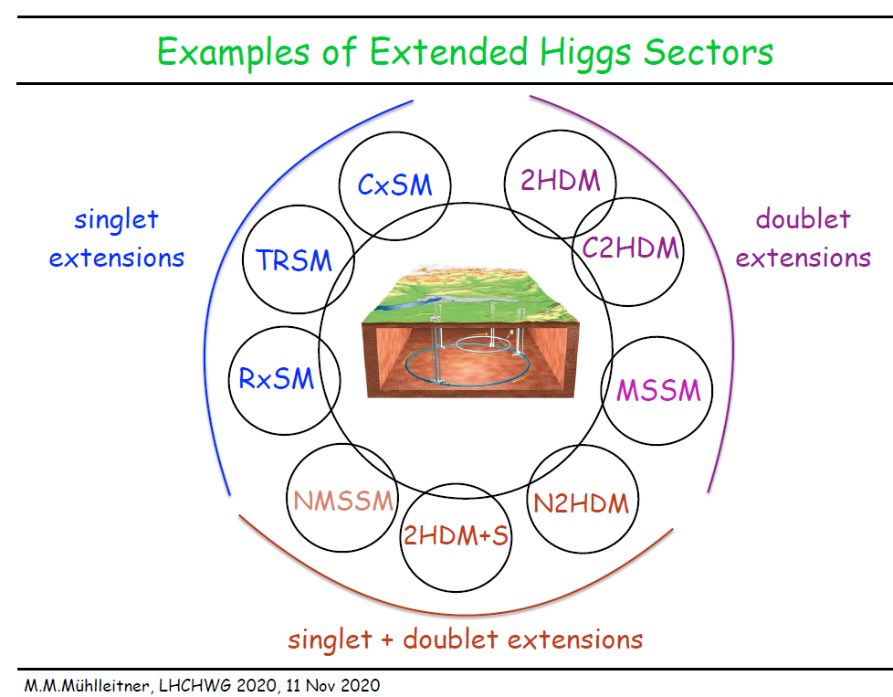

Slide 7


The Next-to-Two Higgs Doublet Model (N2HDM)
The Next-to-2HDM (N2HDM) contains two hypercharge Y = 1 scalar doublets, Φ₁ and Φ₂, and a real scalar gauge singlet, Φ_{S}.
There are several versions of this model, depending on the extra symmetries imposed.
We consider two discrete Z₂ symmetries, of the form
and
Vacua which preserve one or both of these symmetries may yield viable Dark Matter candidates.

Slide 8
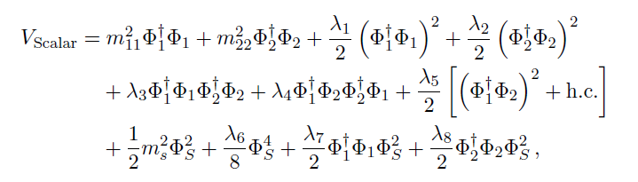

Scalar potential and spontaneous symmetry breaking
With the two Z₂ symmetries chosen, the scalar potential becomes
with all parameters taken, without loss of generality, real.
The most general neutral vacuum has vevs v₁, v₂ for the doublets and v_{S} for the singlet,
Spontaneous CP breaking is not possible in this model (unless one introduces soft breaking terms), so all these vevs are real.

Slide 9
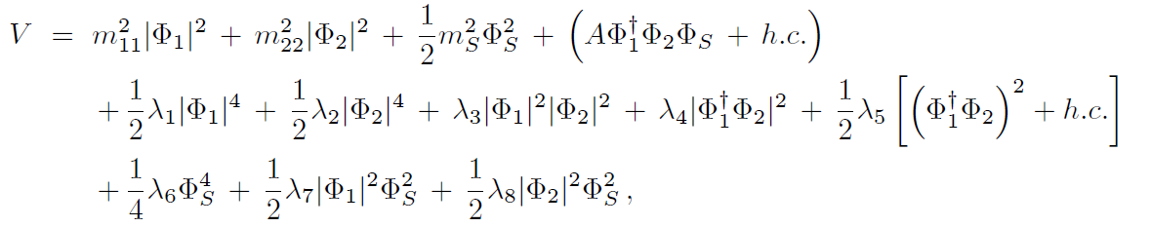
(ASIDE:
If the field content was the same but the discrete symmetry was different,
the scalar potential would become quite different,
where, with the exception of A, all the parameters are REAL.
This model would have the possibility of explicit CP violation and a much different phenomenology.
END OF ASIDE)
CUBIC TERM!
D. Azevedo, P.M. Ferreira, M.M. Muhleitner , S. Patel, R. Santos,
JHEP 1811 (2018) 091

Slide 10
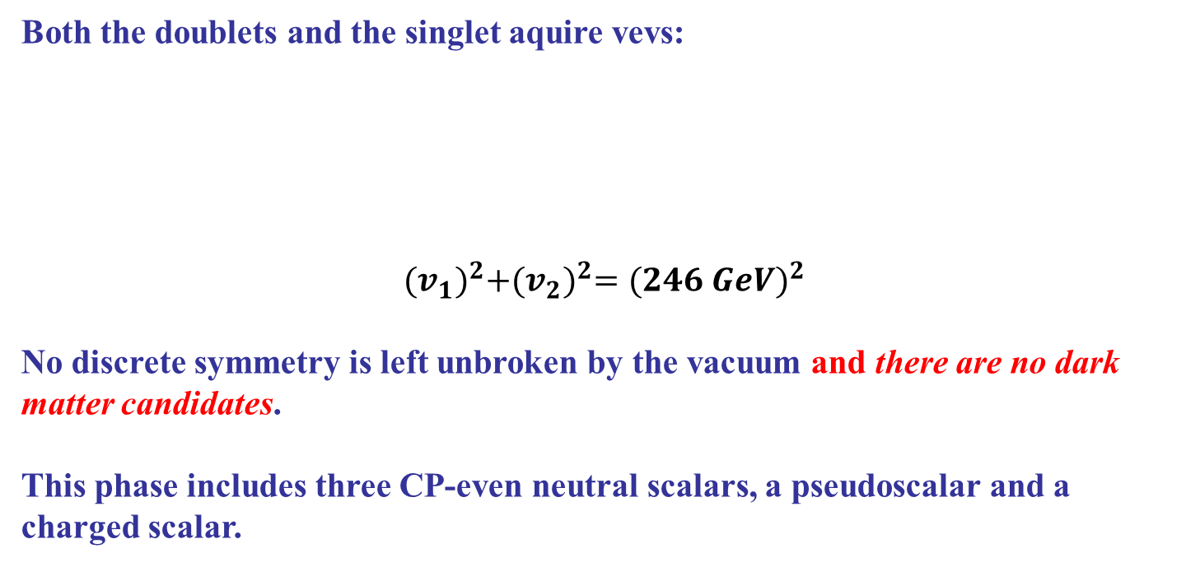

Possible neutral vacua/phases
Depending which vevs are non-zero, there are several possible vacua which preserve or break different symmetries and thus describe different phases of the model, with different phenomenology. In all cases electroweak symmetry breaking occurs.
The Broken Phase (BP)

Slide 11
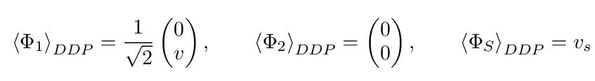
The Dark Doublet Phase (DDP)
Only one of the doublets, and the singlet, aquire vevs:
v = 246 GeV
The discrete symmetry Z₂⁽¹⁾ is left unbroken by the vacuum, and the lightest neutral scalar from the second doublet will be a dark matter candidates.
This phase is the equivalent, within the N2HDM, of the Inert Doublet model, but it has a larger parameter space and is not as constrained by current Dark Matter searches.
The scalar spectrum includes four “dark” scalars which do not couple to fermions (two neutral scalars, a charged one); the singlet neutral field mixes with the neutral component of the first doublet and yields two CP-even scalars.

Slide 12
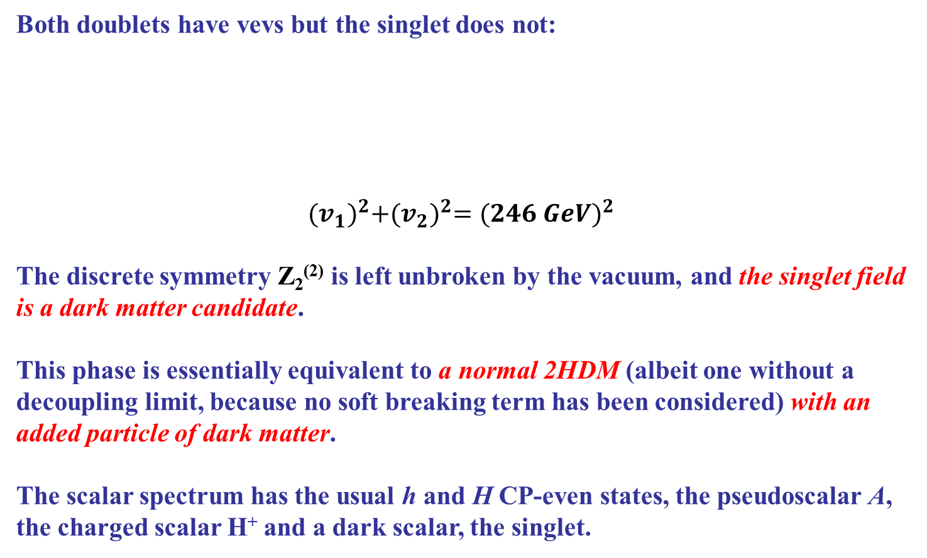
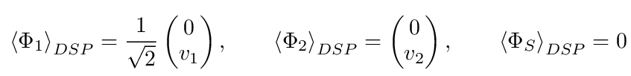
The Dark Singlet Phase (DSP)

Slide 13

The Fully Dark Phase (FDP)
Only one of the doublets has a vev:
v = 246 GeV
Both discrete symmetries are preserved by the vacuum, and we can have two stable, dark, neutral scalars. This phase has a single observable scalar, the SM-like Higgs boson, the remainder scalars – neutral and charged – being “dark” and not interacting with fermions. The preservation of two separate quantum numbers means that there is the possibility of two scalars being stable.
The Yukawa Lagrangian
In all phases, the Yukawa lagrangian considered is the analogous of a Type-I 2HDM – only one of the doublets couples to all fermions:

Slide 14
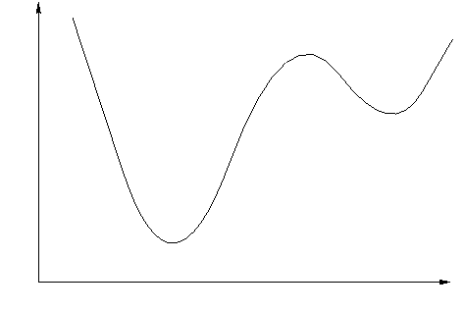
Stability of neutral vacua
We therefore have different possible vacua, and unlike the 2HDM case, in the N2HDM minima which break different symmetries can coexist.
Therefore it is theoretically possible that, for some selection of parameters, a minimum with correct electroweak symmetry breaking is NOT the global minimum of the theory.
Tunelling to a deeper, unacceptable minimum becomes therefore possible – and unlike the SM case, this would already occur at tree-level....
“Our” local minimum -
Global minimum – DIFFERENT EWSB

Slide 15
We therefore have different possible vacua, and unlike the 2HDM case, in the N2HDM minima which break different symmetries can coexist.
Therefore it is theoretically possible that, for some selection of parameters, a minimum with correct electroweak symmetry breaking is NOT the global minimum of the theory.
Tunelling to a deeper, unacceptable minimum becomes therefore possible – and unlike the SM case, this would already occur at tree-level....
It is possible to use a bilinear formalism to obtain analytic expressions for the differences in depth of the potential at two stationary points of different natures – this allows one to draw onclusions about the stability, or lack thereof, of certain minima.
This saves considerable time when considering vacuum stability in numerical scans, as we know certain types of minima are absolutely stable.

Slide 16
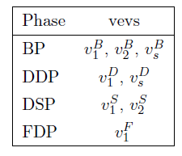
Given that we will be comparing the value of the potential at different stationary points, it becomes necssary to “tag” the vevs of the doublets and singlet, which will have different values at different extrema:
Likewise, we will encounter scalar masses evaluated at different phases, which we also “tag” as: “B” for the Broken Phase; “D” for the Dark Doublet Phase; “S” for the Dark Singlet Phase; and “F” for the Fully Dark Phase.

Slide 17


To see an example of the bilinear formalism in action, let us assume that a Broken Phase (all fields having vevs) stationary point coexists with a Dark Doublet Phase (one doublet has no vev, other doublet and singlet do) extremum. It can be shown that the difference of the potential at both extrema is given by
Notice how the difference of values of the potential is proportional to the square of a Broken Phase vev, and the squared mass of a scalar in the Dark Doublet Phase.
Therefore, if the Dark Doublet Phase is a minimum, that squared mass will necessarily be positive and we conclude
It may also be shown that if the DDP is a minimum, the Broken Phase will necessarily be a saddle point, and this expression shows clearly that it lies above the DDP minimum.

Slide 18
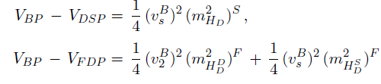
We can perform similar comparisons between the Broken, Dark Singlet and Fully Dark Phases, and we obtain
Similar conclusions apply: whenever there is a DSP or FDP minimum, any Broken Phase extremum that might occur lie ABOVE them. It can also be shown that it would be a saddle point.
But on the other hand, this analysis also shows that if the broken phase is a minimum, it is deeper than any other possible neutral extremum in the model – IT WOULD BE THE GLOBAL MINIMUM OF THE THEORY.

Slide 19
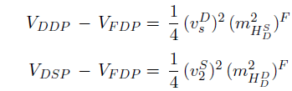
Similar conclusions hold for the Fully Dark Phase: if it is a minimum, it will be the global minimum of the theory. We have already compared the FDP potential with the BP one, and if we do the same for the DDP and DSP cases, we obtain
Note that the difference in values of the potential is always proportional to a
squared scalar mass computed at the Fully Dark Phase – so that, if the FDP is
a minimum, it will necessarily be deeper than the DSP and DDP extrema.
Stability of a Fully Dark Minimum is therefore guaranteed!*
What about the Dark Doublet and Dark Singlet phases? For these two phases, the situation is different: DDP and DSP minima can coexist, and neither is a priori deeper than the other!
* At least against tunelling to other neutral minima, but the possibility of charge breaking for all these phases also has to be taken into account.

Slide 20

In fact, the bilinear formalism applied to Dark Doublet and Dark Singlet stationary points yields
Notice how the difference in depths of the potential depends on the difference between a combination of vevs and masses computed at each extremum.
Unlike previous expressions, the sign of this potential difference is not fixed when either the DDP or DSP are a minimum.
The phases can in fact coexist in the potential as minima of different depths, and different regions of parameter space will have either of them as the global minimum of the model.
Thus in order to ensure the stability of a DDP or DSP minimum one will have to compute the tunneling time to an eventual deeper vacuum, and verify whether it is larger than the current age of the Universe.

Slide 21
Thus, to summarise:
If a minimum of the Broken Phase exists, it is the global minimum of the model – extrema of all other phases wil lie above it and be saddle points. Conversely, if a minimum of any of the other phases exists, any Broken Phase extremum lies above it and is a saddle point.
Similarly, if the Fully Dark Phase is a minimum it is the global minimum. But if any other phase is a minimum, the FDP is a saddle point necessarily lying above it.
There can be coexisting minima of the Dark Doublet and Dark Singlet phases. Either phase can be the global minimum of the theory, depending on the choice of parameters.
A numerical study of the properties of each of the phases reveals interesting aspects of each of them.

Slide 22
IN ALL NUMERICAL ANALYSES PRESENTED, BASIC CONSTRAINTS WERE TAKEN INTO ACCOUNT VIA THE SCANNERS CODE.
The scalar potential must be BOUNDED FROM BELOW and preserve UNITARITY.
Any phase must reproduce ALL the SM’s experimental results. In particular, they must comply with ELECTROWEAK PRECISION DATA.
Substantial constraints to multiscalar models’ parameter space comes from requiring compliance with B-physics data (the b→ s γ measurements, for instance) and the existence of a scalar with mass equal to 125 GeV and properties very similar to those of the SM (ALIGNMENT LIMIT).
HIGGSBOUNDS and HIGGSSIGNALS were also used to account for all current experimental results for the scalar sector.
Dark Matter constraints, namely, the relic density and direct detection cross sections are calculated using MicrOMEGAs. The relic density is required not to oversaturate the observed relic abundance by more than 2σ and the Xenon1T direct detection bound is imposed.

Slide 23

Is it Possible to Distinguish These Phases Experimentally?
The discovery of a charged Higgs boson through its fermionic decays would immediately exclude the Dark Doublet and the Fully Dark phases, given that in those phases the charged scalar would be one of the “dark” particles, without fermionic interactions. The Fully Broken and Dark Singlet phases would still be allowed, of course.
Likewise, the discovery of three extra neutral scalars in the visible sector would exclude all phases except the broken phase.
Precision measurements of the discovered Higgs boson, however, could also provide hints as to the existence of these phases, and help in distinguishing them.
An obvious starting point in the Higgs diphoton decay, which gets contributions from the charged scalar, whether it is “dark” or “visible”. This could impact the diphoton signal strength measured at LHC,

Slide 24
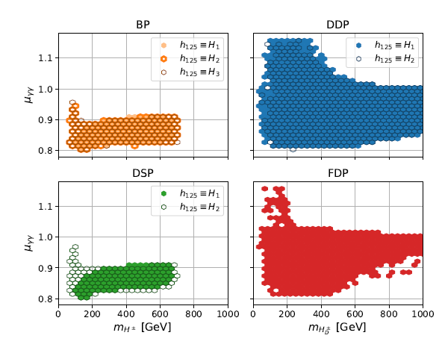
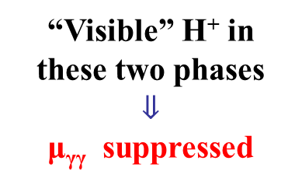
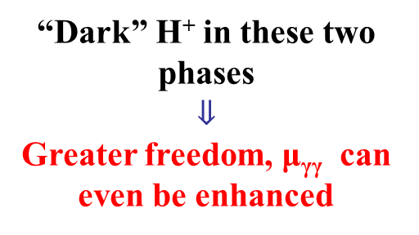
Higgs Diphoton Signal Strength for the Four N2HDM Phases
The existence of several CP-even states opens the possibility that the 125 GeV state is not necessarily the lightest one.
Several possibilities are explored here.

Slide 25
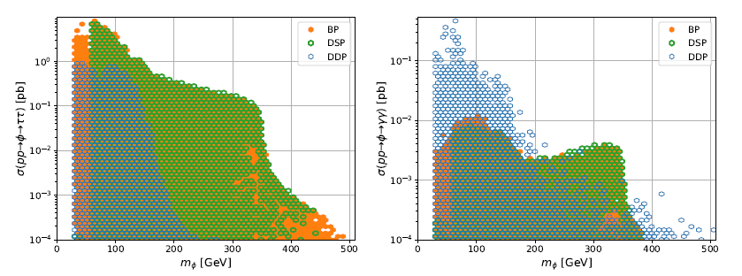
Extra Scalars’ Behaviour in Different Phases
For the phases for which one could have extra visible scalars (not FDP, of course), decays to tau or photon pairs could, for some regions of parameter space, distinguish between several of the phases.
The DDP, for instance, would have enhanced diphoton decays for the extra neutral scalar for masses below 150 GeV, much more than what occurs for the other phases. Di-tau decays, however, would be suppressed for the DDP above that same mass.

Slide 26
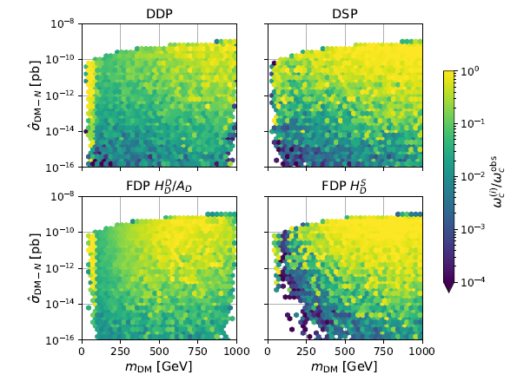
Dark Matter Constraints for all Phases
The Nucleon-Dark Matter direct detection cross section can have values well below 10⁻¹² (the neutrino floor) for all phases, and as such current experimental limits can be easily satisfied, even saturating the relic density bound. Notice how the FDP has contributions from two Dark Matter particles.

Slide 27
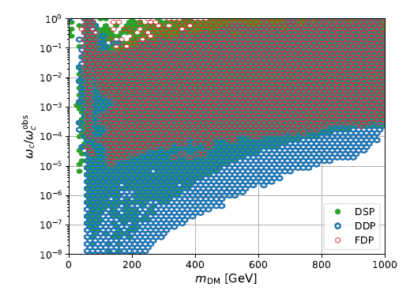
All phases, except for the DDP, have regions of parameter space for which the relic density is saturated – and so Dark matter is fully explained within the N2HDM for that phase – for all values of Dark Matter mass above m_{h}/2.
The DDP has a DM mass region between about 100 and 500 GeV where it is not possible to find parameters such that the relic density is saturated, and therefore and extra DM candidates would be needed. Remember that the DDP is analog of the IDM, and it has been reported that for the Inert doublet Model, the relic density cannot be saturated for DM masses between about 75 and 500 GeV.

Slide 28
CONCLUSIONS (I)
With two discrete symmetries applied, the N2HDM can have several different vacua yielding Dark matter candidates.
An analytical calculation revealed that minima of two of the possible phases would be absolutely stable, two others wouldn’t.
All phases can conform to existing LHC and Dark Matter experimental constraints.
Higgs precision measurements, and new scalars’ properties, could in principle help distinguish between the several phases.

Slide 29
CP IN THE DARK
D. Azevedo, P.M. Ferreira, M.M. Muhleitner , S. Patel, R. Santos,
JHEP 1811 (2018) 091

Slide 30
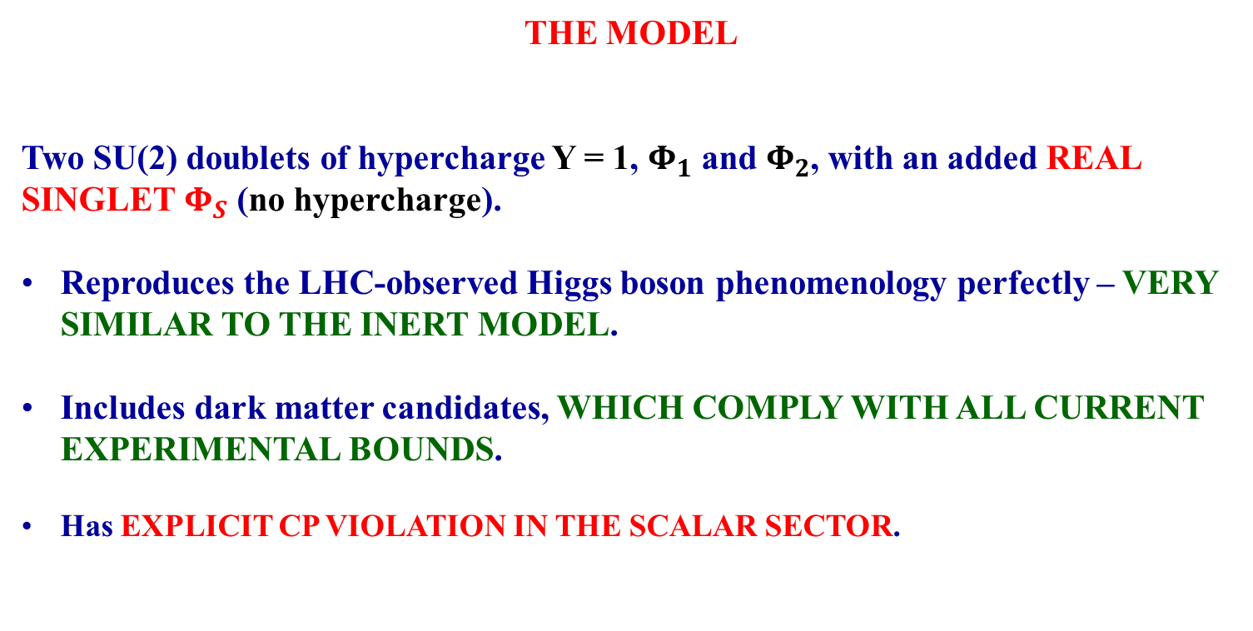
THE MODEL
Two SU(2) doublets of hypercharge Y = 1, $Φ_{1}$ and $Φ_{2}$, with an added REAL SINGLET $Φ_{S}$ (no hypercharge).
Reproduces the LHC-observed Higgs boson phenomenology perfectly – VERY SIMILAR TO THE INERT MODEL.
Includes dark matter candidates, WHICH COMPLY WITH ALL CURRENT EXPERIMENTAL BOUNDS.
Has EXPLICIT CP VIOLATION IN THE SCALAR SECTOR.
HOWEVER, THAT CP VIOLATION IS “CONFINED” TO THE DARK SECTOR.
THE 125 GeV HIGGS WILL BEHAVE LIKE A CP-EVEN SCALAR, WITHOUT SIGNS OF MIXING WITH CP-ODD STATES.
Inspired by A. Cordero-Cid, J. Hernandez-Sanchez, V. Keus, S. F. King, S. Moretti, D. Rojas, and D. Sokolowska, JHEP 12, 014 (2016), 1608.01673.

Slide 31
OUR SCALAR POTENTIAL: we choose to impose a discrete symmetry on the model; the two doublets and the real singlet transform as
Further, we impose a CP symmetry of the form
The scalar potential therefore becomes
where, with the exception of A, all the parameters are REAL.
CUBIC TERM!

Slide 32
Comparison with previous N2HDM
With the two Z₂ symmetries chosen, the scalar potential was
with all parameters taken, without loss of generality, real.
Now:
CUBIC TERM!

Slide 33
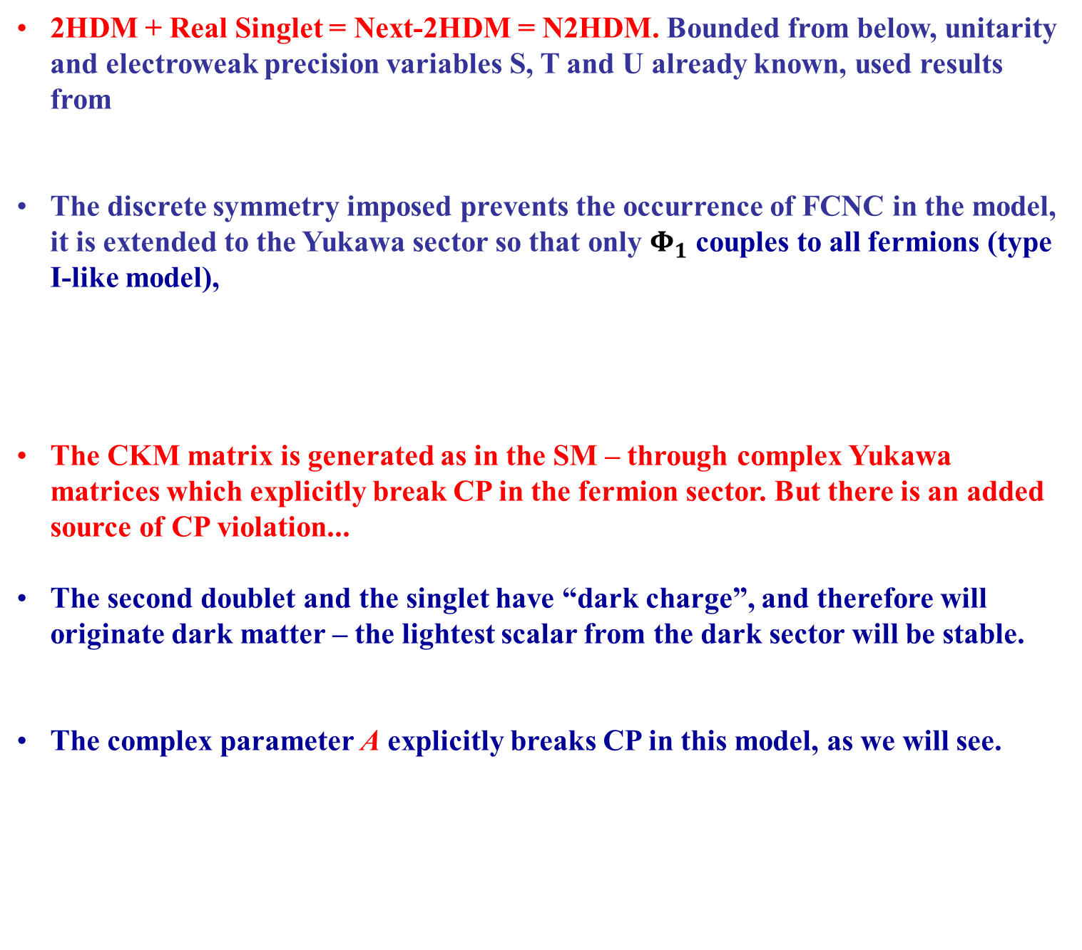
2HDM + Real Singlet = Next-2HDM = N2HDM. Bounded from below, unitarity and electroweak precision variables S, T and U already known, used results from
The discrete symmetry imposed prevents the occurrence of FCNC in the model, it is extended to the Yukawa sector so that only $Φ_{1}$ couples to all fermions (type I-like model),
The CKM matrix is generated as in the SM – through complex Yukawa matrices which explicitly break CP in the fermion sector. But there is an added source of CP violation...
The second doublet and the singlet have “dark charge”, and therefore will originate dark matter – the lightest scalar from the dark sector will be stable.
The complex parameter A explicitly breaks CP in this model, as we will see.

Slide 34




SPONTANEOUS SYMMETRY BREAKING
A vacuum where only the first doublet gains a vev is possible, provided the parameters of the potential obey
with v = 246 GeV. The doublets can be expressed as
with h the 125 GeV scalar, with mass given by
The charged scalar has mass
This is all very IDM-like, but the differences start in the dark neutral scalars...

Slide 35
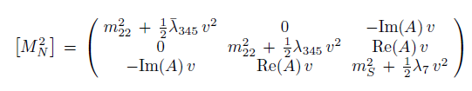

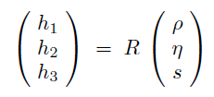
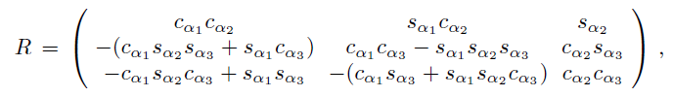
NEUTRAL SCALARS MIXING
The two neutral components of the second doublet mix with the real singlet, yielding a 3×3 mass matrix,
diagonalized by
such that
with
(all angles in the interval –π/2 to π/2, without loss of generality)

Slide 36
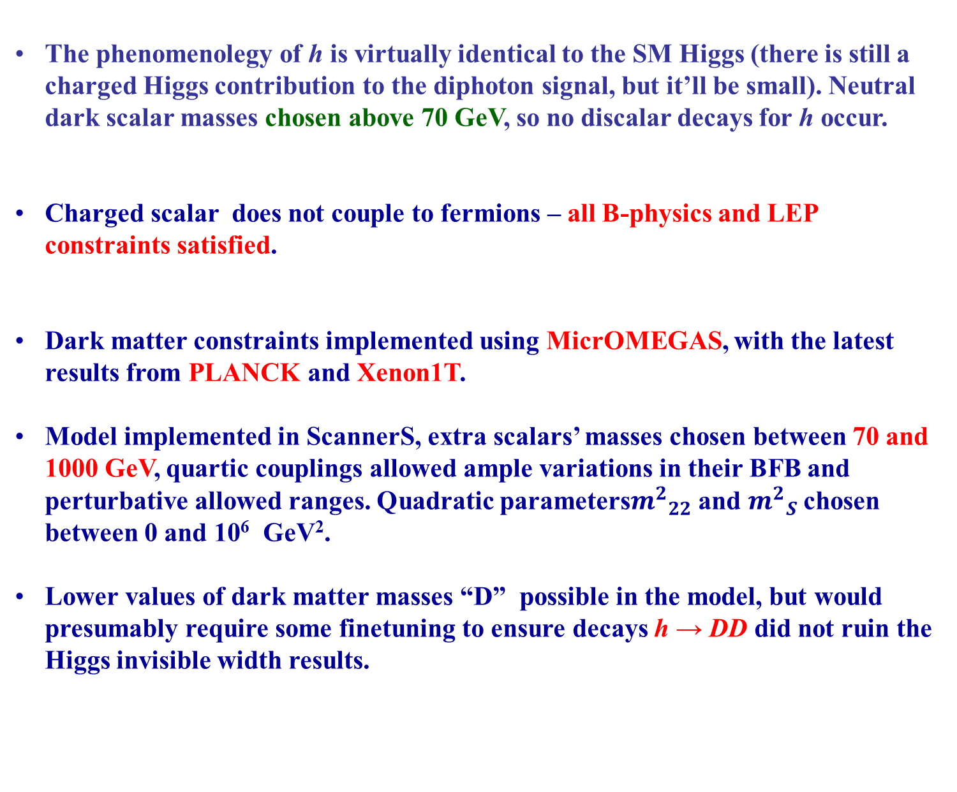
The phenomenolegy of h is virtually identical to the SM Higgs (there is still a charged Higgs contribution to the diphoton signal, but it’ll be small). Neutral dark scalar masses chosen above 70 GeV, so no discalar decays for h occur.
Charged scalar does not couple to fermions – all B-physics and LEP constraints satisfied.
Dark matter constraints implemented using MicrOMEGAS, with the latest results from PLANCK and Xenon1T.
Model implemented in ScannerS, extra scalars’ masses chosen between 70 and 1000 GeV, quartic couplings allowed ample variations in their BFB and perturbative allowed ranges. Quadratic parameters${m^{2}}_{22}$ and ${m^{2}}_{S}$ chosen between 0 and 10⁶ GeV².
Lower values of dark matter masses “D” possible in the model, but would presumably require some finetuning to ensure decays h → DD did not ruin the Higgs invisible width results.

Slide 37
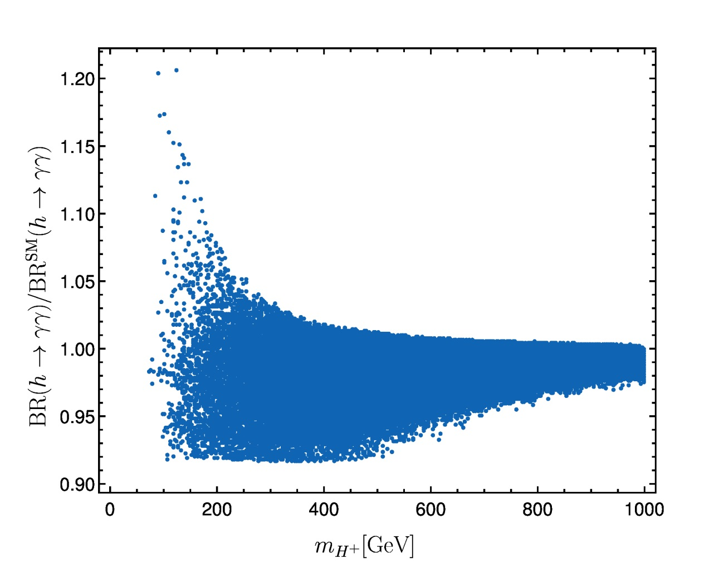
DIPHOTON WIDTH FOR h
Easily reproduces the SM expected value, charged Higgs contributions at most yield a ~20% deviation.

Slide 38
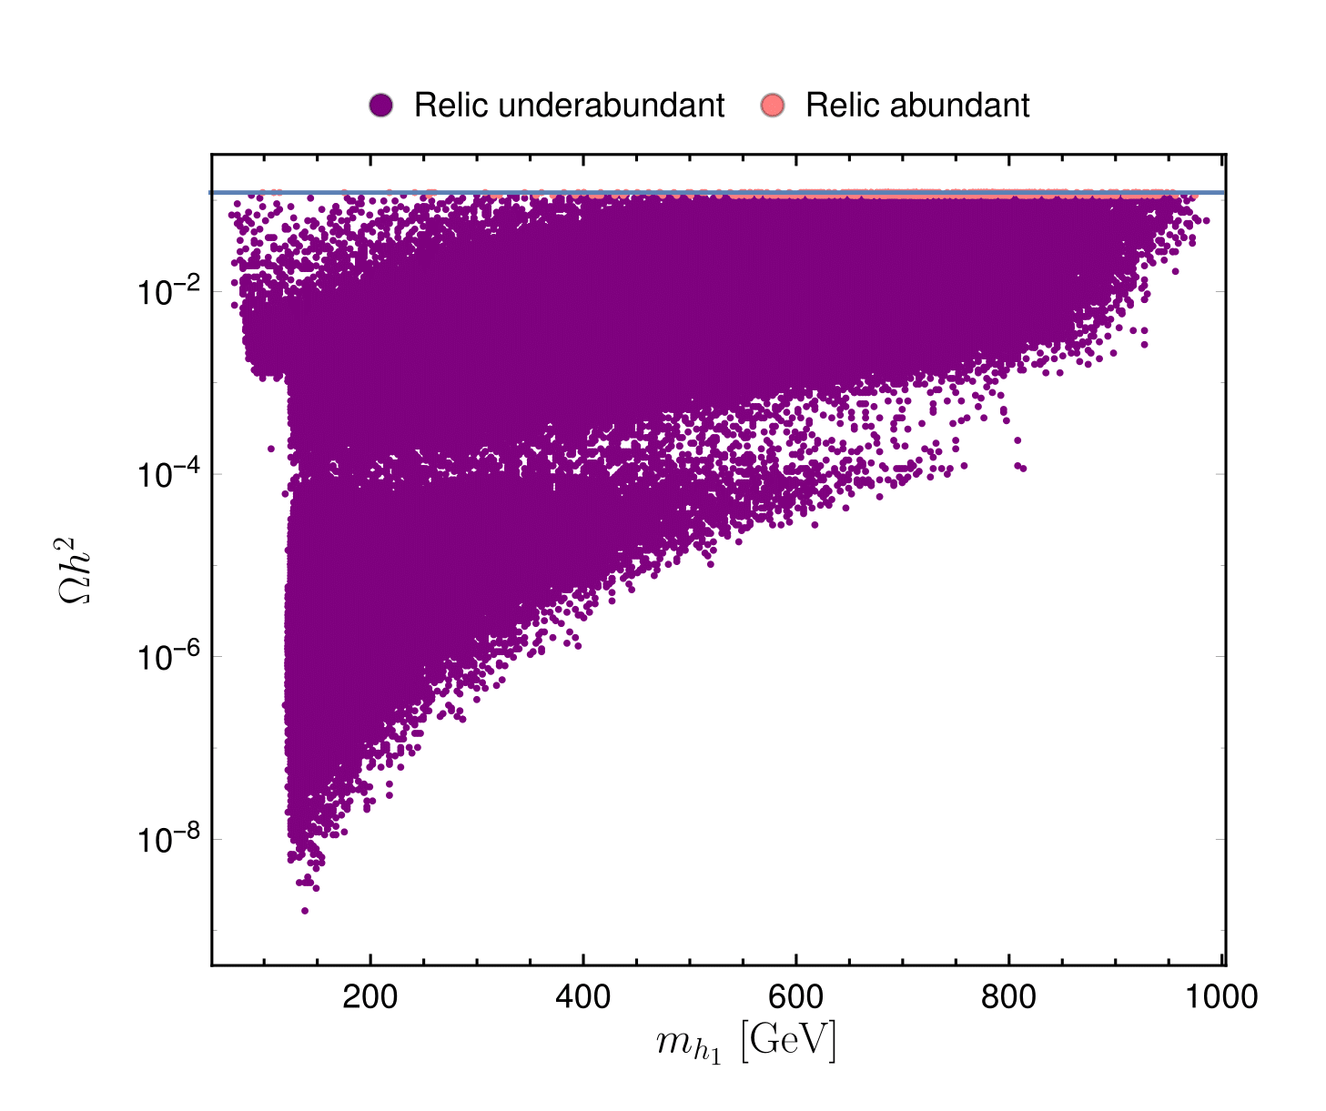
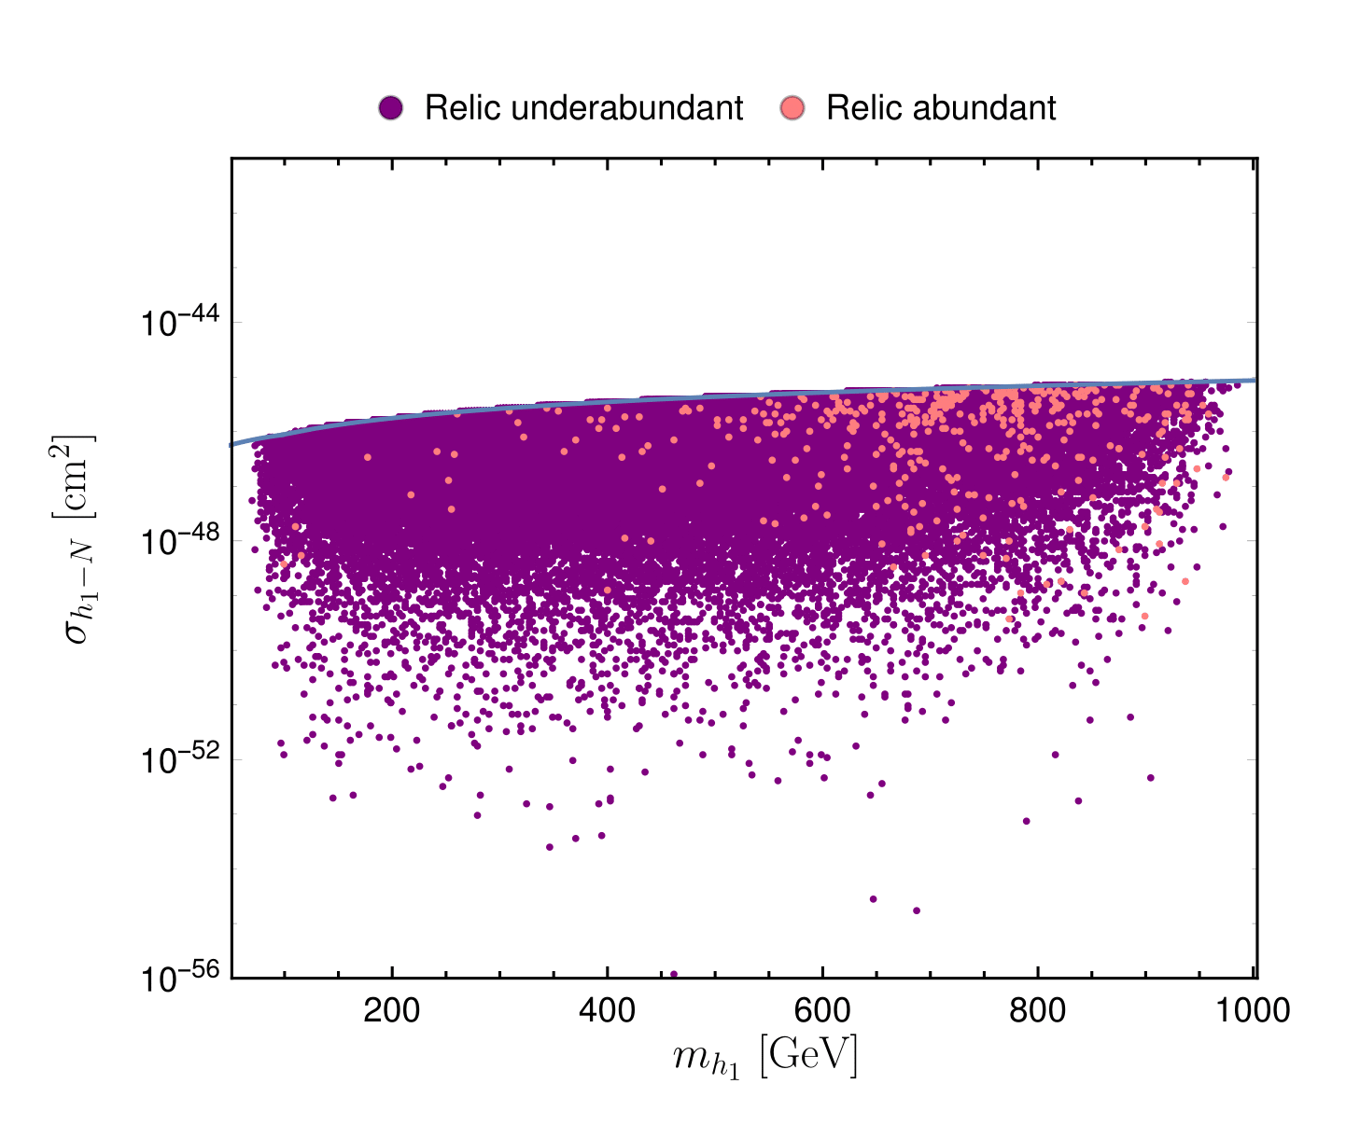
DARK MATTER OBSERVABLES
Both the relic density (LEFT) and direct detection limits (RIGHT) easily accounted for in the parameter space scanned. Grey line represents the latest XENON1T results.

Slide 39
CP VIOLATION IN THE SCALAR SECTOR
CP violation occurs in the model, due to the mixing between two neutral, real, components and the imaginary neutral one. This leads to kinetic terms of the form
Which in turn implies that
are possible – thus, the h_{i} particles cannot have definite CP quantum numbers.
Observation of all vertices of the Z into two scalars would thus in principle be a confirmation CP violation in the scalar sector of the model. But since some of those scalars are dark matter this complicates things – eventual occurrence of these decays yields final states identical to those of other dark matter models, regardless of the CP properties of the particles. Thus this could not probe the CP nature of the model.

Slide 40
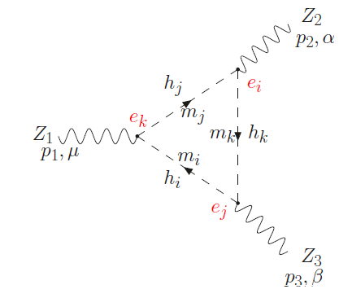

CP VIOLATION IN THE SCALAR SECTOR
A clear sign of CP violation in the model is the fact that CPV form factors in vertices such as ZZZ and ZWW are NON-ZERO due to neutral scalar mixing. For instance, there is a single diagram contributing to the CPV form factor in ZZZ, namely
with the CPV form factor defined by

Slide 41

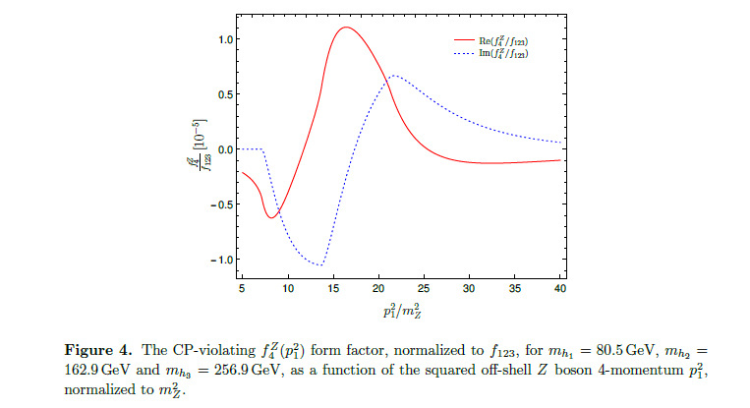

CP VIOLATION IN THE SCALAR SECTOR
The CPV form factor is given in terms of LoopTools functions by (assuming two on-shell Z’s, p₁ the four-momentum of the off-shell third Z)
For our model, in terms of elements of the rotation matrix R,
Thus, notice that without the mixing between real and imaginary
scalar components, one would obtain f₄ = 0 (no CPV).

Slide 42
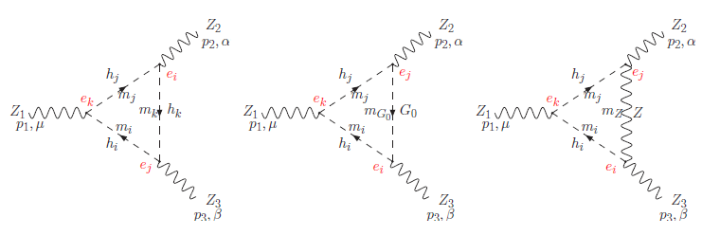
COMPARISON WITH THE C2HDM
This same observable occurs, as a sign of CPV, in the Complex 2HDM (C2HDM), but there three diagrams contribute to it:
In our model the two latter diagrams vanish due to the discrete symmetry imposed. This simplifies considerably the expression for f₄, but typically also reduces the magnitude of the form factor, compared to that obtained in the C2HDM.

Slide 43
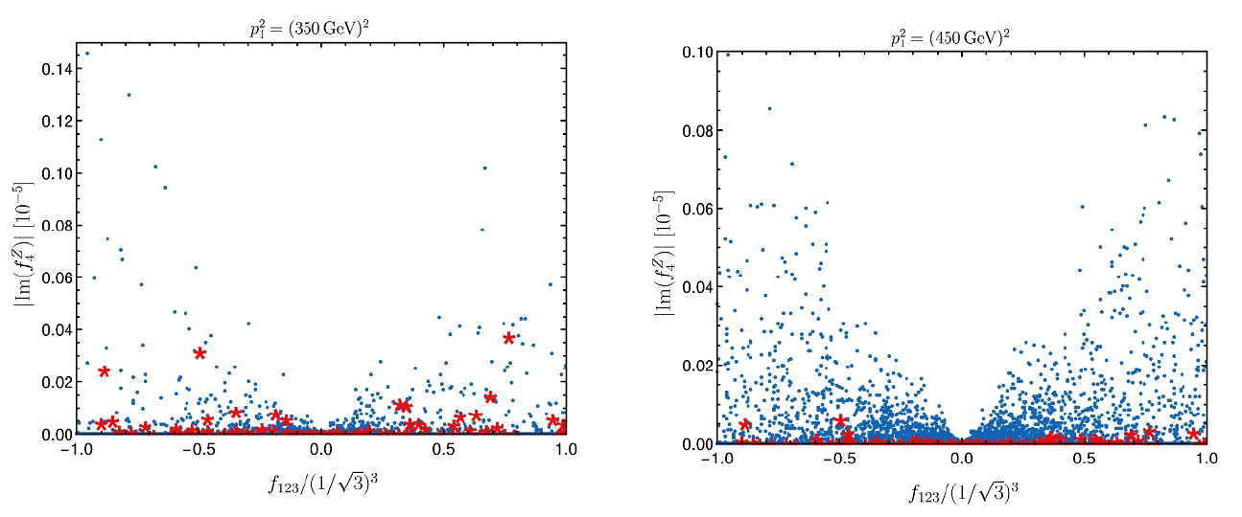

CP VIOLATION
Momentum dependence on the off-shell Z does influence the magnitude
of f₄,
Maximum value allowed for f₁₂₃ is $(1/{\sqrt{3})^{3}}$, red points correspond to all neutral scalars having masses below 200 GeV.
For comparison, in the C2HDM, due to the alignment limit, smaller maximum values of f₁₂₃ would be expected.

Slide 44
CP VIOLATION – EXPLICIT OR SPONTANEOUS?
Non-zero values for f₄ implies, without a doubt, that CP violation occurs. But what type?
The presence of a complex phase in the potential suggests EXPLICIT CP BREAKING, but that is not mandatory. The potential violates the following CP symmetry,
(notice that the singlet does not transform)
However, conceivably another CP symmetry could occur for which the potential is invariant...
Notice, though, that the vacuum of the model PRESERVES the above CP transformation, and still there is CP violation – thus the CP violation is NOT SPONTANEOUS, but rather, as expected, EXPLICIT.

Slide 45
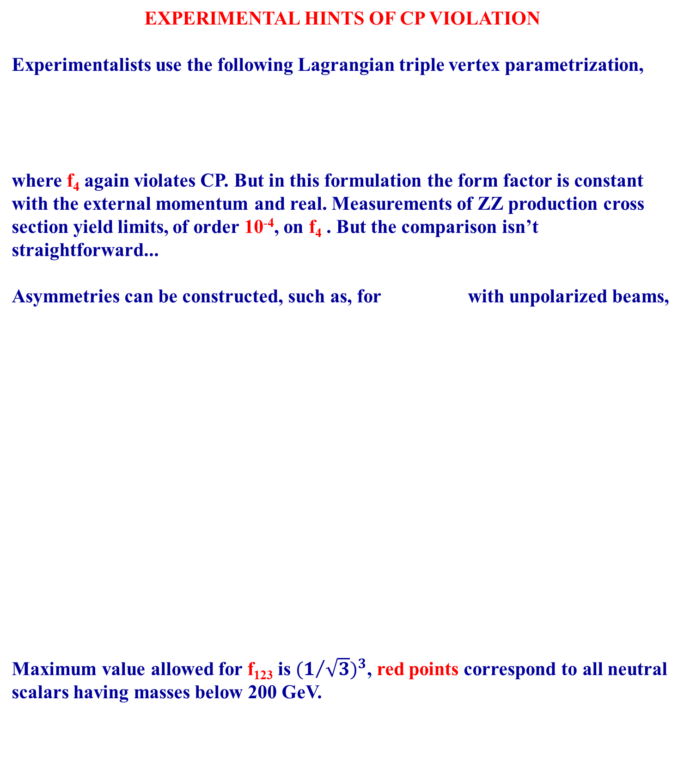
EXPERIMENTAL HINTS OF CP VIOLATION
Experimentalists use the following Lagrangian triple vertex parametrization,
where f₄ again violates CP. But in this formulation the form factor is constant with the external momentum and real. Measurements of ZZ production cross section yield limits, of order 10⁻⁴, on f₄ . But the comparison isn’t straightforward...
Asymmetries can be constructed, such as, for with unpolarized beams,
Maximum value allowed for f₁₂₃ is $(1/{\sqrt{3})^{3}}$, red points correspond to all neutral scalars having masses below 200 GeV.

Slide 46
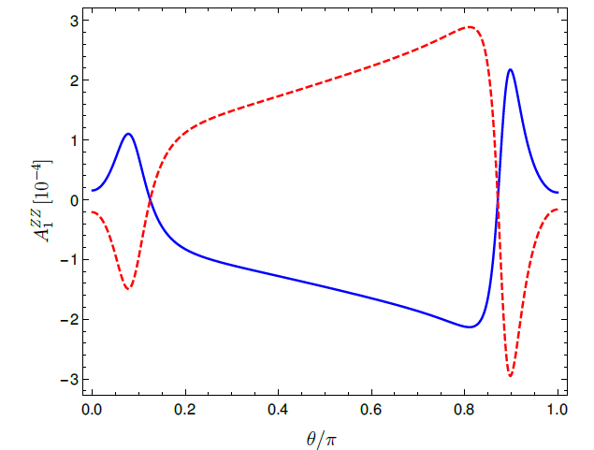
EXPERIMENTAL HINTS OF CP VIOLATION
Too small to measure...?
Other asymmetries, involving other vertices and other form factors, are also possible, but the magnitudes obtained are similar.

Slide 47

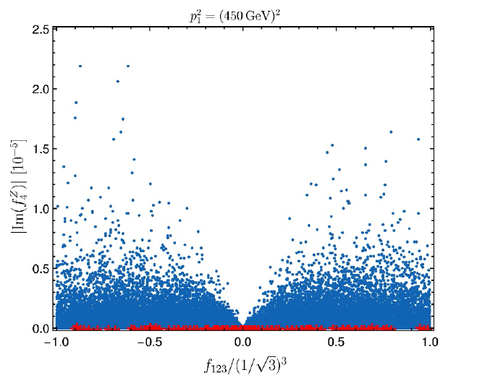
EXPERIMENTAL HINTS OF CP VIOLATION – THE ZW⁺W⁻ VERTEX
Discrete symmetry eliminates all but one diagram contributing to the CPV form factor in the ZWW vertex.
Simple expression:
Notice this form factor now involves the charged mass as well.
Can yield larger values of the CPV form factor than the corresponding ZZZ quantity, by a factor of ten. But still seems to be too small an effect to yet measure...

Slide 48
CONCLUSIONS (II)
A 2HDM complemented with a real singlet and a discrete symmetry yields a model with explicit CPV in the scalar sector and dark matter.
Current dark matter bounds are easily satisfied by the model, without the need for any fine tuning.
CPV occurs exclusively in the “dark” sector – the LHC-observed scalar would behave (up to small loop effects) as a true scalar.
CPV manifests itself in the observable sector in anomalous triple gauge couplings, in the ZZZ or ZWW vertices, among others.
Current experimental bounds on the CPV form factors are orders of magnitude above the values predicted for our model, but the comparison between theory and what the experimentalists set bounds on does not seem trivial...

