Slide 1
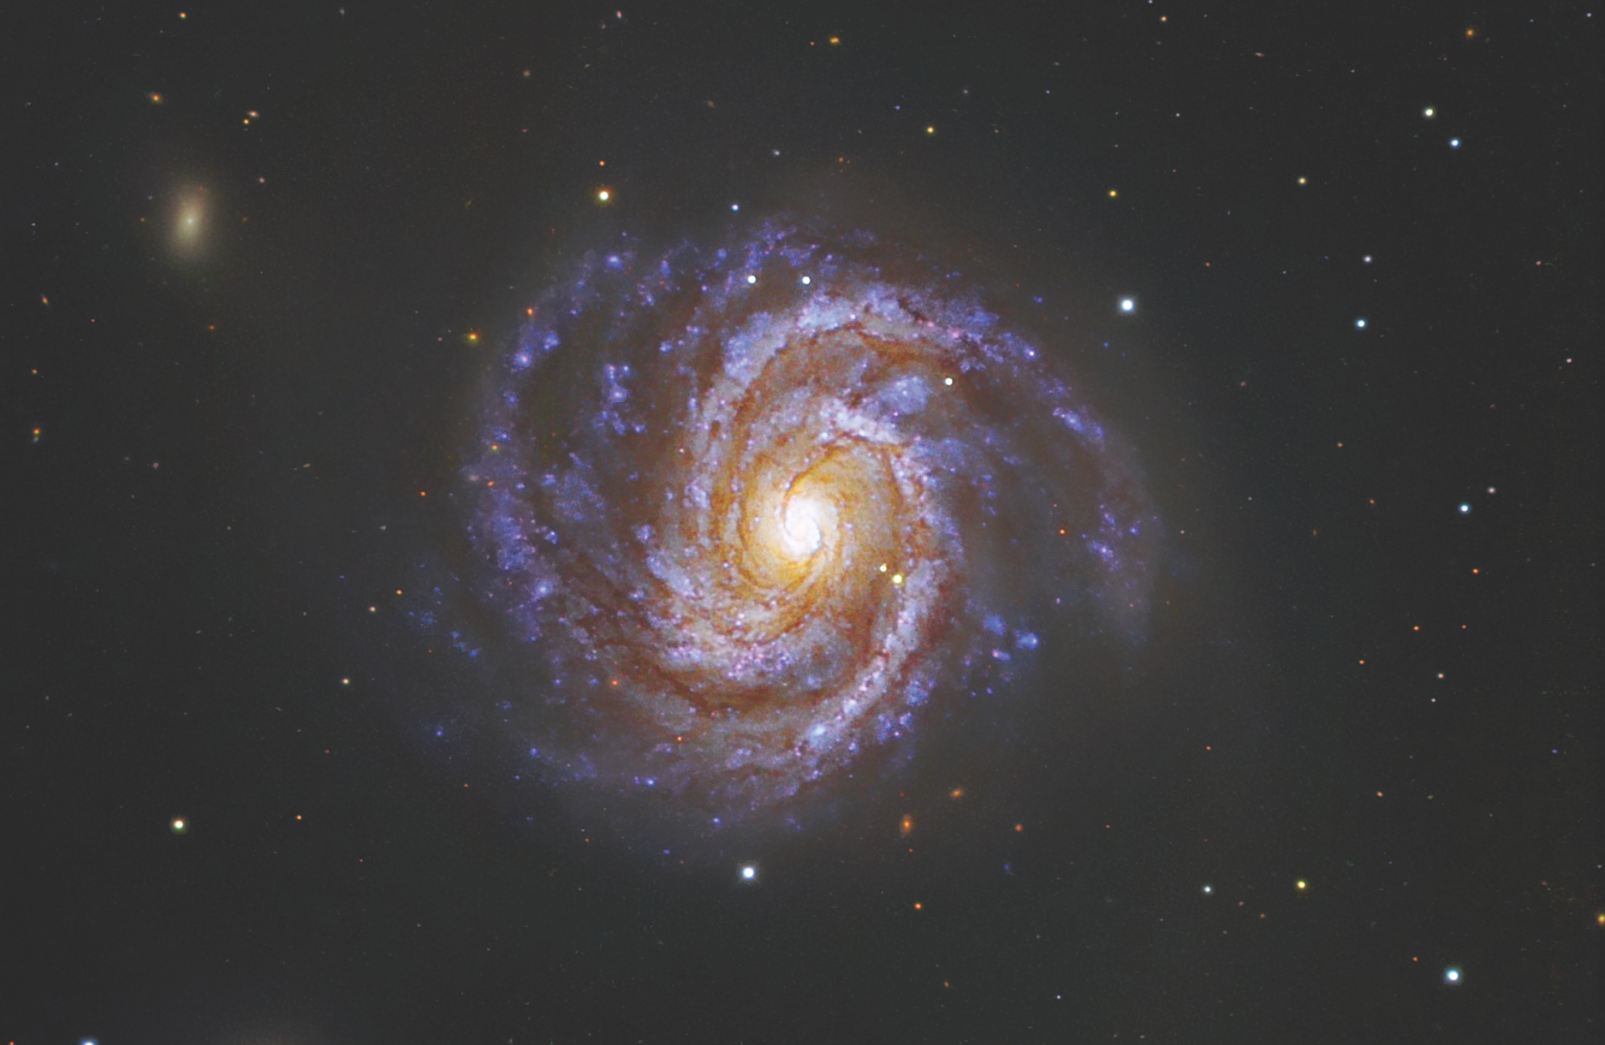

October 2021
Studies of Dark Showers for Present and Future Colliders
by Nicoline Hemme
Supervisor: Caterina Doglioni
Image Source: ESO/IDA/Danish | M100 & SN 2006X

Slide 2
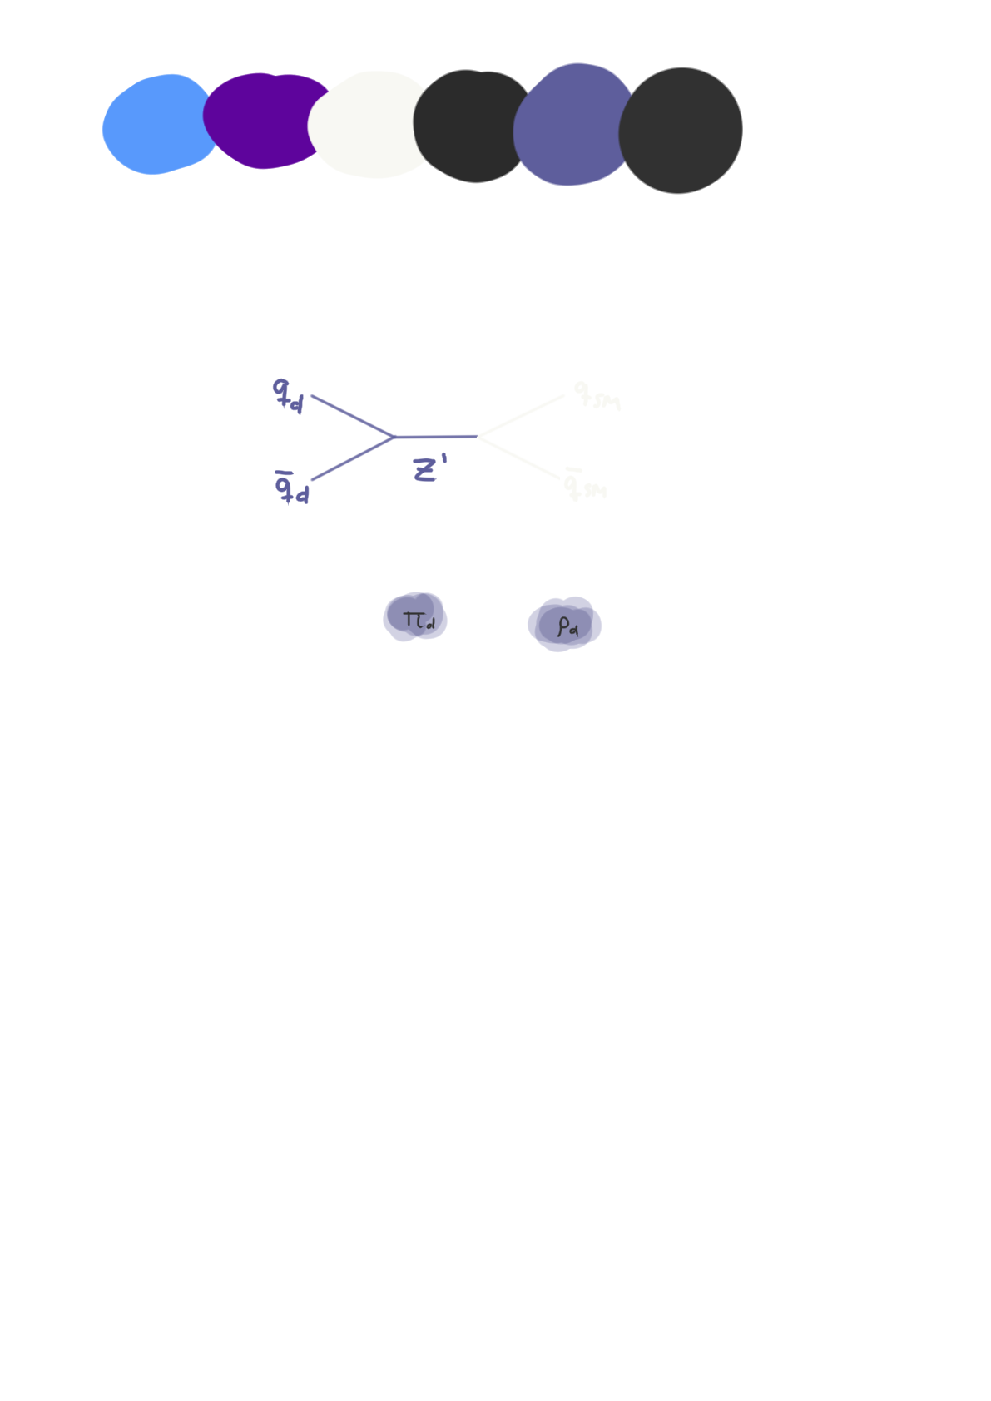
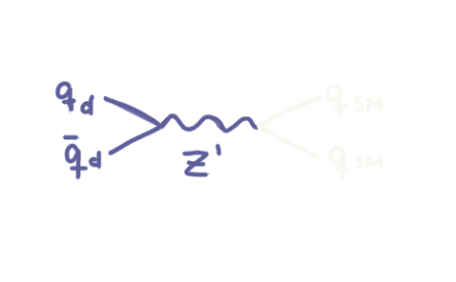
The Dark Sector
October 2021 Nicoline Hemme Lund University
Dark Sector Models Dark Showers
A sector consisting of several dark particles that
  can interact with each other through some force
  only interacts with the SM through some portal(s)
Our dark sector class of models in focus (one out of many):
  Strongly interacting QCD-like theory → dark quarks and hadrons
  Possibility of a QCD-like parton shower within the dark sector → dark showers and dark jets
  Some dark hadron may decay into SM particles
  through a vector boson portal (Z’)

Slide 3
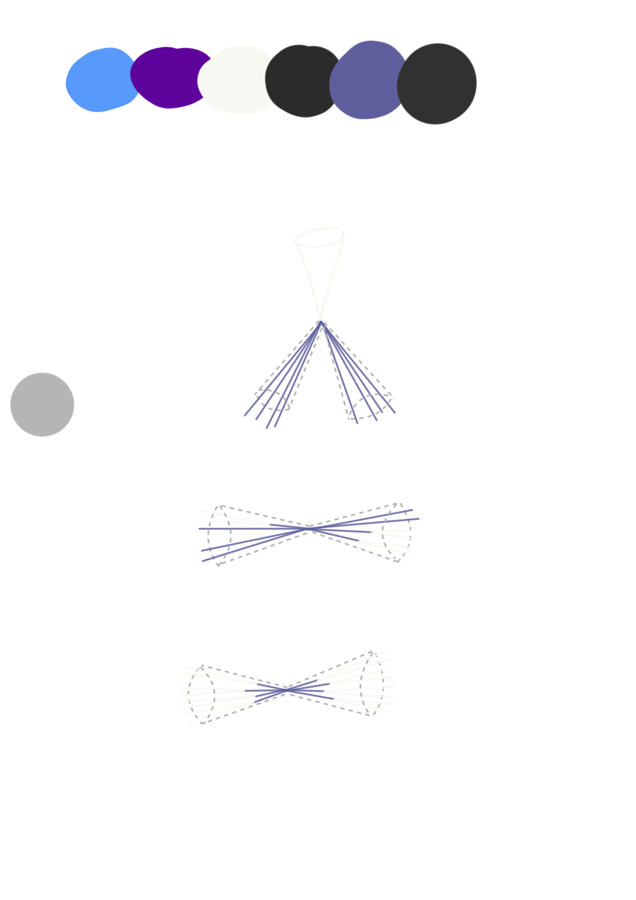




The Dark Sector
October 2021 Nicoline Hemme Lund University
Dark Sector Models Dark Showers
3 types of dark showers that we’re interested in
  Invisible shower
  → No dark hadrons decay to the SM
  Visible shower
  → All dark hadrons decay to the SM
  Semi-visible shower
  → Some dark hadrons decay to the SM
Described by $r_{inv}=\left\langle \frac{\# of stable dark hadrons}{\# of dark hadrons}\right\rangle$
$$r_{inv}=1$$
$$r_{inv}=0$$
$$0<r_{inv}<1$$

Slide 4
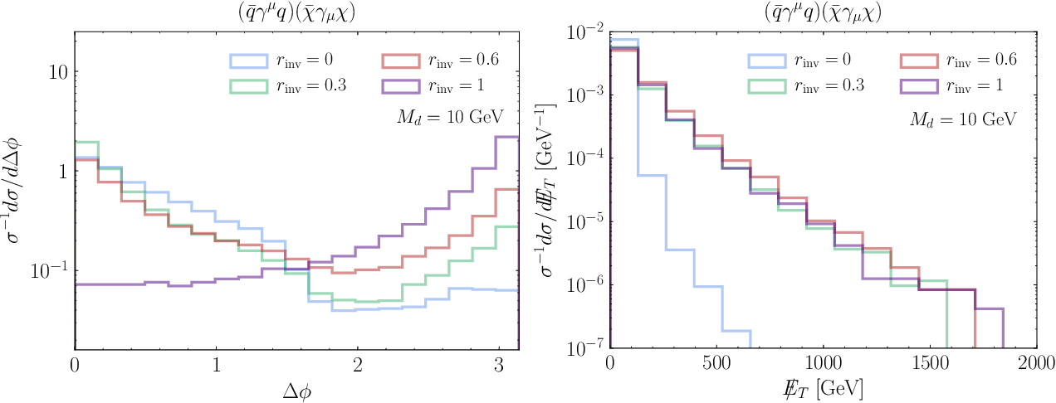

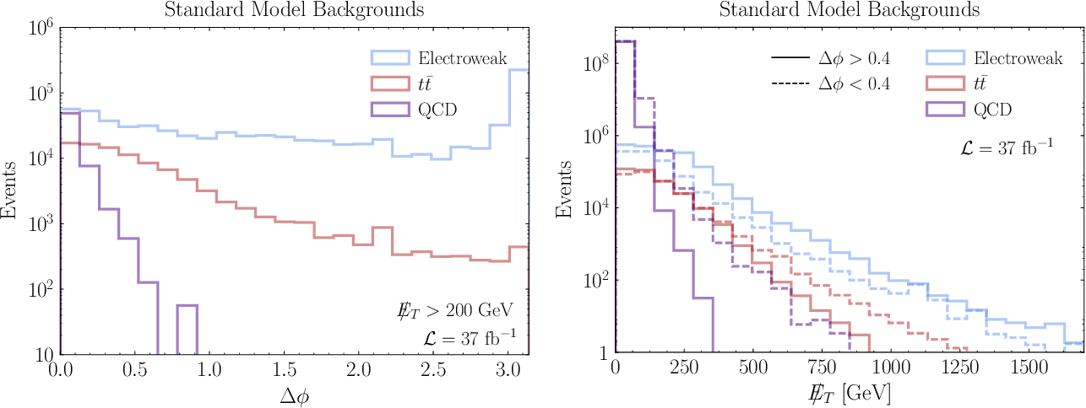


Searching for Dark Showers
October 2021 Nicoline Hemme Lund University
MET Strategies
Resonance Searches
Benchmark Models
How can we see the invisible?
Missing Transverse Energy
Standard searches use a pre-selection cut $∆φ>$ 0.4 – why and can we get around it?
Use $∆φ<$ 0.4 and MET $>$ 800 GeV
$$r_{inv}=1$$
$$0<r_{inv}<1$$
Reference: “LHC Searches for Dark Sector Showers” by T. Cohen, M. Lisanti, H. K. Lou and S. Mishra-Sharma (2017)
Reference: “LHC Searches for Dark Sector Showers” by T. Cohen, M. Lisanti, H. K. Lou and S. Mishra-Sharma (2017)

Slide 5
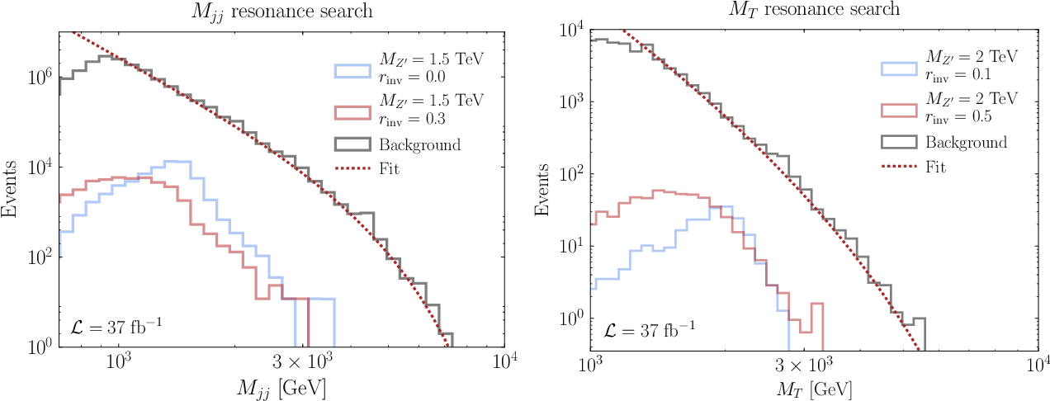
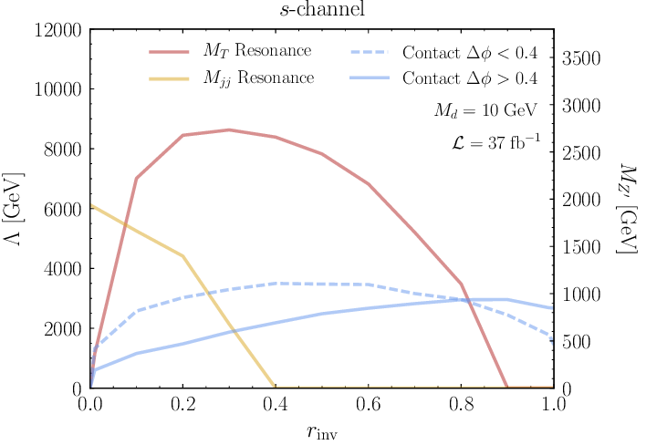
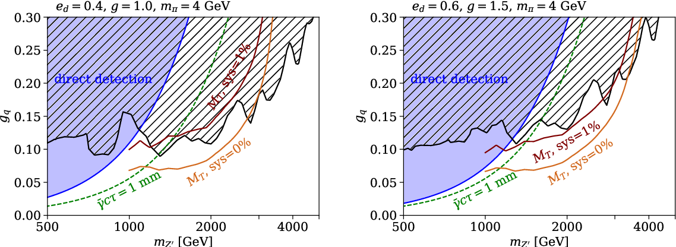

Searching for Dark Showers
October 2021 Nicoline Hemme Lund University
MET Strategies
Resonance Searches
Benchmark Models
Resonance search – maybe we can find a new Z’ boson?
Effective $r_{inv}$ fluctuates
  → washes out peak
  → use transverse mass M_{T}
Reference: “LHC Searches for Dark Sector Showers” by T. Cohen, M. Lisanti, H. K. Lou and S. Mishra-Sharma (2017)
Reference: “LHC Searches for Dark Sector Showers” by T. Cohen, M. Lisanti, H. K. Lou and S. Mishra-Sharma (2017)
Reference: “Strongly interacting dark sectors in the early Universe and at the LHC through a simplified portal” by E. Bernreuther, F. Kahlhoefer, M. Krämer and P. Tunney (2020)

Slide 6
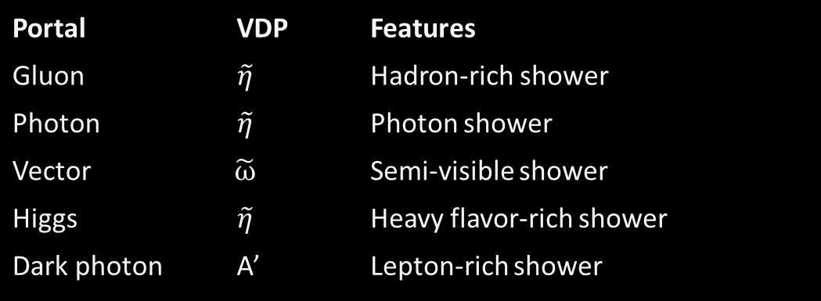
Searching for Dark Showers
October 2021 Nicoline Hemme Lund University
MET Strategies
Resonance Searches
Benchmark Models
Representativity of simplified models can be questioned
Consider benchmark models instead (2021 paper by S. Knapen, J. Shelton and D. Xu)
  Minimal theory priors
  Inclusive signature space
Portal | VDP | Features
Gluon | $$\tilde{η}$$ | Hadron-rich shower
Photon | $$\tilde{η}$$ | Photon shower
Vector | $$\tilde{ω}$$ | Semi-visible shower
Higgs | $$\tilde{η}$$ | Heavy flavor-rich shower
Dark photon | A’ | Lepton-rich shower

Slide 7

This Project
October 2021 Nicoline Hemme Lund University
Part of Snowmass The Project Goals
Snowmass2021 Letter Of Interest “Studies of dark shower benchmarks”
(C. Doglioni, K. F. Di Petrillo, S. Kulkarni, et al., 2021) excerpts:
  Understand the kinematics of the dark jets and associated particles in the different models and signatures
  Contribute to the discussion of dark shower benchmark models for current and future colliders
  Demonstrate reach and shortcomings of existing searches
Snowmass – a particle physics community effort
“Snowmass will define the most important questions for the field of particle physics and identify promising opportunities to address them” (source: https://snowmass21.org/start)

Slide 8
This Project
October 2021 Nicoline Hemme Lund University
Part of Snowmass The Project Goals
Contribute to Snowmass efforts and goals including a Snowmass whitepaper (March 15th 2022)
Explore dark shower models and their signatures
Use pre-existing measurements to check for compatibility with the dark shower model signatures and possibly constrain dark shower models (using Contur)

Slide 9
October 2021
Thank you for your time!
Contact details
Nicoline Hemme – nicolinehemme@gmail.com
Caterina Doglioni – caterina.doglioni@cern.ch

