Slide 1


Toward the End-to-end Optimization of Experimental Design
Science coffee seminar, LUND
November 2, 2021
Tommaso Dorigo
INFN, Sezione di Padova

Slide 2
Warm-ups
1 - AI history in five slides
2 – What is Deep Learning ?
3 – DL for HEP
NB: slides with an * in the title will be skipped unless there are questions

Slide 3
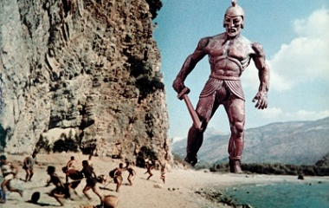
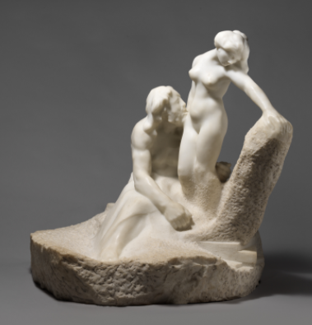
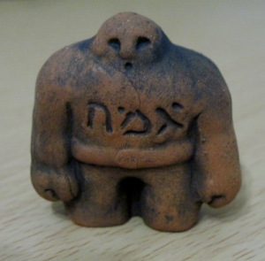
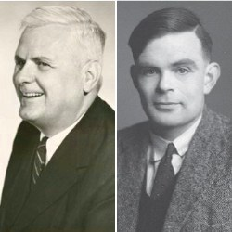
A Five-Slide History of AI : 1 – the Origins
The idea of artificial intelligence in ancient history is only found connected with that of creating life from unanimated matter:
  Talos, an automated guardian of Crete
  Galatea, a statue made by king and sculptor Pygmalion
  The Golem, from Jewish folklore
A different path emerged much later, with the idea of automata and real examples built by craftsmen
A significant development of the underpinnings of AI was produced by SciFi writers in the late XIX and early XX centuries
The study of mathematical logic provided even more concrete bases, with a demonstration that any form of mathematical reasoning could be mechanized [Church 1936; Turing 1936]

Slide 4
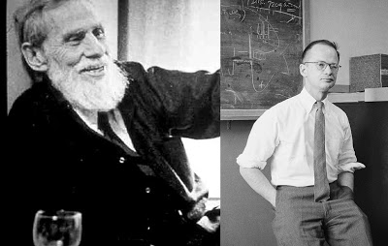
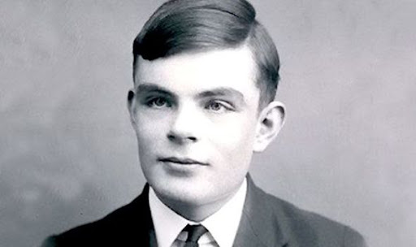
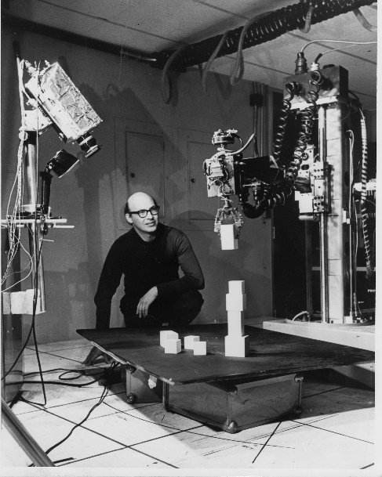
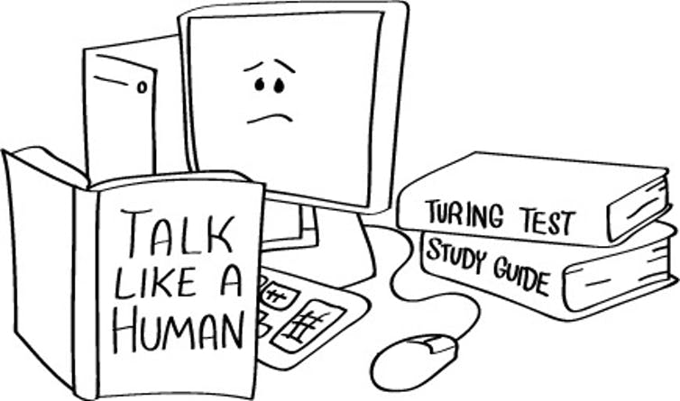
AI History: 2 – Before the Birth
Important milestones toward a recognition of the possibility of artificial thinking:
In 1943 Walter Pitts and Warren McCullock showed how artificial neurons could be arranged in networks to perform simple logic [Pitts 1943](the basic unit term «psychon» never caught up)
In 1950 Turing laid down the bases to discuss about AI, proposing the Turing test («imitation game») to express how intelligent thinking could be defined [Turing 1950]
Marvin Minsky took inspiration from Pitts and McCullock to build the first neural network in 1951

Slide 5
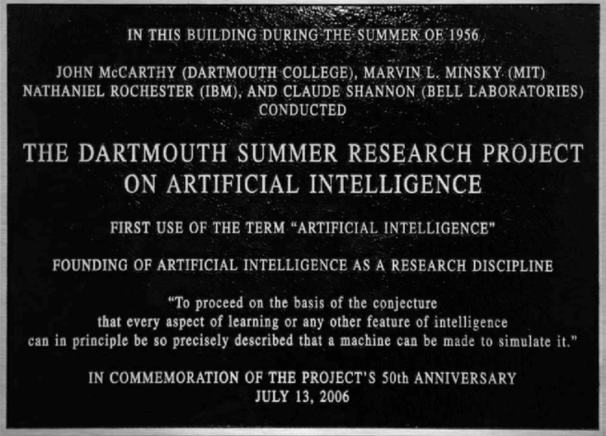
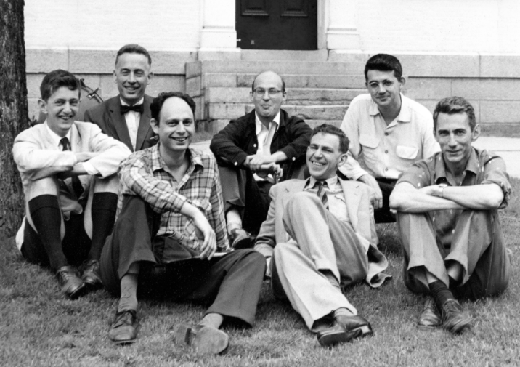
AI History: 3 – The Modern Origins
In 1956 a landmark workshop was organized in Dartmouth by Minsky and John McCarthy. At the workshop were laid the bases of fundamental research in artificial intelligence –a name coined there
The paradigm that was born in Dartmouth was that “every aspect of learning or any other feature of intelligence can be so precisely described that a machine can be made to simulate it”
Simulation!
- A sham object: counterfeit [Merriam-Webster]
The action of pretending: deception [Oxford Languages]
The production of a computer model of something [OL]

Slide 6
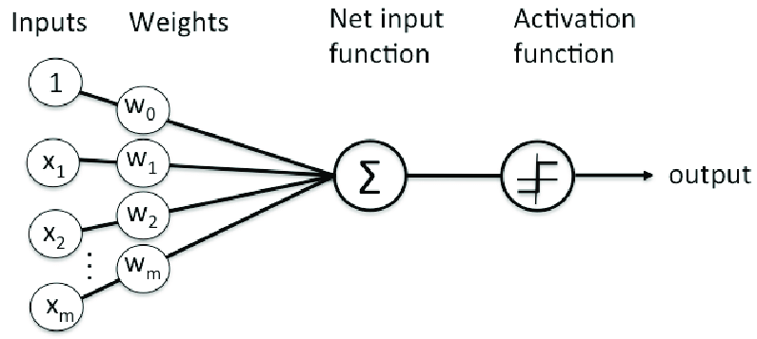
AI History: 4 – Summers …
Following Dartmouth, AI received large funding and ideas thrived. New applications were found and problems solved; enthusiasm reigned:
1958: “Within ten years a digital computer will be the world's chess champion; […] within ten years a digital computer will discover and prove an important new mathematical theorem.” [Simon 1958]
1967: “Within a generation ... the problem of creating 'artificial intelligence' will substantially be solved.” [Minsky 1967]
Frank Rosenblatt invented in 1958 the perceptron, a single-layer NN element [Rosenblatt 1958], and predicted this would bring a breakthrough: “a perceptron may eventually be able to learn, make decisions, and translate languages”.

Slide 7
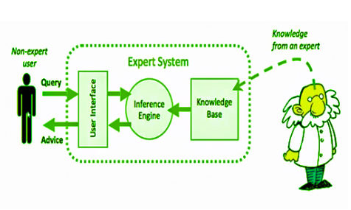
AI History: 4 – ... and Winters
A 1969 book by Minsky and Papert [Minsky 1969] threw serious doubt on the capability of such systems. This had a huge influence on the general perception of AI.
In the early 1970s the lack of results given the high expectations, and the lack of sufficient computing power to handle anything but toy applications, started a period of almost zero funding and academic interest (the «AI Winter»).
A short revival of interest in AI research came in the 1980s, with the focus on «expert systems» - computer programs that answer questions or solve problems about a specific domain of knowledge, using logical rules derived from the knowledge of experts.
But that was also short-lasting, due also to the high cost of specialized hardware and a unfavourable economic juncture → second AI winter

Slide 8
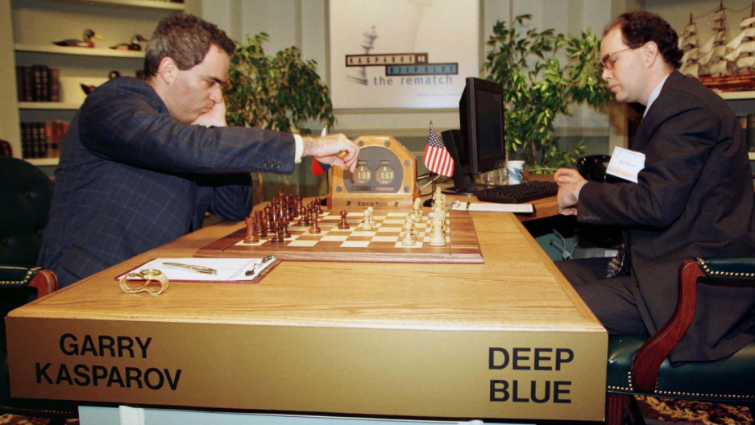
AI History: 5 - Machine Learning → AI
From the 90ies the path to AI took a different direction, eased by increases in cheap CPU, with development of Statistical Learning techniques (e.g., decision trees) and breakthroughs in neural networks research
[Mitchell 1997] provides a succinct deﬁnition of what Machine Learning is: “A computer program is said to learn from experience E with respect to some class of tasks T and performance measure P , if its performance at tasks in T , as measured by P , improves with experience E”
The development of complex neural networks, and their adaptation to different problems, brought many successful applications, where we may now arguably identify artificial intelligence at work
1997: Deep Blue defeats the chess
World Champion G. Kasparov

Slide 9
BTW - Can We Agree on What "Learning" Is?
A relevant question! Artificial intelligence requires machines to learn new tricks from experience.
Some definitions of Learning:
the process of acquiring new, or modifying existing, knowledge, behaviors, skills, values, or preferences
the acquisition of knowledge or skills through study, experience, or being taught.
becoming aware of something, by information or from observation.
Also, see Mitchell's 1997 definition in the previous slide
In general: learning involves adapting our response to stimuli via a continuous inference. The inference is done by comparing new data to data already processed. How is that done? By the use of the mechanism called analogy.

Slide 10

Analogies: The Heart of Thinking
Analogies: arguably the building blocks of our learning process. We learn new features in a unknown object by analogy to known features in similar known objects
True for language, tools, complex systems – EVERYTHING WE INTERACT WITH
... But before we even start to use analogy for inference or guesswork, we (sometimes implictly) classify unknown elements in their equivalence class!
In a sense, Classification is even more "fundamental" in our learning process than is Analogy. Or maybe we should say that classification is the key ingredient in building analogies.

Slide 11
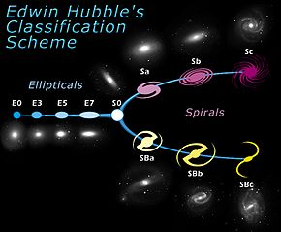
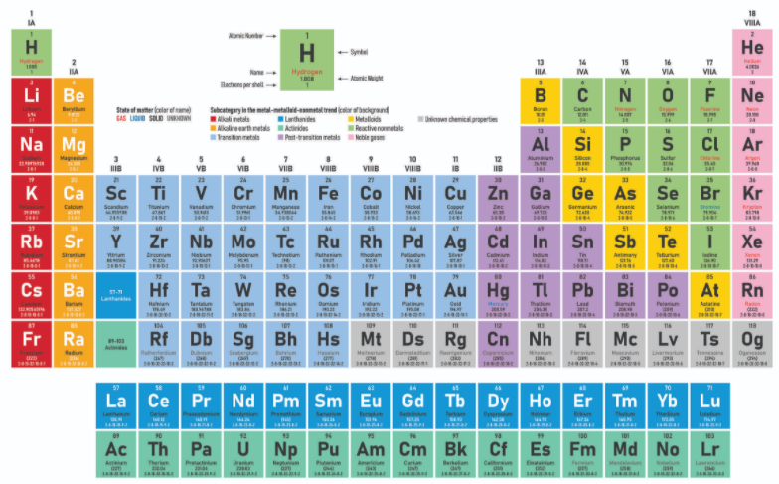
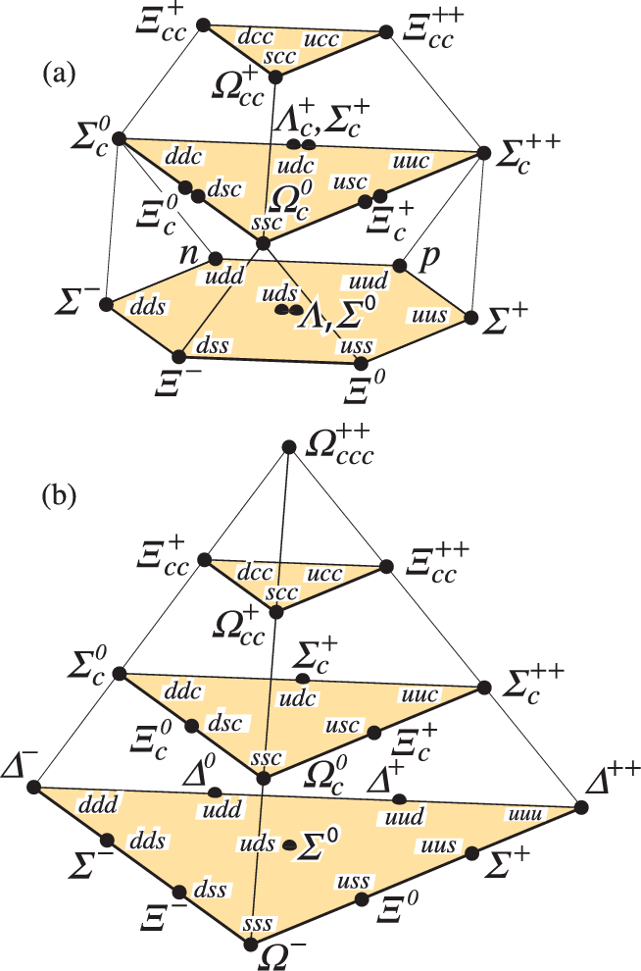
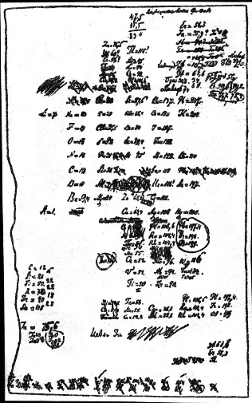
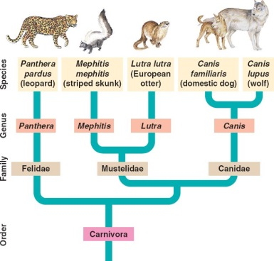
Classification and the Scientific Method
Countless examples may be made of how breakthroughs in the understanding of the world were brought by classifying observations
Mendeleev's table, 1869
Galaxies: Edwin Hubble, 1926
Evolution of species: Darwin, 1859
Hadrons: Gell-Mann, Zweig, 1964
It is thus no surprise that the advancements in supervised learning are bringing huge benefits to fundamental physics research today

Slide 12
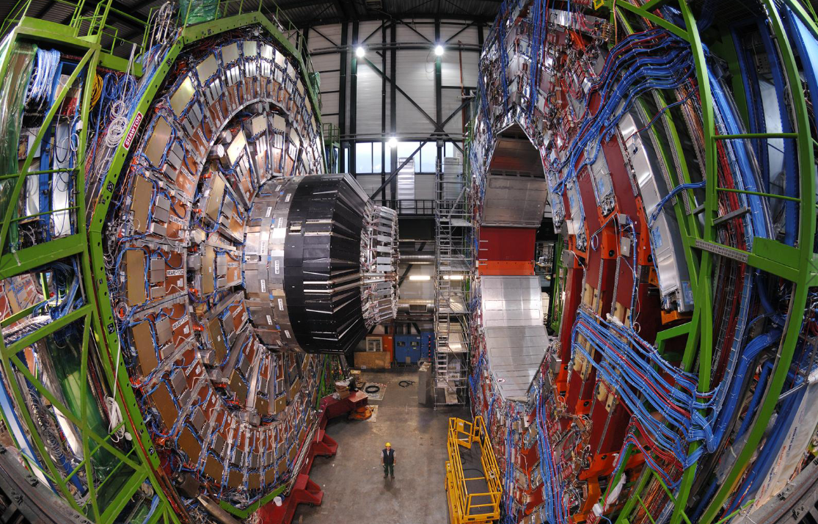
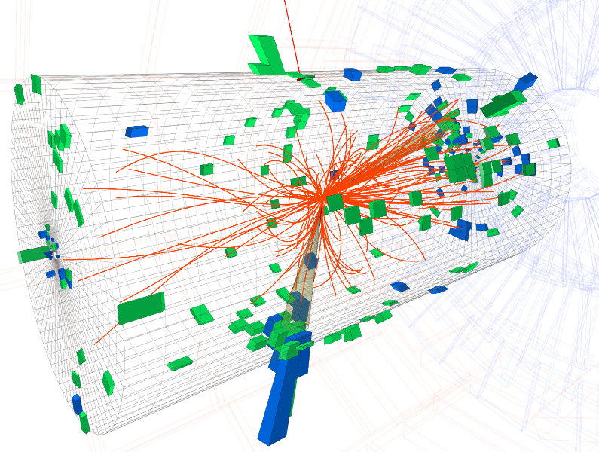
High-Energy Physics and AI
While the use of AI is common to all research areas of fundamental physics [incl. high-energy physics (HEP), astro-HEP, nuclear, neutrino,...], let us focus on HEP examples here
In HEP we study the inner structure of matter by colliding high-energy particle beams. Reactions produce complex «events».
We need to reconstruct the reactions from the information we collect of all secondary interactions between produced particles and detection elements → inference, pattern recognition, dimensionality reduction
We need to identify rare signals in enormous datasets dominated by backgrounds → classification
We want to measure physical quantities with the utmost precision → regression, optimized inference
We search for unpredicted structures in data → unsupervised learning: clustering, anomaly detection
In these and other applications, AI tools are fundamental helpers.
Above: the CMS experiment at CERN; below: computer reconstruction of particle signals produced in a collision

Slide 13
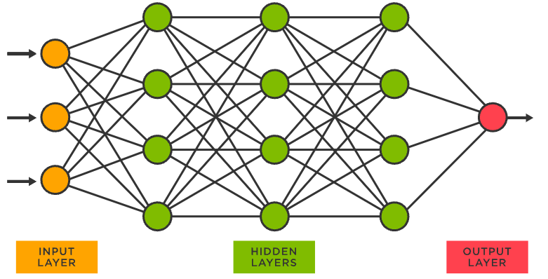
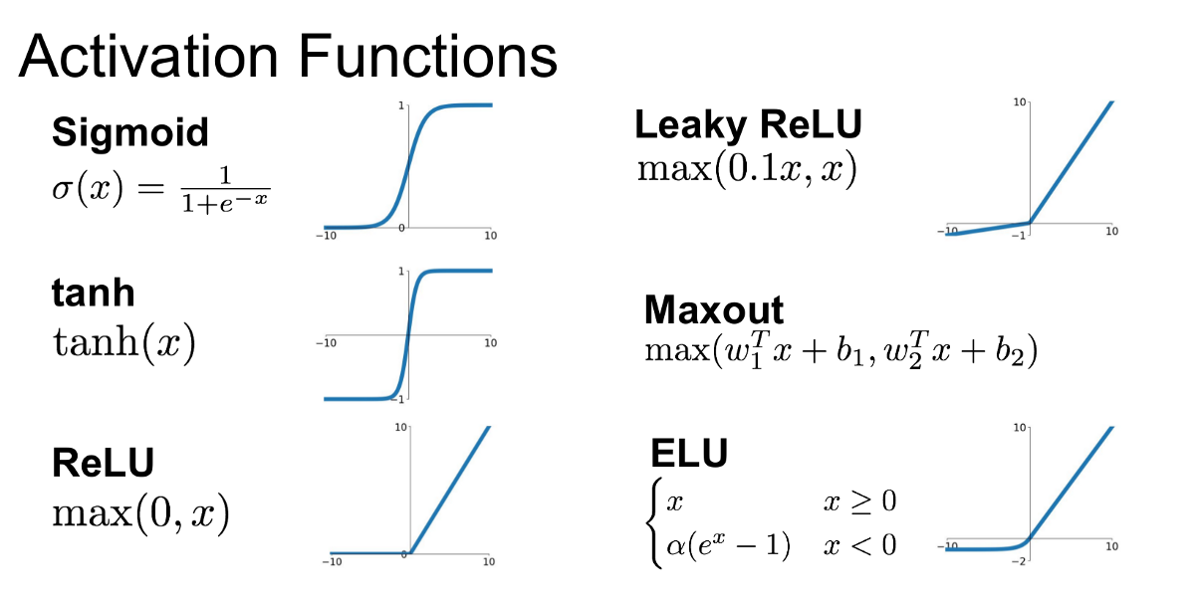
What is Deep Learning?
The mentioned applications are based on what is today called «deep learning», or even more generally “differentiable programming”
A Neural Network (deep if it has >=3 “hidden layers”) is a graph of nodes joined by links. Nodes receive an input from neighboring nodes and produce an output signal to others.
The system «learns» by storing information in weights and biases of nodes (and sometimes by cutting links) to maximize an objective function
At the basis of the process of learning there is the
adaptation of node parameters based on training
data, and on the fundamental process of
backpropagation
The latter is a backward-tracing of derivatives of
the objective function, to answer the question
«given this input, how do I modify node
parameters to maximize my objective?»
Nodes may «fire»
depending on the input
they receive, and based on an activation,
a function of a weight and a bias

Slide 14
AI directions in fundamental physics
The main directions of research in today’s particle physics research, taking the LHC as the playground, include:
identification of the flavour of hadronic jets
identification of hadronic decays within fat boosted jets
event reconstruction in dense environments
generative models and fast simulation of showers
incorporation of nuisance parameters in statistical inference
What do these applications have in common?
They can all be tackled with deep learning algorithms
No time to discuss the above applications and their state of the art. I will only mention a couple of interesting leads, as I wish to rather discuss what is really at the frontier: end-to-end optimization of detector design

Slide 15
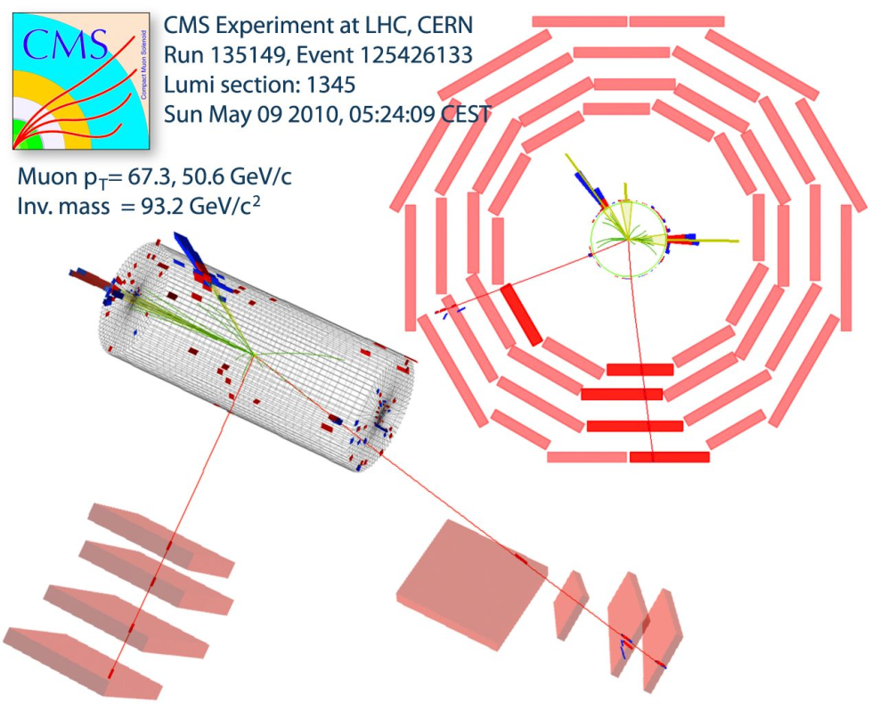
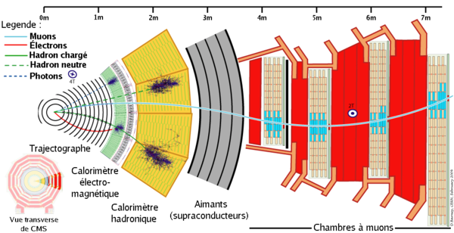
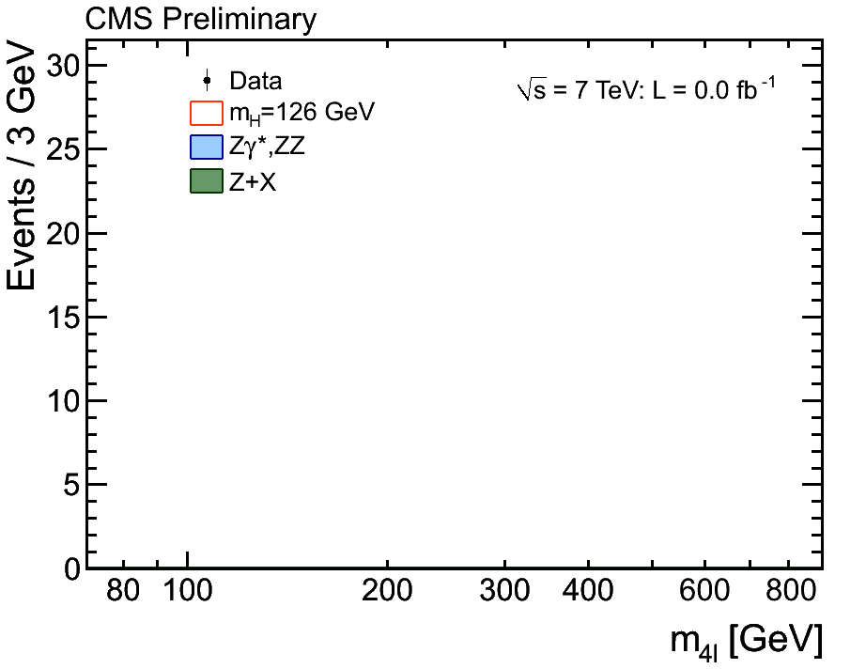
Cooking up good summaries
  The reconstruction of O(100M) electronic signals and its decoding into high-level features that describe what particles whizzed through, and with what energy and direction, is a huge dimensionality reduction task
  The challenge is to retain information as inference is performed on a low-D space of summary statistics...
Below: a section of the CMS detector, highlighting different signals left by particles

Slide 16
The inverse problem: * simulation-based inference
The quantum nature of physical processes at colliders (particle production, decay, interaction with matter) makes their observation a quintessential probabilistic process
The extraction of information from data must be formulated in statistical terms with the inclusion of all steps, to infer theory parameters from final-state observables: reconstruction → identification → measurement → inference
Classification, hypothesis tests, and regression are all based on the specification of a statistical model p(x|θ) that describes the probability to observe x, given parameters θ of a underlying theory
The high dimensionality of x makes the direct derivation of p impossible. We have learned to rely on simulation (forward generation of examples of x given a choice of θ) based on a reduction of the dimensionality of the problem → simulation-based inference
This way, though, we lose information, unless we find ways to retain the sufficiency of the summary statistic on which we base inference on the value of θ.

Slide 17
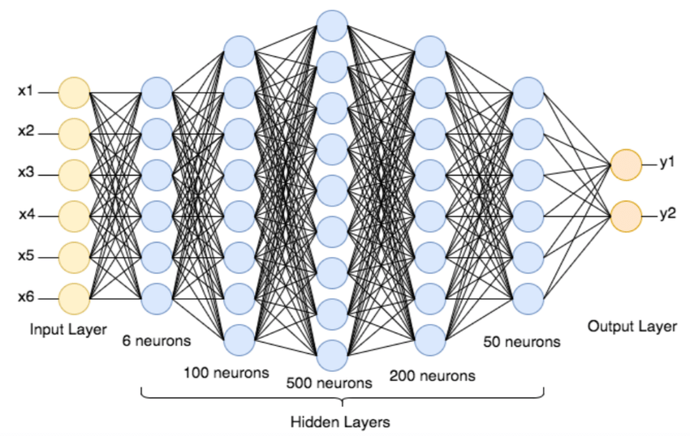
The rise of deep learning in HEP
DNNs use skyrocketed in HEP after 2012, when they were used for the Higgs discovery (2012 is also the turning point in the imagenet challenge). A true paradigm change!
Further evidence of the benefit of ML tools for HEP was given by the Kaggle Higgs challenge [Kaggle 2014], with 1800 teams participating (physicists, statisticians, computer scientists).
Task: separate H→ττ decays from backgrounds
The score was an estimate of
significance of the signal which
could be obtained in a dataset
equivalent to LHC 2011-2012
Solution | Score
Gabor Melis (DNN pooling) | 3.806
MultiBoost | 3.405
TMVA boosted trees | 3.200
Naive Bayesian classifier | 2.060
1D cut-based selection | 1.535
The most effective solution was based on a pool of DNNs, with emphasis on cross-validation
Alternative methods commonly used in HEP (xgboost, Bayesian NN, etc.) were beaten soundly
equiv. to 6 times more data!

Slide 18
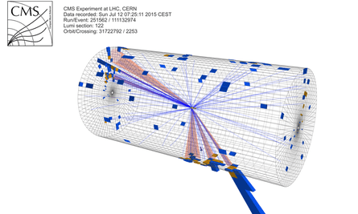
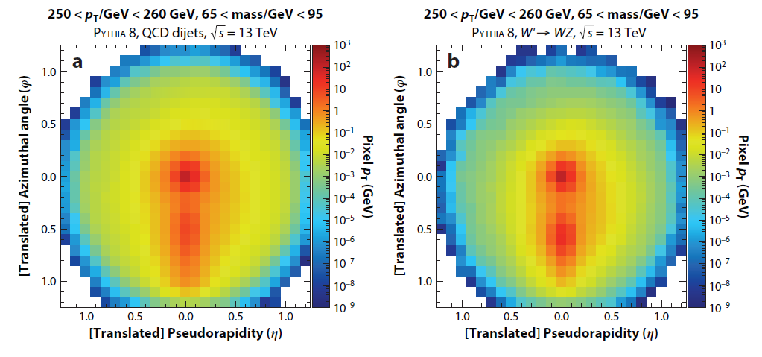
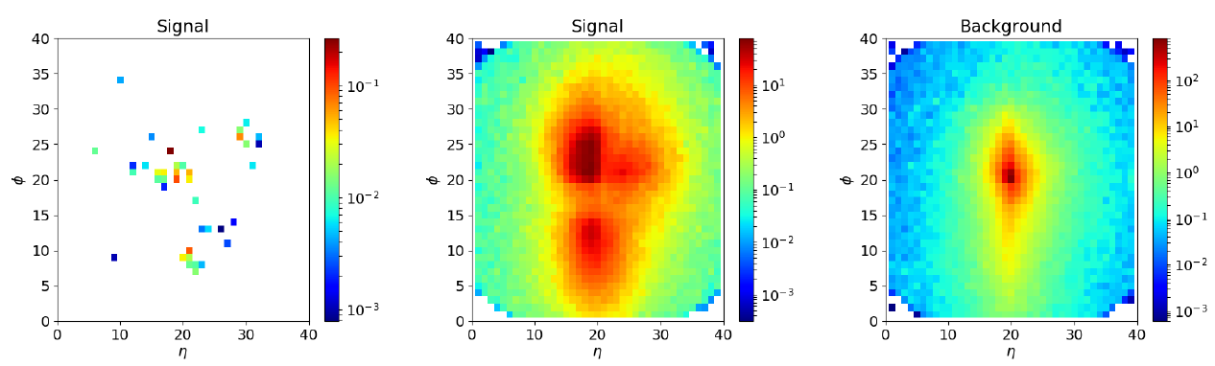
New ways to detect particles: boosted jets *
The W boson (1983) and the top quark (1995) were discovered using decays involving electrons and muons, as the more frequent quark decays are difficult to distinguish from QCD-induced backgrounds
We realized at the LHC that if top, W, Z, H particles have high energy, the jets of hadrons they produce in their quark decays are distinguishable from QCD through their inner structure – something which requires highly granular calorimeters
Today the most sensitive searches for new massive particles benefit from CNN-powered imaging techniques [Kasieczka 2019]
Left: true pattern of particles in a top quark jet. Center: observed average distribution for top quark decays. Right: average shape of QCD jets.

Slide 19
Incorporation of Nuisances in Classification *
Realizing the misaligment between the dimensionality reduction techniques (operated by NN, e.g. in classifying signal vs background based on observed event features) operated in data analysis and the true goal of the analyses (e.g., «smallest total uncertainty in parameter x»), a number of deep learning techniques have flourished in the past five years to
parametrize effect of nuisances as input to NN
decorrelate summary statistics from sensitive variable
penalize the loss to be insensitive of model variations
make the loss of a NN aware of the final objective and method of extraction
etcetera
Impossible to summarize these here, but for those interested P. de Castro and I produced a review [De Castro 2020] (soon to be published in the book «Artificial Intelligence for HEP» by World Scientific)

Slide 20
End of the introduction!
What we discussed so far are ways to use deep learning for fundamental physics research that have become commonplace.
In the remainder of this talk, we’ll go where very few have ventured... Putting everything together, and asking the machines for directions in a more holistic way.
... So it is a good time for you to recall you have an urgent errand ;-)

Slide 21

Foreword/1
The recent publication of the 2020 update of the European Strategy for Particle Physics (EUSUPP) [1] encourages feasibility studies for new large, long-term projects which will once again push our technological skills to their limits.
At the same time, humanity faces unprecedented global challenges (climate change, pandemics, overpopulation) which demand the use of our resources to seek solutions through applied science innovations, rather than investing in fundamental research.
Furthermore, there are indications that wide sectors of society no longer consider the furthering of our understanding of matter at the smallest distance scales, or other projects that require large and coordinated effort and significant funding, a top priority [2].
In this situation, ensuring the maximum exploitation of any resources spent on fundamental research is a moral imperative, and it may be a key to ensure that the long-term projects envisioned by the EUSUPP may be undertaken and sustained.

Slide 22
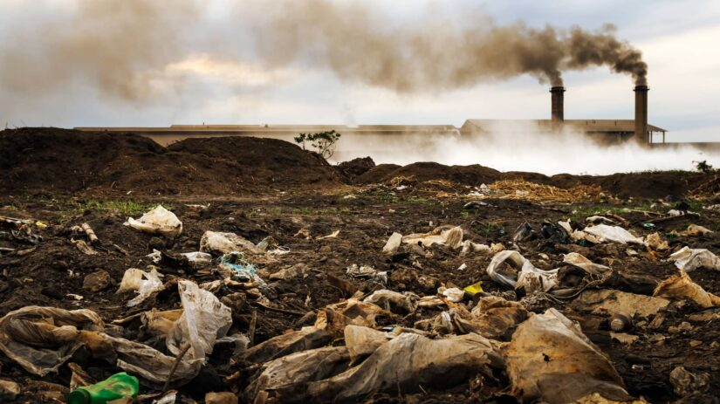
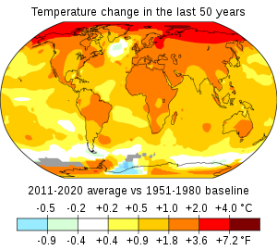
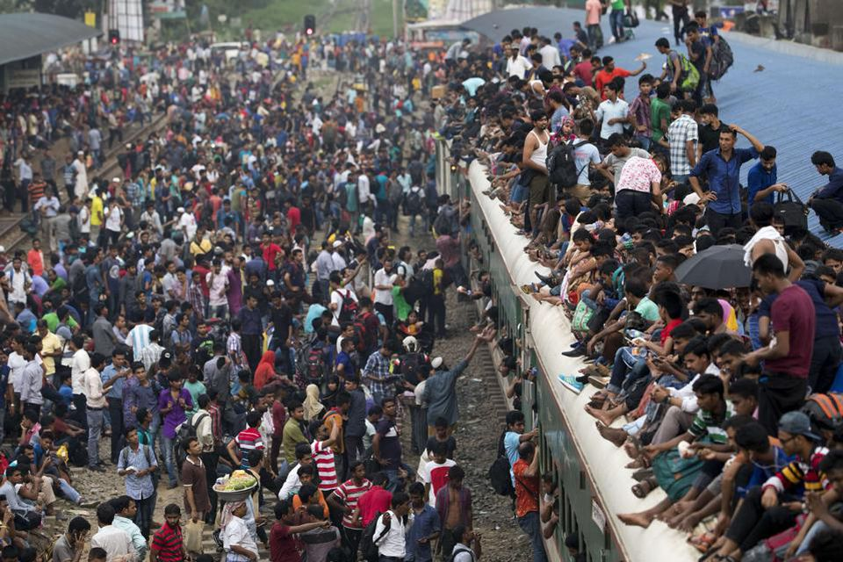
Foreword/2
The recent publication of the 2020 update of the European Strategy for Particle Physics (EUSUPP) [1] encourages feasibility studies for new large, long-term projects which will once again push our technological skills to their limits.
At the same time, humanity faces unprecedented global challenges (climate change, pandemics, overpopulation) which demand the use of our resources to seek solutions through applied science innovations, rather than investing in fundamental research.
Furthermore, there are indications that wide sectors of society no longer consider the furthering of our understanding of matter at the smallest distance scales, or other projects that require large and coordinated effort and significant funding, a top priority [2].
In this situation, ensuring the maximum exploitation of any resources spent on fundamental research is a moral imperative, and it may be a key to ensure that the long-term projects envisioned by the EUSUPP may be undertaken and sustained.

Slide 23
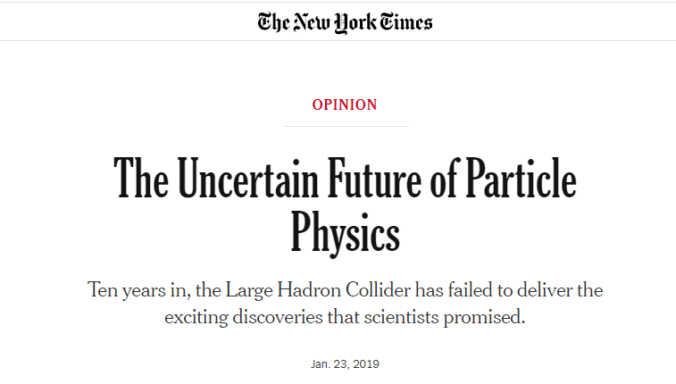

Foreword/3
The recent publication of the 2020 update of the European Strategy for Particle Physics (EUSUPP) [1] encourages feasibility studies for new large, long-term projects which will once again push our technological skills to their limits.
At the same time, humanity faces unprecedented global challenges (climate change, pandemics, overpopulation) which demand the use of our resources to seek solutions through applied science innovations, rather than investing in fundamental research.
Furthermore, there are indications that wide sectors of society no longer consider the furthering of our understanding of matter at the smallest distance scales, or other projects that require large and coordinated effort and significant funding, a top priority [2].
In this situation, ensuring the maximum exploitation of any resources spent on fundamental research is a moral imperative, and it may be key to ensure that the long-term projects envisioned by the EUSUPP may be undertaken and sustained.

Slide 24
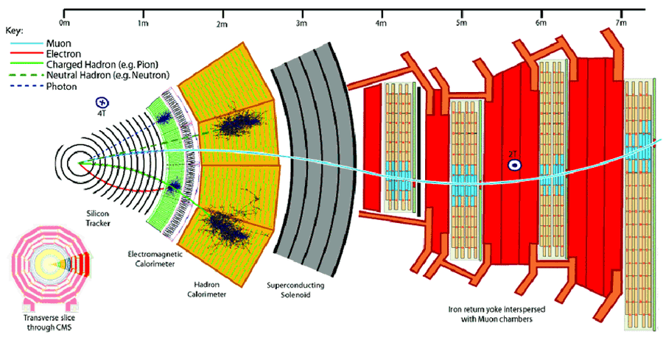
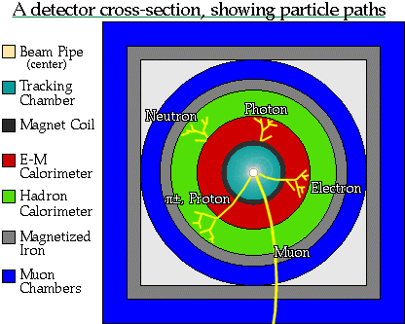
The Status Quo
In the past 50+ years the design of new detectors systematically leveraged the most performant available technologies, often fostering significant further advancements and spin-offs [3].
Yet one observes that the crucial underlying global paradigms of experimental design have remained mostly unchallenged across decades.
“Track first, destroy later”
Redundancy in detection systems
Symmetrical layouts
→ No guarantee of optimality
While these choices have served us very well for a long time, they do not directly maximize a high-level utility function, such as the highest discovery reach for a physical process, or measurement precision for a given physics parameter.

Slide 25
Optimal for what?
The reason why detectors are complex is not only that the studied physics is complex: a lot has to do with Science being a demanding job. We want to study everything and do it better than previously
So, what does it mean for a detector to be optimal?
What loss function do we aim to minimize?
Does it make sense to speak of a single utility function?
Concerning the last question: I am convinced that it does, and I will try to convince you in the next few slides.

Slide 26
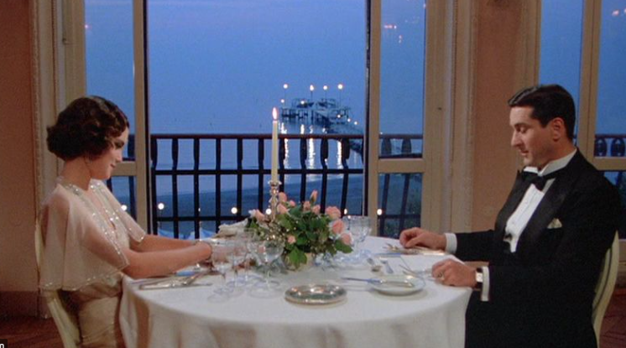

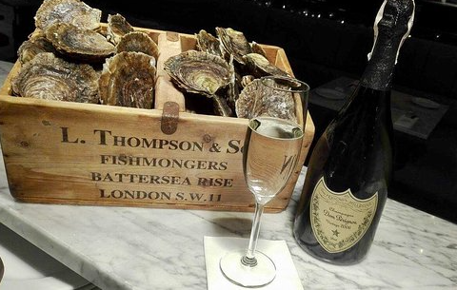





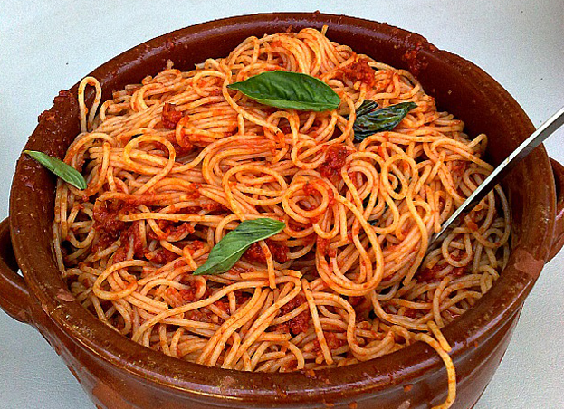
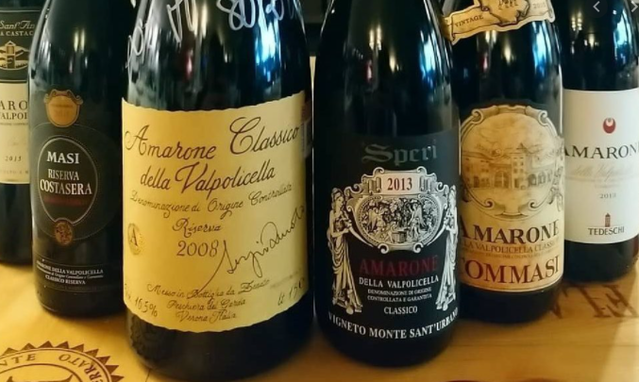
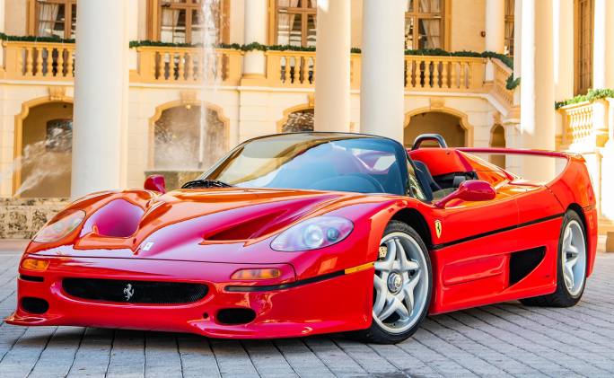

Recipe for a perfect dinner
We are not alien to confidently taking complex decisions in a multi-objective space. We actually do it routinely...
Of course, we are not deterred by knowing that our optimization target is not universal

Slide 27
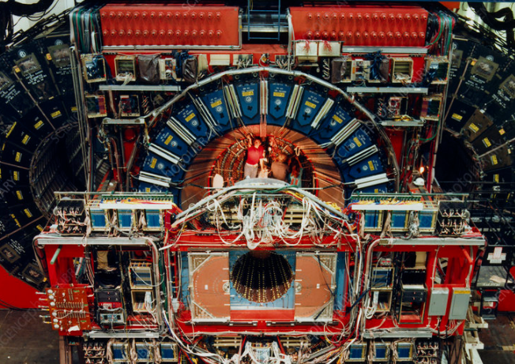

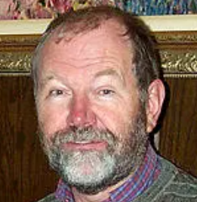
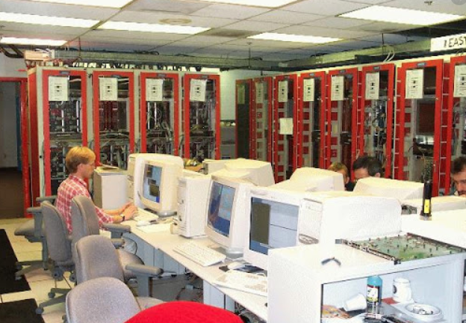
Recipe for a perfect trigger
Similarly, we are actually used to create multi-target optimization strategies, e.g. when we allocate resources for the trigger menu of a collider detector.
Consider CDF, Run 1 (1992-96): taking in
a rate of 300 kHz of proton-antiproton
collisions and having to select 50 Hz
of writable data created some of the
most heated scientifically-driven, rationally motivated, painfully well
argumented debates I ever listened to. The top quark had to be
discovered, but it was not the only goal of the experiment...

Slide 28
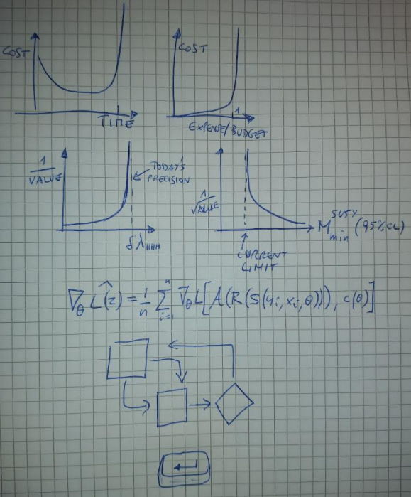
Recipe for a perfect detector
Assess your total budget and time-to-completion
Model as a steep function the cost of overriding budget or time
Assess the scientific impact of each achievable scientific results, optionally as a continuous function of their precision
Create a differentiable model of the geometry, the components, the information-extraction procedures, and the utility function
Construct a pipeline with those modules, enabling backpropagation and gradient descent functionality
Let the chain rule of differential calculus do the hard work for you

Slide 29
Makeshift surrogates of objectives
When we design the sensors for a tracking device, operate choices on budget allocations, define requirements for the resolution of detection elements, or choose composition and layout of calorimeter cells, we pick a working point in a loosely-constrained feature space of hundreds of dimensions. Picking the optimal point is clearly a super-human task.
Because of that, we set our aim on makeshift surrogates of our real objectives.
E.g., we might desire our objective to be “the highest precision on the Higgs boson self-couplings our budget can ensure”, but all we can do is stick to useful proxies suggested by past experience, and rather focus on the “highest achievable energy resolution for isolated photons”, ignoring the rest of the parameter space
Our simulations only allow us to probe the result of specific choices, not to map interdependencies.
Evolving from this modus operandi to directly goal-informed decisions enables potentially enormous performance gains.

Slide 30
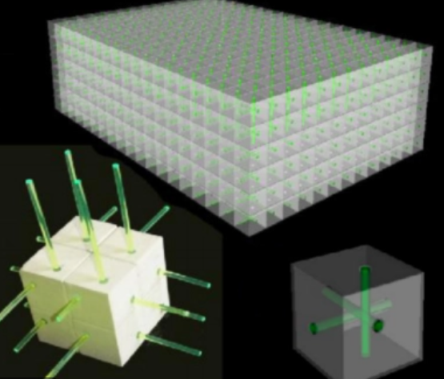
The design space is large – no, larger *
New technological advancements are crucially enabling a better optimization of our instruments by reducing the cost of complex layouts.
3D printing of scintillation detectors are being explored for neutrino physics [4]
Very thin layouts of resistive AC-coupled silicon detector elements may provide large gains in spatial and temporal resolution [5].
The geometry space has become larger and more complex to explore.
New performance demands are also arising:
Tracking in dense environments requires AI solutions
In space, payload and power consumption remain major constraint, making applications especially sensitive to hard-to-make design decisions
Boosted jet tagging at high p_{T} –all the rage for NP searches at the LHC –demands us to invest in better calorimeters

Slide 31
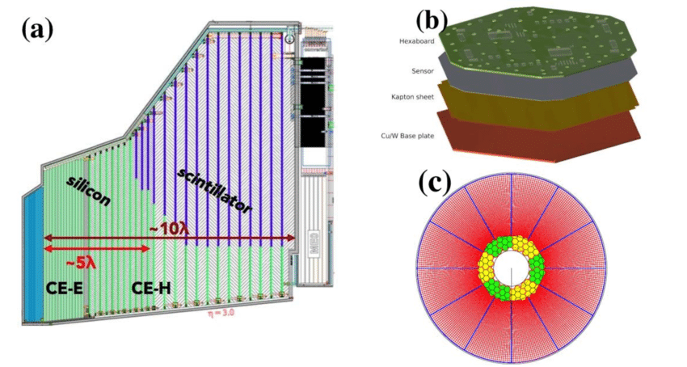
Speaking of calorimeters…
Because of boosted jet tagging, high granularity has become a compelling requirement in HEP
The CMS HGCAL detector [6] is a step in that direction; its design will improve usable information about the showers, development, pointing, and composition, taming pile-up of multiple proton-proton collisions.
For different reasons, similar developments and improvements are planned for other projects (e.g., CALICE [7] or CaloCUBE [8]).
However, an end-to-end optimization of the design of such instruments has not been attempted yet; nor have models of the future potential of machine learning in pattern recognition been considered so far in the design phase
As a telling example, the HGCAL detection elements are arranged in a hexagonal symmetry which offers construction benefits but significantly complicates the most common imaging techniques employing convolutional neural networks (CNN) to shower reconstruction. While solutions to this issue do exist (e.g., see [9]), this is an example of misalignment between design and potential exploitation.

Slide 32
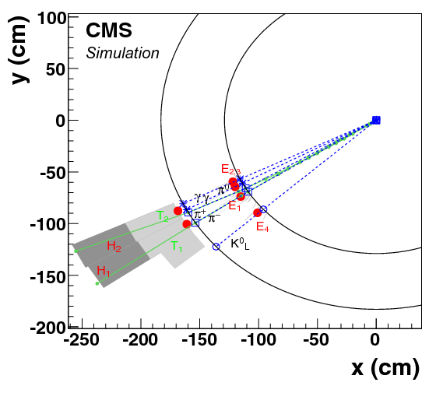
One further note on calorimetry
Take the LHC experiments for a telling example. CMS was originally endowed with a less performant hadron calorimeter than ATLAS. But hadron calorimetry ended up being crucial for a number of new physics searches involving boosted jets.
CMS regained the lost ground through the high performance of its “particle flow” reconstruction algorithm [10].
This was only possible thanks to the high magnetic field integral of CMS, which spreads out charged particles of different momenta within jets, easing their matching to calorimeter deposits.
This post-hoc exploitation of the solenoid characteristics, whose original specifications were rather driven by compactness and transverse momentum resolution of charged particles, is a striking example of how the combined search of hardware and software solutions may be proficuous to inform the optimization of a modern particle detector.

Slide 33
A hybrid calorimeter?
As particle flow techniques allow the tracing of individual particles and the complete reconstruction of dense, collimated jets, we must have more of that:
Optimizing the design of a detector for a long-timescale project based on reconstruction capabilities which will be available in the future [11] seems the right thing to do
Integrating tracking and calorimetry layers may improve the «image» reconstruction of energetic hadronic jets, shown to be crucial for high-mass new particles
Measuring muons from their radiative loss in a dense environment using convolutional neural networks was first shown to be viable (J. Kieseler, CERN) by «accident»
→ Needs to be pursued for high-energy collisions (see infra)
Nuclear interactions have always been dreaded in a tracker, but in combination with calorimetry they may strengthen particle-ID (using probabilistic information coming from nuclear cross sections of different species)
  → this may be of special interest to a number of applications

Slide 34
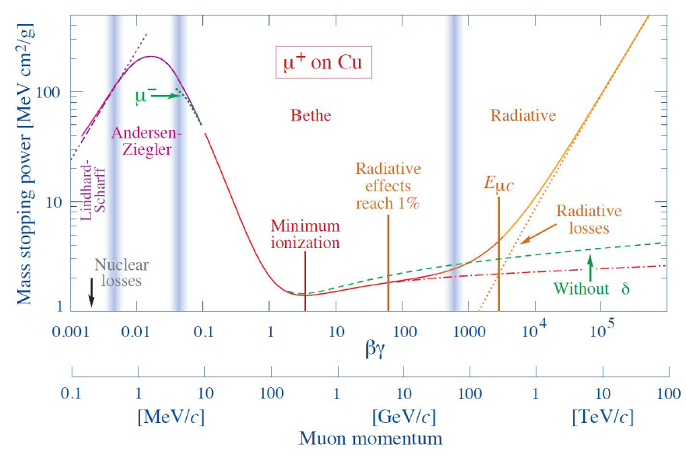
Muon energy measurement in a calorimeter?
Muons interact with matter by ionization, pair production, bremsstrahlung, and photonuclear reactions. The E loss is dominated by the high-end of the Landau distribution (knock-on electrons).
E loss is very modest and stochastic, so we have to rely on magnetic bending for inference on muon momentum
Bending measurements break down at TeV energies: in B=2T, a 1-TeV muon is deflected by a mm by traveling for 2 metres
Resolution scales linearly with momentum, because P=qBR for a charge q in a field B, with R radius of curvature.
E.g., in ATLAS σ(p)/p = 0.1 - 0.2 p depending on angle etc.
Above: mass stopping power for positive muons in Cu, showing the radiative energy loss onset above 1 TeV

Slide 35
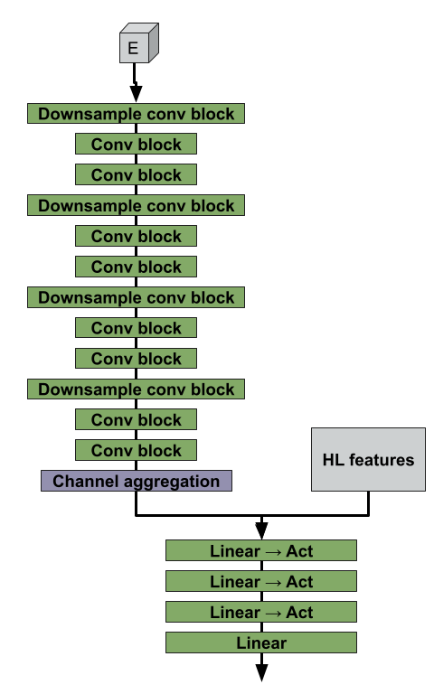
Results of Regression with CNNs
To see how well we can measure high-energy muons in a calorimeter we used a customized deep learning architecture, which combines convolutional blocks and dense layers using both high-level features and raw «image-like» energy deposits in 3D space

Slide 36
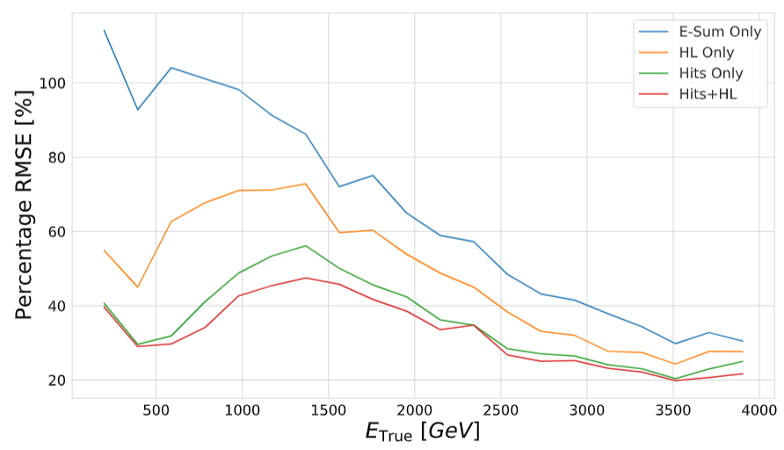

Results of Regression with CNNs
To see how well we can measure high-energy muons in a calorimeter we used a customized deep learning architecture, which combines convolutional blocks and dense layers using both high-level features and raw «image-like» energy deposits in 3D space
Of relevance is the point that the pattern of radiation deposits
contains information useful to regress to true muon energy
Results (right) show that one can reach 20% resolution with radiation loss information at 3-4 TeV, a region where curvature information (here assumed is a relative momentum resolution of 20% from magnetic bending at 1 TeV) becomes useless

Slide 37
How large are the gains of a full optimization?
I recently provided a clear example [13] of how experimental design as is carried out today leaves ample room for improvement from the systematic study of even seemingly irrelevant choices for, e.g., the placement of active and passive material in a simple detector.
The chance of doing so was offered by my refereeing work of the detector proposed by the MUonE collaboration [14], which aims at determining with high precision the cross section of elastic muon-electron scattering.
In the cited study I demonstrated, through the direct exploration of the parameter space of detector geometry, how large gains in suitable utility functions (related to the resolution in the event q²) can be obtained by moving away from choices dictated by past experience

Slide 38



One example of geometry optimization: MUonE
MUonE [14] aims to determine with high precision the muon-electron elastic scattering differential cross section, to extract hadronic contributions and reduce the systematics of the g-2 muon anomaly
The experiment must be sensitive to hadronic loop effects particularly at high energy, where a 10⁻⁴ measurement may substantially improve the theoretical understanding of the g-2 value
Above: the largest known anomaly
in the Standard Model to date, g-2
Above: layout of one of 40 1m-long stations Right: A virtual hadronic loop

Slide 39

MUonE optimization
After unsuccessfully asking MUonE members to study alternative layouts, I wrote a simulation of muon scatterings and of event reconstruction, and then optimized the geometry of the apparatus.
This proved how a factor of 2 improvement in the relevant metric could be achieved without increase in detector cost.

Slide 40

MUonE optimization
After unsuccessfully asking MUonE members to study alternative layouts, I wrote a simulation of muon scatterings and of event reconstruction, and then optimized the geometry of the apparatus.
This proved how a factor of 2 improvement in the relevant metric could be achieved without increase in detector cost.
Original layout
Opimized layout
We can only guess how large are the gains in the final experimental objectives possible if a fully differentiable model is created for detectors of significantly higher complexity than MUonE.
→ My guess: huge.
Above: relative resolution in event q² for different configurations (the higher, black line is the original proposal by the MUonE coll.)

Slide 41
Computer science to the rescue
Progress in CS redefined performance standards of our technologies.
We can today identify AI ingredients in, e.g., language translation, speech recognition, self-driving vehicles.
→ Of course, that AI is not general but application-specific: its potential of providing new solutions to old tasks depends on our ability to create the right interfaces.
A new paradigm shift is offered by differentiable programming [15], which eases the systematic search of minima of arbitrarily complex multi-dimensional functions; by casting the whole problem in a differentiable pipeline a full end-to-end optimization becomes possible.

Slide 42


When technology exists, and is not used...
The 1901 discovery of a wrecked ship in front of Antikythera, a Greek island south of the Peloponnese, brought evidence that the ancient Greeks could craft very complex instruments to predict eclipses and the position of planets, moon and sun at the turn of a crank
It has been argued that such technological marvels could have spurred a revolution that would have brought us to the technology level we’re at now in 300 years, but it did not – there were not enough use cases to attract those early inventor’s wit, nor resources to support basic research.
I’m not saying we run the same risks as the Greeks (and humanity) of 2500 years ago, but revolutions do not start by themselves – we have to take the new technology and adapt it to our use cases!

Slide 43

Automatic Differentiation
Wouldn’t it be nice if you coded
a problem and the dependence
of variables in a program, and the
language took care of figuring out
how functions vary depending on
parameters, and carry out the
complicated task of propagating
derivatives around?
Those of us who have done this
manually can’t be happier by
seeing the rise of Pytorch, TF, etc.
Image from [Baydin 2018] Günes Baydin et al, JMLR 18 (2018) 1–43

Slide 44



INFERNO
As an example of what differentiable programming can do for fundamental research, I designed with P. de Castro an innovative algorithm [16] using automatic differentiation to construct a loss function that directly targets the end result of the analysis instead of an intermediate one.
If the loss function is constructed to incorporate the effects of nuisance parameters on the measurement, virtual optimality of the classification task and large improvements in precision can be achieved
Top: Control flow of INFERNO algorithm, which extracts optimal NN parameters given a final analysis objective, such that the resulting measurement becomes maximally robust to nuisance parameters. Data x generated by a simulator g (left block) which depend on nuisances θ_{MC} are used to train a NN h (second block), producing output y. The output is made differentiable by a softmax function (third block) and used to construct a summary statistic t, which is histogrammed to compute a saturated likelihood L_{A} used to perform inference (right block). The expected variance U on the parameter of interest may be derived from the information matrix I, and used as NN loss, whose parameters φ are optimized by backpropagation.
The code of INFERNO (in TF 1.0) is available on github[24].
Giles C. Strong also made available[25] a PyTorch implementation and is demonstrating its performance on astro-HEP use case.
Lukas Layer ported the code to TF2.0.
Presently, this technology is being tested in a
real CMS analysis, using open Run1 data to replicate
a top cross section measurement, by Lukas Layer
Left: profile likelihood on the parameter of interest for a neural network with (blue) and without (red) the feedback on effect of nuisances provided by INFERNO

Slide 45


A study of muon shielding in SHIP
In another seminal work [17], local generative surrogates of the gradient of the objective function were proven to allow for the minimization by SGD and a strong reduction in muon background fluxes in the SHIP experiment
Geometry optimization at work in real time!

Slide 46

Realigning design choices and ultimate goals
The target of MODE is to design and offer to the community a scalable, versatile architecture that can provide end-to-end optimization of particle detectors, proving it on a number of different applications across different domains.
  Study cases:
  Demonstration of muon energy measurement in optimized calorimeter → 2 articles in preparation
  Muon tomography detector optimization [18] → in progress
  Hybrid calorimeter design integrating tracking layers → activity starting
  Other use cases being considered include:
  - Hadron therapy (iMPACT project [19]);
  Muon collider detector shielding [20];
  Optimized sensitivity to long-lived signatures at FCC-ee

Slide 47

And for the time being...
«Simple» use case: muon tomography. We need no surrogate of a simulator, yet all other pieces of the puzzle still need to be carved and set in.
Muon tomography consists in exploiting the flux of cosmic rays that impinge constantly on the Earth’s surface, as a source of data with which to produce inference (or directly imaging) on the contents of unknown volumes of material
Applications are countless:
study core of volcanos
prevent smuggling of dangerous materials in containers
study wear of industrial apparata (e.g. steel pipes, furnace material)
archaeological prospections
and many more
Two main methods for inference:
1 – exploit dependence of scattering angle
of muons, θ, on atomic number of material, Ζ
2 – use incoming momentum spectrum of muons
and absorption of parts of it by thick matter layers
to infer thickness (in 3D, with multiple scans)

Slide 48

And for the time being...
«Simple» use case: muon tomography. We need no surrogate of a simulator, yet all other pieces of the puzzle still need to be carved and set in.
For a simple test, we model a scanned volume of unknown density (e.g. one including a high-Z block of 0.5x0.1x0.1 m³ somewhere inside a 0.6x1x1m³ of low-Z material)
The system «learns» how to compromise cost and precision to optimize the inference on the Z map, and where detector elements are less useful
Still under development, but promising first results already achieved (see next slide)
Right: scheme of the
modeled apparatus (graph courtesy G. C. Strong)

Slide 49


Preliminary results – a breathing pipeline! *
The code and results shown have been produced by Giles C. Strong
These graphs show the result of a run of 100 epochs training, followed by a prediction with 100k muons
First proof of principle of correct training of a differentiable model of a schematic muon tomography apparatus.
The loss is a combination of detector cost (itself a function of sensors efficiency and resolution) and RMSE on rad length estimate
Still a long way to go, but an important milestone for this use case
Above, top to bottom: loss, loss composition, resolution map, and efficiency map of detection elements after minimization.
Right: predicted and true X₀ of passive volume

Slide 50











Machine-Learning Optimized
Design of Experiments
MODE Collaboration
https://mode-collaboration.github.io
A. G. Baydin⁵, A. Boldyrev⁴, K. Cranmer⁸, P. de Castro Manzano¹, T. Dorigo¹, C. Delaere², D. Derkach⁴, J. Donini³, A. Giammanco², J. Kieseler⁷, G. Louppe⁶, L. Layer¹, P. Martinez Ruiz del Arbol⁹, F. Ratnikov⁴, G. Strong¹, M. Tosi¹, A. Ustyuzhanin⁴, P. Vischia², H. Yarar¹
1 INFN, Sezione di Padova (and associates from Padova and Naples Universities), Italy
2 Université Catholique de Louvain, Belgium
3 Université Clermont Auvergne, France
4 Laboratory for big data analysis of the Higher School of Economics, Russia
5 University of Oxford
6 Université de Liege
7 CERN
8 New York University
9 IFCA
Outdated list – now 28 members

Slide 51
The strategy of MODE
We are fully aware that the dream of informing the design of a complex detector for a fundamental physics endeavour entails a walk in the desert...
Yet we must start it, as in 20 years the shortcomings of having designed experiments that are misaligned with goals and information-extraction procedures will otherwise be paid dearly.
The strategy is thus to start with easy use cases, where further proof may be brought of the gains of using DL architectures to parametrize the essential ingredients of the design problems
Hopefully, we will be able to convince the community, or else, we’ll have to wait for a generation change.
The important observation is that the developed architectures for optimization are modular, hence we will be able to recycle part of the work for one application when we move to the next one.

Slide 52

Status and next steps
An article describing the MODE program has been published last month in Nuclear Physics News International [21]
A white paper on differentiable programming for detector design optimization is being drafted
We organized a workshop on “Differentiable Programming for Design Optimization” on September 6-8 2021 in Louvain-la-Neuve, which allowed interested scientists to join and discuss together the means and the possible applications

Slide 53

NPNI article
A short «advertising» article describing the plans of the MODE collaboration has been published in Nuclear Physics News International (paper version out this fall, already available online[21])

Slide 54
MODE and You
If you are doing experimental research in HEP, astro-HEP, neutrino physics, or high-energy nuclear physics, or if you are working at spin-offs involving, e.g., muon tomography, hadron therapy, or other endeavours which operate with instruments that extract information from the interaction of energetic radiation with matter, you are very likely to have a use case – a system liable to benefit from a study with differentiable programming.
The idea of MODE is to bring together ML experts who are developing the interfaces for these applications, with the researchers who have problems to solve in their area of interest
We cannot offer a solution to any given problem (we lack the manpower to work on-demand), but together we may work toward it
→ Consider joining MODE, and bring your use case!
Do I have a use case checklist:
Are you involved in the design, assembly, or upgrade of an instrument?
Can you specify one or a set of desirable scientific goals from its use?
Are those goals achieved through
information processing?
If your answers to all are «yes»,
you have something to optimize and
chances are this can’t be done
without a deep learning model of
the full information extraction chain.

Slide 55
THANK YOU FOR YOUR ATTENTION!

Slide 56
Four-slide description of a differentiable model for design optimization - 1
An end-to-end detector design optimization task can be briefly formalized in the following way.
We start with a simulation of the physics processes of relevance for the considered application, which generates a multi-dimensional, stochastic input variable x, distributed with a PDF f(x).
The input is turned by the simulation of the detection apparatus into sensor readouts z distributed with a PDF
p(z|x,θ),
which constitute the observed low-level features of the physical process; readouts z depend through p( ) on parameters θ that describe the physical properties of the detector and its geometry.

Slide 57
Four-slide description of a differentiable model for design optimization - 2
The observations z are used by a reconstruction model R( ) that produces high-level features
ζ(θ) = R[z,θ,ν(θ)]
(e.g. particle four-momenta), by employing knowledge of the detector parameters as well as a model of the detector-driven nuisance parameters ν(θ) which affect the pattern recognition task.
In turn, high-level features ζ(θ) constitute the input of a further, less dramatic, dimensionality reduction, the data analysis step: this is typically performed by a classifier or regressor NN( ) powered by a neural network.
Once properly trained for the task at hand, the network produces a low-dimensional summary statistic
s = NN[ζ(θ)]
with which inference can finally be carried out to produce the desired goal of the experiment.

Slide 58

Four-slide description of a differentiable model for design optimization - 3
In general, one may formally specify the problem of identifying optimal detector parameters as that of finding estimators $\hat{θ}$that satisfy
$$\hat{θ}=arg\min_{θ}{\int{L\left[NN\left(ζ\right),c\left(θ\right)\right]p\left(z | x,θ\right)f\left(x\right)dxdz}}$$
c(θ) is a function modeling the cost of the considered detector layout of parameters θ, and the loss function L[NN,c] is constructed to appropriately weight the result of the measurement in terms of its desirable goals, as well as to obey cost constraints and other use-case-specific limitations.
Since in the cases of interest the PDF p(z|x,θ) is not available in closed form –the considered models are implicit–, we must rely on forward simulation: we approximate $\hat{θ}$ with a sample of n events:
$${\hat{θ}}_{a}=arg\min_{θ}{\frac{1}{n}}\sum_{i=1}^{n}{L\left[NN\left(R\left(z_{i}\right)\right),c\left(θ\right)\right]}$$
where z_{i} is distributed as F(x_{i},θ) to emulate p(z|x,θ) as x_{i} is sampled from its PDF f( ) by the simulator. One may thus obtain an estimate of the loss function and the detector parameters which minimize it.

Slide 59

Four-slide description of a differentiable model for design optimization - 4
It has been shown how in applications such as those of our interest it is viable to approximate the non-differentiable stochastic simulator F( ) with a local surrogate model,
z = S(y,x,θ),
that depends on a parameter y describing the stochastic variation of the approximated distribution[49]. This allows to descend to the minimum of the approximated loss $\hat{L(z)}$ by following its surrogate gradient
$$∇_{θ}\hat{L(z)}=\frac{1}{n}\sum_{i=1}^{n}{∇_{θ}L[NN\left(R\left(S\left(y_{i},x_{i},θ\right)\right)\right),c(θ)]}.$$
The above recipe requires to learn the differentiable surrogate S( ): this is a task liable to be carried out independently from the optimization procedure.
The modular structure of a differentiable pipeline modeling the optimization cycle allows the user to turn on and off specific parts of the chain, helping the system in its exploration of the feature space.

Slide 60
References
1. The European Strategy Group, "2020 Update of the European Strategy for Particle Physics," CERN, Geneva, https://europeanstrategy.cern/, doi: http://dx.doi.org/10.17181/ESU2020Deliberation, 2020.
2. The topic has been discussed widely in blogs and other social media. E.g., see Sabine Hossenfelder’s discussion here: http://backreaction.blogspot.com/2019/06/if-we-spend-money-on-larger-particle.html, or see Alessandro Strumia’s guest post at the same site: http://backreaction.blogspot.com/2020/06/guest-post-who-needs-giant-new-collider.html. Also see the New York Times op-ed by S. Hossenfelder, https://www.nytimes.com/2019/01/23/opinion/particle-physics-large-hadron-collider.html

Slide 61
References / cont’d
3. F. Hartmann, Evolution of Silicon Sensor Technology in Particle Physics, Springer Tracts in Modern Physics, 2017, ISBN 978-3-319-64436-3; P. Delpierre, A history of hybrid pixel detectors, from high energy physics to medical imaging, J. INST. 9 (2014) C05059, doi: 10.1088/1748-0221/9/05/C05059; P. Allport, Applications of silicon strip and pixel-based particle tracking detectors, Nature Reviews Physics 1 (2019) 567–576, doi: https://doi.org/10.1038/s42254-019-0081-z; G. Case, New trends in silicon detector technology, JINST 15 (2020), https://iopscience.iop.org/article/10.1088/1748-0221/15/05/C05057; M. Garcia-Sciveres and N. Wermes, A review of advances in pixel detectors for experiments with high rate and radiation, Rep. Prog. Phys. 81 (2018) 066101, doi: http://doi.org/10.1088/1361-6633/aab064.

Slide 62
References / cont’d
4. Y. Mishnayot et al., “3D Printing of Scintillating Materials”, arXiv:1406.4817[cond-mat.mtrl-sci] (2014); Y. Abreu et al. (SoLID Collaboration), “A novel segmented-scintillator antineutrino detector”, JINST 12 (2017) P04024, doi: 10.1088/1748-0221/12/04/P04024.
5. M. Mandurrino et al., "Demonstration of 200 --, 100 --, and 50 micron Pitch Resistive AC Coupled Silicon Detectors (RSD) With 100% Fill Factor for 4D Particle Tracking,” IEEE Electron Device Letters 40, 11 (2019) 1780, arXiv:1907.03314[physics.ins-det]; M. Mandurrino et al., “Analysis and numerical design of Resistive AC Coupled Silicon Detectors (RSD) for 4D particle tracking”, Nucl. Instr. Meth. A959 (2020) 163479, doi: 10.1016/j.nima.2020.163479; M. Tornago et al., “Resistive AC-Coupled Silicon Detectors: Principles of operation and first results from a combined analysis of beam test and laster data”, NIM A 1003 (2021) 165319, https://www.researchgate.net/publication/343095980 .
6. CMS Collaboration, “The Phase-2 Upgrade of the CMS Endcap Calorimeter”, CERN-LHCC-2017-023 (2018), https://cds.cern.ch/record/2293646?ln=en .

Slide 63
References / cont’d
7. J. Repond et al., “Hadronic Energy Resolution of a Combined High Granularity Scintillator Calorimeter System”, JINST 13 (2018) P12022, doi: 10.1088/1748-0221/13/12/P12022; C. Adloff et al., “Tests of a particle flow algorithm with CALICE test beam data”, JINST 6 (2011) P07005, doi: 10.1088/1748-0221/6/07/P07005.
8. P.W. Cattaneo et al., “CaloCube: a novel calorimeter for high-energy cosmic rays in space”, JINST 12 (2017) 06, C06004, doi: 10.1088/1748-0221/12/06/C06004 .
9. E. Hoogeboom et al., “HexaConv”, arXiv:1803.02108[cs.LG] (2018)).
10. M. Sirunyan et al. (CMS Collaboration), “Particle-flow reconstruction and global event description with the CMS detector”, JINST 12 (2017) P10003, doi: 10.1088/1748-0221/12/10/P10003 .

Slide 64
References / cont’d
11. See e.g. S.R. Qasim, J. Kieseler, Y. Iiyama, and M. Pierini, “Learning representations of irregular particle-detector geometry with distance-weighted graph networks”, Eur. Phys. J. C79 (2019) 7,608, doi: 10.1140/epjc/s10052-019-7113-9; J. Kieseler, “Object condensation: one-stage grid-free multi-object reconstruction in physics detectors, graph and image data”, arXiv:2002.03605[physics.data-an] (2020); J. Alimena, Y. Iiymana, J. Kieseler, “Fast convolutional neural networks for identifying long-lived particles in a high-granularity calorimeter”, arXiv:2004.10744 [hep-ex] (2020).
12. T. Dorigo, J. Kieseler, L. Layer and G. Strong, “Muon Energy Measurement from Radiative Losses in a Calorimeter for a Collider Detector”, http://arxiv.org/abs/2008.10958 (2020).
13. T. Dorigo, "Geometry Optimization of a Muon-Electron Scattering Detector," Physics Open 4 (2020) 100022, arXiv:200200973[physics.ins-det], doi: 10.1016/j.physo.2020.100022.
14. G. Abbiendi et al., “Letter of Intent: The MUonE Project”, CERN-SPSC-2019-026/SPSC-I-252 (2019).

Slide 65
References / cont’d
15. A. Güneş Baydin, B.A. Pearlmutter, A.A. Radul, and J.M. Siskind, “Automatic Differentiation in Machine Learning: a Survey”, Journal of Machine Learning Research (JMLR) 18 (153) (2018) 1, http://jmlr.org/papers/v18/17-468.html; Y. LeCun, Y. Bengio, and G. Hinton, “Deep learning”, Nature, 521(7553) (2015) 436, doi: 10.1038/nature14539.
16. P. de Castro Manzano and T. Dorigo, “INFERNO: Inference-Aware Neural Optimization”, Comp. Phys. Commun. 244 (2019) 170; Arxiv:1806.04743v2 [stat.ml] (2018), doi: 10.1016/j.cpc.2019.06.007.
17. S. Shirobokov, A. Ustyuzhanin, A. Güneş Badyin et al., “Differentiating the Black-Box: Optimization with Local Generative Surrogates”, arXiv:2002.04632v1[cs.LG] (2020).
18. S. Wuyckens, A. Giammanco, P. Demin, and E. Cortina Gil, “A Portable muon telescope based on small and gas-tight Resistive Plate Chambers”, Phil. Trans. Royal Soc. A377 (2019) 2137, arXiv:1806.06602v2[physics.ins-det] (2018), doi: 10.1098/rsta.2018.0139.

Slide 66
References / cont’d
19. P. Giubilato et al., “iMPACT: innovative pCT scanner”, IEEE Nuclear Science Symposium and Medical Imaging Conference (NSS/MIC) IEEE (2015), https://ieeexplore.ieee.org/abstract/document/7581240; S. Mattiazzo, et al., “Advanced proton imaging in computed tomography”, Radiation protection dosimetry 166.1 (2015) 388, https://academic.oup.com/rpd/article/166/1-4/388/1612689; S. Mattiazzo et al., “The iMPACT project tracker and calorimeter”, Nucl. Instr. Meth. A845 (2017) 664, https://www.sciencedirect.com/science/article/pii/S0168900216303412; N. Pozzobon et al. “Calorimeter prototyping for the iMPACT project pCT scanner”, Nucl. Instr. Meth. A936 (2019) 1, https://ui.adsabs.harvard.edu/abs/2019NIMPA.936....1P/abstract.
20. N. Bartosik et al., “Preliminary Report on the Study of Beam-Induced Background Effects at a Muon Collider,” arXiv:1905.03725[hep-ex] (2019); N. Bartosik et al., “Detector and Physics Performance at a Muon Collider,” J. Inst. 15 (2020) P05001, doi: 10.1088/1748-0221/15/05/P05001.
21. A.G. Baydin et al., “Toward Machine Learning Optimization of Experimental Design”, submitted to Nuclear Physics News International, 2021.

Slide 67
References / cont’d
22. W.K. Sakumoto et al., “Measurement of TeV muon energy loss in iron”, Phys. Rev. D 45, 9 (1992) 3042.
23. IceCube Collaboration, Contributions to the 30th International Cosmic Ray Conference (ICRC2007), Merida, Mexico, August 2007, arXiv:0711:0353v1

Slide 68
What is Intelligence ?
Before we discuss artificial intelligence, and how we are getting there today, we should agree on what intelligence is – and what isn’t.
The term «intelligence» comes from Latin “intelligo”
→ to comprehend, to perceive
…but that does not help much. Consider the literature for help: we find that notable definitions differ significantly, also in relation to what can be general and what is specific of human beings:
“The aggregate or global capacity of the individual to act purposefully, to think rationally, and to deal effectively with his environment” [Wechsler 1944]
“The unique propensity of human beings to change or modify the structure of their cognitive functioning to adapt to the changing demands of a life situation” [Feuerstein 1990]
But also, and more useful to us, are more abstract definitions such as:
“Intelligence measures an agent's ability to achieve goals in a wide range of environments” [Legg 2007]
“Intelligence is goal-directed adaptive behavior” [Sternberg 1982]

Slide 69
What is Artificial Intelligence ?
Curiously, a precise definition of Artificial Intelligence is not less challenging than that of Intelligence at large
AI: “Intelligence demonstrated by machines” – devices that have the ability to perceive the environment and take actions toward achieving some goal
  The above puts automatic wipers and thermostats in the AI category…
Patricia McCorduck describes the AI effect: «AI is what hasn’t been done yet» [Mc Corduck 2004]
We continue to raise the bar as we get accustomed to progress in artificial intelligence research:
  Self-driving cars? Just a smart NN with lots of input data
  Speech recognition? Only an algorithm, not real AI
  Facebook targeted ads, gmail text completion? Specialized data-crunching, little more than nearest-neighbor techniques
At the basis of this is the perception that we, as sentient beings, «know» what we are doing. But we, too, are machines!

Slide 70



A Digression: Statistical vs Machine Learning
While the progress of AI research was going through the above described roller-coaster, statisticians were happily using tools that we today have repurposed into modern machine learning ones – no revolution, from their perspective
Indeed, one can really just as well do «learning» with old-fashioned, century-old tools. Take a k-nearest neighbor algorithm, for example: a classic SL tool.
In a recent study (to be published soon) I showed* how the regressor can be overparametrized by assigning a weight w_{i} and a bias b_{i} to every training event i=1...N:
$\hat{x}=\sum_{i=1}^{k}{x_{i}}$ → $\hat{x}=\sum_{i=1}^{k}{(w_{i}x_{i}+b_{i})}$
This introduces 2N = O(1M) tunable parameters, which can be optimized by stochastic gradient descent to the minimum of a loss function exactly as a neural network does. Nonlinearity is introduced through locality of multi-D metric for distance.

Slide 71



Looking deeper into the best solution
In a recent study[Strong 2020], Giles C. Strong reproduced Gabor Melis’ performance with a similar but much more GPU-efficient setup.
He could thus study the ingredients which were the most useful to improve the solution: Data augmentation + Swish activation + Densely connected layers = more performant model
  Require fewer models in ensemble to achieve same performance (10 versus 70)
  Ensemble much quicker to apply at inference time
Fewer models + 1-cycle schedule = quicker to train
Accounting for difference in GPU (Titan → 1080 Ti) processing power, new solution:
  13x quicker to train on GPU, 7x quicker on laptop CPU
  33x quicker to apply on GPU, 3x quicker on laptop CPU

Slide 72
Tracking Particles in Dense Environments
CMS reconstructs particles emerging from collision events using a technique called «particle flow»[10], where every charged as well as neutral particle is assigned energy deposits and hits
This is challenging when there is overlap of many collisions in the same «bunch crossing» – but that’s precisely where we are heading with HL-LHC
  To study deeper in the structure of matter we need more luminosity, as explorers in a dark cavern
To preserve the performance of our reconstruction methods in O(200) pileup conditions, Jan Kieseler has proposed a technique[Kieseler2020] based on object condensation, showing increases in the performance of particle flow method

Slide 73

Object condensation
  Aim:
    Determine object properties (e.g. particles 4-momenta, ID)
    One shot: no seeding
    Aggregate all object properties in representative 'condensation point’
    Allow for fractional/ambiguous assignments
  Define truth:
    Assign each vertex to one object (e.g. highest fraction)
    Assign all object properties to each assigned vertex
  Predict per vertex
    Object properties are collective of all clustered points
    Confidence β of assignment
    Cluster coordinates x
  Define charge, attractive and repulsive potential which allows to
  condense objects in loss minimum
J.Kieseler, arxiv:2002.03605, EPJC
Attractive potential for an object in the
presence of three other objects nearby
Slide contents are courtesy Jan Kieseler

Slide 74

Object condensation / 2 –
Example on image data
  Proof of principle using images with large overlaps (<=90%)
    Condensation, object ID
    Rather simple CNN
  TASK: identify objects of different kind, associate each to a condensation point representative of the object
  Inference
    Start with highest β vertex, collect points
    Get object properties
    Repeat until βmin≅0.1
Image+condensation points
Pixel class
Cluster coordinates
JK, arxiv:2002.03605, EPJC
Slide contents are courtesy Jan Kieseler
Test image during training

Slide 75




OC 3 - Application to particle reconstruction
Hits
OC cluster space
  Try it on a simplified shower: only consider EM objects
  Shoot up to 9 particles per event;
  approximate tracker by one layer + truth momentum smearing
  Comparison to CMS-like Particle flow:
  → Excellent extrapolation properties beyond training conditions
  Low fake rate, and fakes only at low energies
  Improved single particle resolution
Slide contents are courtesy Jan Kieseler

Slide 76


How good is that, BTW?
1
TeV
Measuring multi-TeV muons has been a Group-2 issue before LHC experiments started to consider it
The resolution of muons traversing 1.5km of ice (=3850 X₀) in IceCUBE has been determined with three different methods in[23].
Although of course the problem is very different, I have not resisted the temptation to overlay to the graph on the right the ballpark of the resolution we achieve with a 2m-long lead tungstate calorimeter (=225 X₀) + CNN reconstruction
→ 3x better

Slide 77





Speaking of systematic uncertainties,
MUonE correctly identified the need for locating the scattering vertex to within 10μm along the beam axis (it has a strong impact on the q² resolution), and proceeded to design a very fancy holographic laser system, to be mounted on each station (=40 systems) to monitor the sensors locations
Cost: several hundred kEuro
The optimization study showed that with 5’ of muon beam data, the location, tilt and bow of all detector and target elements can be determined with O(1μ) accuracy by a global fit to the vertex
This is an example of the dividends that the study of a full model of (physics)+(detector)+(reco method)+(inference extraction) can provide
Top left: global chi2 vs x tilt; right: vs z offset;
Bottom left: vs y tilt; right: vs transverse bow.

Slide 78
Realigning our design choices to future AI
A point which cannot be stressed enough is that if we design today something that will operate 10 or 20 years in the future, we need to account for the pattern recognition capabilities of future automated systems
In 20 years, will we use a Kalman filter to reconstruct trajectories in our trackers, or photon energy and direction in our calorimeters?
No, we won’t. We will employ AI technology, streamlined by a decade of consolidation in similar tasks.
Shouldn’t we then build those devices by considering how AI technology could best exploit them? If we do not, we will suffer a misalignment of our design choices and the future capabilities of the software we will end up using.
How to get around this problem?
We can and should try to model increasingly performant pattern recognition in our optimization loops, and verify whether there are discontinuities in the solutions space.
It is not going to be easy, but it is IMHO absolutely necessary to start getting equipped.

Slide 79
(not-so) Abstract
In the past few decades particle physics has made giant leaps by studying matter at the shortest distance scales with detectors built on a few paradigms (track-first-destroy-later, redundancy, cross-verification and calibration) which worked very well, but which today look increasingly misaligned with the progress of information-extraction procedures, as the construction choices of complex apparatus live in hundreds-dimensional parameter spaces which until recently humans have been unable to probe systematically.
The result of not investigating the full space of solutions to particle detection, pattern recognition, and inference extraction is a huge potential loss in performance. Our saviour may be differentiable programming, which exploits the formulation of continuous models of all the ingredients of measurements in fundamental physics, as well as, crucially, a carefully constructed objective function. Backpropagation through a differentiable pipeline of all the elements of the problem may allow to probe the design space and realign design and goals of experiments that base their operation on the interaction of radiation with matter, besides finding entirely new ways to solve our detection problems.
In this seminar I will illustrate how we can set out to create the interfaces to solve our difficult optimization problems, with great prospects for future endeavours in HEP, astro-HEP, nuclear and neutrino physics when these allow for time and resources to carry out such studies.

