Slide 1
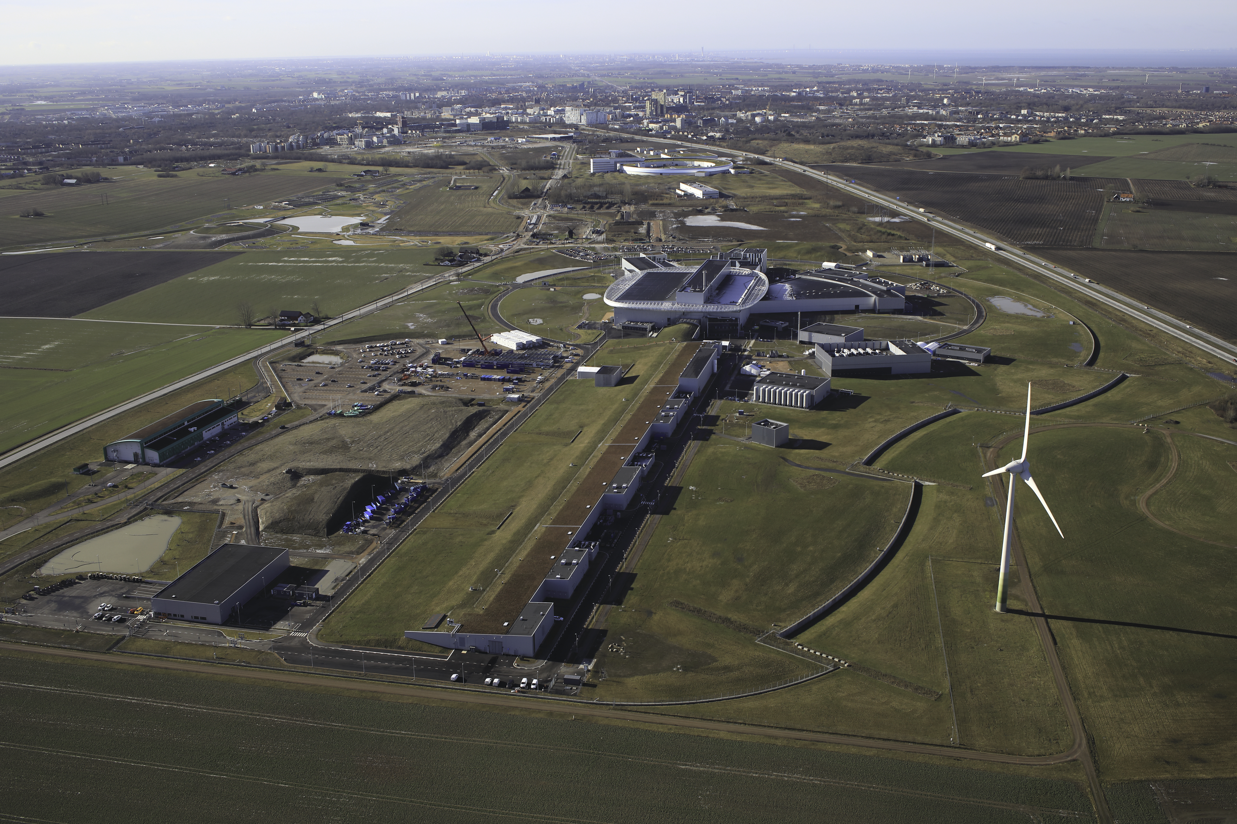
My PhD project at the European Spallation Source
Blahoslav Rataj
Source: Nordeng, Perry. europeanspallationsource.se/media-bank.
“Aerial View over ESS Site.” European Spallation Source, April. 2022.
Notes:
Change title

Slide 2
Outline of the presentation
My background
Extracurricular activities
HighNESS project at the ESS
PhD Project: Designing a cold neutron source for ESS
My favourite courses at Lund University
Outlook
1

Slide 3
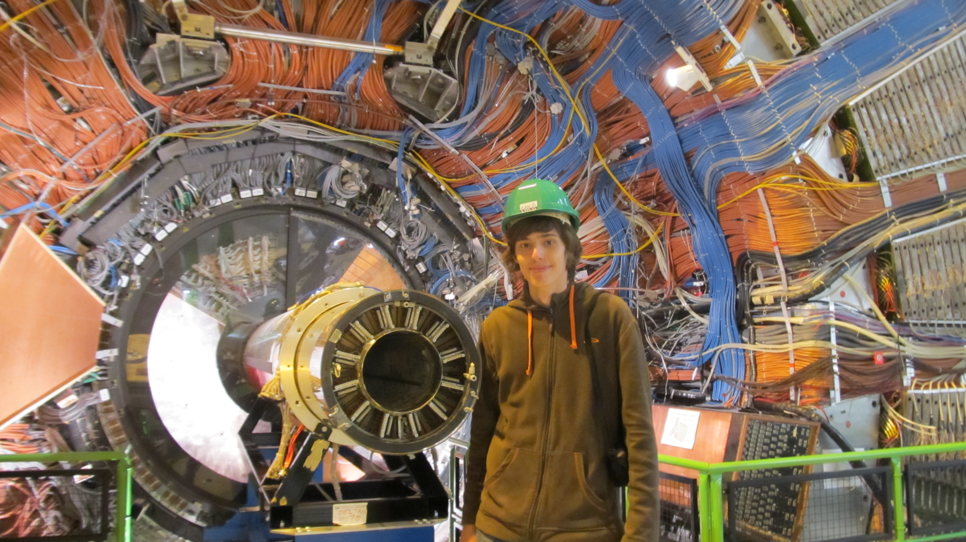
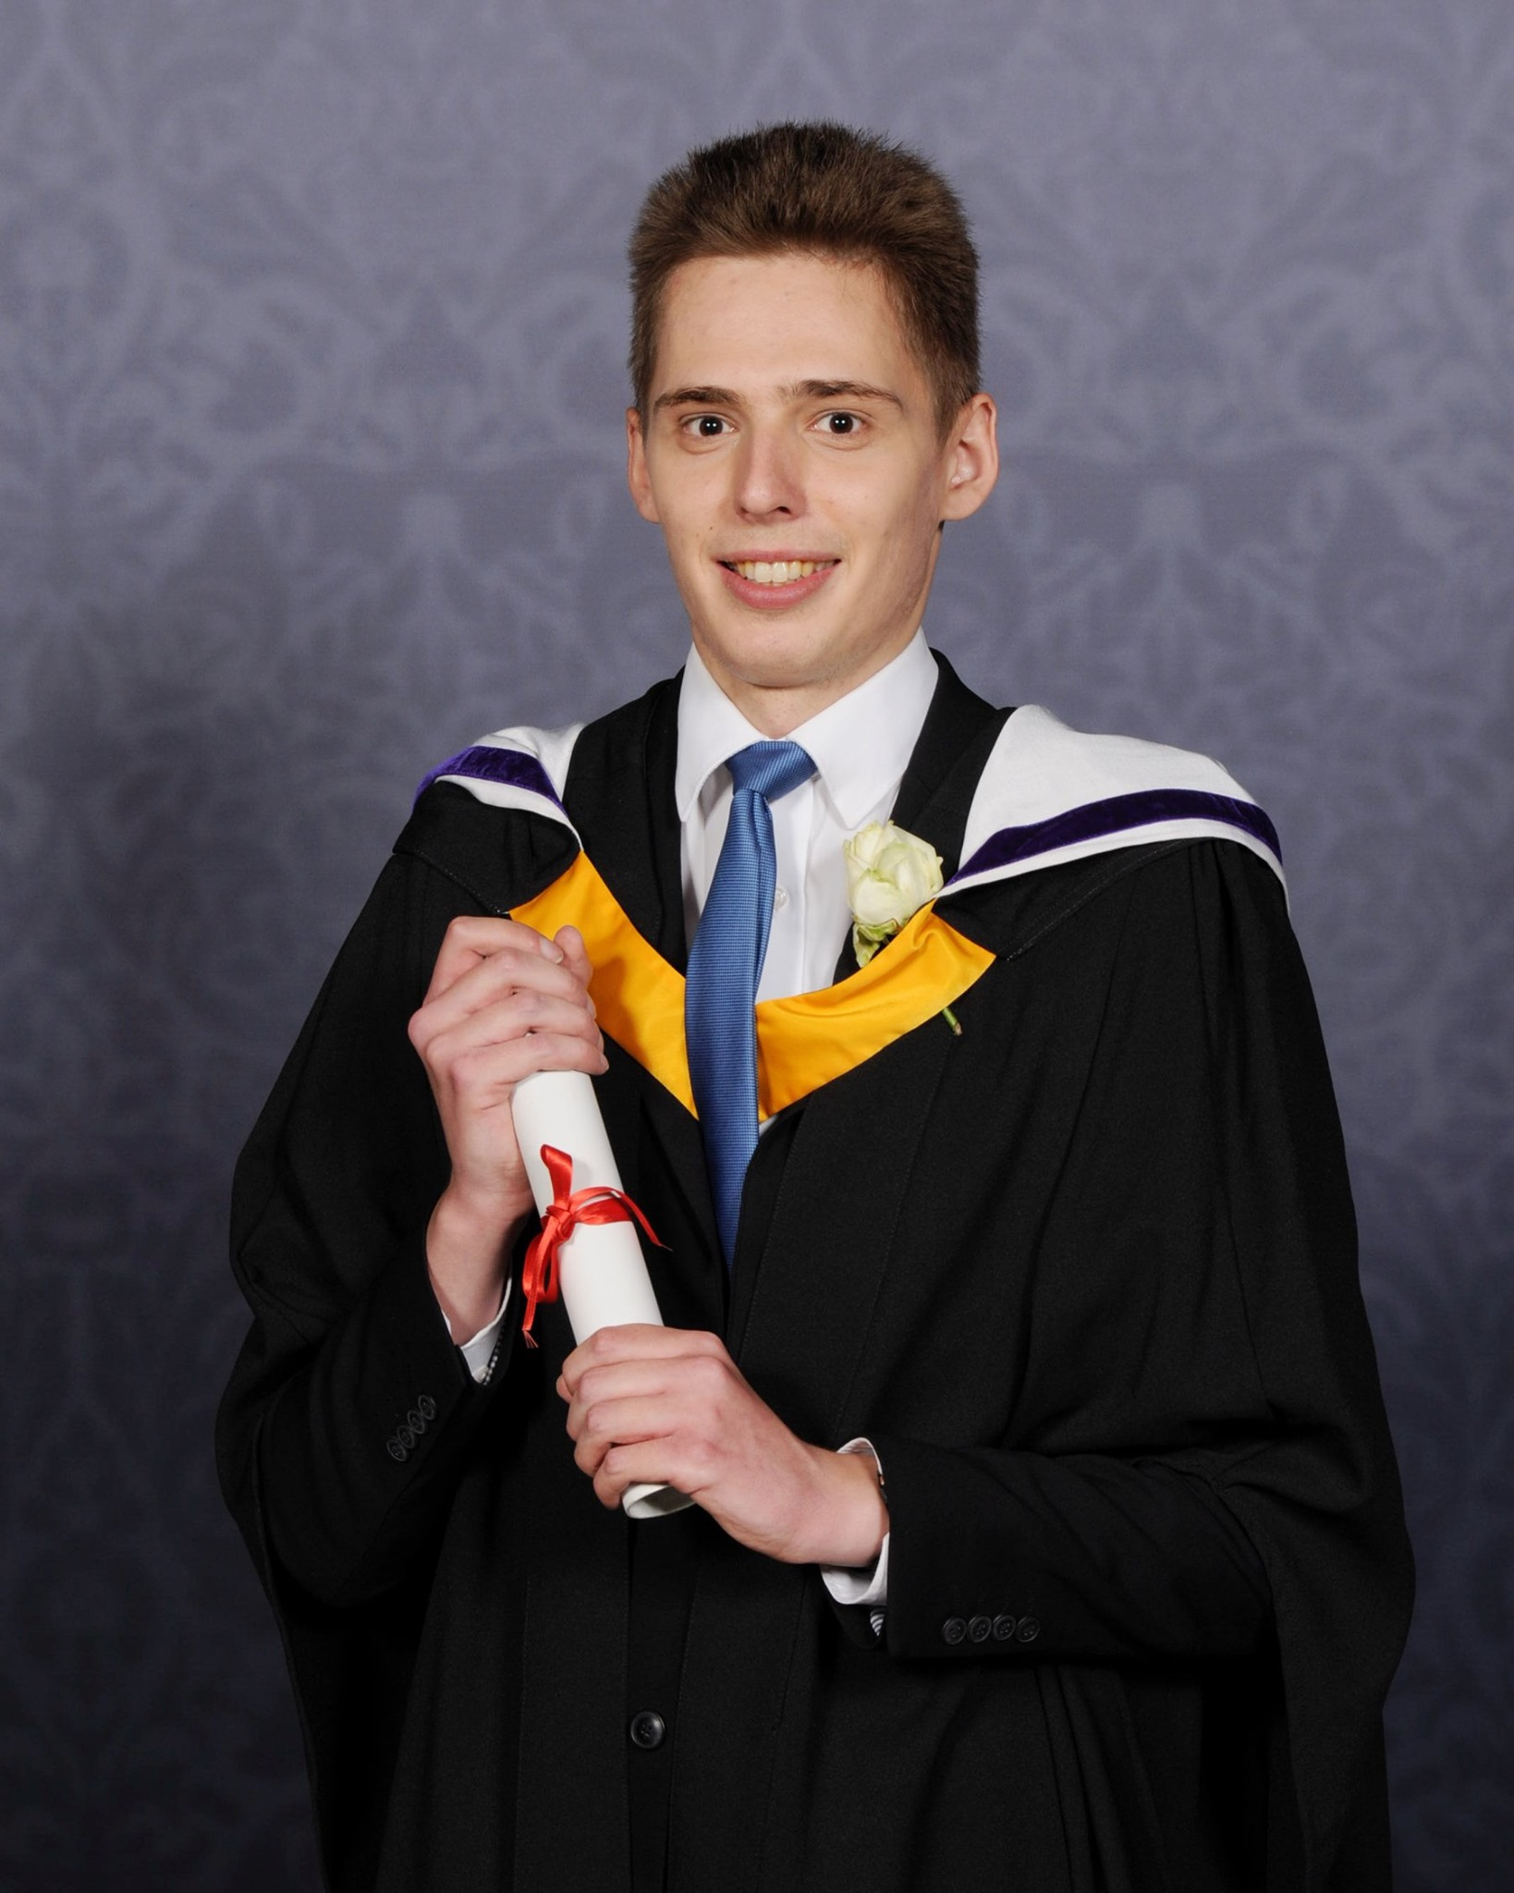
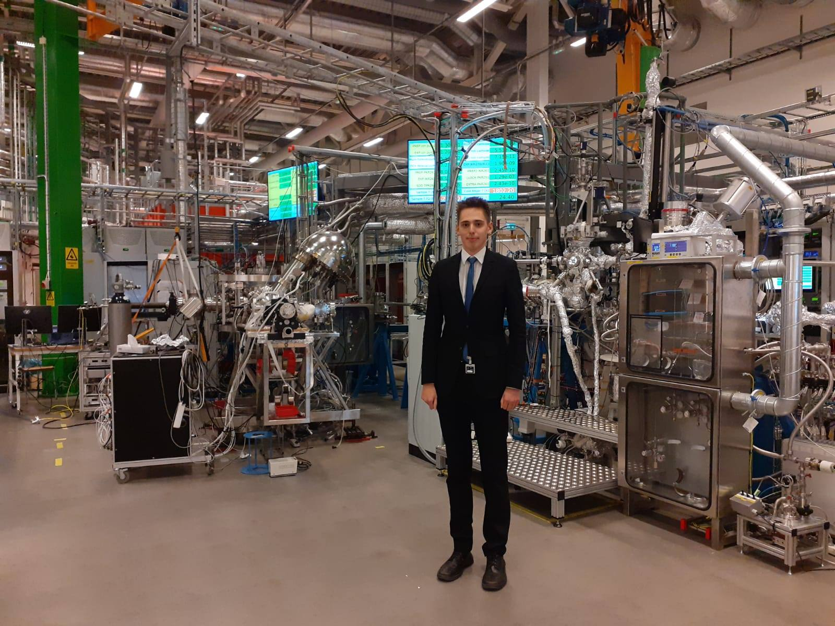


From technical secondary school to PhD at the ESS and Lund University
Smichov secondary technical school: Visiting the LHCb detector
BSc Physics, Imperial College London: Graduation ceremony
MSc Physics, Lund University: Labs at MAX IV
2

Slide 4

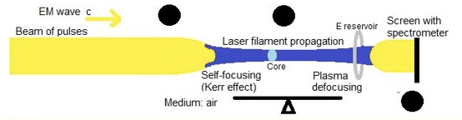

From technical secondary school to PhD at the ESS and Lund University
BSc project: Laser Filament Propagation
MSc project: Background Studies of HIBEAM Experiment at the ESS
Measuring background of fast neutrons
Measuring background of fast neutrons
3

Slide 5
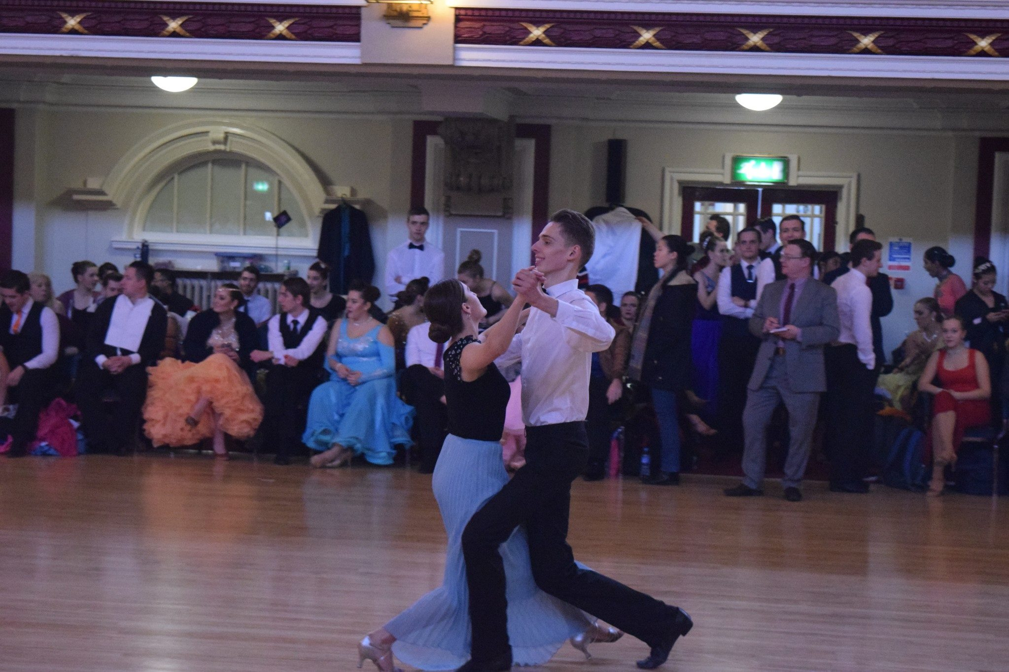
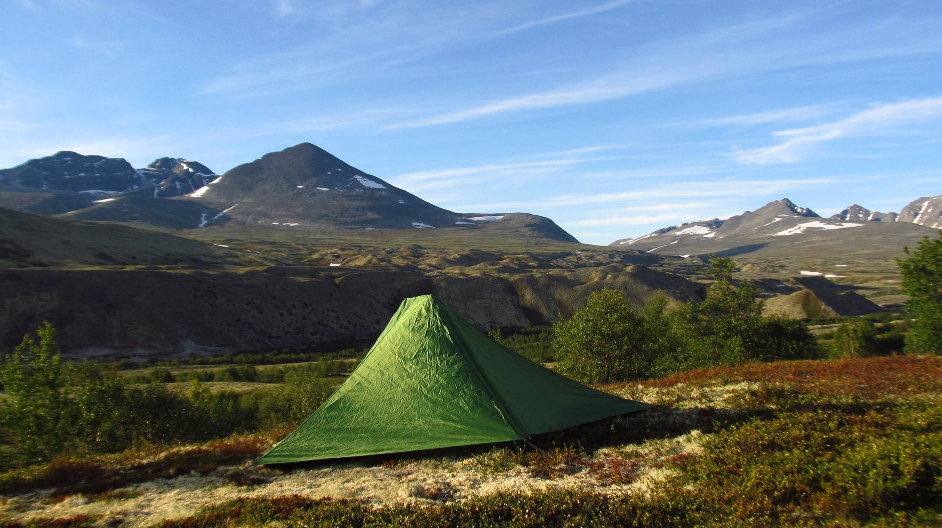
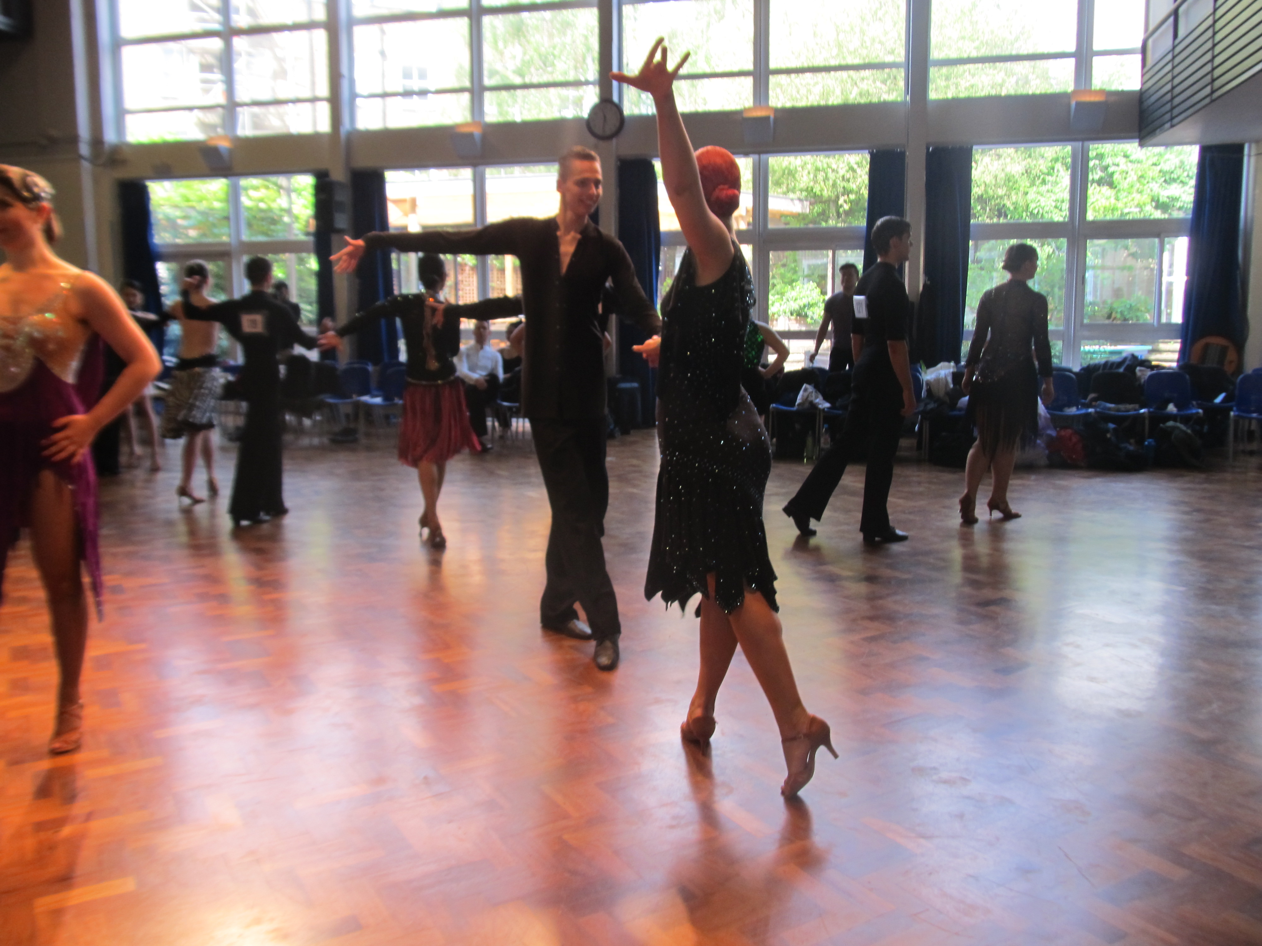
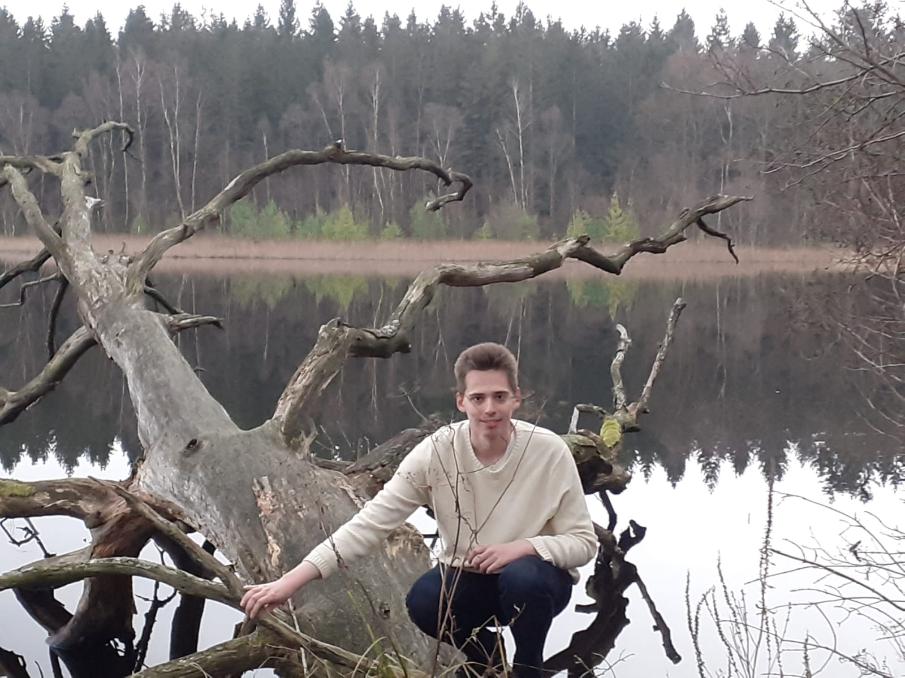
Extracurricular activities – dancing and hiking
4

Slide 6
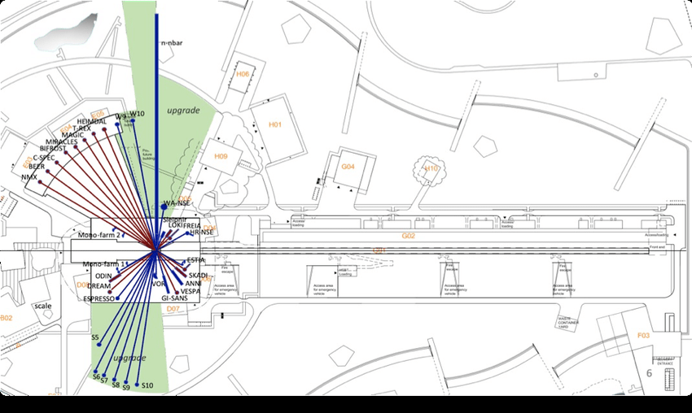
Space for an upgrade at the ESS
The area depicted in green can accommodate new instruments which can take advantage of a new neutron source.
Source: Santoro, Valentina, et al. "Development of high intensity neutron source at the European Spallation Source." Journal of Neutron Research 22.2-3 (2020): 209-219.
5

Slide 7
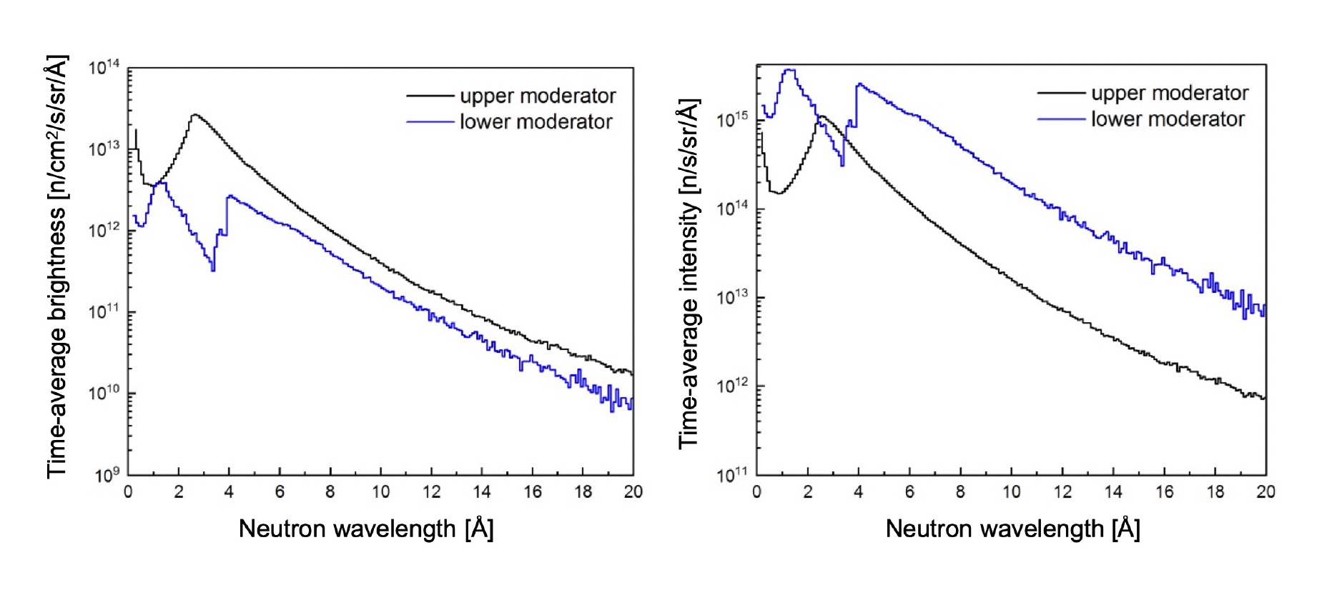
HighNess proposes a new cold neutron moderator for the ESS
The proposed cold neutron moderator below the target maximizes intensity
On the contrary, the currently constructed Butterfly moderator above the target maximizes brightness
Some neutron scattering instruments will benefit from a larger emission window and/or a colder spectrum than the upper moderator.
(a.) Brightness comparison
(b.) Intensity comparison
Zanini, Luca. Very Cold and Ultra Cold sources for ESS. 2022, https://indico.esss.lu.se/event/2810/contributions/15312/attachments/12771/23074/HighNESSZanini.pdf.
6

Slide 8
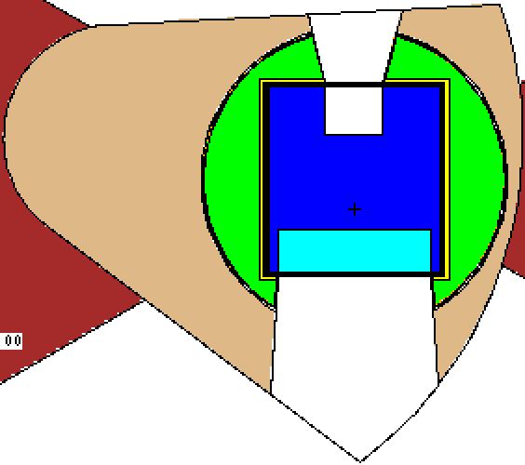
The goal of WP4 of the HighNESS project is to design 3 neutron sources
1
2
3
COLD – CN (2 – 20 Å)
High intensity liquid LD2 at about 20 K
VERY COLD – VCN
(10 - 120 Å)
VCN extraction from main source using advanced reflectors
Dedicated VCN converter
ULTRA COLD – UCN
(> 500 Å)
In beam UCN
In pile UCN
7
20
Notes:
Emphasize Butterfly optimised for brightness,
D2 optimised for intensity
Show comparison of spectrum

Slide 9
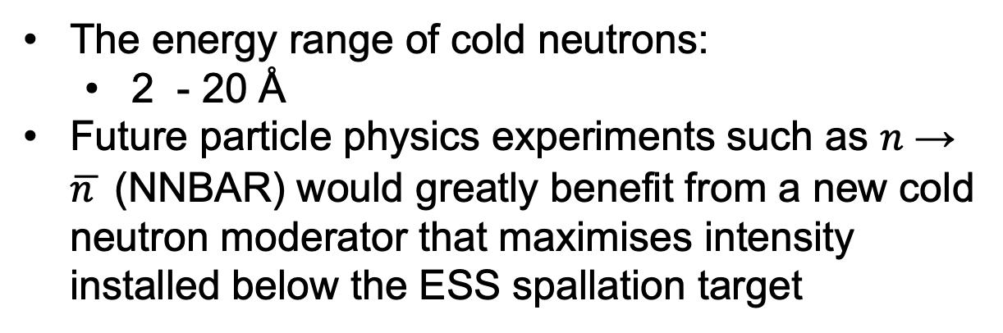
The cold neutrons opens new possibilities for fundamental physics
The energy range of cold neutrons:
2 - 20 Å
Future particle physics experiments such as $n$ → $\overline{n }$ (NNBAR) would greatly benefit from a new cold neutron moderator that maximises intensity installed below the ESS spallation target
8
Notes:
Emphasize Butterfly optimised for brightness,
D2 optimised for intensity
Show comparison of spectrum

Slide 10
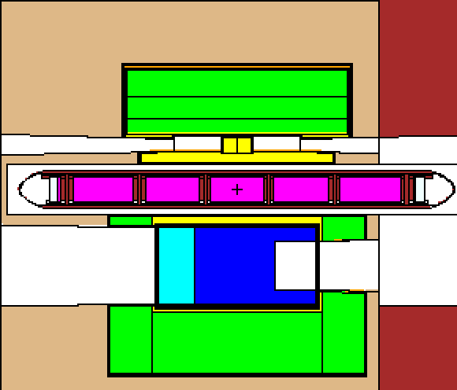
Optimization of the LD2 moderator to improve the intensity of cold neutrons for NNBAR and WP7
Liquid Deuterium
NNBAR
24 CM
WP7
Beryllium filter
Water premoderator
48.5 CM
Beryllium reflector
Baseline model of the moderator from February 2022
9

Slide 11
Optimization of the LD2 moderator to improve the intensity of cold neutrons for NNBAR and WP7
WP7
45 CM
Liquid Deuterium
40 CM
Beryllium filter
Water premoderator
NNBAR
Beryllium reflector
Baseline model of the moderator from February 2022
10
Notes:
Looks Steel and Be
Beryllium reflector = Beryllium filter
Beryllium 300 K = Beryllium reflector
Oceanic water = water

Slide 12
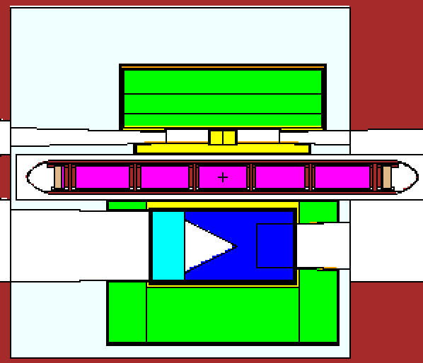
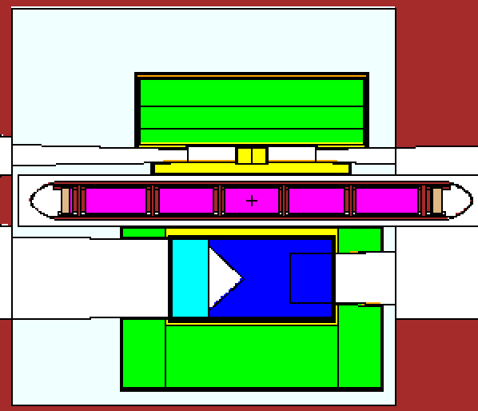
Introducing reentrant holes on the NNBAR and WP7 sides to increase the intensity
Optimizing for different shapes of the reentrant hole
using Dakota together with MCNP
Cone
Wedge
11

Slide 13
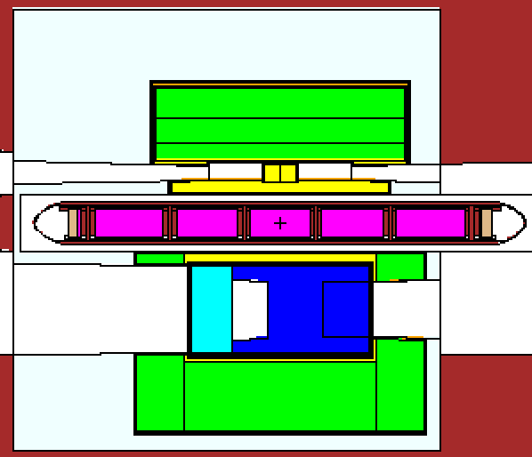
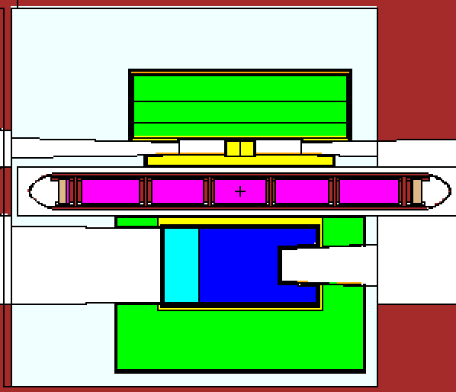
Introducing reentrant holes on the NNBAR and WP7 sides to increase the intensity
Optimizing for different shapes of the reentrant holes
using Dakota together with MCNP
Truncated cone
Divergent reentrant hole
Gives 11 % improvement w.r.t the baseline at the NNBAR detector 300 m from the center (McStas simualtion)
12

Slide 14
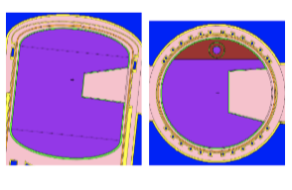
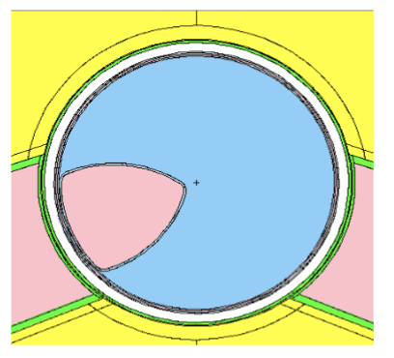
Outlook for the optimization – trying out more shapes
Side view
Top view
Adapted from Bergmann, R. M., et al. "Simulation methods and results of the SINQ cold neutron source upgrade study." Journal of Physics: Conference Series. Vol. 1021. No. 1. IOP Publishing, 2018.
Adapted from Lu. W, ”ANSTO’s Cold Neutron Source Status Future Development Program.” ANSTO
13

Slide 15
My favourite courses at Lund University
Physics: Experimental tools
Astronomy: Observational Techniques and Instrumentation
Physics: Modern Subatomic Physics
Physics: Modern Experimental Particle Physics
Theoretical Physics: Statistical Mechanics
Theoretical Physics: Theoretical Particle Physics – very intense
14

Slide 16
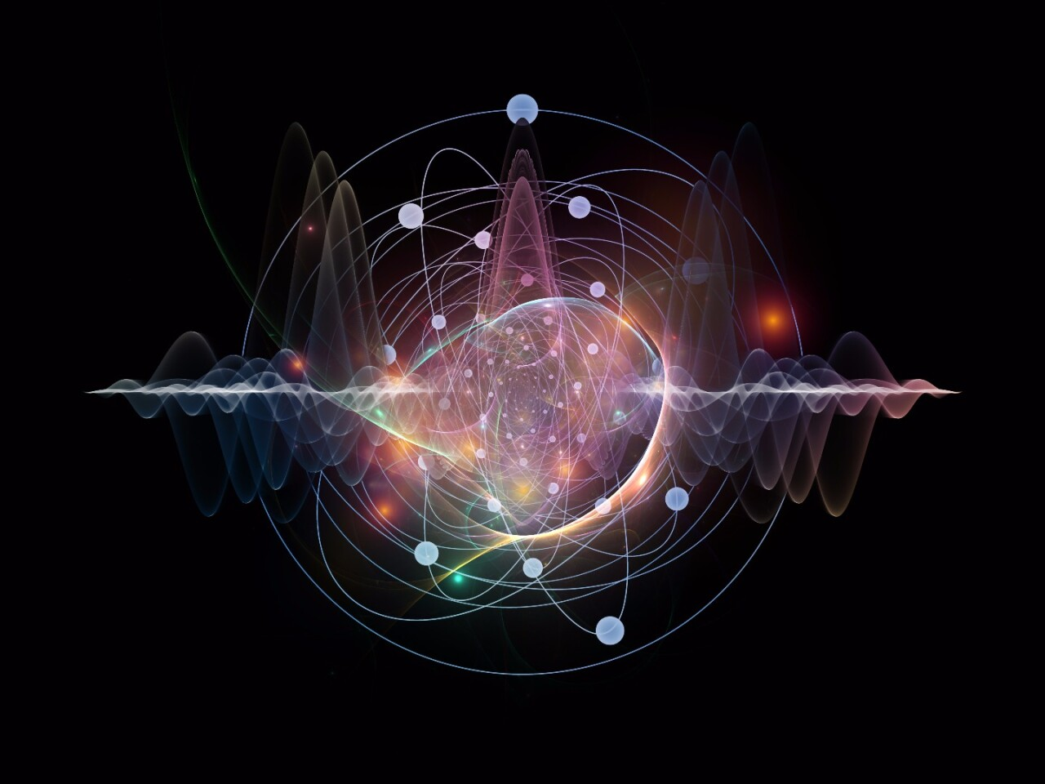
Summary of the presentation
Adapted from Jeffrey, C. (2016). A long way from everything: The search for a Grand Unified Theory. Retrieved 21 November 2021, from https://newatlas.com/einstein-quantum-field-theory-relativity-gravity/42389/
15

