Slide 1


Interplay between core and corona from small to large systems
Y. Kanakubo et al., Phys. Rev. C 105 (2022) 2, 024905
Y. Kanakubo, 2208.07029 [nucl-th]
Yuuka Kanakubo
SOPHIA
HADRON
PHYSICS
GROUP
Sophia University
University of Jyväskylä
Collaborators: Yasuki Tachibana^{A}, Tetsufumi Hirano
Sophia University, Akita International University^{A}

Slide 2
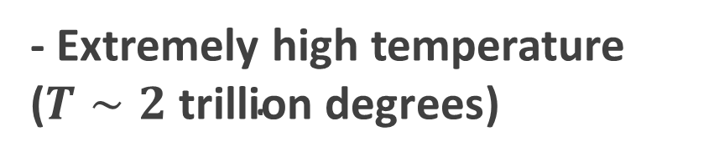

Quark gluon plasma (QGP)
A state of quarks and gluons under thermal & chemical equilibrium
Gluon
Quark
- Extremely high temperature ($T∼2 \text{trillion} \text{degrees}$)
$$T$$
- Early universe
Hadron
QGP
Goal: Revealing the properties of the primordial matter
Only way to create QGP on the earth…
High energy heavy-ion collisions

Slide 3
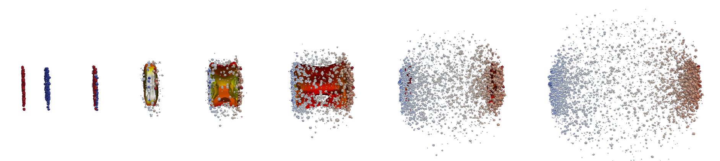
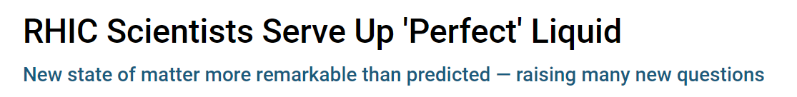
High-energy heavy-ion collisions
QGP
Hadrons
arXiv:1804.06469
How can we access the properties of QGP from HIC experimental data?
Dynamics of locally equilibrated matter
Relativistic hydrodynamics
Press release on 2005/04/18
https://www.bnl.gov/newsroom/news.php?a=110303

Slide 4
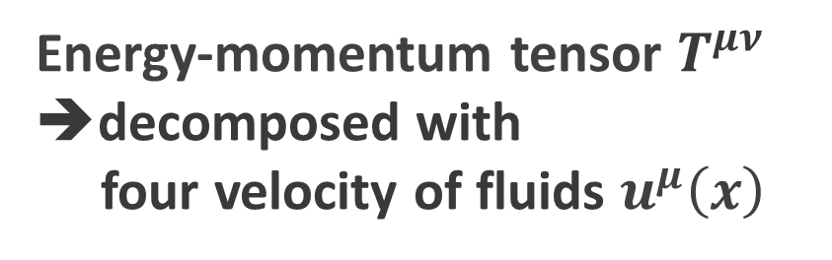



Relativistic hydrodynamics in one slide
Energy-momentum tensor $T^{μν}$ ➔decomposed with
four velocity of fluids $u^{μ}\left(x\right)$
Energy-momentum conservation
$$∂_{μ}T^{μν}=0$$
Lattice EoS (high T)
Hadronic resonance gas EoS (low T)
Equation of state (EoS)
$$P=P\left(e\right)$$
Many-body system of quarks and gluons
$$u^{μ}\left(x\right)$$
Dynamics of locally-equilibrated patches
➔ Local equilibration

Slide 5



Hydro-based multi-stage dynamical model
$$t$$
QGP is a transient state in HIC!
Different stage needs different picture
Detector
Hadronic transport
Hadron gas
Fluids ➔ particles
Relativistic hydrodynamics
QGP
$$z$$
Collision
Initial condition
Space-time evolution of HIC
Standard model in HIC

Slide 6
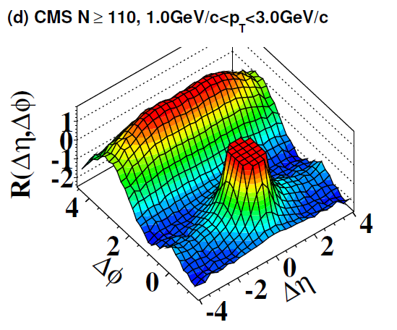
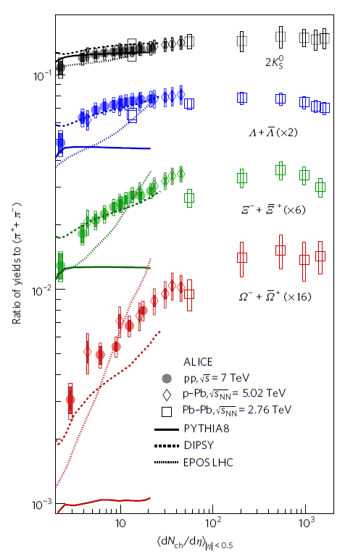


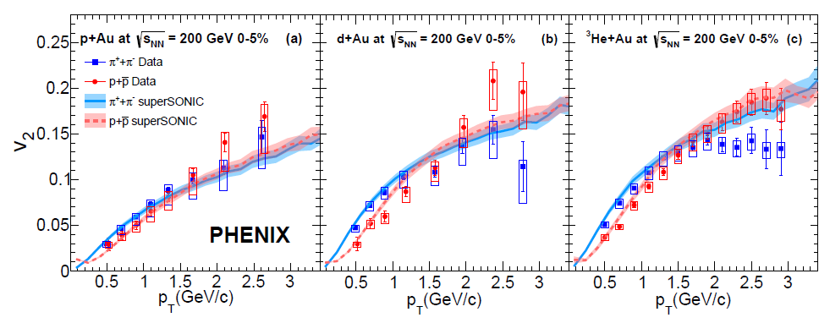
QGP signals in high-multiplicity small systems
pp collisions as a reference for HIC with QGP formation…
Strangeness enhancement
Paradigm shift (2010-)
Experimental data in high-multi. pp
Long range correlation
Thermal strange hadron productions
JHEP 09 091 (2010)
Nature Phys. 13 535-539 (2017)
Hydro-like collectivity
➔QGP signals observed in HIC
Comprehensive picture from pp to AA?
Phys. Rev. C 97, 064904 (2018)
Flow harmonics

Slide 7

Comprehensive picture from pp to AA
pp
AA
Y. Kanakubo et al., PTEP 2018 12, 121D01 (2018);
Y. Kanakubo et al., Phys. Rev. C 101 2, 024912 (2020);
Y. Kanakubo et al., Phys. Rev. C 105 (2022) 2, 024905
Dynamical Core-Corona Initialization framework (DCCI)
Core: fluids (equilibrated matter)
Corona: non-equilibrated partons
➔ From low to high $p_{T}$, from forward to backward, and from pp to AA
Core-corona: K. Werner, Phys.Rev.Lett. 98 (2007) 152301

Slide 8
Dynamical Core-Corona Initialization model
2
Y. Kanakubo et al., arXiv:2108.07943

Slide 9

Model flowchart of DCCI2
Y. Kanakubo et al., Phys. Rev. C 105 (2022) 2, 024905
Initial partons:
PYTHIA8/PYTHIA8 Angantyr
T. Sjöstrand et al., Comput. Phys. Commun. 191, 159 (2015)
C. Bierlich et al., JHEP 1610 139 (2016)
Dynamical initialization of QGP fluids based on core-corona
Equilibrated matter (core)
(3+1)-D hydro with source terms
Non-equilibrated partons (corona)
Y. Tachibana et al., Phys. Rev. C 90, 021902 (2014)
PYTHIA8 (string fragmentation)
iS3D (thermal hadron sampling)
M. McNelis et al., Comput. Phys.Commun.258, 107604 (2021)
Hadronic afterburner: JAM
Y. Nara et al.,Phys. Rev. C61, 024901 (2000)

Slide 10

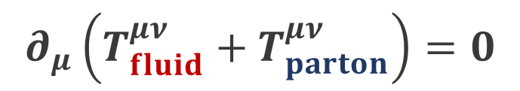
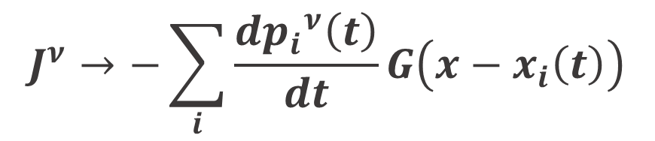
Dynamical initialization framework
Continuum eq. for fluids + partons
Two-component picture
➔ fluids and partons
$$∂_{μ}\left(T_{fluid}^{μν}+T_{parton}^{μν}\right)=0$$
Hydrodynamic eq. with source term
fluids
$∂_{μ}T_{fluid}^{μν}=J^{ν}$
Gaussian profile $G$ and straight trajectory for a parton
partons
$$J^{ν}→−\sum_{i}{\frac{d{p_{i}}^{ν}\left(t\right)}{dt}}G\left(x−x_{i}\left(t\right)\right)$$
Total system
“Sources of fluids”
= “Four-momentum deposition from partons”

Slide 11

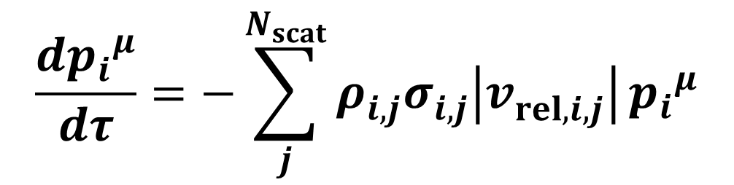


Dynamical core-corona picture
Multiple scatterings among partons ➔ partial equilibration
$$\frac{d{p_{i}}^{μ}}{dτ}=−\sum_{j}^{N_{scat}}{ρ_{i,j}^{}σ_{i,j}^{}\left|v_{rel, i,j}^{}\right|}{p_{i}}^{μ}$$
Defined at a co-moving frame with $η_{s, i}$
Energy-momentum deposition
➔ # of scatterings with partons (non-equilibrated and equilibrated)
Low $p_{T}$ and/or dense region
Core (fluids)
High $p_{T}$ and/or dilute region
Corona (non-equilibrated partons)

Slide 12
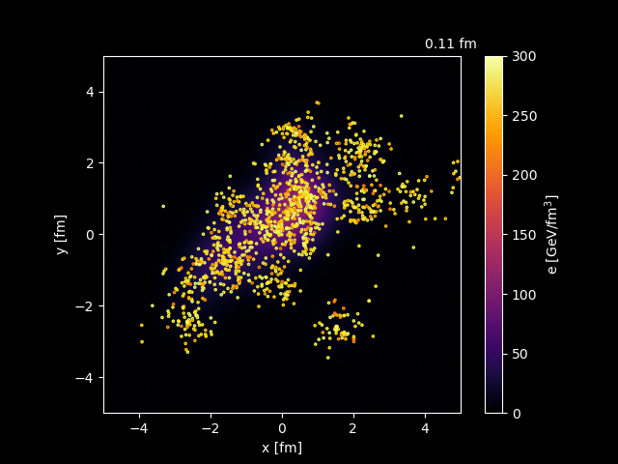
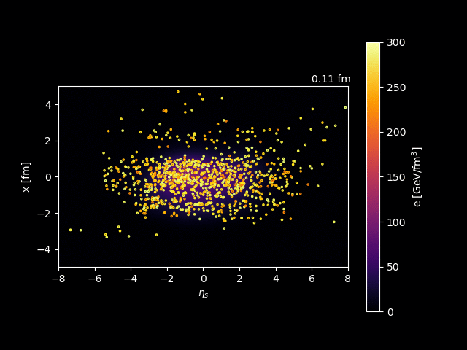
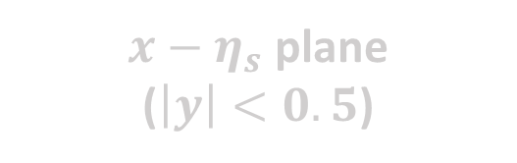

Dynamical core-corona initialization
PbPb 2.76 TeV
Transverse plane
($\left|η_{s}\right|<0.5$)
$x−η_{s}$ plane
($\left|y\right|<0.5$)

Slide 13
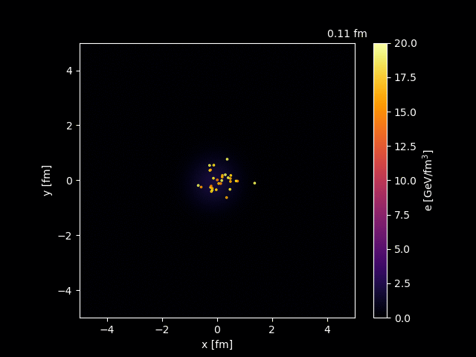
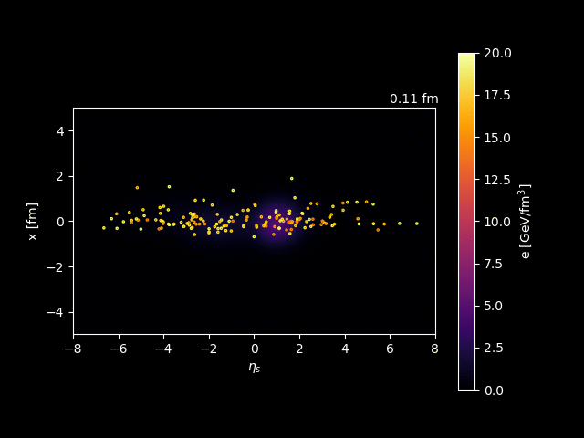

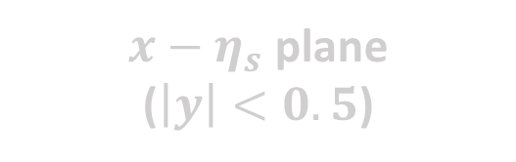
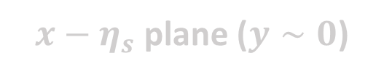
Dynamical core-corona initialization
pp 7 TeV
Transverse plane
($\left|η_{s}\right|<0.5$)
$x−η_{s}$ plane
($\left|y\right|<0.5$)
$x−η_{s}$ plane ($y∼0$)

Slide 14
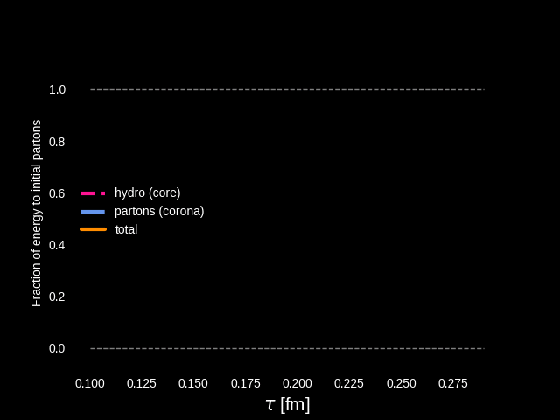
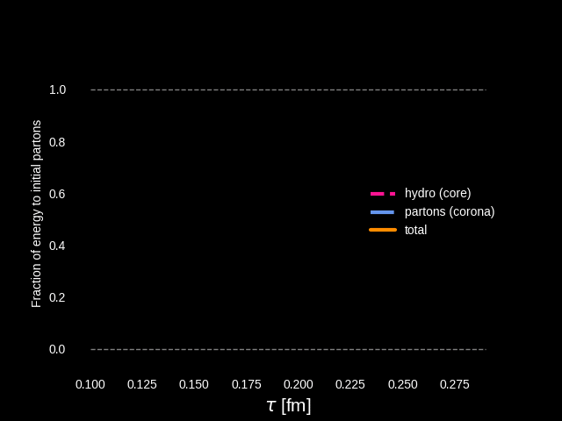

Energy budget in dynamical core-corona initialization
Dynamical energy conversion from initial partons (corona) to fluids (core)
PbPb
pp
Starting from vacuum $T^{μν}=0$ for fluids
Energy & momentum conservation as total system
Characteristic of DCCI2?
Dynamical realization of core-corona picture

Slide 15













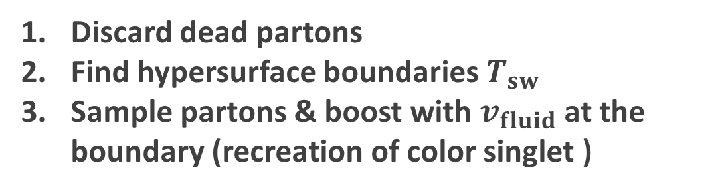


Corona components from string modification
$$τ_{s}=0.3 fm$$
$$τ_{s}<τ<τ_{fo}$$
String cutting
Parton-pairing
String modification caused by ..
Discard dead partons
Find hypersurface boundaries $T_{sw}$
Sample partons & boost with $v_{fluid}$ at the boundary (recreation of color singlet )
・Spatial overlap of strings and medium
・Completely fluidized partons

Slide 16


Corona components from string modification (cont’d)
$$τ_{s}=0.3 fm$$
$$τ_{s}<τ<τ_{fo}$$
String cutting
Parton-pairing
4. Surviving partons traverse medium
5. Make a pair for a parton coming out from medium
Non-thermal & thermal
➔ Contributes as corona components
*$p_{T, cut}$: threshold to/not to modify a string

Slide 17
Model flowchart of DCCI2
Y. Kanakubo et al., Phys. Rev. C 105 (2022) 2, 024905
Initial partons:
PYTHIA8/PYTHIA8 Angantyr
T. Sjöstrand et al., Comput. Phys. Commun. 191, 159 (2015)
C. Bierlich et al., JHEP 1610 139 (2016)
Dynamical initialization of QGP fluids based on core-corona
Equilibrated matter (core)
(3+1)-D hydro with source terms
Non-equilibrated partons (corona)
Y. Tachibana et al., Phys. Rev. C 90, 021902 (2014)
PYTHIA8 (string fragmentation)
iS3D (thermal hadron sampling)
M. McNelis et al., Comput. Phys.Commun.258, 107604 (2021)
Hadronic afterburner: JAM
Y. Nara et al.,Phys. Rev. C61, 024901 (2000)

Slide 18
DCCI2: combination of hydro and PYTHIA
DCCI2
Hydro (and hadronic) afterburner on PYTHIA
From HIC community’s point of view
From high-energy physics community’s point of view
Corona (non-equilibrium) correction on hydro

Slide 19
Parameter fixing in DCCI2

Slide 20
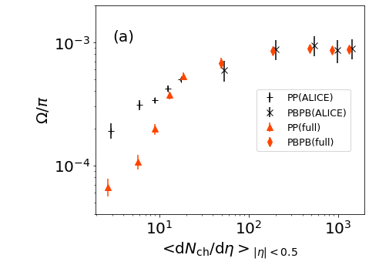


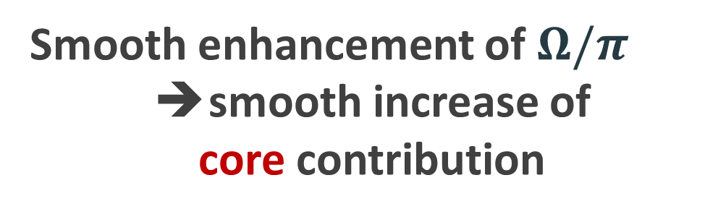
$Ω/π$ ratio from pp to PbPb
Fixing parameters to control fraction of core/corona
Core
Smooth enhancement of $Ω/π$
smooth increase of
core contribution
B. Abelev et al. (ALICE Collaboration), Phys. Lett. B 728, 216-227 (2014); erratum 734, 409-410 (2014)
J. Adam et al., (ALICE Collaboration), Nature Phys. 13 535-539 (2017)
Starting point
Corona
Describe composition of matter

Slide 21
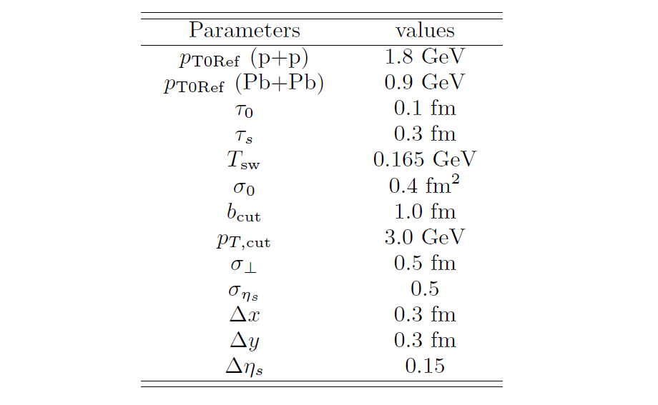

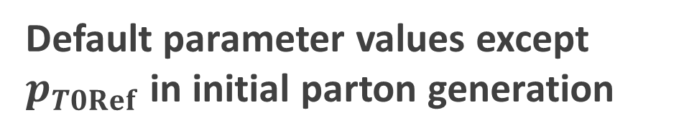
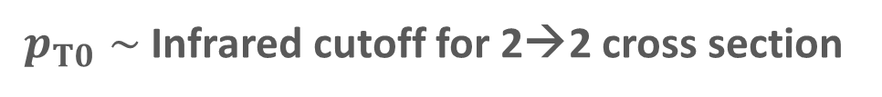

Parameter set for PYTHIA part: almost Monash Tune
How far can we go as a naive combination of hydro and PYTHIA
PYTHIA
…with simple starting point
Default parameter values except $p_{T0Ref}$ in initial parton generation
Hydro with dynamical core-corona
$$\frac{dσ_{2→2}}{dp_{T}^{2}}∝\frac{α_{s}^{2}\left(p_{T}^{2}\right)}{p_{T}^{4}}→\frac{α_{s}^{2}\left(p_{T}^{2}+p_{T,0}^{2}\right)}{{\left(p_{T}^{2}+p_{T,0}^{2}\right)}^{2}}$$
$p_{T0}∼$ Infrared cutoff for 2→2 cross section

Slide 22
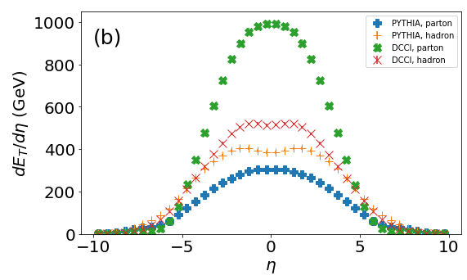
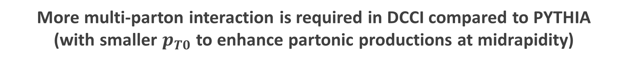

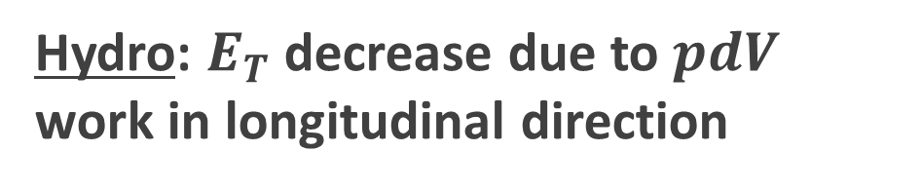
Difference of $E_{T}$ evolution between hydro and string frag.
PbPb (MB)
Hydro: $E_{T}$ decrease due to $pdV$ work in longitudinal direction
String fragmentation:
$E_{T}$ enhance
More multi-parton interaction is required in DCCI compared to PYTHIA
(with smaller $p_{T0}$ to enhance partonic productions at midrapidity)
Different dynamics in later stage
➔ Require different initial energy profile

Slide 23
Results

Slide 24
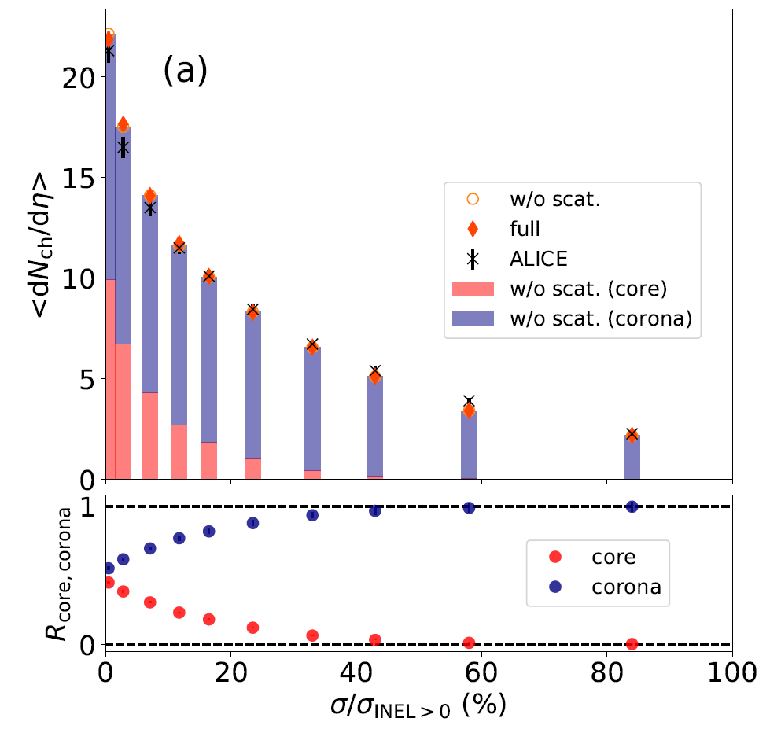
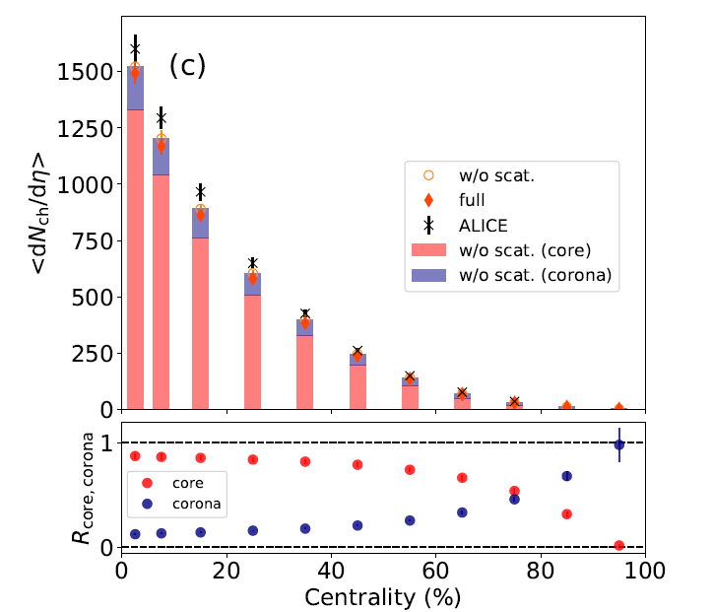
Fraction of core and corona in pp and PbPb
pp 7 TeV
PbPb 2.76 TeV
Corona
J. Adam et al., (ALICE Collaboration), Nature Phys. 13 535-539 (2017)
Core
K. Aamodt et al., (ALICE Collaboration), Phys. Rev. Lett. 106 032301 (2011)
pp: core/corona $∼50\%$ at the highest multiplicity class (0-0.95%)
PbPb: corona $∼20\%$ at intermediate centralities (40-60%)

Slide 25
Fraction of core and corona in pp and PbPb
pp 7 TeV
PbPb 2.76 TeV
Corona
J. Adam et al., (ALICE Collaboration), Nature Phys. 13 535-539 (2017)
Core
K. Aamodt et al., (ALICE Collaboration), Phys. Rev. Lett. 106 032301 (2011)
➔ Need both equilibrated and non-equilibrated matter
in both pp and AA

Slide 26
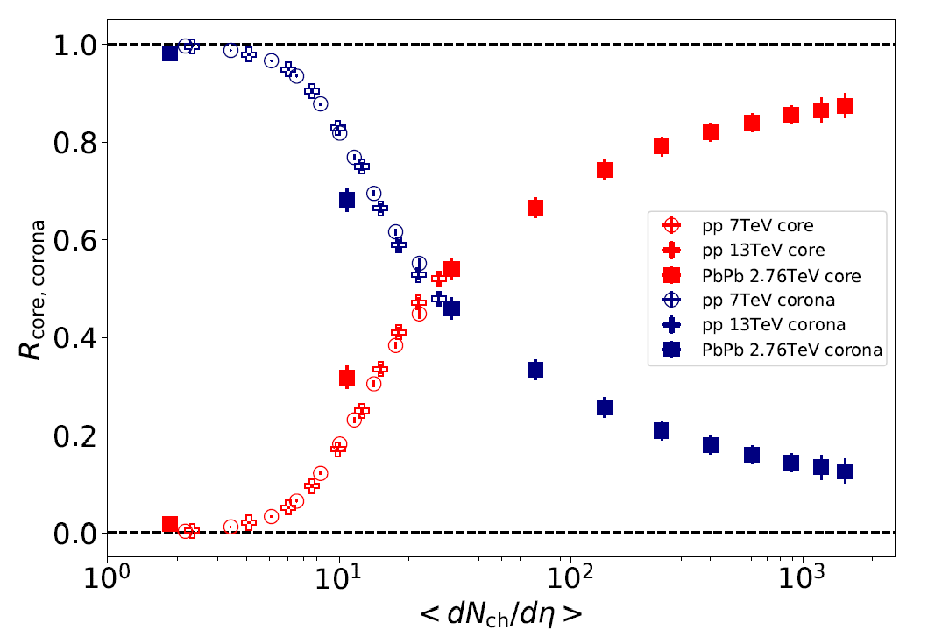

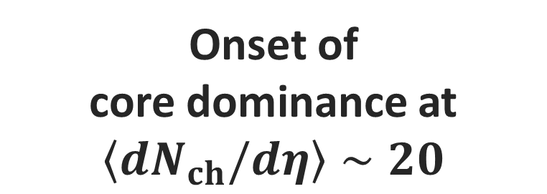
Onset $\left\langle dN_{ch}/dη\right\rangle$ of core dominance
Core
Clear scaling with multiplicity
Onset of
core dominance at $\left\langle dN_{ch}/dη\right\rangle ∼20$
Corona
PbPb
pp

Slide 27
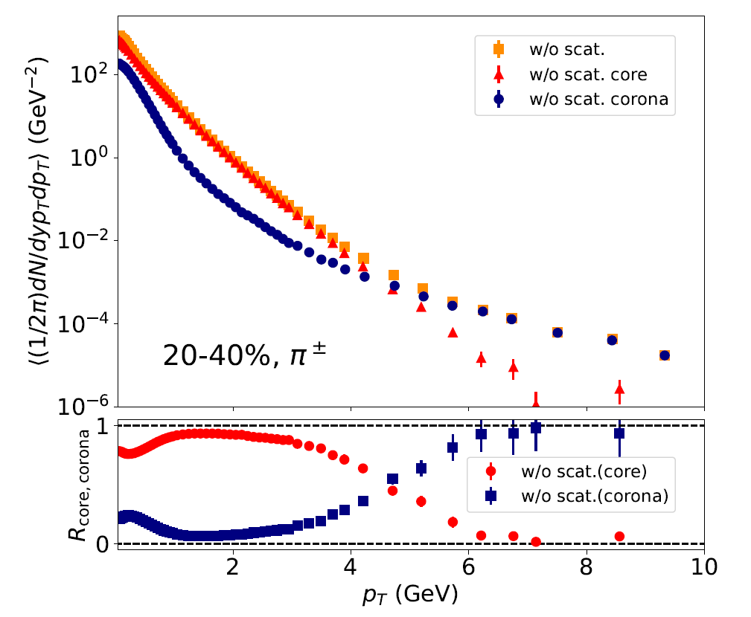





Fraction of core and corona vs. $p_{T}$
Charged $π$, PbPb 2.76 TeV, 20-40%
Core
Low $p_{T}$: core dominance
high$p_{T}$: corona dominance
Corona
Core-corona picture
➔ From low to high $p_{T}$ within one framework
$$p_{T} (GeV)$$

Slide 28
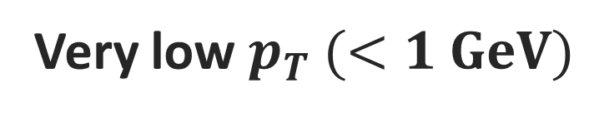
Fraction of core and corona vs. $p_{T}$
Charged $π$, PbPb 2.76 TeV, 20-40%
Core
Very low $p_{T} (<1 GeV)$
Slight enhancement of corona components
Corona
Non-equilibrium corrections to core (equilibrium)
$$p_{T} (GeV)$$

Slide 29
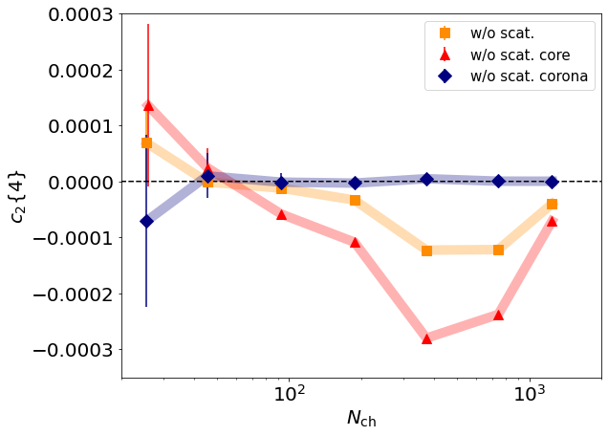
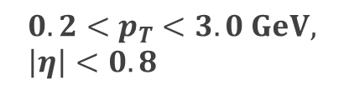
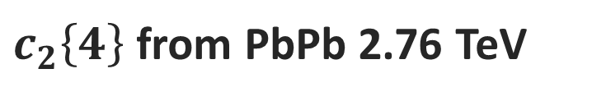



Corona corrections to flow
$c_{2}\left\{4\right\}$ from PbPb 2.76 TeV
$$c_{2}{\left\{4\right\}}_{core}≠c_{2}{\left\{4\right\}}_{tot}$$
$$0.2<p_{T}<3.0 GeV, \left|η\right|<0.8$$
➔ Diluted by corona
Conventional Hydro model
$c_{2}\left\{4\right\}$
Comparison
Experiment
➔ Need both equilibrated and non-equilibrated matter
$$N_{ch}$$

Slide 30

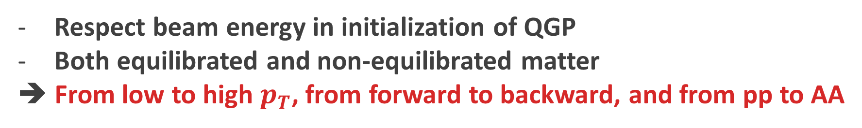
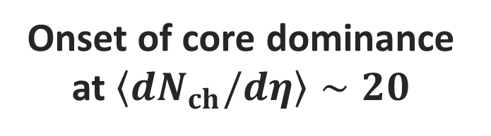
Summary
Dynamical core-corona initialization (DCCI2)
Respect beam energy in initialization of QGP
Both equilibrated and non-equilibrated matter
➔ From low to high $p_{T}$, from forward to backward, and from pp to AA
Yield ratios of strange hadrons from pp to PbPb
Onset of core dominance at $\left\langle dN_{ch}/dη\right\rangle ∼20$
Non-equilibrium corrections to core (equilibrium)
Need both equilibrated and non-equilibrated matter in both pp and AA
How far can we go with combination of hydro and PYTHIA?

Slide 31
backup

Slide 32
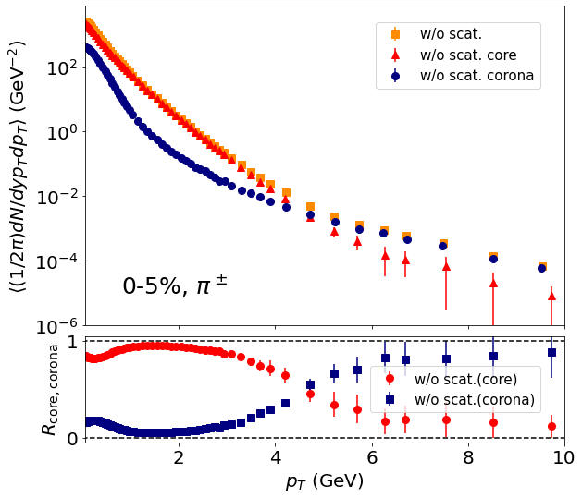
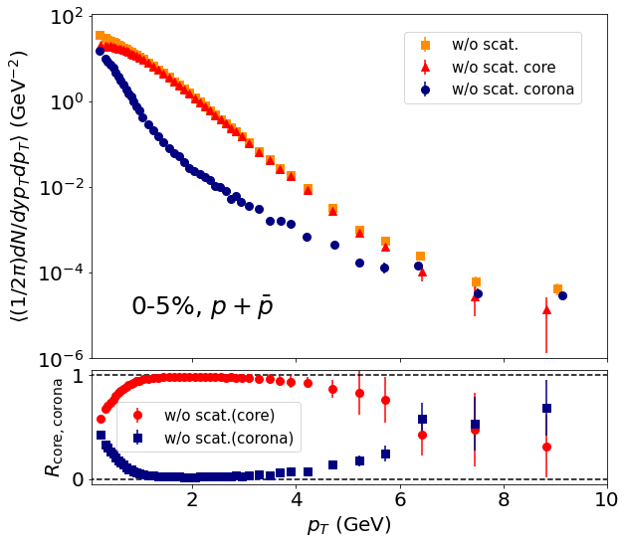




Fraction of core and corona vs. $p_{T}$
Core
$$π$$
$$p$$
Corona
$$p_{T} (GeV)$$
$$p_{T} (GeV)$$
Core dominance up to higher $p_{T}$
for heavier hadrons
T. Hirano and Y. Nara, Phys. Rev. C 69, 034908 (2004).

Slide 33
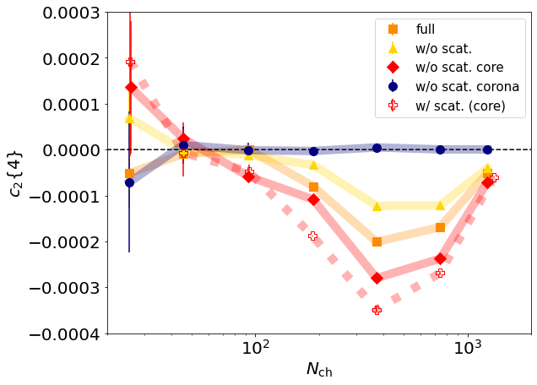
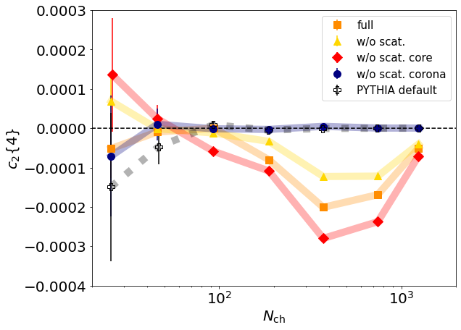

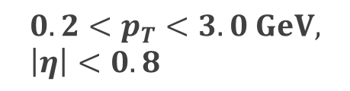
$c_{2}\{4\}$ vs $N_{ch}$
$$0.2<p_{T}<3.0 GeV, \left|η\right|<0.8$$

