Slide 2
The ESS accelerator KVA visit to ESS 2022
Mats Lindroos on behalf of the ESS accelerator collaboration

Slide 3
High Power 5MW Proton Accelerator
Target
Target
Target
ISrc
LEBT
RFQ
MEBT
SPK
HEBT
Dump
ISrc
LEBT
RFQ
MEBT
DTL
SPK
MBL
HBL
HEBT
Dump
DTL
HBL
Dump
MEBT
MBL
HEBT
Dump
ISrc
LEBT
RFQ
MEBT
HEBT
ISrc
LEBT
RFQ
DTL
SPK
HBL
DTL
SPK
MBL
HBL
MBL
75 keV
3.6 MeV
90 MeV
216 MeV
571 MeV
870 MeV
75 keV
3.6 MeV
21 MeV
90 MeV
216 MeV
571 MeV
75 keV
75 keV
3.6 MeV
3.6 MeV
90 MeV
90 MeV
216 MeV
571 MeV
216 MeV
571 MeV
Target
The ESS accelerator was designed and is built by a collaboration of 23 institutes and universities in Europe
More then 50% of the total budget is delivered as In-kind with most systems being IK deliveries. The main exceptions are the cryo plants, the 704 MHz klystrons and modulators.
ESS accelerator division is responsible for functional requirements, coordination of work, installation including infrastructure, testing & commissioning and operation.
The linac shall in the full scope deliver 5 MW at 2 GeV, 14 Hz with 2.86 ms long pulses
For Beam on Dump and Ready for Beam on target the accelerator will operate at 572 MeV able to put 1.4 MW on the target with nominal duty-cycle. Planned with the medium beta elliptical section , but two high beta will be used to compensate for medium beta cavities needing reprocessing
For End-Of-Construction in 2027, an additional cryomodules will be installed and powered enabling operation at 2 MW, 870 MeV with nominal duty cycle
The remaining cryomodules will be installed in the tunnel during shutdowns but not powered with RF. Control and operation of e.g. tuners and cryogenics will be available for all cryomodules.

Slide 4
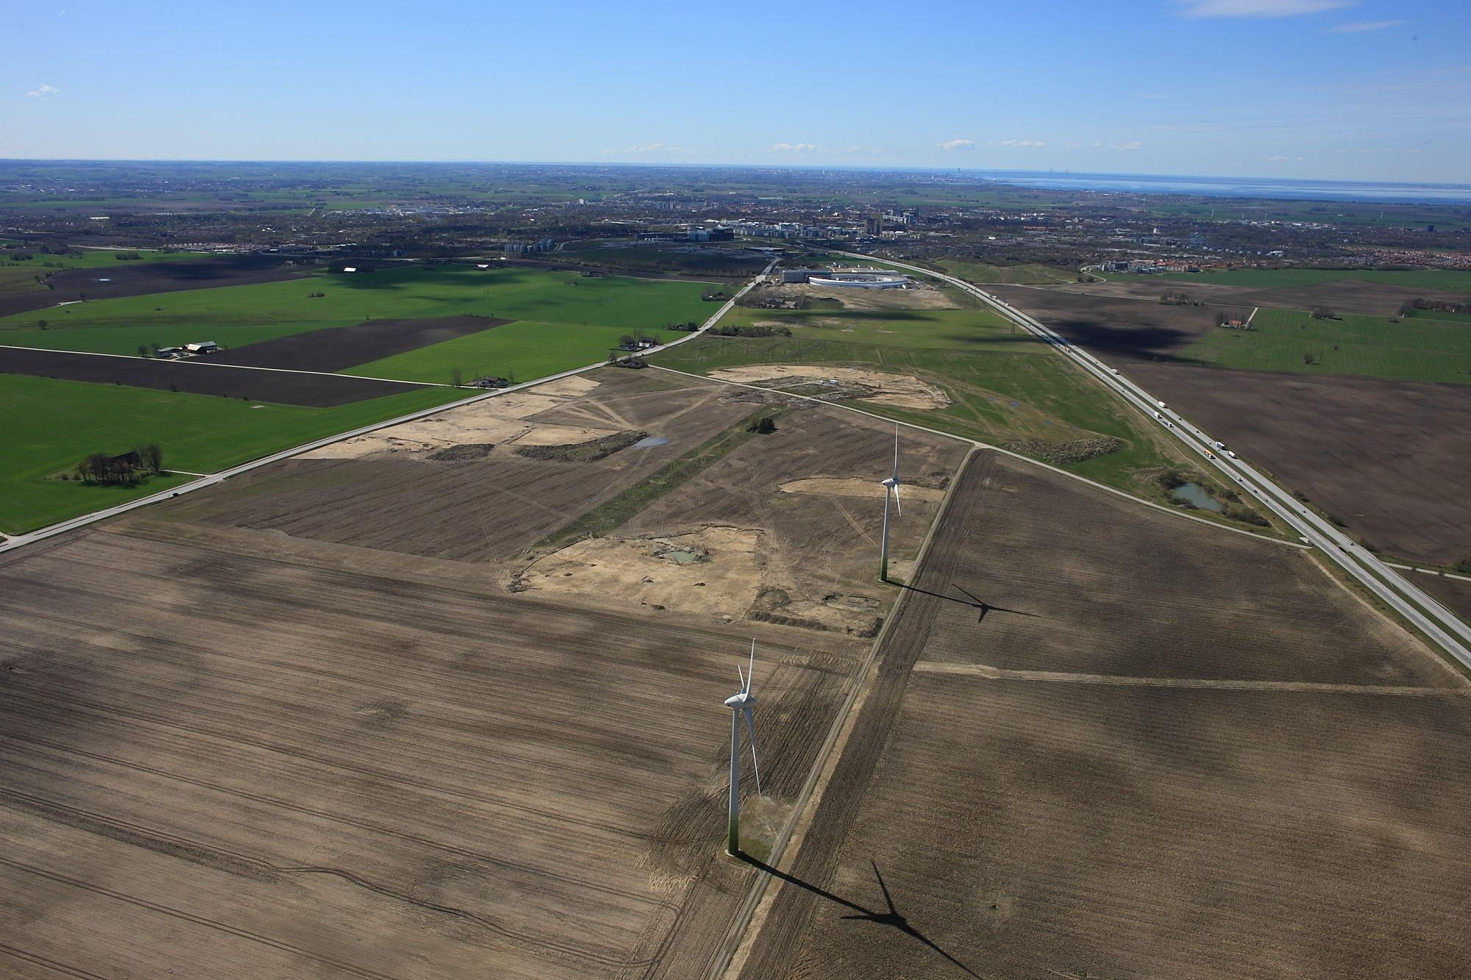
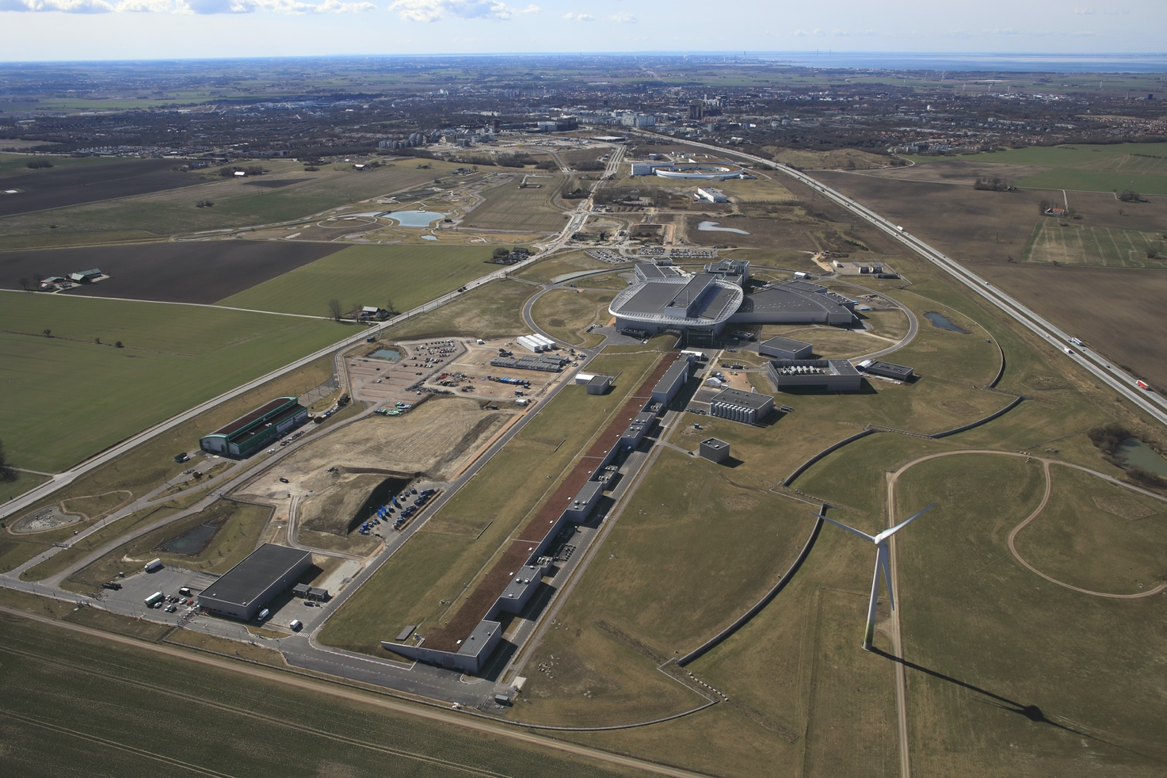
From Green Field to ESS
May 2014 vs April 2022

Slide 5







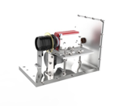
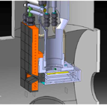

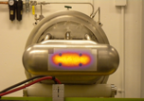


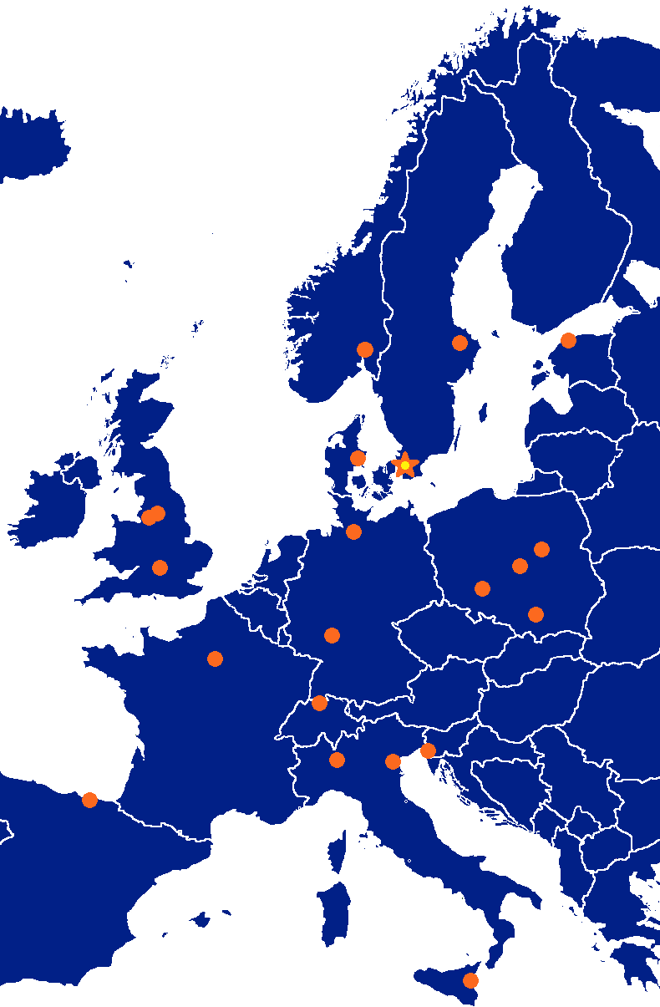










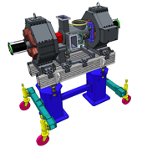


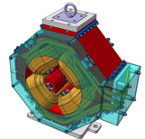




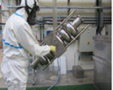


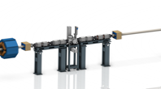






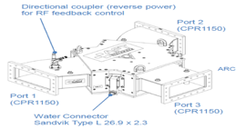
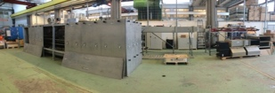





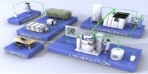










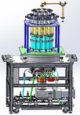
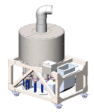



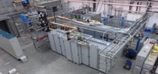

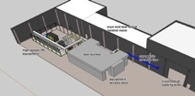
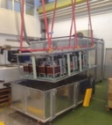

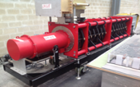
Accelerator Collaboration Collaboration - Accelerator
352.21 MHz
704.42 MHz
2.4 m
4.6 m
3.8 m
39 m
56 m
77 m
179 m
Target
Source
LEBT
RFQ
MEBT
DTL
Spokes
Medium β
High β
HEBT & Contingency
75 keV
3.6 MeV
90 MeV
216 MeV
571 MeV
2000 MeV
5

Slide 6
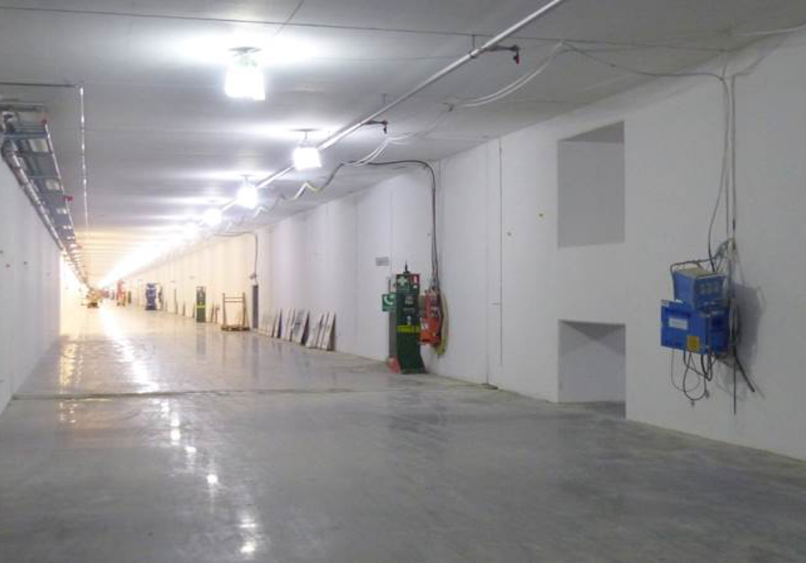
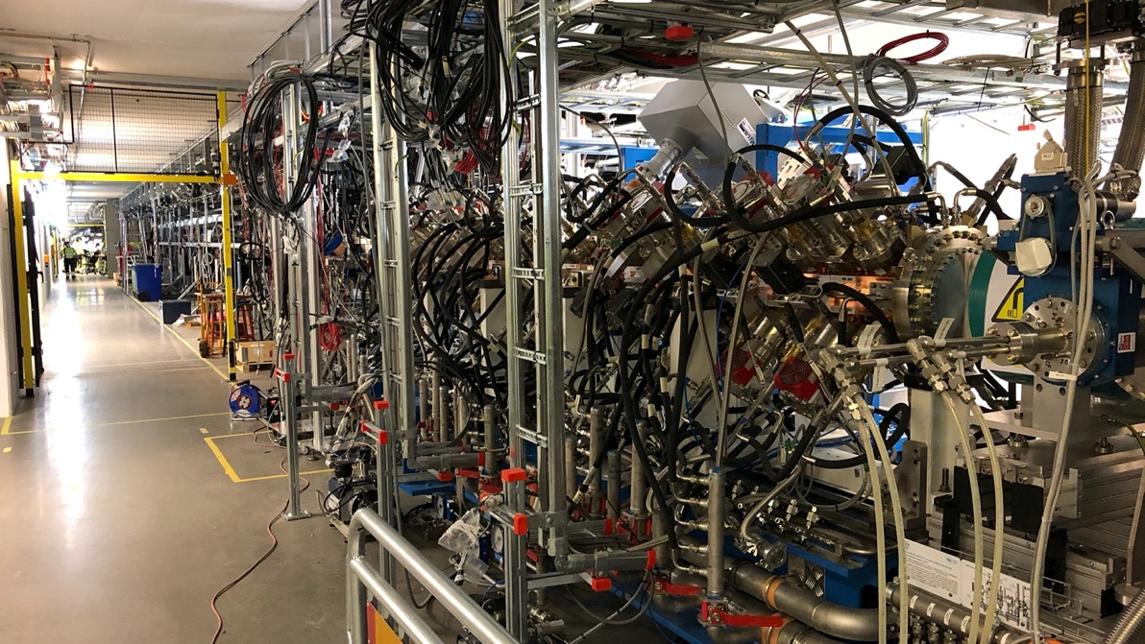
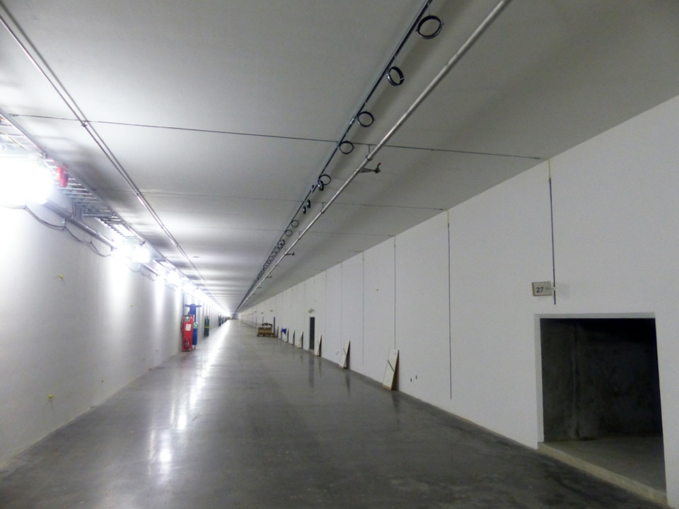
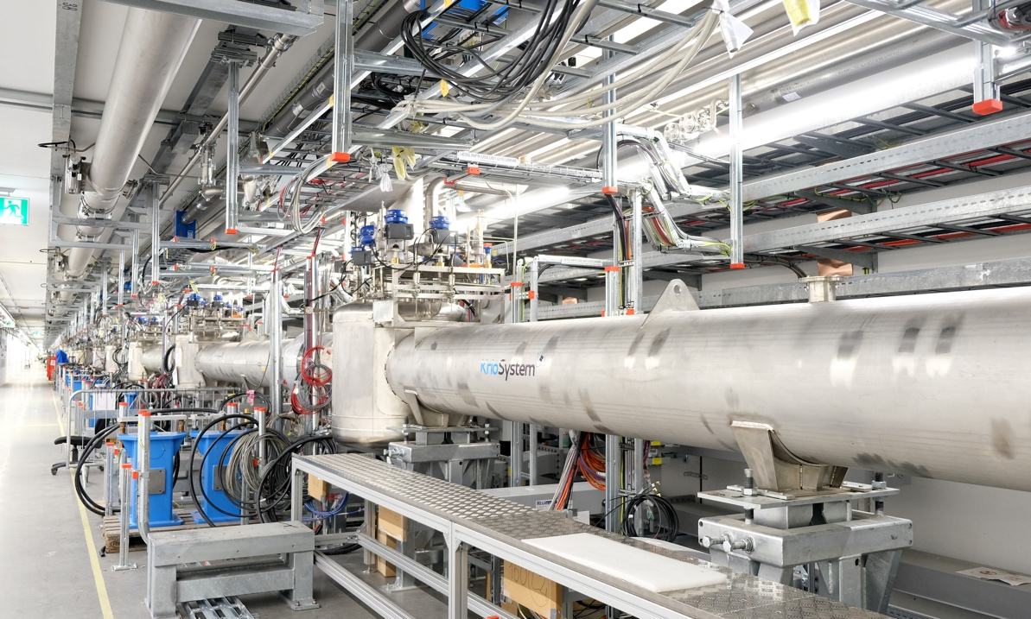
Tunnel view then and now
Parts of Normal
Conducting Linac
Under commissioning
Cryo Distribution Line
Testing underway, followed by
cryomodule installation

Slide 7
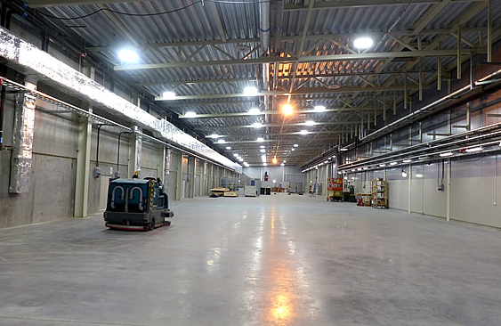
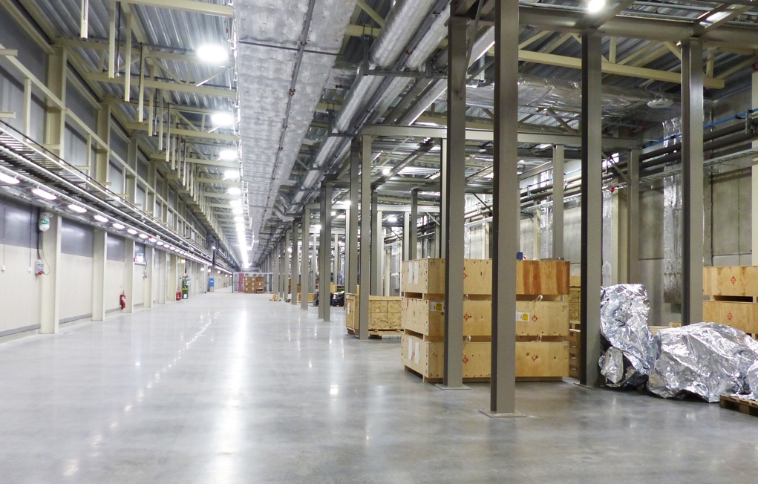
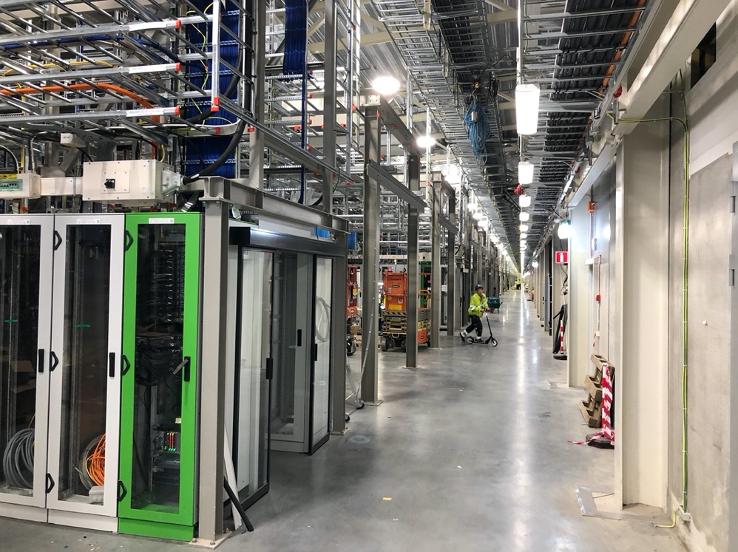
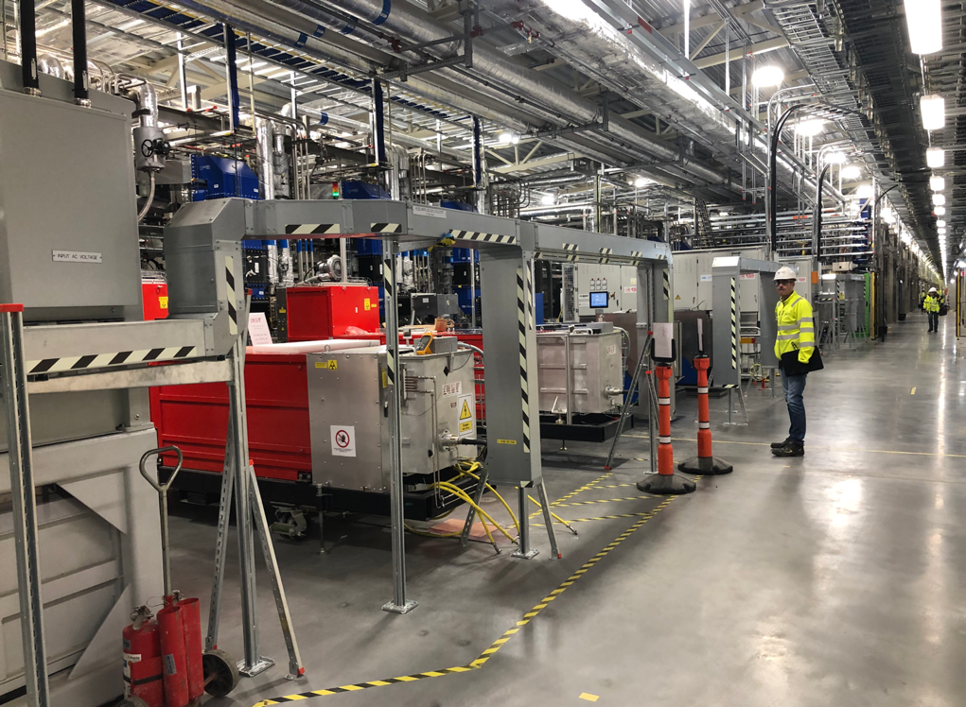
Klystron Gallery Then and Now
RF for normal conducting
part installed and tested.
Installation and testing
ongoing in superconducting
part

Slide 8
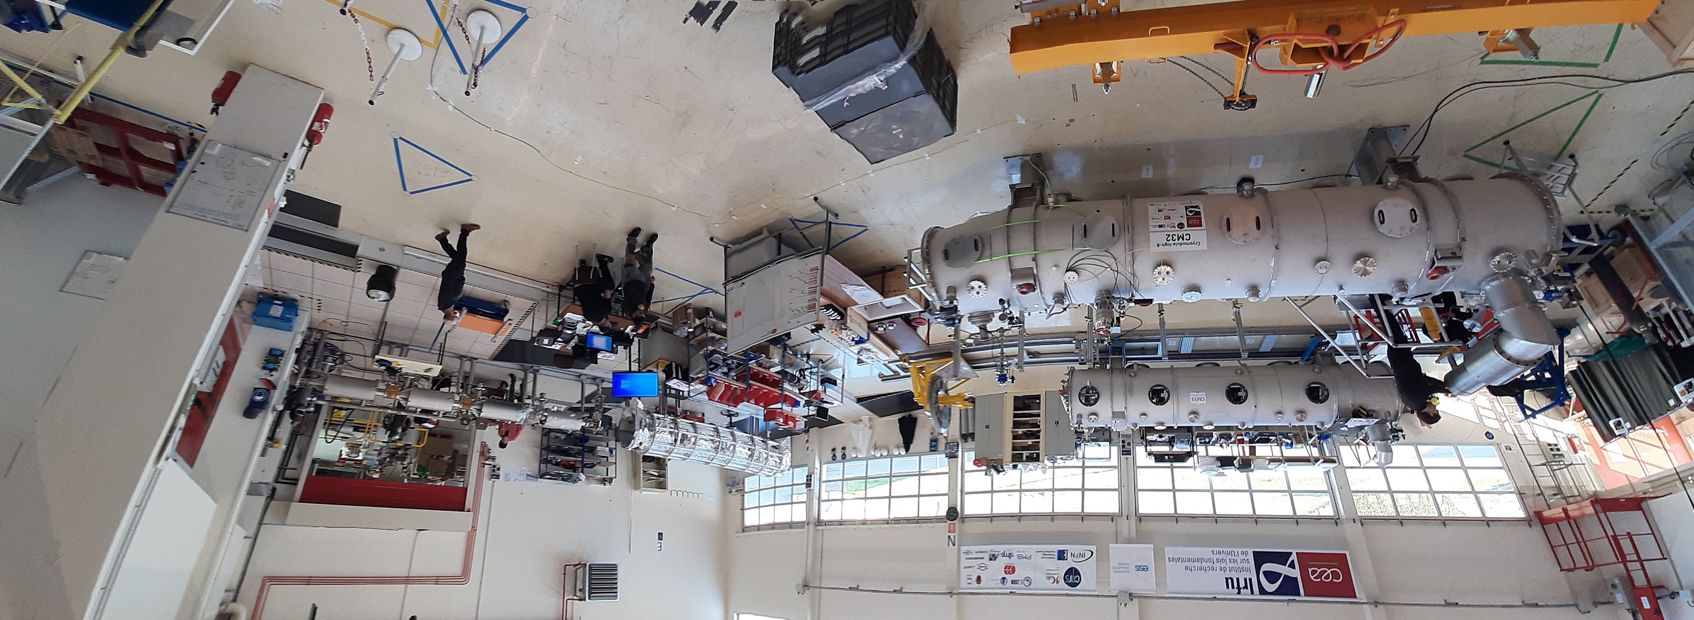
CEA Elliptical Cryomodule assembly

Slide 9
Spoke Cryomodule assembly at IJC-Lab

Slide 10
STFC SURF lab with High beta cavity testing well underway

Slide 11
Spoke Cryomdoule testing in Uppsala

Slide 12
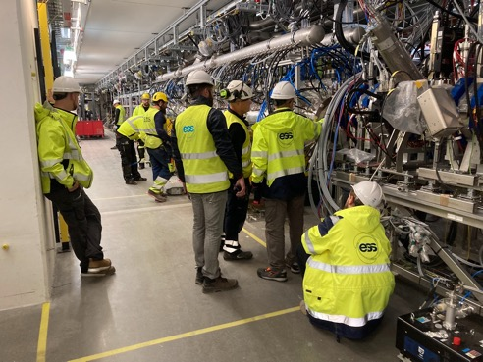
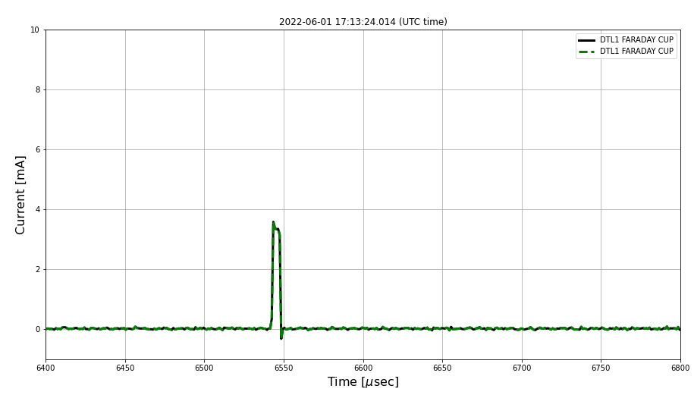
DTL1
The story of a decade of effort
~10 Months
Design
Manufacturing
Installation and Testing
RF Conditioning
Assembly
Beam Commissioning
2010s
DTL1 in G01:
18 August 2021
First RF Pulse:
07 March 2022
First Beam:
01 June 2022
DTL1 Installation
Start of DTL1 Conditioning
First Beam Pulse Through DTL1
3.5 mA, 5 us, 1 Hz

Slide 13
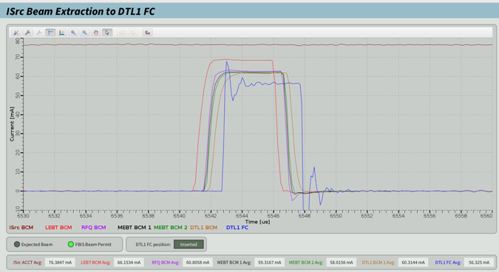
DTL1
The story of a decade of effort
DTL1 Conditioning History
Excellent collaboration between:
ESS local teams
INFN Legnaro and INFN Torino – DTL systems
ESS Bilbao – Elements of the RF system
DTL1 conditioned successfully and meets the requirements: 3 MV/m, 14 Hz, 3.2 ms.
Successful beam commissioning campaign with nominal peak current reached a month after establishing first beam
Strong foundation for the upcoming commissioning phases:
Critical functionality demonstrated
Beam to DTL4 (Q2 2023)
Beam to Tuning Dump (Q4 2024)
Beam to Target (Q2 2025)
DTL1 First Beam at Nominal Peak Current
62.5 mA, 5 us, 1 Hz

Slide 14
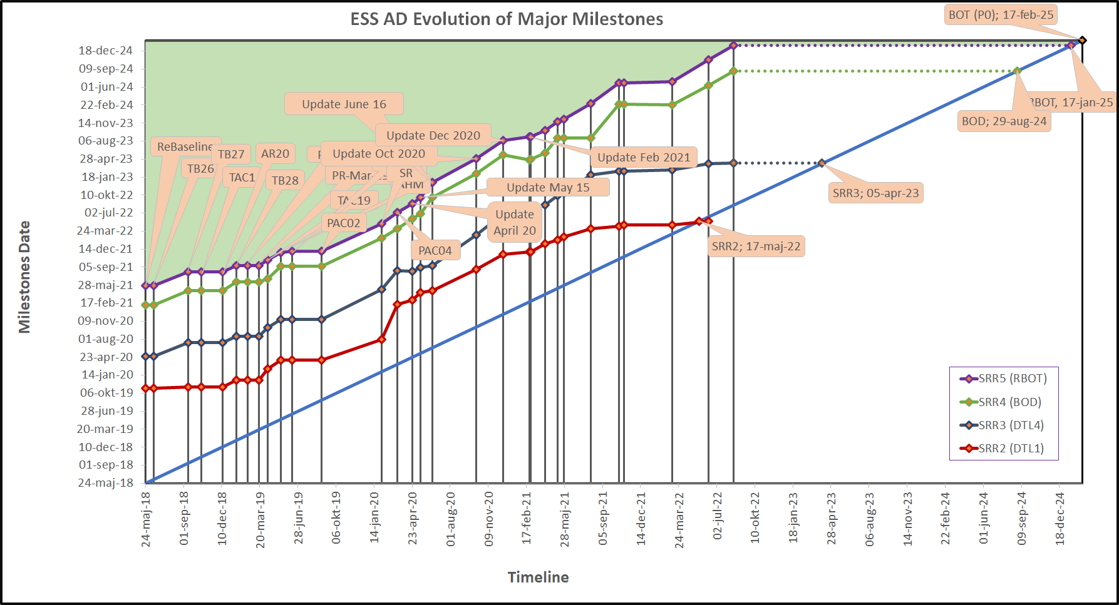
Progress
Cryogenic distribution system delay
PROGRESS
Nominal short pulse beam though DTL1
DTL4 and DTL3 in position in the tunnel and DTL2 is in final assembly
Cryogenic Distribution System installed and under vacuum and control test
12 elliptical cryomodules for RBOT are delivered to ESS with 7 tested
11 spoke cryomodules (out of 13) are tested and delivered to ESS
Last spoke cryomodule should be delivered tested to ESS in February 2023

Slide 15
Key Accelerator Milestones to hold
SRR3 Completed - Beam to DTL4
ESS Facility RBOT
11 Apr '23
10 Apr '25
SRR4 Completed - Beam to Dump
ACC RBOT
BOT
19 Jul '24
7 Nov '24
6 May '25
2022
2023
2024
2025
Today
28 Mar '23 - 10 Apr '23
SRR3
11 Apr '23 - 14 Jul '23
Beam Commissioning to DTL4
8 Jul '24 - 19 Jul '24
SRR4
19 Aug '24 - 22 Oct '24
Beam Commissioning to Dump
25 Oct '24 - 7 Nov '24
SAR5
28 Mar '25 - 10 Apr '25
SRR5
11 Apr '25 - 6 May '25
Beam Commissioning to Target
7 May '25 - 10 Sep '25
Beam Commissioning to Target
1 Nov '22 - 10 Mar '23
CDS Installation and Commissioning
Critical Path
13 Mar '23 - 1 Mar '24
CM Installation and Testing
4 Mar '24 - 2 Apr '24
PSS FIT
3 Apr '24 - 16 Jul '24
CM Warm and Cold Conditioning

Slide 16
Upgrades beyond Start of User Program
Reaching ESS nominal power of 5 MW (2 GeV)
All Cryomodules will be built and installed in the tunnel as part of the construction projects
To reach 3 MW, Additional klystrons (24) and modulators (6) required
To reach 5 MW, Additional RF distribution, klystrons and modulators required
To be realized when council can make additional funds available
Power upgrade to 7.5 MW (2.5 GeV)
Additional cryomodules (9), klystrons and modulators required
Short pulse capability at ESS using the existing target station
Studies done for an accumulation ring at ESS (ESSnuSB) and first studies underway for how to create a medium short pulse which is matched to the modulator time constant (50-100 microsceonds) and sufficiently long to assure that the target can sustain it.
The 1.2 microsecond beam pulse from the ESSnuSB ring could be destructive for the target and isn’t matched to the moderator time contstant
Staggered beam extraction of a pulse train and other slow extractions schemes still to be studied.
Staggered beam extraction of a bunch train pioneered at ISOLDE at CERN to enable liquid metal target operation at the pulsed CERN PS Booster).

Slide 17
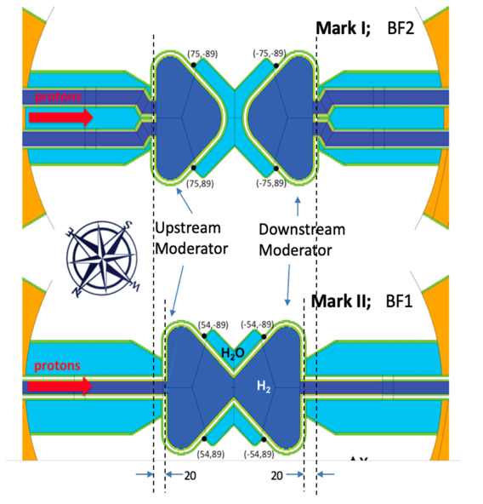
Advantage of increasing the energy
Relative performance at various energies per power, from Masatoshi Arai, ESS
Ratio of brightness of MARK-I against 2GeV-II (MARK-II) per power
Ratio of brightness of MARK-I against 2GeV-I (MARK-I) per power
a)
b)
2GeV-II
2GeV-I
Power + OH + Ohmic Losses (kW)
Figures show relative performance for MARK-I, including focul point effect, asymmetric effect and energy effect.
We can clearly see the most effective energy could be close to 1.3GeV. Therefore, increasing Ep close to 1.3GeV is very beneficial. There are increases ranging from 5% to 15% accoirdance with the increase of Ep from 0.8GeV to 1.3GeV.

Slide 18
In kind Advantages
It would not have been possible to build ESS without in kind partners!
Green field site and no existing organization.
Very few labs can build everything in house. For a green field site, this is not an option.
In kind provides access to intellectual property, competence and qualified manpower (including procurement staff) at partner labs.
For the member countries, it is a way to get local return on investment in a facility located in a different country.

Slide 19
In kind Challenges
Scope sometimes divided based on partner lab preferences and interest rather than according to functional breakdown. Can lead to complicated interfaces (and problems tend to happen at the interfaces)
Partner lab priorities may change after agreements signed
Partner labs may want to take on scope to expand their competence in areas where they have limited experience.
Partner labs may lose critical competence, which may not be replaced in time.
For scope that is procured from industry, adding another communication layer (can be challenging in case issues with vendor need to be resolved)

Slide 20
IK that works
Works best when it is a team effort between partner and host.
Partnership rather than subcontracting
Need a clearly defined recipient (person or group) of the IK scope at host lab.
Jointly developed high level functional requirements and and interfaces descriptions
Cost book principle: jointly agree on total cost, and understanding of how to manage changes
Joint ownership of issues
Good and functioning quality system at the IK partner is crucial
Very active ILOs with a broad mandate!
Gold star to Big science organizations in Sweden and Denmark
In short: work together and not on separate islands!

Slide 21
Summary
Good progress for completion of first phase of the ESS accelerator (550 MeV) in Q3 2024
The 2 MW accelerator to be completed for the Start of the User Program (SOUP)
The in-kind model made it possible to build the ESS accelerator on a green field site in a country with little experience of the required key-technologies
Lessons learnt on how to manage an In-Kind project should benefit future similar European projects

Slide 22
End of presentation

Slide 23
Accelerator Division – organigram for line org (in white) and contractors/visitors for the sub-project + In-kinds
Headcount 132 (2022-10-05)
103 employees (incl those coming and on leave)
16 from EIS, Visitors, Consultants, Students, Planners, Controller
15 In-kind
Mats Lindroos – Head of Division
Håkan Danared – Deputy Head of Division
Ciprian Plostinar – Deputy (sub) Project Leader
IN-KIND from IFJ PAN Poland
Marek Skiba
Pawel Halczynski
Artur Krawczyk
Agnieszka Zwozniak
Filip Skalka
Marta Skalka
Marcin Wartak
Krystian Wartak
Henry Przybilski
IN-KIND from Norway
Greyson Christoforo, Oslo
Håvard Gjersdal, Oslo
Documentation
John Weisend II
Planning and Project Control
Peter Gustavsson
Fredrik Håkansson
Diana Bergenholtz
Anders Sunesson
IN-KIND from Warsaw University of Technology
Krystian Bec
Lukasz Czuba
Administration
Caroline Prabert
Katalin Gergely
Gunilla Jacobsson
IN-KIND from INFN
Francesco Grespan
Andrea Baldo
Beam Physics, Operations & Beam Diagnostics group
Andreas Jansson - GL
Linac group
Håkan Danared- GL
Cecilia Maiano
Iñigo Alonso (on leave)
Electrical Power Systems group
Carlos Martins- GL Leaving 31 Dec
Mats Lindroos Acting GL from 1 Oct.
Göran Göransson
Marko Kalafatic
Rutambhara Yogi
Dana McKenzie
Matthew Bergstrom
Manish Kumar
Hadi Sadeghzadeh
Levan Tabatadze (until 19 April 2023)
Yury Loayza (C)
Max Collins (C)
RF group
Morten Jensen – GL
Rafael Montano
Bruno Lagoguez
Chiara Marrelli
Staffan Ekström
Stevo Calic
Anders Svensson
Christian Amstutz
Walther Borg
Anirban Krishna Bhattachanyya
Linus Ternelius Svensson
Slavisa Micic
Nils Öst
Gustav Mörk
Tomas Olsson
Bo Nilsson
Patrick Krämer
Dan Vasilenco
Cryogenics group
Philipp Arnold – GL
Xiaotao Su
Johnny Råström
Mattias Olsson
Per Nilsson
Romain Goncalves
Jianqin Zhang
Theodoros Vasilopoulos
Hideki Tatsumoto
Piotr Tereszkowski (C)
Yijun Chao (S)
Vacuum group
Marcelo Juni Ferreira (on leave) – GL
Håkan Danared – Acting GL
Hilko Spoelstra
Ralf Huber
Laurence Page
Fredrik Svensson
Delphine Hardion
Thomas Cornes
Mattias Malmström
Artur Gevorgyan
Adrien Besson
Niklas Cerovina
Karl-Hampus Lenton
Rosa Camilleri-Lledó (EIS)
ACCSYS Project group
Mats Lindroos – Acting GL
Olle Lagerblad
Ciprian Plostinar
Anders Sunesson
Jaroslaw Fydrych
Georg Hulla
Kristofer Falkland
Nikola Andonovski
Magnus Jönsson
Maurizio Serluca (Post Doc
Björn Rundcrantz (C)
Beam Physics
Mamad Eshraqi – SL
Renato de Prisco (on leave)
Ryoichi Miyamoto
Yngve Levinsen
Natalia Milas
Daniel Noll
Mina Akhyani (PhD)
Beam Diagnostic
Tom Shea– SL
Cyrille Thomas
Hooman Hassanzadegan
Hinko Kocevar
Irena Dolenc Kittelmann
Rafael Baron
Edvard Bergman
Clement Derrez
Slava Grishin
Elena Donegani
Kaj Rosengren
Roxana Tarkeshian
Johan Norin (C)
Mehdi Mohammadnezhad (C)
Front End & Magnets
Bryan Jones - SL
Alejandro Garcia Sosa
Emmanouil Trachanas
Rihua Zeng
Domenic Nicosia
Stuart Sandilands
Superconducting RF
Paolo Pierini – SL
Luca Sagliano
Wolfgang Hees
Emilio Asensi
MuYuan Wang
Nuno Elias
Philippe Goudket
Operations
Lali Tchelidze – SL
Marc Munoz
Benjamin Bolling
Joe Christie
Arkadiusz Gorzawski
Enric Bargalló
Sölve Slettebak
Tina Barath
Betina Ferreira
Cedric Lombard

