Slide 1
Overview of the ESS Fundamental Physics Possibilities
Valentina Santoro
ESS
ESS Symposium by the Royal Swedish Academy of Science’s Physics Class

Slide 2
Outline
1. | The ESS fundamental physics program
2. | Why fundamental physics at the ESS ?
3. | Overview of the different proposals

Slide 3
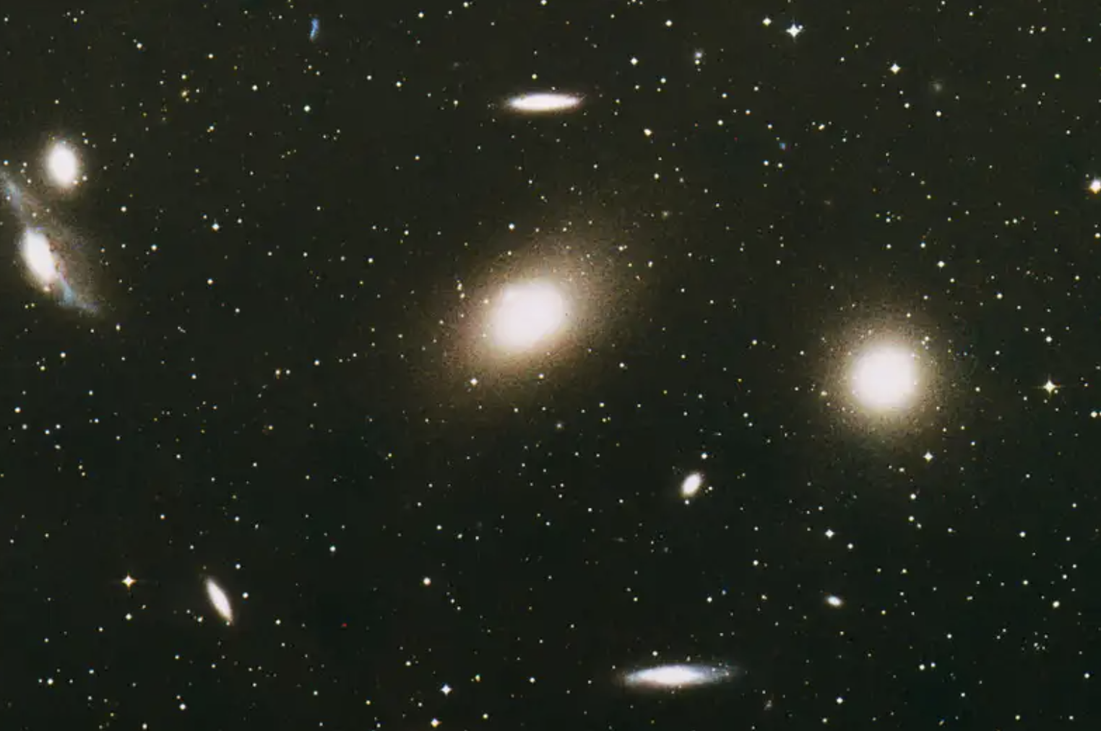
The ESS Fundamental Physics Program (I)
The ESS will be the brightest neutron source in the world enabling new opportunities for many different scientific fields, including materials and life sciences, energy, environmental technology, cultural heritage and fundamental physics
Notes:
Across many scientific field

Slide 4
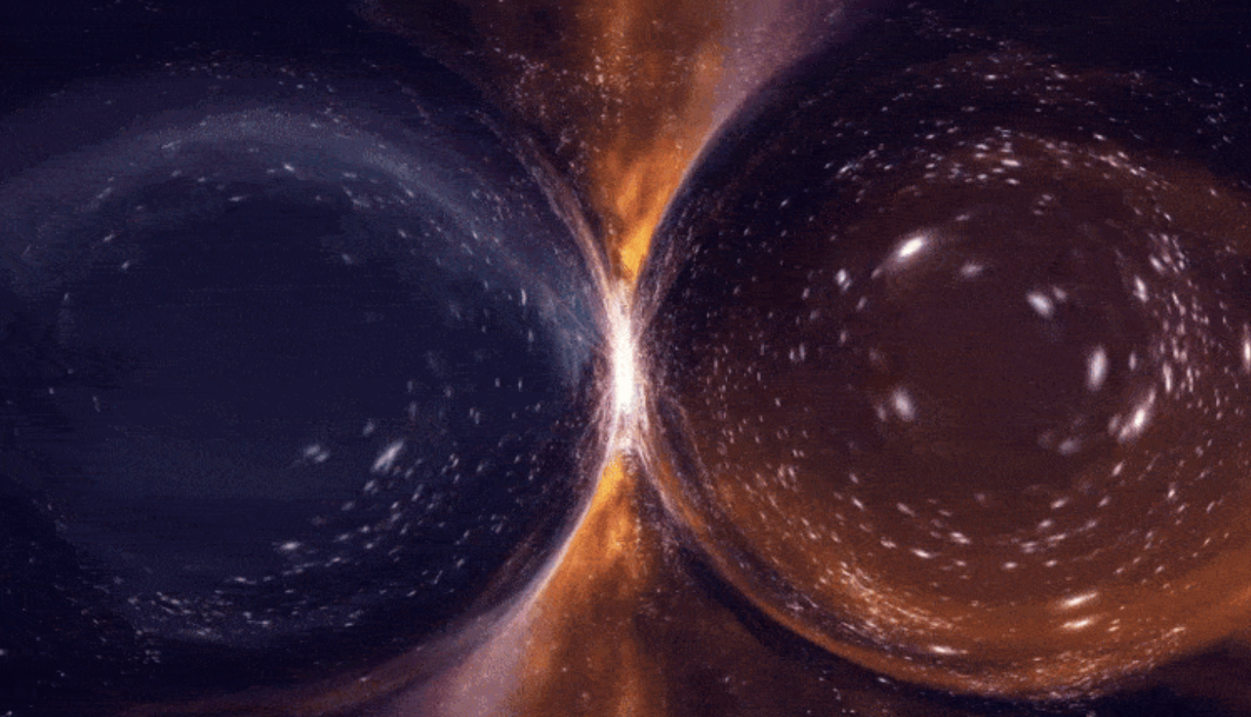
The ESS Fundamental Physics Program (I)
The ESS will be the brightest neutron source in the world enabling new opportunities for many different scientific fields, including materials and life sciences, energy, environmental technology, cultural heritage and fundamental physics
The ESS will have the unprecedented capability to access and unlock some of the greatest challenges of the universe

Slide 5
The ESS Fundamental Physics Program (I)
The ESS will be the brightest neutron source in the world enabling new opportunities for many different scientific fields, including materials and life sciences, energy, environmental technology, cultural heritage and fundamental physics
The ESS will have the unprecedented capability to access and unlock some of the greatest challenges of the universe
We are developing a broad fundamental physics program, that will be evaluated in few years, with a time span of at least two decades
This includes mainly
Physics with neutrons
Physics with neutrinos

Slide 6
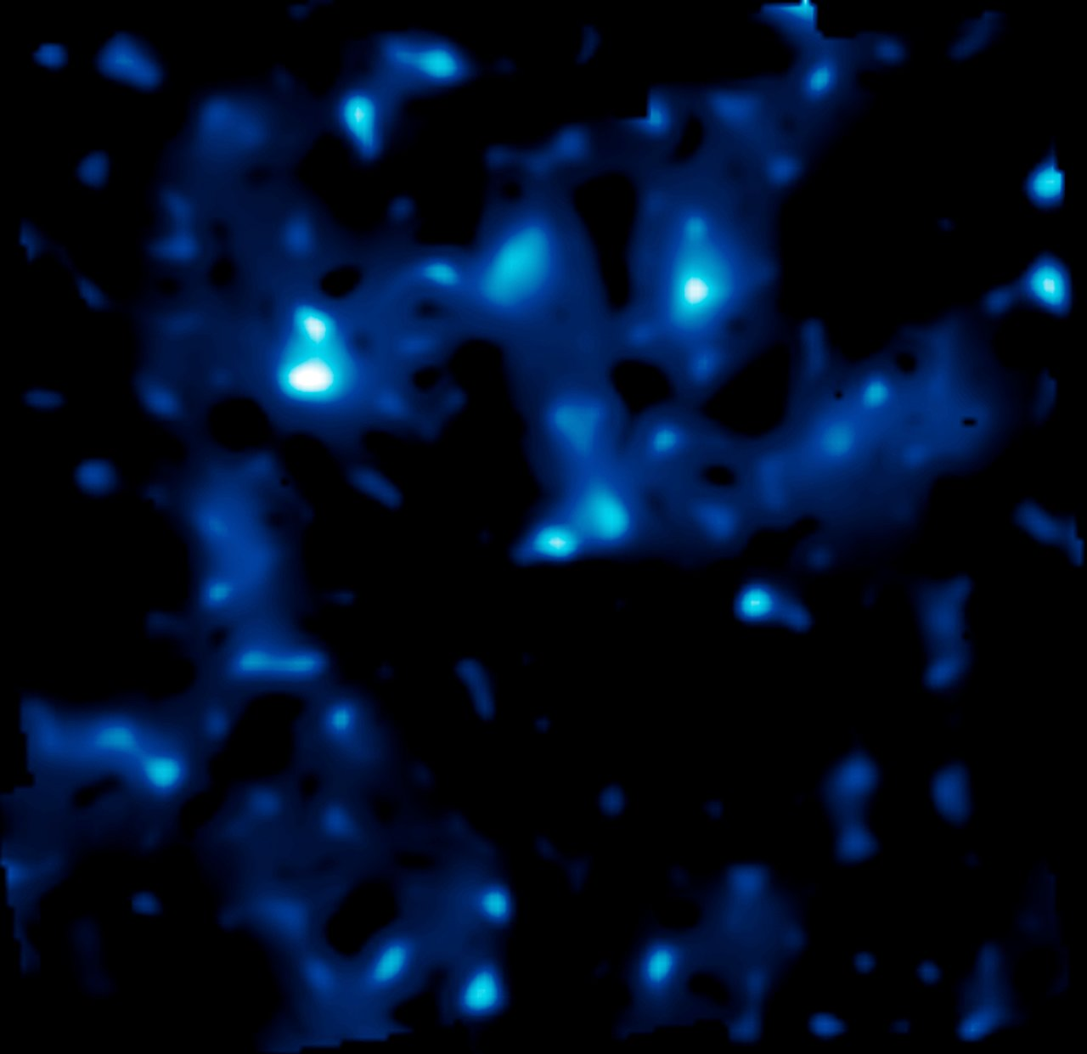
The ESS Fundamental Physics Program (II)
The Dark Sector is more hidden than expected —> direct searches for BSM failed so far at LHC
Physics at the High Intensity Frontier offers unprecedented opportunities for BSM searches in the near future (LHCb/BELLE2 upgrades, MEG, g-2, mu2e, neutrino beams T2k, DUNE. ecc..)

Slide 7
The ESS Fundamental Physics Program (II)
The Dark Sector is more hidden than expected —> direct searches for BSM failed so far at LHC
Physics at the High Intensity Frontier offers unprecedented opportunities for BSM searches in the near future (LHCb/BELLE2 upgrades, MEG, g-2, mu2e, neutrino beams T2k, DUNE. ecc..)
ESS will search for neutron-antineutron oscillations, neutrino flavour oscillations and sterile neutrons and neutrinos
The searches and measurements will address the matter antimatter asymmetry problem of the universe and the dark matter problem

Slide 8

The ESS Fundamental Physics Program (II)
The Dark Sector is more hidden than expected —> direct searches for BSM failed so far at LHC
Physics at the High Intensity Frontier offers unprecedented opportunities for BSM searches in the near future (LHCb/BELLE2 upgrades, MEG, g-2, mu2e, neutrino beams T2k, DUNE. ecc..)
ESS will search for neutron-antineutron oscillations, neutrino flavour oscillations and sterile neutrons and neutrinos
The searches and measurements will address the matter antimatter asymmetry problem of the universe and the dark matter problem
ESS search can be complementary and competetive with LHC

Slide 9
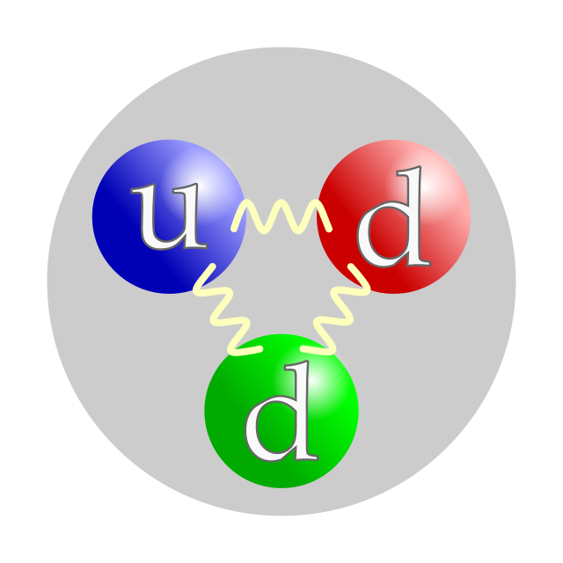
Fundamental physics possibilities with neutrons
Standard Model of particle physics (SM)
Precision experiments
Beyond SM
New interactions
Fundamental Physics Beamline
HIBEAM experiment Search for sterile neutron
Neutron beta decay
Hadronic parity violation
Electromagnetic properties of the neutron
Search for Neutron antineutron oscillation (NNBAR)
Matter –Antimatter asymmetry of the Universe
Ultra Cold Neutron
Electric Dipole moment of the neutron (EDM)
Gravity resonance spectroscopy
Neutron beta decay
see David Milstead’s talk
see David Milstead’s talk

Slide 10
Fundamental physics possibilities with neutrons
Standard Model of particle physics (SM)
Precision experiments
Beyond SM
New interactions
Fundamental Physics Beamline
HIBEAM experiment Search for sterile neutron
Neutron beta decay
Hadronic parity violation
Electromagnetic properties of the neutron
Search for Neutron antineutron oscillation (NNBAR)
Matter –Antimatter asymmetry of the Universe
Ultra Cold Neutron
Electric Dipole moment of the neutron (EDM)
Gravity resonance spectroscopy
Neutron beta decay

Slide 11
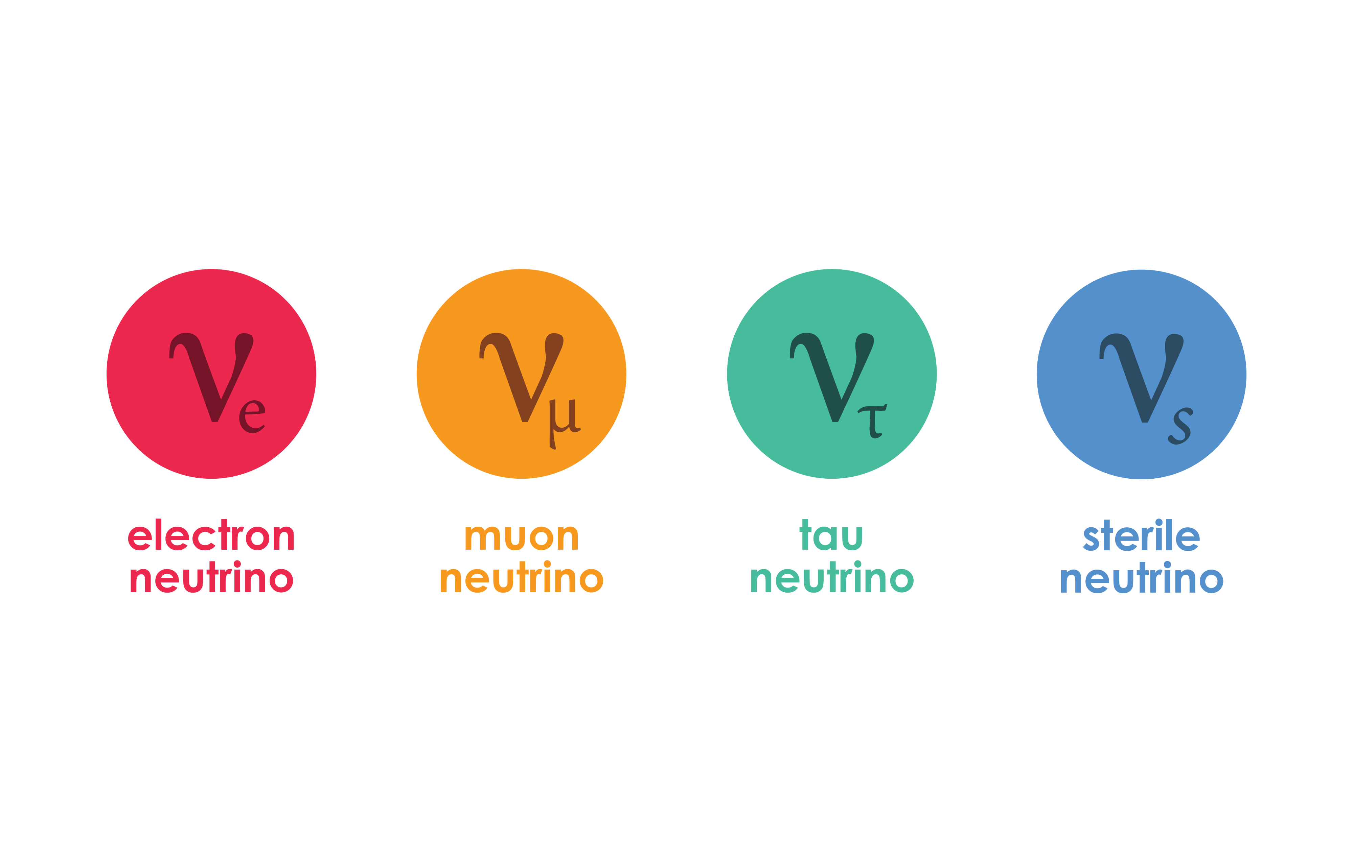
Fundamental physics possibilities with neutrinos
Standard Model of particle physics (SM)
Precision experiments
Beyond SM
New interactions
nuESS
Coherent Elastic Neutrino-Nucleus Scattering at the ESS
High-statistics, precision CEνNS measurements
ESSnuSB
Discover and measure neutrino CPV
see Else Lytke talk
see Tord Ekelöf talk

Slide 12
Why fundamental physics at the ESS ?

Slide 13
ESS is special

Slide 14
ESS is special particularly for particle physics

Slide 15


ESS is special particularly for particle physics because it is equipped with two superpowers

Slide 16

Superpower number 1
ESS is equipped with an accelerator that could go to 10MW without extra infrastructure

Slide 17
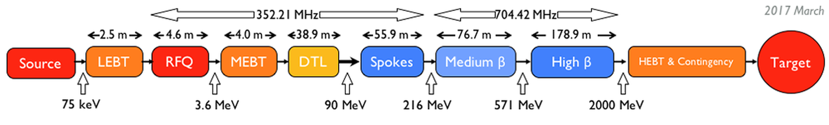
Superpower number 1
ESS is equipped with an accelerator that could go to 10MW without extra infrastructure
ESS Accelerator design at 2GeV and 5MW power on target

Slide 18
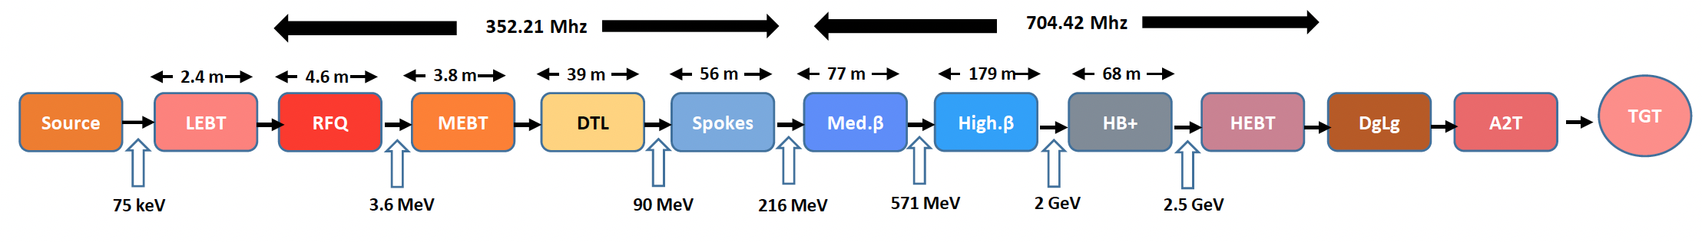
Superpower number 1
ESS is equipped with an accelerator that could go to 10MW without extra infrastructure
ESS Accelerator design at 2GeV and 5MW power on target
ESS Accelerator coud be “easily” upgraded to 10MW

Slide 19
The world’s most powerful proton accelerator offers unique capabilities by itself

Slide 20
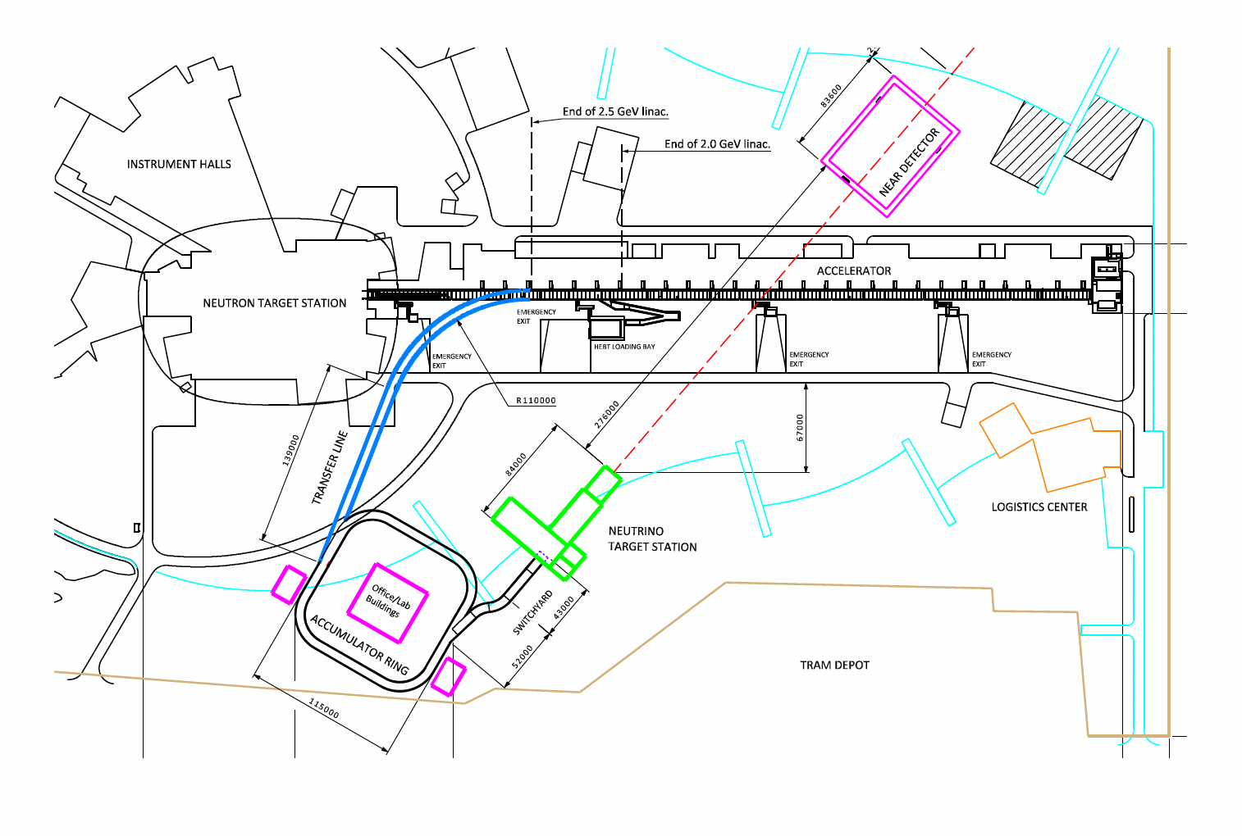
The world’s most powerful proton accelerator offers unique capabilities by itself
Lots of neutrons, neutrinos…….
One very interesting possibility is the ESS neutrino Super Beam (ESSnuSB)
see Tord Ekelöf talk

Slide 21
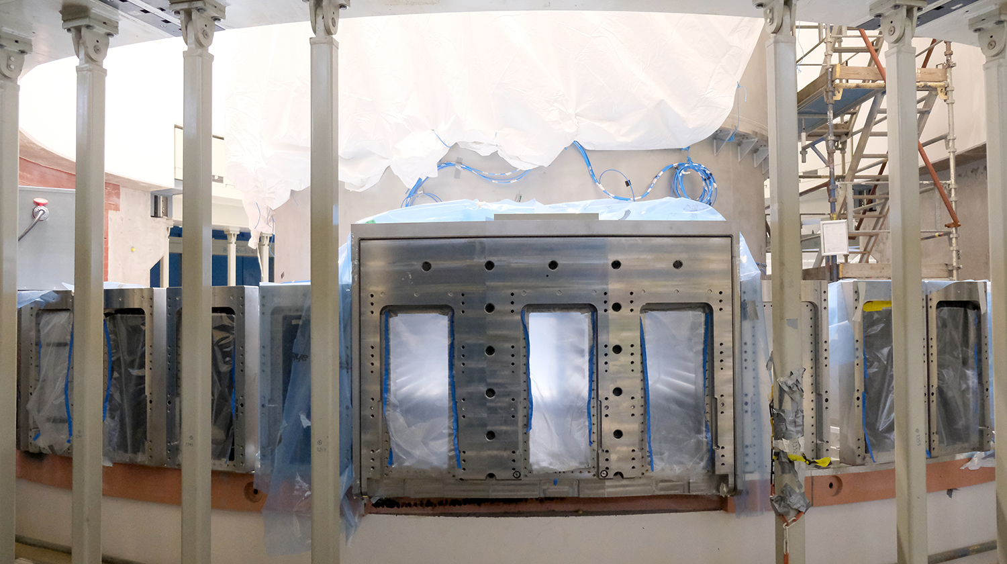
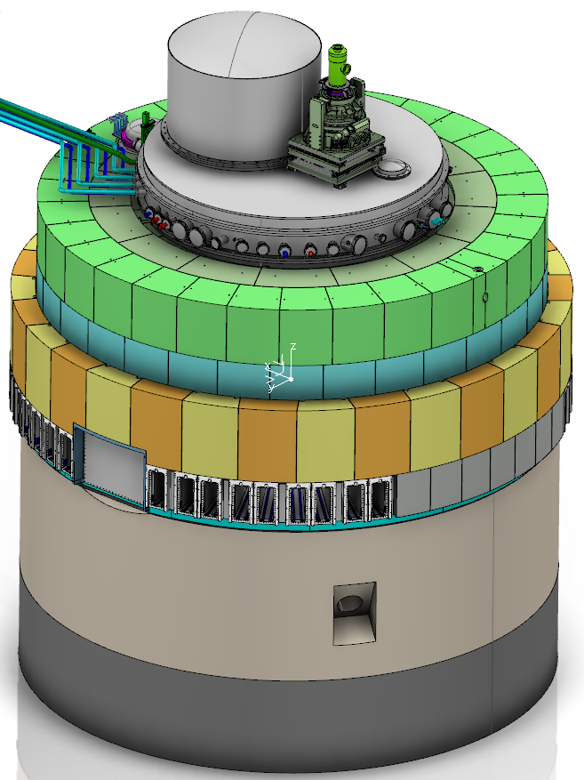
ESS is equipped with a 1m x 1m neutron beam port
Superpower number 2
ESS Large Beam Port

Slide 22
ESS is equipped with a 1m x 1m neutron beam port
Superpower number 2
Standard Neutron
Beam Port

Slide 23
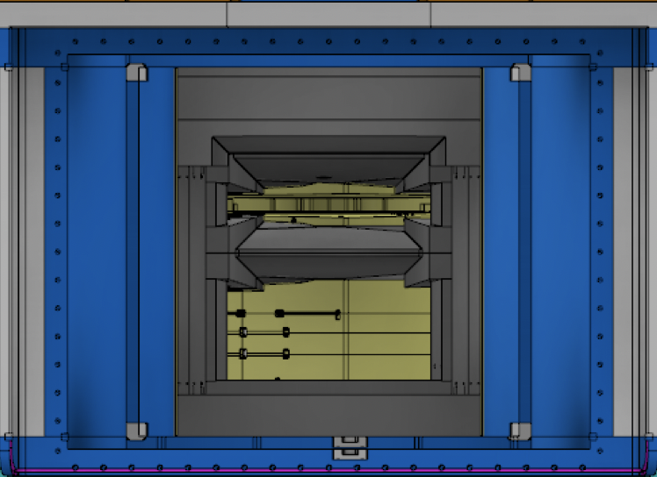
ESS is equipped with a 1m x 1m neutron beam port
Superpower number 2
Upper Moderator
Lower Moderator
NNBAR Large Beam Port has been constructed to provide sufficient intensity for $n→\overline{n}$search

Slide 24
ESS is equipped with a 1m x 1m neutron beam port
Superpower number 2
Upper Moderator
Lower Moderator
NNBAR Large Beam Port has been constructed to provide sufficient intensity for $n→\overline{n}$search
It is able to deliver 1.5x10¹⁵ n/s there is no beamline currently available or planned at any other facility that could reach a flux even close to this number

Slide 25
ESS is equipped with a 1m x 1m neutron beam port
Superpower number 2
Upper Moderator
Lower Moderator
In addition to the for $n→\overline{n}$ experiment the Large Beam Port could be used for developing a world leading Ultra Cold Neutron source

Slide 26
1. | The ESS fundamental physics program
2. | Why fundamental physics at the ESS ?
3. | Overview of the different proposal

Slide 27
Coherent Elastic Neutrino-Nucleus Scattering (CEνNS) at the ESS
ESSnu
See Else Lytke talk

Slide 28
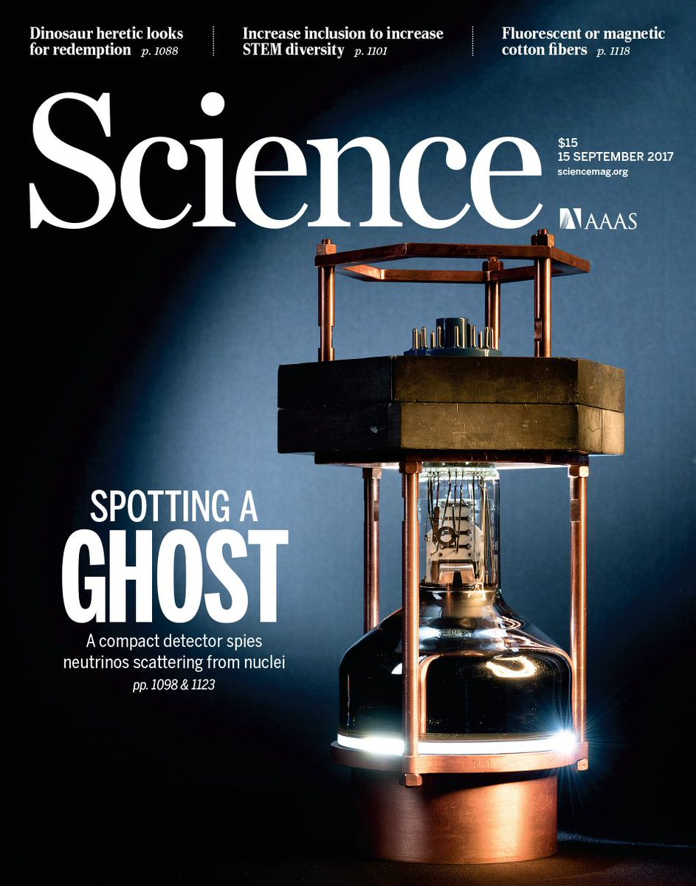
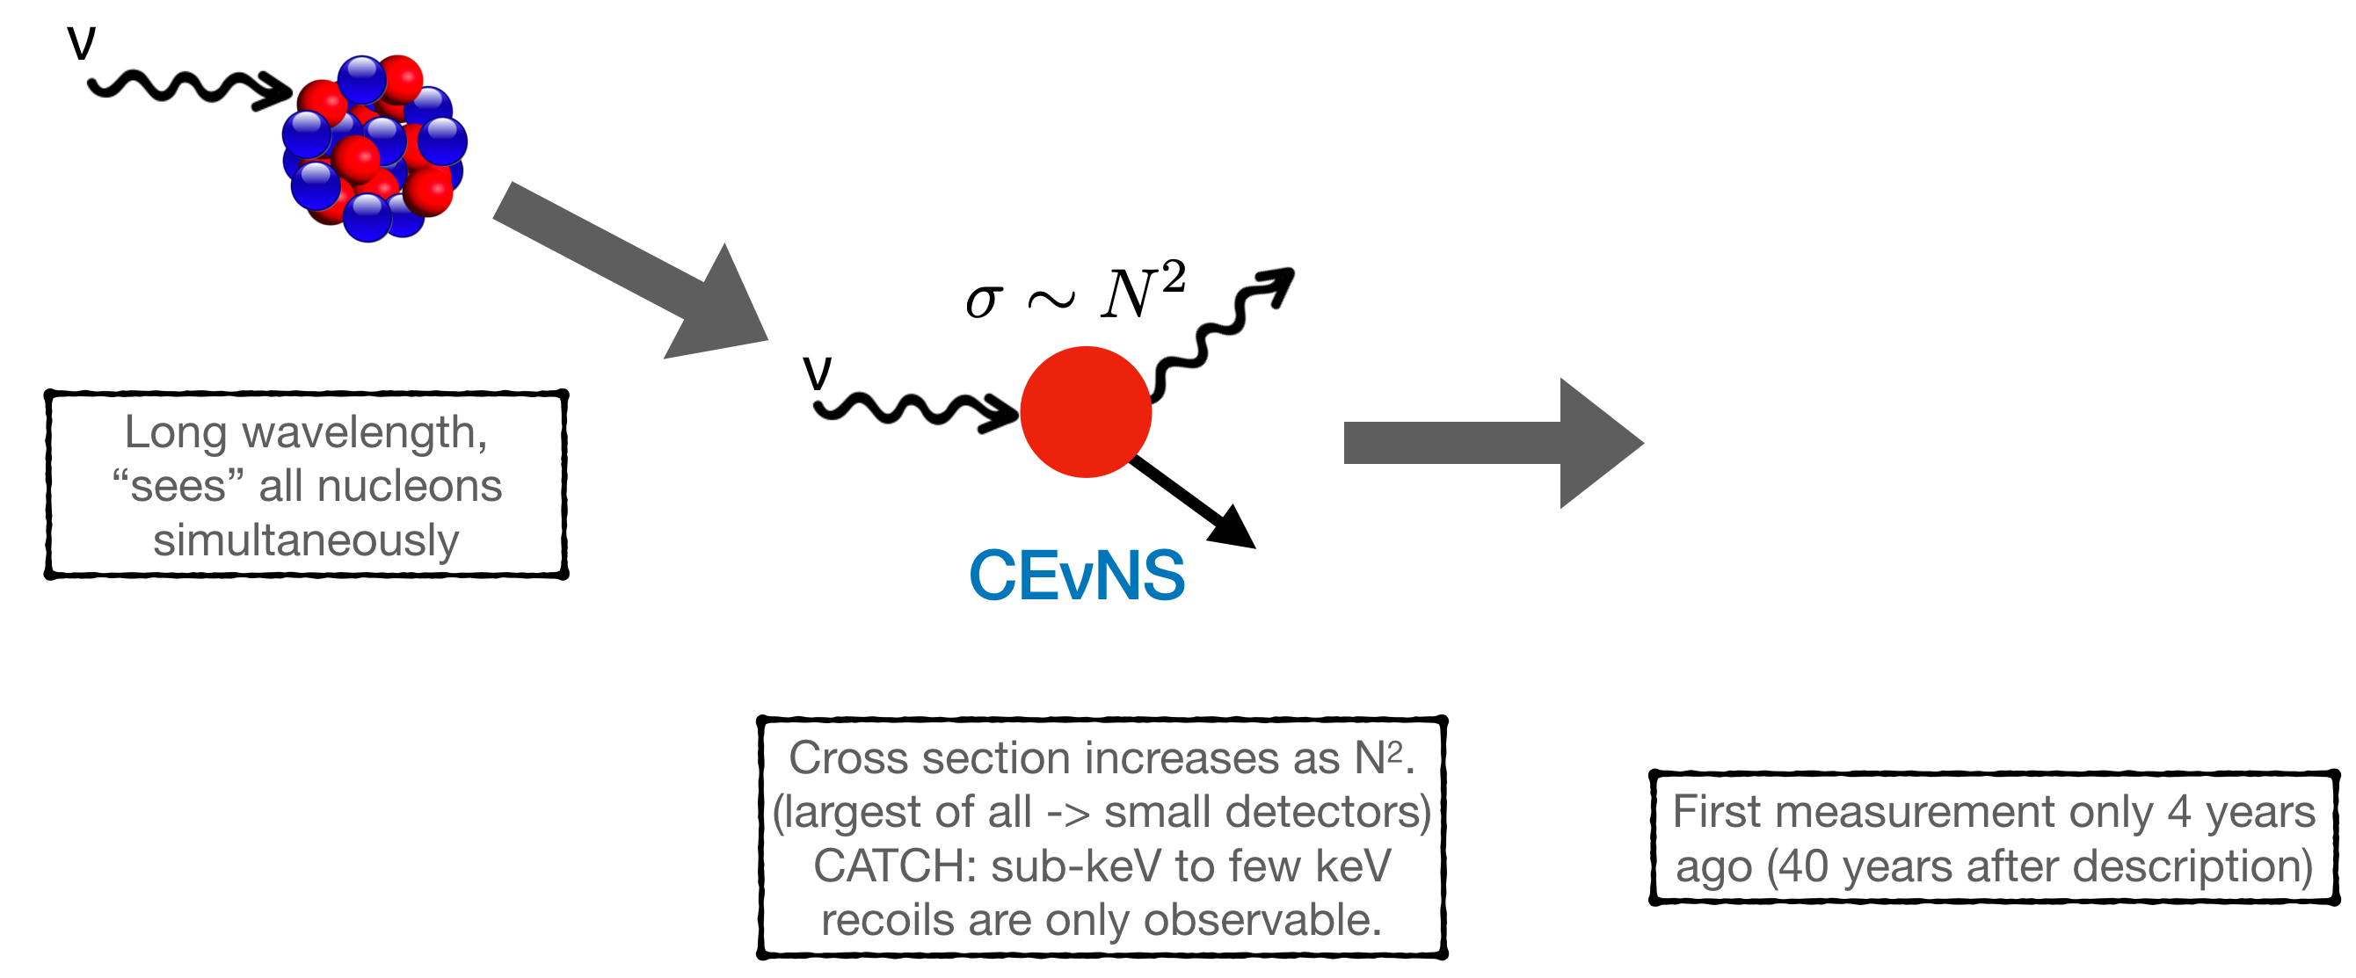
Coherent Elastic Neutrino-Nucleus Scattering (CEνNS)
Notes:
At low energy the neutrinos. Cannot resolve the nucleus the neutrino interact coherently with all the nucleus with large enhancement of the cross section
Coherent elastic neutrino nucleus scattering is the most probable mechanism for low energy neutrinos interactions
Nucleons participate coherently in this neutral current process resulting in a copupling proportional to the square of the number of neutrons in the target nucleus

Slide 29
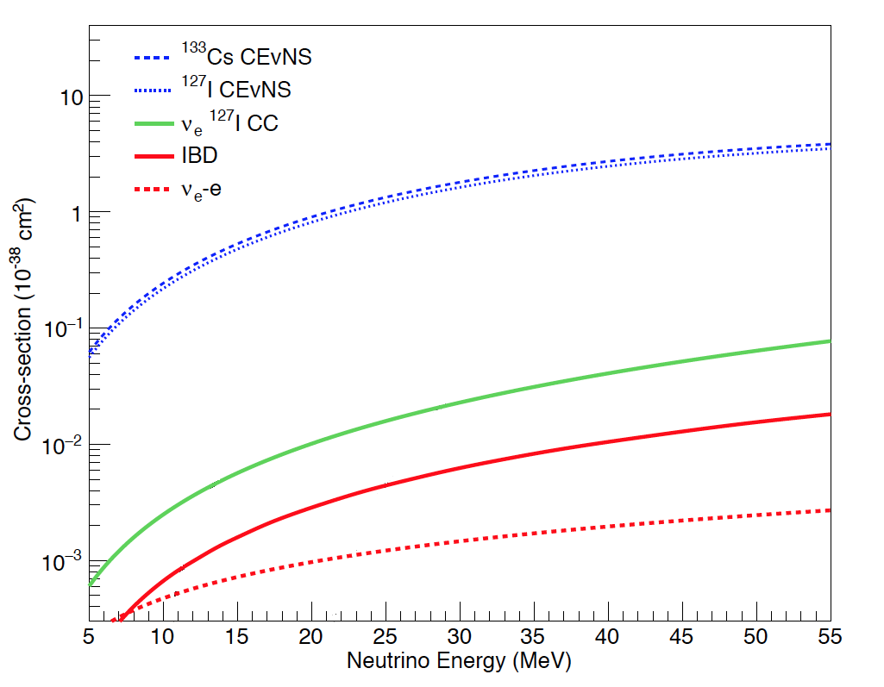
Coherent Elastic Neutrino-Nucleus Scattering (CEνNS)

Slide 30
Coherent Elastic Neutrino-Nucleus Scattering (CEνNS)
Notes:
The signal is a recoiling nucleus, which generates a signal in the few keV to subkeV energy range, difficult

Slide 31
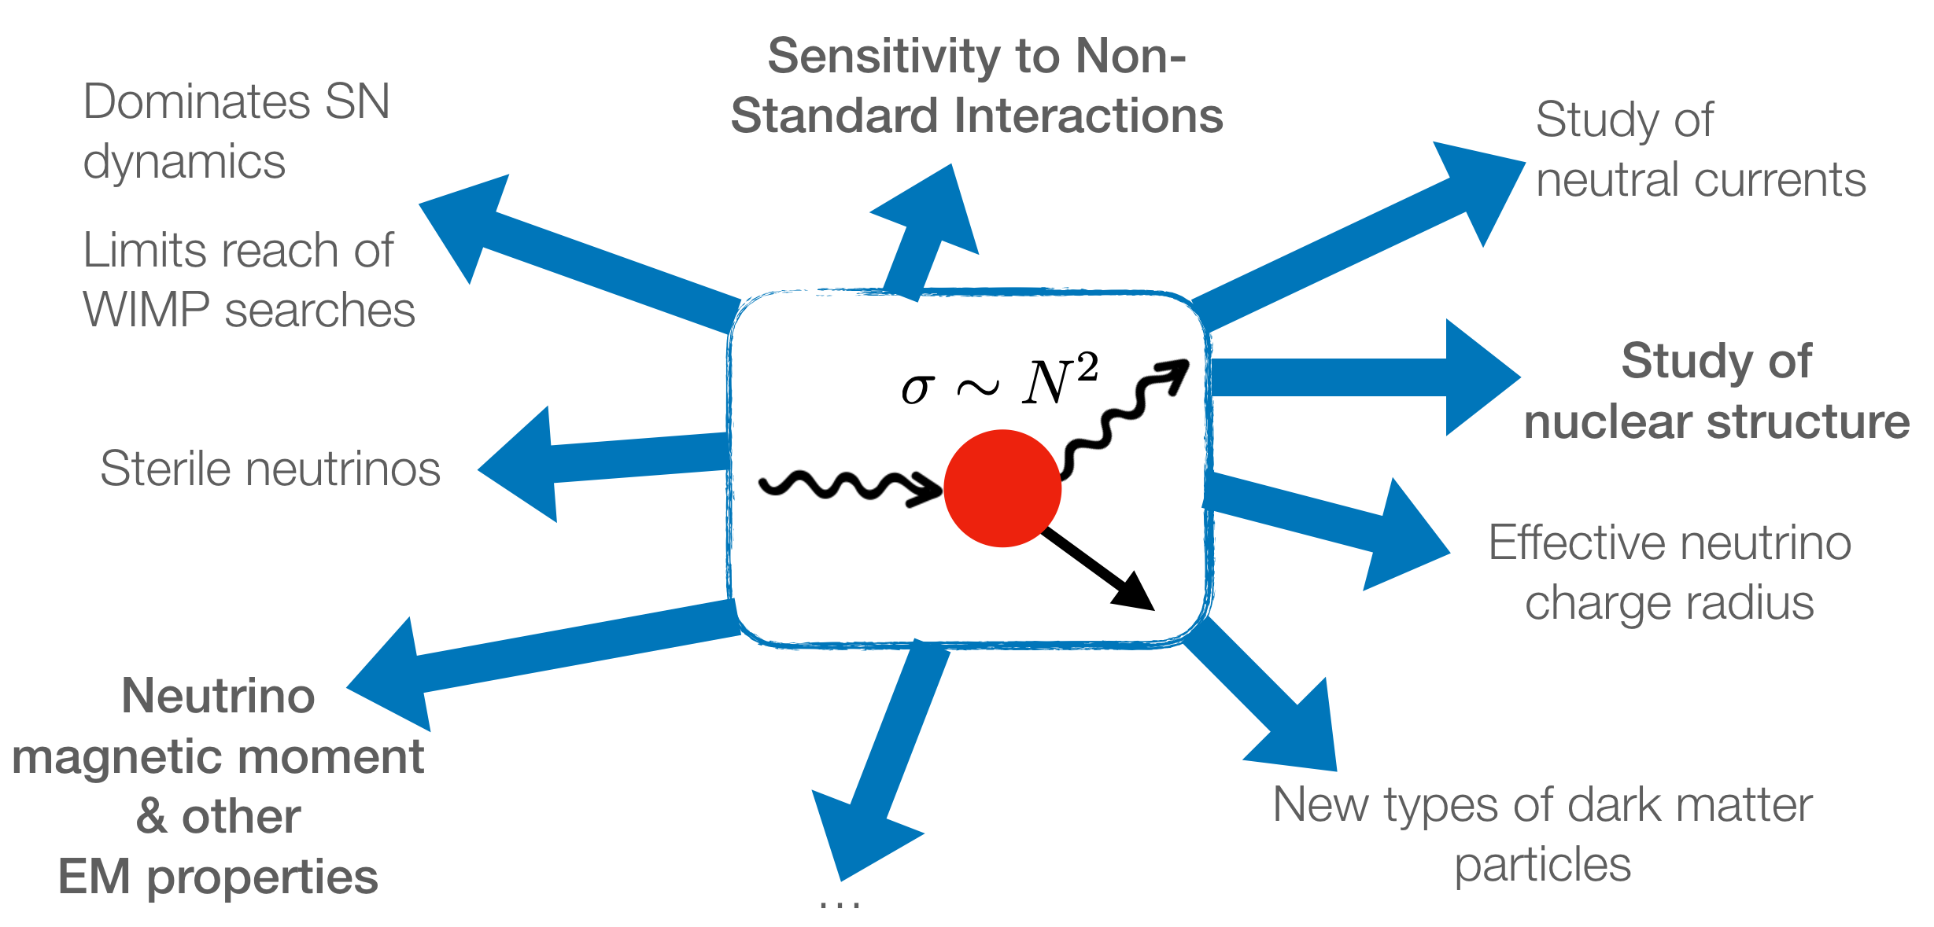
Coherent Elastic Neutrino-Nucleus Scattering (CEνNS)
Rich phenomenology (45 years worth of it)
and counting
(~100 citations / year for 1st measurement)
see Else Lytke talk
Notes:
Searches for sterile neutrinos,
Neutrino magnetic moment,
Nonstandard interactions mediated by new particles ,
Probes of nuclear structure ,
Improved constraints on the value of the weak nuclear charge
CEνNS is also expected to dominate neutrino transport in neutron stars and during stellar collapse
Direct searches for weakly interacting massive particles (WIMPs)—the dark matter candidates most favored at present

Slide 32
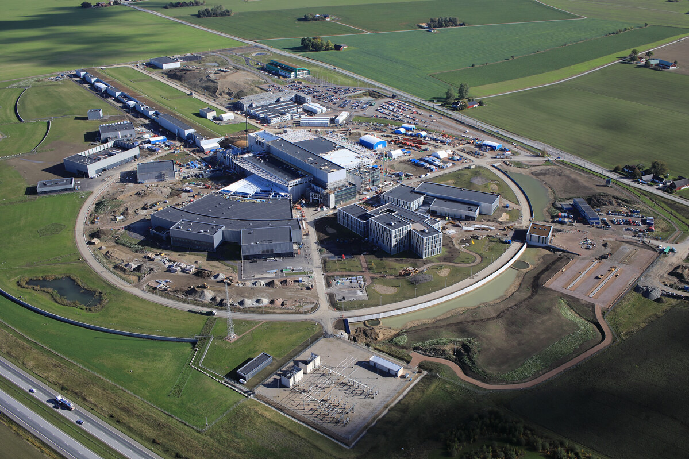
CEνNS at ESS the ESSnu program
ESS is the ultimate source for CEνNS, as far as the eye can see.
ESS has a very high yield of low energy neutrinos which allow for high statistics measurements

Slide 33
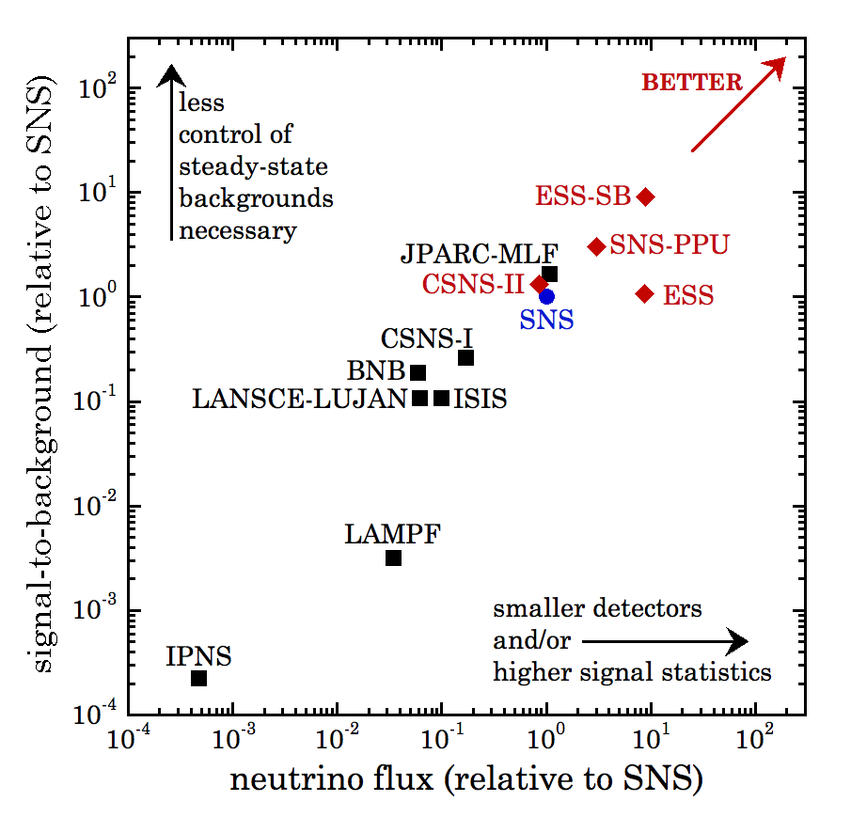
CEνNS at ESS the ESSnu program
ESS is the ultimate source for CEνNS, as far as the eye can see.
ESS has a very high yield of low energy neutrinos which allow for high statistics measurements
At 5MW, 2 GeV ESS is expected to provide an order of magnitude increase in neutrino flux respect to SNS at ORNL the site of the first CEνNS discovery

Slide 34
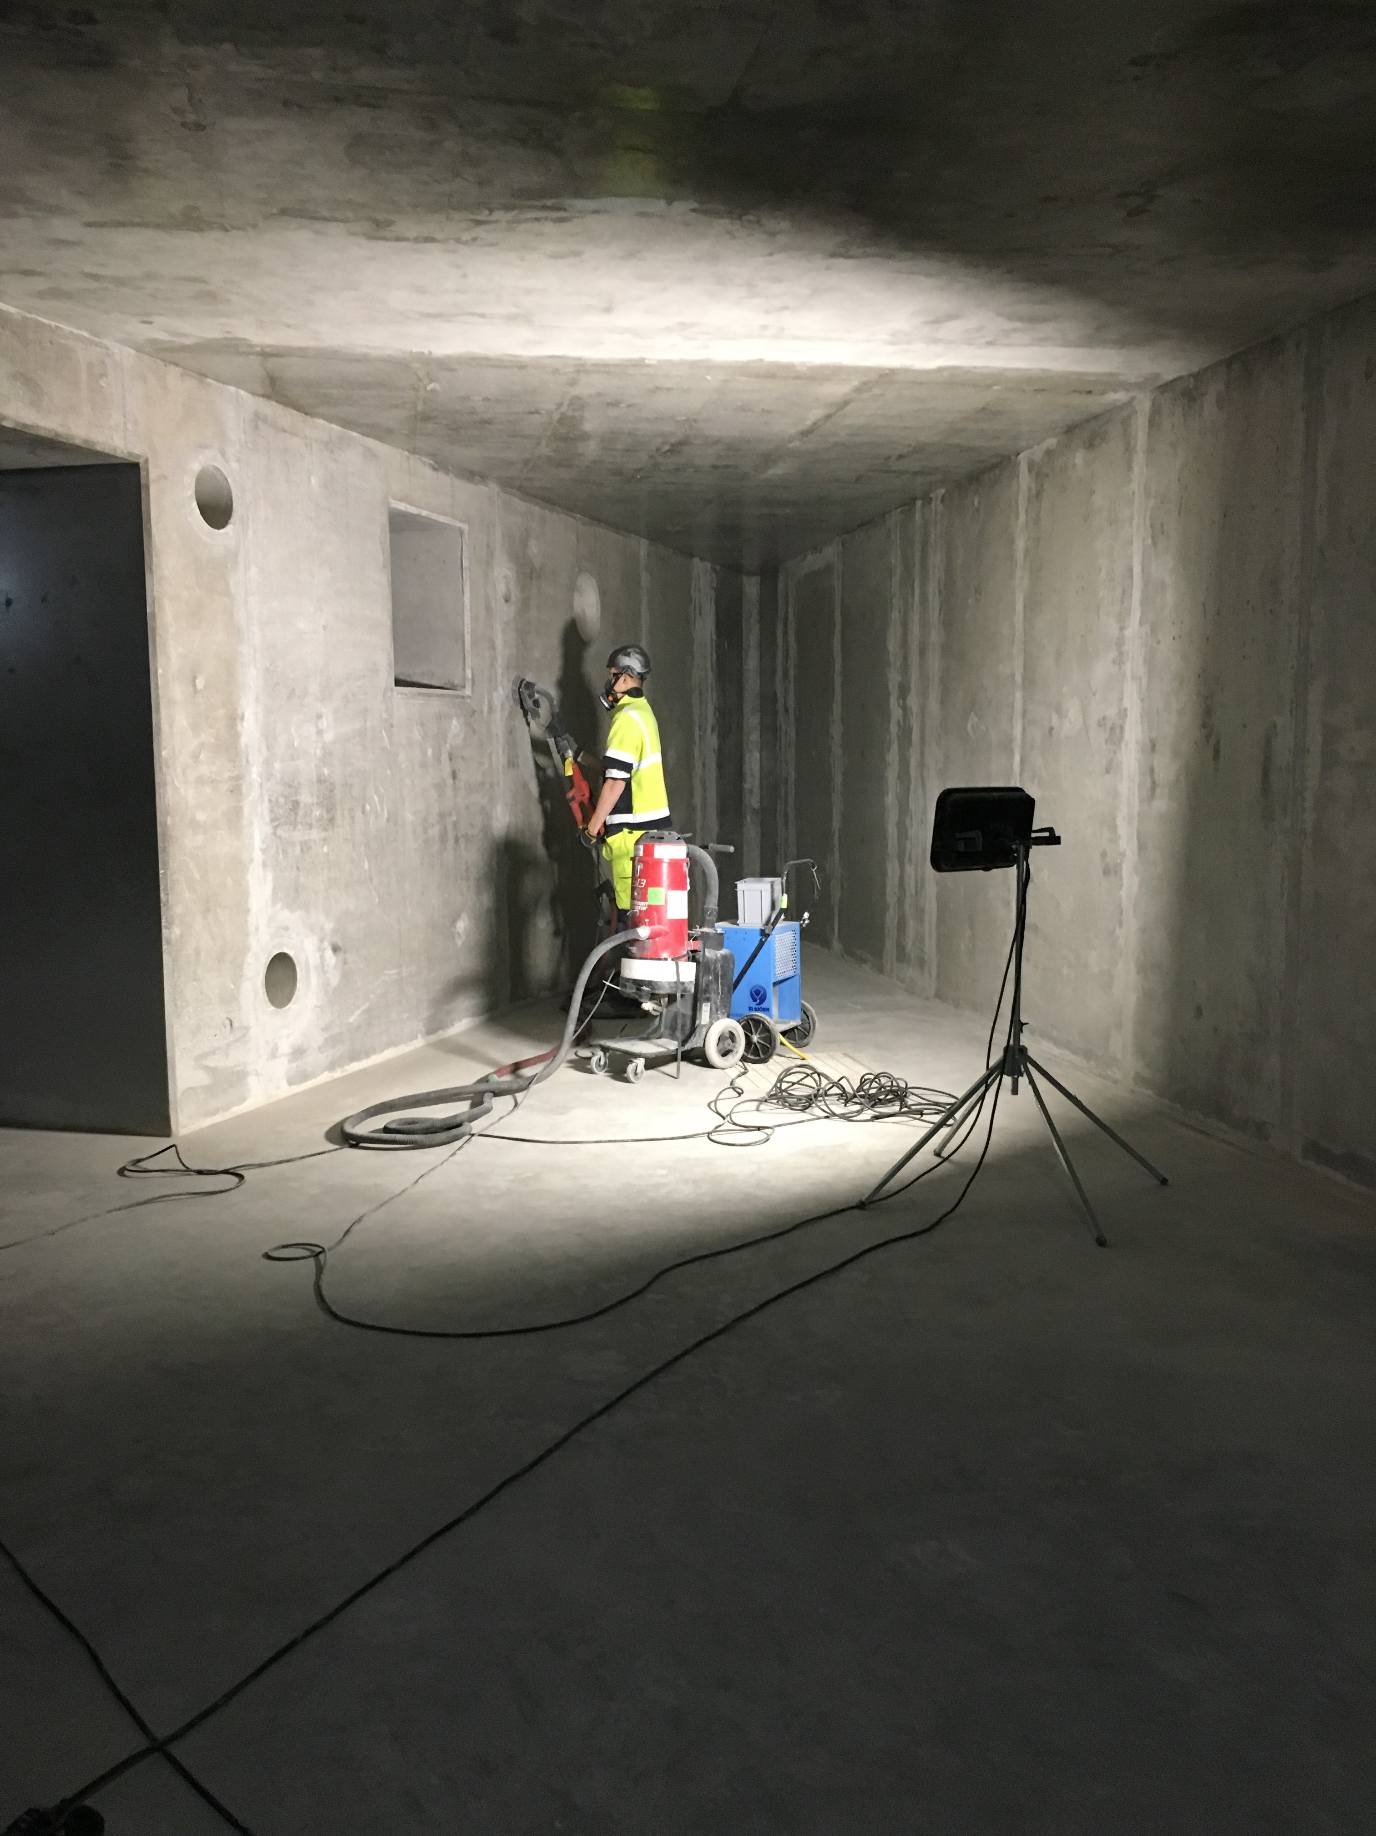
CEνNS at ESS the ESSnu program
ESS is the ultimate source for CEνNS, as far as the eye can see.
ESS has a very high yield of low energy neutrinos which allow for high statistics measurements
At 5MW, 2 GeV ESS is expected to provide an order of magnitude increase in neutrino flux respect to SNS at ORNL the site of the first CEνNS discovery
The ESSnu collaboration is in close contact with ESS a possible location for the experiment has been selected –>moving close to the approval process
Utility room that can be used for CEνNS

Slide 35
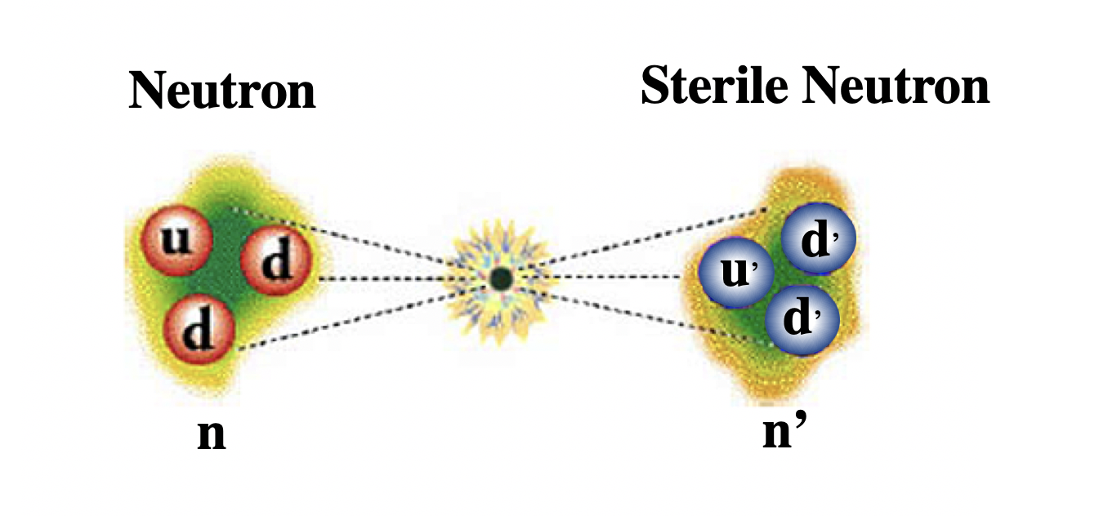
The HIBEAM experiment:
search for sterile neutron oscillations
see David Milsted talk
Notes:
The signal is a recoiling nucleus, which generates a signal in the few keV to subkeV energy range, difficult

Slide 36
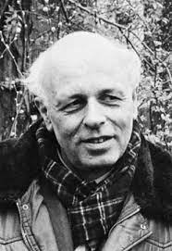
The HIBEAM/NNBAR program: search for Baryon Number Violation
BNV is a key Sakharov condition for the understanding of the matter-antimatter asymmetry of the universe
BNV generic feature of SM extensions (eg SUSY, extra dimensions..) → Important to probe possible BNV channels
The HIBEAM/NNBAR program will search for Baryon Number violation through neutron oscillations
Two stage program:
HIBEAM will search for neutron to sterile neutron oscillation n→n’ (|ΔB|=1)
NNBAR will search for the direct transition n→n̅ (|ΔB|=2) sensitivity increase of 10³ compared to previous experiments
Notes:
BNV generic feature of SM extensions (eg SUSY, extra dimensions B-L is conserved, not B, L separately

Slide 37
The HIBEAM/NNBAR program: search for Baryon Number Violation
BNV is a key Sakharov condition for the understanding of the matter-antimatter asymmetry of the universe
BNV generic feature of SM extensions (eg SUSY, extra dimensions..) → Important to probe possible BNV channels
The HIBEAM/NNBAR program will search for Baryon Number violation through neutron oscillations
Two stage program:
HIBEAM will search for neutron to sterile neutron oscillation n→n’ (|ΔB|=1)
NNBAR will search for the direct transition n→n̅ (|ΔB|=2) sensitivity increase of 10³ compared to previous experiments
Notes:
BNV generic feature of SM extensions (eg SUSY, extra dimensions B-L is conserved, not B, L separately

Slide 38
The HIBEAM/NNBAR program: search for Baryon Number Violation
BNV is a key Sakharov condition for the understanding of the matter-antimatter asymmetry of the universe
BNV generic feature of SM extensions (eg SUSY, extra dimensions..) → Important to probe possible BNV channels
The HIBEAM/NNBAR program will search for Baryon Number violation through neutron oscillations
Two stage program:
HIBEAM will search for neutron to sterile neutron oscillation n→n’ (|ΔB|=1)
NNBAR will search for the direct transition n→n̅ (|ΔB|=2) sensitivity increase of 10³ compared to previous experiments
Notes:
BNV generic feature of SM extensions (eg SUSY, extra dimensions B-L is conserved, not B, L separately

Slide 39
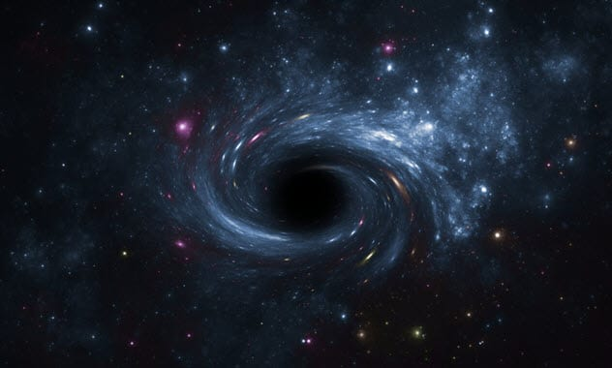
Sterile Neutrons
Sterile neutrons are states that can belong to a Dark Sector of particles that interact via gravity

Slide 40
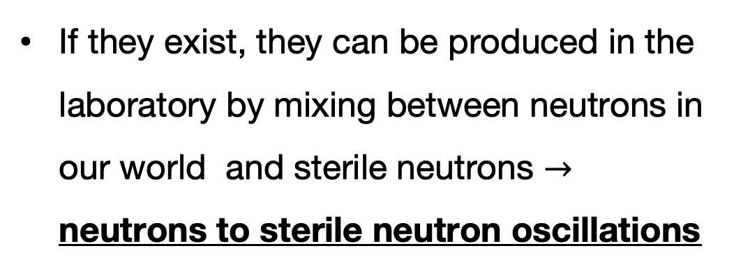
Sterile Neutrons
Sterile neutrons are states that can belong to a Dark Sector of particles that interact via gravity
If they exist, they can be produced in the laboratory by mixing between neutrons in our world and sterile neutrons $→$ neutrons to sterile neutron oscillations

Slide 41

Sterile Neutrons
Sterile neutrons are states that can belong to a Dark Sector of particles that interact via gravity
If they exist, they can be produced in the laboratory by mixing between neutrons in our world and sterile neutrons $→$ neutrons to sterile neutron oscillations
2020 European Particle Physics Strategy Update ”searches for dark sector and feebly interacting particles are essential activity”

Slide 42
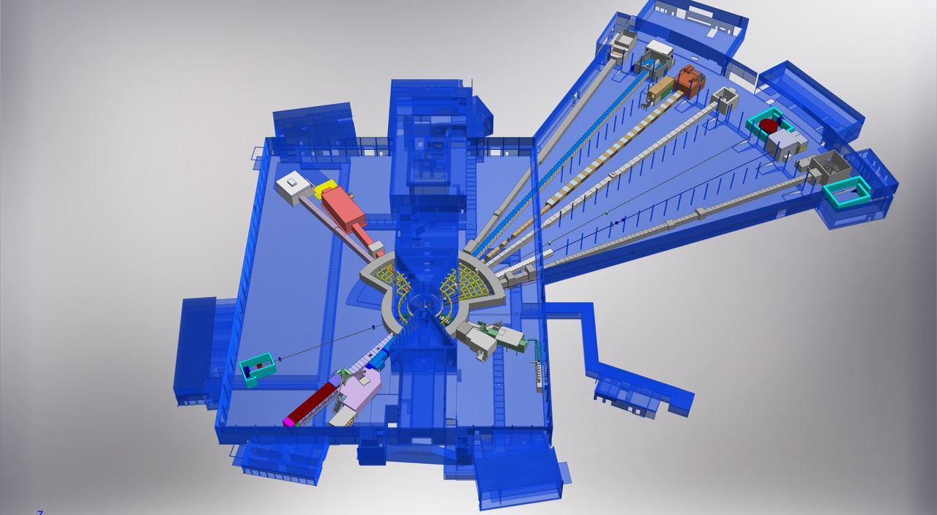
HIBEAM at the ESS test beamline
Test Beamline
Proton beam
The ESS Test beamline will be used in the early day of ESS to measure the performance of the neutron source (2025-2027)

Slide 43
HIBEAM at the ESS test beamline
Test Beamline
Proton beam
The ESS Test beamline will be used in the early day of ESS to measure the performance of the neutron source (2025-2027)
In 2027-2028 will be used by the HIBEAM team for performing prototypes tests and preliminary measurements

Slide 44
HIBEAM at the ESS test beamline
Test Beamline
Proton beam
The ESS Test beamline will be used in the early day of ESS to measure the performance of the neutron source (2025-2027)
In 2027-2028 will be used by the HIBEAM team for performing prototypes tests and preliminary measurements
It could be upgraded with moderate budget (2.5M€) to become an ESS fundamental physics beam line able to deliver already at 2MW world leading measurements

Slide 45

The NNBAR experiment:
search for neutron to antineutron oscillations
see David Milstead talk
Notes:
The signal is a recoiling nucleus, which generates a signal in the few keV to subkeV energy range, difficult

Slide 46
The NNBAR experiment @ ESS
The observation of neutrons turning into antineutrons would constitute a discovery of fundamental importance for particle physics and cosmology

Slide 47
The NNBAR experiment @ ESS
The observation of neutrons turning into antineutrons would constitute a discovery of fundamental importance for particle physics and cosmology
Observing a neutron converting in antineutrons would show that the baryon number is violated by 2 units and provide a clue to how the matter in our universe might have evolved from the B=0 early universe

Slide 48
The NNBAR experiment @ ESS
The observation of neutrons turning into antineutrons would constitute a discovery of fundamental importance for particle physics and cosmology
Observing a neutron converting in antineutrons would show that the baryon number is violated by 2 units and provide a clue to how the matter in our universe might have evolved from the B=0 early universe
NNBAR will have a sensitivity increase of 10³ compared to previous experiments → Opportunities for such a leap in sensitivity are rare
New high-sensitivity searches for neutrons converting into antineutrons and/or sterile neutrons at the HIBEAM/NNBAR experiment at the European Spallation Source
A Addazi et al 2021 J. Phys. G: Nucl. Part. Phys. 48 070501

Slide 49
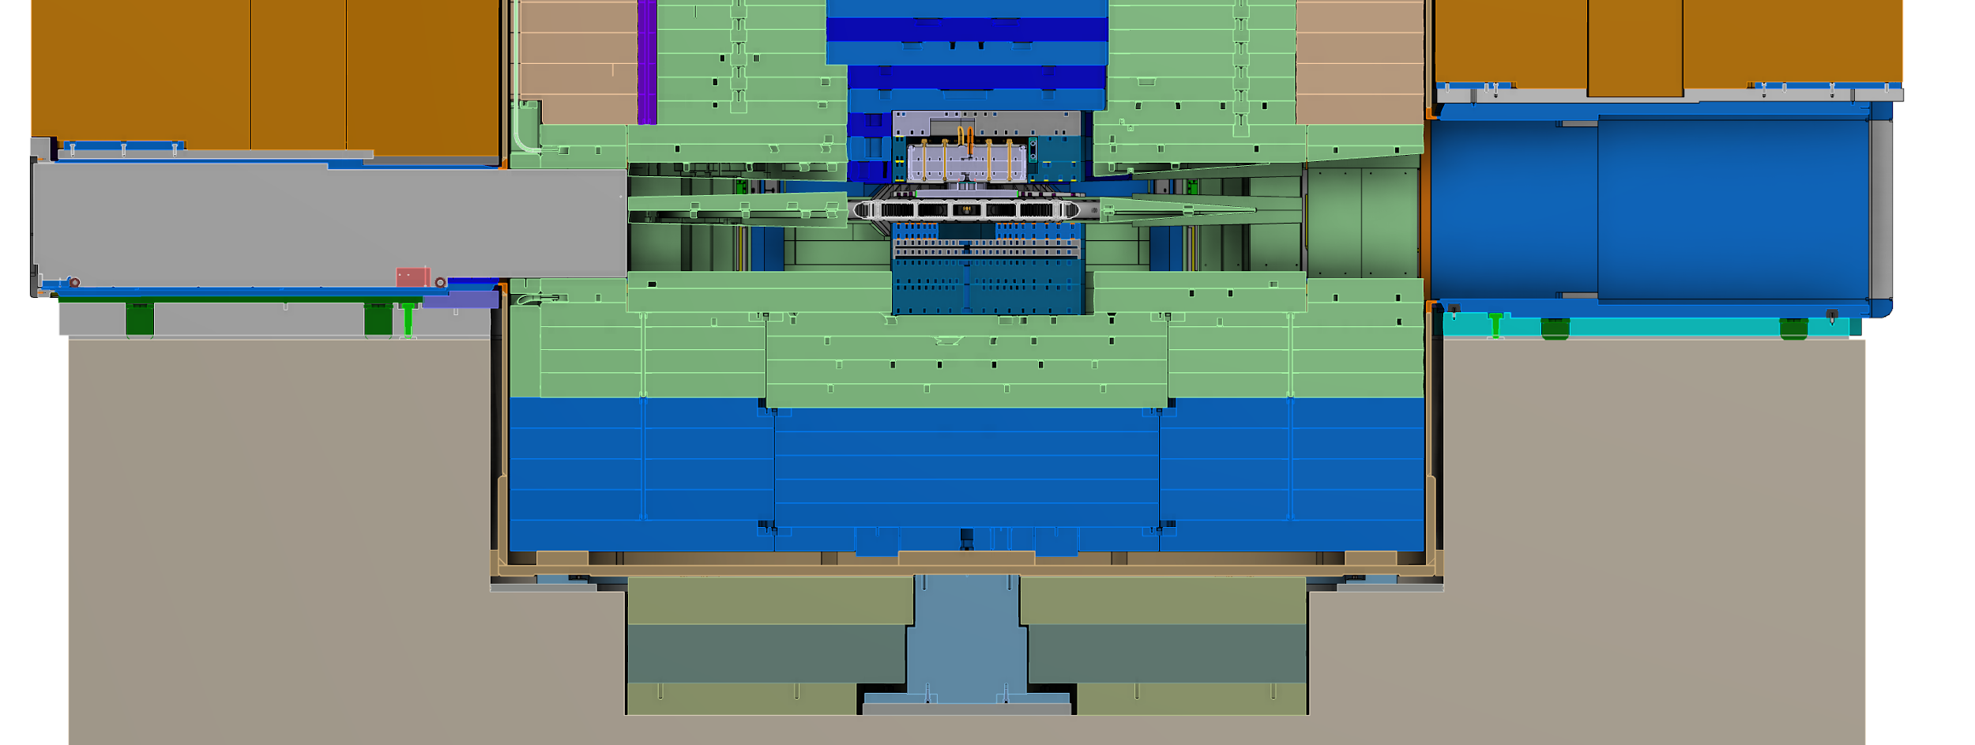
Why NNBAR at ESS ?
A large beam port has been built at ESS specifically for NNBAR to allow for extraction of a high intensity beam to provide sufficient intensity for neutron to antineutron search
ESS Target
Area
ESS moderator located above the spallation target
NNBAR Large Beam Port
ESS moderator located below the spallation target

Slide 50
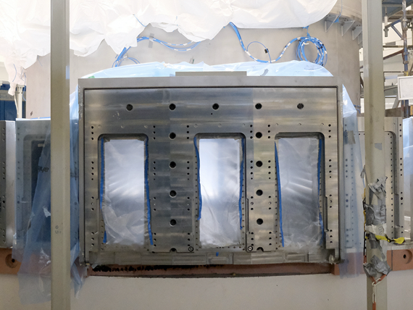
Why NNBAR at ESS ?
A large beam port has been built at ESS specifically for NNBAR to allow for extraction of a high intensity beam to provide sufficient intensity for neutron to antineutron search
ESS Target
Area
ESS moderator located above the spallation target
NNBAR Large Beam Port
ESS moderator located below the spallation target
Upper Moderator
Lower Moderator

Slide 51

The HighNESS Project
Development of High Intensity Neutron Source at the European Spallation Source
The HighNESS project (3 MEURO funded by the European Commission) has as purpose the development of the new source that will be installed at ESS >2030

Slide 52
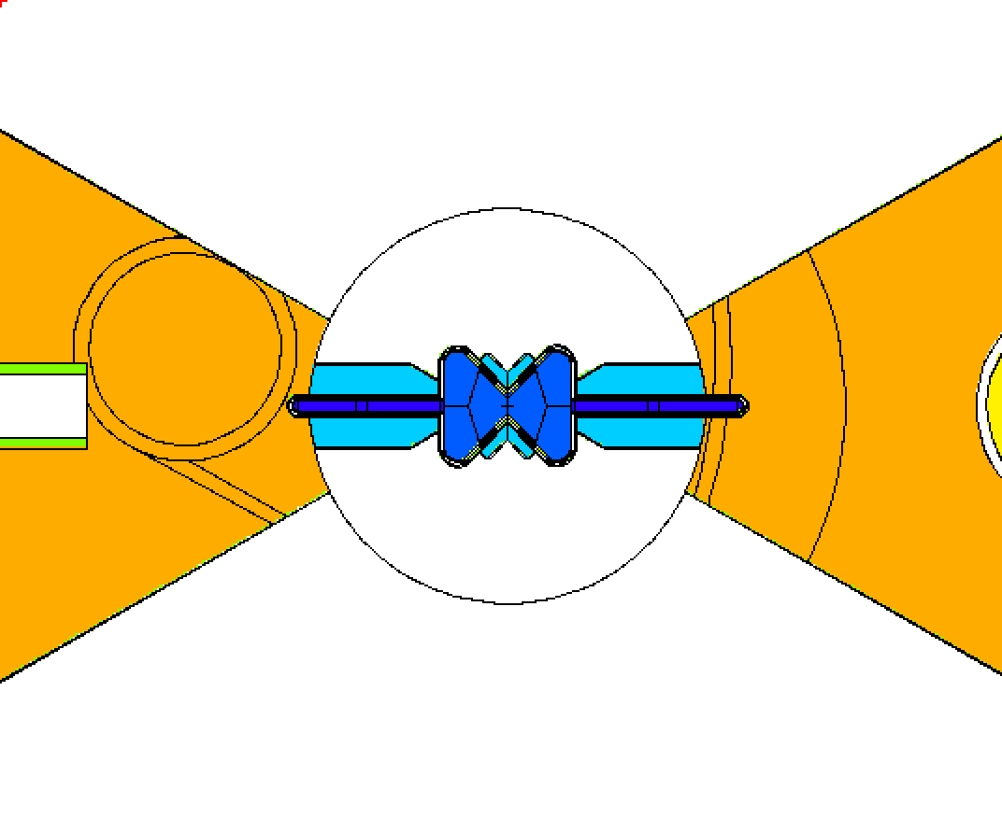
The HighNESS Project
Development of High Intensity Neutron Source at the European Spallation Source
The HighNESS project (3 MEURO funded by the European Commission) has as purpose the development of the new source that will be installed at ESS >2030
The new source will be composed by Liquid deuterium moderator D2
D2

Slide 53
The HighNESS Project
Development of High Intensity Neutron Source at the European Spallation Source
The HighNESS project (3 MEURO funded by the European Commission) has as purpose the development of the new source that will be installed at ESS >2030
The new source will be composed by Liquid deuterium moderator D2
The liquid deteurium will serve a Ultra Cold Neutron moderator and a Very Cold Neutron source
D2
VCN
UCN

Slide 54
The HighNESS Project
Development of High Intensity Neutron Source at the European Spallation Source
The HighNESS project (3 MEURO funded by the European Commission) has as purpose the development of the new source that will be installed at ESS >2030
The new source will be composed by Liquid deuterium moderator D2
The liquid deteurium will serve a Ultra Cold Neutron moderator and a Very Cold Neutron source
The associated condensed matter instruments that will use the new source are also being developed
D2
VCN
UCN

Slide 55
The HighNESS Project
Development of High Intensity Neutron Source at the European Spallation Source
The HighNESS project (3 MEURO funded by the European Commission) has as purpose the development of the new source that will be installed at ESS >2030
The new source will be composed by Liquid deuterium moderator D2
The liquid deteurium will serve a Ultra Cold Neutron moderator and a Very Cold Neutron source
The associated condensed matter instruments that will use the new source are also being developed
The Conceptual design report of the neutron antineutron oscillation experiment NNBAR will also be developed (see David’s Milstead talk)
D2
VCN
UCN

Slide 56
The HighNESS Project
Development of High Intensity Neutron Source at the European Spallation Source
The HighNESS project (3 MEURO funded by the European Commission) has as purpose the development of the new source that will be installed at ESS >2030
The new source will be composed by Liquid deuterium moderator D2
The liquid deteurium will serve a Ultra Cold Neutron moderator and a Very Cold Neutron source
The associated condensed matter instruments that will use the new source are also being developed
The Conceptual design report of the neutron antineutron oscillation experiment NNBAR will also be developed (see David’s Milstead talk)
Thanks to this new source NNBAR can reach the expected sensitivity already at 2MW
D2
VCN
UCN

Slide 57
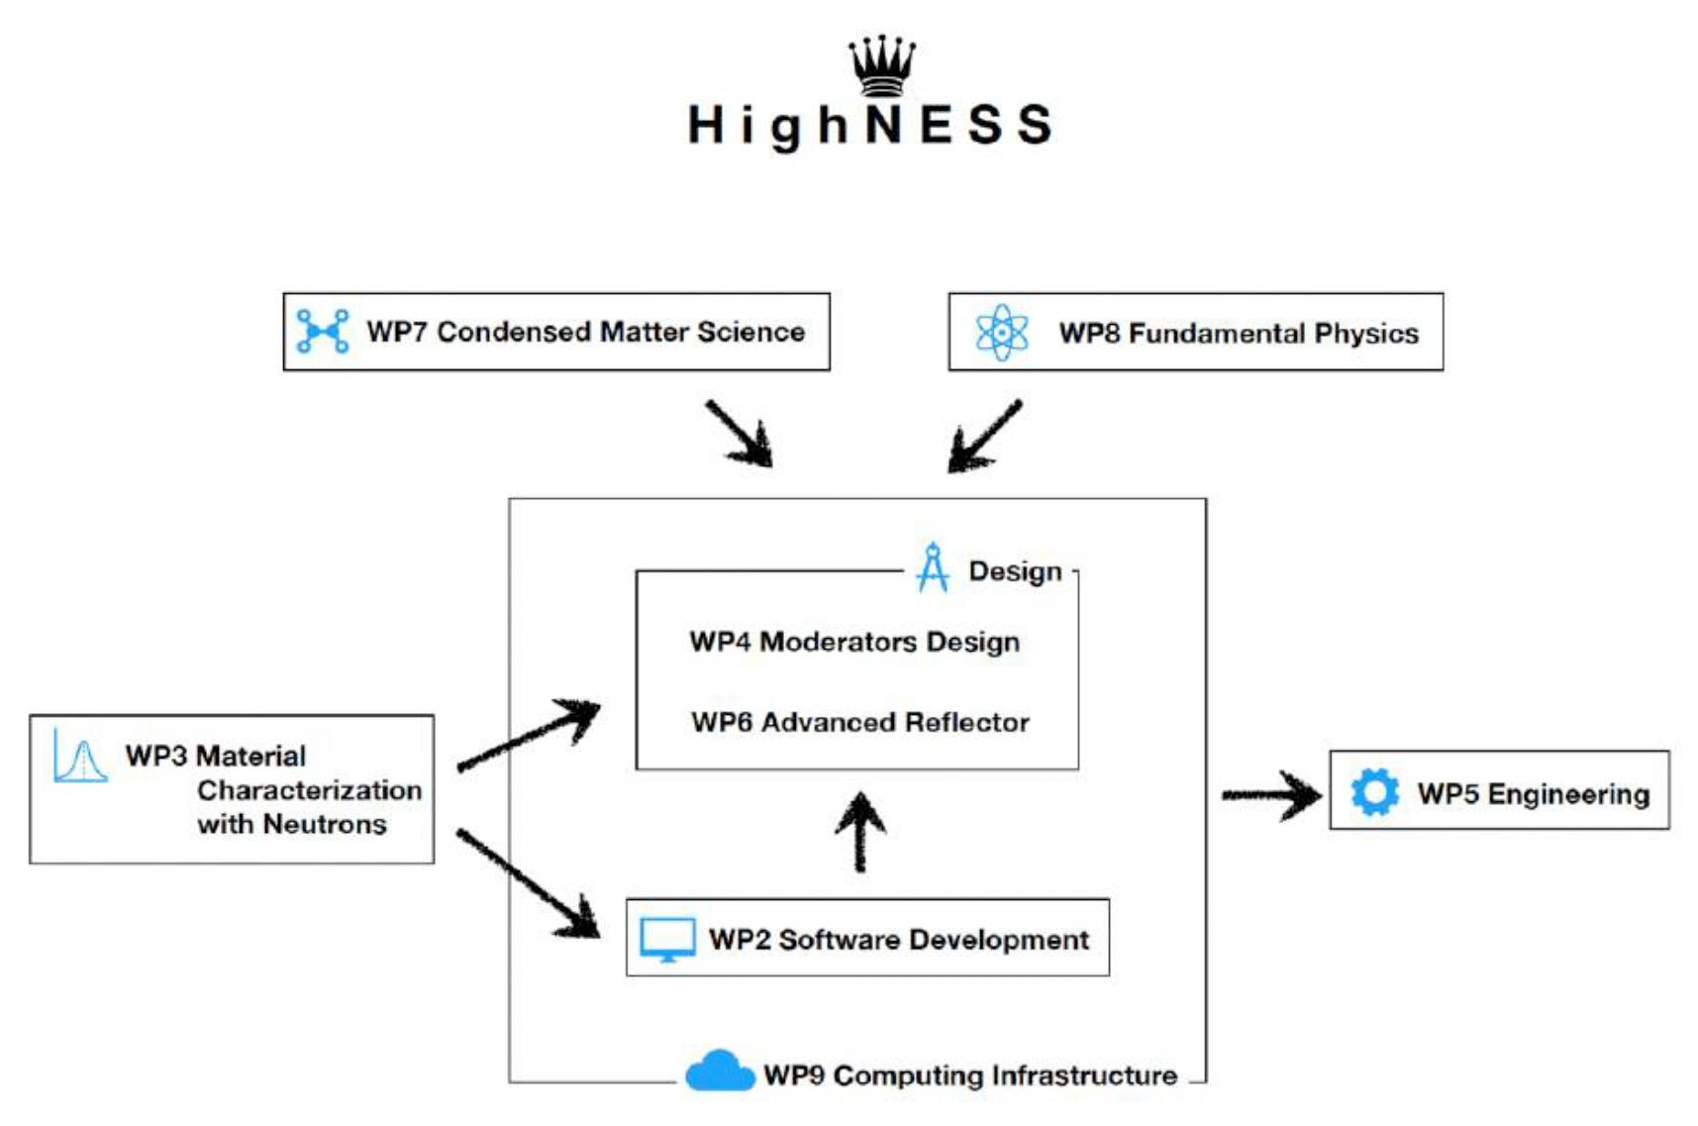







The HighNESS project at ESS
Cross disciplinary project (condensed matter+ particle physics)
Conceptual Design Report of the ESS upgrade is expected by the end of 2023
8 EU Institutes,
7 countries,
42 people presently involved

Slide 58

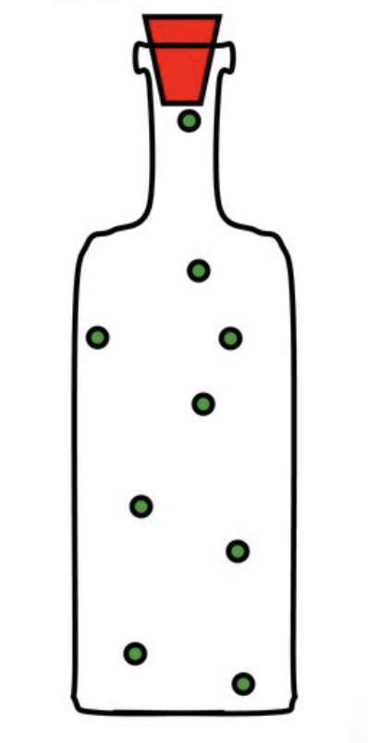
Ultra Cold Neutron Source for the ESS
ESS
-90° C
-270° C
-272.35° C

Slide 59
Ultra Cold Neutron (I)
Ultracold neutrons (UCN) have energies in the neV range, this is sufficiently low to allow them to be totally reflected under any angle of incidence.
This property enables experimentalists to store them in ”neutron bottles” made of suitable materials with small cross sections for neutron absorption.
Notes:
Velocity = (velocity < 8 m/s) 30 km/h temperature < 4 mK kinetic energy < 300 neV)
Interaction gravity: V=mghweak interaction (allows UCN to decay)magnetic fields: V=-•Bstrong interaction

Slide 60
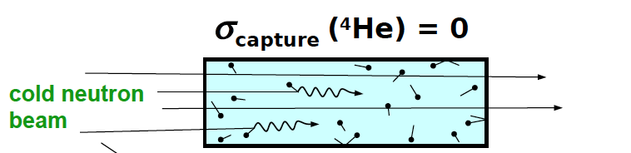
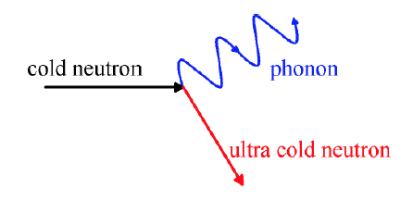
Ultra Cold Neutron (I)
Ultracold neutrons (UCN) have energies in the neV range, this is sufficiently low to allow them to be totally reflected under any angle of incidence.
This property enables experimentalists to store them in ”neutron bottles” made of suitable materials with small cross sections for neutron absorption.
The production of the UCN is mostly based on superfluid Helium (⁴He) installed at the end of neutron guide where neutrons with energy of 1meV can lose their energy in single scattering events.
Notes:
Velocity = (velocity < 8 m/s) 30 km/h temperature < 4 mK kinetic energy < 300 neV)
Interaction gravity: V=mghweak interaction (allows UCN to decay)magnetic fields: V=-•Bstrong interaction

Slide 61
Ultra Cold Neutron (II)
UCN source are motivated by the study of several neutron properties:
Measurement of the neutron lifetime
Its value impacts the abundance of light chemical elements in big-bang nucleosynthesis
Input for test of unitarity of the CKM weak quark mixing matrix (together with beta-asymmetry and data from kaon decays)

Slide 62
Ultra Cold Neutron (II)
UCN source are motivated by the study of several neutron properties:
Measurement of the neutron lifetime
Its value impacts the abundance of light chemical elements in big-bang nucleosynthesis
Input for test of unitarity of the CKM weak quark mixing matrix (together with beta-asymmetry and data from kaon decays)
Measurement of the neutron electric dipole moment (EDM)
The neutron EDM violates P and T (and hence CP) symmetry.
SM predicts undetectably small EDMs, whereas theories beyond the SM almost inevitably lead to much larger values.

Slide 63
Ultra Cold Neutron (II)
UCN source are motivated by the study of several neutron properties:
Measurement of the neutron lifetime
Its value impacts the abundance of light chemical elements in big-bang nucleosynthesis
Input for test of unitarity of the CKM weak quark mixing matrix (together with beta-asymmetry and data from kaon decays)
Measurement of the neutron electric dipole moment (EDM)
The neutron EDM violates P and T (and hence CP) symmetry.
SM predicts undetectably small EDMs, whereas theories beyond the SM almost inevitably lead to much larger values.
Gravitational spectroscopy with neutrons
Quantum-mechanical states of the neutron bound by Earth’s gravity to a horizontal mirror offer a way to search for new interactions beyond the Standard Model

Slide 64
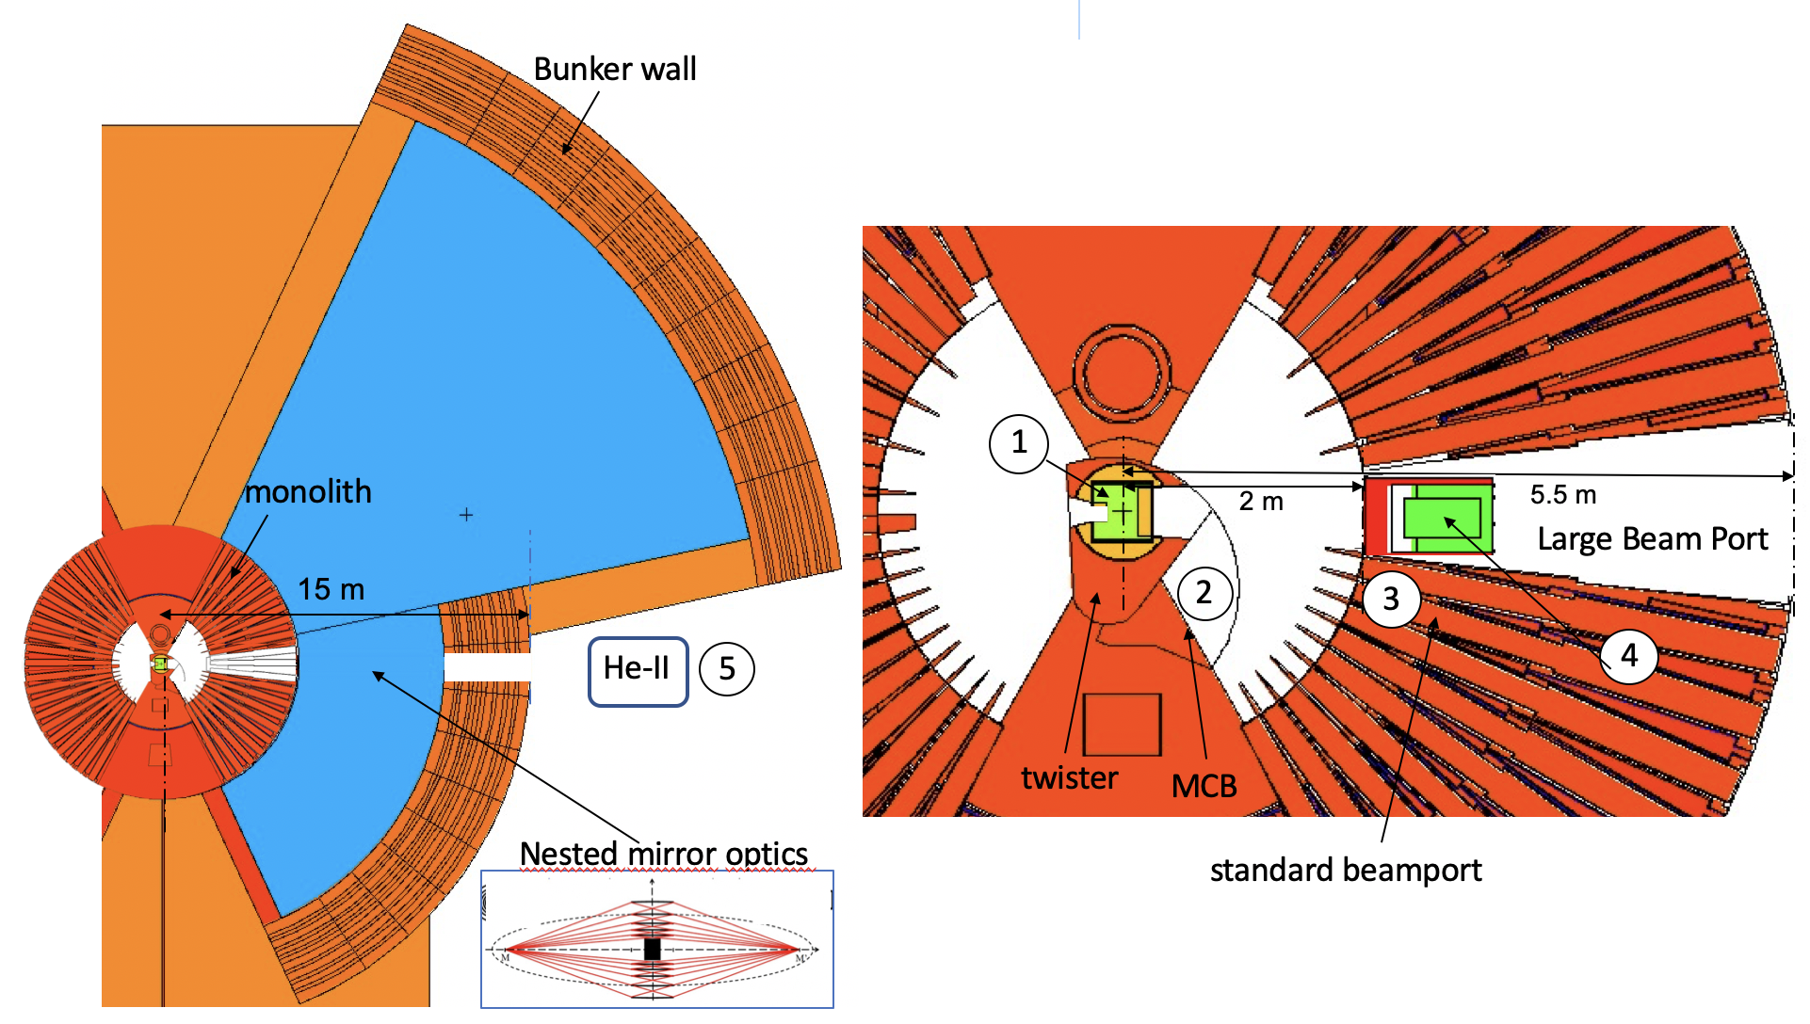
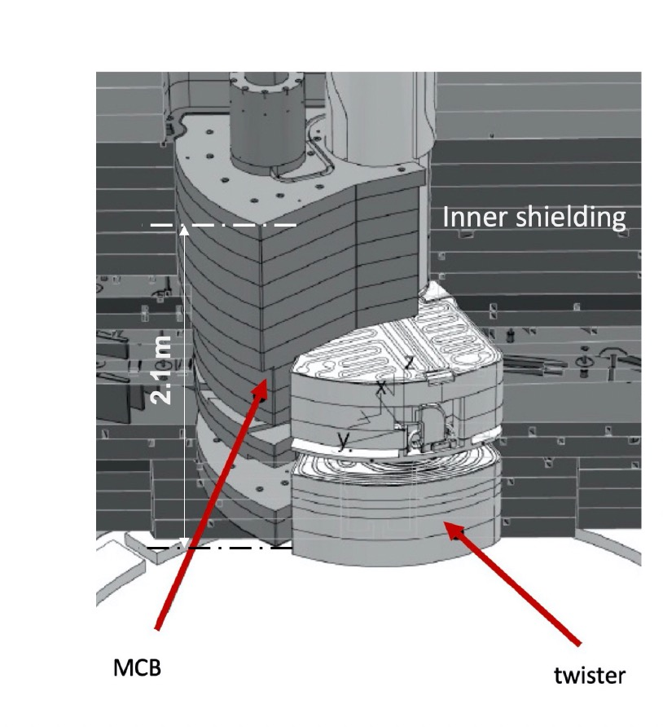
UCN sources design at the ESS : possible locations currently under study at ESS
Source: Luca Zanini

Slide 65

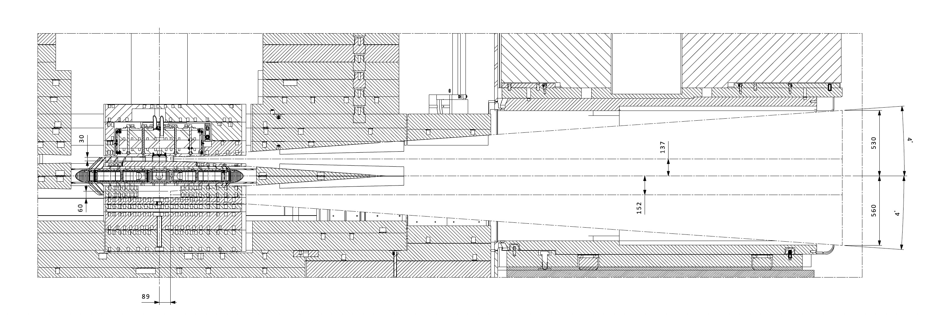
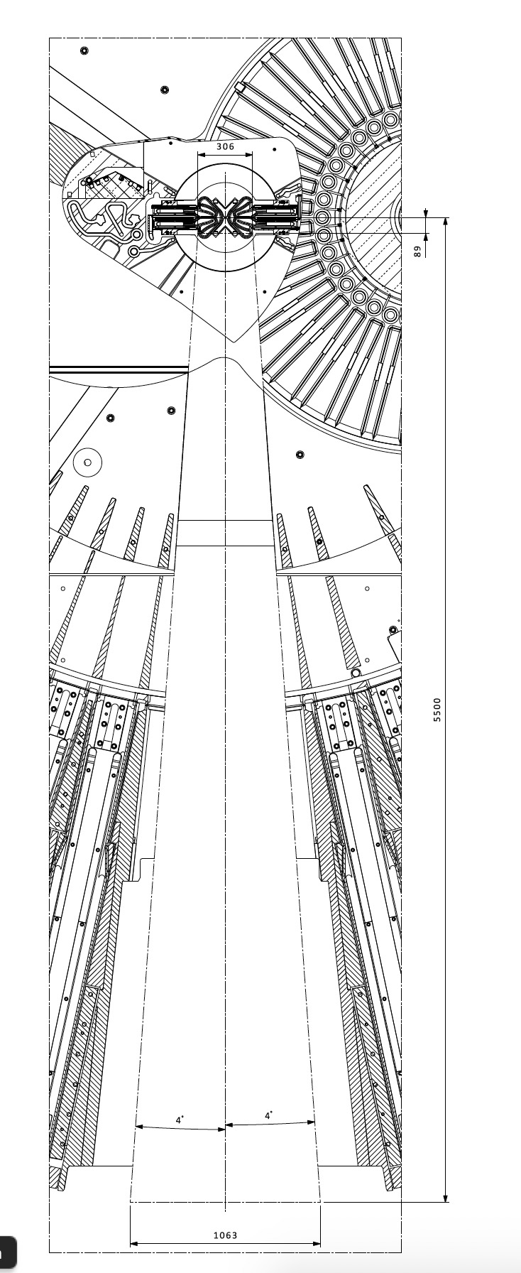
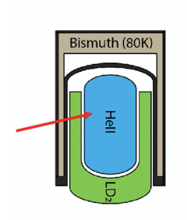
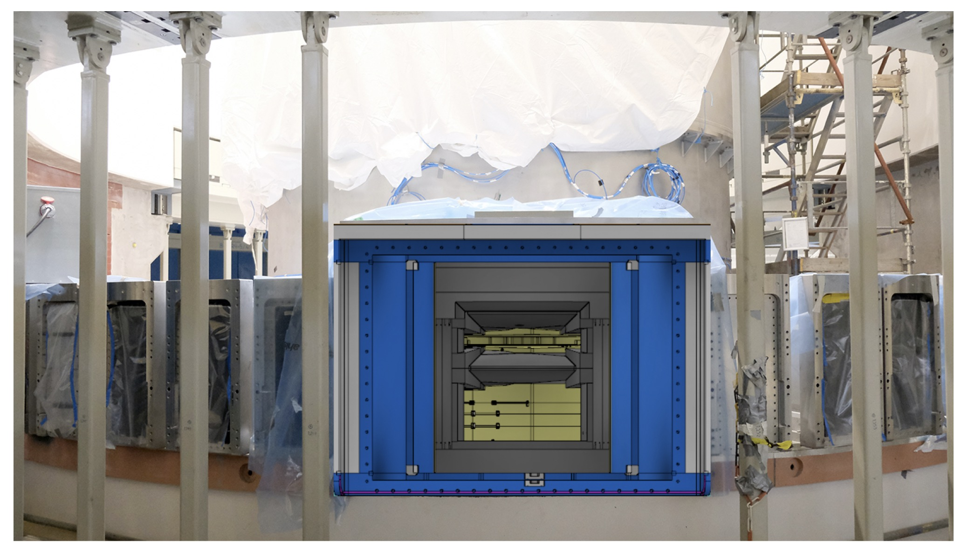
The Large Beam port could offers 2 extremely promising UCN design: design 1

Slide 66
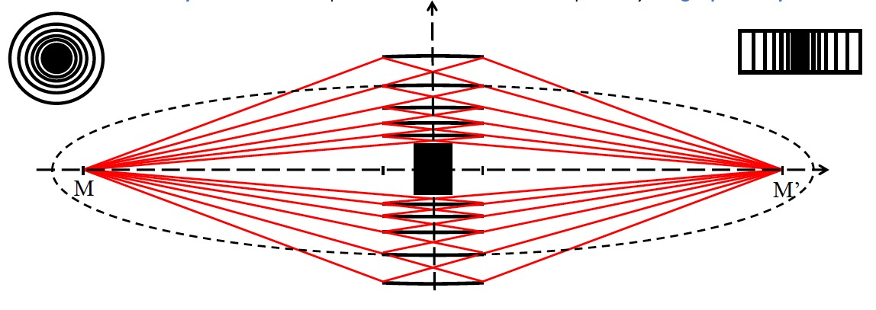
The Large Beam port could offers 2 extremely promising UCN design: design 2
In-beam solution with superfluid He converter and advanced optics system outside the large beamport (concept O. Zimmer)
Neutronic study in progress
Need a neutron delivery system with high brilliance transfer from moderator to UCN source, with largest technically possible solid angle

Slide 67
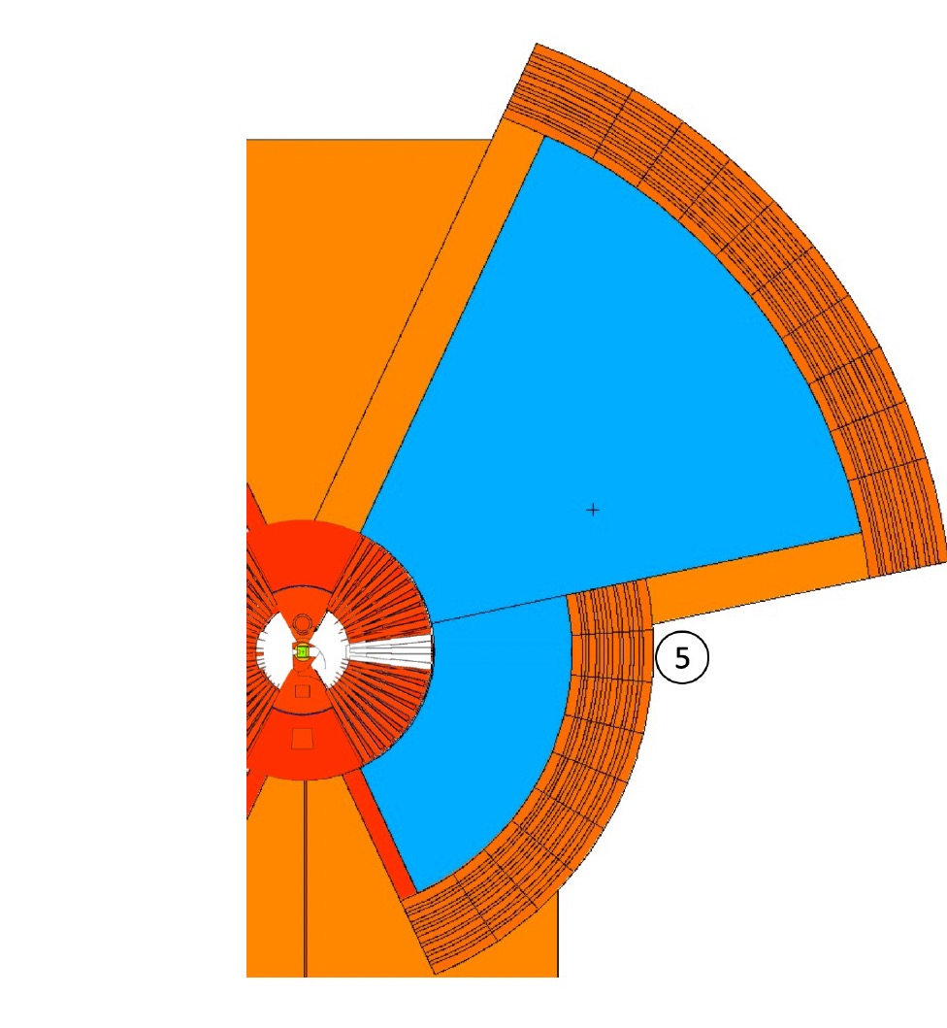
The Large Beam port could offers 2 extremely promising UCN design: design 2
In-beam solution with superfluid He converter and advanced optics system outside the large beamport (concept O. Zimmer)
Neutronic study in progress
Need a neutron delivery system with high brilliance transfer from moderator to UCN source, with largest technically possible solid angle
Neutron imaging from the moderator to the UCN source via nested mirrors has been identified as a particularly efficient solution
Need a neutron delivery system with high brilliance transfer from moderator to UCN source, with largest technically possible solid angle
UCN converter

Slide 68
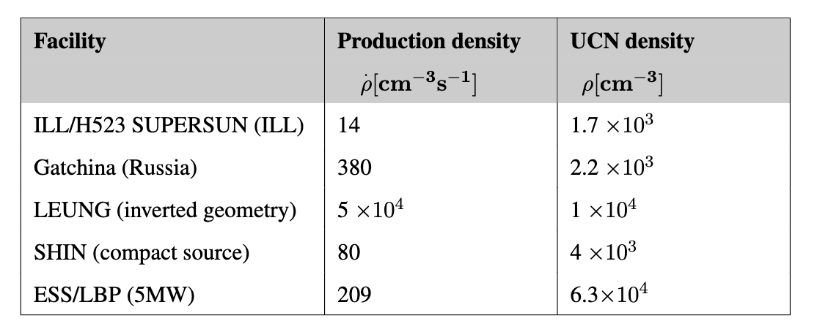
Potential world-leading UCN densities compared to other facilities under design or construction
Source: O. Zimmer, UCN/VCN workshop 2022
First results (in beam with use of nested mirror optics) are very promising.
Potential higher production in other locations, currently under investigation.

Slide 69
The ANNI Beamline
A cold neutron beam facility for particle physics
Notes:
The signal is a recoiling nucleus, which generates a signal in the few keV to subkeV energy range, difficult

Slide 70
The ANNI Beamline
Neutron instrument proposal for a dedicated particle physics beamline

Slide 71
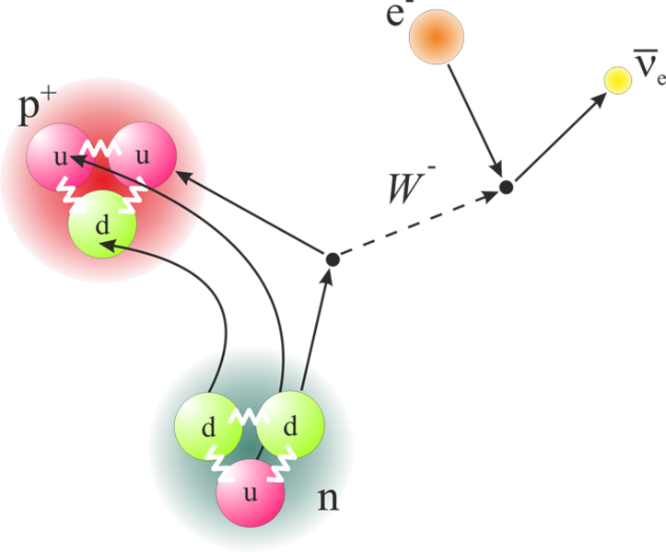
The ANNI Beamline: scientific case
Neutron beta decay correlation coefficients
The differential decay probability of the free neutron can be expanded in correlations between the involved particles (momenta or spin) parametrized by correlation coefficients
Measuring several correlation coefficients in the neutron beta decay provides broad band probes for physics beyond the standard model
Notes:
Least understood weak interaction

Slide 72
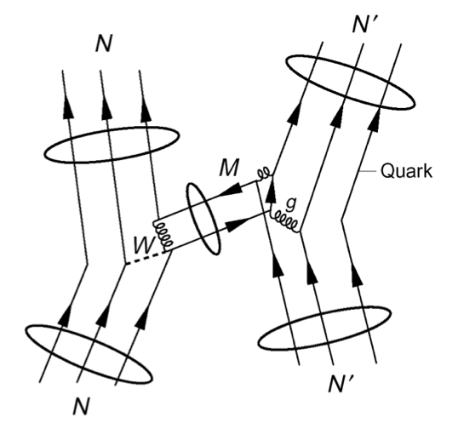
The ANNI Beamline: scientific case
Neutron beta decay correlation coefficients
The differential decay probability of the free neutron can be expanded in correlations between the involved particles (momenta or spin) parametrized by correlation coefficients
Measuring several correlation coefficients in the neutron beta decay provides broad band probes for physics beyond the standard model
Hadronic weak interaction
Complicated by nuclear structure
Unique PV (parity-violation) signature
Notes:
Least understood weak interaction

Slide 73
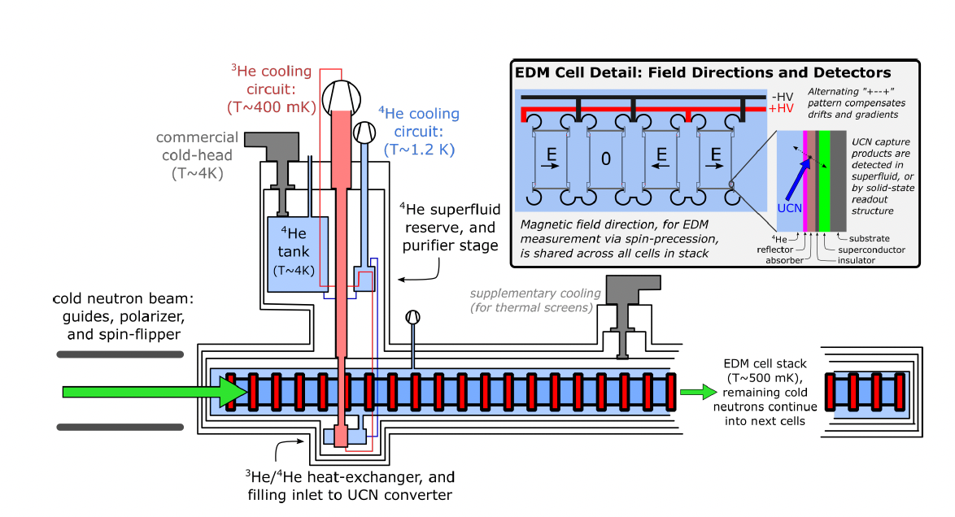
The ANNI Beamline: scientific case
Neutron beta decay correlation coefficients
The differential decay probability of the free neutron can be expanded in correlations between the involved particles (momenta or spin) parametrized by correlation coefficients
Measuring several correlation coefficients in the neutron beta decay provides broad band probes for physics beyond the standard model
Hadronic weak interaction
Complicated by nuclear structure
Unique PV (parity-violation) signature
Electromagnetic properties of neutron (both measured with in beam methodology and with UCN in situ production)
Notes:
Least understood weak interaction

Slide 74
The ANNI Beamline: scientific case
Neutron beta decay correlation coefficients
The differential decay probability of the free neutron can be expanded in correlations between the involved particles (momenta or spin) parametrized by correlation coefficients
Measuring several correlation coefficients in the neutron beta decay provides broad band probes for physics beyond the standard model
Hadronic weak interaction
Complicated by nuclear structure
Unique PV (parity-violation) signature
Electromagnetic properties of neutron (both measured with in beam methodology and with UCN in situ production)
All these measurements could be done at a generic beamline dedicated to fundamental physics at the ESS like the upgraded test beamline
Notes:
Least understood weak interaction

Slide 75
The ESS neutrino Super Beam (ESSnuSB)
Notes:
The signal is a recoiling nucleus, which generates a signal in the few keV to subkeV energy range, difficult

Slide 76
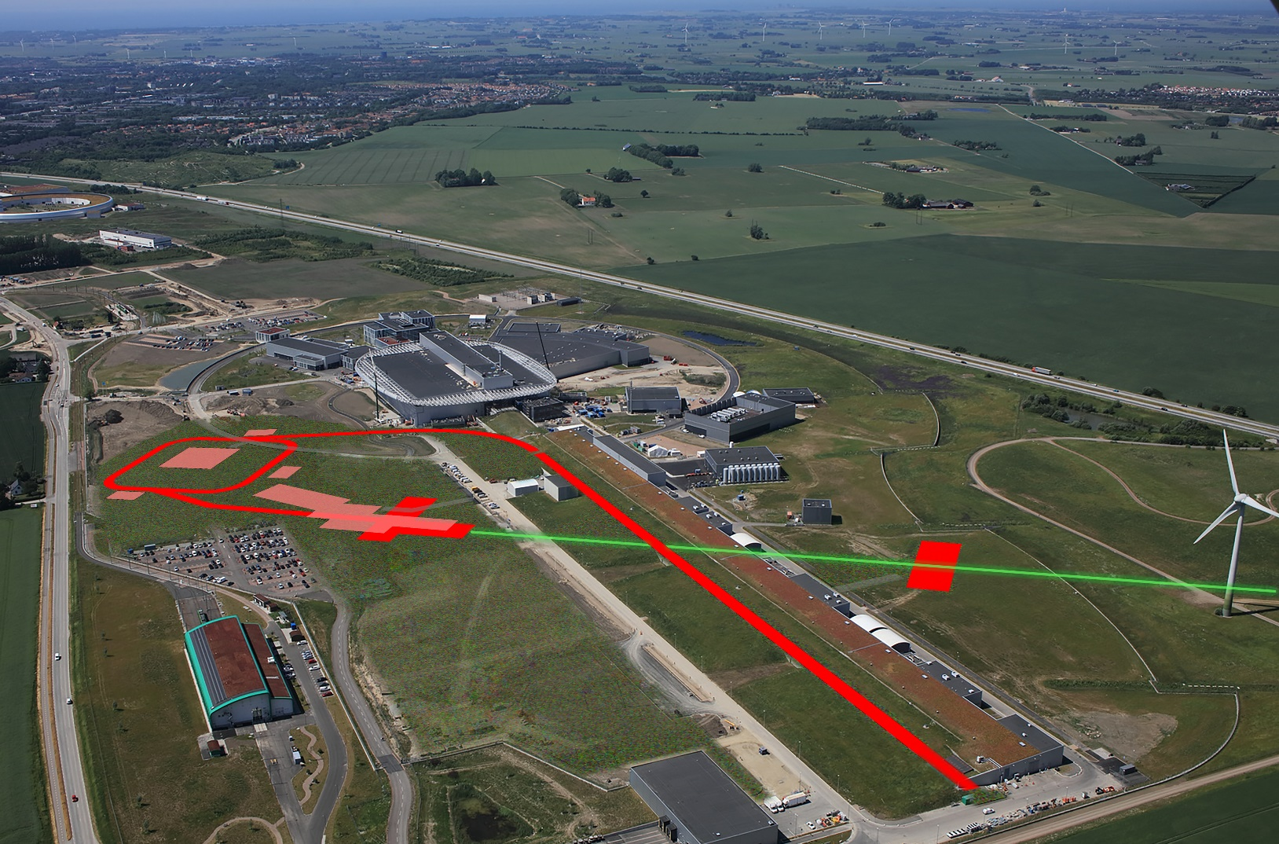
The ESS neutrino Super Beam (ESSnuSB)
The ESSnuSB is a proposed accelerator based long baseline neutrino experiment at ESS
The ESSnuSB will search for CP violation in the leptonic sector with higher precision

Slide 77
The ESS neutrino Super Beam (ESSnuSB)
The ESSnuSB is a proposed accelerator based long baseline neutrino experiment at ESS
The ESSnuSB will search for CP violation in the leptonic sector with higher precision
The ESS accelerator needs to be upgraded to 2.5 GeV energy and power to 10 MW. An accumulator ring will be built to shorten the ESS pulse to 1.2μs

Slide 78
The ESS neutrino Super Beam (ESSnuSB)
The ESSnuSB is a proposed accelerator based long baseline neutrino experiment at ESS
The ESSnuSB will search for CP violation in the leptonic sector with higher precision
The ESS accelerator needs to be upgraded to 2.5 GeV energy and power to 10 MW. An accumulator ring will be built to shorten the ESS pulse to 1.2μs
A neutrino production target station will be built
There will be a near detector close to the neutrino target station and a far detector in the north of Sweden
see Tord Ekelöf talk

Slide 79

Time to wrap up my presentation

Slide 80
External funding received for the ESS fundamental physics program
1.5 M€ 5 years ERC Starting Grant
2 M€ Basque Government
2.8 M € ERC Advanced Grant
HighNESS 3M€ (EC)
HIBEAM RFI Grants (VR) 1.5 M€
HIBEAM Swedish Foundation Strategic Research 1.5M€
ESSnuSB 3 Grants (EC) 4M€ +4M€
nuESS
HIBEAM/NNBAR
ESSnuSB

Slide 81
External funding received for the ESS fundamental physics program
1.5 M€ 5 years ERC Starting Grant
2 M€ Basque Government
2.8 M € ERC Advanced Grant
HighNESS 3M€ (EC)
HIBEAM RFI Grants (VR) 1.5 M€
HIBEAM Swedish Foundation Strategic Research 1.5M€
ESSnuSB 3 Grants (EC) 4M€ +4M€
nuESS
HIBEAM/NNBAR
ESSnuSB
~ 20M€ of external funding

Slide 82
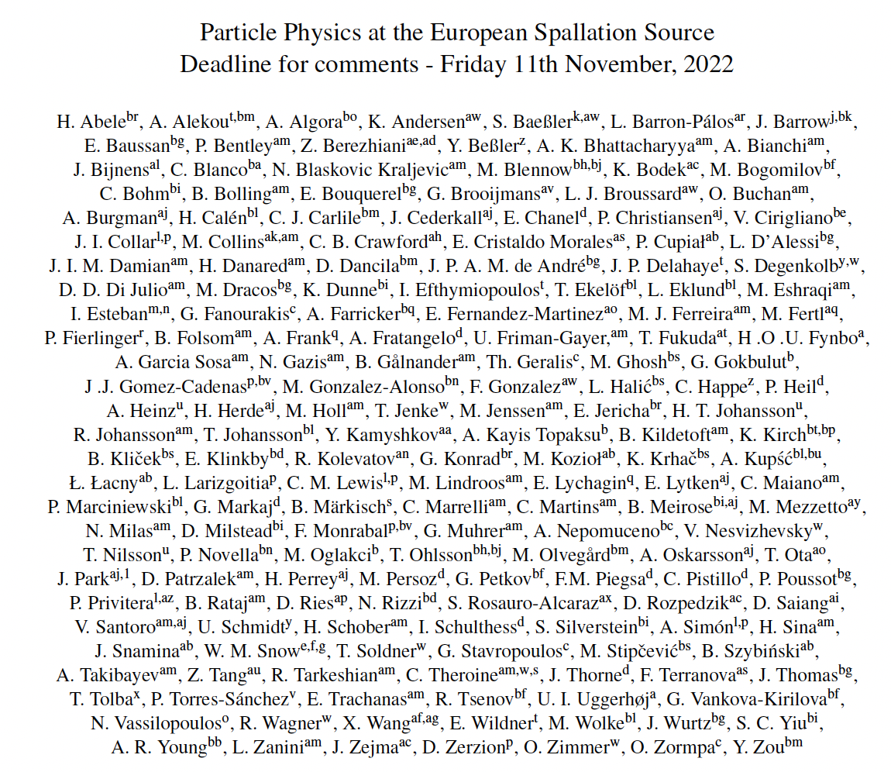
The ESS Fundamental physics paper
178 Authors, 74 Institutions, will be submitted to the arXiv tomorrow

Slide 83
Conclusions (I)
Several exciting possibilities for fundamental physics at ESS are available
CEνNS at ESS and HIBEAM at the test beam line can start in a relatively short amount of time ~ 5 years from approval
ANNI could be one of the future instrument 16-22 will require a new call from proposal from ESS
NNBAR will need of the order of ~ 10 years (both for facility upgrade, beamline design and detector development)
ESSnuSB needs a major facility upgrade ~ 15/20 years

Slide 84
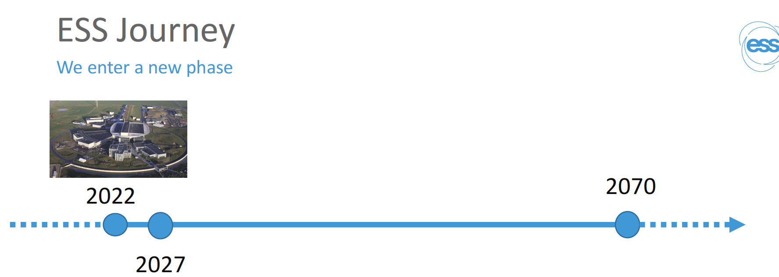
Conclusions (II)
We are developing a world leading program for the next 20/30 years
ESSnu, HIBEAM
2035

Slide 85
Conclusions (II)
We are developing a world leading program for the next 20/30 years
ANNI
NNBAR
2035/2045

Slide 86
Conclusions (II)
We are developing a world leading program for the next 20/30 years
ESSnuSB
UCN source at the Large Beam Port
2050

Slide 87
Conclusions (II)
We are developing a world leading program for the next 20/30 years
ESSnuSB
UCN source at the Large Beam Port
2050
The ESS fundamental physics program is an incredible opportunity for Swedish science that should not be missed

Slide 88


ESS Fundamental Physics Program är en fantastisk möjlighet för svensk vetenskap som inte får missas!

Slide 89
BACK UP SLIDES

Slide 90
Neutron beta decay correlation coefficients
The differential decay probability of the free neutron can be expanded in correlations between the involved particles (momenta or spin) parametrized by correlation coefficients
σ_{e}
P conserving
P violating
P conserving
P violating
T violating
n → p e ν_{e}
4 “detectable” quantities:
Neutron spin
Electron momentum
Electron spin
Neutrino momentum
N
H
V
Correlations:
twofold
4 threefold
5 fourfold
fivefold
Correlations:
twofold
4 threefold
5 fourfold
fivefold
+ Fierz term (e-spectrum)
+ lifetime
+ rare decay modes (H, γ)
Correlations:
twofold
4 threefold
Correlations:
twofold
G
R
L
p_{e}p_{ν}, σ_{n}p_{e}
σ_{n}
B
σ_{n}(p_{e}×p_{ν})
p_{ν}
A
D
a
(σ_{e}p_{e})(p_{e}p_{ν})
Inspired by
Dubbers & Schmidt, Rev. Mod. Phys. 83 (2011) 1111
(σ_{e}p_{e})(σ_{n}(p_{e}×p_{ν}))
p_{e}
Measuring several correlation coefficients in the neutron beta decay provides broad band probes for physics beyond the standard model
90

Slide 91
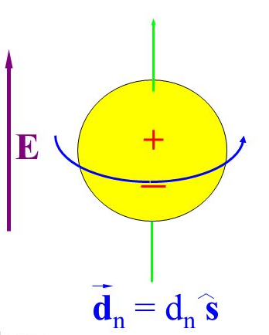
Neutron EDM
The electrical neutrality of neutrons are not required by the SM.
Standard Model EDMs are due to CP violation in the quark mixing matrix CKM
The neutron EDM is Standard Model is predicted to be 10⁻³² e⋅cm
The current experimental neutron limit is
d_{n} <2.9⋅ 10⁻²⁶ e⋅cm (@ 90% CL)
A large class of grand unified theories (with additional CP violation BSM) set a lower bound for the neutron EDM of
d_{n} > 3⋅ 10⁻²⁸ e⋅cm
91

Slide 92
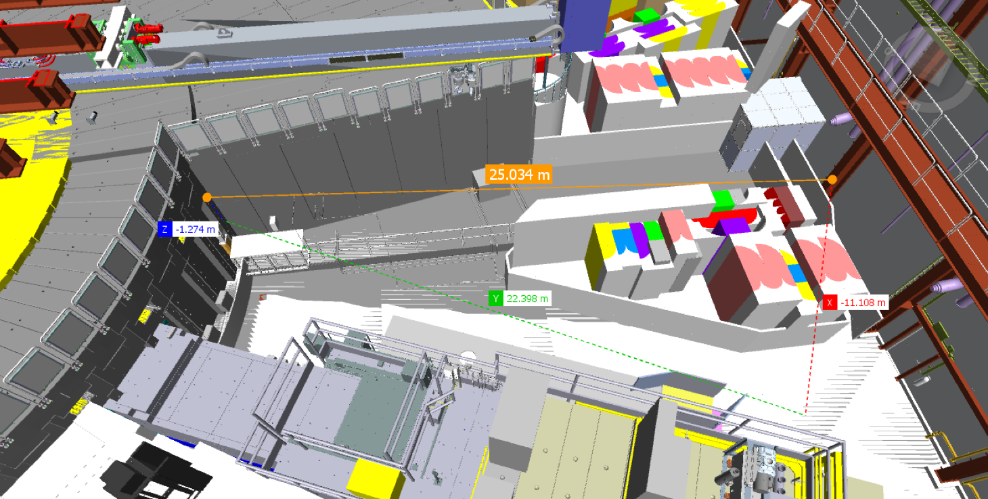
HIBEAM at the test beamline
25m
•Sensitivities of the oscillation searches depend linearly on the number of neutrons and quadratically or to the 4th power (depending on the channel) on the flight path
•With a 25m flight path the HIBEAM at the test beamline will have the longer flight path currently available for this kind of searches

Slide 93
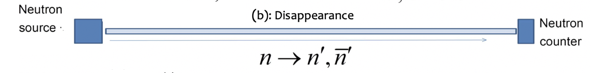
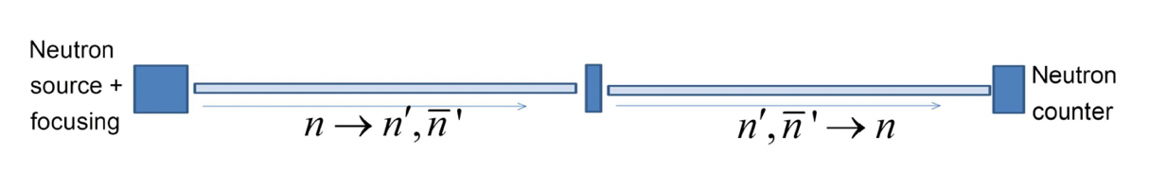
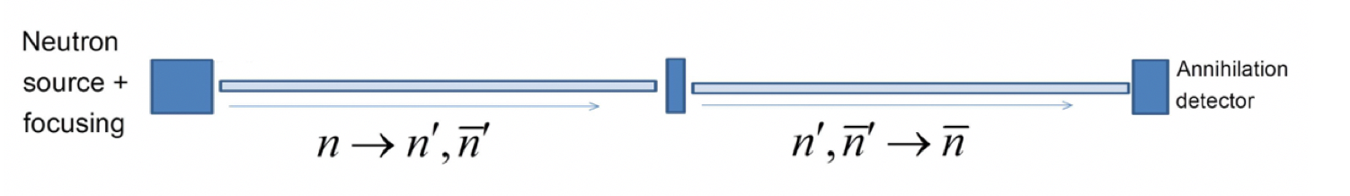

Search for sterile neutron oscillations at HIBEAM
Disappearance
Neutron
Beam
Regeneration $n→n′→n$
Beam Stop
Neutron
Beam
Neutron antineutron conversion via sterile neutron $n→n′→\overline{n}$
Beam Stop
Neutron
Beam
Annihilation
Detector
see David Milstead’s tallk

Slide 94
Thanks for the Attention

Slide 95
The ESS neutrino Super Beam (ESSnuSB): scientific motivation
In 2012 it was discovered that the neutrino ν₁ and ν₃ mass eigenstates mixing angle θ₁₃ = 8.8º, a value which was much larger than assumed

Slide 96
The ESS neutrino Super Beam (ESSnuSB): scientific motivation
In 2012 it was discovered that the neutrino ν₁ and ν₃ mass eigenstates mixing angle θ₁₃ = 8.8º, a value which was much larger than assumed
In the light of this finding the sensitivity of CP violation δ_{CP} has a strong enhancement at the second oscillation maximum compared to that at the first oscillation maximum

Slide 97
The ESS neutrino Super Beam (ESSnuSB): scientific motivation
In 2012 it was discovered that the neutrino ν₁ and ν₃ mass eigenstates mixing angle θ₁₃ = 8.8º, a value which was much larger than assumed
In the light of this finding the sensitivity of CP violation δ_{CP} has a strong enhancement at the second oscillation maximum compared to that at the first oscillation maximum
However placing the far detector at the 2nd maximum implies the need of a very high intensity neutrino super beam to compensate for the longer baseline

Slide 98
The ESS neutrino Super Beam (ESSnuSB)
To produce an intense neutrino beam at the same time of the intense neutron beam it is a needed a major upgrade of the ESS facility
The ESS accelerator needs to be upgraded to 2.5 GeV energy and power to 10 MW this requires additional H- source and increase of linac duty cycle from 4% to 8%

Slide 99
The ESS neutrino Super Beam (ESSnuSB)
In 2012 it was discovered that the neutrino ν₁ and ν₃ mass eigenstates mixing angle θ₁₃ = 8.8º, a value which was much larger than assumed
In the light of this finding the sensitivity of CP violation δ_{CP} has a strong enhancement at the second oscillation maximum compared to that at the first oscillation maximum
However placing the far detector at the 2nd maximum implies the need of a very high intensity neutrino super beam to compensate for the longer baseline
The ESSnuSB is a proposed accelerator based long baseline neutrino experiment at ESS

Slide 100
The ESS neutrino Super Beam (ESSnuSB): scientific motivation
In 2012 it was discovered that the neutrino ν₁ and ν₃ mass eigenstates mixing angle θ₁₃ = 8.8º, a value which was much larger than assumed
In the light of this finding the sensitivity of CP violation δ_{CP} has a strong enhancement at the second oscillation maximum compared to that at the first oscillation maximum
However placing the far detector at the 2nd maximum implies the need of a very high intensity neutrino super beam to compensate for the longer baseline
The ESSnuSB is a proposed accelerator based long baseline neutrino experiment at ESS

Slide 101
Production, transportation and storage is motivated by the study of several neutron properties:
Measurement of the neutron lifetime (its value impacts the abundance of light chemical elements in big-bang nucleosynthesis )
Measurement of the neutron electric dipole moment (EDM)
Observation of the gravitational interactions of the neutrons
In a previous experiment ILL physicists have observed quantized state of matter under the influence of gravity for the first time.
Nesvizhevsky V et all. Quantum states of neutrons in the Earth's gravitational field. Nature. 2002 Jan 17;415(6869):297-9. doi: 10.1038/415297a. PMID: 11797001.
CopyDownload .nbib

Slide 102
The ESS neutrino Super Beam (ESSnuSB)
To produce an intense neutrino beam at the same time of the intense neutron beam it is a needed a major upgrande of the ESS facility
The ESS accelerator needs to be upgraded to 2.5 GeV energy and power to 10 MW this requires additional H- source and increase of linac duty cycle from 4% to 8%
An accumulator ring will be built to shorten the ESS pulse to 1.2μs
A neutrino production target station composed of four identical target will be built

Slide 103
The ESS neutrino Super Beam (ESSnuSB)
To produce an intense neutrino beam at the same time of the intense neutron beam it is a needed a major upgrande of the ESS facility
The ESS accelerator needs to be upgraded to 2.5 GeV energy and power to 10 MW this requires additional H- source and increase of linac duty cycle from 4% to 8%
An accumulator ring will be built to shorten the ESS pulse to 1.2μs
A neutrino production target station composed of four identical target will be built
There will be a near detector to monitor the neutron beam
The far detector will be located at the Zinkgruvan mine 360 km from ESS or at the Garpenberg mine at 540 km from ESS

Slide 104


ESSnSB design study from 2018-2022 supported by the European Commission
Title of Proposal: Discovery and measurement of leptonic CP violation using an intensive neutrino Super Beam generated with the exceptionally powerful ESS linear accelerator
Duration: 4 years
Total cost: 4.7 M€
Requested budget: 3 M€
15 participating institutes from 11 European countries including CERN and ESS
6 Work Packages
They will submit soon a new applitcation to the call HORIZON-INFRA-2022-DEV01
Developing European Research Infrastructures to maintain global leadership Deadline: 20 April 2022

Slide 105



Near and Far Dectors
Near Water Cherenkov Detector
Located 250 m from the target
11 m lenth, 4.72 m radius, 770 m³ voume
In front of it there a Plastic Cube Tracker (sFGD)
1.4 × 1.4 × 0.5 m³ with 1 cm³ cubes
Two Far Water Cherenkov Detector
Located 370 km from the target
Each detector 74 m height, 74 m diameter, 270 m³ volume
Total fiducial volume: 540 m3
Order 100’000 20 inch photomultiplies
40% coverage

Slide 106

Accelerator upgrade and accumulator ring
Upgrade of energy to 2.5 GeV and power to 10 MW with extra H- pulses
- requires additional H- source and increase of linca duty cycle from 4% to 8%
Compression of the 2.86 ms linac pulses to
1.3 μs by multi-turn injection and
Single-turn ejection – requires H- pulses
to be injected and stripped at injection

Slide 107
BACK UP SLIDES

Slide 108



Moderator cooling block location number 2
MCNP model under development -> could be challenging for cooling of He-II

Slide 109


in 2012 it was discovered that the neutrino ν₁ and ν₃ mass eigenstates mixing angle θ₁₃ = 8.8º, a value which was much larger than assumed before 2012 when HyoperK and DUNE were designed
solar
atmospheric
for "large" θ₁₃ 1st oscillation maximum is dominated by atmospheric term
for small θ₁₃ 1st oscillation maximum is better
atmospheric
solar
L/E
L/E
CP interference
(arXiv:1110.4583)
θ₁₃=1º
CP interference
θ₁₃=8.8º
2nd oscillation maximum
δ_{CP}=-90
δ_{CP}=0
δ_{CP}=+90
P(ν_{μ}→ν_{e})
1st oscillation max.: A=0.3sinδ_{CP}
2nd oscillation max.: A=0.75sinδ_{CP}
θ₁₃=8.8º
("large" θ₁₃)
(see arXiv:1310.5992 and arXiv:0710.0554)
L/E
more sensitivity at 2nd oscillation max.

Slide 110
Conclusions - The discovery of a large - in comparison with assumptions made before 2012 - value of θ₁₃ implies that the influence of irreducible systematic errors in the search for, and measurements of, leptonic CP violation is close to three times lower at the second neutrino oscillation maximum as compared to the first. As it is the systematic errors that currently limit the accuracy in the measurement of the CP violation using neutrino long-baseline experiments, measuring at the second oscillation maximum represents a crucial advantage. However, making measurements at the times more distant second maximum requires a significantly more intense neutrino beam to keep the statistical errors comparable to the systematic errors, implying the need for an exceptionally powerful proton driver. - The ESSνSB project proposes to use the world-uniquely powerful 5MW ESS proton LINAC to produce a very intense neutrino beam, and place the far detector at a distance corresponding to the second oscillation maximum. With the use of a 540 kt fiducial mass Cherenkov detector, it has been demonstrated that ESSνSB will reach, after 10 years of data taking, 70% δCP discovery coverage with a significance larger than 5 σ. After discovery of leptonic CP violation, ESSνSB will measure δCP with a a standard error smaller than 8◦ for all values of δCP. -The compression of the 3.84 ms linac pulse required for the neutrino Super beam will profit also neutron material science, Coherent Neutrino Scattering (CEνNS) and Decay at Rest (DAR) (as I explained earlier today). - Moreover, ESSνSB has a high potential for future upgrades by using the muons produced at the same time as the neutrinos for the realisation of a future low energy nuSTROM and, in a longer term perspective, a Muon Collider.

Slide 111
The HIBEAM and the NNBAR program
Two stage program:
HIBEAM (≳2028): focus is to search for sterile neutron transitions
NNBAR direct transitions for n→n̅ oscillations (sensitivity increase of 10³ compared to previous experiments )

Slide 112


The HIBEAM program search for neutron to sterile neutron conversion (II)
Sterile neutron oscillations also violate the baryon number, a key Sakharov condition for the understanding of the matter-antimatter asymmetry of the universe
Sterile neutrons can also address a long-standing anomaly of the neutron lifetime
2020 European Particle Physics Strategy Update ”searches for dark sector and feebly interacting particles are essential activity”

Slide 113
Summary of HIBEAM
HIBEAM will search for neutron to sterile neutron transition with neutron flight
These measurements have never been done before
TDR by the end of 2023 funded by the Swedish Research Council
Background and detector studies are ongoing
Many possibilities for collaborations (simulations, detector prototype, data analysis)

Slide 114
The ESS test beamline (II)
Test beamline will be needed in the early day of ESS operations (2025-2027)
•In 2027-2028 could be used by the HIBEAM/NNBAR team for performing prototypes tests and preliminary measurements
• It could be upgrade to become an ESS fundamental physics beam line

Slide 115




Towards the CDR of the NNBAR experiment
10¹⁶ $n$
$\overline{n}$
To design the NNBAR experiment you need to take into account several different aspects:
Source (Moderator): It determines the number of cold neutrons emitted by the source
NNBAR needs an internse source of neutrons

Slide 116





Towards the CDR of the NNBAR experiment
10¹⁶ $n$
$\overline{n}$
Neutron reaching
the Annihilation Target
Reflector :
How many neutrons you collect, transport and focus in the experiment
Optimization studies on-going at ILL +collaborators

Slide 117

Scanning the magnetic field (I)
The measurements proposed in this project should be performed scanning the magnetic fields (±500 mG)
A neutron in a sterile sector may in fact be affected by a sterile magnetic field B′ generated by ionization and flow of gravitationally captured dark material in and around the Earth
B’’
The presence of the sterile magnetic field B′ and the laboratory magnetic field B suppress the oscillations unless B∼B′
13
Notes:
The measurements proposed in the NEOS project should be performed scanning a wide range of magnetic fields (±500mG) to induce a neutron to sterile neutron oscillations ;
B’ is generated by hypothetical ionization and flow of gravitationally captured dark material around the Earth
Gas clouds of sterile atoms captured by Earth
Present experimental and cosmological limits still allow the presence of a relevant amount of sterile material on the Earth

Slide 118
Current Status
The ESS will be the brightest neutron source in the world enabling new opportunities for researchers across the spectrum of scientific discovery, including materials and life sciences, energy, environmental technology, cultural heritage and fundamental physics
The ESS will have the unprecedented capability to access and unlock some of the greatest challenges of the universe
We are developing a broad fundamental physics program, that will be evaluated in few years, with a time span of at least two decades
This includes mainly
Physics with neutrons
Physics with neutrinos

