Slide 1



The design and performance of the
ESS neutrino Super Beam
ESSνSB
Presentation at the KVA ESS Symposium in Lund 17 November 2022
Tord Ekelöf
Uppsala University
XDC

Slide 2
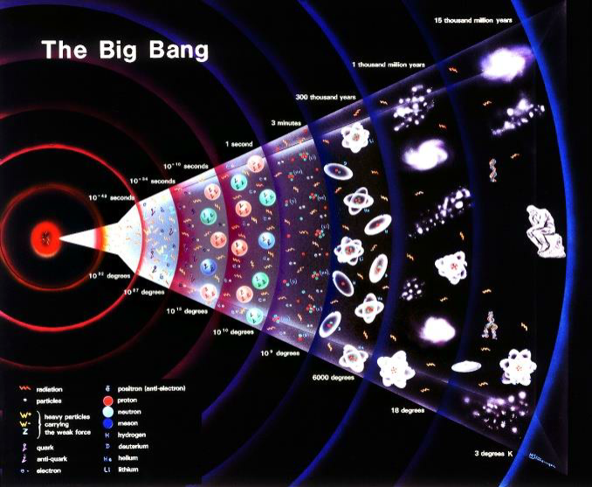
Why is there matter in the Universe?
In the Big Bang equal amounts of matter and antimatter were created
that instantly annihilated with each other again producing radiation.
Today we have a Universe consisting of matter and radiation but no antimatter.
How can we explain that?

Slide 3
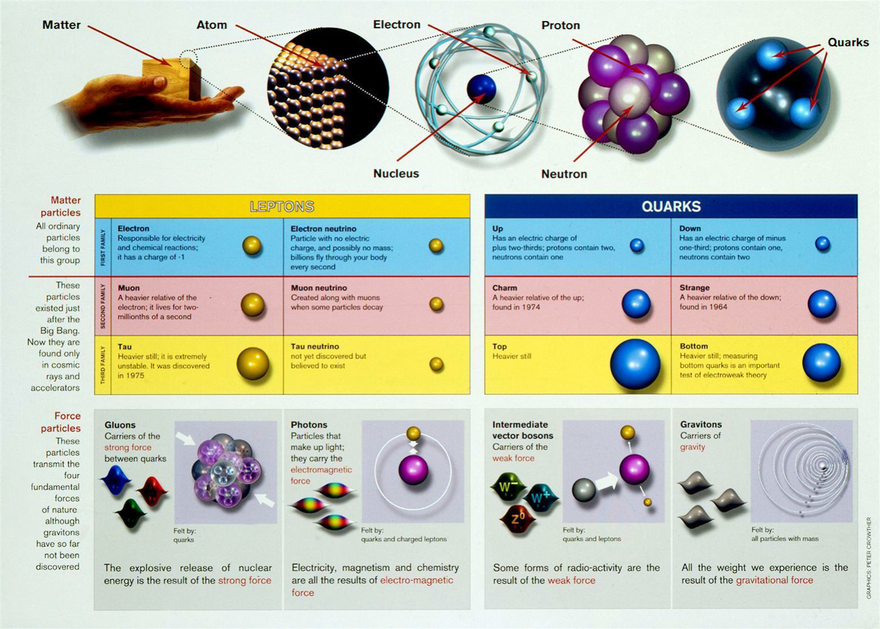

Slide 4
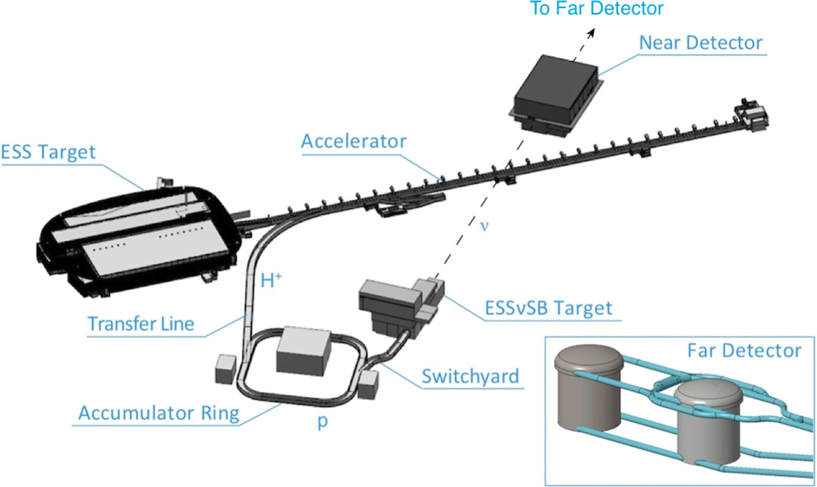
The ESS neutrino Super Beam Project
-

Slide 5

https://arxiv.org/abs/2203.08803

Slide 6
ESSnuSB Design Study ESSνSB January 2018 - March 2022
EU application submitted in 2017
3 M€ granted for the period 2018-2022
All results now published in
European Physics Journal Special Topics
220 pages
Publication date: 16 November 2022
https://link.springer.com/content/pdf/10.1140/epjs/s11734-022-00664-w.pdf

Slide 7
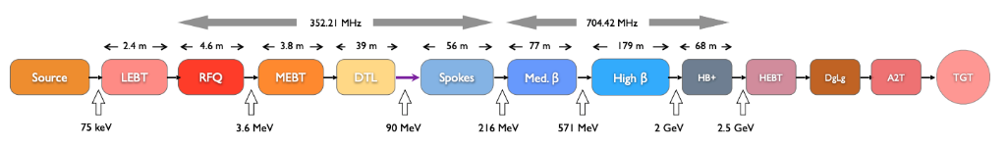
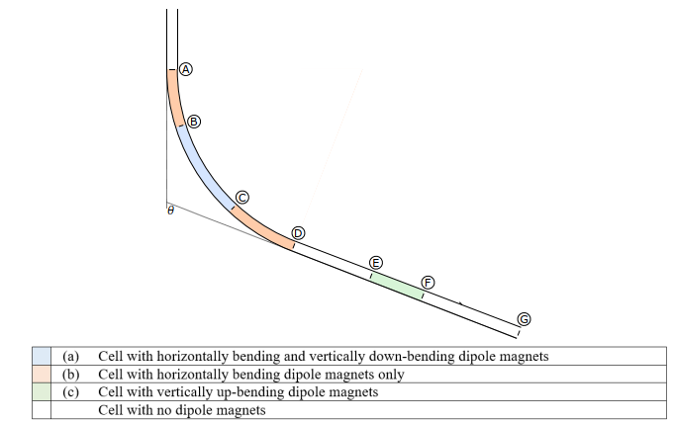
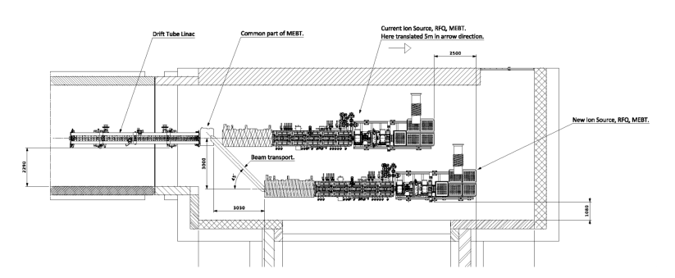
The ESS linac
2.86 ms pulses at 14 Hz pulse frequency increase to 28 Hz, implying an increase of the beam power from 5 MW to 10 MW
Transfer Line to Accumulator addition
ESSnuSB addition
H⁻
p
ESSnuSB addition
The linac
Normalconducting part
Superconducting part
The merging of the H+ and the H- beams in the MEBT
Transfer Line with bending limited by H⁻ Lorenz stripping

Slide 8
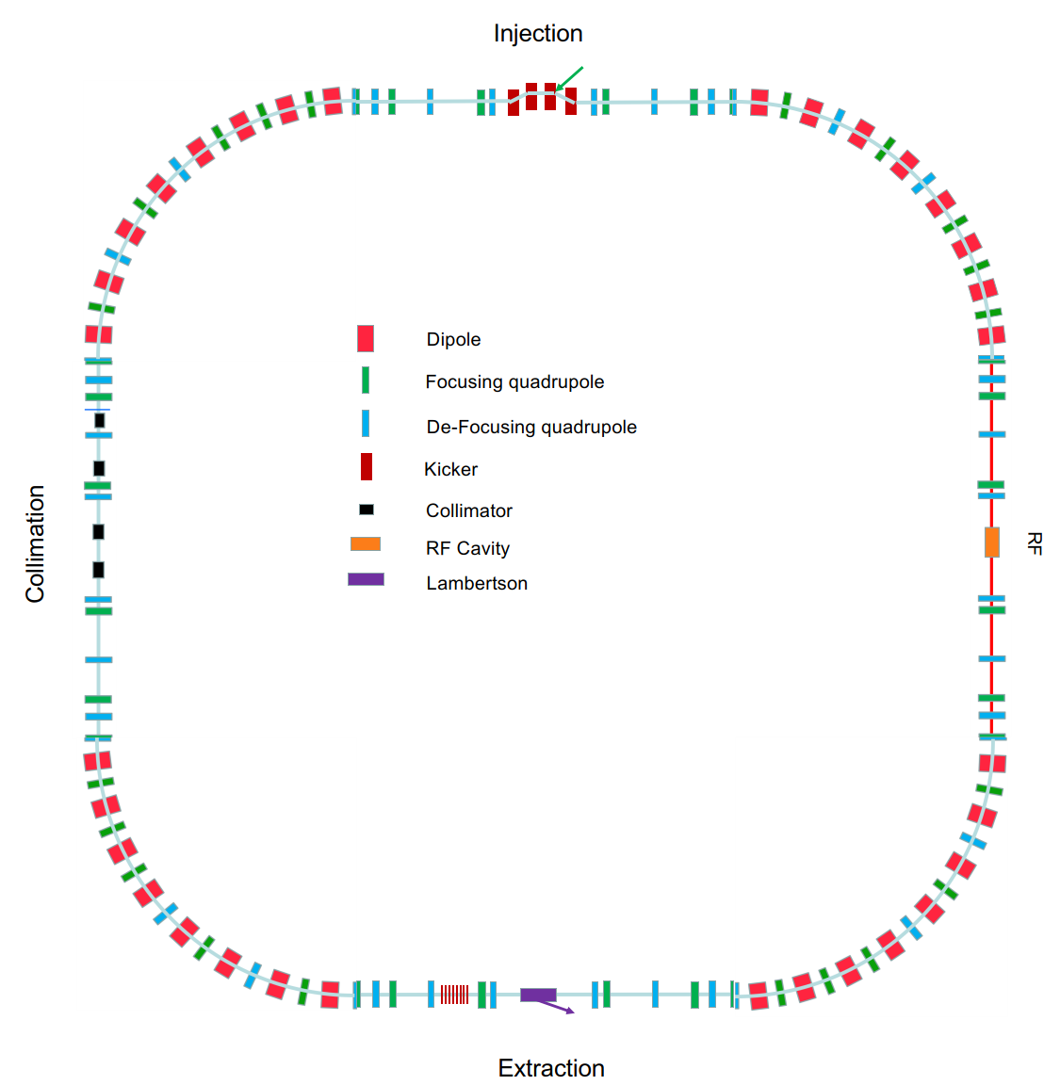
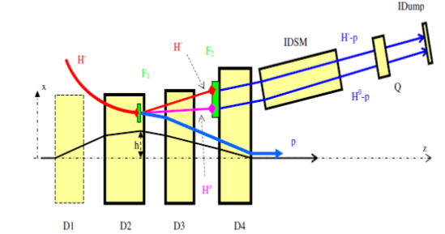
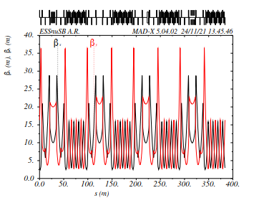
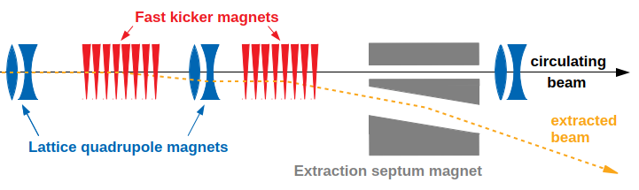
The Accmulator ring
Injection with H- stripping
β funcion
around
the ring
Extraction

Slide 9
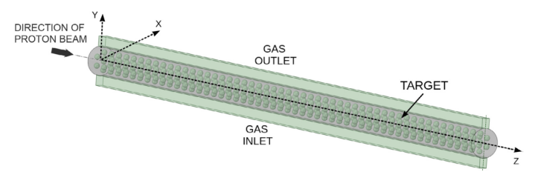
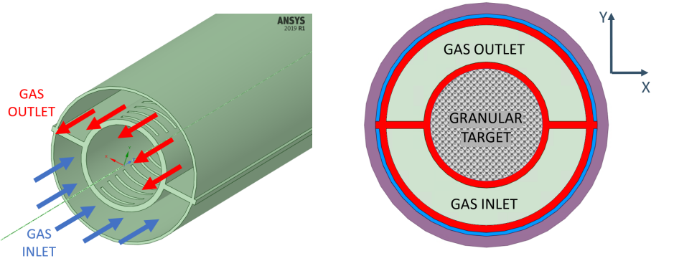
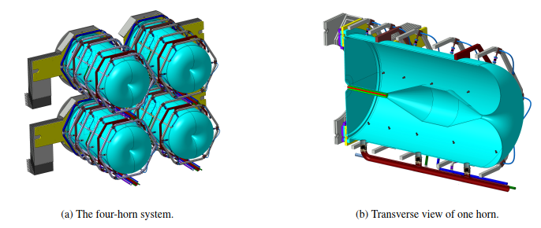
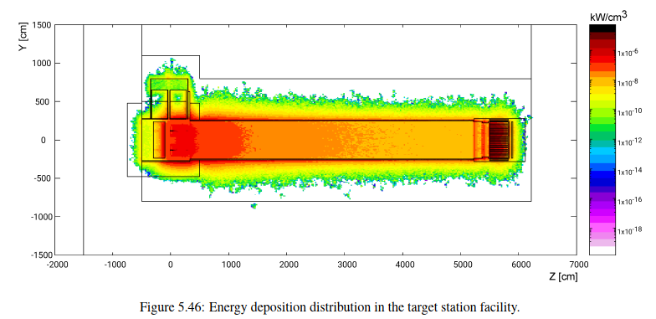
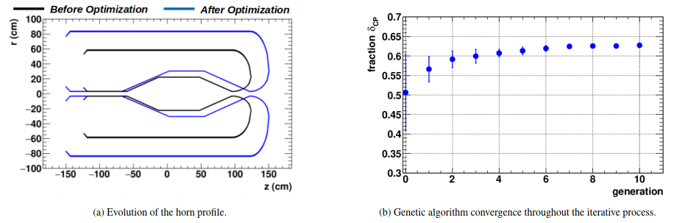
Beam switch-yard and the target station

Slide 10
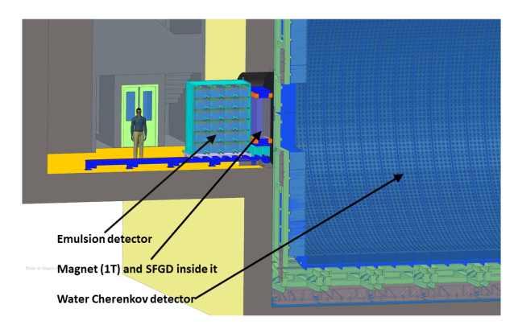
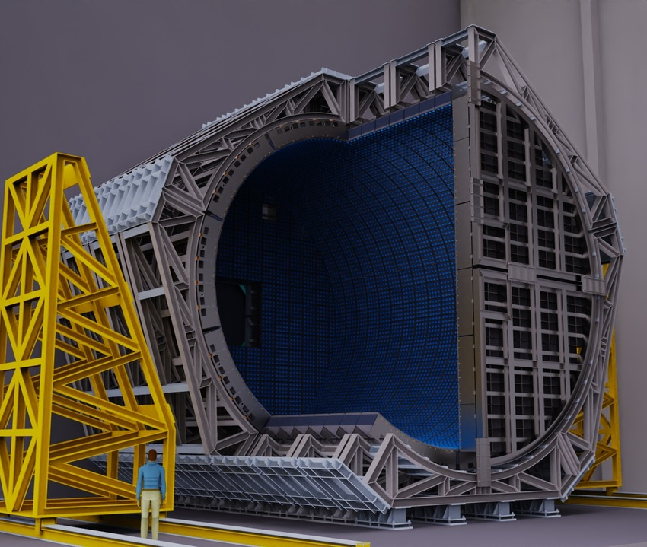
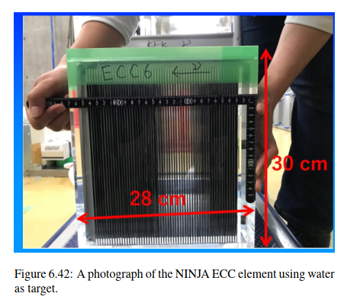
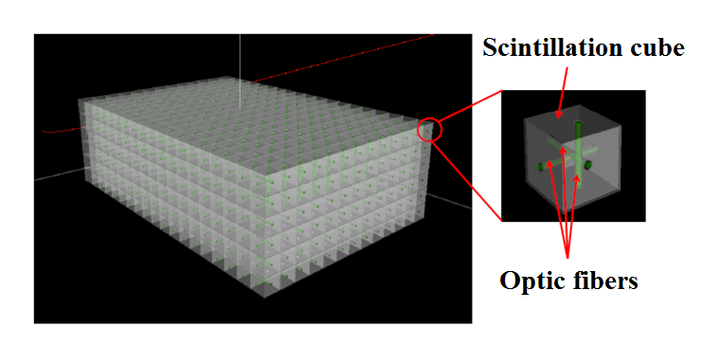
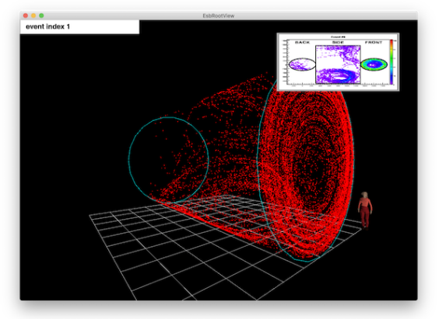
The Near Detector
Near Detector underground station
A 1 kton water Cherenkov detector
NINJA emulsion detector
The super Fine-Grained Detector sFDG
A muon Cherenkov ring

Slide 11
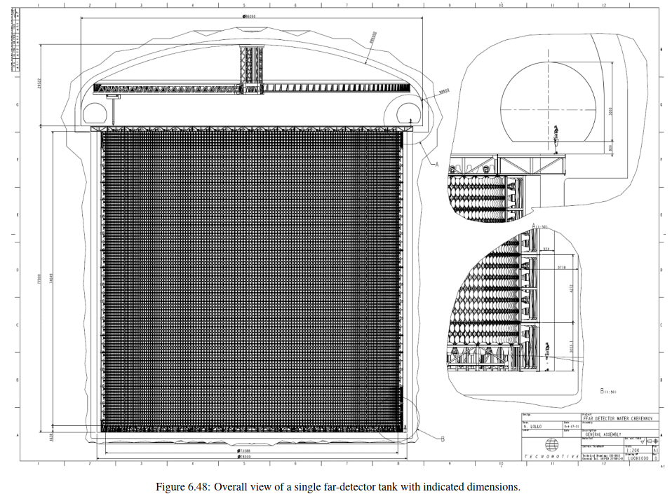
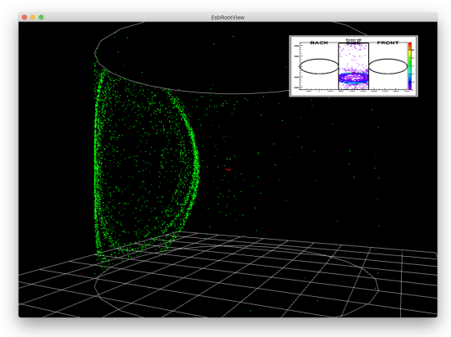
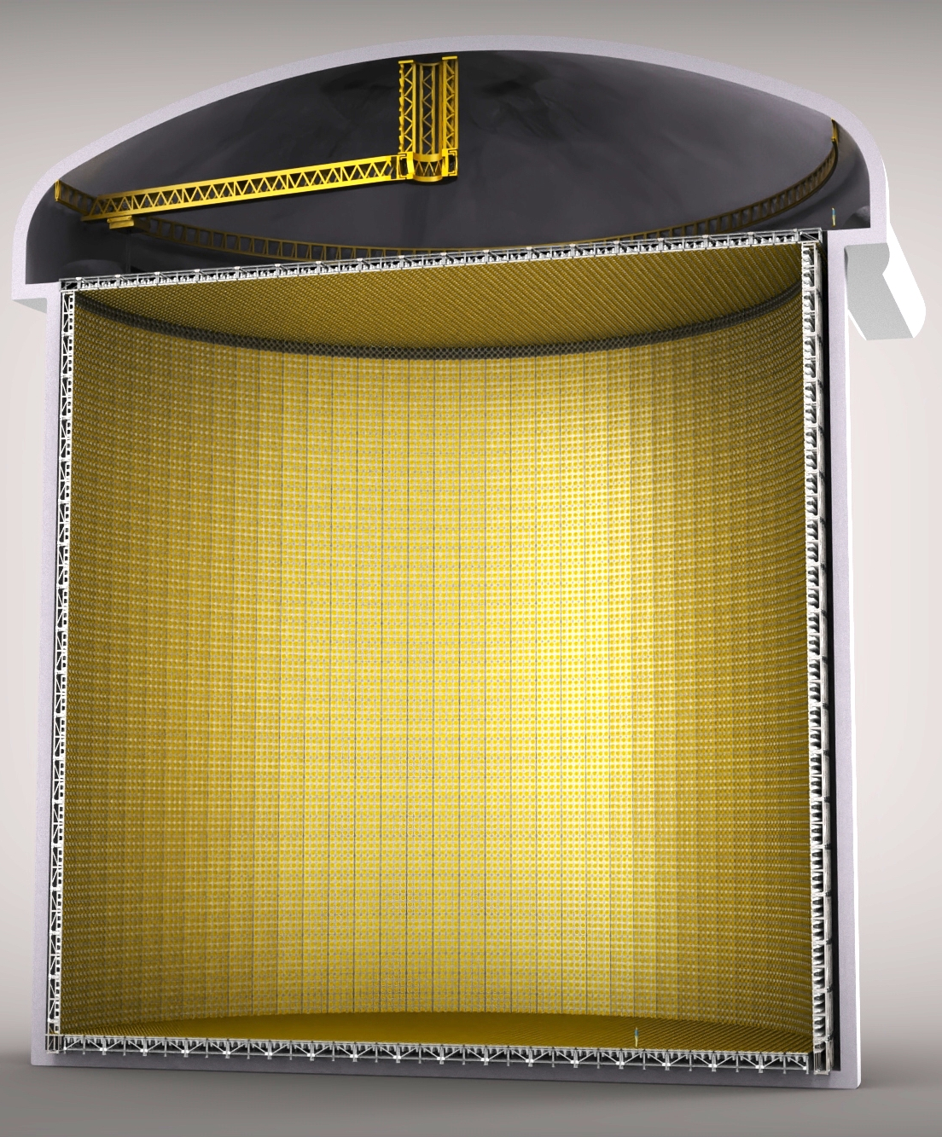
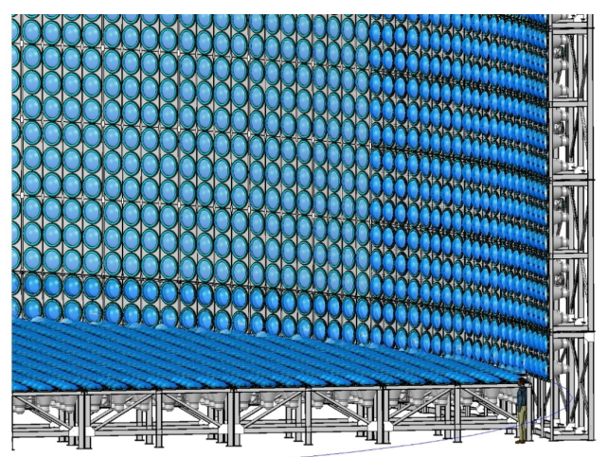
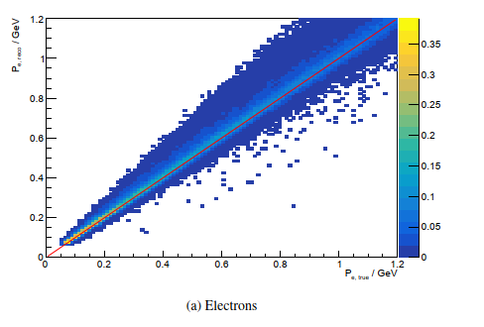
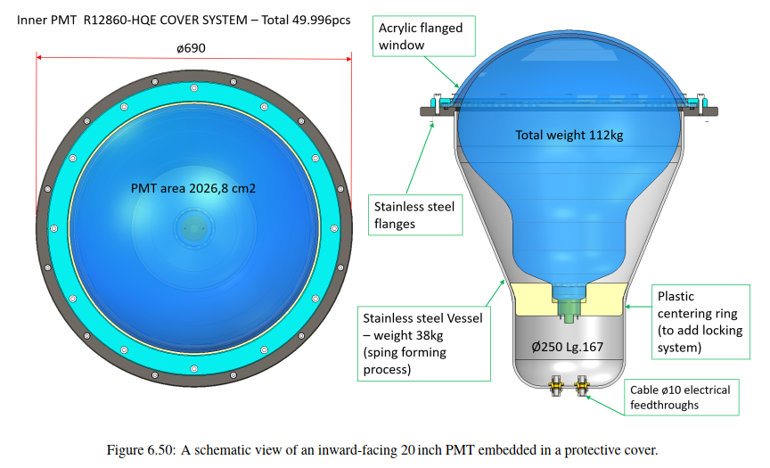
The Far Detector
Two 270 kton fiducial voume water Cherenkov detector
A muon Cherenkov ring
For Cherenkov imagies in the Far Detector see https://drive.google.com/drive/folders/1DidkJRA05GJtm0vFSqpfpCTAooNWAv22

Slide 12
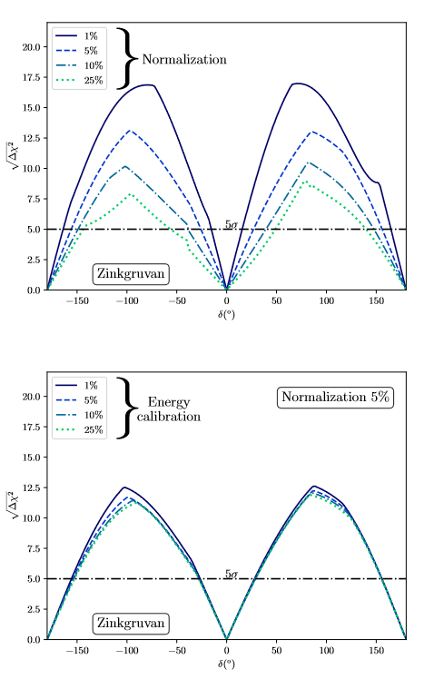
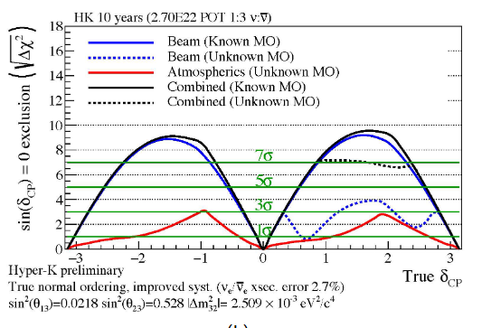
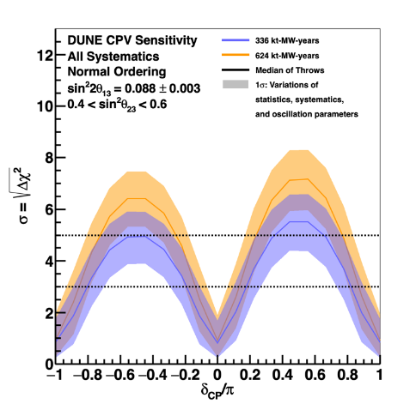
ESSnuSB performance in the international context – CPV discovery
5%
ESSnuSB March 2022 with 5% normalization error
DUNE Snowmass March 2022
HyperKamokande Snowmass March 2022

Slide 13
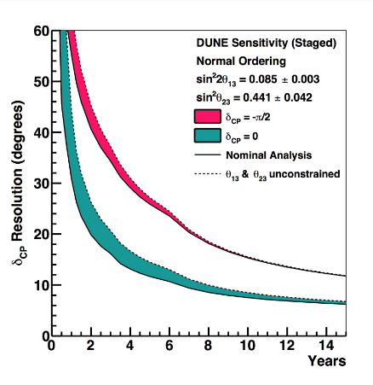
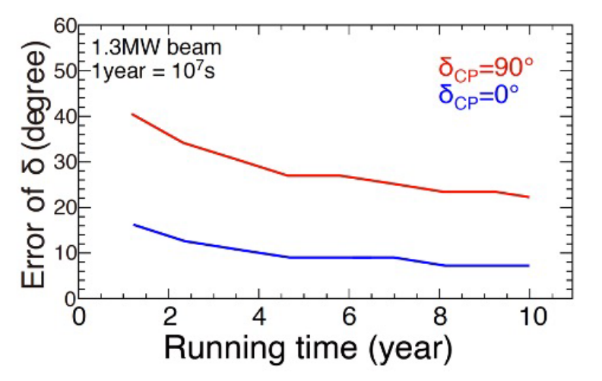
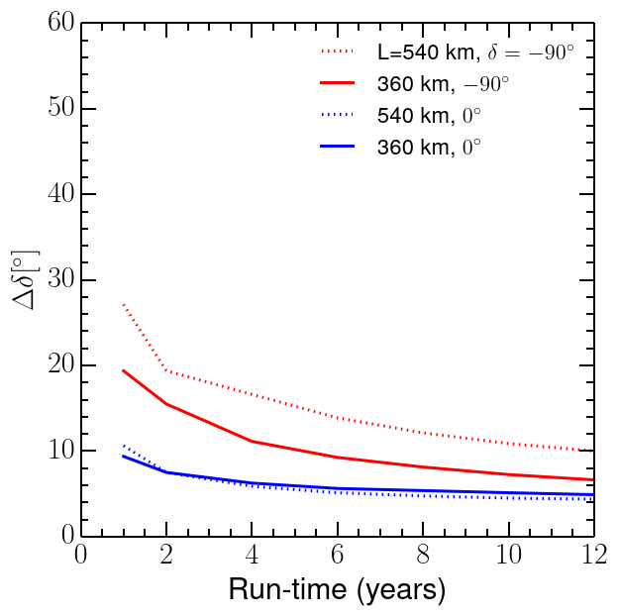
ESSnuSB performance in the international context – CPV resolution
ESSnuSB March 2022 with 5% normalization error
DUNE Snomass March 2022
HyperKamokandeSnowmass March 2022

Slide 14
ESSnuSB performance in the international context – precision in δ_{CP}
ESSnuSB 10 years
DUNE 10 years yellow curve
HyperKamiokande 10 years

Slide 15
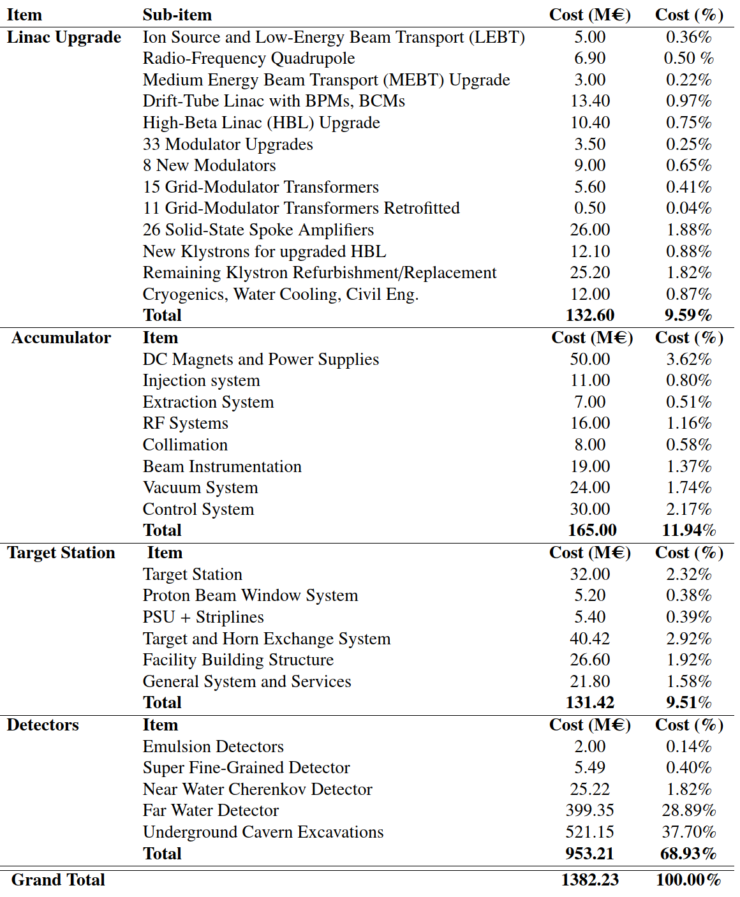
ESSnuSB Cost Esimate
Total Cost 1’382 M€
The ca 75’000 20 inch PMTs and the excavation of the cavern for the two Far Detectors represents 67% of the total cost.
The cost of civil engineering on the ESS site is not included. A cost estimate of this civil engineering will require a detailed study of the implementation of the components on the ESS site, that will be made only in the next phase of the study.

Slide 16
Continuation of design studies 2023-2026
ESSnuSB+ proposal granted by EU 26/07/2022 with 3 M€
Design of a racetrack storage ring for low energy muons produced with a beam from the ESS linac.
Design a transfer system from the initial collection and extraction of pions behind the target station, up to the injection point.
Design a transfer line from the ESSνSB ring-to-switchyard transfer line to the nuSTORM target.
Design an injection scheme for the racetrack storage ring
Design a Monitored Neutrino Beam (low energy ENUBET)
Optimize the performance of the ESSνSB accelerator complex
Cross-section measurements with:
Low Energy nuSTORM: π⟶ μ ⟶ e+ν_{μ}+ν_{e}
Low Energy ENUBET: π ⟶ μ+ν_{μ}

Slide 17
ESSνSB+
Title of Horizon Europe EU Proposal: Study of the use of the ESS facility to accurately measure the neutrino cross-sections for ESSνSB leptonic CP violation measurements and to perform sterile neutrino searches and astroparticle physics.
Acronym of Proposal: ESSνSB+
26/07/2022
Participant no. | Participant organisation name | Part. short name | Country
1 (Coordinator) | Centre National de la Recherche Scientifique | CNRS | France
2 | Université de Strasbourg | UNISTRA¹ | France
3 | Rudjer Boskovic Institute | RBI | Croatia
4 | Tokai National Higher Education and Research System, National University Corporation | NU² | Japan
5 | Uppsala Universitet | UU | Sweden
6 | Lunds Universitet | ULUND | Sweden
7 | European Spallation Source ERIC | ESS | Sweden
8 | Kungliga Tekniska Hoegskolan | KTH | Sweden
9 | Universitaet Hamburg | UHH | Germany
10 | University of Cukurova | CU | Turkey
11 | National Center for Scientific Research "Demokritos" | NCSRD | Greece
12 | Aristotelio Panepistimio Thessalonikis | AUTH¹ | Greece
13 | Sofia University St. Kliment Ohridski | UniSofia | Bulgaria
14 | Lulea Tekniska Universitet | LTU | Sweden
15 | European Organisation for Nuclear Research | CERN | IEIO³
16 | Universita degli Studi Roma Tre | UNIROMA3 | Italy
17 | Universita degli Istudi di Milano-Bicocca | UNIMIB | Italy
18 | Istituto Nazionale di Fisica Nucleare | INFN | Italy
19 | Universita degli Istudi di Padova | UNIPD¹ | Italy
20 | Consorcio para la construccion, equipamiento y explotacion de la sede espanola de la fuente Europea de neutrones por espalacion | ESSB | Spain
^{[1]} Affiliated Partner
^{[2]} Associated Institute
^{[3]} International European Interest Organisation
Excellent supporting letter from the ESS director

Slide 18
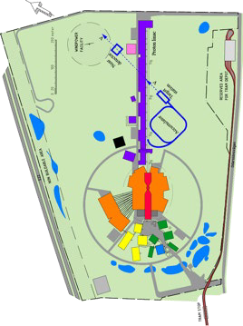
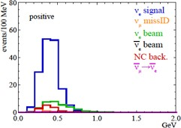












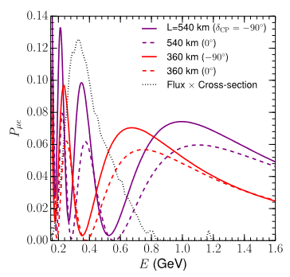








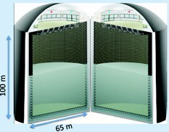

Schedule for the 2nd generation
ESS-based neutrino Super Beam ESSnuSB
2036-:
Start of data taking
2029-2035:
2027-2028:
Construction of the facility and detectors, including commissioning
2023-2026:
Continuation of Design Study, final costing and an TDR to ESFRI
Preconstructi on Phase, International Agreements
2022: End of ESSνSB
Design Study,
preliminary costing and CDR
2018:
Beginning of ESSνSB
Design
Study (EU- H2020)
2016-2019:
Beginning of COST
Action EuroNuNet
2012:
Inception of the project
Nucl. Phys. B 885 (2014) 127
18

Slide 19
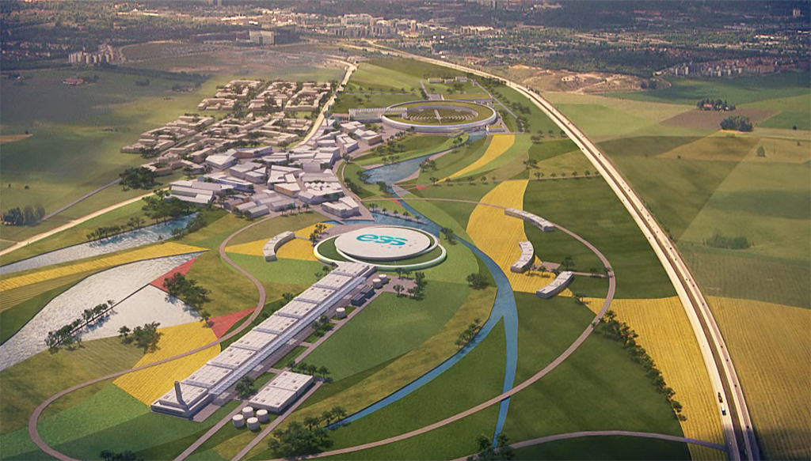
Summary
The ESS neutron spallation source currently under construction in Lund can be the basis also for a world-unique neutrino facility, ESSνSB, which in a first conceptual design study has been proven to have very high physics performance and potential.
With ESSνSB 5σ discovery potential for CP violation can be reached over 70% of the δ_{CP} range and δ_{CP} can be measured with an error less than 8° independently of its value.
Complementary studies of this project will be made in a second Design Study 2023-2026 enabling in particular:
-Precise neutrino cross-section measurements
-Sterile neutrino searches
-SuperNova and relic neutrinos measurements, proton life-time…
Kick-off 17-18 January 2023 at the ESS site of the 4-years ESSnuSB+ EU funded continuation to produce an ESSnuSB Technical Design Report by 2026

Slide 20
Thank you

