Slide 1

HEP Doktoranddag
Mirror Symmetry and Proton Emission in the Upper fp Shell
Yuliia Hrabar
December 7, 2022

Slide 2
PhD research projects:
Proton-𝛾 Spectroscopy in the Upper fp Shell
Characterization of the Anti-Compton Shield for Compex Germanium Detectors in Lundium decay station

Slide 3
Outline
Scientific motivation
Experimental campaign
Detector systems optimisation
  Gammasphere
  Fragment Mass Analyzer (FMA)
  Microball CsI detectors
  Silicon detectors
  Neutron detectors
Summary and outlook

Slide 4
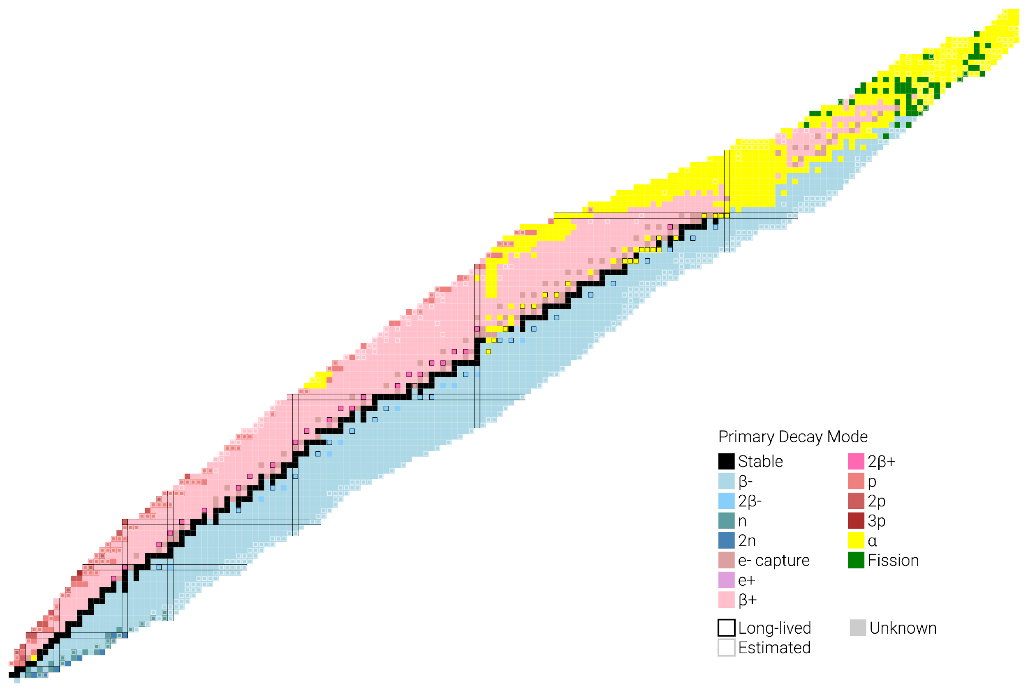
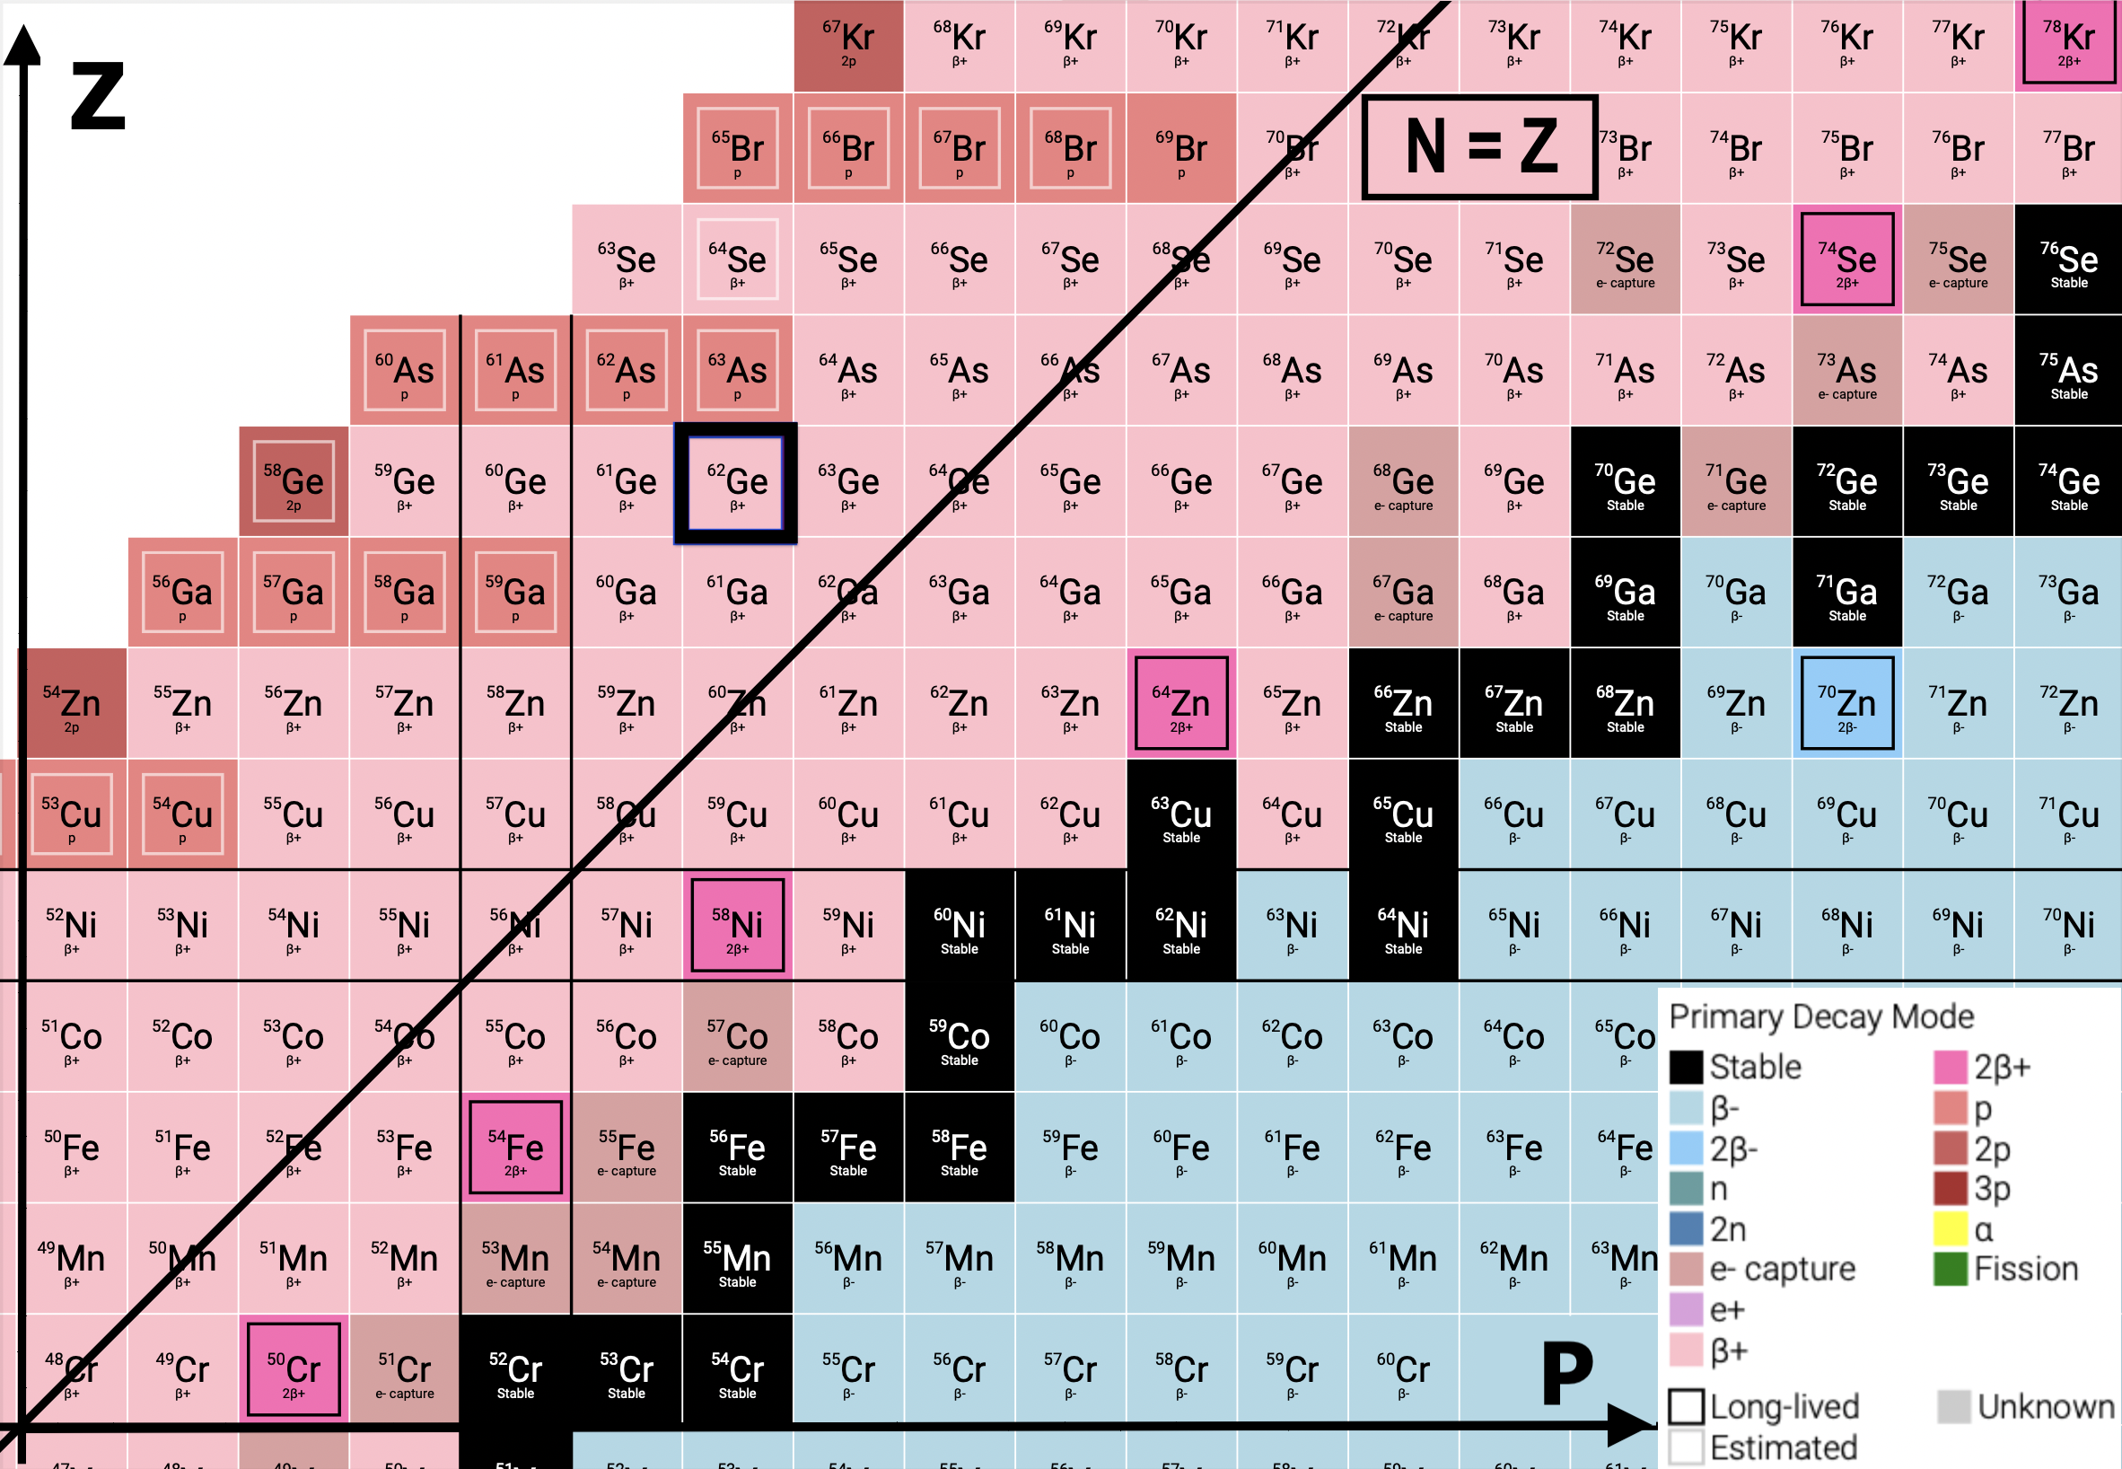
Scientific Motivation
Proton drip-line
- Mirror symmetry
- Proton emission
(discrete energy)
A ≈ 60 region
odd Z,
N<Z isotopes

Slide 5

Experimental campaign
Proton-gamma spectroscopy in the upper fp shell
Where? ATLAS facility
When? Summer 2020
How? Enhanced Gammasphere + FMA setup
Who? Three experiments led by Lund

Slide 6
Timeline
First COVID remote experiments at ANL
~20% of ANL’s beam time in 2020
exp1239
exp1582
exp1855
23 - 26 of June
29 June - 10 of July
27 July - 12 of August
13 - 26 of August
27 August - 4 September
ATLAS restart
Preparations / Test Beam Time
Particle and Gamma-Ray Coincidence Spectroscopy of ⁵⁷Cu
Mass A=61,62 Nuclides: Isospin Symmetry and Proton Decay in the Upper fp Shell
⁶¹Ga
Proton-gamma Spectroscopy of ⁶⁵As:
Isospin Symmetry at the Limits of Nuclear Binding

Slide 7
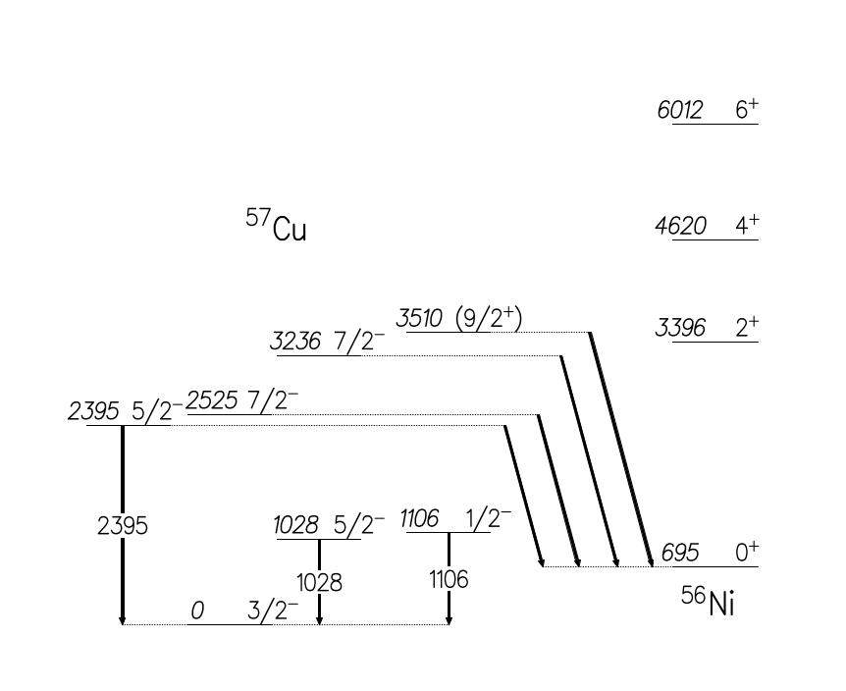
First experiment
Particle and Gamma-Ray Coincidence Spectroscopy of ⁵⁷Cu
Proton-emitting states in ⁵⁷Cu:
Angular distribution of 2.8 MeV proton benchmark
Discrete proton emission states
[1] Nucl. Data Sheets, www.nndc.bnl.gov/ensdf/ [2] A. Jokinen et al., Eur. Phys. J. direct A 3, 1 (2002)
Notes:
Add proton lines in red + text “discrete proton emission states”

Slide 8
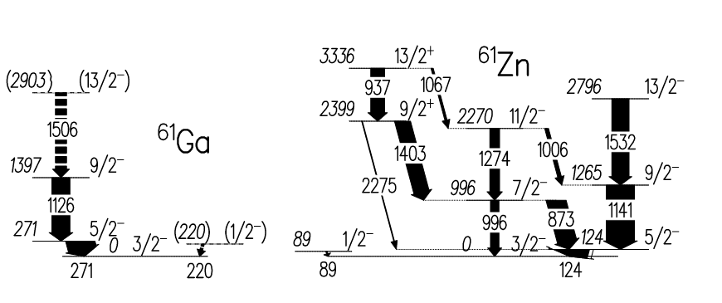
Second experiment
Mass A=61,62 Nuclides:
Isospin symmetry and proton deexcitation in the Upper fp Shell
Isospin symmetry ⁶¹Zn - ⁶¹Ga
2.2 MeV proton emission in ⁶¹Ga ?
⁶⁰Zn + p
9/2⁺
1430 ?
2.2 MeV proton emission?
7/2⁻
699 ?
190(50)
[2] L.-L. Andersson et. al., Phys. Rev. C. 71, 011303 (2005)
Notes:
Same style coherent
Add reference 61Ga

Slide 9
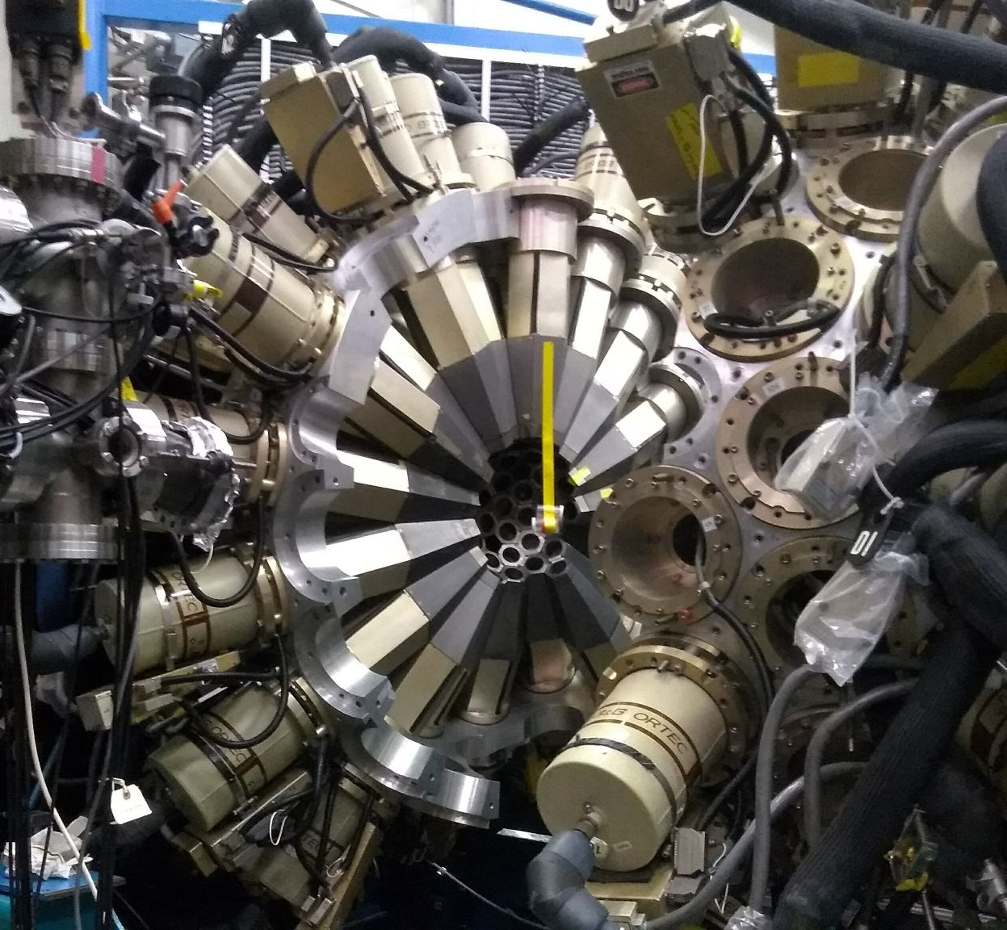
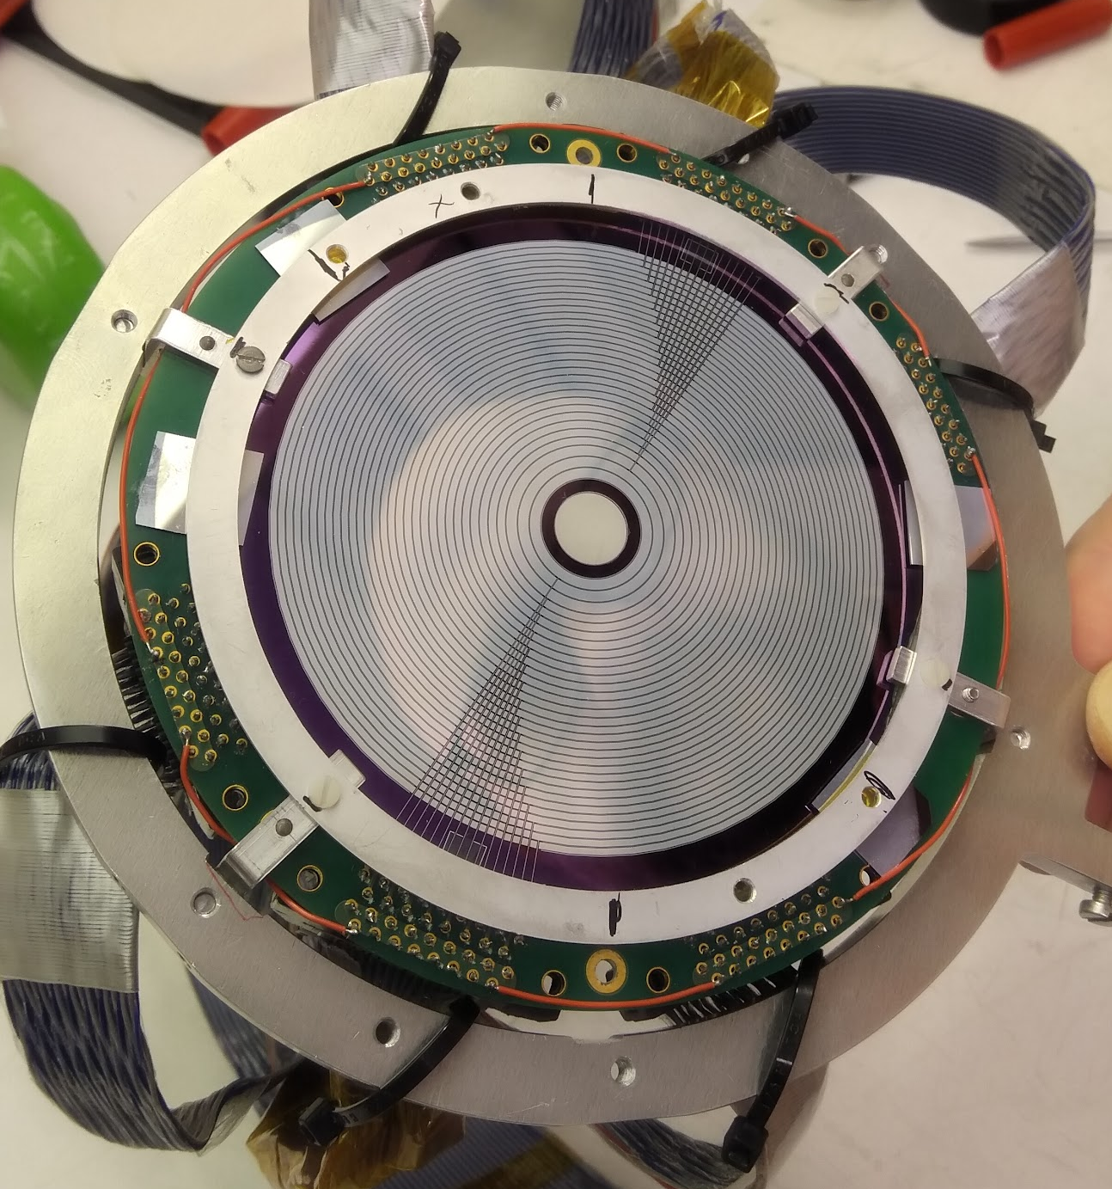
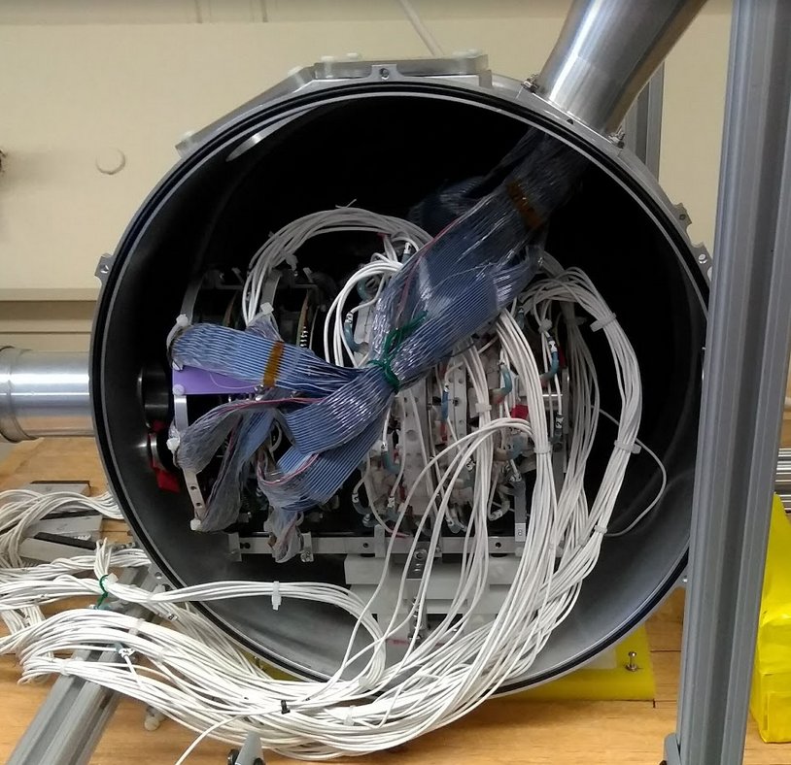
Enhanced setup
Proton spectroscopy and tracking with 2 × 2048 pixels
2 x CD-DSSDs
Microball CsI
Gammasphere

Slide 10
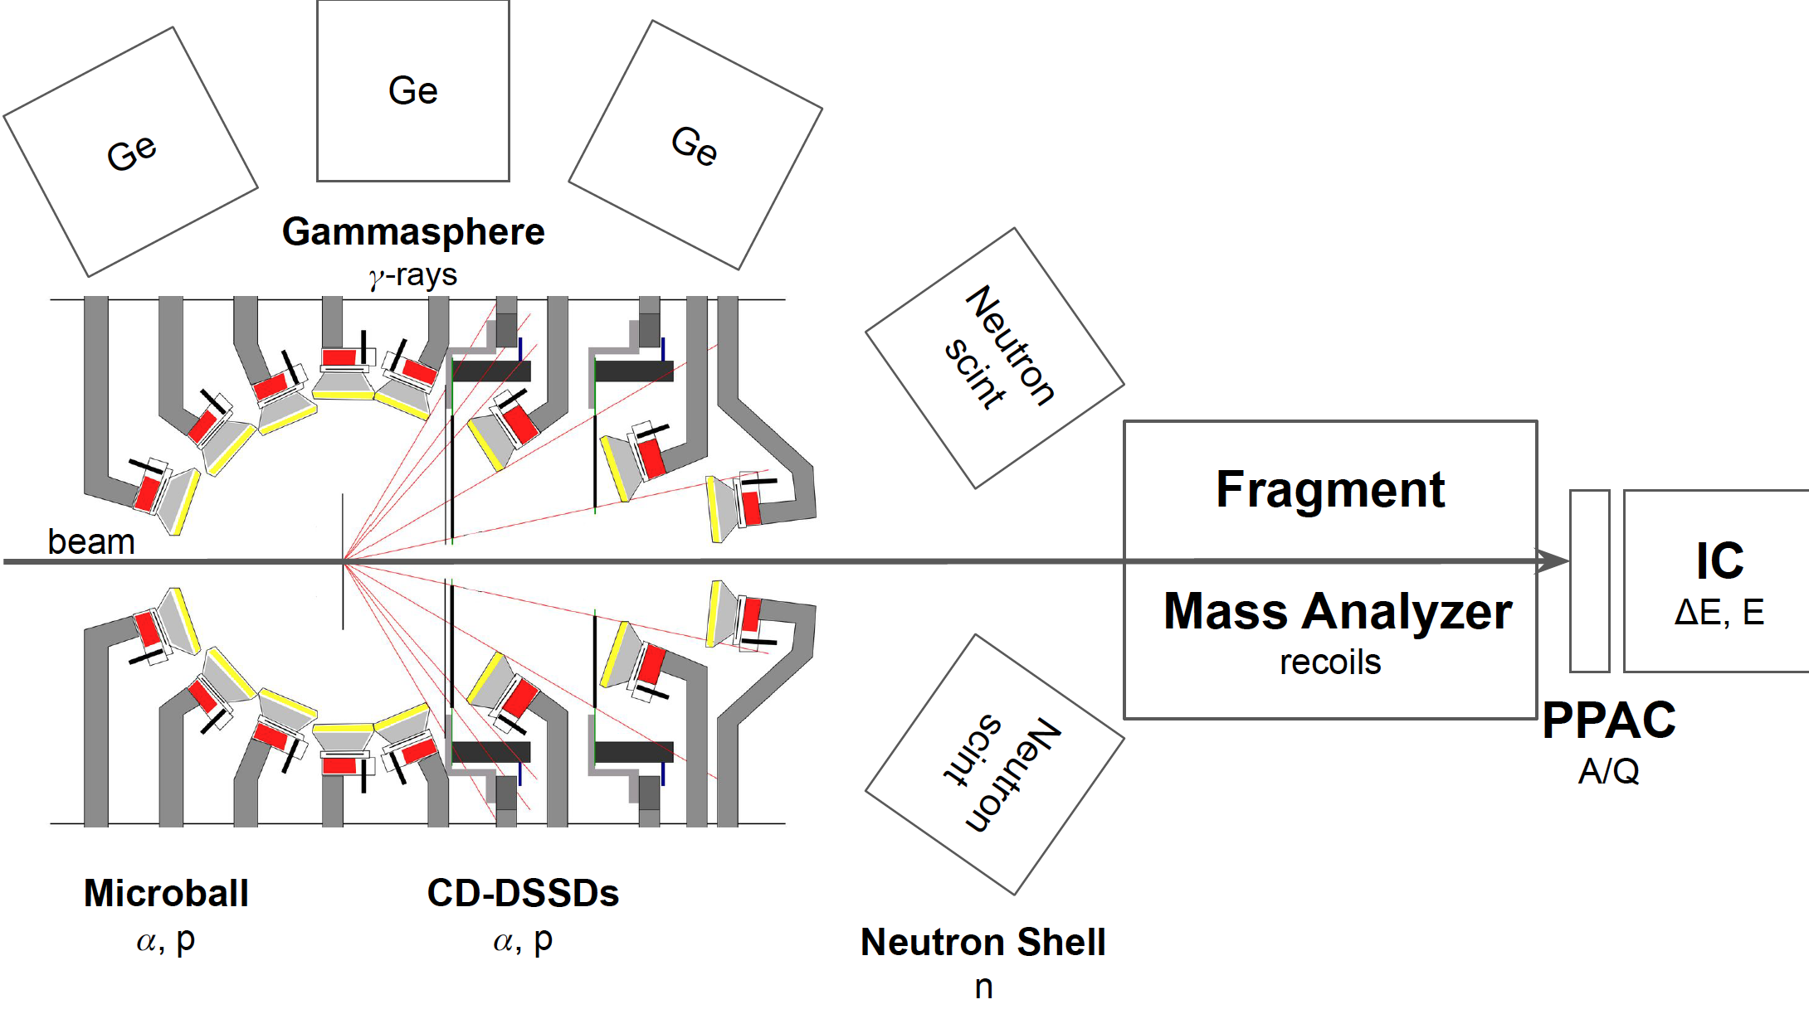
Detector Systems
⁴⁰Ca + ²⁴Mg 🠚 ⁶¹Ga + p + 2n
~10⁻⁵ relative cross section

Slide 11
Data acquisition systems
3 DAQs (timestamp correlated):
  Digital Gammasphere (DGS): Gammasphere (2 “clean” Ge)
  Digital FMA (DFMA): FMA, IC, Microball, DSSDs
  WUDAQ: Neutron Shell (fast trigger 3 “dirty” Ge)

Slide 12
Analysis Code
Data divided into runs and grouped into subsets
Raw Data
GEBMerge
GEBSort
Raw data ordered by timestamps
Opens a 8 µs window and constructs the events
3 major parts : DGS, DFMA, WUDAQ

Slide 13
Analysis
MSc by Dalia Farghaly (completed)
“Nuclear Structure near the Proton Drip-line: A Search for Excited States in ⁶²Ge“
  Gammasphere calibration
  Neutron shell - neutron selection
  FMA + IC with focus on ⁶²Ge
BSc by Linus Persson (completed)
“Digitised charged-particle discrimination in CsI detector signals“
  Improved Microball 𝛼 - proton selection
PhD by Yuliia Hrabar (ongoing)
  PPAC data recovery (completed)
  CD DSSDs proton tracking
  FMA + IC with focus on ⁶¹Ga (completed)

Slide 14
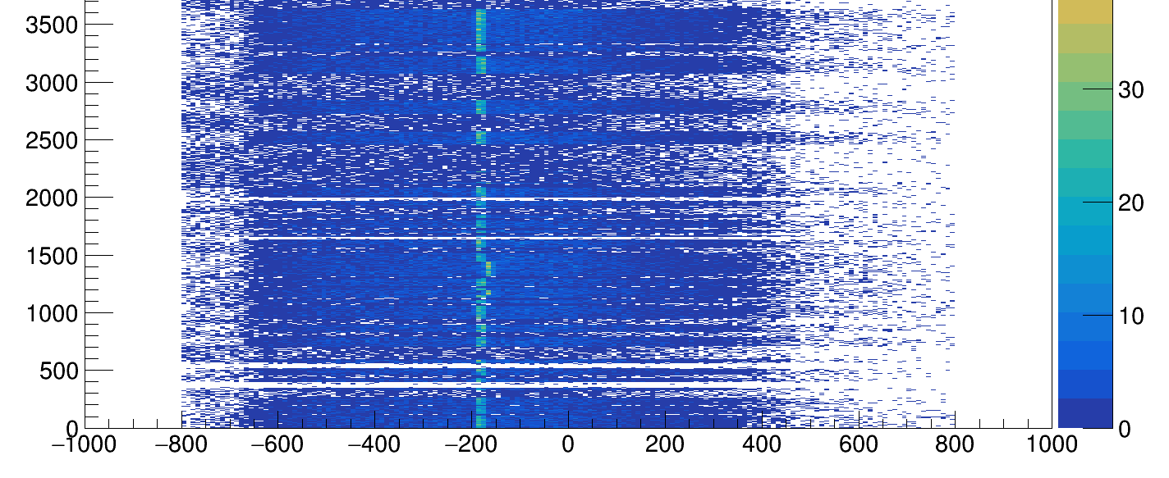
PPAC - Need for data recovery
Missing time correlation with Gammasphere?
Time (s)
Time difference PPAC and GS
800 bins = 8us
Notes:
Highlight missing region
Make it pop

Slide 15
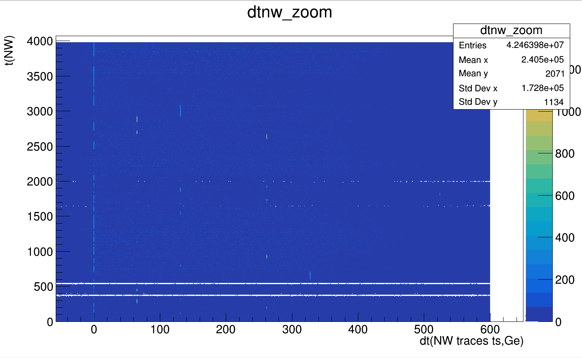
First iteration
131072
(2¹⁷)
65536
(2¹⁶)
262144
(2¹⁸)
524288
(2¹⁹)
MISSING
327680
(2¹⁸+2¹⁶)
Jumps as large as 2²⁰ (10 ms)
Need for two iterations
Flag in timestamp
6ms

Slide 16
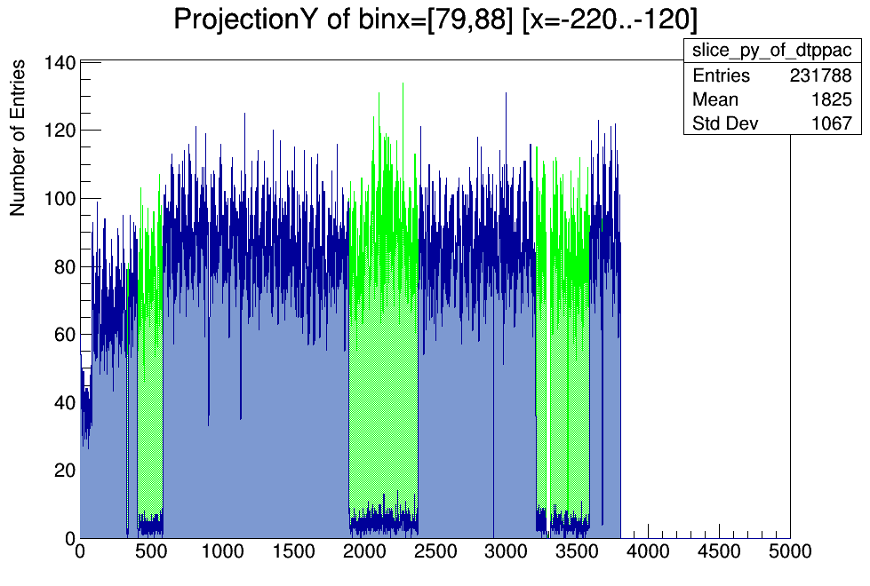
PPAC - Recovery
Recovered
The second experiment:
80 runs processed
Statistics ppac:
  62% before
  88% after
Time (arbitrary units)

Slide 17
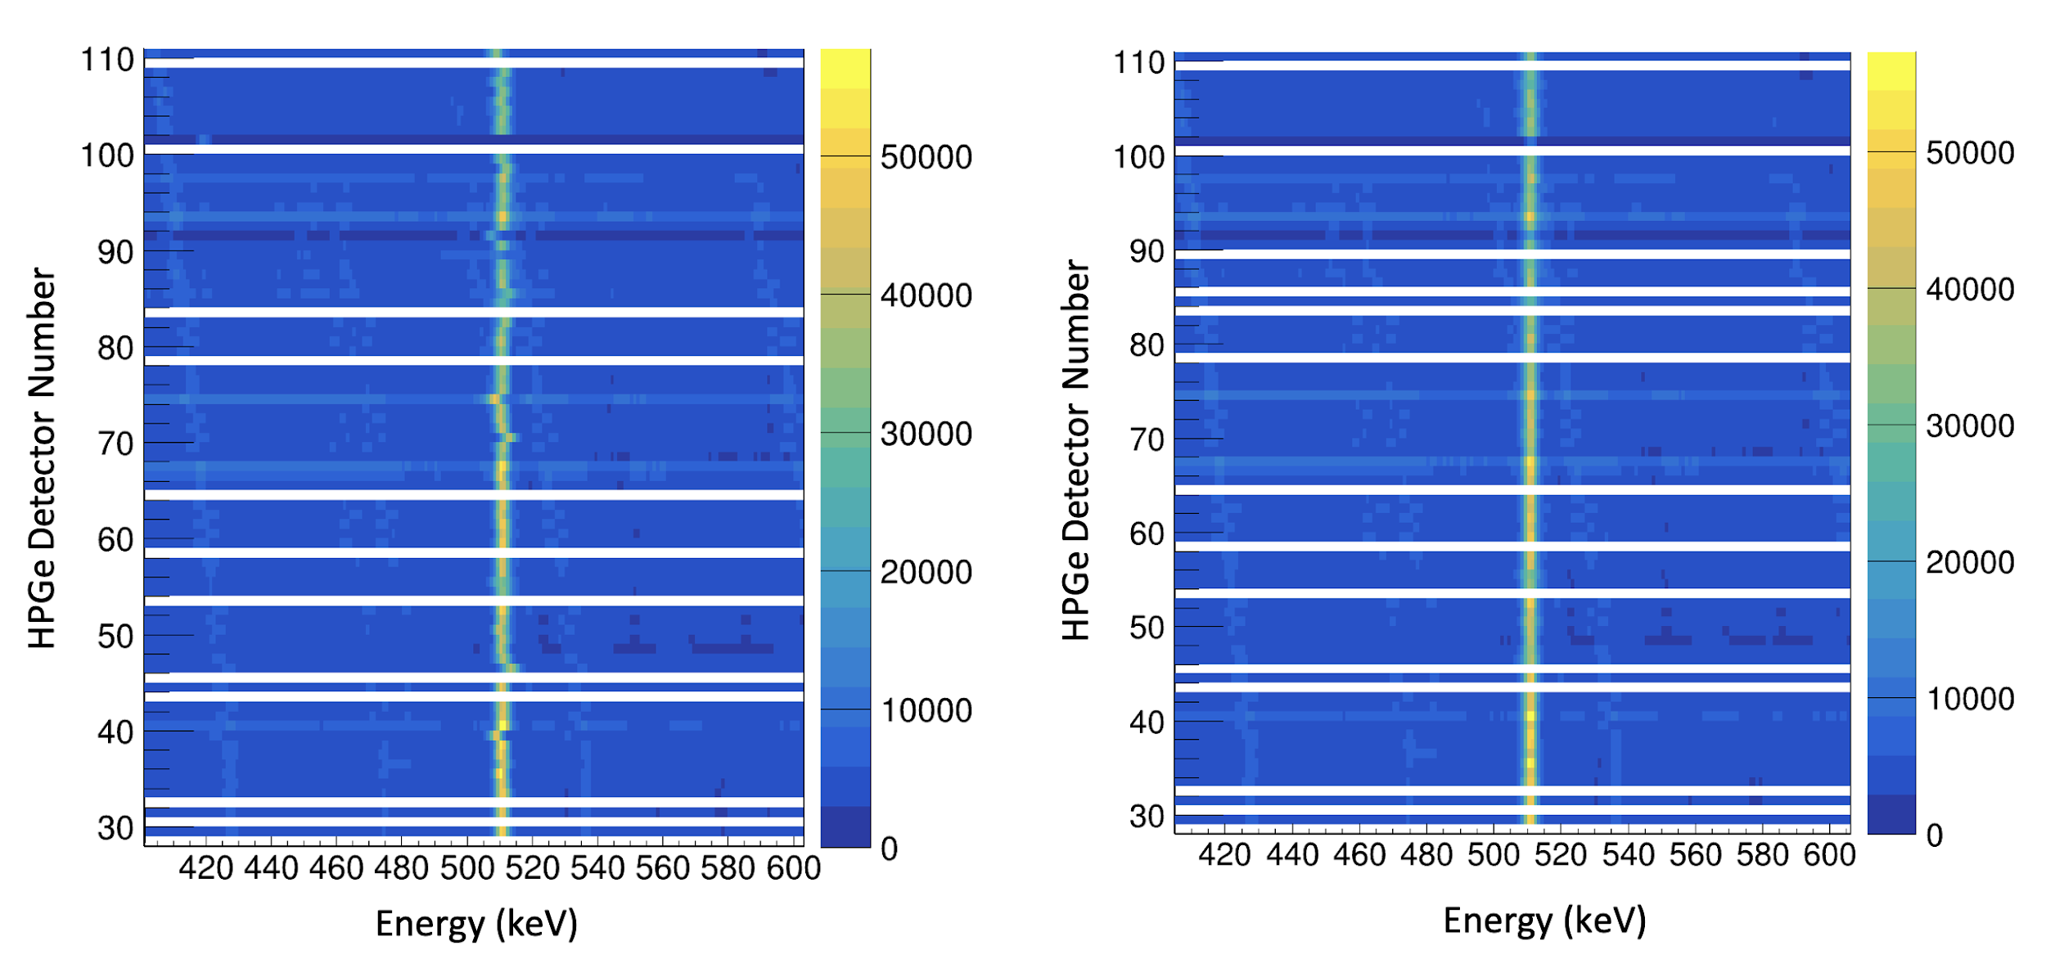
Gammasphere: Calibration
Energy calibration:
¹⁵²Eu source
77 Ge detectors
Source
In Beam

Slide 18
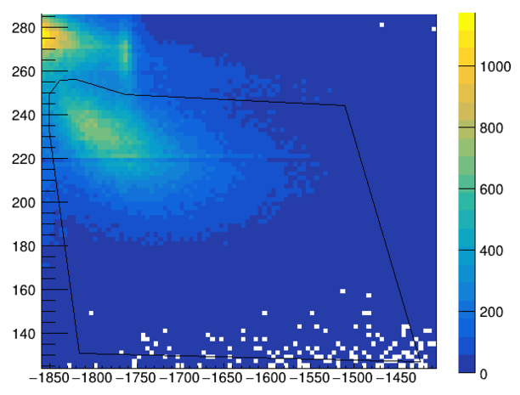
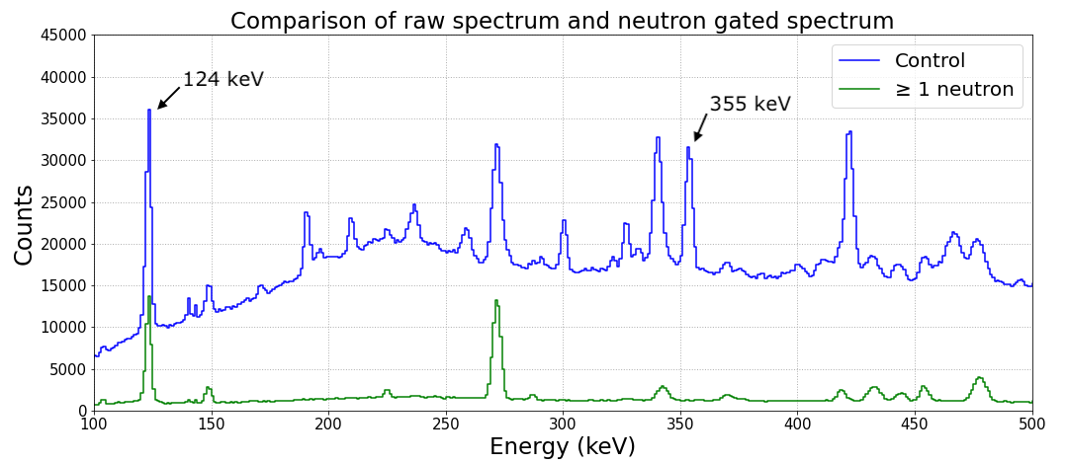
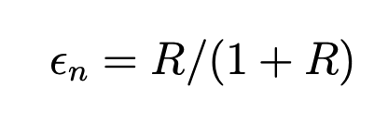
Neutron Shell: Neutron Selection
Neutron Shell: Neutron selection
n
Tail-to-total ratio (arbitrary units)
Time (arbitrary units)
1. Neutron efficiency calculated
>30%
2. Charged particle leak-through
Statistics not adding up…
Notes:
Put statistics in red, pop

Slide 19
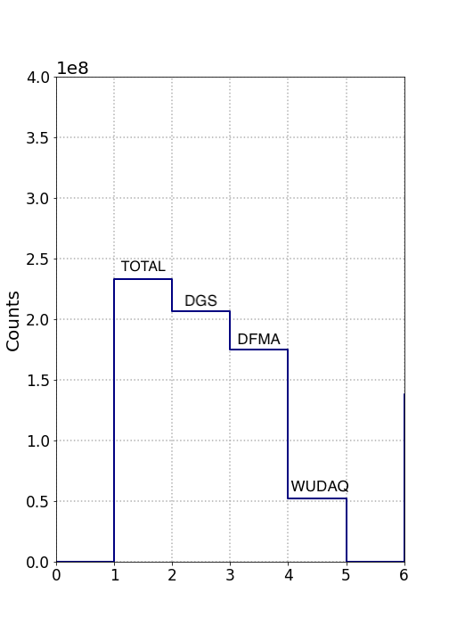
Neutron Shell: Missing statistics
25% of expected statistics recorded
  Sizes of raw data files checked
  Sizes of merged data files checked
From remaining events:
  Half of WUDAQ events not correlated to any DGS events

Slide 20
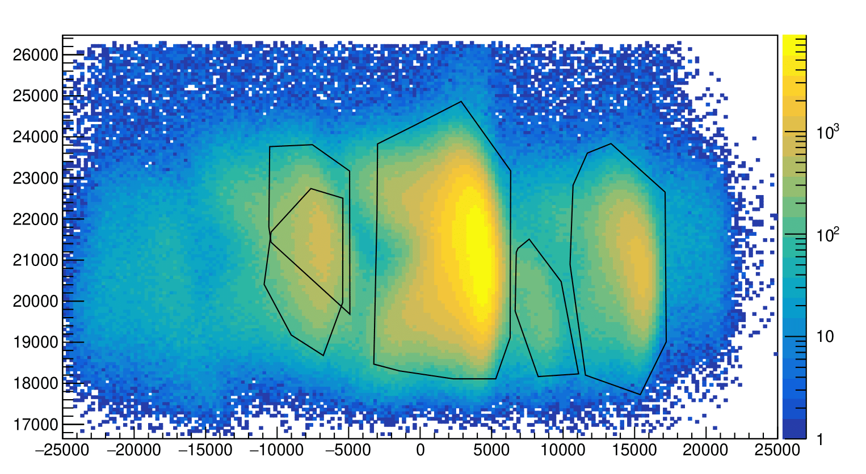
FMA: A selection
A = 57
A = 58
A = 61
Total Energy Deposited in IC (arbitrary units)
A = 60
A = 62
PPAC Position (arbitrary units)
Notes:
Focus on 61 and 60

Slide 21
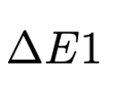
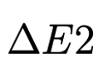

IC: Energy Loss Functions
Ionisation Chamber
Incoming Recoils
Z dependent!
‹#›

Slide 22
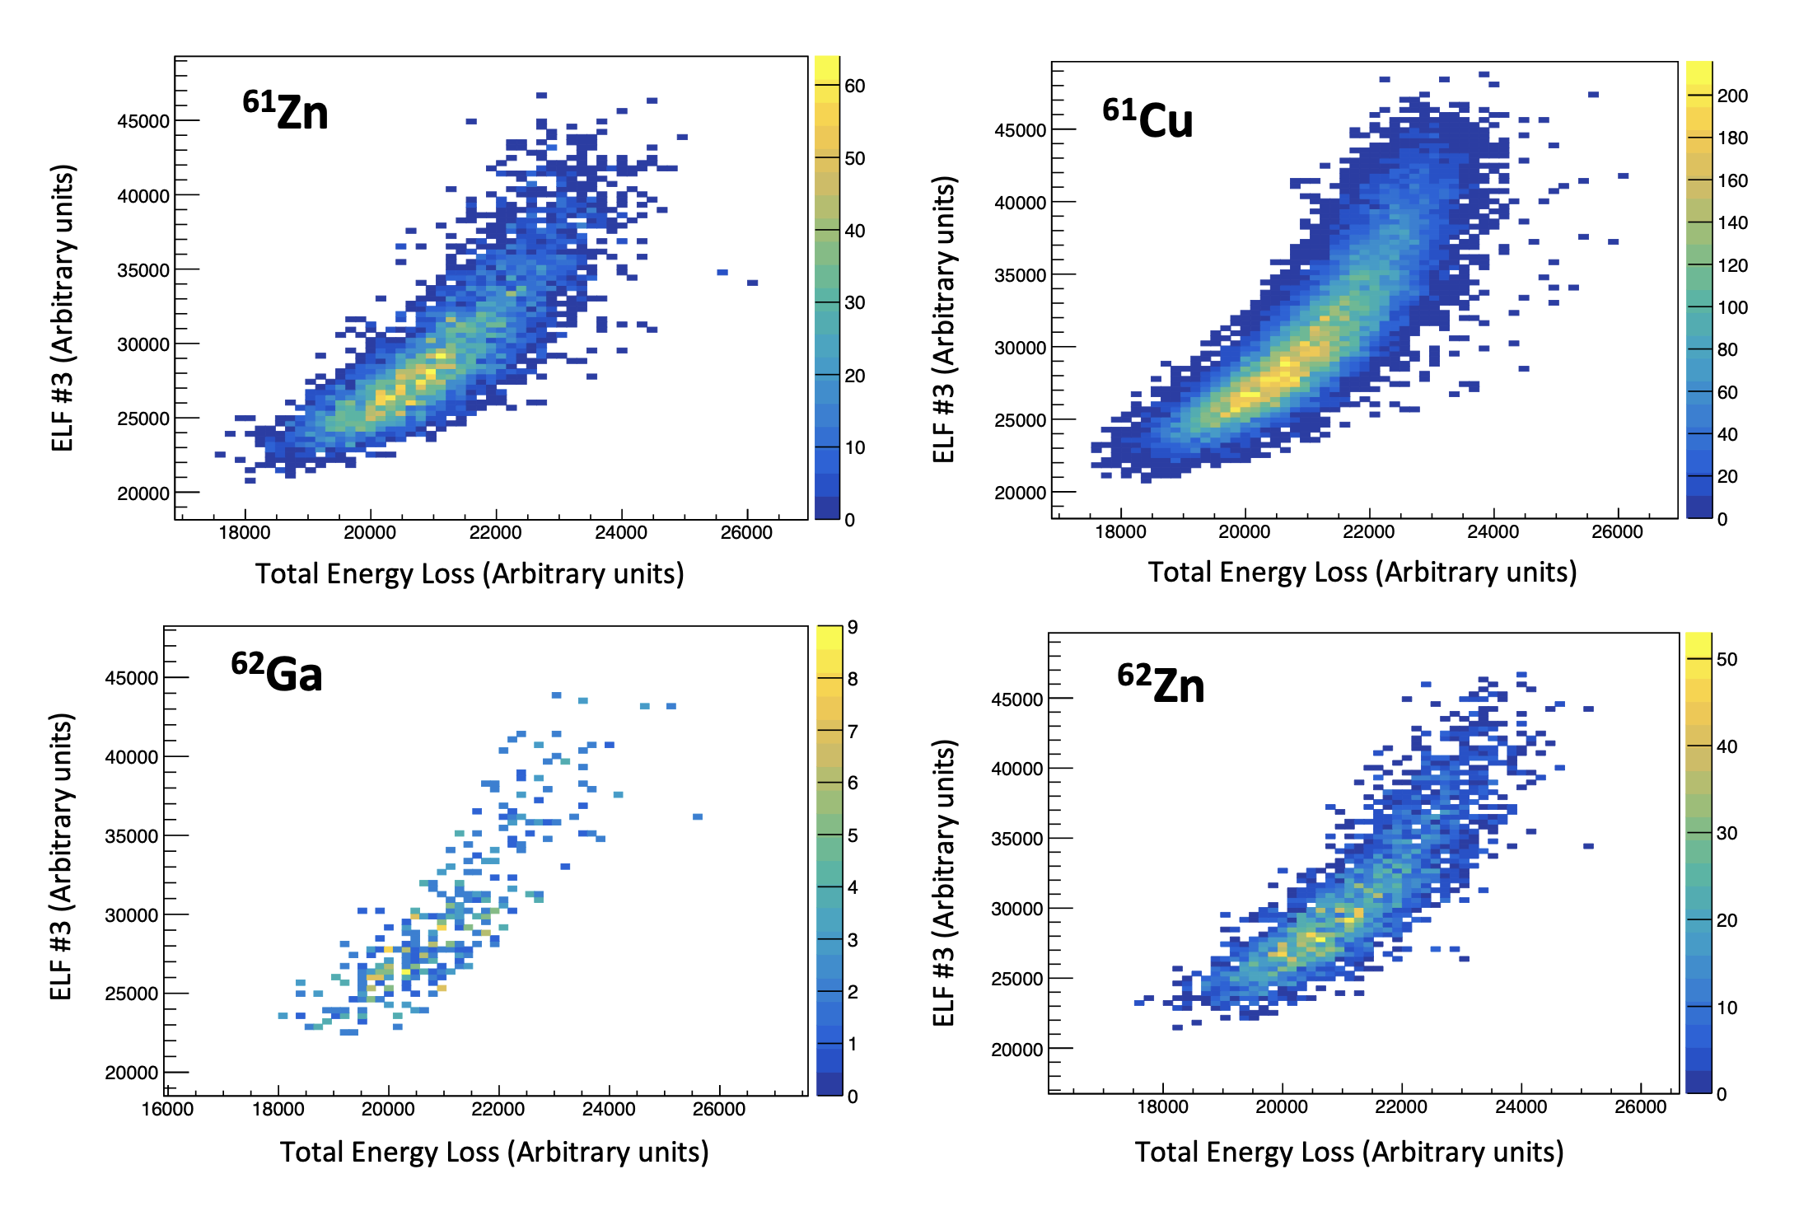
Statistics: subsets 1-5
‹#›

Slide 23
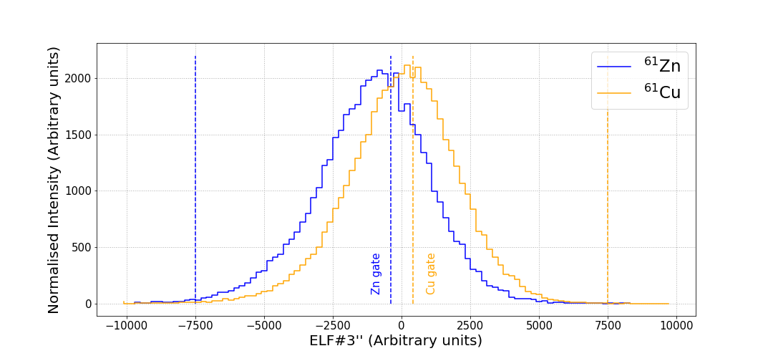
IC Spectra: ⁶¹Zn and ⁶¹Cu
Noticeable Z separation!
‹#›

Slide 24
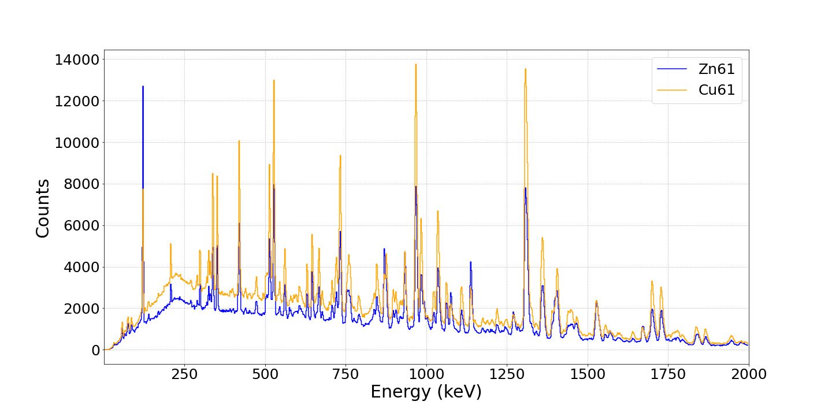
⁶¹Zn and ⁶¹Cu Spectra
‹#›

Slide 25
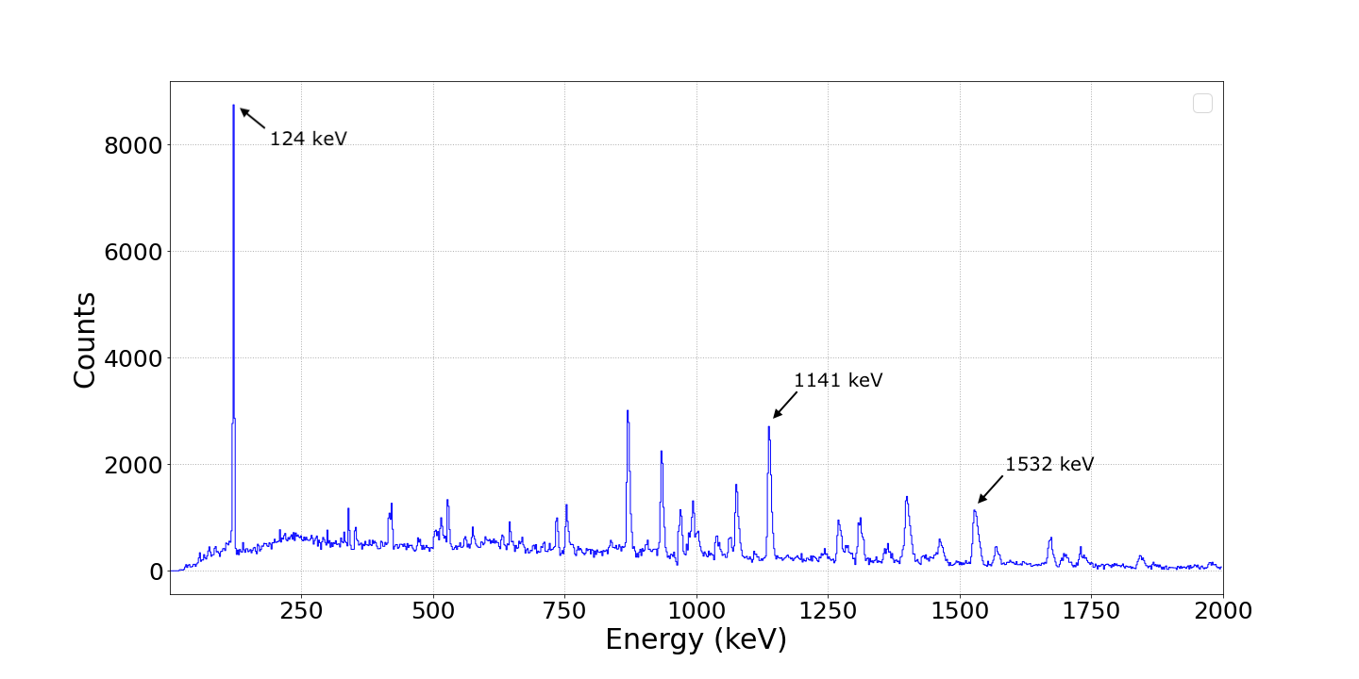
Cleaned ⁶¹Zn Spectrum
‹#›

Slide 26
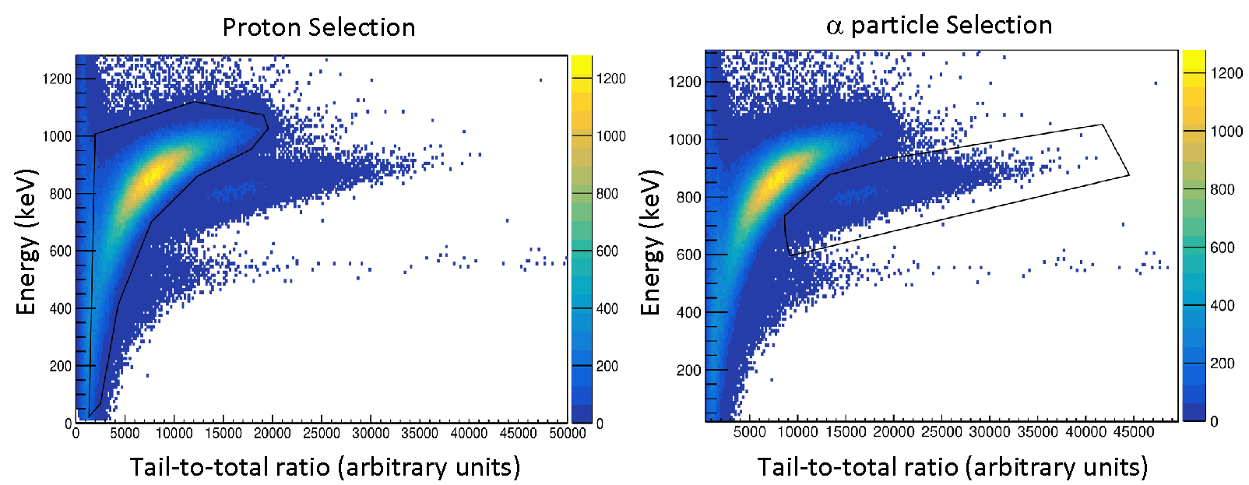
Microball - proton-𝛼 discrimination
p
𝛼
Traditional gates for forward detectors
Notes:
Greek alpha

Slide 27
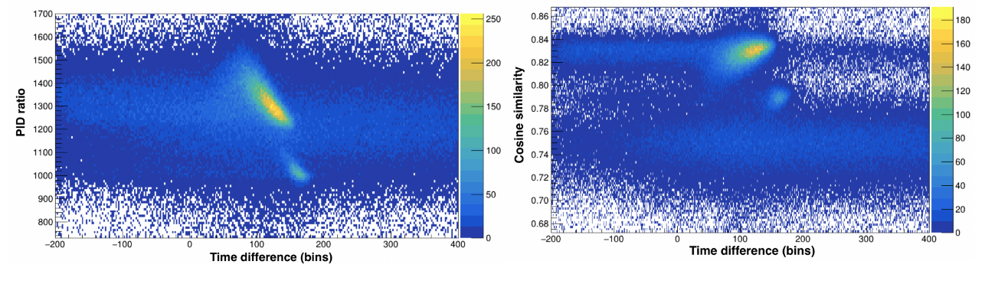
Microball
Digitized signals
Two methods:
Charge-comparison
Cosine similarity measure
p
p
𝛼
uncorrelated background
𝛼
Optimised for all detectors
Implemented for all detectors
Notes:
Proton
Alpha
Uncorrelated background

Slide 28
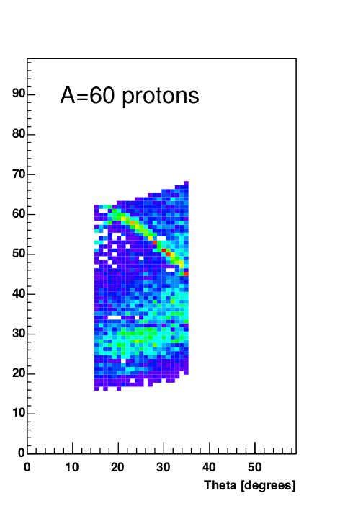
CD-DSSDs detectors
⁴⁰Ca + ²⁴Mg 🠚 ⁶¹Ga + p + 2n
Plan:
Recalibration along all three experiments
2D proton - 𝛼 separation
Proton tracking analysis (beam-spot position)
Search for proton emission lines
Simulated 2.2 MeV protons
Notes:
Alpha greek
Take figure from the proposal with proton lines
Add figure from the proposal

Slide 29
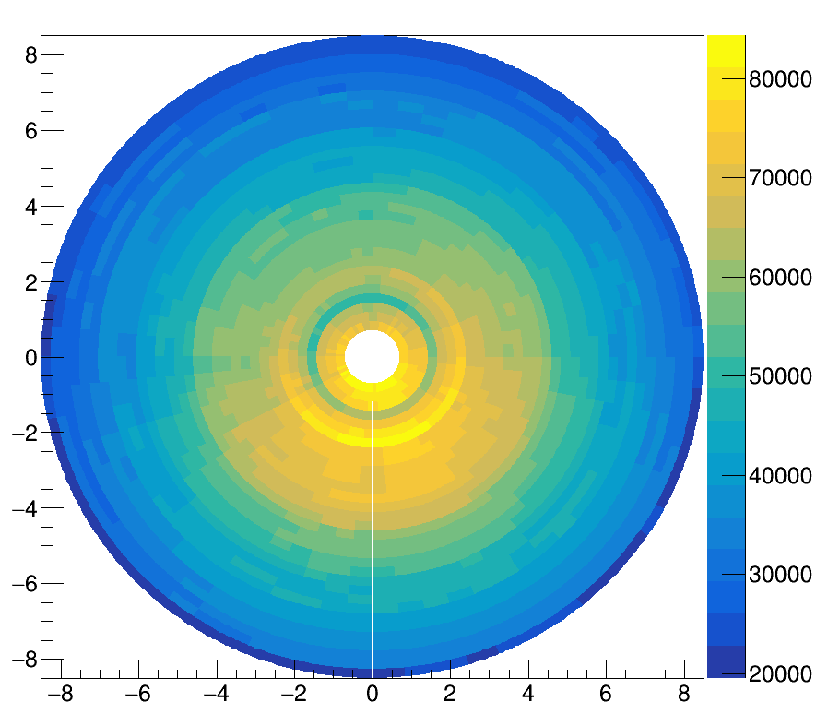
CD-DSSDs: hit pattern of DSSD1
DSSD1
𝛼
Bins (cm)
p
n-side of DSSD1
Bins (cm)
Notes:
Alpha greek
Take figure from the proposal with proton lines
Add figure from the proposal

Slide 30
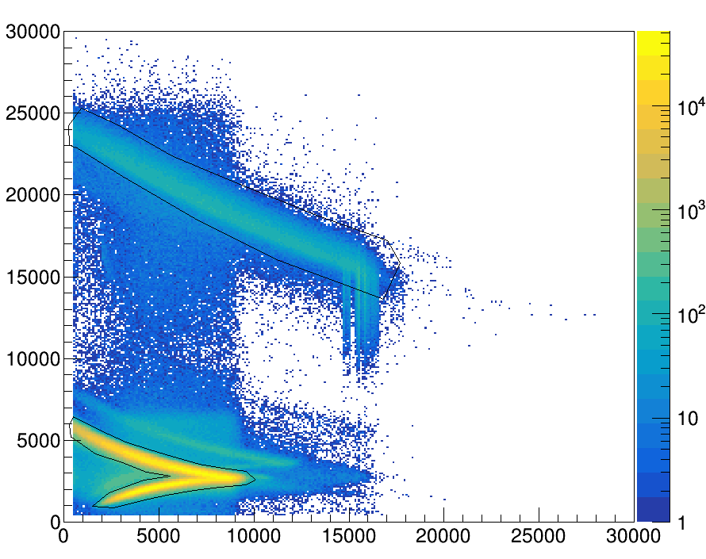
CD-DSSDs: proton-𝛼 separation
𝛼
Energy deposited in DSSD1 (keV)
p
Energy deposited in DSSD2 (keV)
Notes:
Alpha greek
Take figure from the proposal with proton lines
Add figure from the proposal

Slide 31
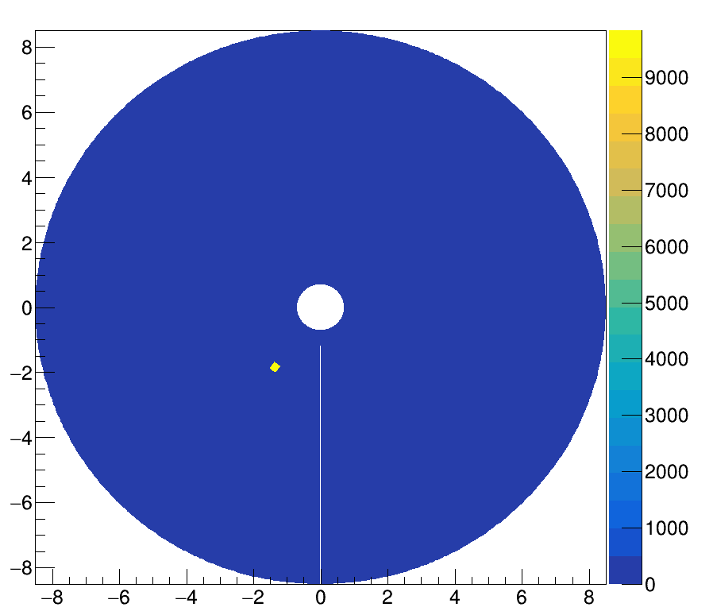
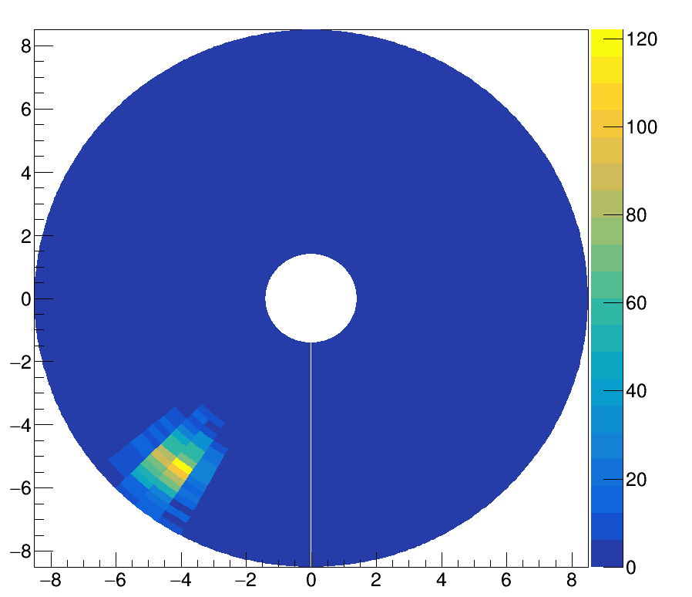
CD-DSSDs: particle tracking I
DSSD1
DSSD2
Notes:
Alpha greek
Take figure from the proposal with proton lines
Add figure from the proposal

Slide 32
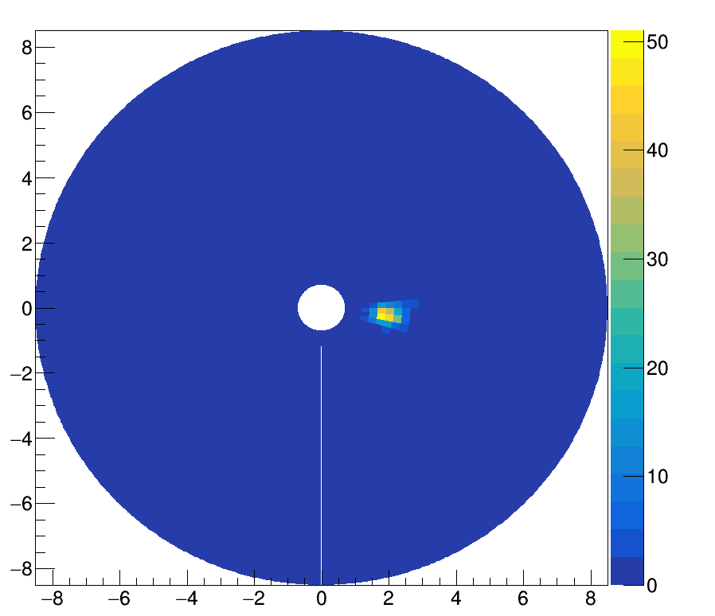
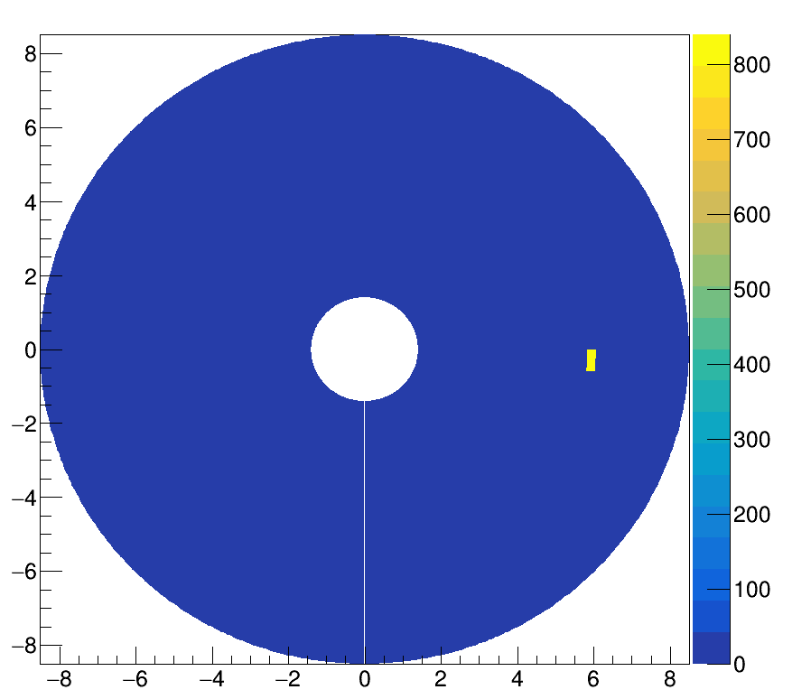
CD-DSSDs: particle tracking II
DSSD1
DSSD1
DSSD2
Notes:
Alpha greek
Take figure from the proposal with proton lines
Add figure from the proposal

Slide 33
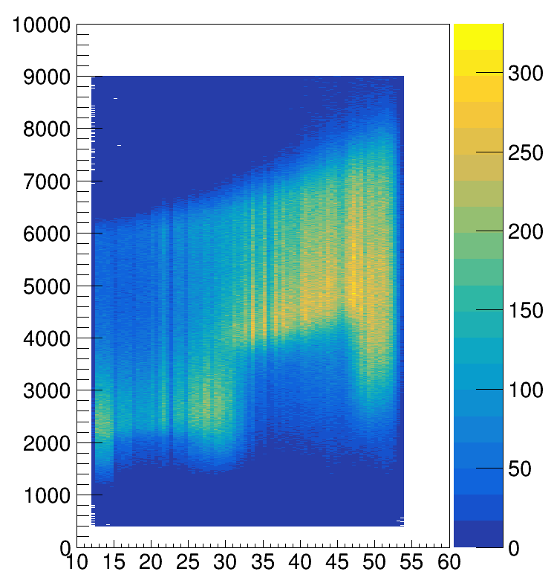
CD-DSSDs: search for proton emission lines
⁴⁰Ca + ²⁴Mg 🠚 ⁶¹Ga + p + 2n
preliminary
Simulated 2.2 MeV protons
Energy deposited in DSSD1 (keV)
Theta (degrees)
Notes:
Alpha greek
Take figure from the proposal with proton lines
Add figure from the proposal

Slide 34
Summary
Completed:
Detection system optimisation
  Gammasphere
  Neutron Shell
  FMA
  Microball
  IC
Search for ⁶²Ge
Ongoing:
Detection system optimisation
  Silicon detectors
Focus on ⁶¹Ga

Slide 35
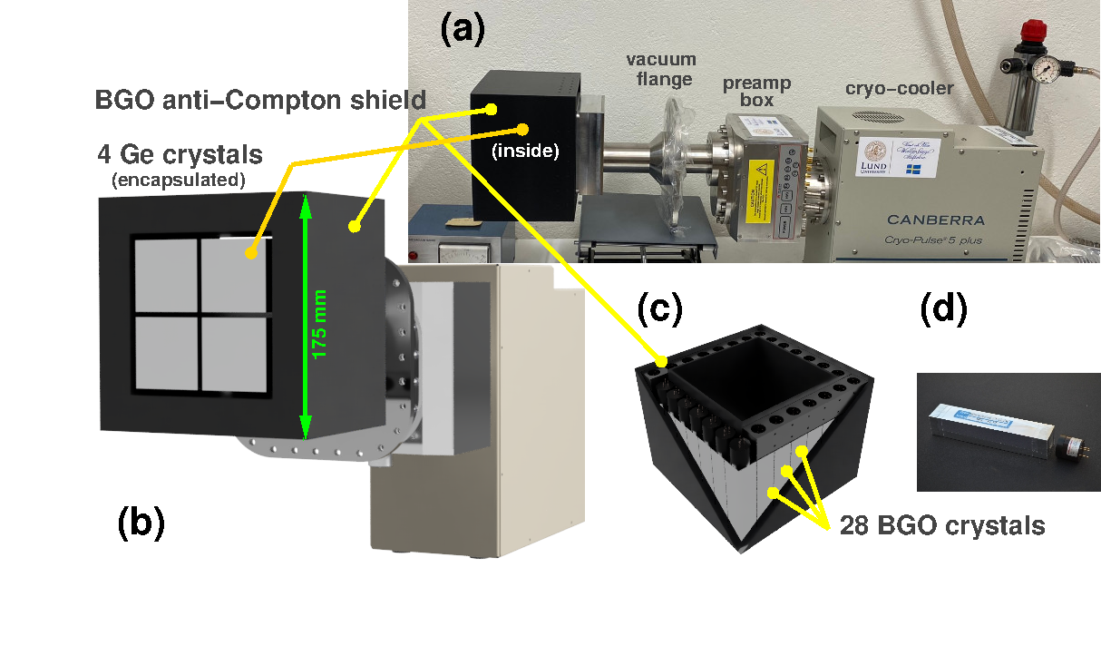
Project II: Detectors development
Anti-Compton Shield for Compex germanium detectors
4 Ge crystals allow running in add-back mode
BGO (Bismuth-germanate) scintillation detectors
Custom made ACS shields (pockets)
  Full cover
  Corner cover
Notes:
Same style coherent
Add reference 61Ga

Slide 36
Thank you for attention!

Slide 37
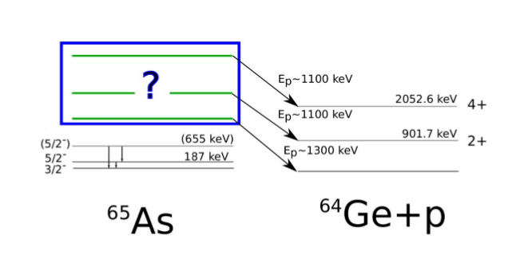
Third experiment
Proton-gamma spectroscopy of ⁶⁵Ar:
Isospin Symmetry at the Limits of Nuclear Binding
Potential positive-parity proton-emitting states in ⁶⁵As

Slide 38
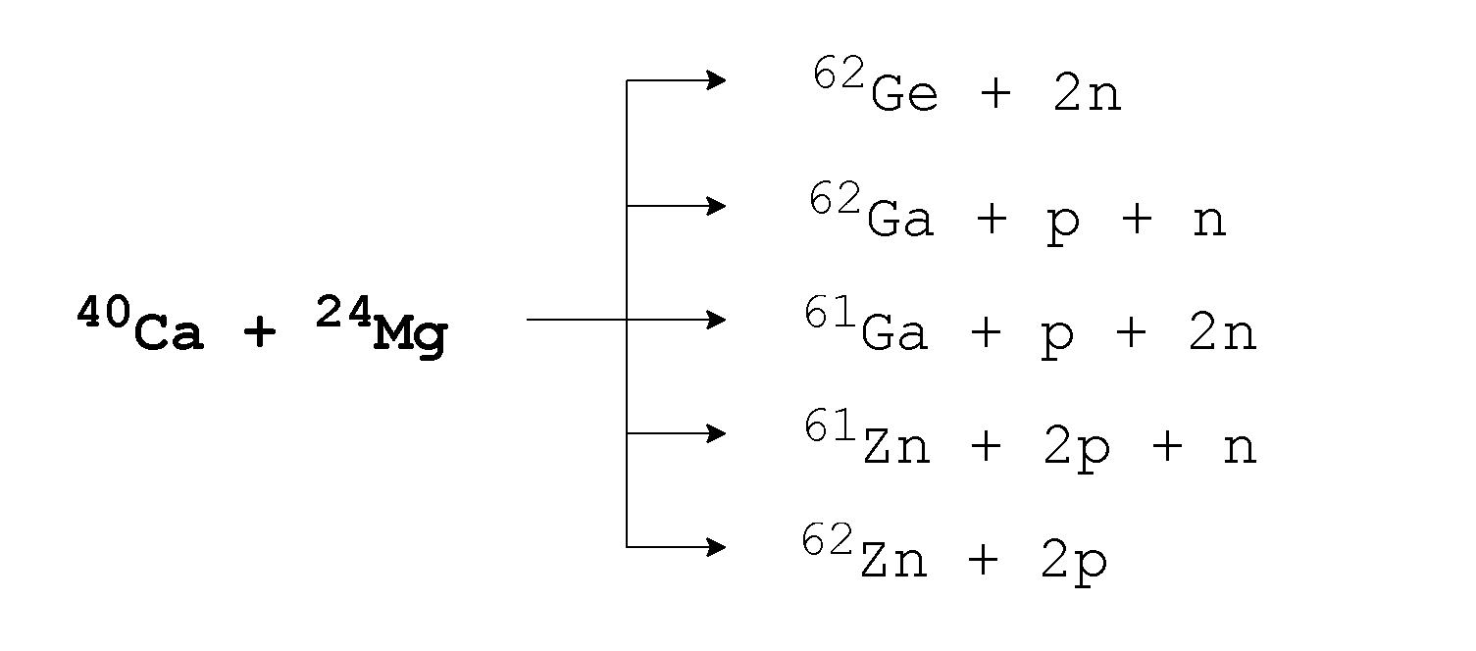
Selecting reaction channels
With focus on the second experiment:
MSc project
Dalia Farghaly
my PhD analysis
Method I:
FMA + evaporated particles
Method II:
FMA + IC

Slide 39
Selecting reaction channels II
Method I
Microball:
⍺ & p
+
FMA:
A & TOF
+
Neutron Shell:
n
Gammasphere:
Detector Alignment
Data
Microball:
⍺ & p
+
FMA:
A & TOF
+
IC:
Z
Method II

Slide 40
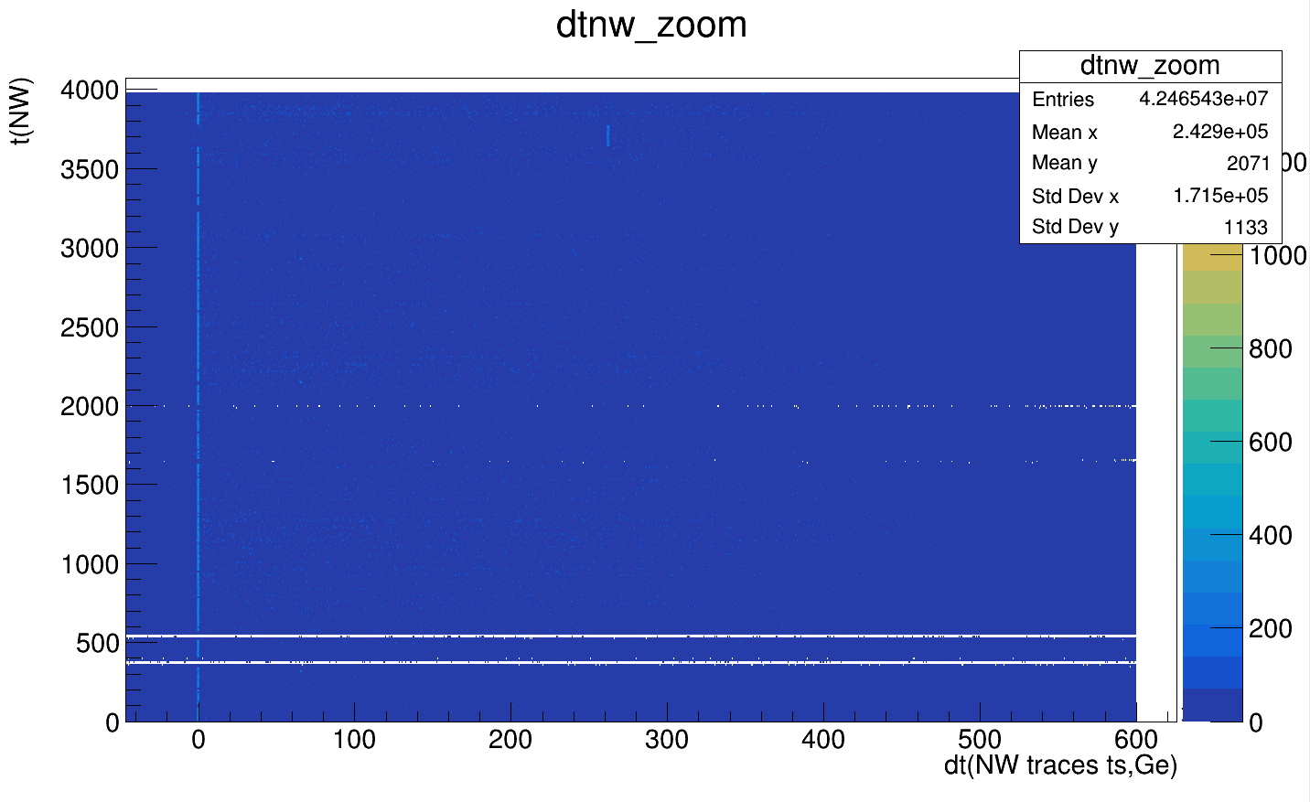
Second iteration
1310720
(2²⁰ + 2¹⁸)
1048576
(2²⁰)
Jumps as large as 2^20 (10 ms)
Need for two iterations
Flag in timestamp

Slide 41
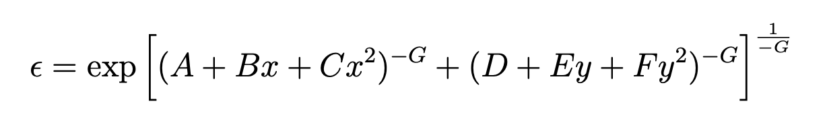
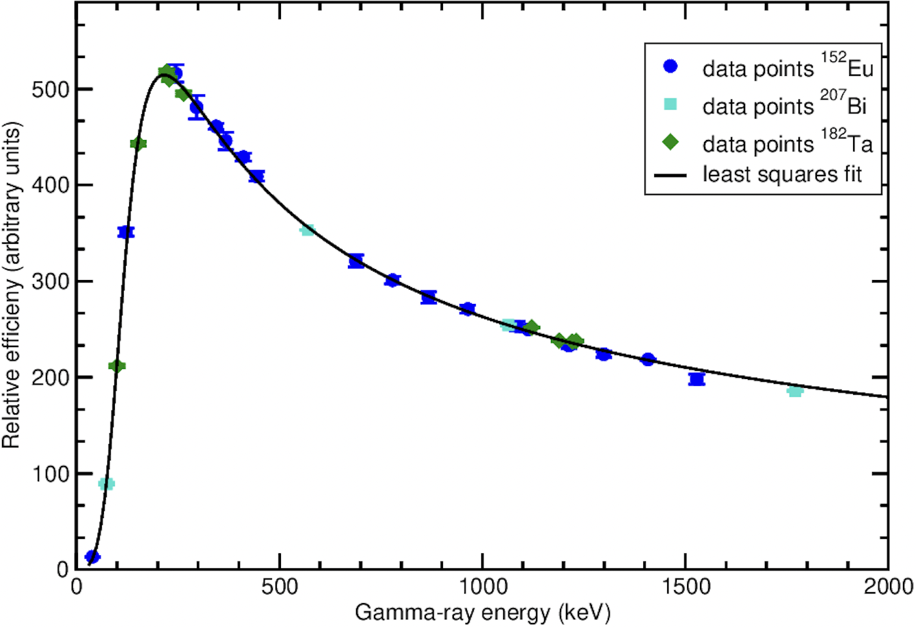
Gammasphere: Calibration II
Efficiency calibration:
¹⁵²Eu, ²⁰⁷Bi and ¹⁸²Ta sources
4 rings + total

Slide 42
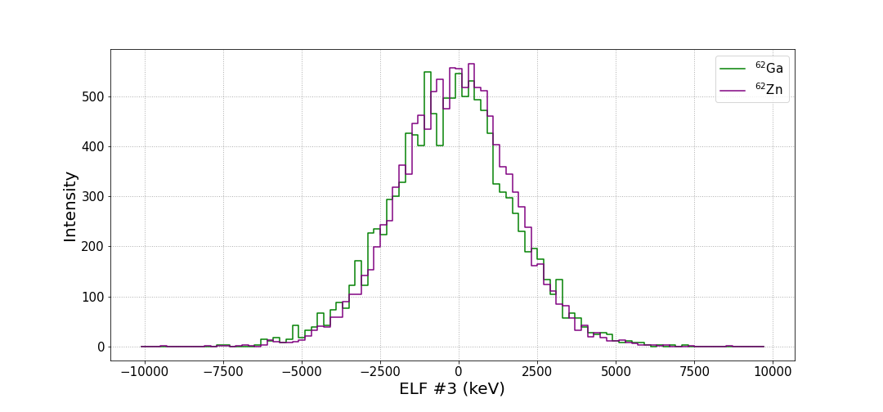

IC Spectra: ⁶²Ga and ⁶²Zn
No Z separation…
‹#›

Slide 43
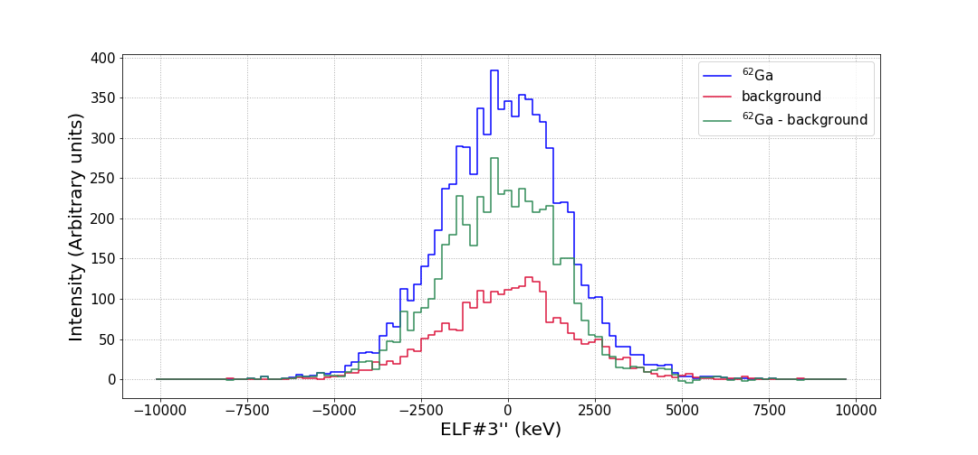
Attempt at improving Z separation
More investigation needed
‹#›

Slide 44
Search for ⁶²Ge
Two approaches:
A = 62, 0 charged particles + at least 1 neutron:
  Looking at gamma-gamma coincidence matrices
  Full experiment statistics
  No evident peaks
A = 62 and Z = 32:
  Poor Z separation for A=62
No conclusive evidence for ⁶²Ge transitions at the present stage of analysis
‹#›

Slide 45
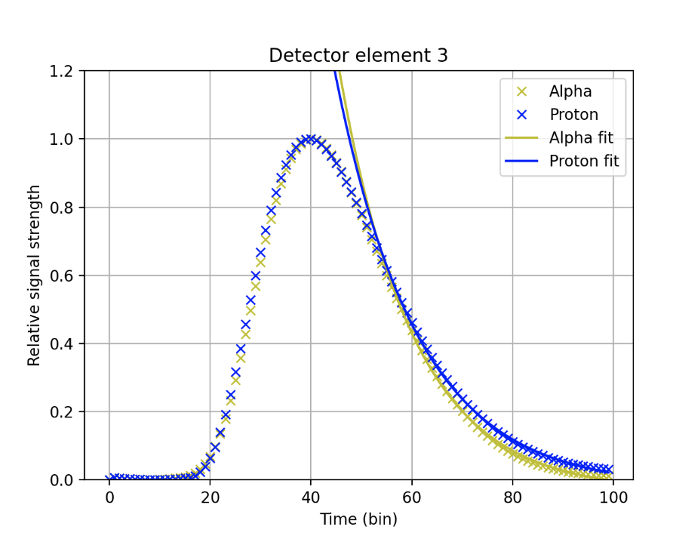
Microball: Average proton and 𝛼 pulses
‹#›

Slide 46
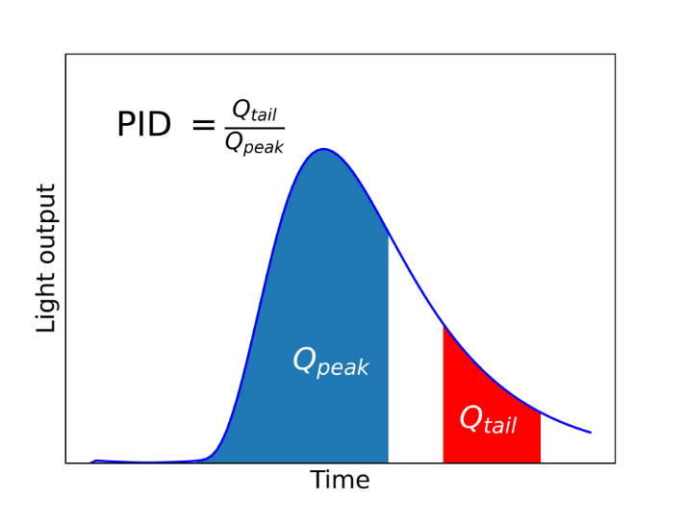
Microball: Charge-comparison method
Particle identification (PID) ratio from integration of two regions of a pulse:
Optimal placement of integration limits depends on detector characteristics
‹#›

Slide 47
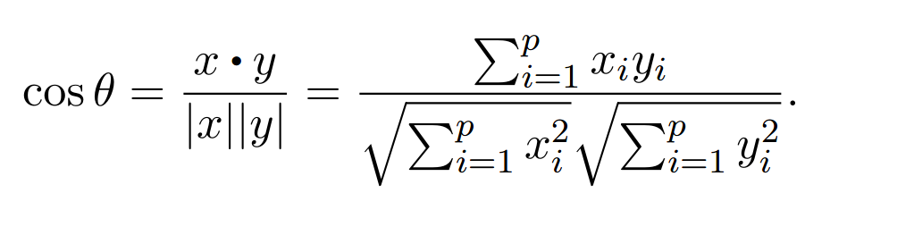
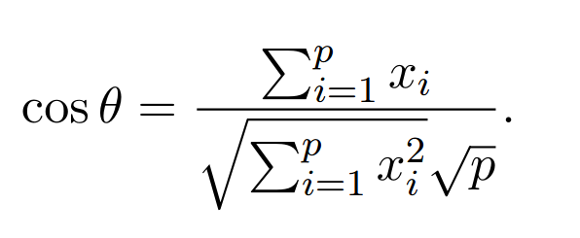
Microball: Cosine similarity measure
The cosine similarity between two vectors x and y is:
Various reference pulses can be used, such as averaged 𝛼-particle pulses or step pulse. For the step pulse:
‹#›

Slide 48
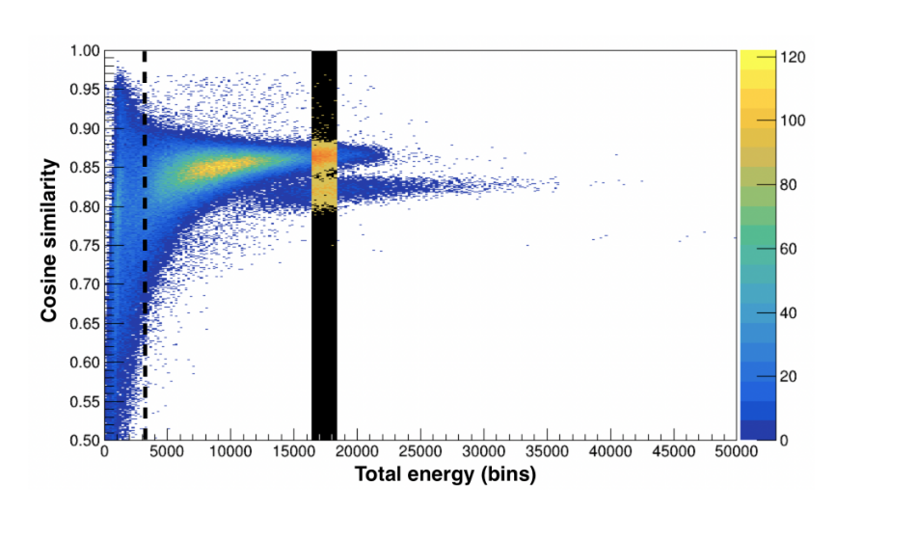
Microball: Cosine similarity measure II
Histograms with cosine similarity rather than PID ratio on vertical axis
A step pulse becoming unity at 10% of the amplitude was used
Projections were made and FOM computed
‹#›

