Slide 1

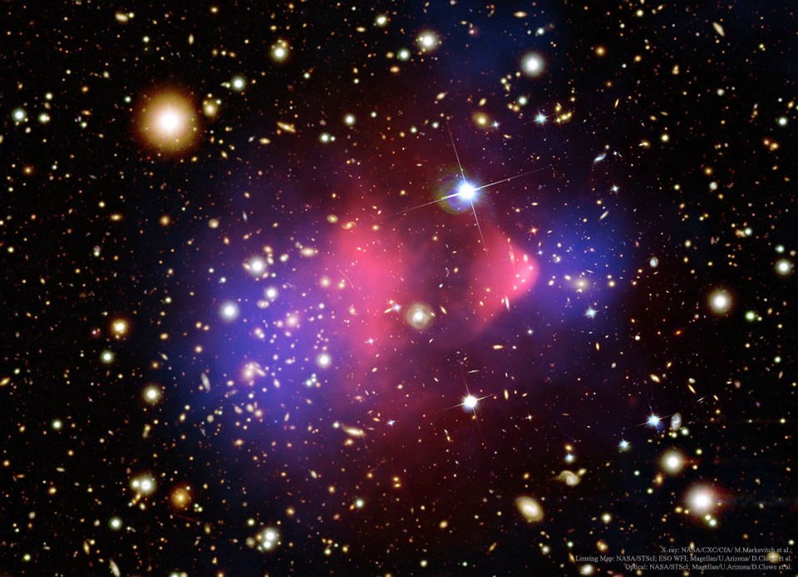
Spin-1 Thermal Targets for Dark Matter Searches at Fixed Target Experiments arXiv:2307.02207
Taylor R. Grayª
In collaboration with Riccardo Catenaª
ªChalmers University of Technology
Supported by a research grant from the Wallenberg foundation

Slide 2








Sub-GeV Dark Matter
Thermal equilibrium between DM and SM in the early universe.
Thermal DM Window
$m_{χ}$ (GeV)
$${10}^{−30}$$
$${10}^{−20}$$
$${10}^{−10}$$
$${10}^{0}$$
$${10}^{10}$$
$${10}^{20}$$
sub-GeV
WIMPs
$$m_{χ}$$
KeV
MeV
GeV
TeV
Sub-GeV DM is largely experimentally unexplored..
  Out of reach of nuclear recoil direct detection exps
DM produced through freeze-out near weak scale
GeV-TeV scale thermal DM already widely tested
Notes:
`

Slide 3
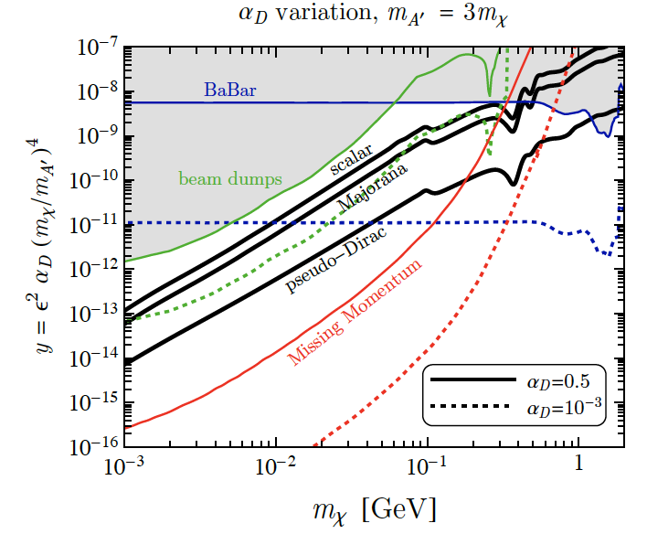
Sub-GeV Dark Matter
Fixed target experiments can probe sub-GeV DM
Future fixed target experiments such as LDMX will reach new sensitivities in the sub-GeV mass range.
How about spin-1 DM?
Spin-0
LDMX
Spin-1/2
arXiv:1807.0170

Slide 4
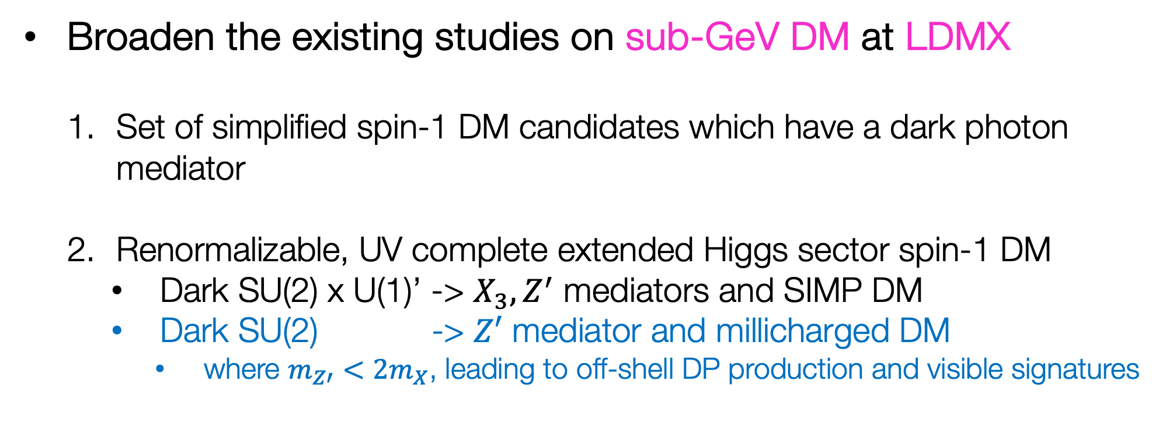
The Goal
Broaden the existing studies on sub-GeV DM at LDMX
  Set of simplified spin-1 DM candidates which have a dark photon mediator
  Renormalizable, UV complete extended Higgs sector spin-1 DM
    Dark SU(2) x U(1)’ -> $X_{3}, Z^{′}$ mediators and SIMP DM
    Dark SU(2) -> $Z′$ mediator and millicharged DM
      where $m_{Z′}<2m_{X}$, leading to off-shell DP production and visible signatures
Ongoing work!

Slide 5
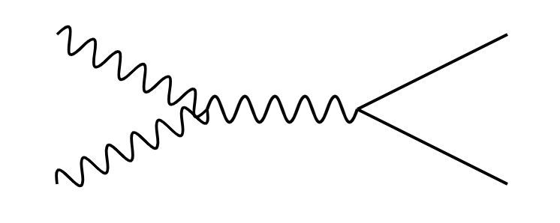


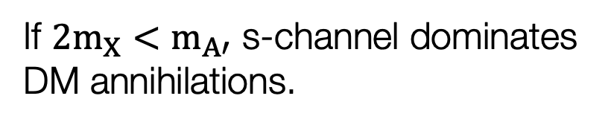




Simplified Spin-1 Dark Matter Models with a Dark Photon Mediator
DM Freeze-Out
$b_{5}$: real
$b_{6}$: complex
$b_{7}$: complex
$h_{3}$: real
$$X$$
$$f$$
$$A′$$
$$h_{3}≡εe$$
$$\overline{f}$$
$$X^{†}$$
$f$: SM leptons and quarks (excluding neutrinos)
If ${2m}_{X}<m_{A′}$ s-channel dominates DM annihilations.

Slide 6
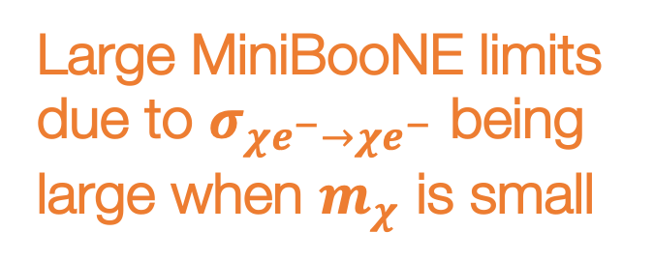
Strong Limits on Spin-1 Relic Targets
Large MiniBooNE limits due to $σ_{χe^{−}→χe^{−}}$ being large when $m_{χ}$ is small
Ruled out by current experiments and CMB

Slide 7
Spin-1 DM is the first to be probed by LDMX!
Let's now consider a UV complete model where unitarity is not violated!

Slide 8
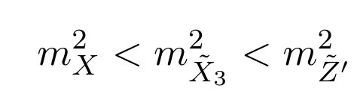


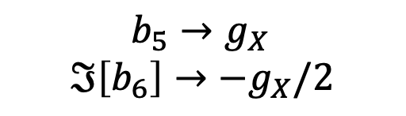



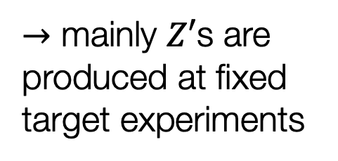

SIMP Spin-1 Dark Matter with $Z′$ and $X_{3}$ as mediators
$b_{5}→g_{X}$
$$ℑ\left[b_{6}\right]→−g_{X}/2$$
$$X_{+}X_{−}→f\overline{f}$$
processes setting the relic density
$$→$$
$$X_{+}X_{+}X_{−}→X_{+}{\tilde{X}}_{3}$$
$→$ mainly $Z′$s are produced at fixed target experiments
$X_{+}X_{−}→{\tilde{X}}_{3}$ ${\tilde{X}}_{3}$
Dominant since $g_{X}≫eϵ$
arXiv:1904.04109

Slide 9
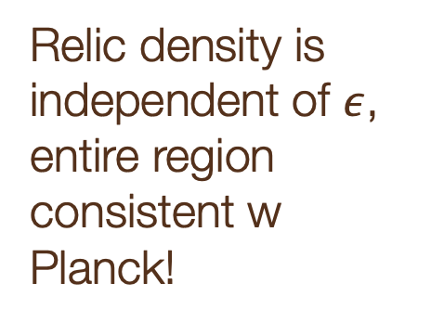
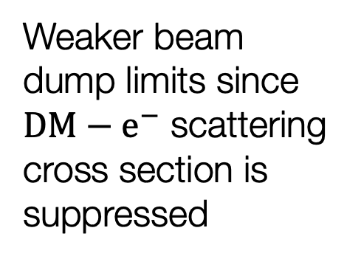
Weaker beam dump limits since $DM−e^{−}$ scattering cross section is suppressed
Relic density is independent of $ε$, entire region consistent w Planck!

Slide 10
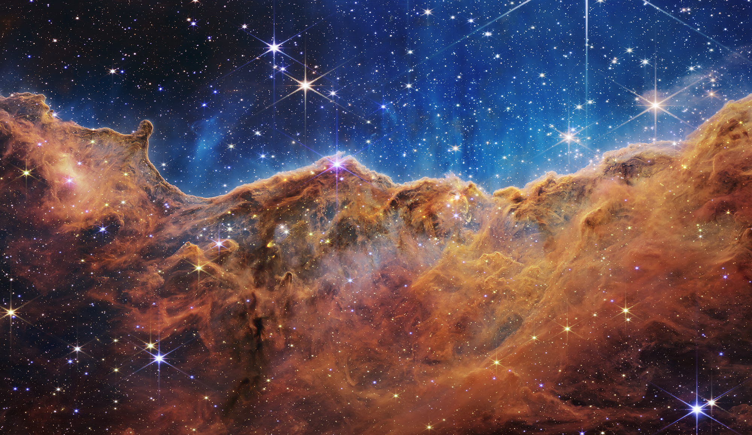
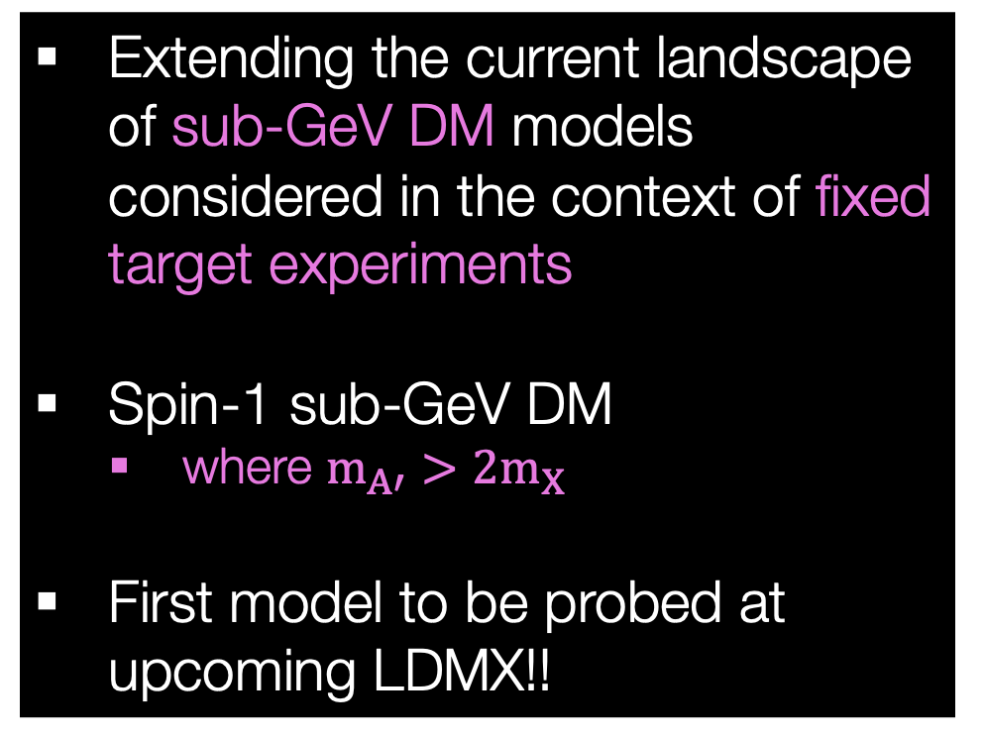
Summary
Future
Extending the current landscape of sub-GeV DM models considered in the context of fixed target experiments
Spin-1 sub-GeV DM
  where $m_{A′}>2m_{X}$
First model to be probed at upcoming LDMX!!
Ongoing work with dark SU(2)xU(1)’ Vector DM
Ongoing work with GAMBIT
Vector DM models with dark dipole dark photons

Slide 12
Backup Slides

Slide 13
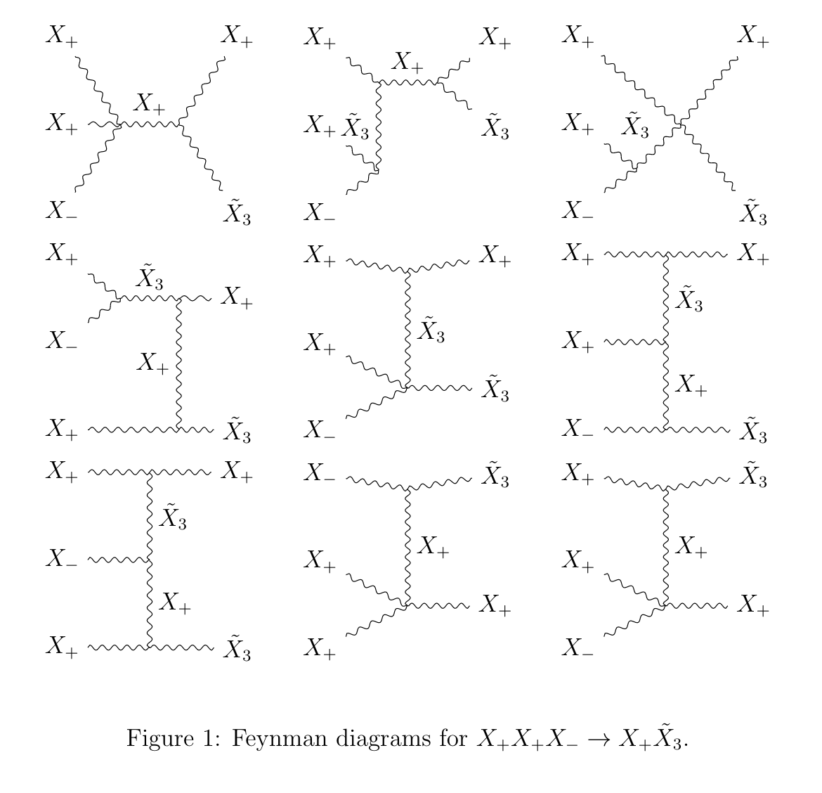
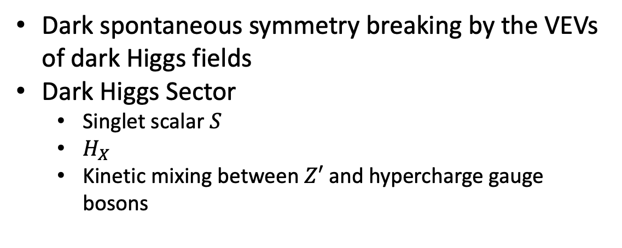
SIMP spin-1 DM
Dark spontaneous symmetry breaking by the VEVs of dark Higgs fields
Dark Higgs Sector
  Singlet scalar $S$
  $H_{X}$
  Kinetic mixing between $Z′$ and hypercharge gauge bosons

Slide 14
Relic Targets of DM Models
Muon channel becomes allowed
Hadronic resonances

