Slide 1
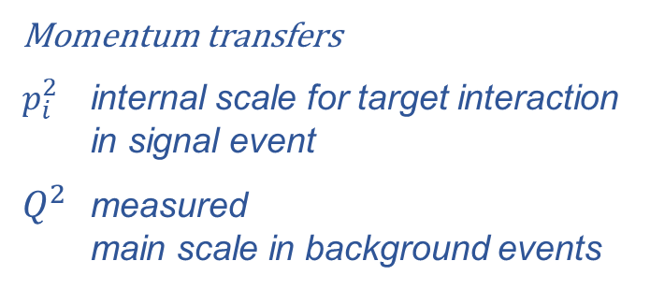


LDM events – understanding backgrounds
$$Q^{2}$$
Momentum transfers
$p_{i}^{2}$ internal scale for target interaction
in signal event
$Q^{2}$ measured
main scale in background events
$$p_{i}^{2}$$
⇓
Momentum
transfer
scale
⇓
Quantum
states
& theory
hadrons
ChPT
hadrons → partons
form factors + starting PDFs
partons
pQCD

Slide 2

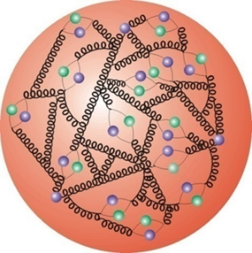


Understanding PDFs and the proton spin puzzle
A. Ekstedt, H. Ghaderi, G. Ingelman, S. Leupold
arXiv:1807.06589 Nucleon parton distributions from hadronic quantum fluctuations
arXiv:1808.06631 Towards solving the proton spin puzzle
model for
PDFs at $Q_{0}$
hadronic fluctuations
DGLAP $Q^{2}$ evolution of PDFs
p-wave → L=1 not observed in DIS

Slide 3
Fock expansion of proton state

Slide 4
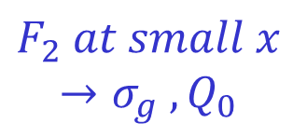
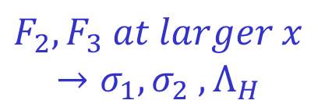
Unpolarised
structure functions
↓
parameter values
!! ??
Pauli principle !?
hadron-parton
transition !!

Slide 5
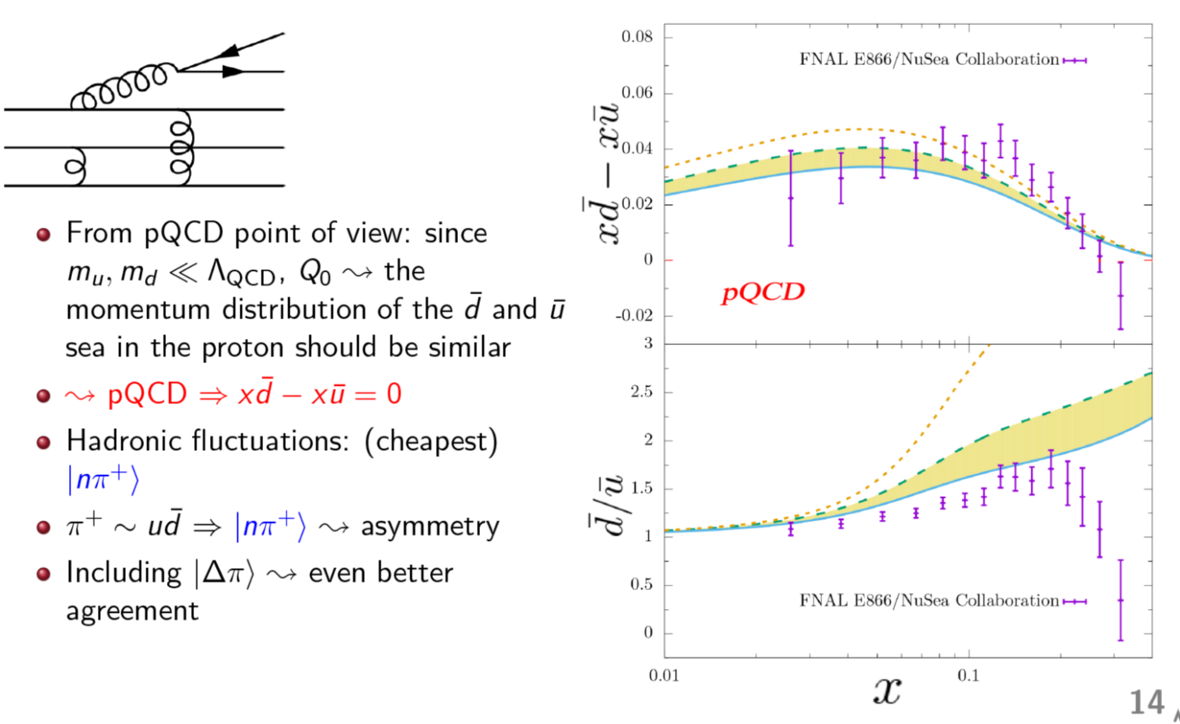
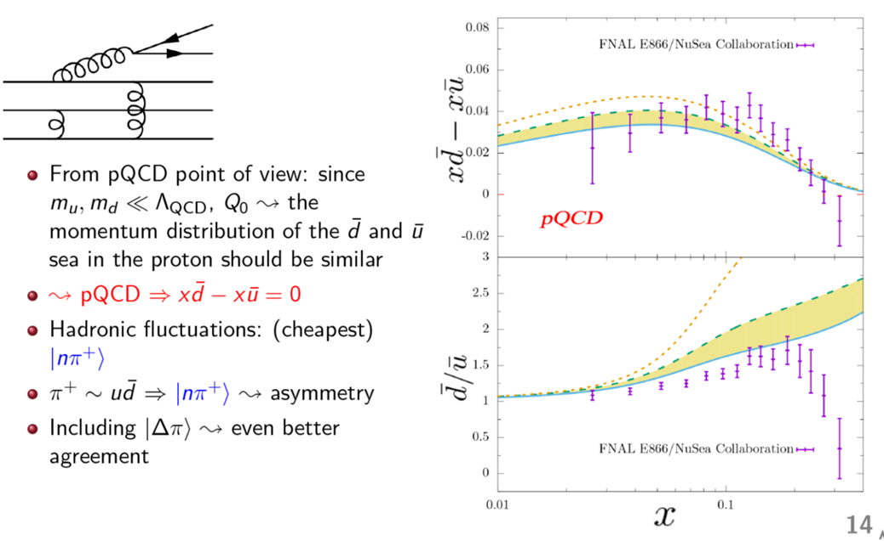

Resulting unpolarised PDFs
based on 5 physical parameters
→ understanding!
cf. conventional PDF fits with
∼30 parameters
Also explains sea quark asymmetries:

Slide 6
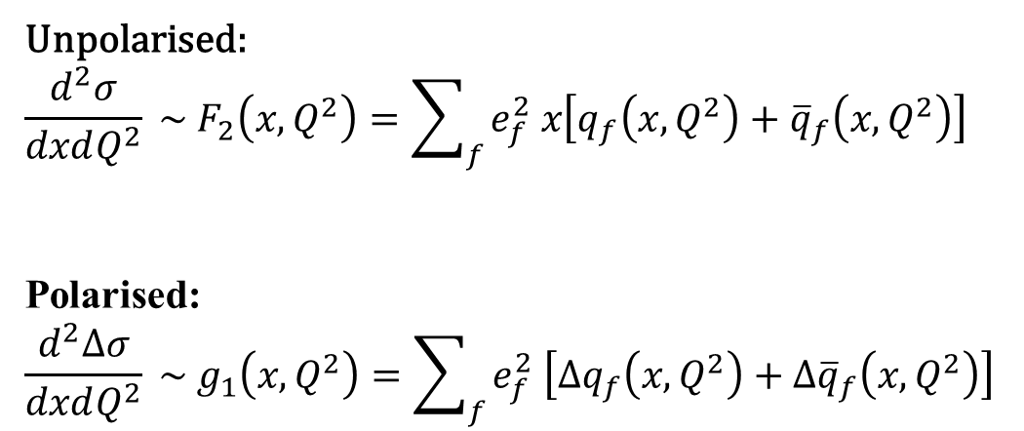
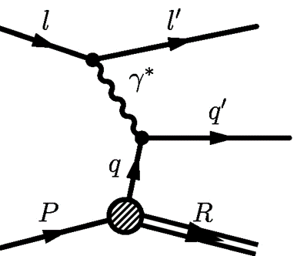
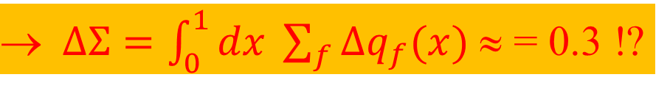
The proton spin puzzle / “crisis”
1988 European Muon Collaboration:
measured polarization of quarks adds to only ∼1/3 of proton spin 1/2
↑
PDF:
↑↓
↑
Polarised PDF:
proton spin

Slide 7
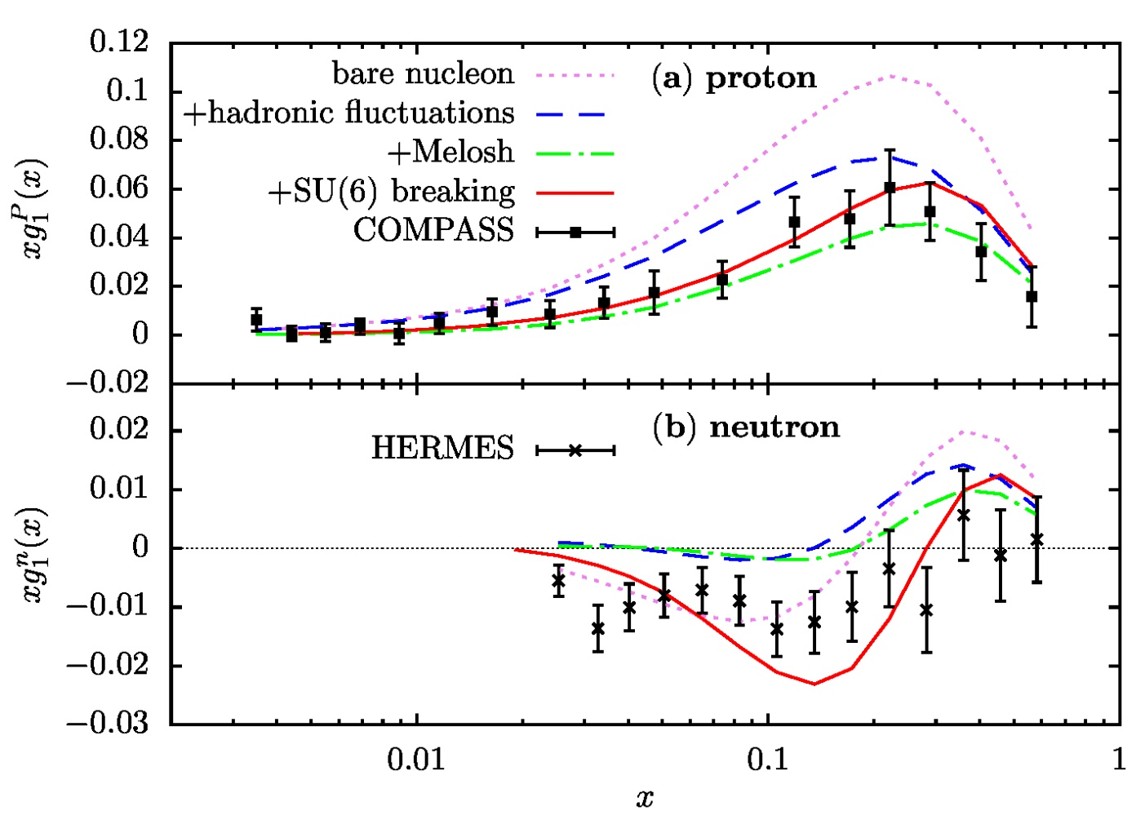
Polarised PDFs:
Melosh = relativistic
spin transformation
p spin OK !
But not n spin ?
Solutions …?
SU(6) breaking
available range
in constrast to SU(6) quark model !!??
Problem in extracting neutron state from deuterium state ??

Slide 8
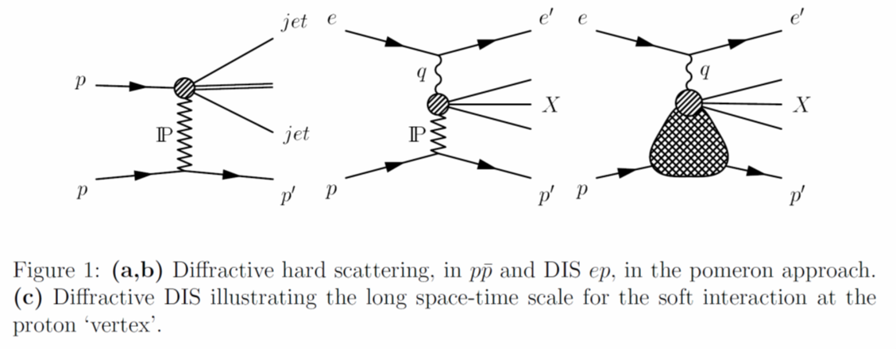
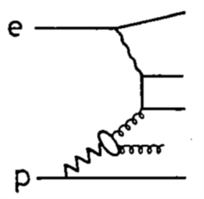

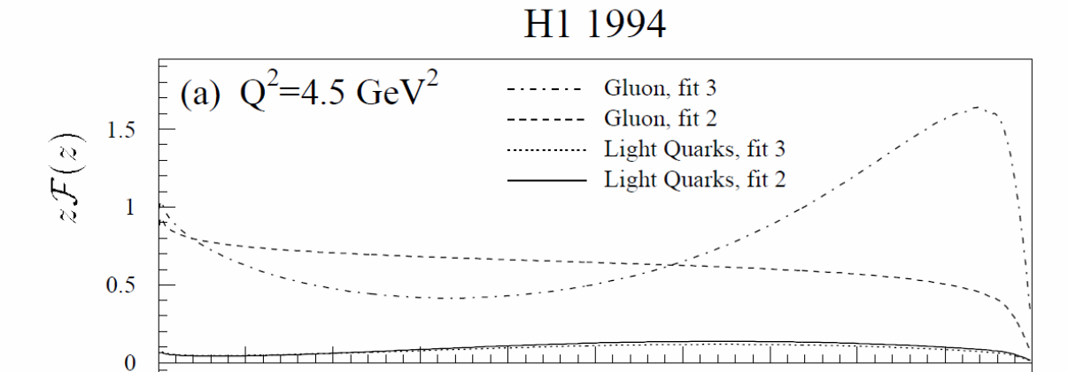
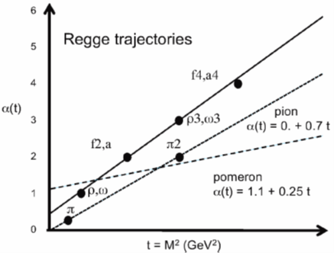
Possible effects of soft gluon fields missing !!
Information available from diffractive scattering
X
p
Regge theory (soft pre-QCD):
pomeron factorization
pomeron flux
pomeron trajectory
Pomeron as color singlet gluon field

Slide 9
Extra material

Slide 10
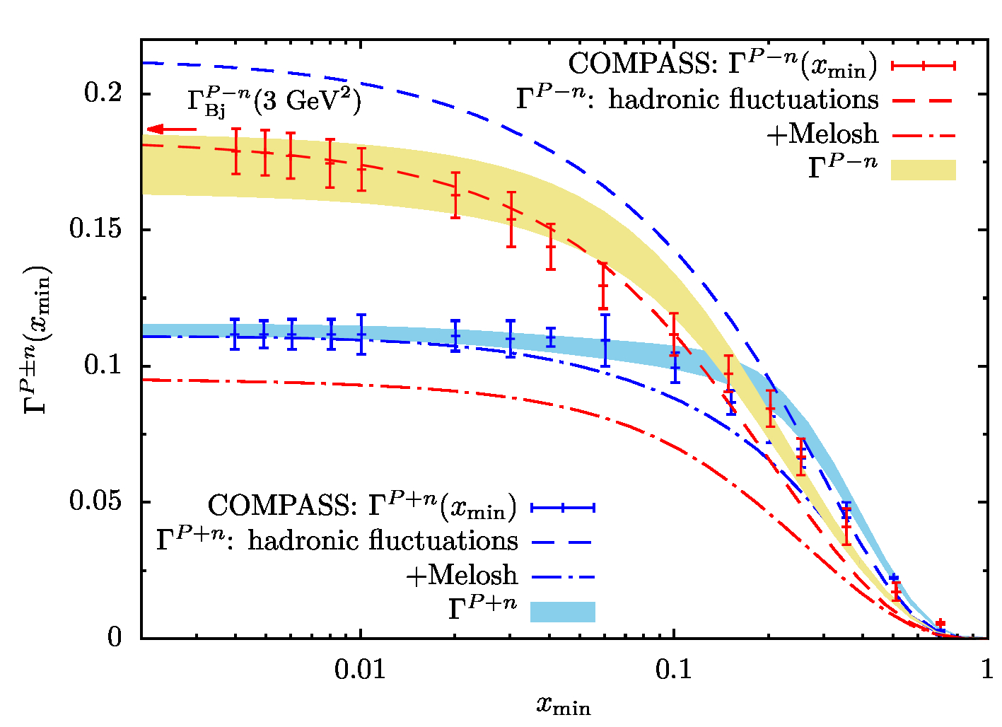
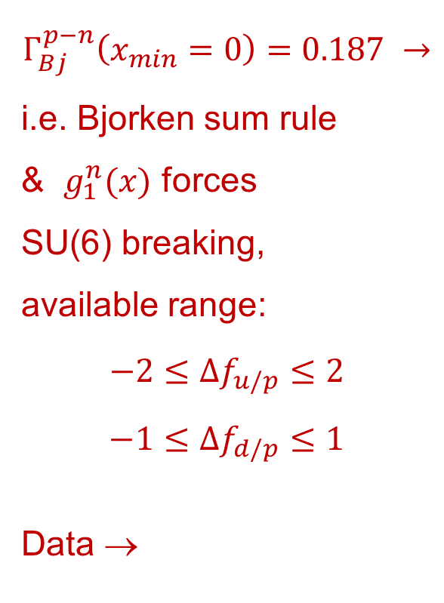
More info in spin sum rules:
in constrast to SU(6) quark model !!??

Slide 11
Conclusion
Hadron fluctuations (ChPT) + non-pQCD parton fluctuations
+ pQCD DGLAP evolution + SU(6) quark flavor-spin symmetry
→ repoduce data on
proton spin structure function
Ellis-Jaffe sum rule
proton quark spin sum ΔΣ
+ SU(6) breaking → reproduce data on
neutron spin structure function
Bjorken sum rule

Slide 12
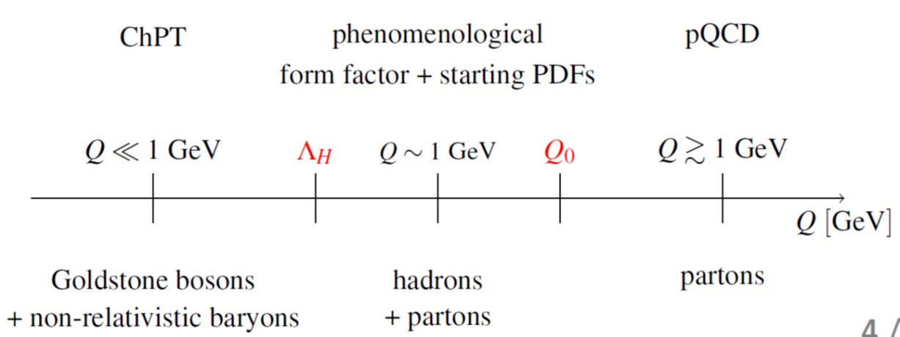
QCD established as the theory for strong interactions,
but soft non-pQCD is the major unsolved problem within the Standard Model
ChPT hadrons ← ??? → partons pQCD
Soft gluon fields !?
Consider information from soft elastic/diffractive hadron scattering
Pomeron 2-gluon reggeized gluon field theory/phenomenology exchange gluon ladder vacuum fluctuation

Slide 13


Possible effects of soft gluon fields missing !!
Information available from diffractive hard scattering:
Based on:
pomeron factorization
pomeron flux
pomeron trajectory
from Regge phenomenology with

