Slide 1
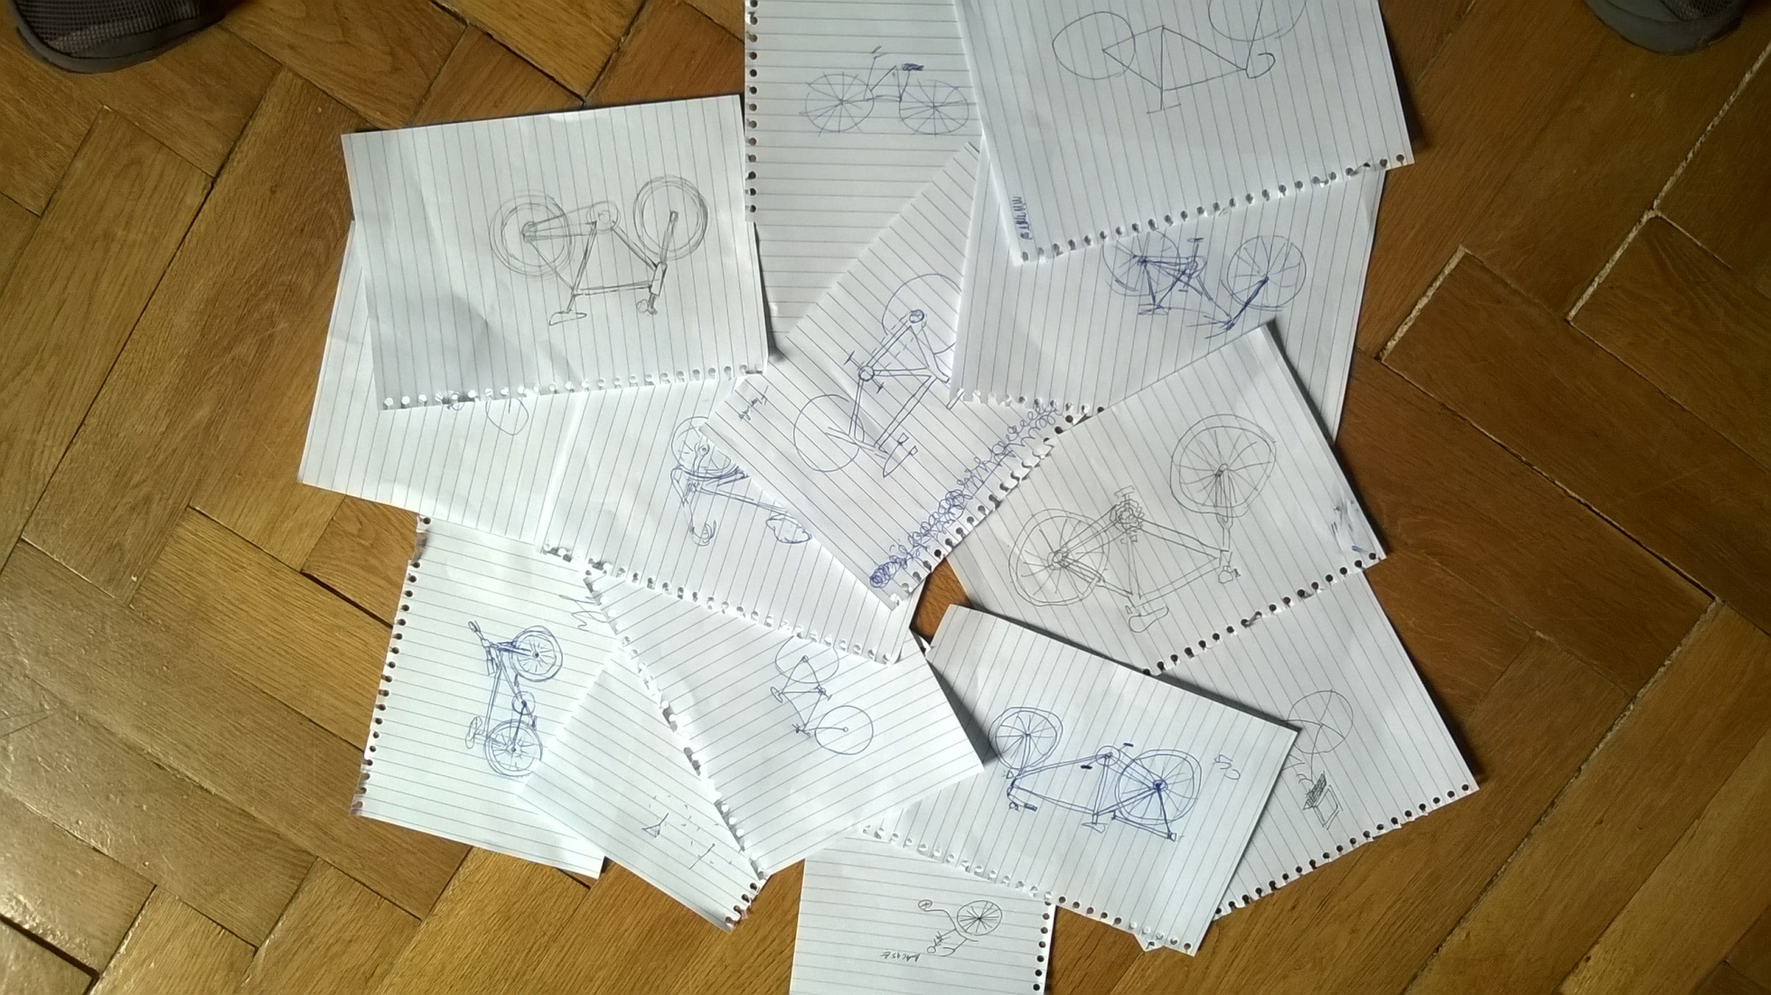
Bike Design Award Ceremony
The Velocipedia project:
www.gianlucagimini.it/prototypes/velocipedia.html

Slide 2
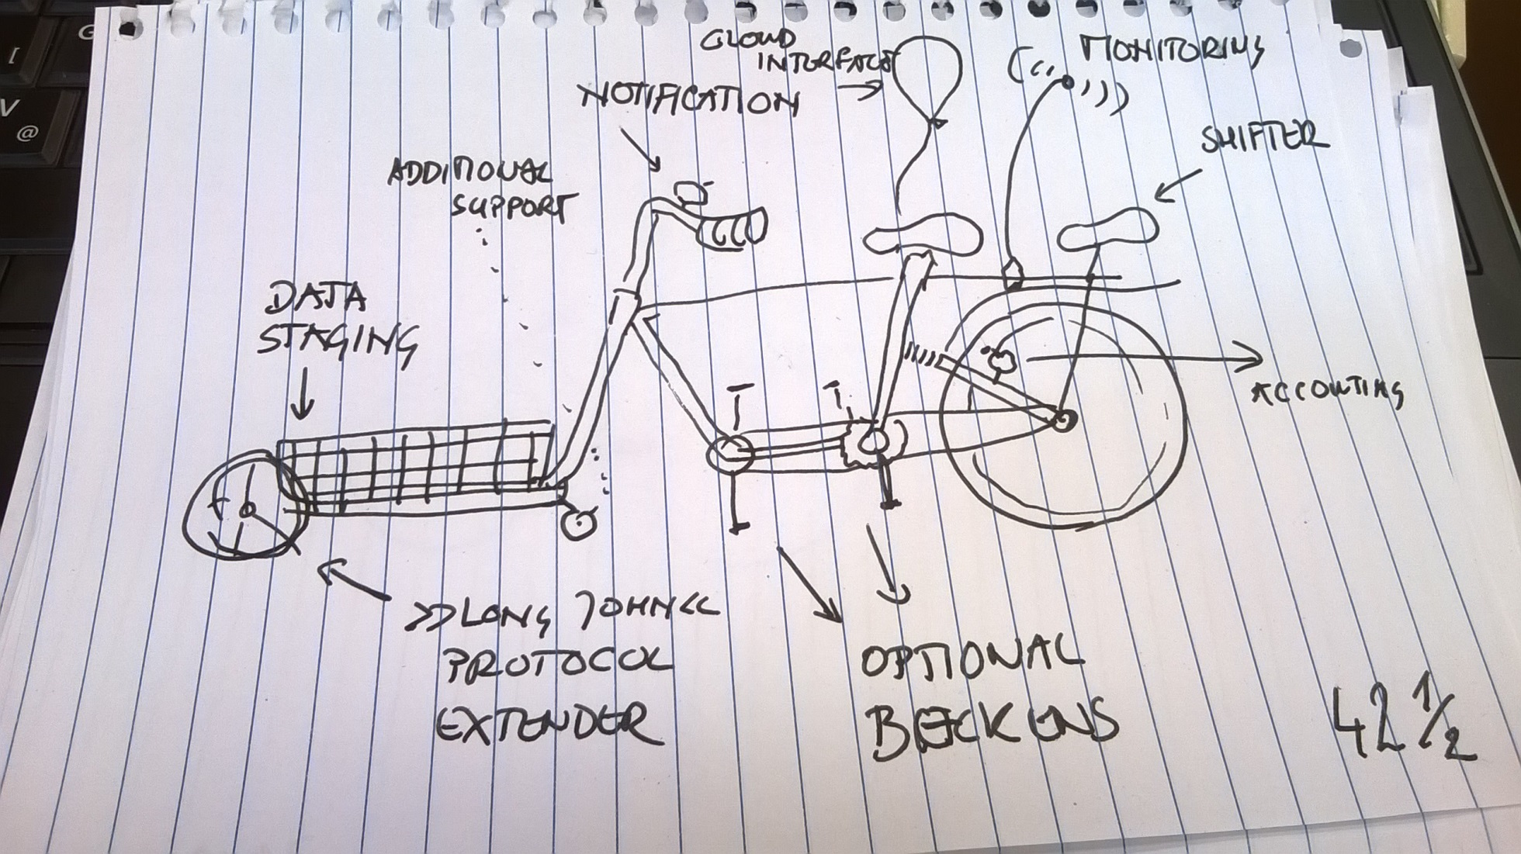
Out-of-the-program submission 1

Slide 3
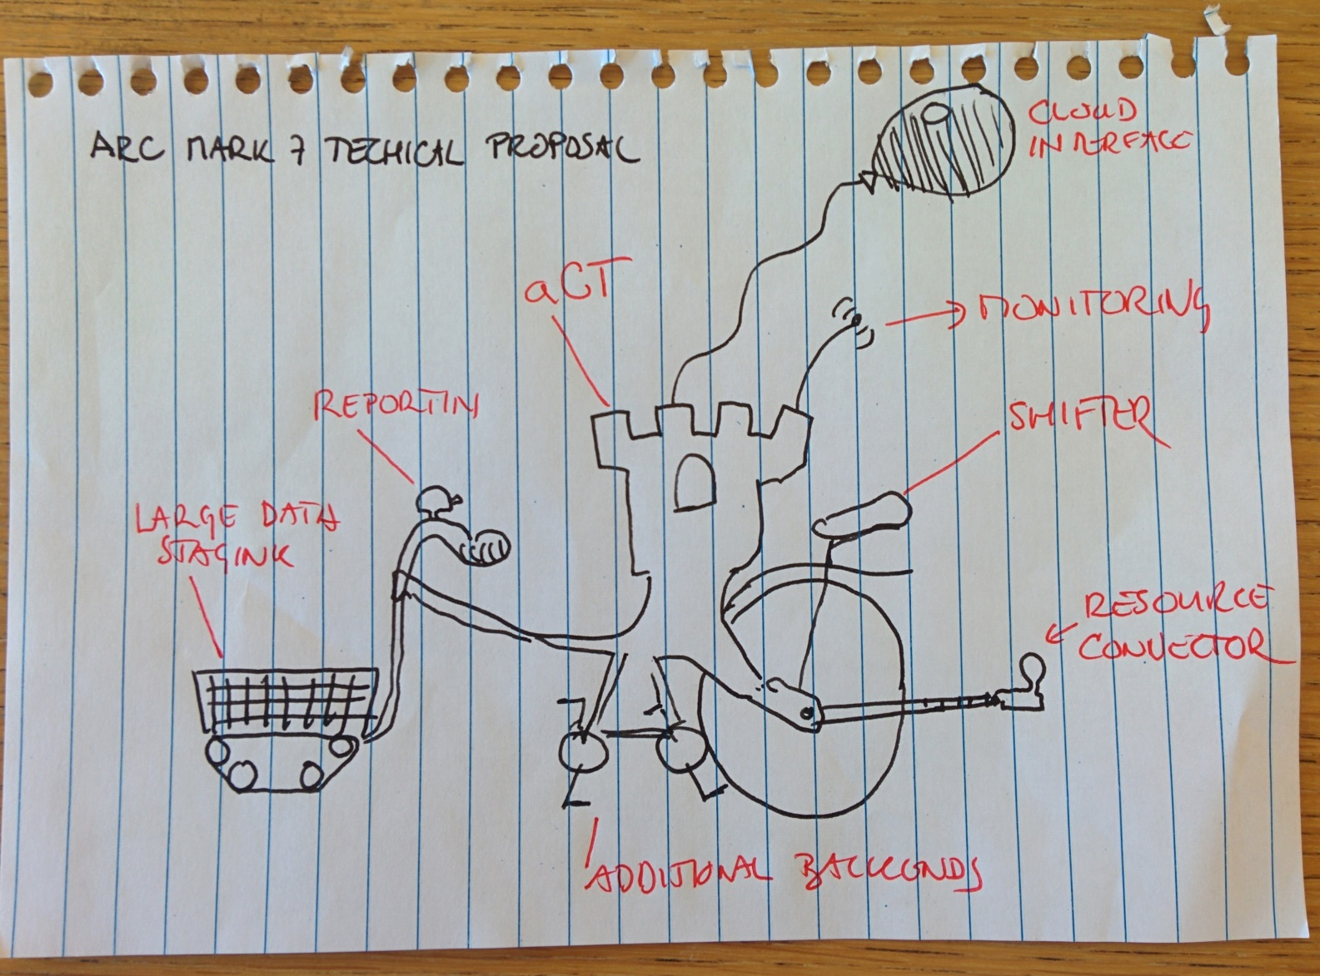
Out-of-the-program submission 2

Slide 4
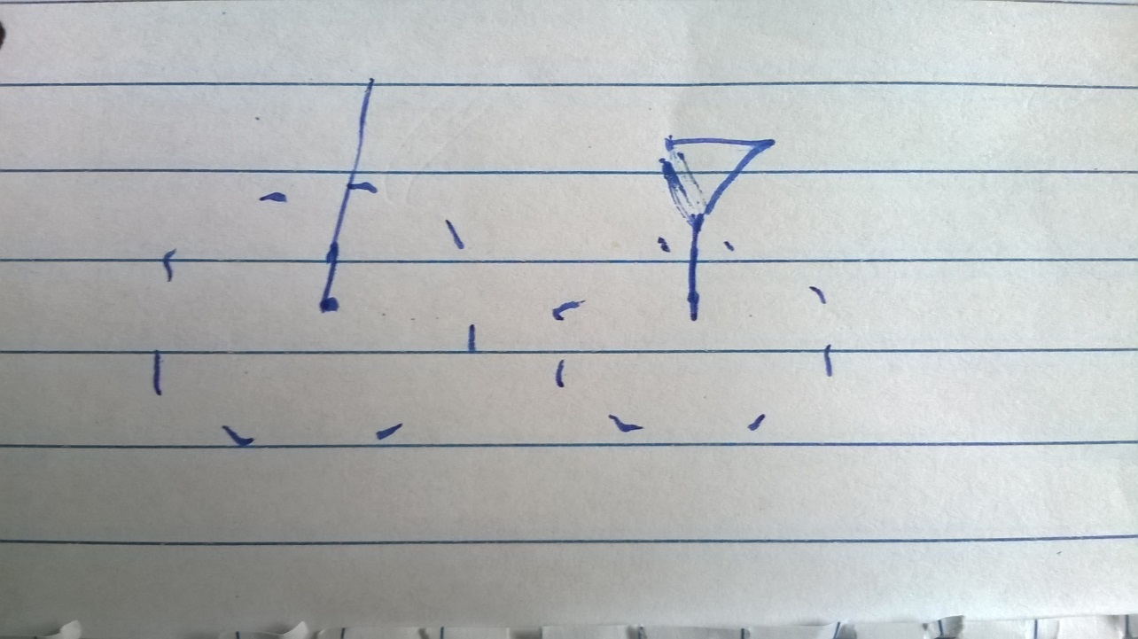
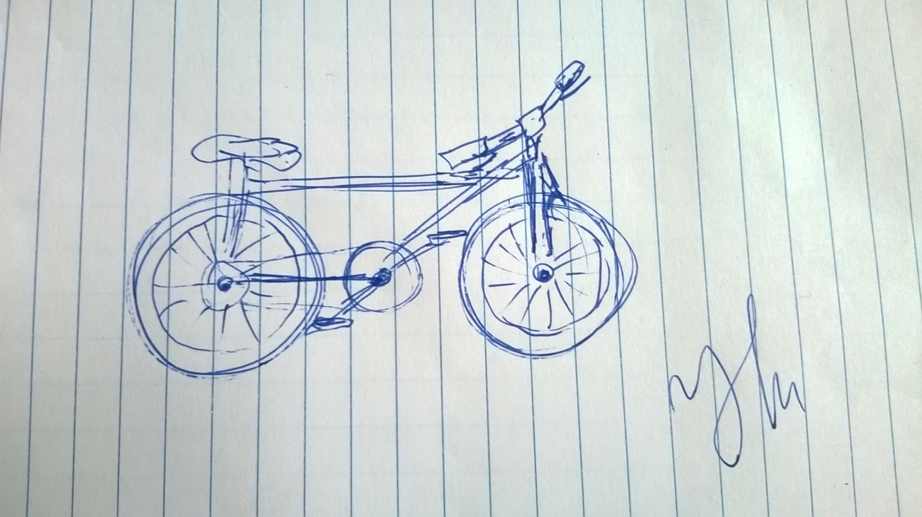
Third prize

Slide 5
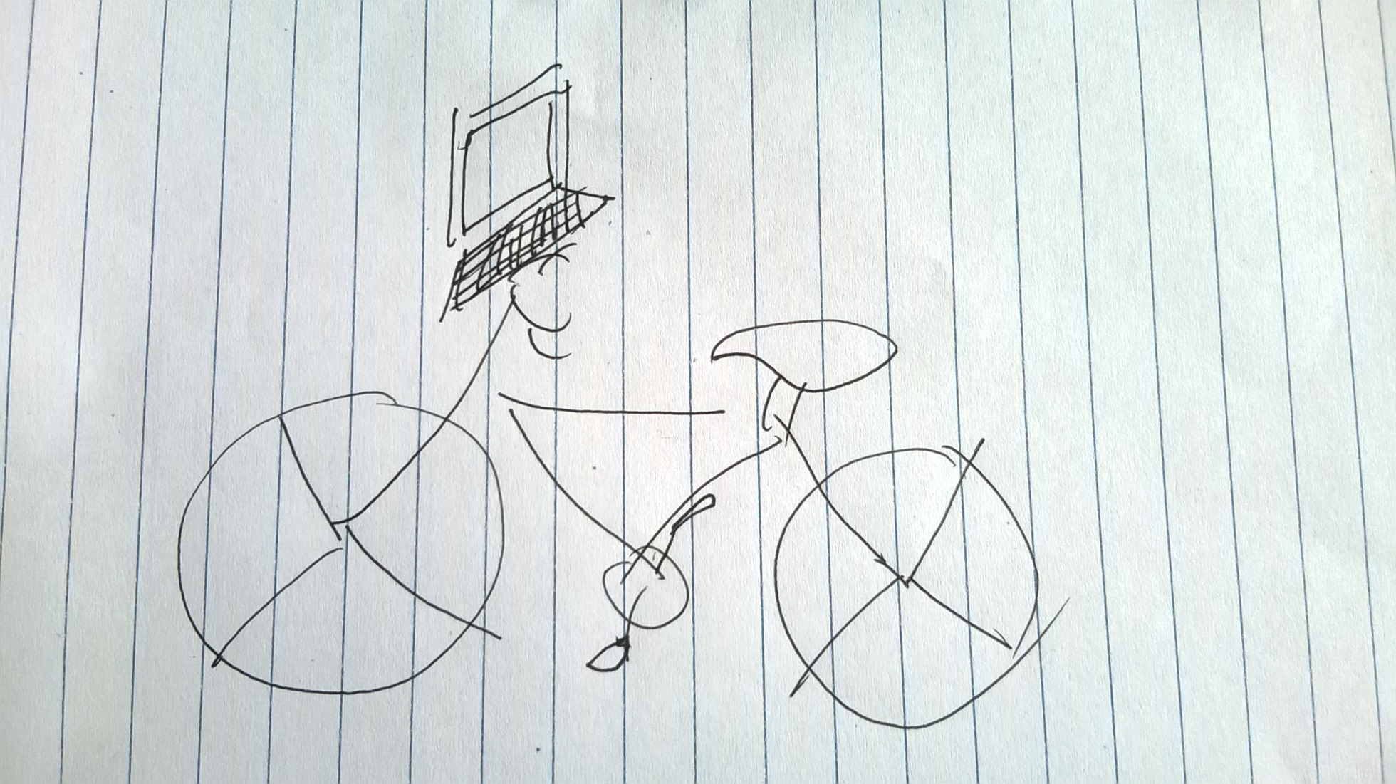
Second prize

Slide 6
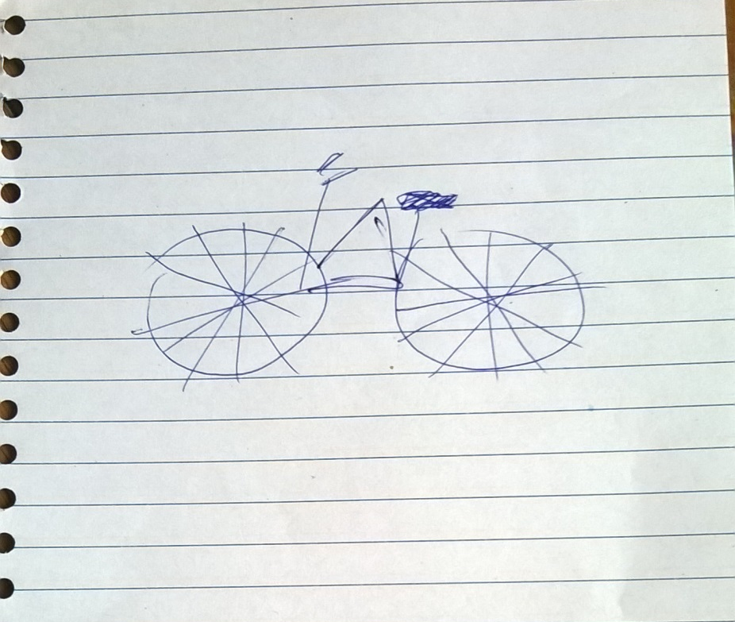
First prize

Slide 7
NG2016 Award (most votes)
1 vote: 2, 3, 10, 12
3 votes: 4, 9, 14
4 votes: 13

