Slide 1
Grid-node software as a tool for the interaction with Grid network
Iana Kokriashkina

Slide 2
Grid-node software consists of:
Server
Client
Installed on Ubuntu
Communicate with ARC Client
Installed on any OS
Displays results from server
Communicate with database
Send results to client
Not local data
Database
Contains User data
Data is encrypted

Slide 3
Advantages
Easy to deploy server
All data are stored on one machine
Cross-platform
Username and password are encrypted

Slide 4
Disadvantages
I am the only one developer
I am not a senior Java developer
There are many-many bugs
It is not finished yet

Slide 5
Complexity of using (Usability)

Slide 6
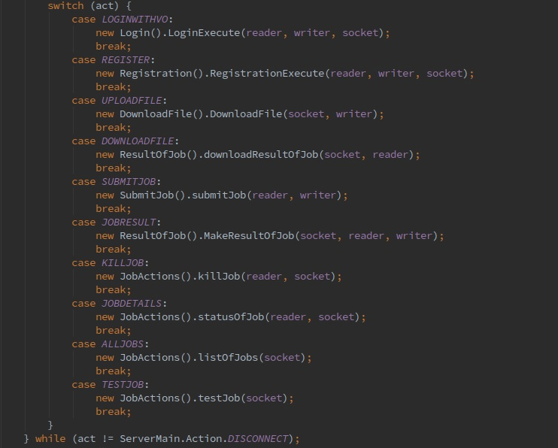
Server requirements
Java
Ubuntu
MySQL
Run Installation file

Slide 7
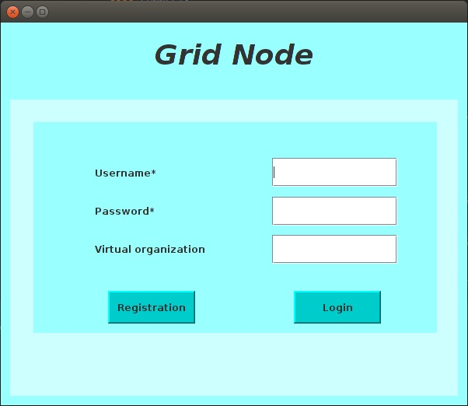
Login Page
Username is required
Password = private key
VO is not required
Go to registration page
Sends data to the server
Server does proxy initialization

Slide 8
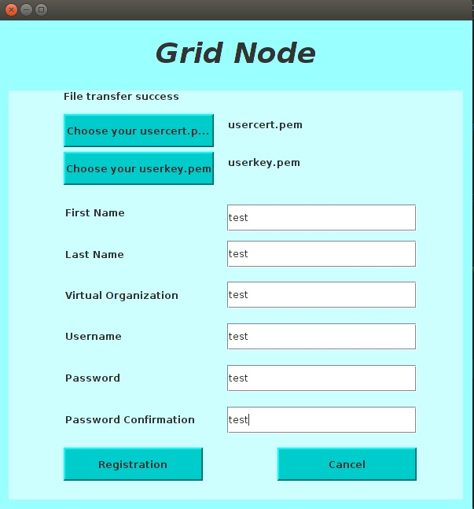
Registration Page
Uploads cert and key
Sends all data to the server
Server creates Ubuntu user
Server creates .globus folder
Executes all actions and is ready to proxy initialization

Slide 9
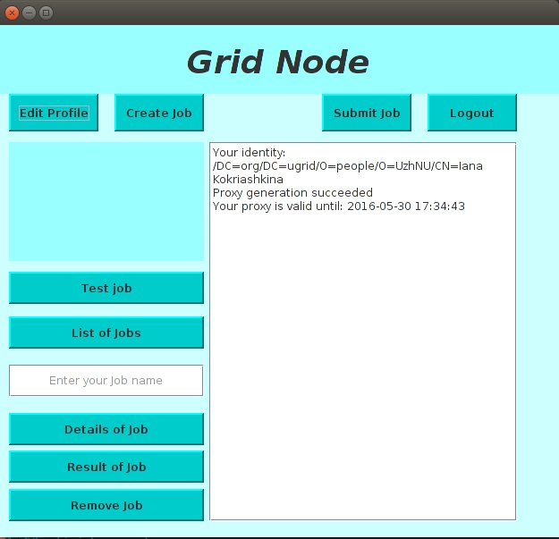
Profile Page
Output of known commands
Sends test job
Gets list of presence jobs
Displays details of selected job
Downloads result
Removes selected job

Slide 10
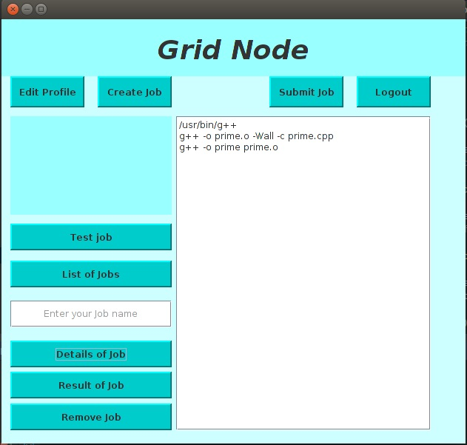
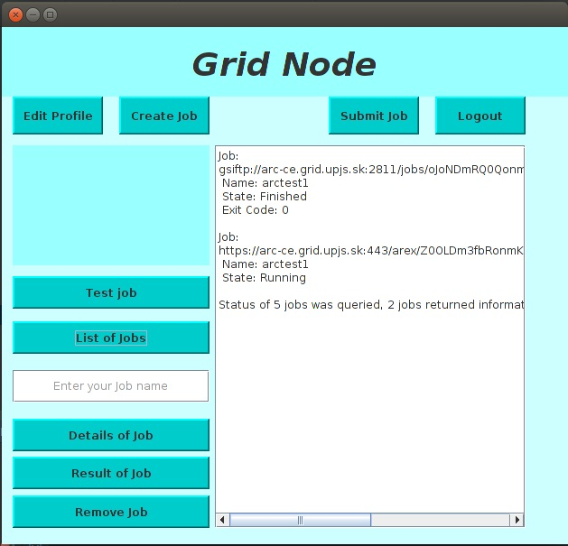
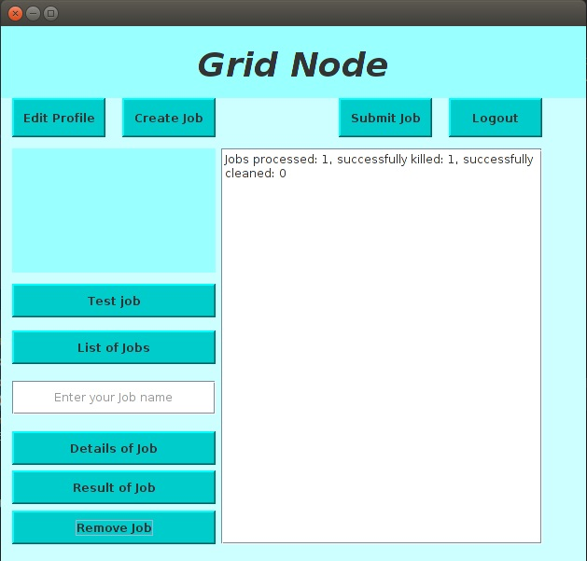
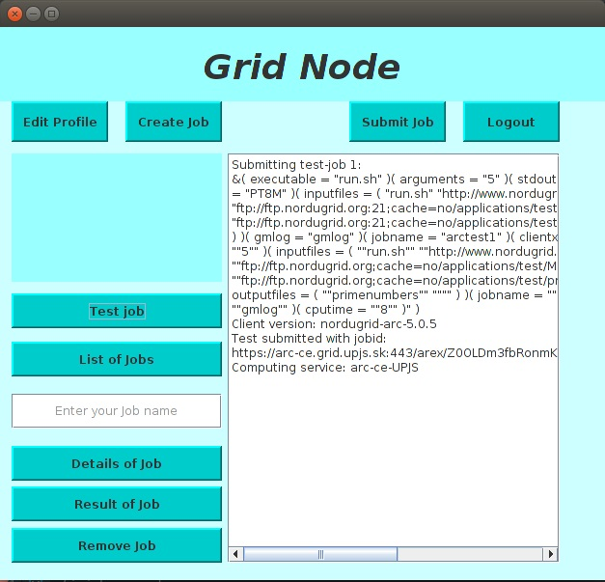

Slide 11
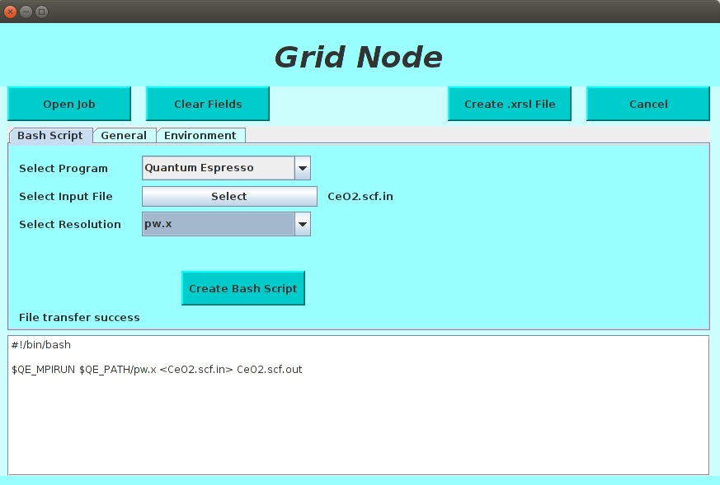
Create job Page
Creates bash script
Creates .xrsl script
Sends all files to server
Displays details of selected job

Slide 12
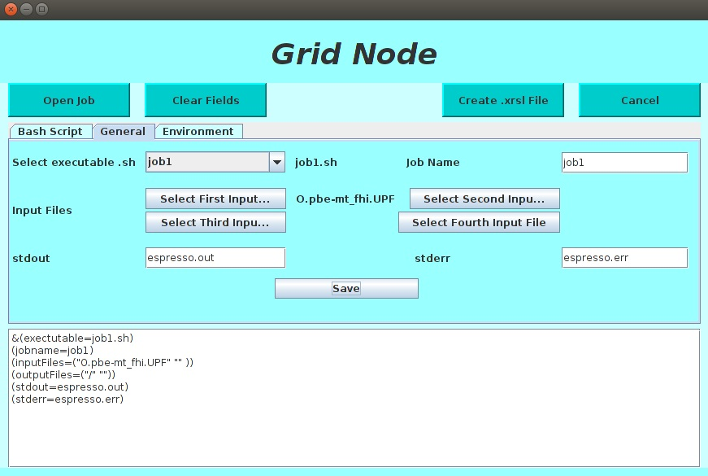
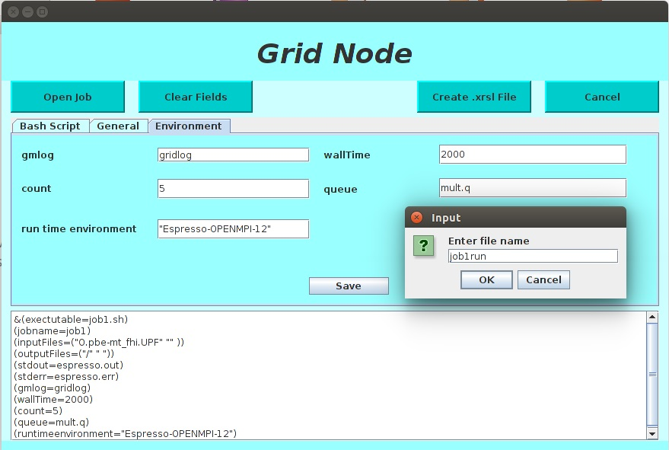

Slide 13
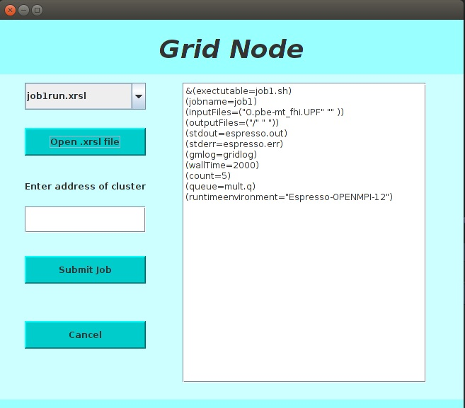
Submit job Page
Displays list of all user’s xrsl files
Displays content of selected file
Submits job to selected cluster
Displays results of submitting

Slide 14
Thanks! email: yana.gusti@gmail.com Skype: yanochka_3007

