Slide 1
ARC101
Technical Meeting, Kosice 2016
Balázs Kónya, Lund University
NorduGrid Technical Coordinator

Slide 2

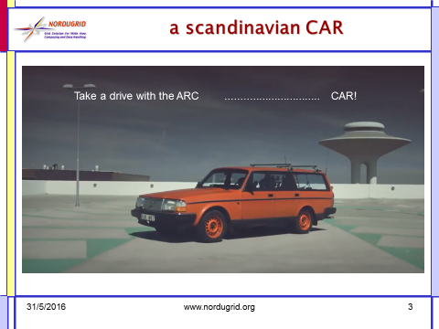
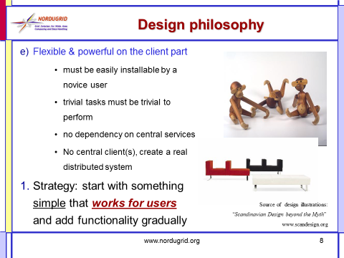
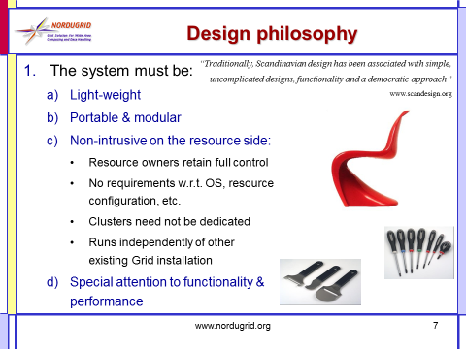



What is this thing called
Advanced Resource Connector (ARC)?

Slide 3




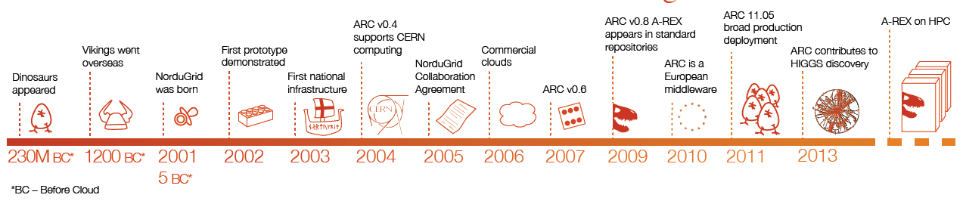
”you might already recognize him
.... that early ... memory”

Slide 4

”A master piece of kinetic energy, dynamics and mechanics, sprung from the hands of engineering wizzards of a bygone era
A master piece
  job management via gridftp and WS-EMIES
  ARC SDK
  integrated inteligent data staging
  dynamic LDAP-based information system
engineering wizzards
  NorduGrid binarians, coders
a bygone era:
  batch processing via job description
  X509 certificates
  pull-mode information discovery

Slide 5

”forged ... in different sources”
ARC is open source
  distributed under Apache licence
Modular source, e.g. the latest release 15.03u7 consists of:
  NorduGrid ARC, version 5.1.1 (main components)
  NorduGrid ARC Documents v. 2.0.7
  metapackages for client tools, computing element and information index, version 1.0.7
  Nagios probes for ARC CE, v. 1.8.4
  common authentication library caNl++, version 1.1.0
  gangliaarc, v. 1.0.0

Slide 6

”Equipped with both an inside and an outside”
The ”inside” of the ARC CE:
  abstraction layer on top of cluster
  Batch system (LRMS) interaction
  Resource information collection
  Job environment preparation
  data provisioning for the job
  global – local unix user mapping
  Minimal intrusion on the nodes
  Accounting data collection
  „controldir, sessiondir”
  The art of interior design:find the right ballance of hiding details and managing heterogeneity

Slide 7

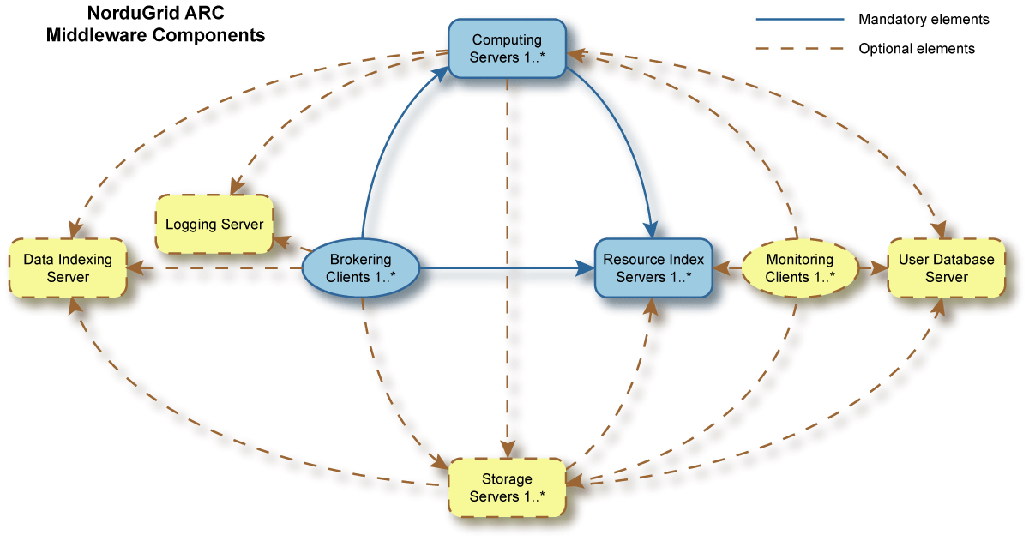
”Equipped with both an inside and an outside”
The ”outside” of the ARC middleware
  Exposed external interfaces (of ARC CE):
  job management, job desciption, information discovery, data channels, secure connections
  Underlying technologies: WS-SOAP, LDAP, gridftp, X509
  A pioneer in standardization
  APIs, CLIs and GUIs:
  SDK: C++, Python, JAVA
  Arc* command line client tools
  GUI attempts

Slide 8
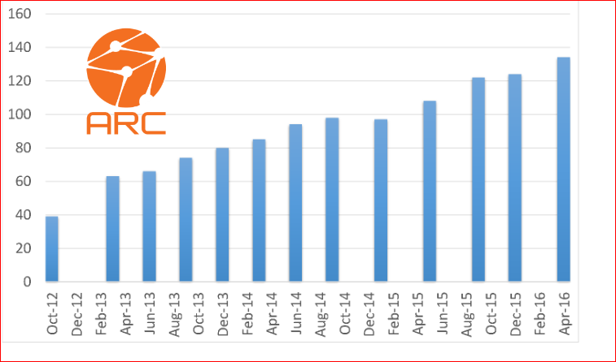
”Equipped with both an inside and an outside”
The ”outside” of the ARC middleware
  Integration with the EGI infrastructures:
  Accounting: JURA, SGAS, APEL
  Information: BDII, GOCDB
  Monitoring: Nagios
  USER mngmt: VOMS, ARGUS,..
  ARC is fully compatible with EGI operations!
  Integration with High Energy Physics production frameworks:
  ”Nordic Cloud”, ARC Control Tower for ATLAS
  Condor-based solution for CMS

Slide 9



“Spinsie winsies on both sides … and four door handles”
Core functionality:
An enabling technology within distributed computing that
  Provides computing cycles and related data access mechanisms
  via special authentication (X509) and authorization layer (VOMS ACCs)
With other words:
  You can execute a batch of computational tasks remotely on a cluster ☺
  ARC is mostly a Computing Element
WARNING: things do get broken!

Slide 10

”Pop that pony’s face: a real ladies magnet”
Shared file system
Head Node
Session
directory
Control directory
CA certificates
Cache
infoproviders
DTR
SLURM controller
A-REX
gridftp/http
Runtime env.
ARIS
JURA
users
registration
process
user
mapping
Worker
Node
Legend
(ARC components in orange):
SLURM daemon
files
Worker
Node
processes
SLURM daemon

Slide 11

”... and hepatitis b”
Security aspects:
Job payload is ”well isolated”
  User separation, pool accounts
Fine-grained access control
  Both external and local authorization points supported
  ARGUS, VOMS interoperability
Most of the services do not require root priviliges
  Though some functionality loss may occur
X509 framework, openssl
  “Several ARC services relying on openssl (A-REX with both GridFTP and WS interfaces, ACIX) are affected by the Heartbleed vulnearibility

Slide 12

”A recipe holder”
ARC comes with extensive documentation, e.g.:
Server side:
  ARC Computing Element System Administrator Guide, NORDUGRID-MANUAL-20
  arc.conf.reference
Client side:
  The libarcclient - A Client Library for ARC, NORDUGRID-TECH-20
  ARC Clients User Manual, NORDUGRID-MANUAL-13
See also the Nordugrid wiki full of recipes

Slide 13

”Hmmmmm ART”
Editing configuration file
  Mostly authorization part
Interpreting error messages
  Mostly on the client side

Slide 14


Prepared for big data
  The ARC CE comes with advanced integrated data features
  Data Cache with ACIX cache index
  DTR supports all major storages systems and protocols:
    Dcache, StoRM, DPM, so on
    Gridftp, SRM, https, webdaw
  Handles data download and/or data stage out
    User specifies where to store results and the CE automagically uploads the data

Slide 15

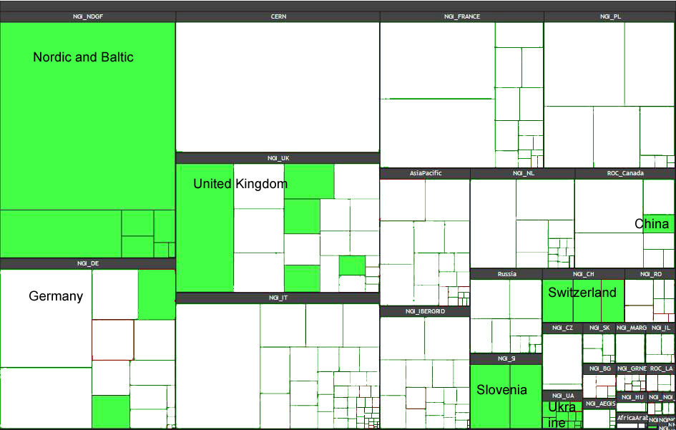
”340 000 circular bends”
Heavy usage by ”big science”: WLCG monitoring board:
Missing out on the ”long tail scientists”

Slide 16

ARC is there and looking forward to the 21st century...

Slide 17
Final remark
The video is a masterpiece from Castor,
„some sort of mgfx artist / creative in Malmö” (theworkofcastor.com),
who tried to sell his car this way on blocket.

Slide 18


Slide 19

a scandinavian CAR
Take a drive with the ARC ............................... CAR!

