Slide 1
David Cameron
A-REX Cache and related services

Slide 2
ARC CE cache
More info: CE manual: 6.4
A-REX cache has been an integral part of ARC CE since the beginning
A-REX downloads job input files to configured cache directory(ies) – typically on shared file system
Those files are linked (or copied) to a job’s session directory
Multiple jobs can use the same cache file
Cache files are deleted in LRU order to keep space between configured watermarks
Cache is like a self-managing internal storage element

Slide 3
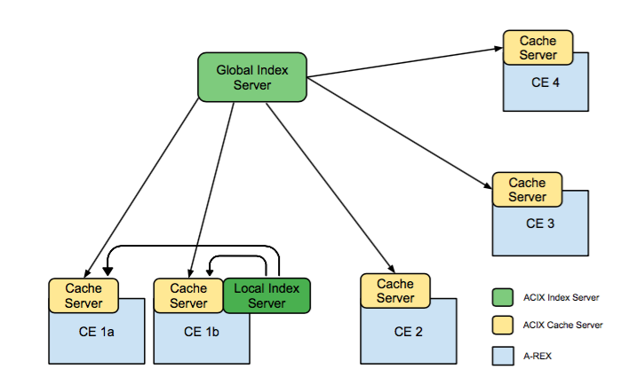
ARC Cache Index (ACIX)
More info: CE manual: 4.4.3.3
It’s useful to know what files are in the cache, eg to send jobs where inputs are already cached
ACIX provides a catalog of caches contents using 2 components:
  Cache server: Runs on CE, periodically scans cache and constructs a Bloom filter of contents
  Index server: Runs centrally and pulls Bloom filters from CEs
Clients query the index server to ask in which caches a file is:
  https://cacheindex.ndgf.org:6443/data/index?url=http://www.nordugrid.org:80/data/echo.sh,http://my.host/data1
  Returns a JSON map of URLs to cache locations

Slide 4
Cache service
More info: http://wiki.nordugrid.org/wiki/Cache_Service
When pilot jobs first appeared, the cache service was conceived as a solution for data transfer
A service running inside HED which could be instructed to do data transfer and cache handling
  The pilot on the WN calls the cache service with list of input files it needs
  The cache service downloads files to cache if they are not there, then links to the job’s session directory
  This gets around the problem of no middleware or external network connectivity from the WN
This service was never used in production, aCT was used instead
  Planned to be removed in ARC release 5 but found out someone (Ukranian Grid) was using it!

Slide 5
Cache access
More info: CE manual: 4.4.3.2
NDGF requested the ability for one CE to download from another CE’s cache
  The other CEs can be closer than the NDGF disk pools
Setting “cacheaccess” in arc.conf opens up the cache to outside access, eg
  cacheaccess=“srm://srm.ndgf.org/atlas/.* voms:vo atlas”
  This allows anyone in atlas VO to access cached files where the original URL matches srm://srm.ndgf.org/atlas/.*
  Cache file can be accessed at https://a-rex.host/arex/cache/srm://srm.ndgf.org/atlas/…
Discovery of cache content is done through ACIX
  Setting acix_endpoint=“…” in arc.conf tells A-REX to look up extra replicas of each input file in ACIX
  If a cache is exposed ACIX returns a URL to A-REX web service instead of just a hostname
  “preferredpattern” can be set to prefer caches over grid storage

Slide 6
Cache publishing in ATLAS Rucio
More info: New in 5.1.1!
It is too difficult to integrate ACIX directly in ATLAS
Easier to create a Rucio Storage Element (RSE) per cache
  Rucio supports the concept of caches which are controlled outside Rucio itself and may not be consistent
  The cache can publish its content to Rucio through add/delete messages
The ACIX cache server can create dumps of cache content, and a separate script runs periodically to calculate the diff and send messages to Rucio
The cache RSEs are associated to the CE’s Panda queue and so Panda can broker jobs to queues where the data is cached
Since Rucio will have all cache contents, maybe no need for ACIX index?

Slide 7
Cache-related conf changes in ARC 6
ARC 5 | ARC 6
cache options in [grid-manager] | cache options in [grid-manager/cache]
cachelogfile | logfile
cacheloglevel | loglevel
remotecachedir | (removed)
acix_endpoint | use_remote_acix
cacheaccess | in new block [grid-manager/wsinterfaces/cache]
enable_cache_service | [grid-manager/wsinterfaces/dfpj]*
[acix/cacheserver] | [acix/cachescanner]
cacheserver | cachescanner
*Downloader For Pilot Jobs

