Slide 1
David Cameron
Andrej Filipcic
ARC Control Tower and ARC CE:
The truth about ATLAS computing

Slide 2
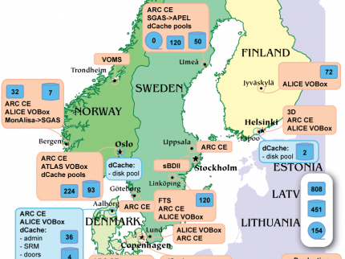
ARC CE and NDGF
Distributed dCache
  Requires synchronous data transfer and local caching
No middleware or connectivity from worker nodes
ARC CE performs pre and post job data transfer
Input files are downloaded to local shared filesystem cache

Slide 3
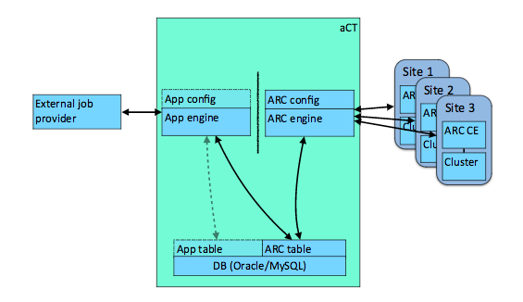
Need for ARC Control Tower
The pilot model does not work well for NDGF
  Requires middleware on the WN, outbound connectivity, synchronous data-staging
Put a service in between Panda and ARC CE
  A “fake fat pilot” pulling jobs, sending them to ARC and dealing with communication with Panda
  Started as ATLAS-specific project, now generic

Slide 4

Pilot factory (APF) vs aCT job submission
CERN
CERN
Panda
APF
Panda
aCT
pilot
Site
ARC CE
Data
Site
ARC CE
Data
WN
WN

Slide 5
Issues with pilot job framework
ATLAS uses different workloads by memory, cputime, corecount requirements
  But pilots are submitted with fixed requirements
The only way to run different workloads is different Panda queues:
  single-core
  multi-core
  analysis
  hi-memory
  very hi-memory
  …
A task with radically new requirements requires a new Panda queue – heavy maintenance cost
Fixed requirements lead to sub-optimal batch system scheduling

Slide 6
aCT “Truepilot” mode
For sites running ARC CE who do not need the full “native” mode with staging etc
aCT fetches the payload and submits it to the ARC-CE
ARC-CE submits the batch job with predefined payload and requirements
Pilot on the worker node does the same as on the conventional pilot sites, but skips the fetching of payload from PanDA
aCT sends heartbeats to Panda up until job is running, then leaves it to pilot

Slide 7
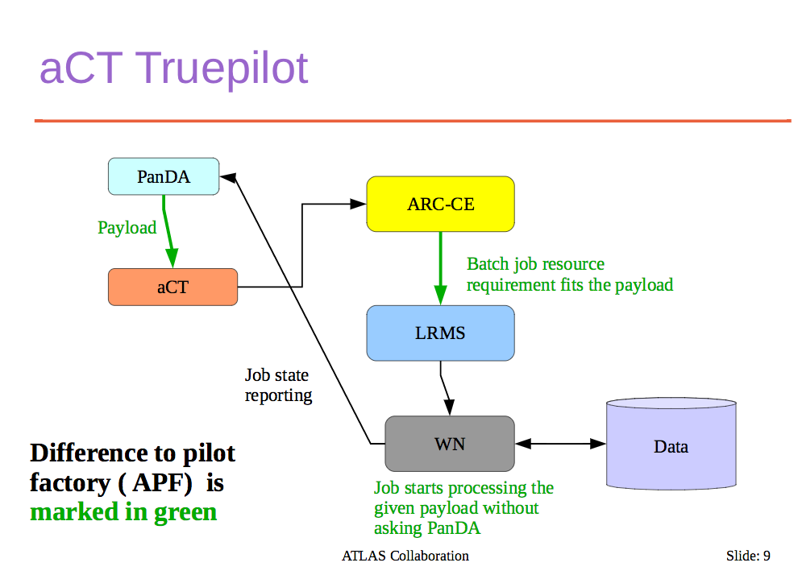
A. Filipcic, CHEP 2015

Slide 8
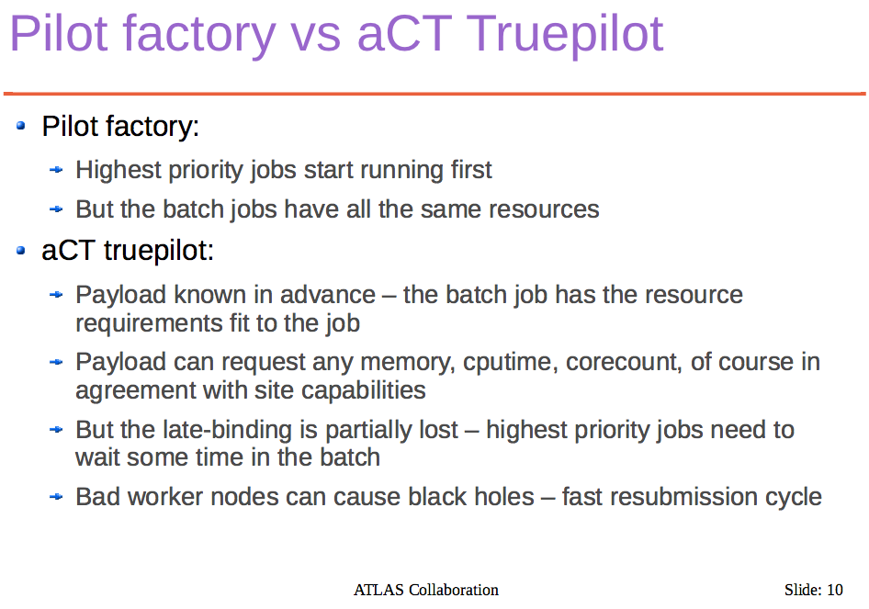
A. Filipcic, CHEP 2015

Slide 9
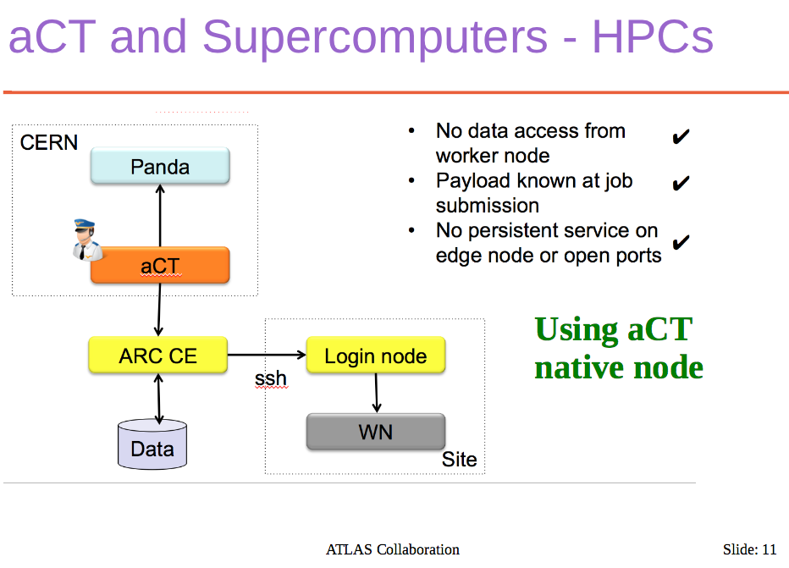
A. Filipcic, CHEP 2015
Used at HPCs in Switzerland, Germany, China

Slide 10
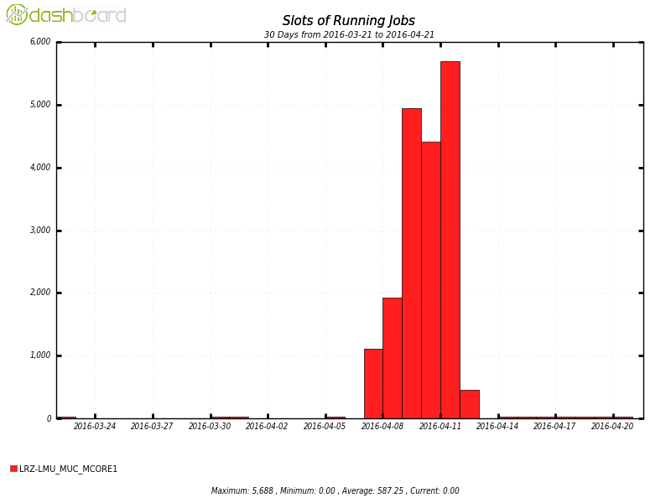
aCT, ARC CE and Event Service
Solution for HPC backfilling where there is no WN connectivity
Instead of uploads to OS from WN, ARC CE uploads all events at the end of the job
  This was shown to be a bottleneck – zipping by pilot can address this issue
aCT reports completed events to Panda
For jobs preempted by the batch system:
  An ARC CE plugin “unfails” the job and does pilot post-processing (metadata xml, log tarball etc)
  Tested in SuperMUC HPC (300 x 24 cores)

Slide 11
aCT service and sites
4 machines at CERN
  2 prod: large physical machines, one master, one hot spare
  2 dev: VMs, for testing, eg Event Service workflow
Databases:
  Prod machines: MySQL database on demand
  Dev machines: local MySQL
Serving ~12% of all ATLAS jobs:
  ND, DE T2s, RAL, TW, BOINC, …
Very basic monitoring:
  https://voatlas403.cern.ch/data/aCTReport.html
Kibana service status probe is running (but reporting 100%)
Source code (5k lines of python): https://gitlab.cern.ch/arc/aCT

Slide 12
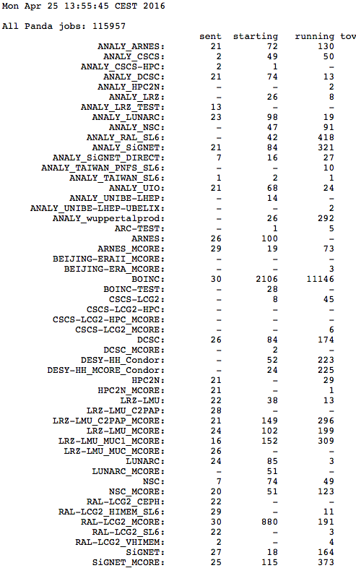
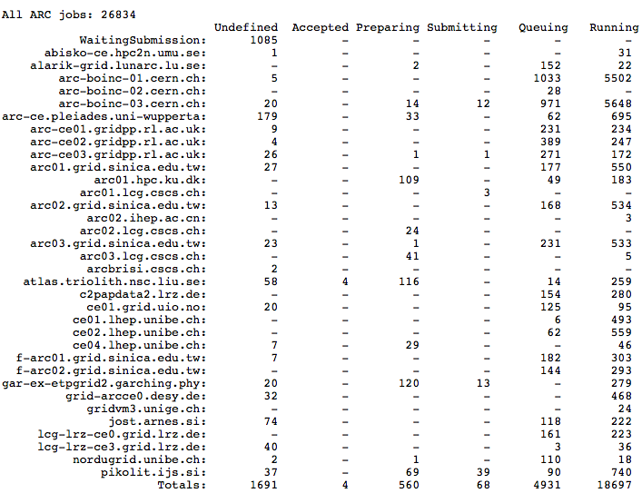
Monitoring

Slide 13
Summary of aCT/ARC modes
1. APF
2. NorduGrid
3. aCT Truepilot
CERN
CERN
Panda
CERN
APF
Panda
aCT
Panda
aCT
pilot
Site
Site
ARC CE
ARC CE
Data
Site
ARC CE
Data
WN
Data
WN
WN

Slide 14
References
CHEP papers:
  http://iopscience.iop.org/article/10.1088/1742-6596/664/6/062042/pdf
  http://iopscience.iop.org/article/10.1088/1742-6596/664/6/062042/pdf
CHEP talks:
  https://indico.cern.ch/event/304944/contributions/1672319/attachments/578552/796696/chep2015act.pdf
  https://indico.cern.ch/event/304944/contributions/1672645/attachments/578833/797024/ARC_Control_Tower_-_CHEP2015v5.pdf
Operations twiki:
  https://twiki.cern.ch/twiki/bin/view/AtlasComputing/ARCControlTower

