Slide 1
David Cameron Riccardo Bianchi Claire Adam Bourdarios Andrej Filipcic Eric Lançon Wenjing Wu
ATLAS@Home

Slide 2







@Home projects
People voluntarily running scientific tasks on their home PCs’ spare time
Most projects use the Berkeley Open Infrastructure for Network Computing (BOINC) software

Slide 3
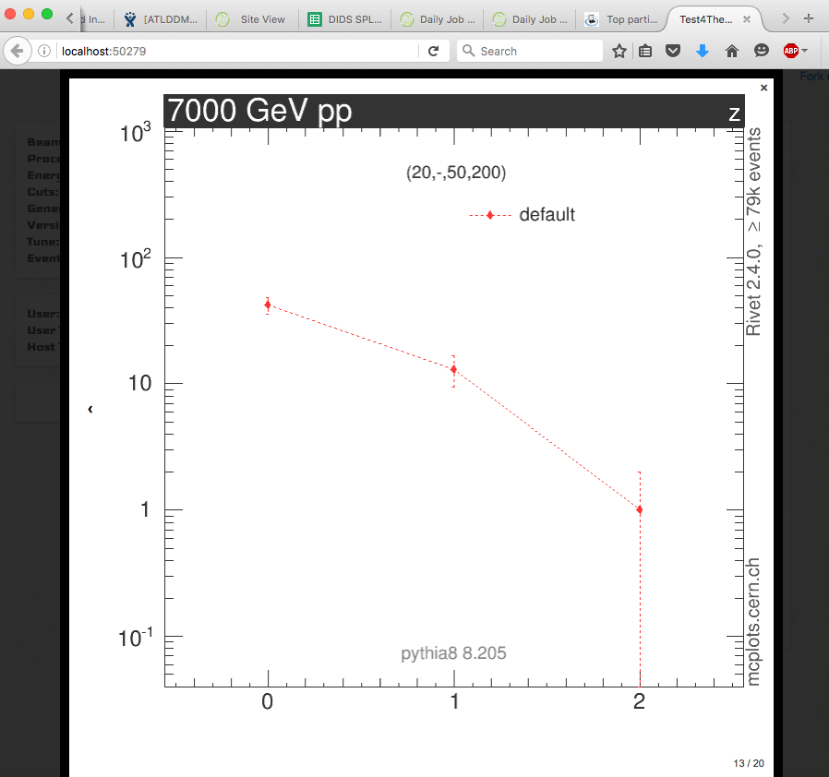
Volunteer computing at CERN
2004: LHC@Home: Sixtrack
LHC beam simulations
2011: LHC@Home: Test4Theory
Pioneered virtualisation within BOINC
2014: ATLAS@Home, CMS@Home, Beauty@Home (LHCb)
LHCb and CMS still in beta

Slide 4

ATLAS@Home
Why use volunteer computing for ATLAS?
(Almost) free resources
Public outreach
Why contribute to ATLAS@Home?
Credit (see later)
Helping science

Slide 5
Design considerations
Resources can come and go at any time, cannot be relied upon
Resources may also have poor internet connection
ATLAS software only runs on SLC6, the rest of the world uses Windows
Nothing sensitive can be sent to volunteers (eg grid certificates)
All the volunteer computers should look like one regular Grid site

Slide 6
Design solutions
Run MC Simulation
Low I/O to CPU ratio – nicer for volunteers
Low priority tasks only – no problem if PC is turned off for a week
Use virtualisation
CERN Virtual Machine with SLC6 and ATLAS sw inside – run on any platform
Use ARC Computing Element
Interface to submit jobs on many Grid sites – look like regular Grid site
Handles input and output data – no need for Grid credentials in job

Slide 7
Basic ATLAS@Home Architecture
ATLAS Job Management System (PanDA)
ARC Control Tower
Grid Catalogs and Storage
ARC CE
proxy cert
BOINC Plugin
Job Working
Directory
Volunteer PC
BOINC Client
Shared Directory
BOINC server
Data Staging Area
VM

Slide 8
Current ATLAS@Home Setup
CERN
Panda Server
ARC Control Tower
Grid Catalogs and Storage
BOINC PQ
ARC CE
arc-boinc-01.cern.ch
Shared NFS (2TB)
ARC cache
ARC sessiondir
BOINC stagingdir
ARC CE
arc-boinc-03.cern.ch
Volunteer PC
BOINC Plugin
BOINC Client
MySQL
(DB on demand)
BOINC server (vLHC@Home)
boincai02.cern.ch
Shared Directory
VM

Slide 9
ATLAS@Home jobs
Real simulation tasks
Full athena jobs
25 events/job
Each job runs for 1-4 hours
Real Grid jobs ~12 hours (1000 events and 8 cores)
Virtual image is 1.1GB (500MB compressed) and downloaded only once
Input files (data file + small scripts) is 1-100MB
Output is ~25MB
Virtual machine memory is now 2.3GB (was 1GB initially, but now more complex jobs)
This is the limiting factor for many volunteers
Even the simplest ATLAS jobs are way more resource-intensive than most @home projects!

Slide 10
Validation of results
Several steps of validation
Per work unit, that correct output is produced (just that file exists)
The contents of the output is verified in a later merging process
Physics validation comparing results to regular Grid task
Full physics validation of the BOINC Monte-Carlo simulation was successfully verified in May 2015

Slide 11
How does it work for volunteers?
Install BOINC client and VirtualBox
Linux, Mac and Windows supported
Currently 80% of hosts have Windows
In BOINC client choose ATLAS@Home and create an account
That’s it!
BOINC client can be configured to run whenever is convenient, e.g.:
After computer is idle for 5 mins
Only between 5pm and 8am
More info in backup slides

Slide 12
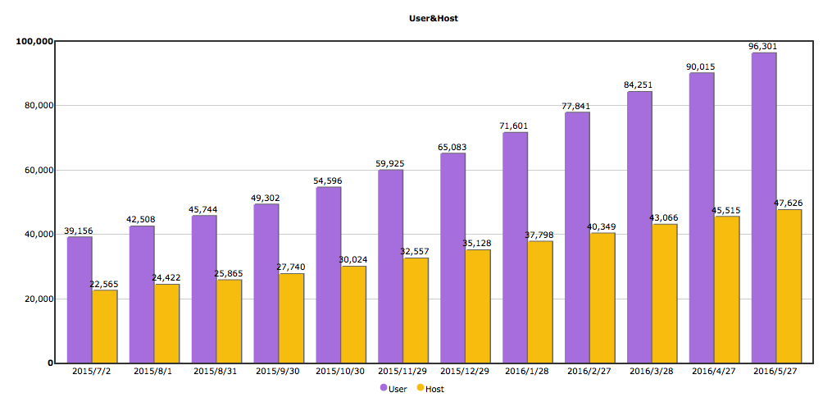
Volunteer growth
Currently close to 100k volunteers:
10k ran at least one job
3k currently active
Einstein@Home: 300k volunteers, 47k active
Seti@Home: 5 million volunteers, 150k active

Slide 13
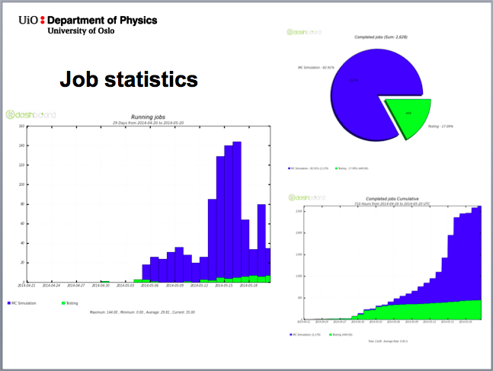
NorduGrid 2014, Helsinki, Finland, 20 May 2014
140 running jobs
2500 completed jobs

Slide 14
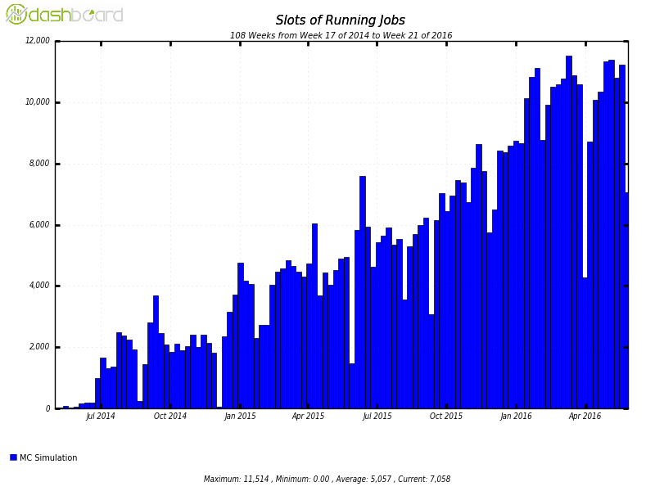
Job statistics since May 2014
Continuous increase in running jobs
Now 11-12k parallel running jobs
5M completed jobs
8M CPU hours
90M events simulated
Gaps are due to technical issues, not lack of volunteers

Slide 15
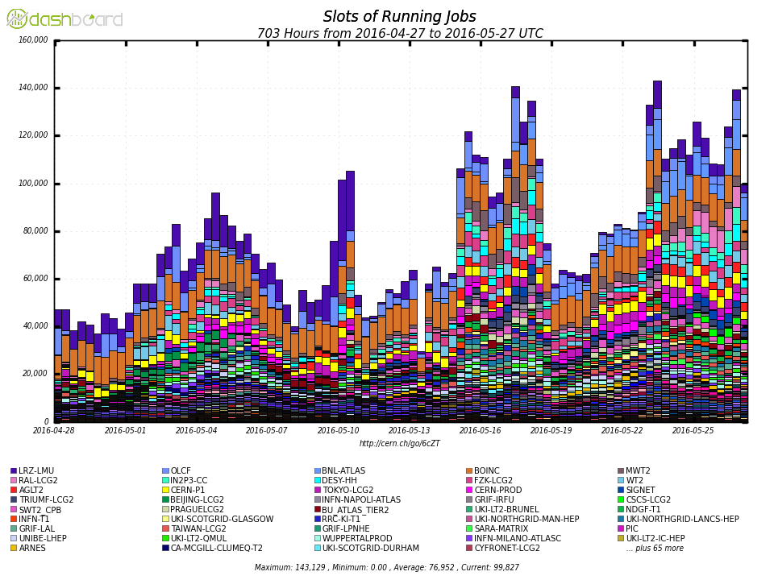
Scale of ATLAS@Home
MC Simulation on all Grid sites
~10% of slots
~2.5% of events produced
only ¼ of jobs are doing anything at a given time

Slide 16
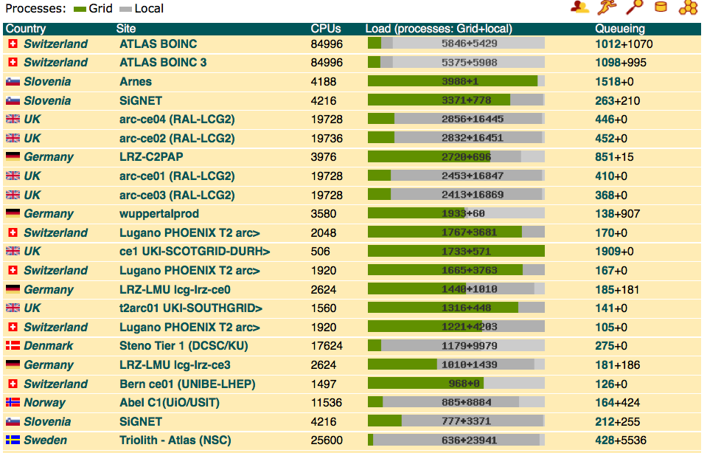
2 busiest ARC CEs in the world!

Slide 17
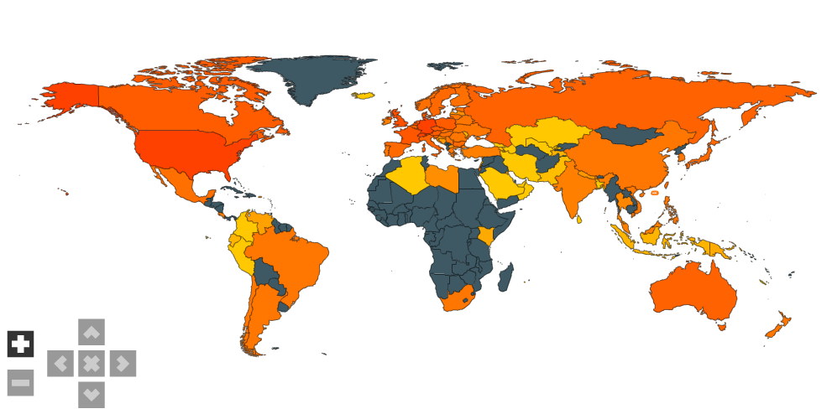
Volunteers
BOINC has a huge dedicated community
Many volunteers are active in several projects
http://boincstats.com/en/stats/152/project/detail/country

Slide 18
BOINC credit
Credit
Allocated by BOINC for successfully completed jobs
Very roughly 3 credits/event
No monetary value but a strong motivator
Golden rule: always give credit for work done!
If a job crashes but used significant CPU, credit is still given

Slide 19
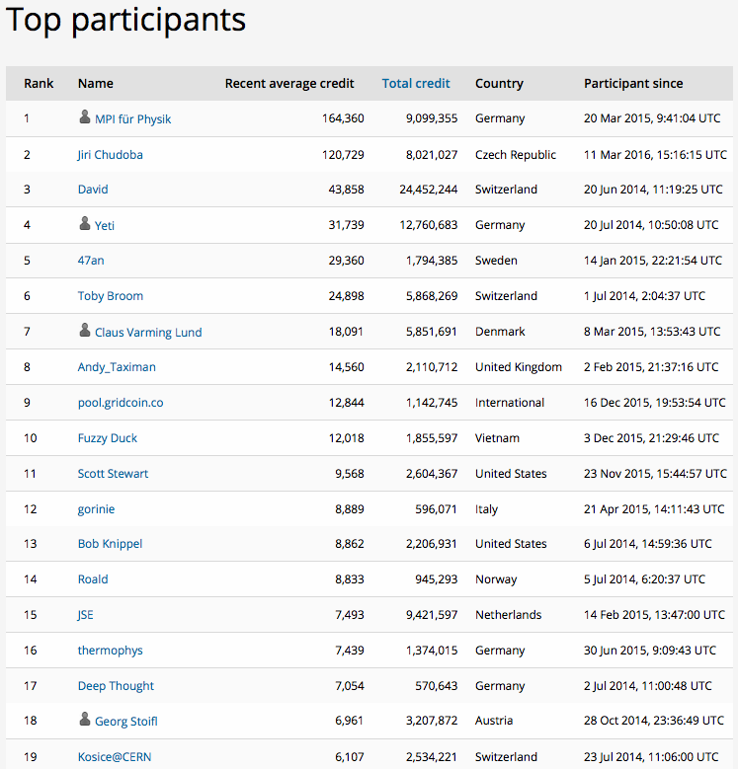
http://atlasathome.cern.ch/top_users.php
Top 2: Institute clusters in Munich and Prague (~120 cores each)
No.3: David Smith (CERN IT)
The rest: no idea!

Slide 20
ATLAS@Home potential
It is not possible to run all ATLAS jobs on ATLAS@home
See earlier considerations about I/O, unreliability etc
But ~50% of jobs could feasibly run on this platform
Event generation, MC simulation, other non-data intensive tasks
A solution for lightweight storage-less sites?
Instead of setting up all the Grid infrastructure just install BOINC on the worker nodes
Our top 2 contributors are like CPU-only T3s
One issue is accounting/recognition
Idle administrative desktops
eg now available as part of NICE (CERN’s Windows environment), to put on CERN administrative PCs

Slide 21
Summary
Setting up and running ATLAS@Home has been an exciting and fruitful experience
The volunteer base is steadily increasing (without any big publicity campaign)
Hardware is free and manpower running costs (< 1 FTE) are a fraction of an equivalent-sized computing centre
But the volunteers don’t come completely for free
Some volunteers are extremely competent and knowledgeable and help others
But some expect support/feedback/rewards
New improvements coming soon
Adding graphical interface with visualisation of events and physics info
Multi-core jobs will help with memory consumption
There is a lot of potential as long as we keep the public interested

Slide 22

Acknowledgements
Our CERN IT colleagues in LHC@Home for providing the BOINC infrastructure and storage space and for support
BOINC developers for rapid response to our questions and problems
Please join us!
http://atlasathome.cern.ch

Slide 23
Backup

Slide 24
How to join ATLAS@Home in a few clicks
http://boinc.berkeley.edu/download.php
Install the package and start it
Tools -> Add project or account manager…
Add project
Select ATLAS@Home
Enter email address and a password
Click Finish
Optionally add information to your profile

Slide 25
Configure BOINC Client
BOINC by default will run one task per core
ATLAS@Home is too heavy for this on most PCs
Preferences -> Computing preferences -> % of the processors
eg to use 1 core of a 4 core PC:

