Slide 1
State of the ARC & sTaTE of the ART
Balázs Kónya, Lund University
NorduGrid Technical Coordinator

Slide 2
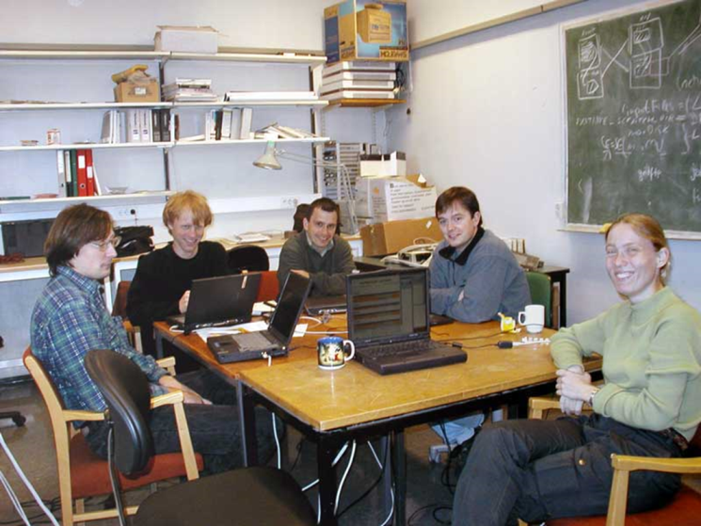
Purpose...
high-level overview, position ARC within the field of distributed computing
not intended to go deep into technicalities
it is not a ”what is ARC” talk
giving these talks for many years
explain ARC status through it historical background

Slide 3
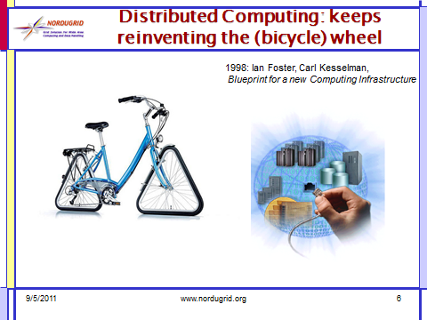
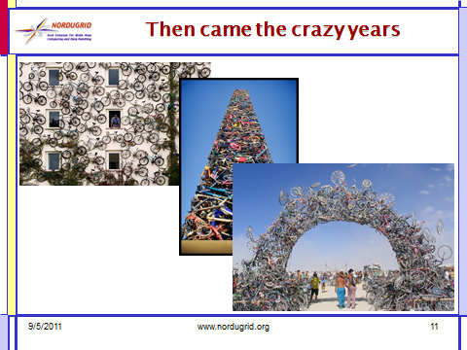
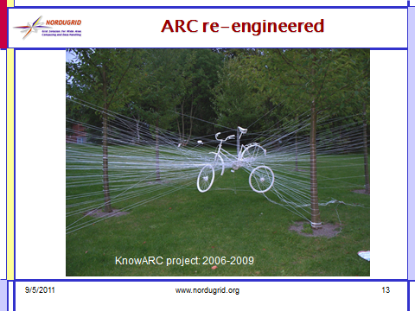
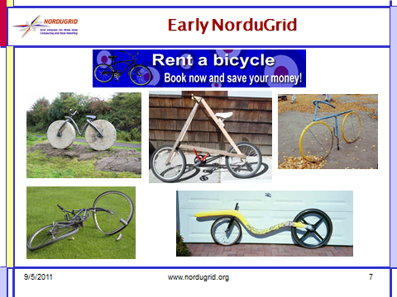
NG11, Sundvolden: the bikes

Slide 4
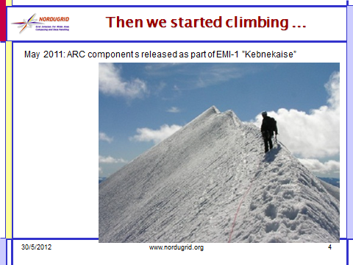
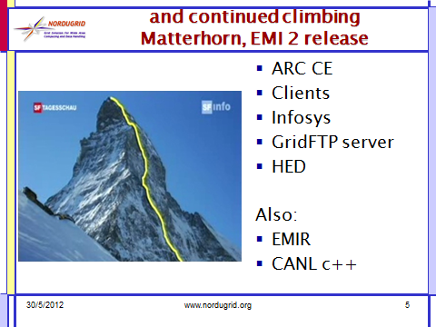
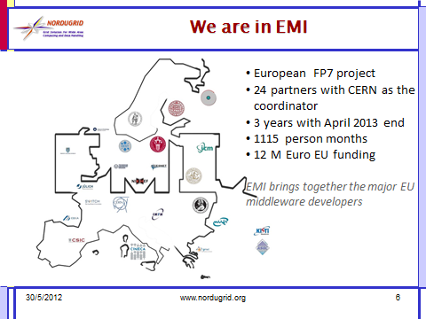
NG12, Uppsala: EMI hills

Slide 5

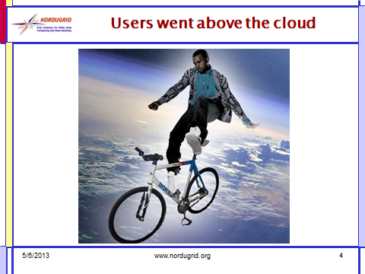
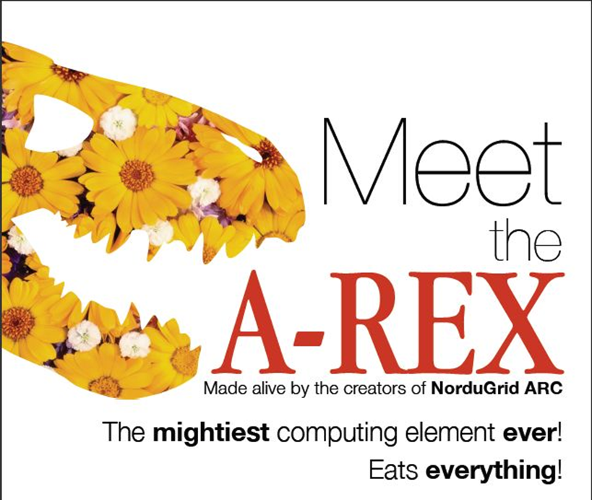
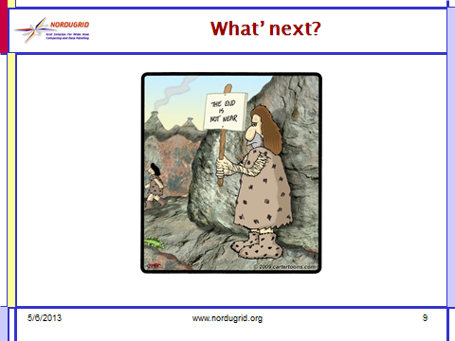
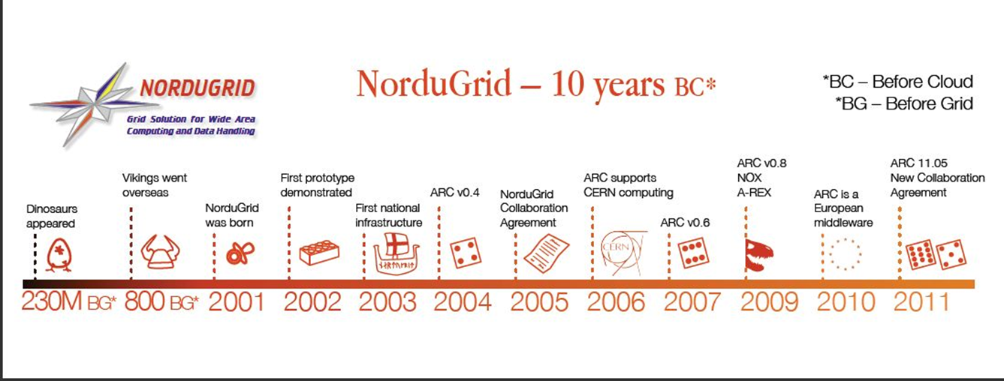
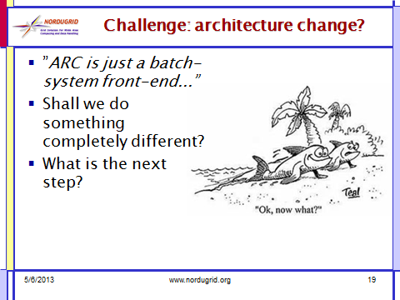
NG13, Siauliai: the dinosaur

Slide 6
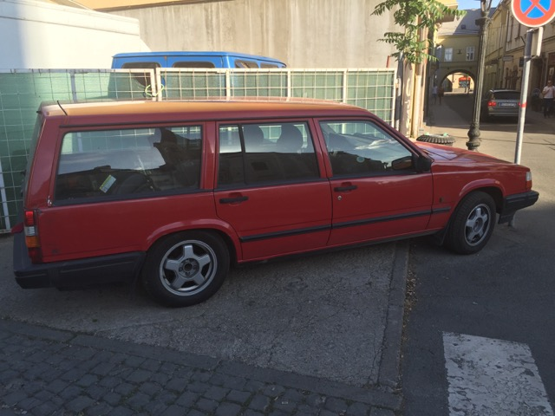
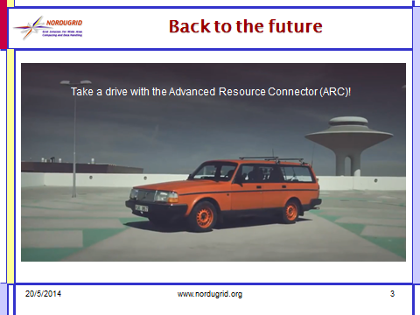
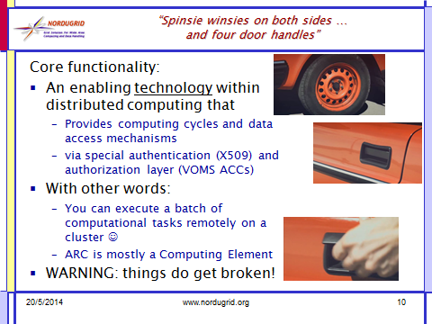
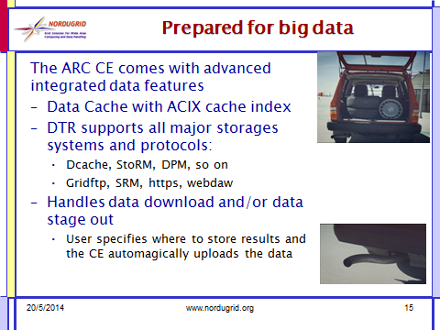
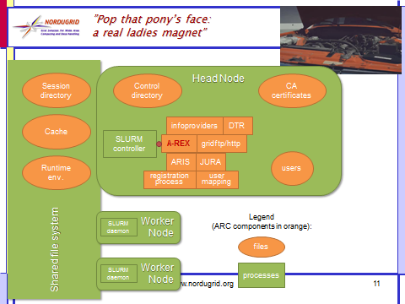
NG14, Helsinki: the old volvo car

Slide 7

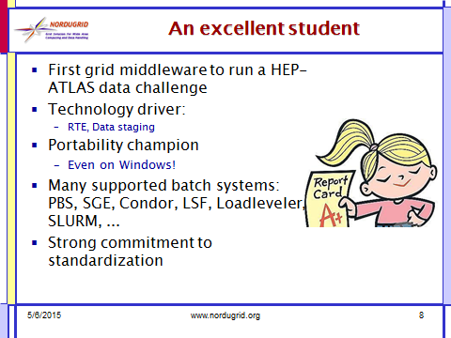
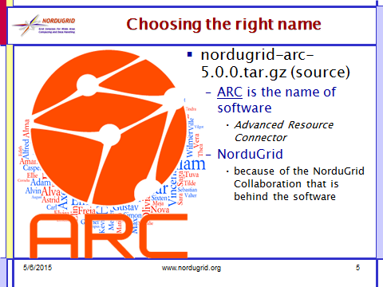
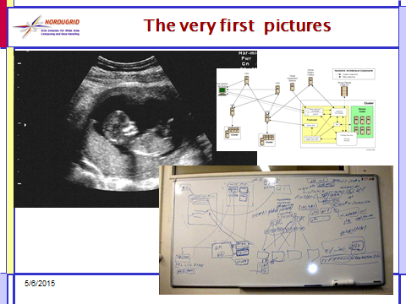
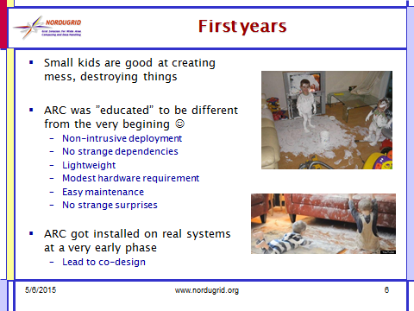
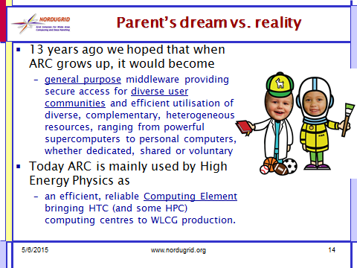
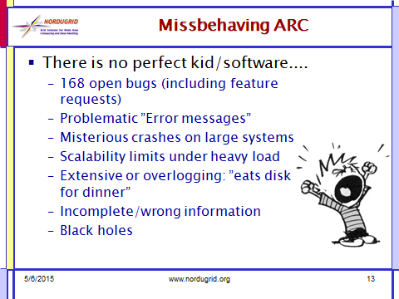
NG15 Bern, 13th birthday

Slide 8
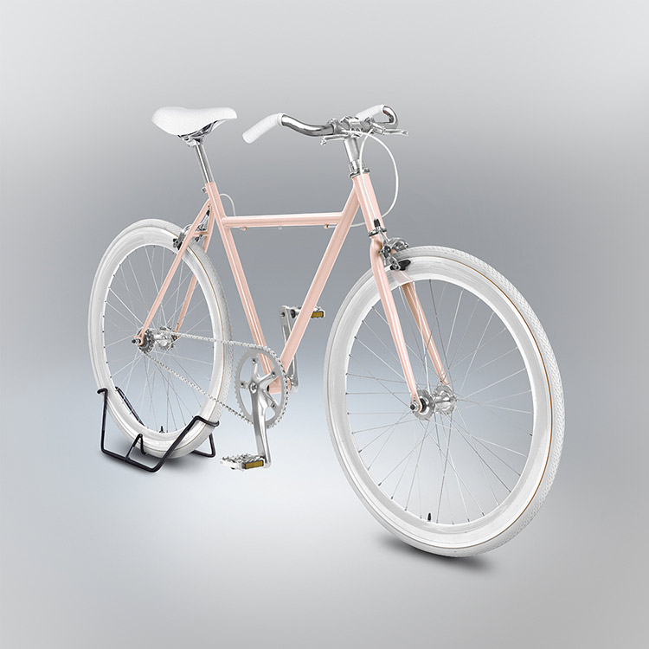
NG16, Kosice: the ART project
Walked up to friends and random strangers with a pen and a sheet of paper asking them immediately draw a men’s bicycle, by heart.
Collected hundreds of drawings, an incredible diversity of new typologies emerging from the technically error-driven design drawings.
No designer could invent so many new bike designs!
Rendered them as if they were real!
Velocipedia project from the designer, Gianluca Gimini
“Might have noticed there’s something
wrong with this bike. Or you might have not.”

Slide 9
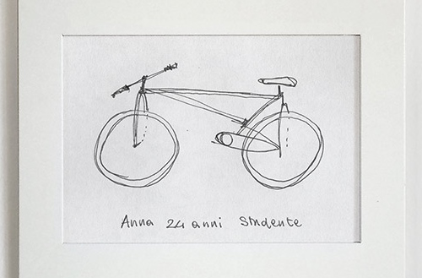
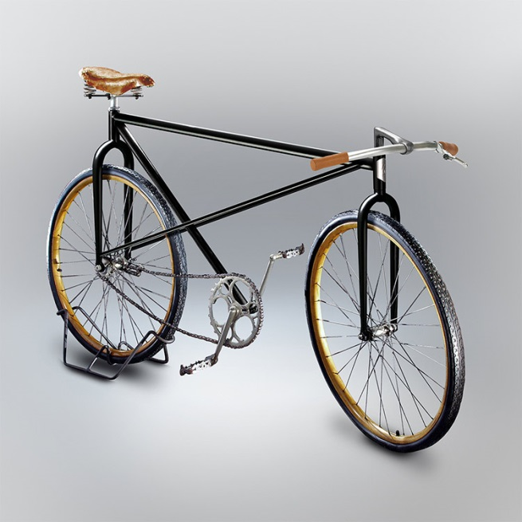
Lessons learnt: design vs. reality
One should build systems to realize their design flaws
Things can look very different when you build those
Obvious and trivial things can easily turn out to be rather complicated in real life
It is good to keep simple things simple
Users may have very different and diverging views of the internals
Not easy to capture how users look at your system
Mistakes, misunderstanding and errors may lead to great inventions
ARC current status is a good example:
ARC development choices that got picked up not exactly the same way as it was originally meant to be....

Slide 10
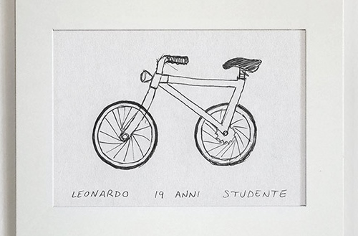
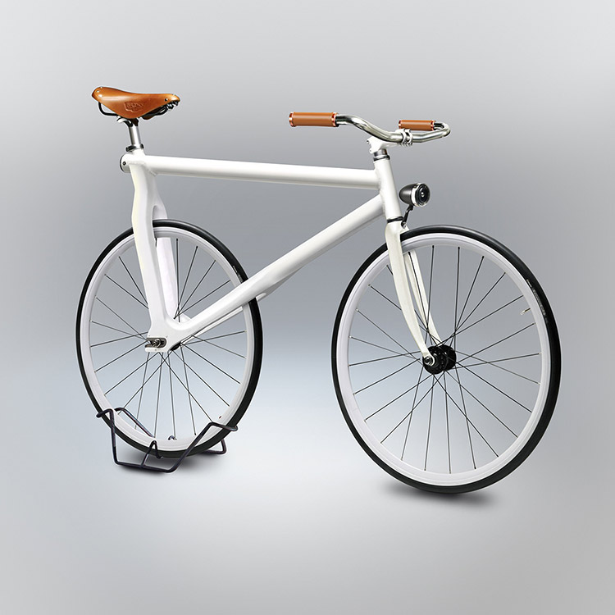
ARC status: a well-understood use-case
Aimed for a general purpose end-to-end middleware solution
compute,data,info,...., grid-bank, the full OGSA bag
(The) Computing Element of WLCG
data-intensive
high throughput
distributed computing
Well-focused domain with a well-understood extremelly challenging usage pattern

Slide 11
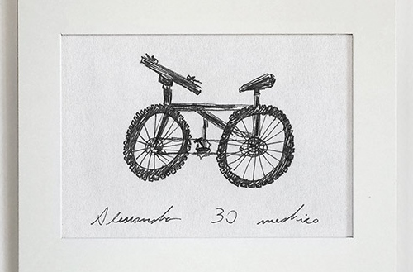
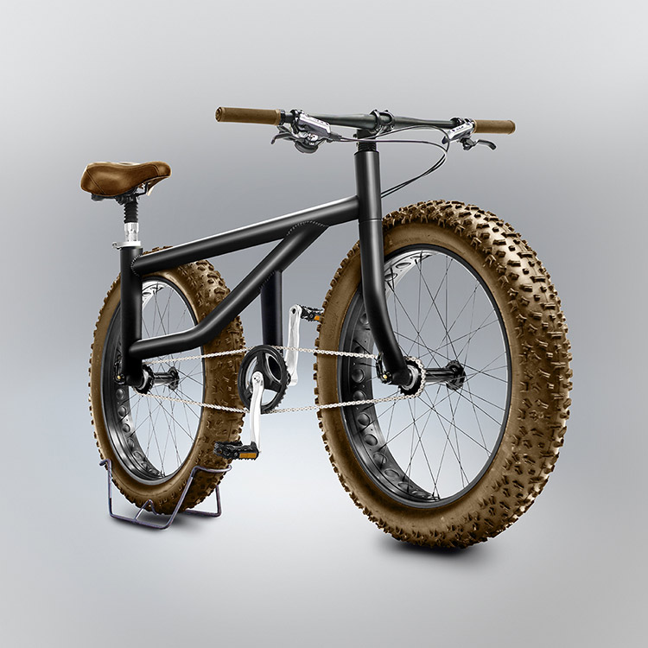
ARC status: importance of DATA
Aimed for integrated data treatment from the very begining
Data staging should be taken care by the middleware
Data is the heavy beast ...
Very strong data capabilities
Computing Engine with cache
Integrated data movers
Support for ”all” data protocols
Support for various Data Indexing solutions

Slide 12
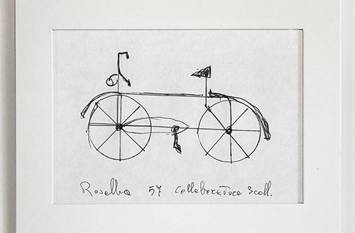
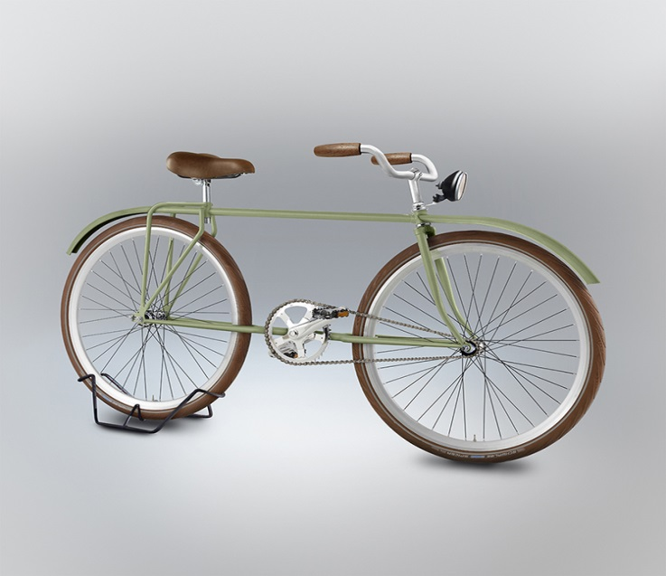
ARC status: standard compliance
Aimed for standard-based interoperability
ARC, Condor, Unicore, Globus, gLite, ....
Large investment into standardization
Definition of specs for accounting, info, job management
Implementation
Interface jungle in ARC
”own”, classic interfaces
Standard-based interfaces

Slide 13
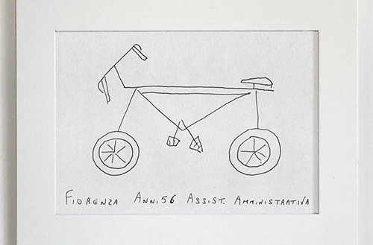
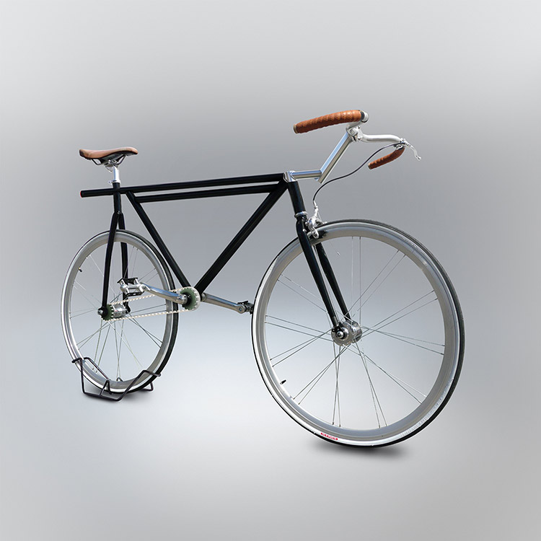
ARC status: middleware over batch systems
ARC was designed as a middle layer on top of LRMS (batch systems)-managed clusters
Clear separation of cluster and middlware layers
ARC is not a ”stand-alone” solution for Computing Engine
Built-in ”fork” engine is rather primitive
Strong dependency on third-party external LRMS systems such as SLURM, Condor, Torque,...
We are the ”middle man”

Slide 14

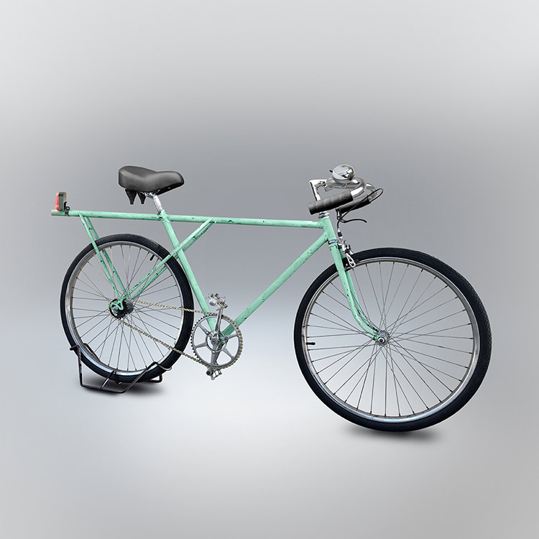
ARC status: centralized distributed services
Loosely coupled network of dynamic, self-organizing, autonoumous services
P2P like dynamic components
Decentralized topology
Service Oriented Architectures (SOA)
Centrally managed ”production frameworks”
Production 24x7 sites with static services
Hierarchical topology
Rather static components
WSRF/SOAP looks rather archaic by now
➔Large part of ARC functionality is not utilised

Slide 15
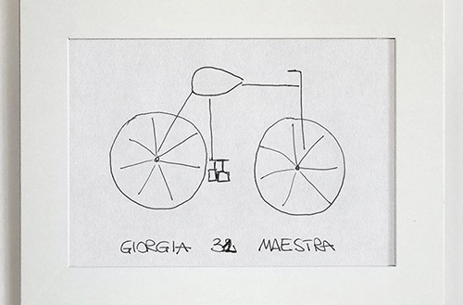
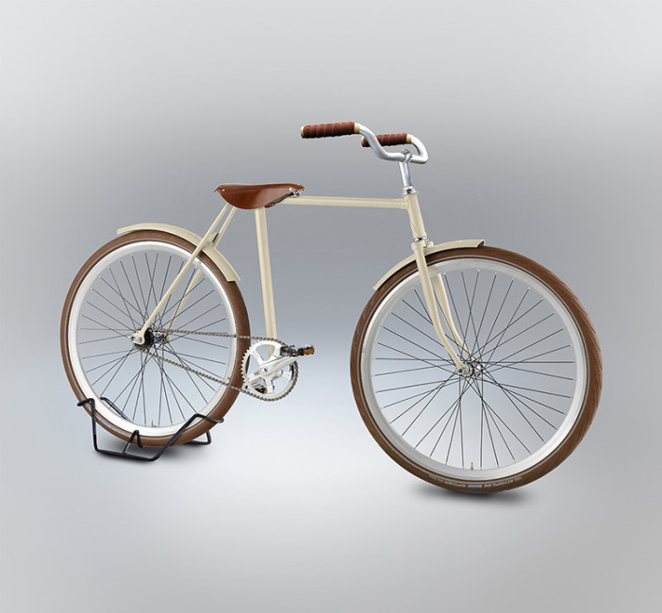
ARC status: heavy security
Secure, trusted environment for resource sharing
Secure but very heavy security framework with
X509 certificates
delegations
VO-based attributes
Virtual Organization (VO) became an extremely overloaded concept
VOs prefer dedicated resources
sharing is seen as a complication

Slide 16
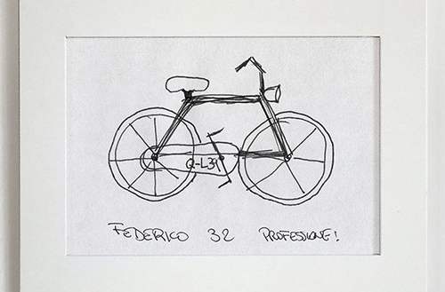
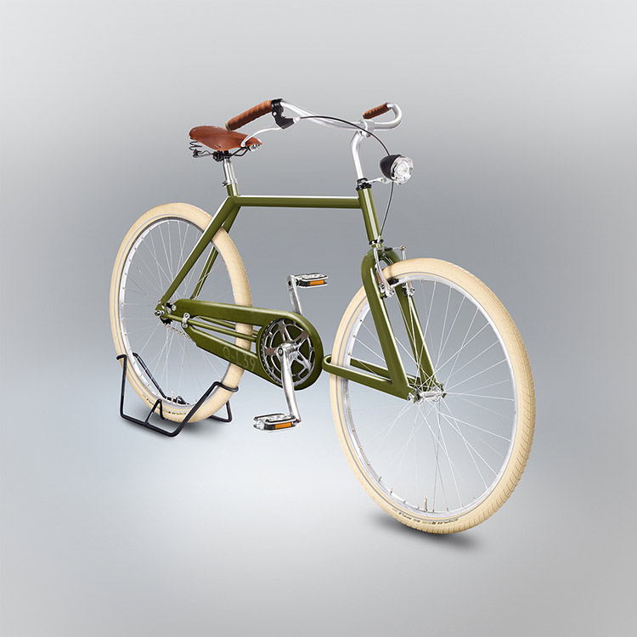
ARC status: open source software
We were dreaming of open source model with sustainable funding
There are very few self-sustaining academic softwares
No real business model because of limited market
Project-based funding
Strong community
Including sysadmins!

Slide 17



Change of the climate
The crowd has gone..., Technology providers, just like the ”G” words, are dissappearing
except for NorduGrid-ARC
and those who were ”doing cloud computing long before it was called Grid” ☺
The technology landscape has changed dramatically
We are adapters and not driving the technology any longer...

Slide 18
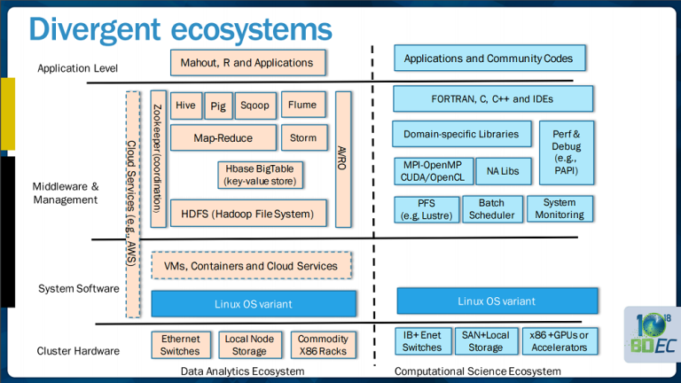
Technology landscape (1/2)
SC15 BDEC workshop: Exascale and Big Data Convergence, divergent ecosystem

Slide 19

Technology landscape (2/2)
2015 Bossie Awards by Infoworld
(some 100 winners in six categories):
The best open source applications
The best open source application development tools
The best open source big data tools
The best open source data center and cloud software
Docker Machine, Compose, and Swarm; CoreOS and Rkt; RancherOS; Kubernetes; Apache Mesos; SmartOS and SmartDataCenter; Sensu; Prometheus; Elasticsearch, Logstash, and Kibana; Ansible; Jenkins; GlusterFS;
The best open source desktop and mobile software
The best open source networking and security software

Slide 20
Nevertheless, running business as usual....
Meanwhile on nordugrid-discuss
ARC and openldap 2.4.40 problems
which ARC meta package will install these globus rpms?
CLI vs api, ARC api and DIRAC
Issue with arcsub and matchmaking (MainMemorySize problem)
Changes in proxy handling on A-REX side
ARCCE: memory requirements translation to HTCondor jdl [cgroup vs. Periodic_remove]
ARC 5.1.1 and SLURM
Could ARC publish resource usage at VO level instead of site level?
on the development frontier:
arc.conf
Logging & errors
Performance number collection
Scalability & stability
Looking at simplifications & cleanup: even more lightweight CE(!)

Slide 21

and looking forward to the future
BIG DATA calls for a monster☺

Slide 22
Thanks Jozef and UPJS for hosting the NorduGrid event!
The Velocipedia project:
www.gianlucagimini.it/prototypes/velocipedia.html

