Slide 2
From Complexity to Clarity: Design, Characterization and Tuning of High-Power Accelerators
Unveiling Beautiful Physics
PRESENTED BY Benjamin Bolling

Slide 3
Agenda
1 ESS Introduction
2 A Recipe
3 The Complicated Cocktail
4 Objective: Beam Shape
5 Objective: Modelling
6 Outlook

Slide 4














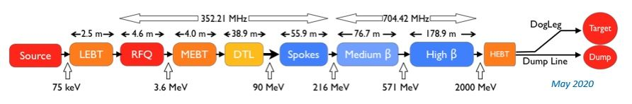
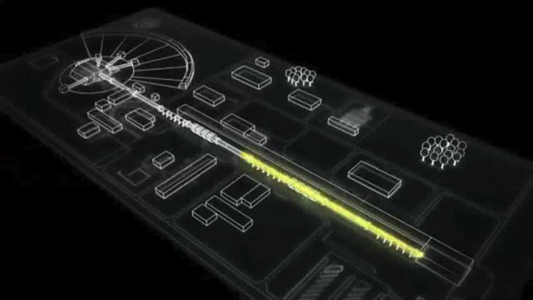
European Spallation Source
What is ESS? A quick background walkthrough
Collaboration of 13
Particle accelerator
Protons
Focusing charged items (repulsion, space-charge)
Accelerating the charged items
More energy = less repulsion ?
Nominal:
2.86ms, 14Hz
62.5mA
Beam destinations and beam intercepting devices
Limitations on the beam

Slide 5
European Spallation Source
A recipe for an advanced scientific research institute (still background)
Goal: Kick neutrons like soccer balls to scientists. How? Simple!
Water electrolysis -> hydrogen
Hydrogen gas -> plasma
Shaping and accelerating beam
Spallation
Now we have neutrons in the target wheel…
Let’s cool them down!
Target moderator (hydrogen)
Instruments, beam ports, and neutron guides
While continuously measuring & monitoring beam parameters

Slide 6
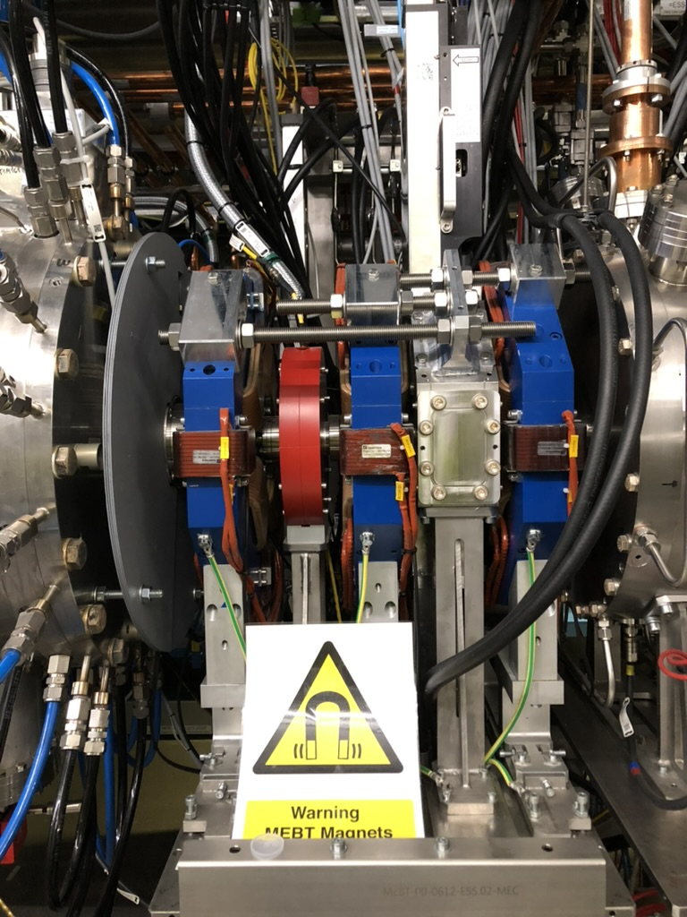
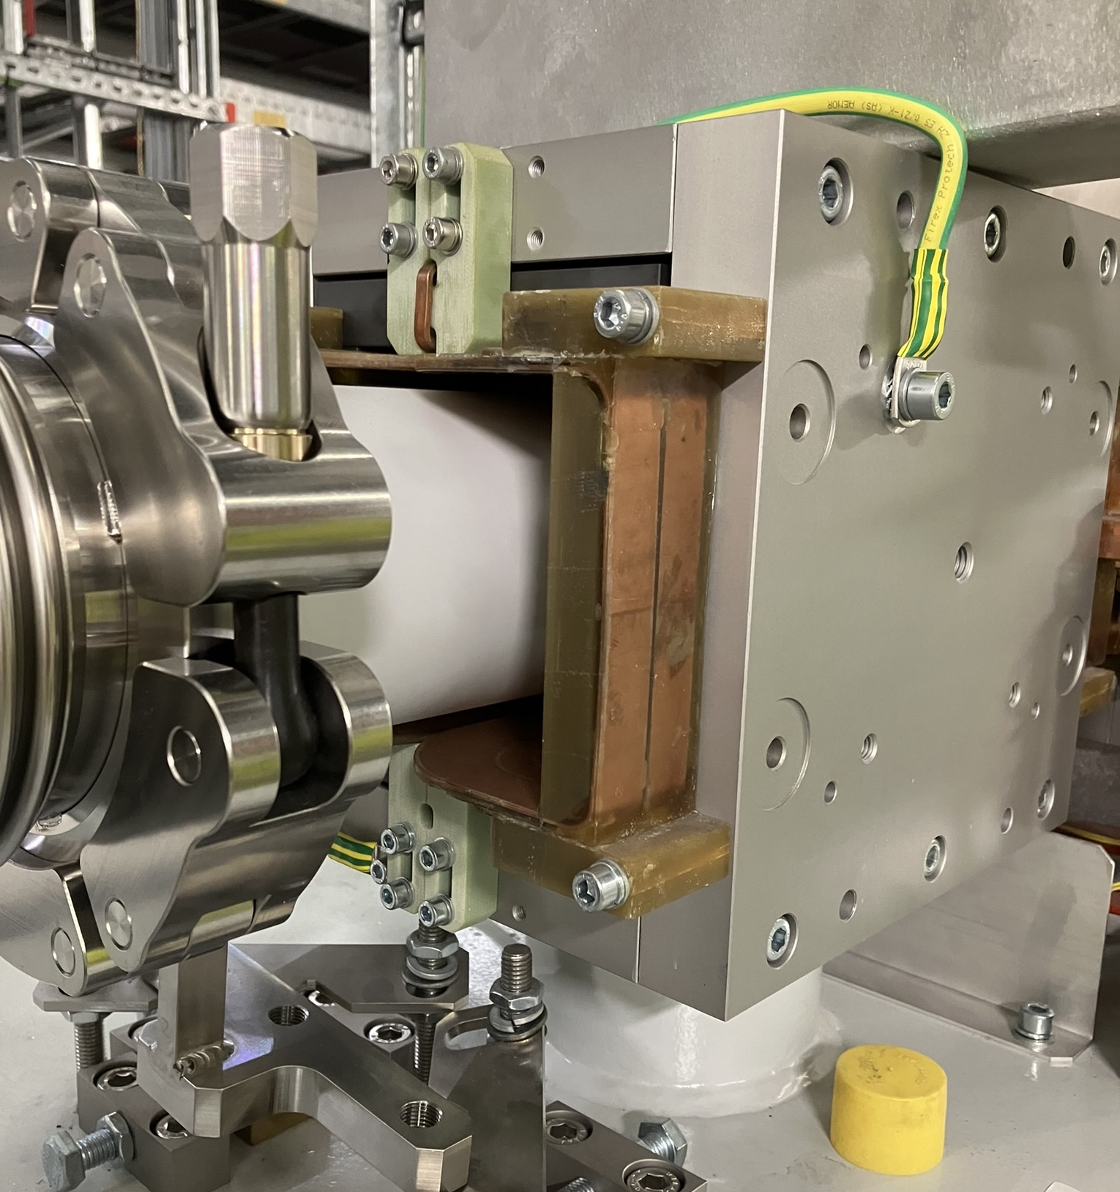
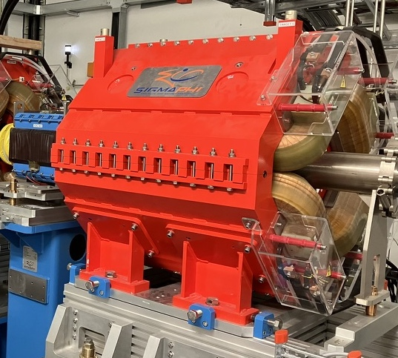
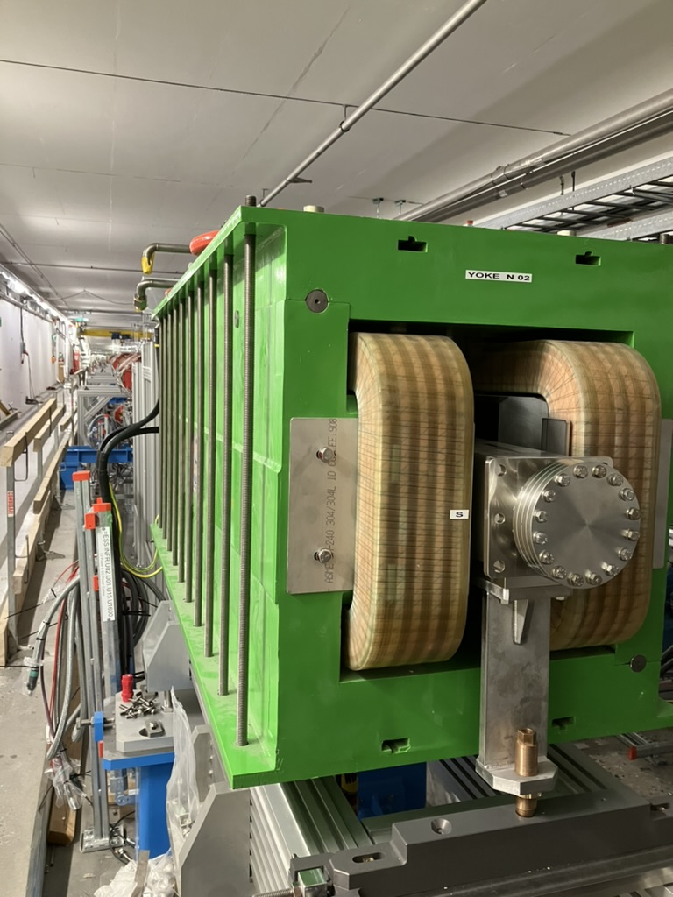
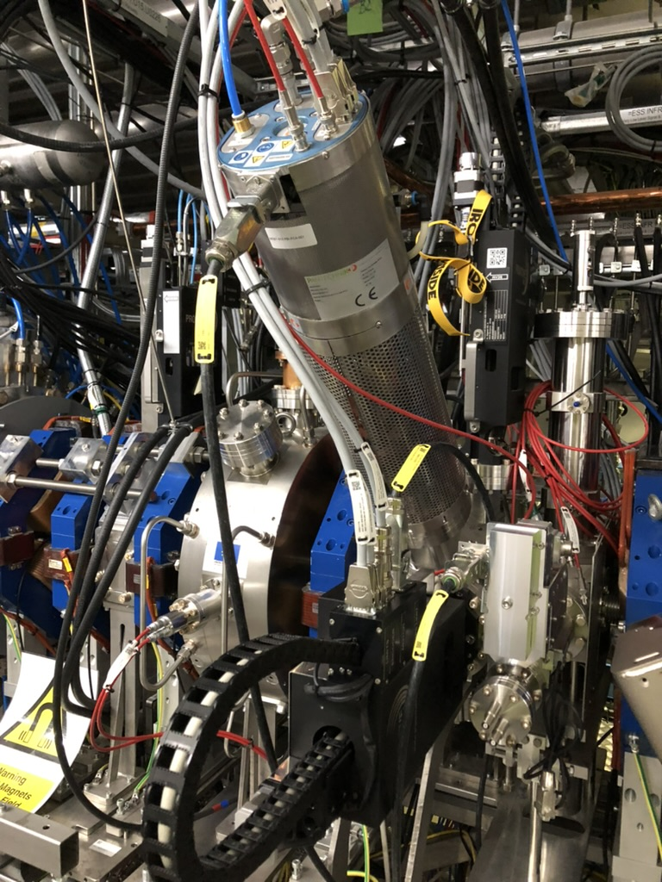
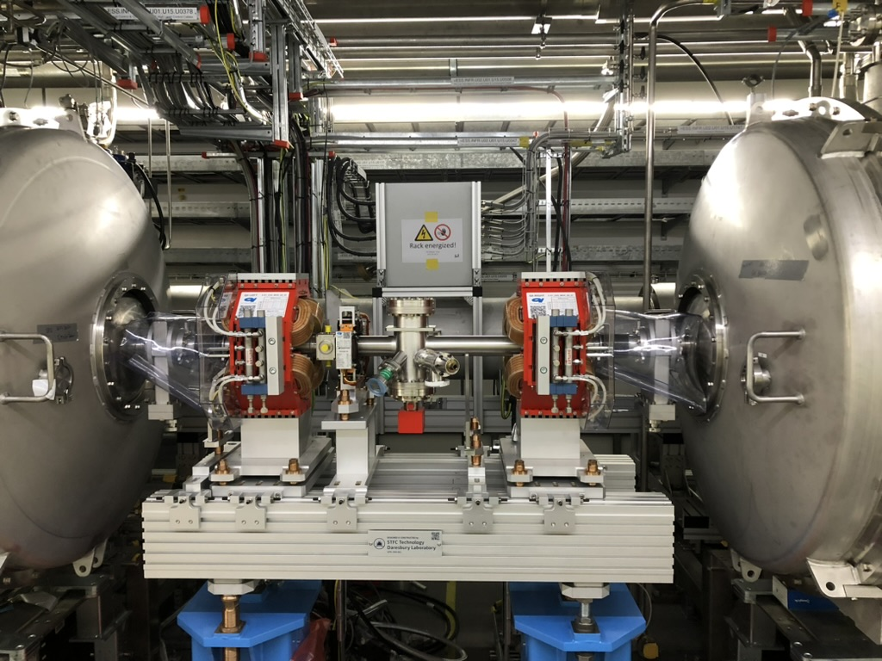
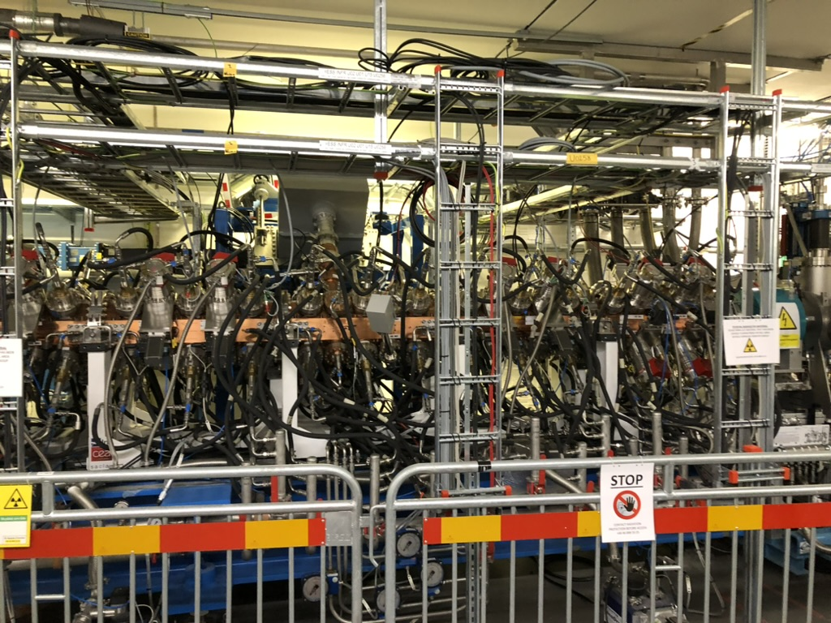
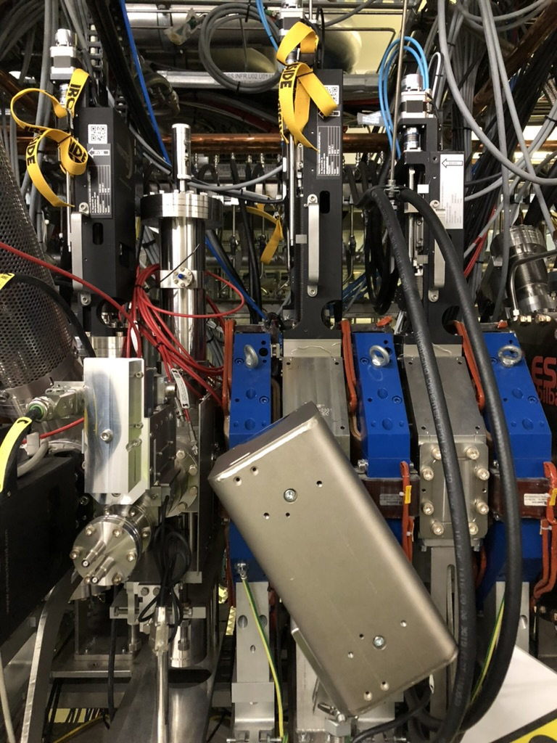
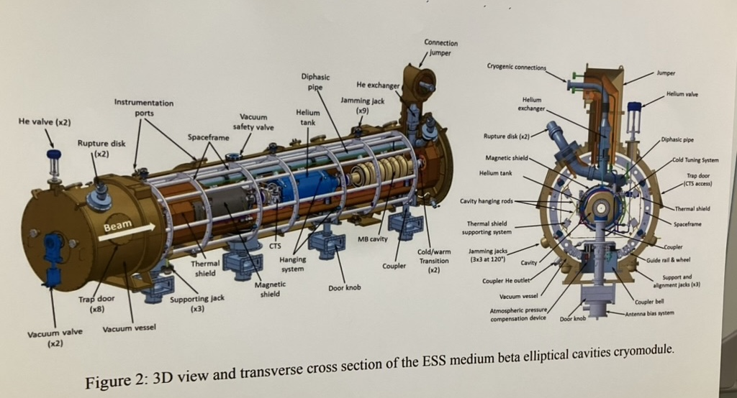
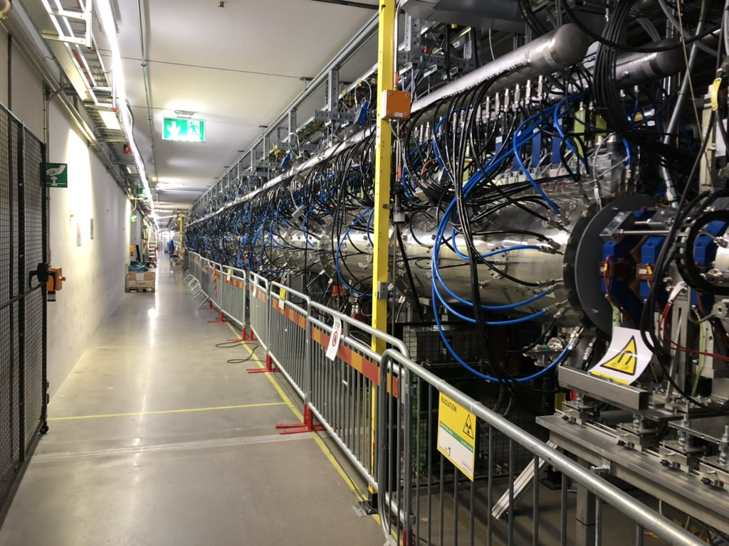
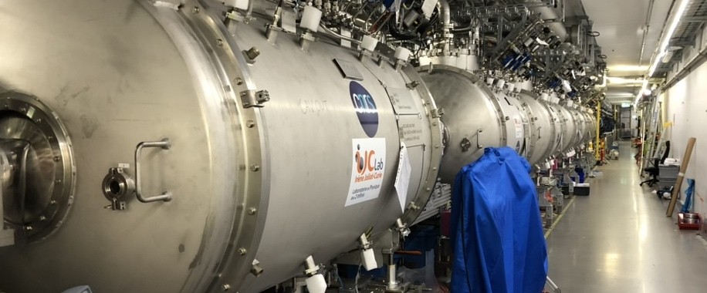

Is it really that hard?
Let’s complicate things
Beam dynamics
Beam elements
Acceleration
Steering, focusing, rastering
Measurements
Stop/collection
Without vs with space charge
High-intensity beam -> challenging:
Characterization
Optimization
x, y
Protons
z
$$F_{SC}$$

Slide 7


Space-charge
Why is this challenging?
Envelope:
Less computational complexity (faster)
Less accurate
Multi-particle:
Intreraction between each, complex (slower)
Higher accuracy
$$F_{SC}$$
$$F_{SC}$$
1
2
4
3
7
5
6

Slide 8
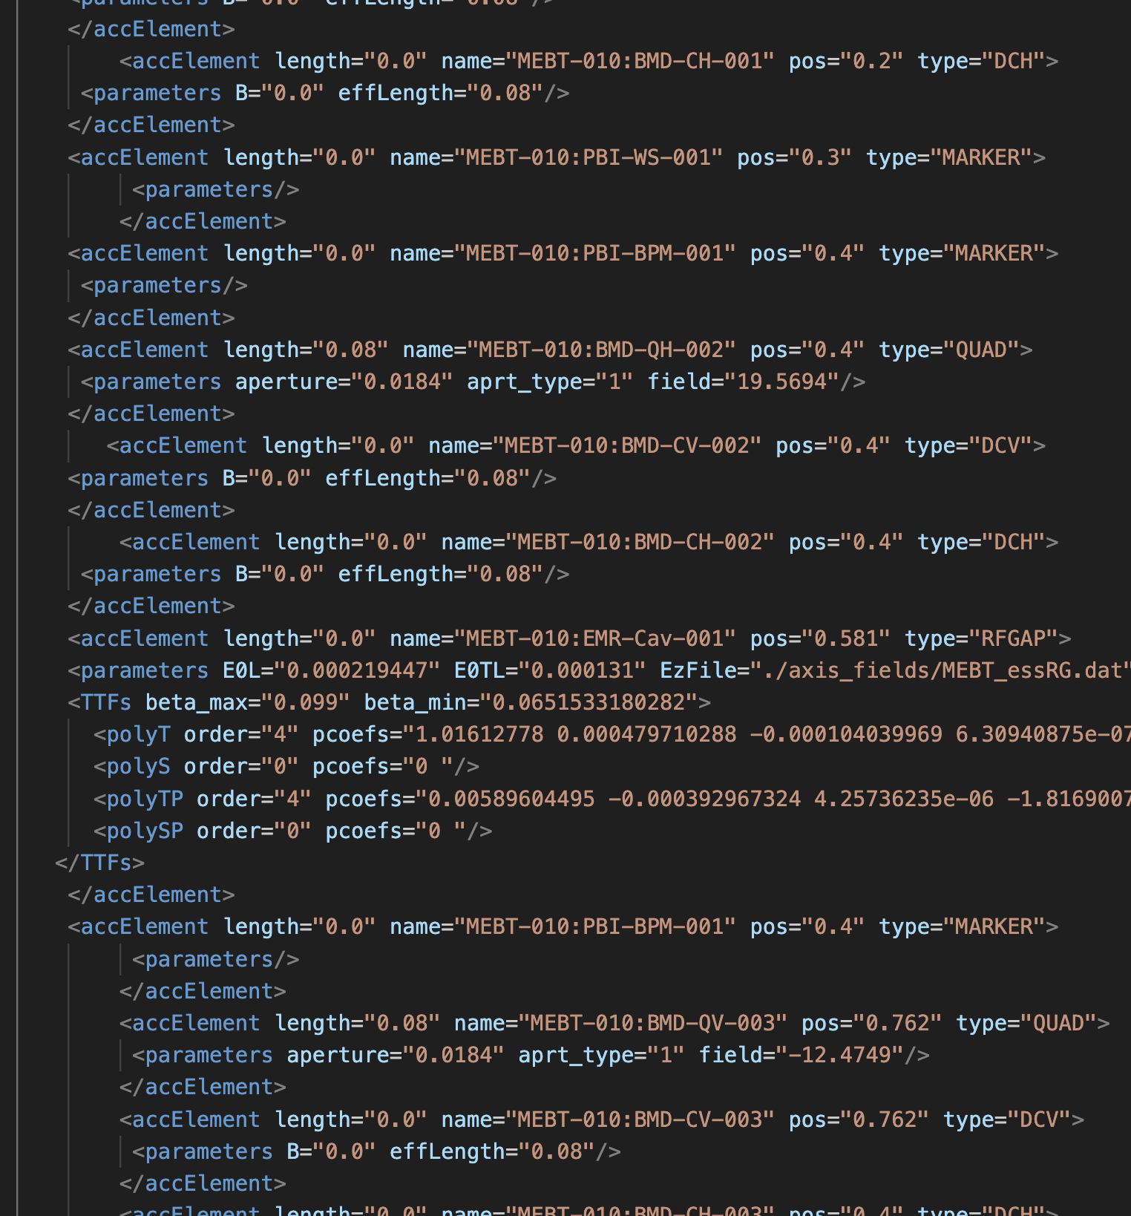
Objective
Improvement of Particle Accelerators
PyOrbit3
Motivation
Open-source collaboration
Multiparticle tracker
Extension: Online requirements
Benchmarking
Discrepancies - origin
Predictability
Development of/contribution to a reliable model and conversion method

Slide 9
No differences?
No space charge – no problems

Slide 10
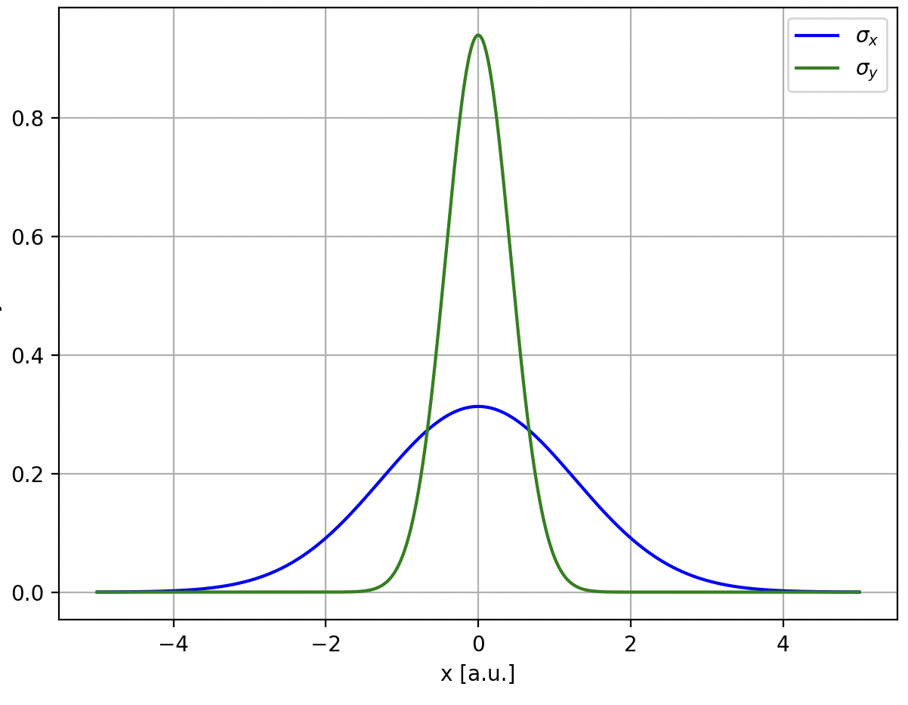
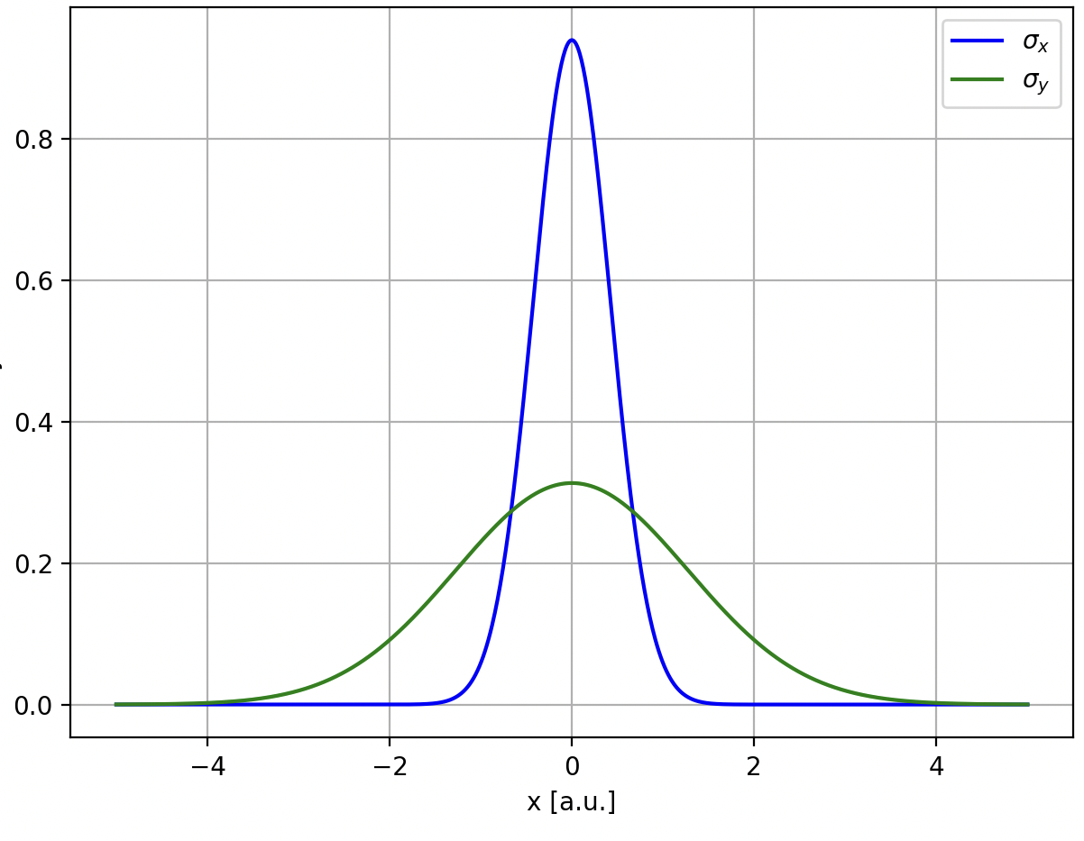
Small but important difference!
ESS: High-intensity beam(highly space-charge-dominated)

Slide 11
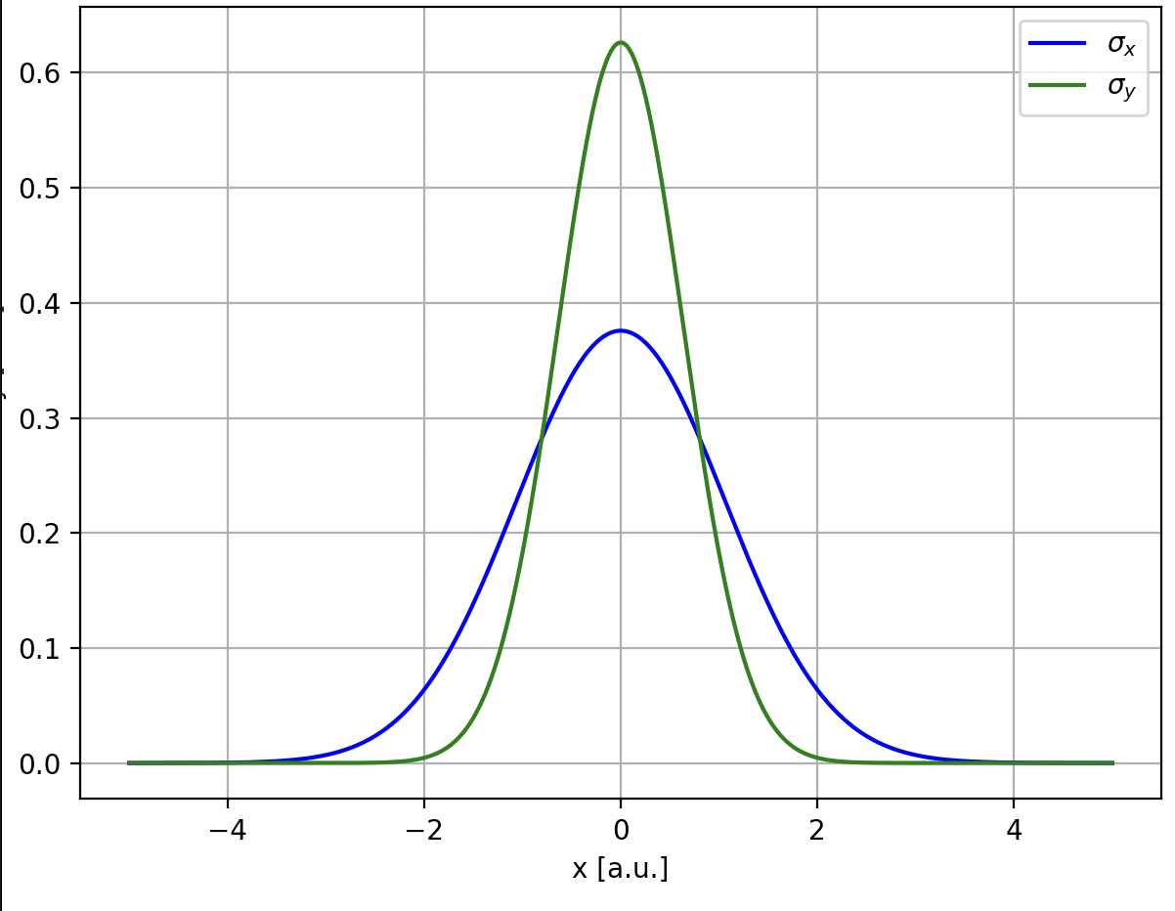
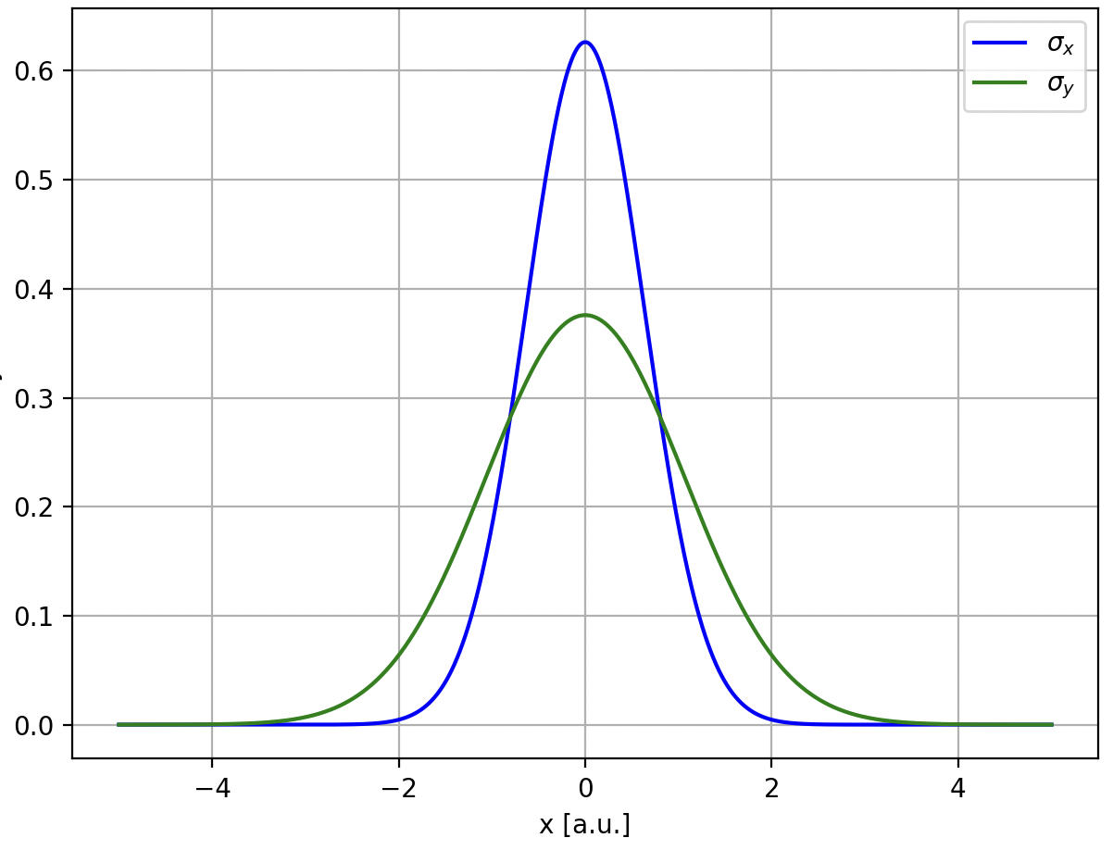
Small but important difference!
ESS: High-intensity beam(highly space-charge-dominated)

Slide 12
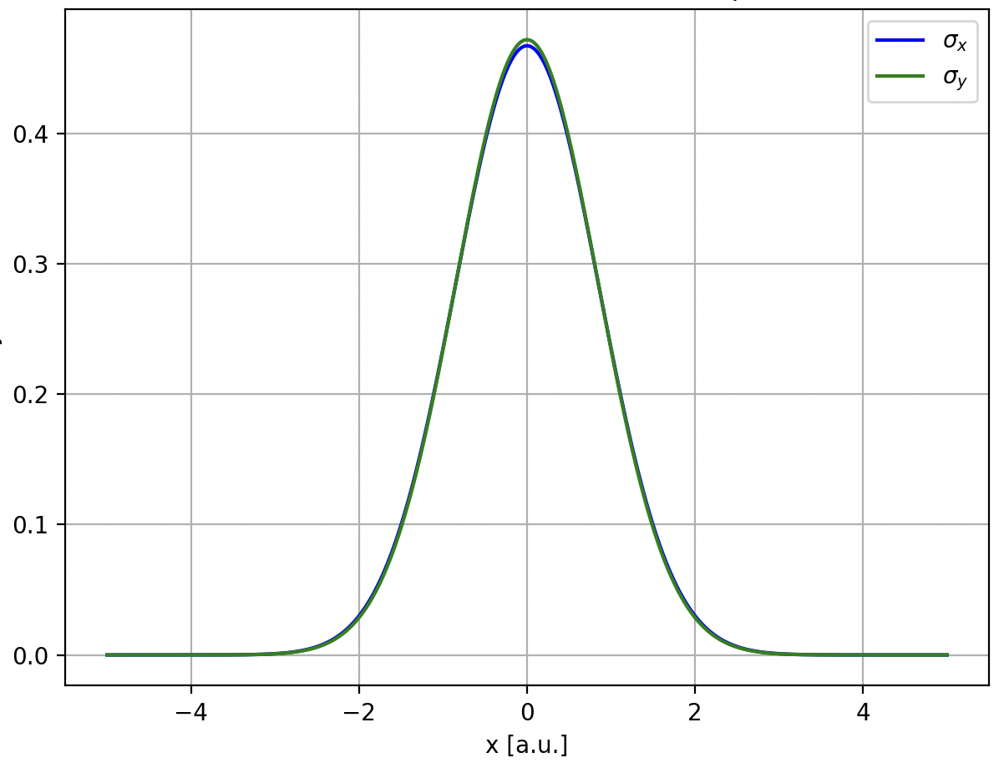
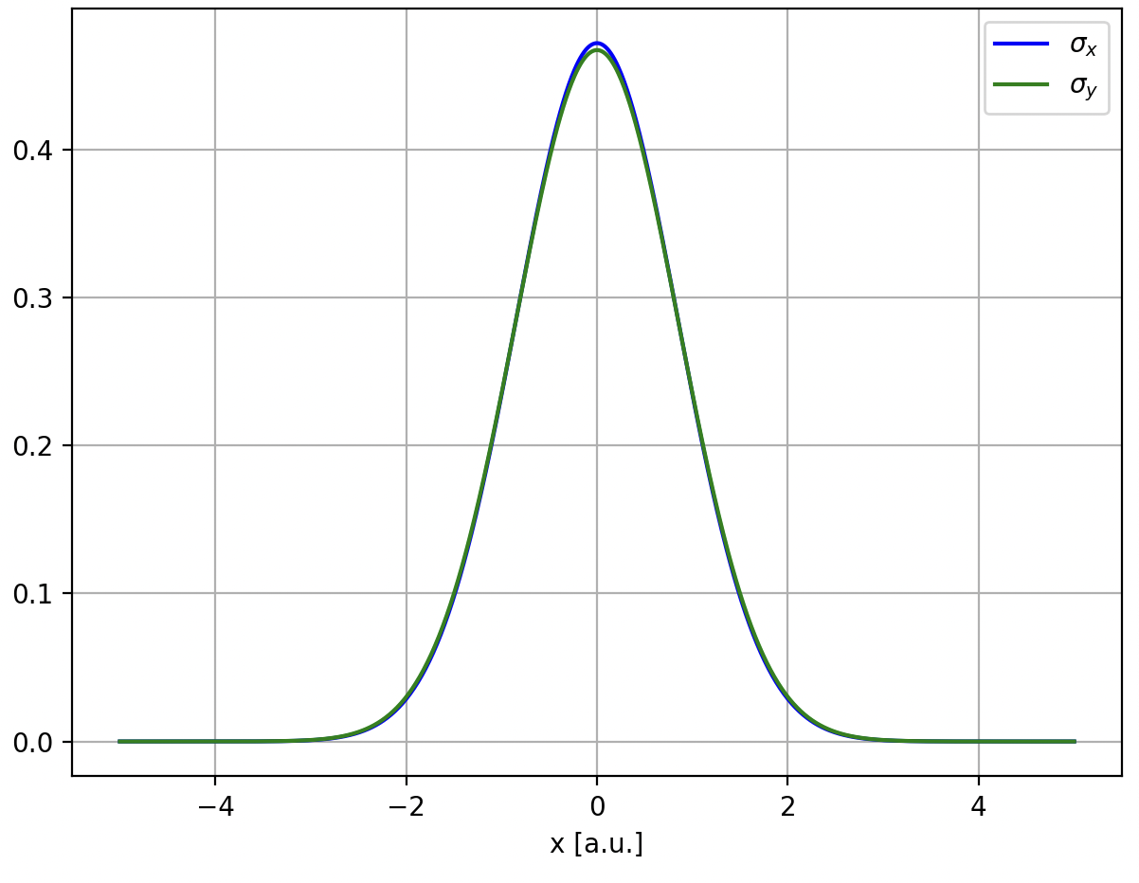
Small but important difference!
ESS: High-intensity beam(highly space-charge-dominated)

Slide 13
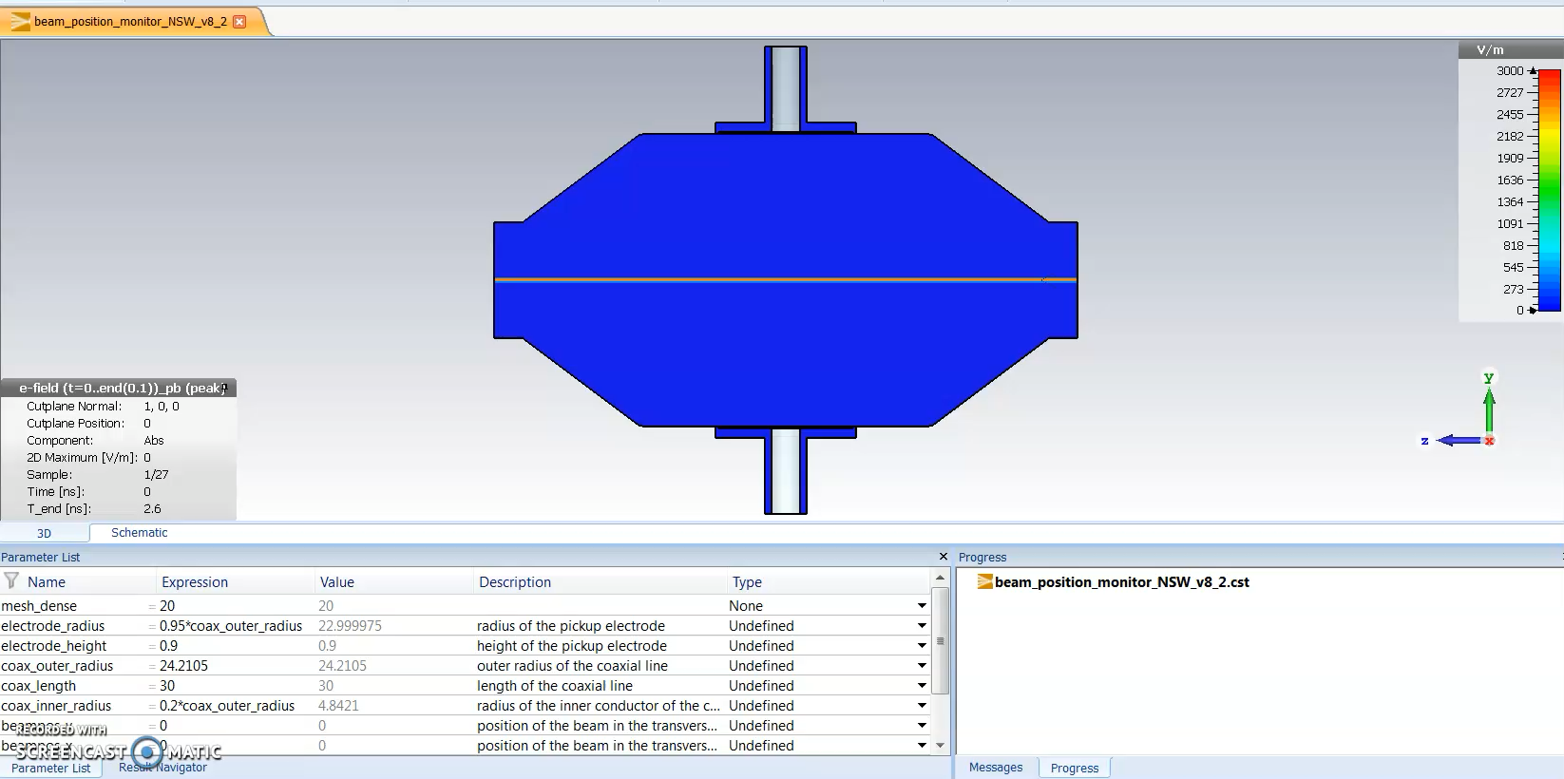
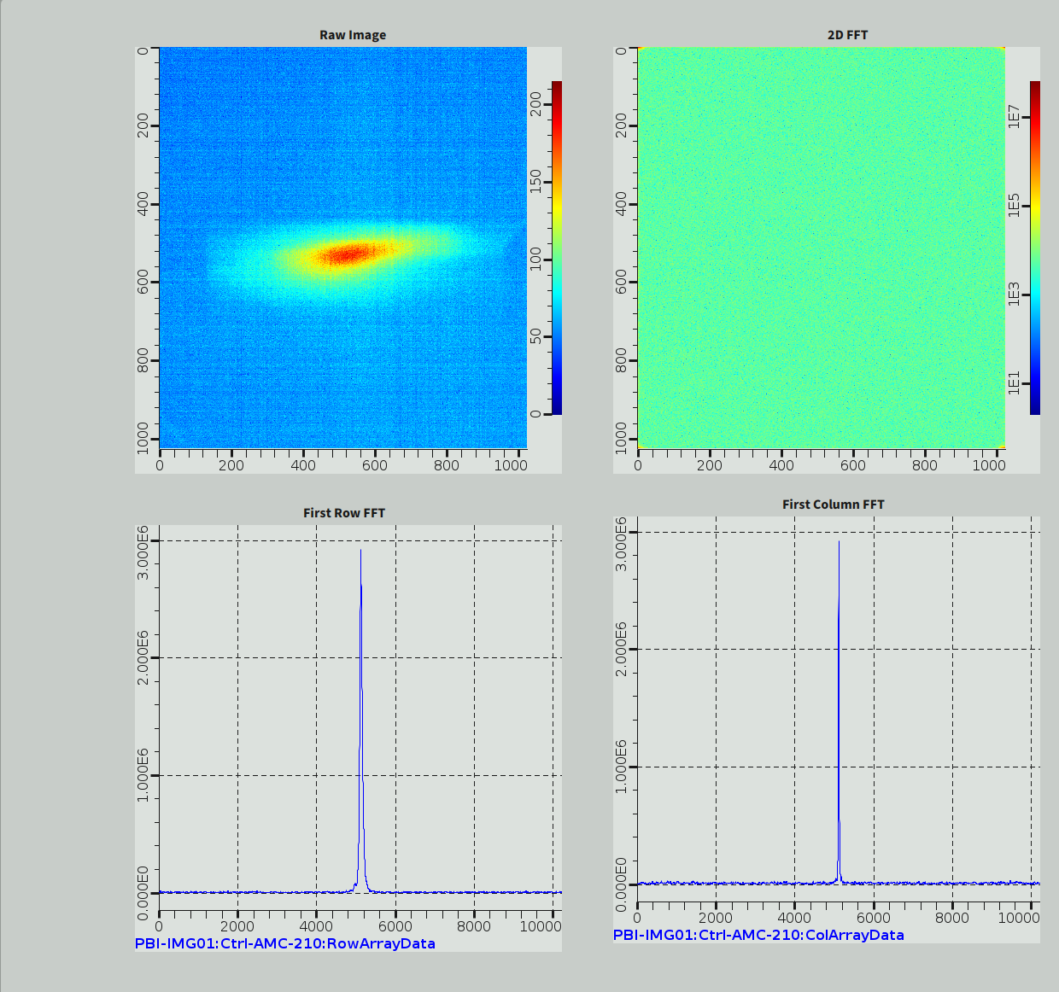
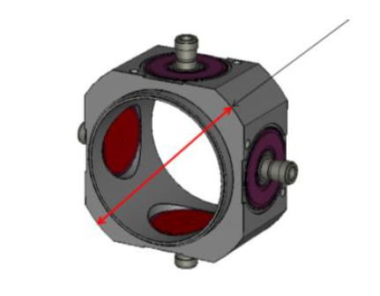
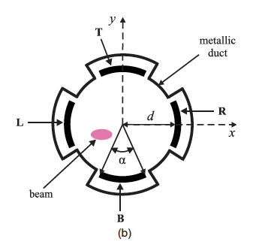


Objective
Improvement of Particle Accelerators
Beam Position Monitors
Critical device, parasitic
Beam profile, width: Interceptive devices
Quadrupolar component of the beam:
Question: Is it measurable enough to do matching?
Hardware limitations (noise, drifts); not designed purpose
Benefits: Valuable transverse (longitudinal) characterization
Credits: Rafael Baron (NSW BPM)
This would be a goal to strive after to achieve parasitically rather than interceptically

Slide 14
Objective
Improvement of Particle Accelerators
Conclusively:
Develop model(s) that fits PyOrbit3
Implement the model in PyOrbit3
Test matching using quadrupolar components for the ESS linac
Perform measurements
Evaluate

Slide 15
Outlook
Further ahead
Is it sufficient to model the quadrupolar component?
Additional beam study planned for next week
Current and future particle accelerators may benefit from
being able to parasitically determine the quadrupolar component of the beam, and
utilizing PyOrbit3 as an open source project with the variety of tools, both online and offline models, and the openness towards future extensions and model development and improvement
Another example: The ESS medium pulse solution
Compressing the ESS proton pulses
2.86ms is long
50-100us is medium
Motivation:
Better matching the moderator time-constant of thermal neutrons
How to implement this? Way forward?
It’s complicated, albeit contribute by using and developing necessary extensions in PyOrbit3

Slide 16
Thanks for listening

