Slide 1
Challenges in the Assessment of Internal Exposure to European Spallation Source (ESS) Radionuclides
Belikse Ramljak

Slide 2
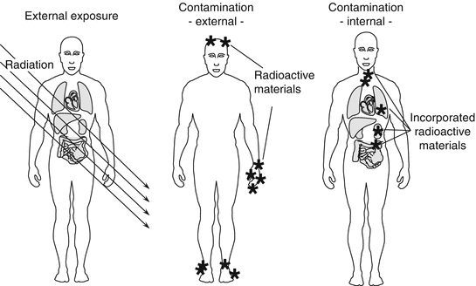
What is internal dosimetry?
Photo from https://radiologykey.com/general-considerations-in-radiation-disaster-medicine/

Slide 3
When do we care about internal dosimetry?
Usually a single radionuclide
Medical treatments
Nuclear or radiological accidents
Usually a mix of different radionuclides

Slide 4
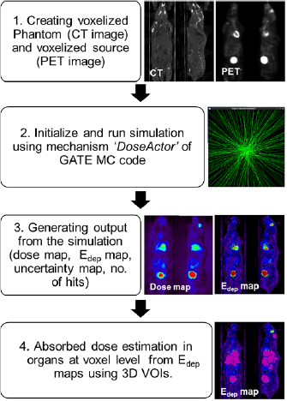
Why it is important?
It aids in assessment of:
Acute radiation effects
(almost instant damage to organs)
Long-term effects like cancer
Extract from GATE MC toolkit
simulation of activity and final absorbed dose to the rat
after injection of PET radiotracer, ¹⁸F-fluorodeoxyglucose (18F-FDG)
Arun Gupta et al 2019 Phys. Med. Biol. 64 095007

Slide 5
Where do we use internal dosimetry results?
In the estimation of the effective dose received by the individual
In contamination monitoring strategies
In the design of medical treatment procedures
In the design of protection strategies for the public and workers during a nuclear or radiological accident

Slide 6
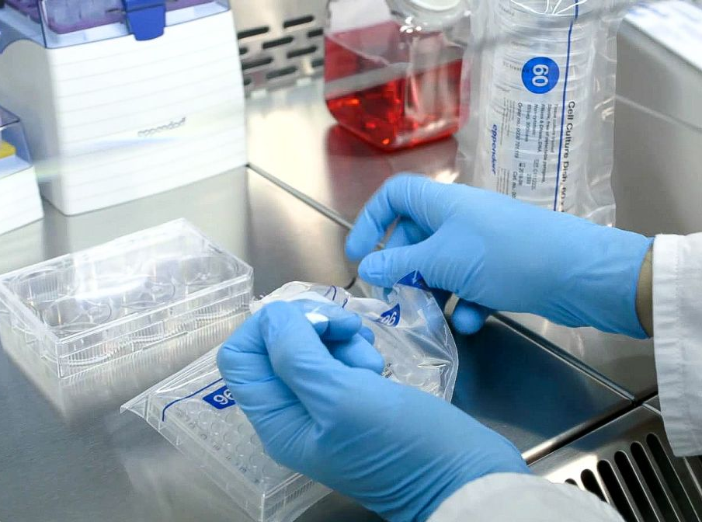
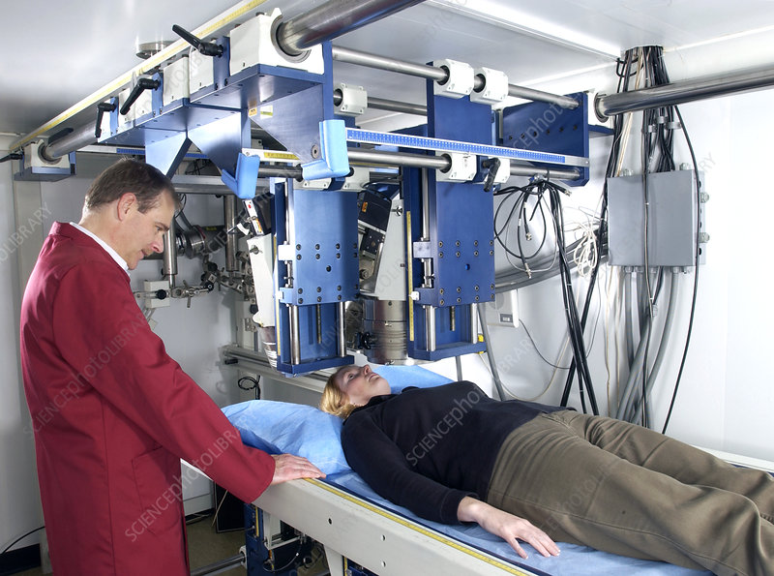
How do we estimate internal contamination?
  Examination of excretion samples
Whole body counting
Image taken from 3AW Melbourne
Image taken from SciencePhotoLibrary

Slide 7

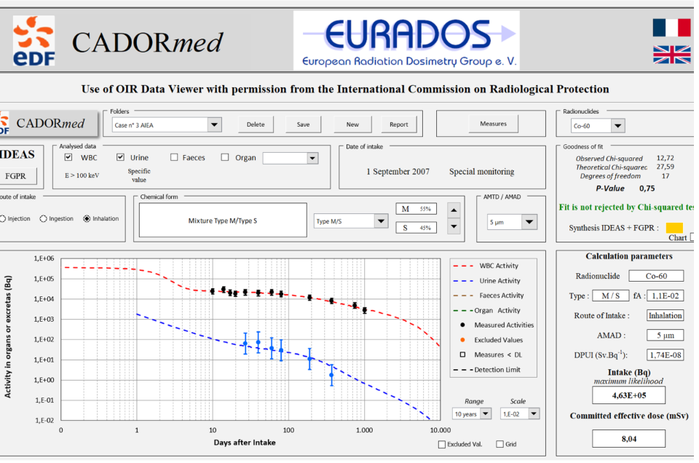

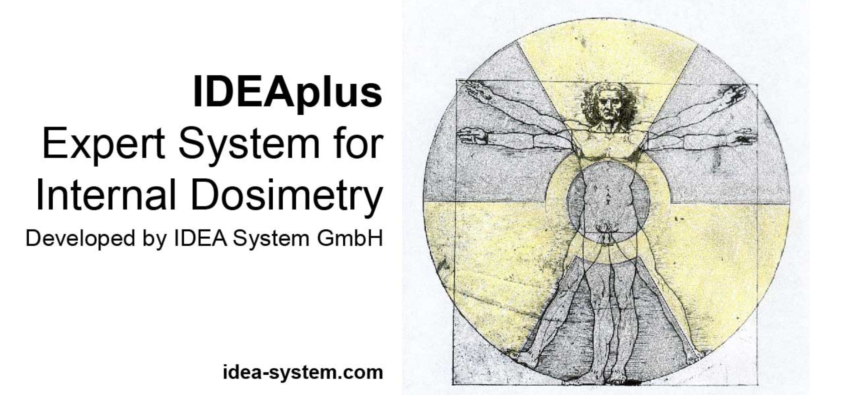
With the help of…
Free software
Commercial software
Note: Simulation toolkits such as Geant4 are usually used solely for research purposes and usually only for a single radionuclide incorporation in the body!

Slide 8
Focus today
Internal dose assessment challenges for European Spallation Source radionuclides
Nuclear /radiological emergency:
  Mix of radionuclides
  Radionuclides can be unevenly spread in different geographical areas
  Monitoring strategies have to be quick and effective

Slide 9
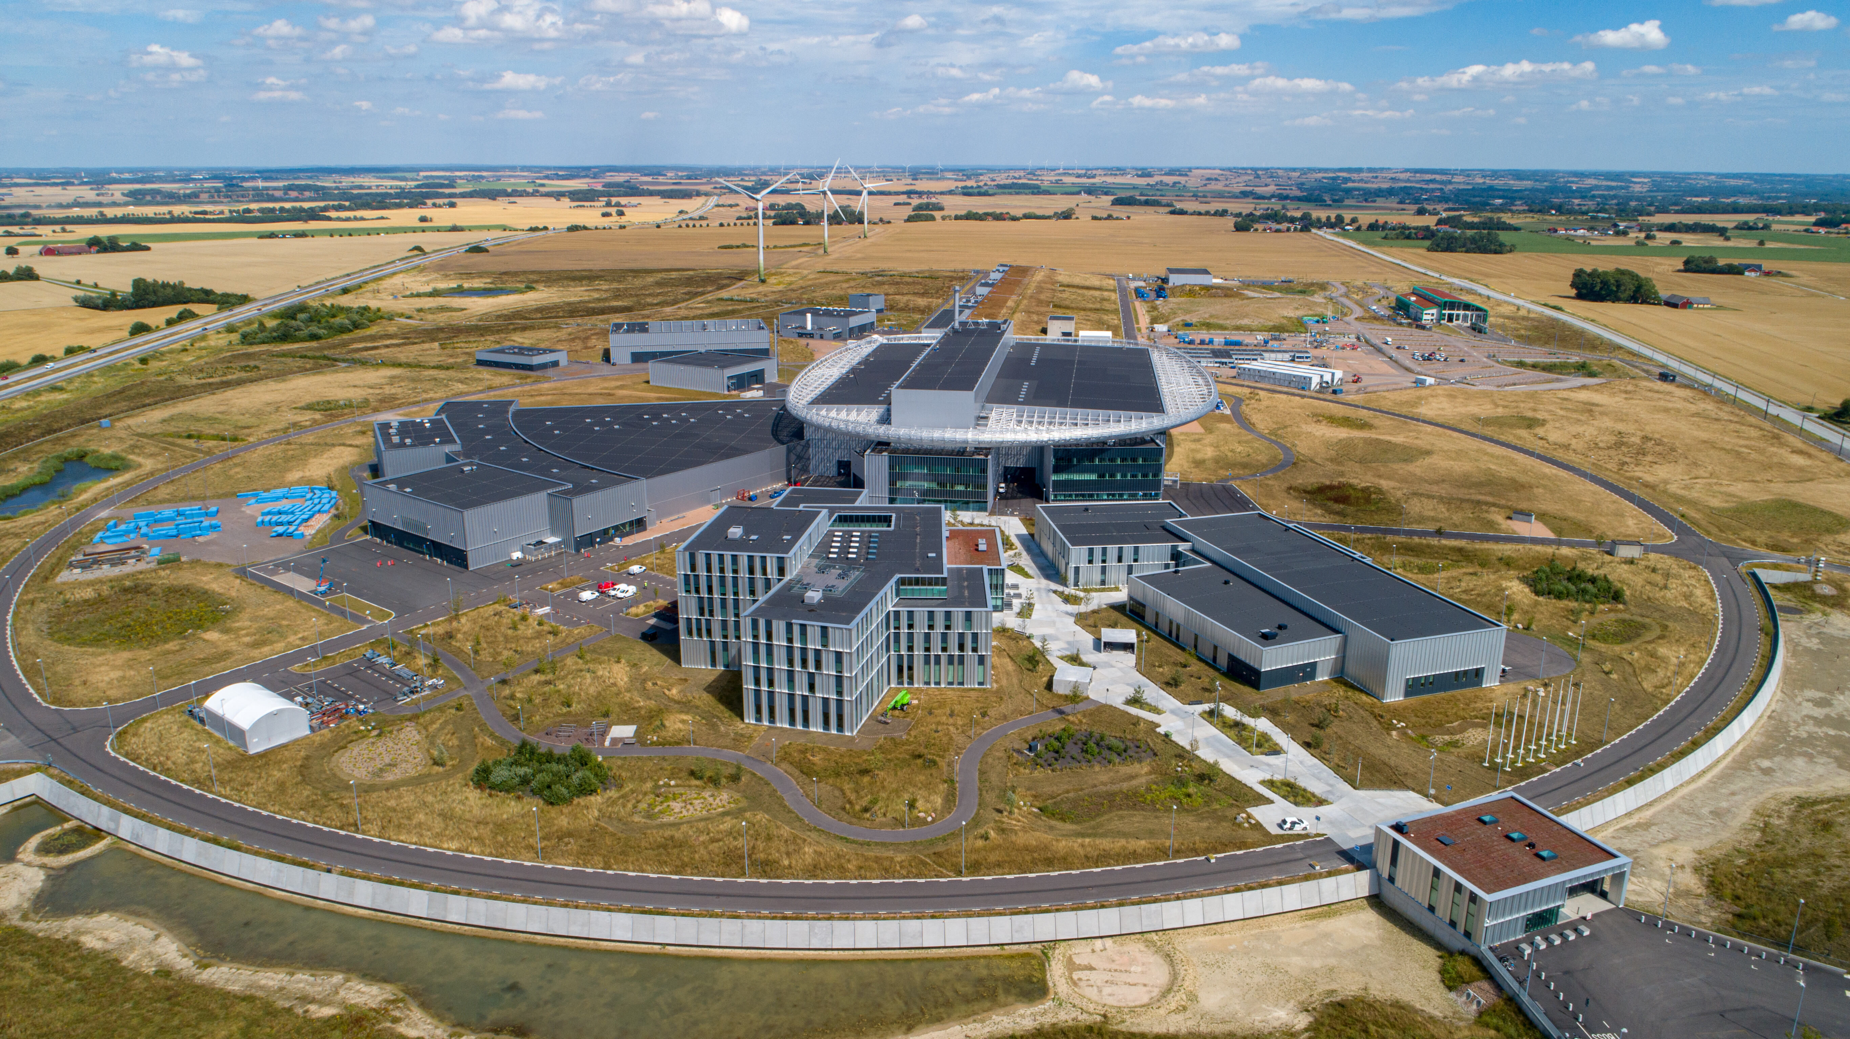
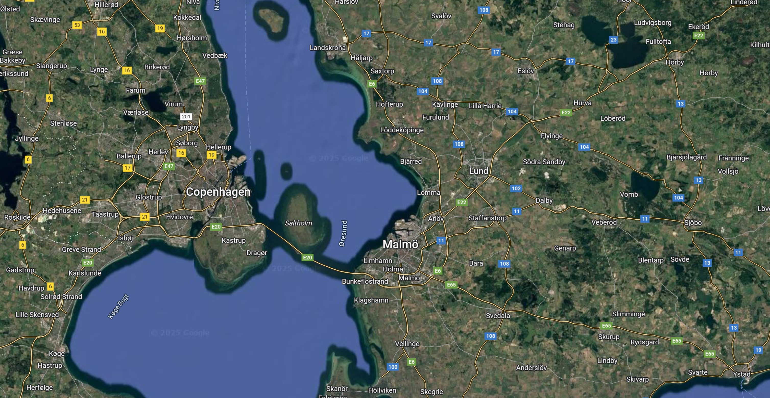

European Spallation Source
(ESS)
Roger Eriksson/ESS - https://dam.esss.lu.se/asset-bank
It will produce intense beams of neutrons for scientific research across physics, chemistry, biology, materials science, engineering, and energy research.

Slide 10
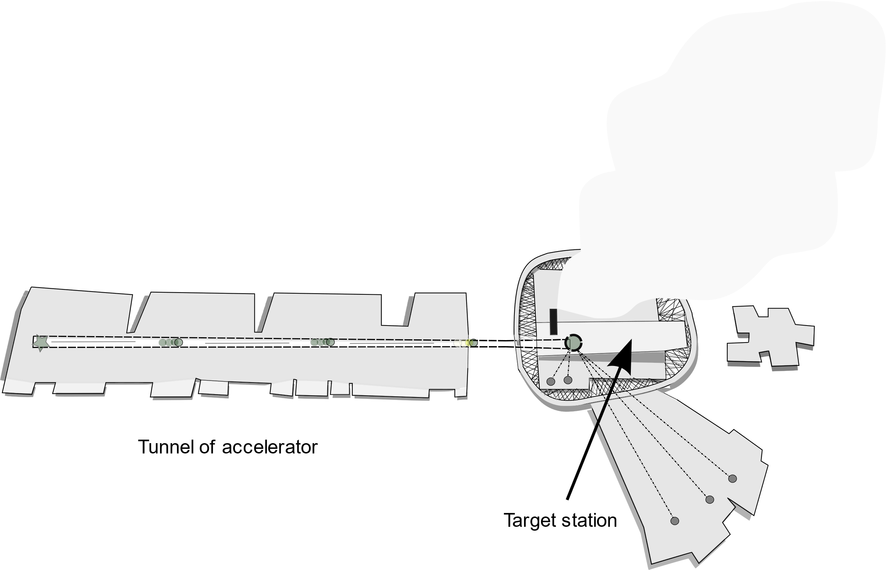
European Spallation Source (ESS)
1
A high-energy proton beam (accelerated to 2 GeV) strikes a tungsten target.
2
The impact releases a large number of neutrons from the target atoms.
3
These neutrons are then slowed down and guided to experimental stations

Slide 11
European Spallation Source (ESS)
1
A high-energy proton beam (accelerated to 2 GeV) strikes a tungsten target.
2
The impact releases a large number of neutrons from the target atoms.
3
These neutrons are then slowed and guided to experimental stations
Around 1000 radionuclides will be generated as by–products of spallation and activation reactions.

Slide 12
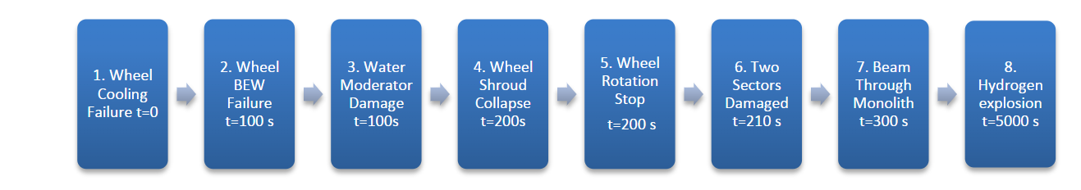
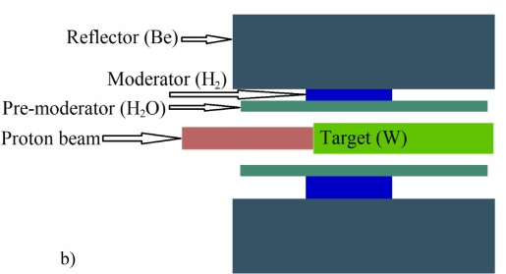
Accident scenario –loss of cooling
Image provided by ESS
Radionuclides are most likely to appear as oxide compounds.
Radionuclide releases are most likely to be fine aerosols (<10 µm).
An aerosol is a suspension of fine solid particles or liquid droplets in air or another gas. (Wikipedia)
Vytenis Barkauskas, Kristina Stenström, Prediction of the radionuclide inventory in the European Spallation Source target using FLUKA,
Nuclear Instruments and Methods in Physics Research Section B: Beam Interactions with Materials and Atoms,Volume 471,2020,Pages 24-32,
ISSN 0168-583X,

Slide 13
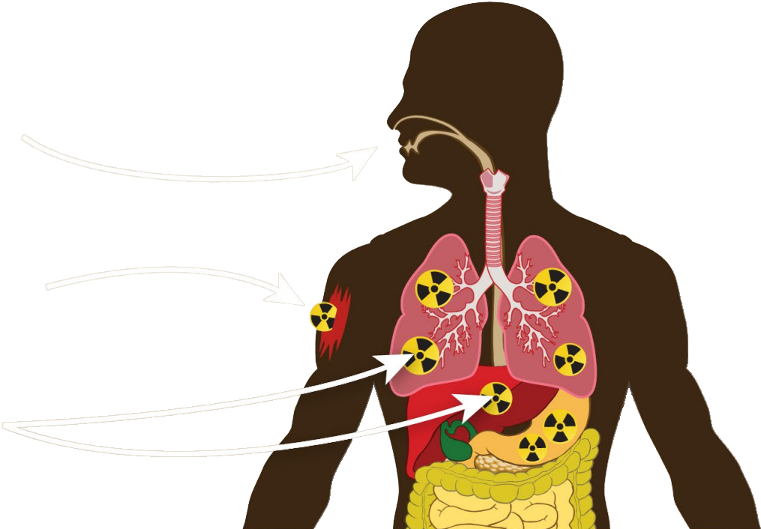
Route of intake
Inhalation
Ingestion
Wound

Slide 14
Which information we need to assess internal contamination?
where radionuclides will end up, geographically (atmospheric dispersion modelling);
how will they move through the body, where they will deposit (biokinetics modelling);
how we can detect them effectively (radiometry).

Slide 15
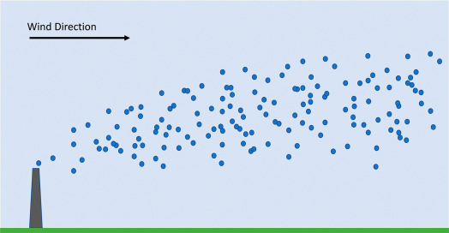
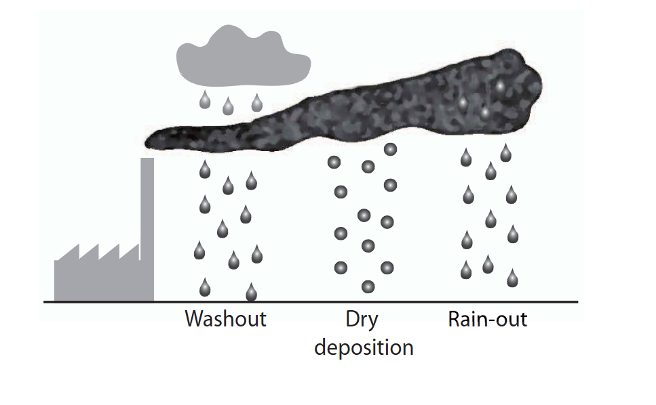
Challenges in atmospheric dispersion modelling
Environmental radioactivity and emergency preparedness, Mats Isaksson and Christopher L. Rääf, Series in Medical Physics and Biomedical Engineering, Taylor and Francis Group, 2017

Slide 16
Challenges in atmospheric dispersion modelling
Averaging of wind speed
Simple turbulence model
Simple parameterization of deposition
No chemistry considerations
RIMPUFF (DTU) – used by Swedish Radiation Safety Authortiy

Slide 17
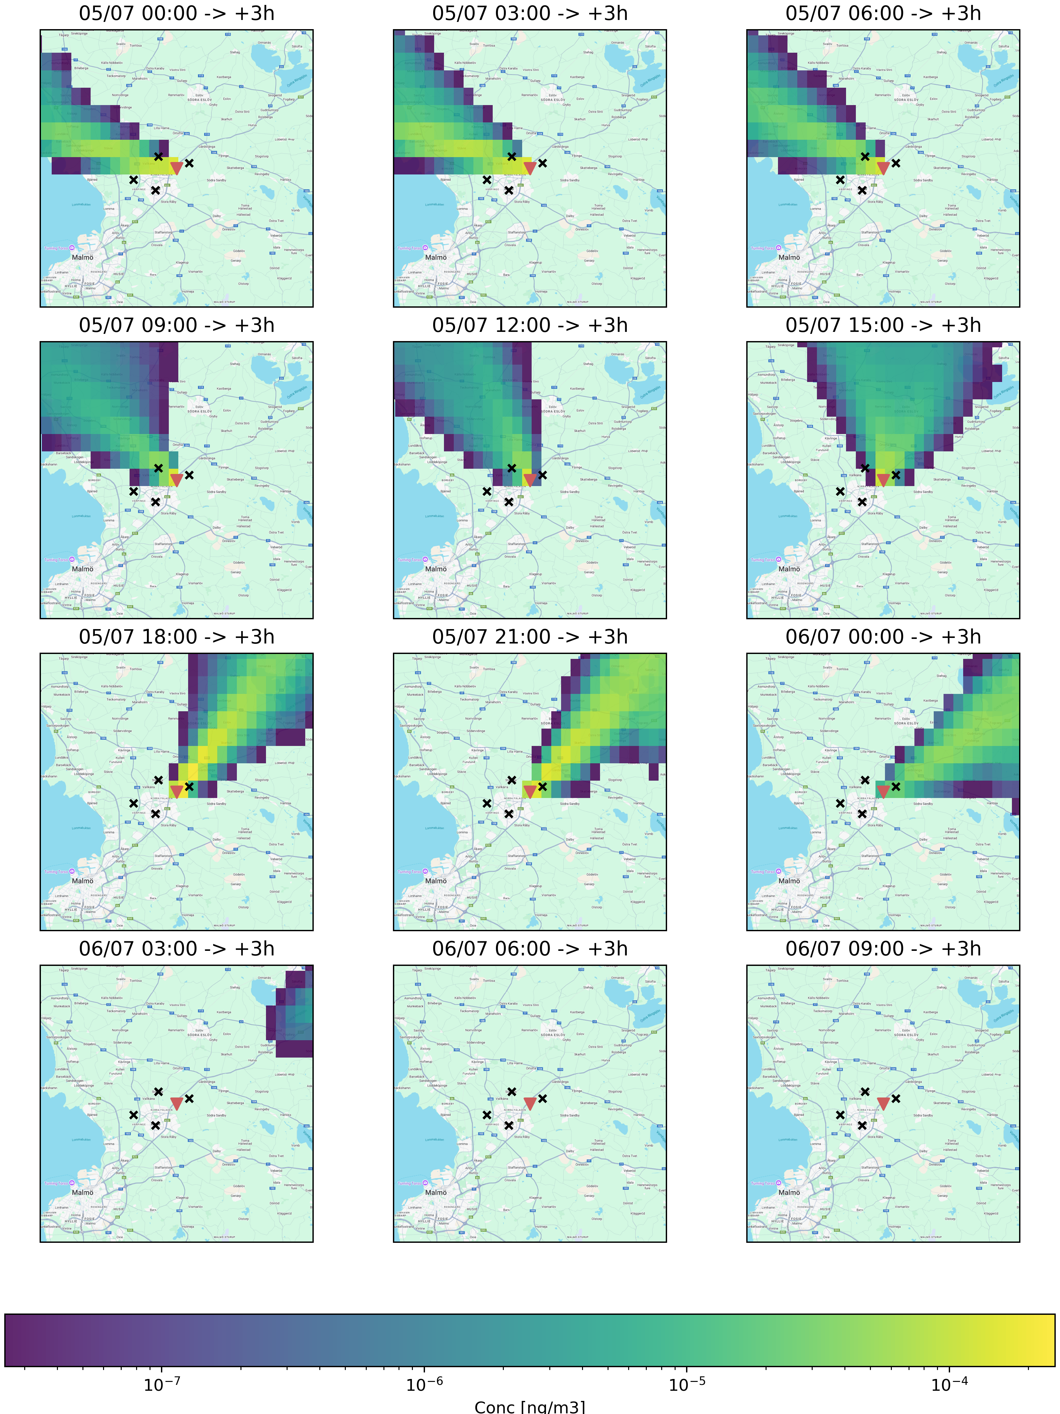

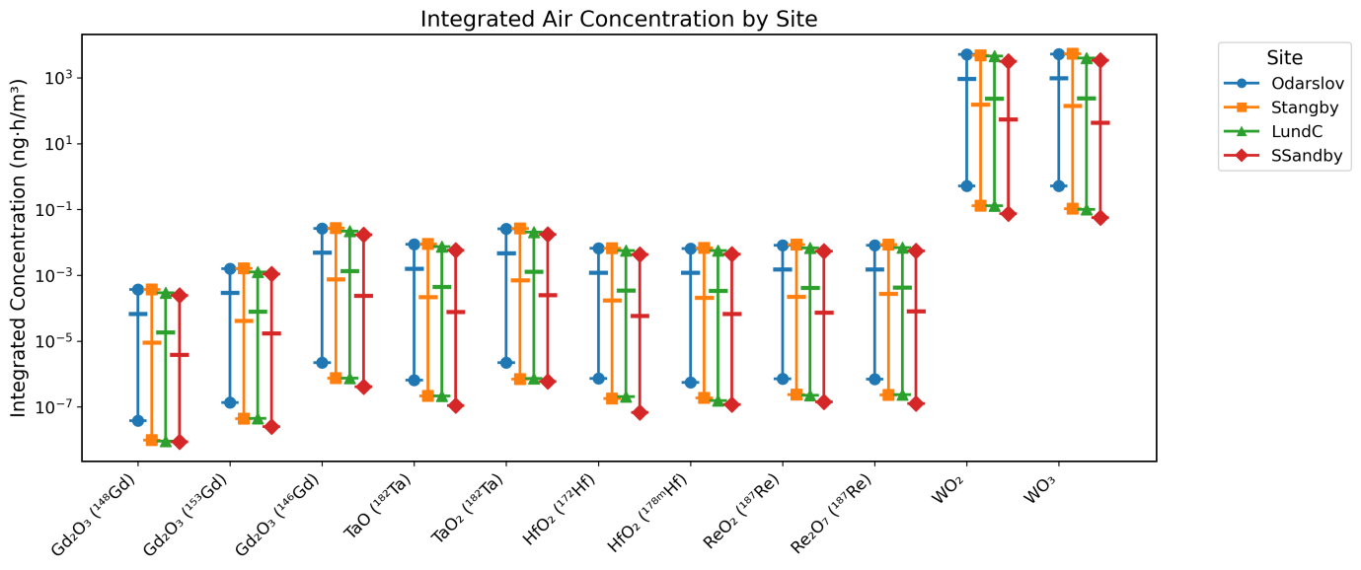
FLEXPART

Slide 18
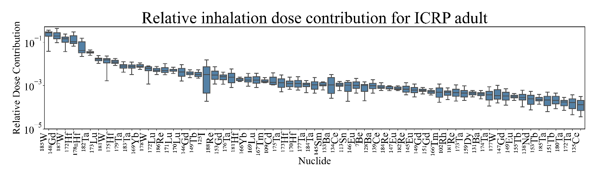
Challenges in biokinetics modelling
Radionuclide | Half life | Dose coefficient (Sv/Bq)
148Gd | 71.1 y | 5.6E-8
187W | 23.9 h | 6.3E-10
172Hf | 1.87 y | 1.0E-9
182Ta | 115.0 d | 1.5E-9
178mHf | 31 y | 4.7E-9
Around 1000 radionuclides!
We need to make a selection!

Slide 19
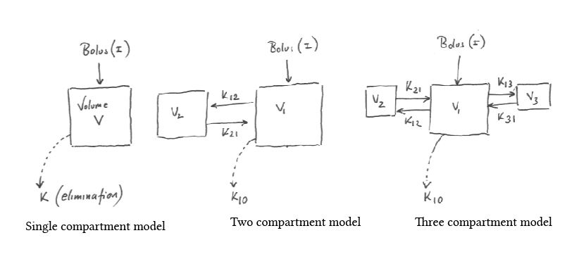
Alex Yartsev, Single and multiple compartment models of drug distribution | Deranged Physiology

Slide 20
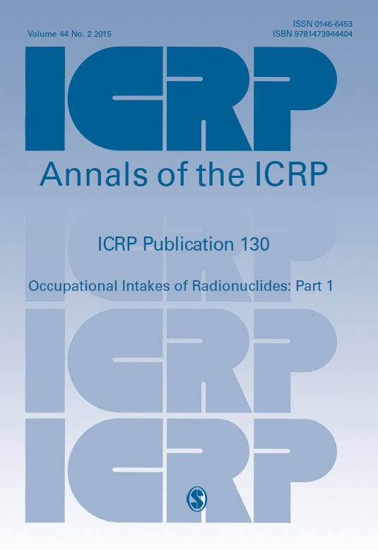
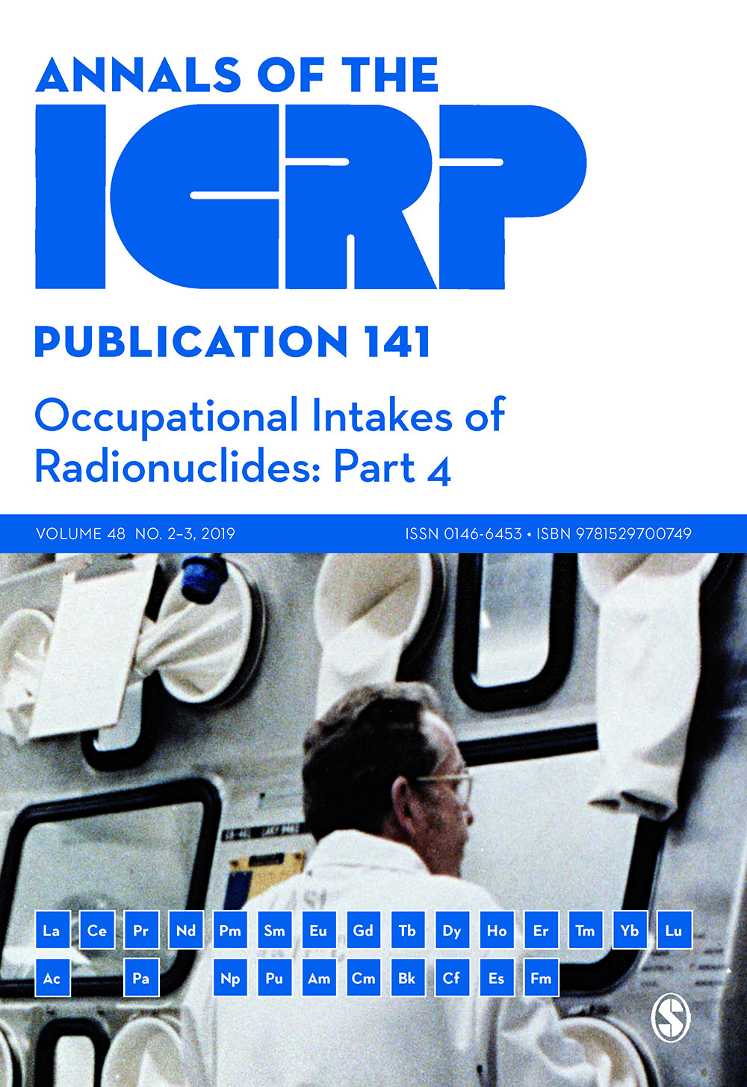
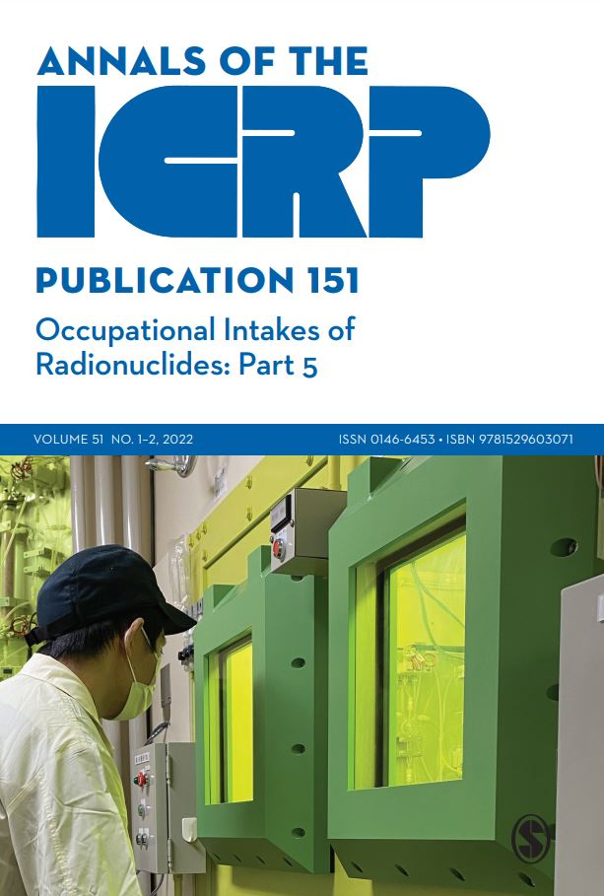
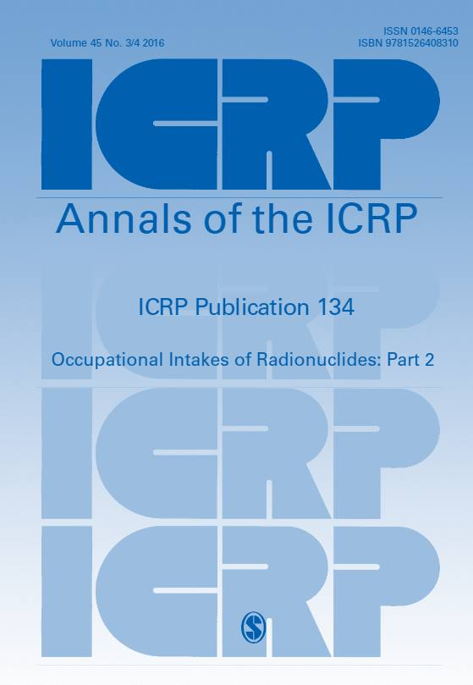
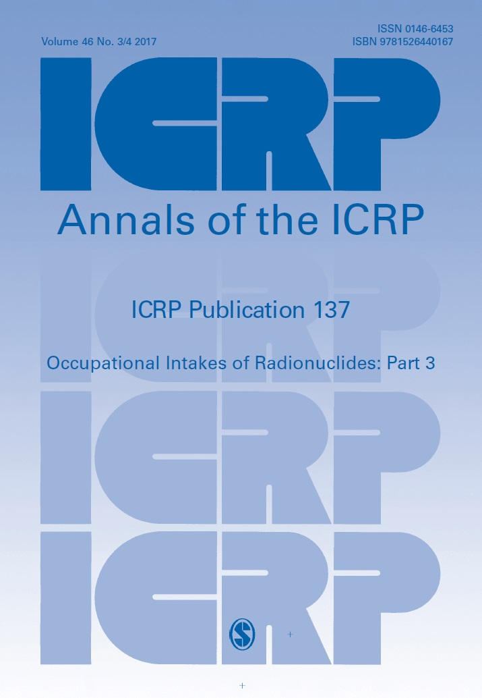
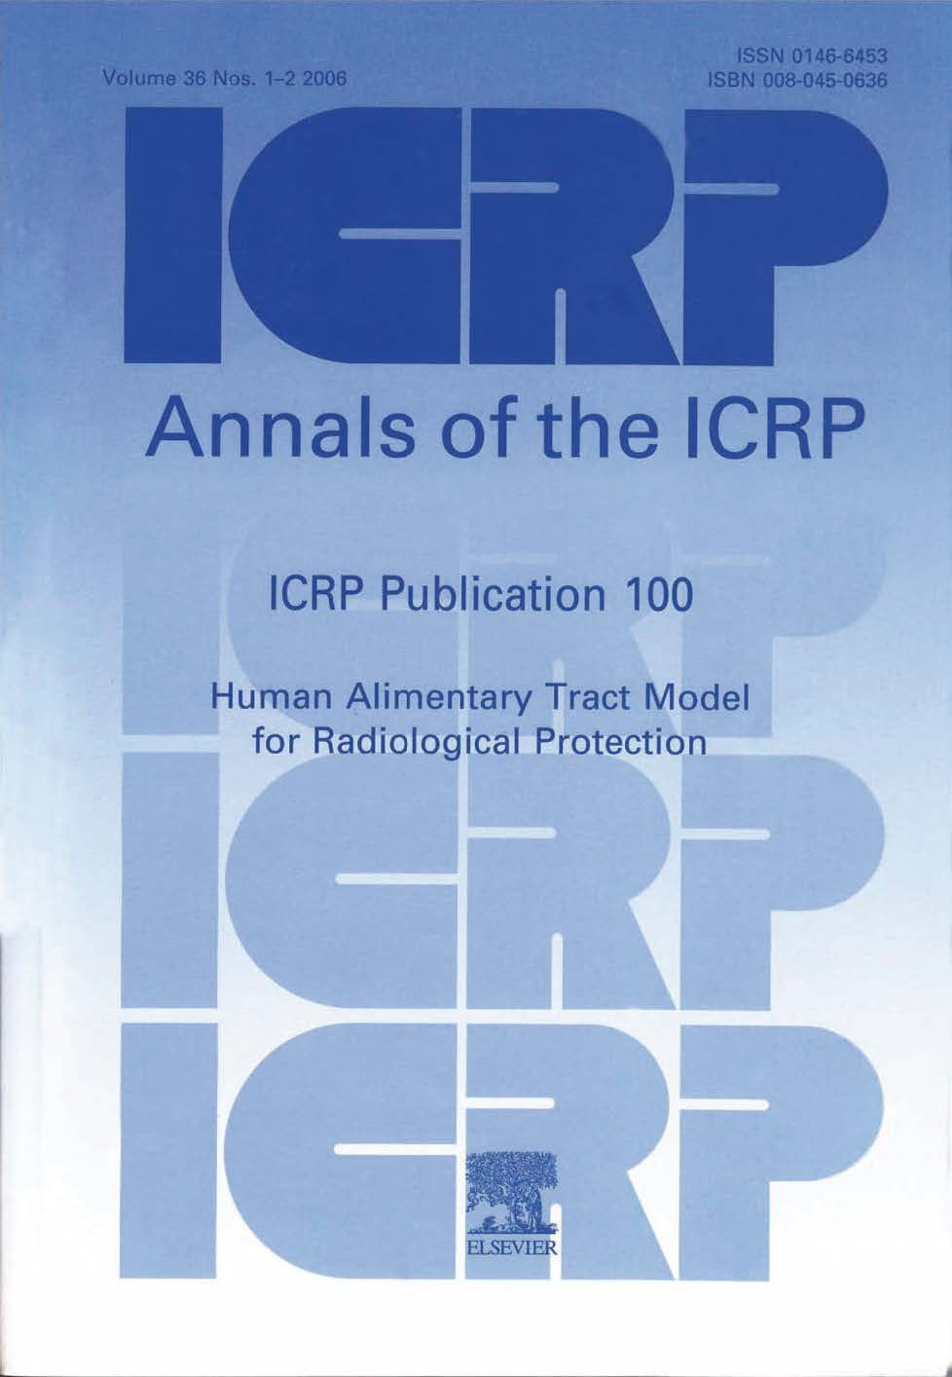
Lack of data (experiments) on gadolinium, tungsten, hafnium, and tantalum!

Slide 21

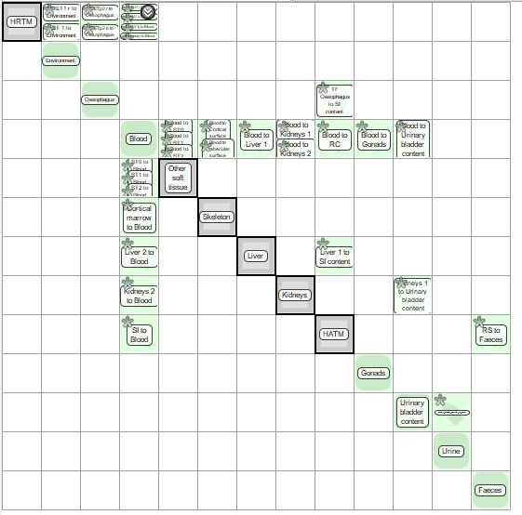

Biokinetic model of gadolinium

Slide 22
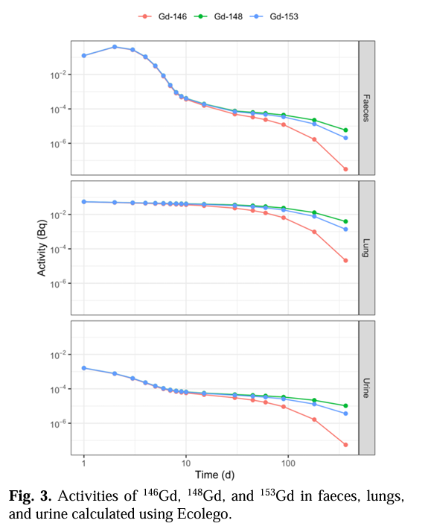
More advanced model hopefully coming soon!
SENSITIVITY ANALYSIS OF THE ICRP BIOKINETIC MODEL PREDICTING THE ACTIVITY OF GD IN LUNGS AND 24-HOUR EXCRETION SAMPLESRamljak, B., Malusek, A., Eriksson Stenström, K. & Rääf, C., 2023 nov. 11, Kaunas University of Technology. Kaunas University of Technology, s. 55-59 (MEDICAL PHYSICS IN THE BALTIC STATES ).

Slide 23
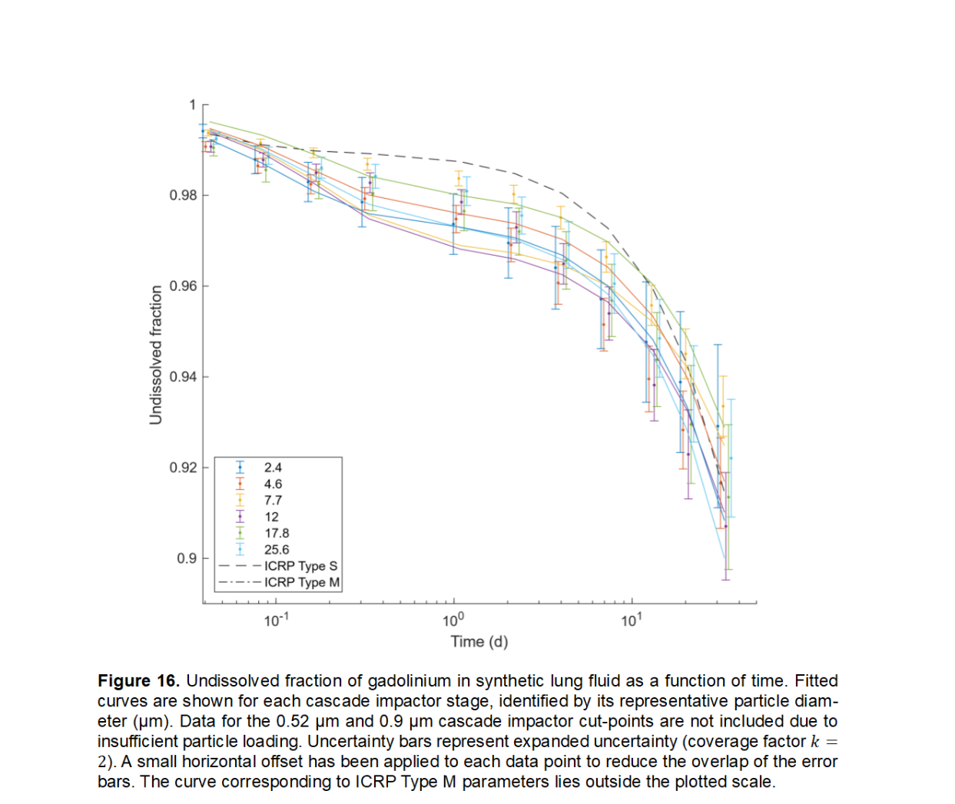
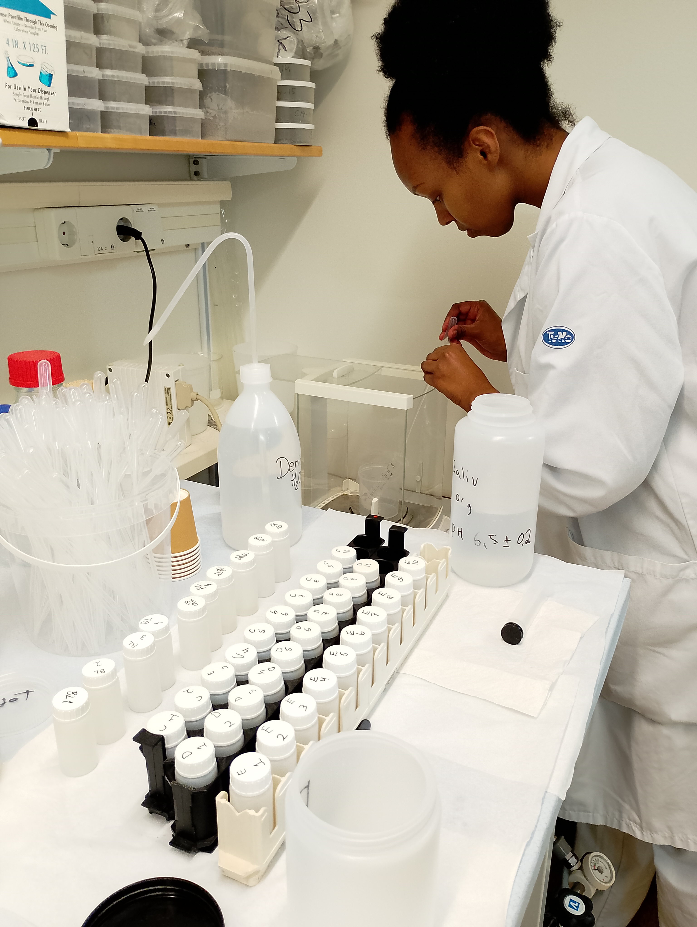

I mentioned lack of data
Experimental investigation of dissolution of gadolinium in lungs

Slide 24
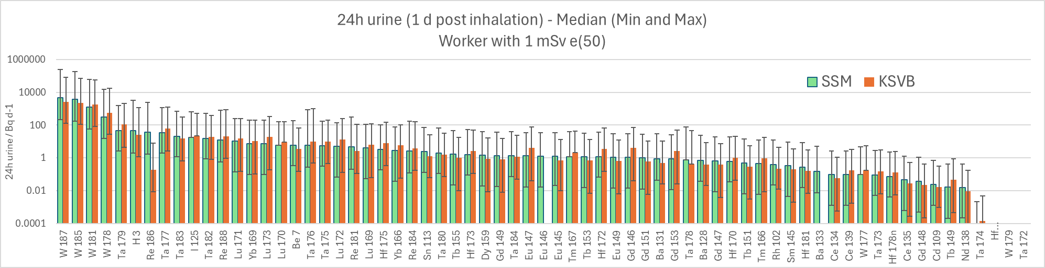
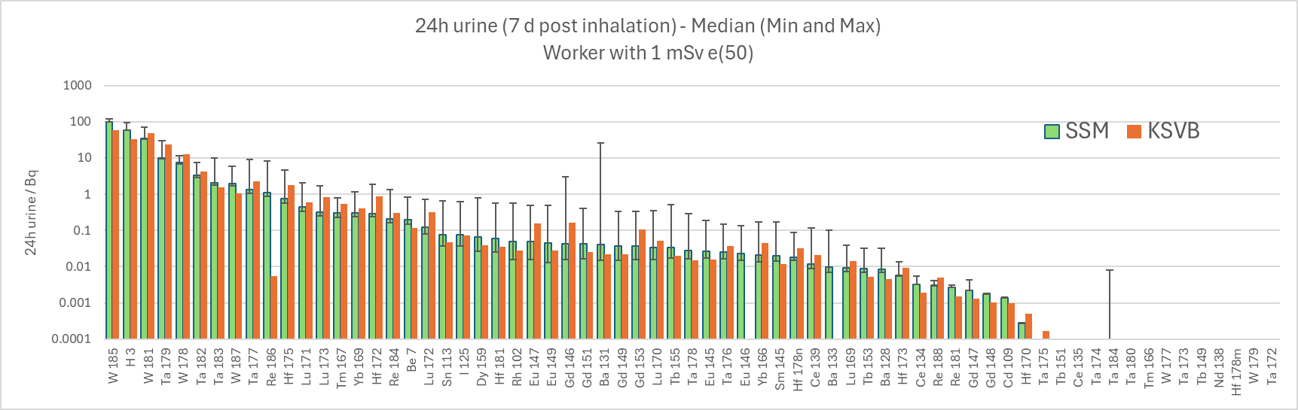
Challenges in radiometry
Which equipment to select?
Which radionuclides we can monitor?
What is the good time period to monitor?

Slide 25
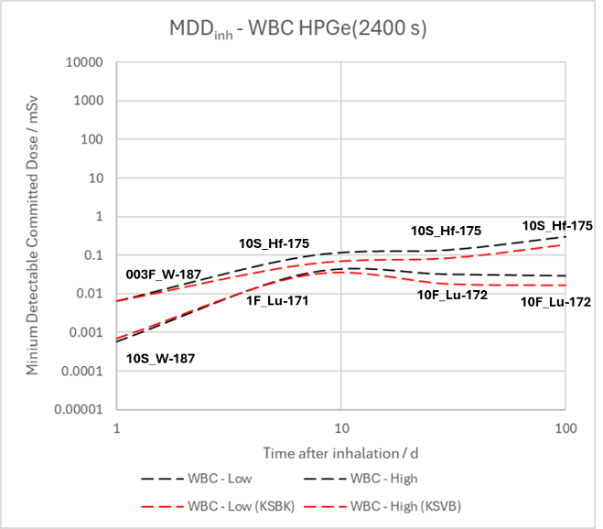
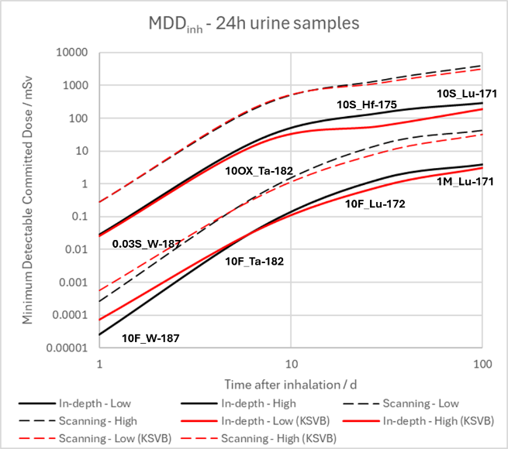
Challenges in radiometry

Slide 26
End slide, logotype only

