Slide 1


Study of Λ – Hadron Correlations in
Pb-Pb Collisions Using the ALICE Detector
Lund University
PhD Student Day
Joey Staa – 2025/12/11

Slide 2
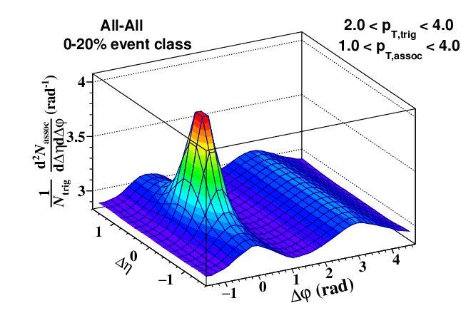
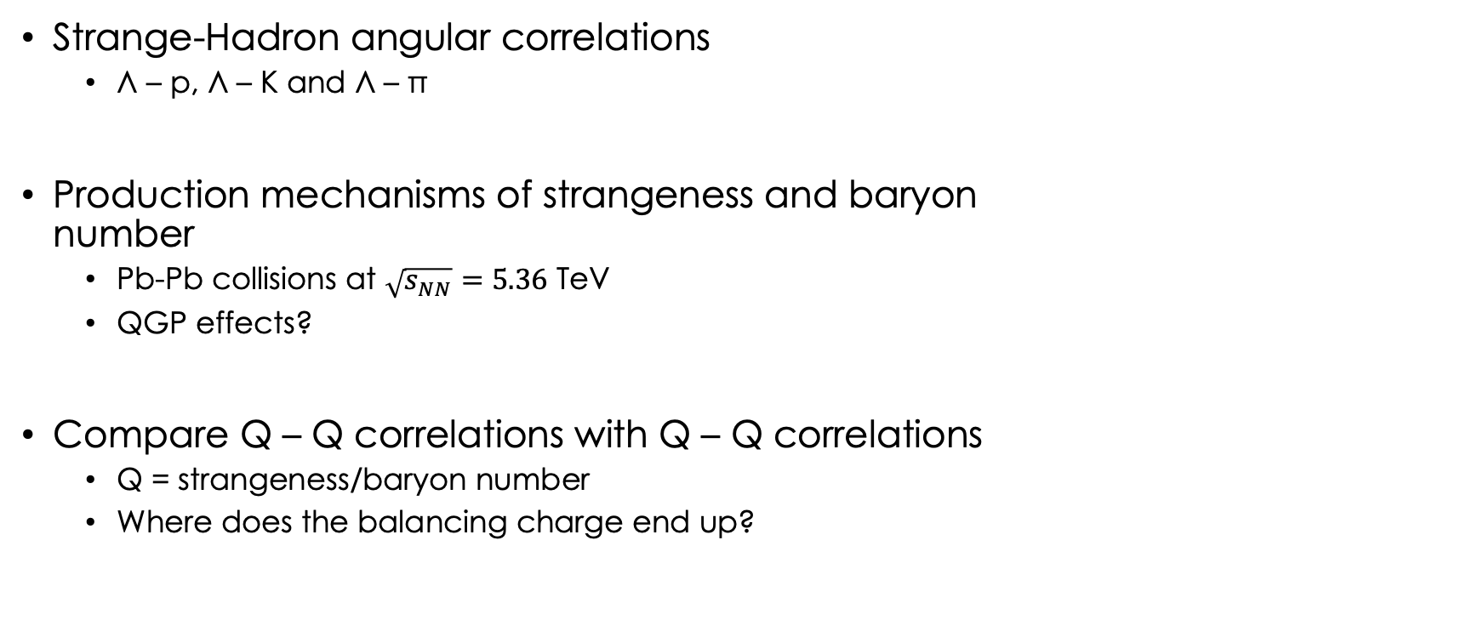
Introduction & Motivation
Strange-Hadron angular correlations
  Λ – p, Λ – K and Λ – π
Production mechanisms of strangeness and baryon
number
  Pb-Pb collisions at $\sqrt{s_{NN}}=5.36$ TeV
  QGP effects?
Compare Q – Q correlations with Q – Q correlations
  Q = strangeness/baryon number
  Where does the balancing charge end up?
doi: 10.48550/arXiv.2209.06213

Slide 3
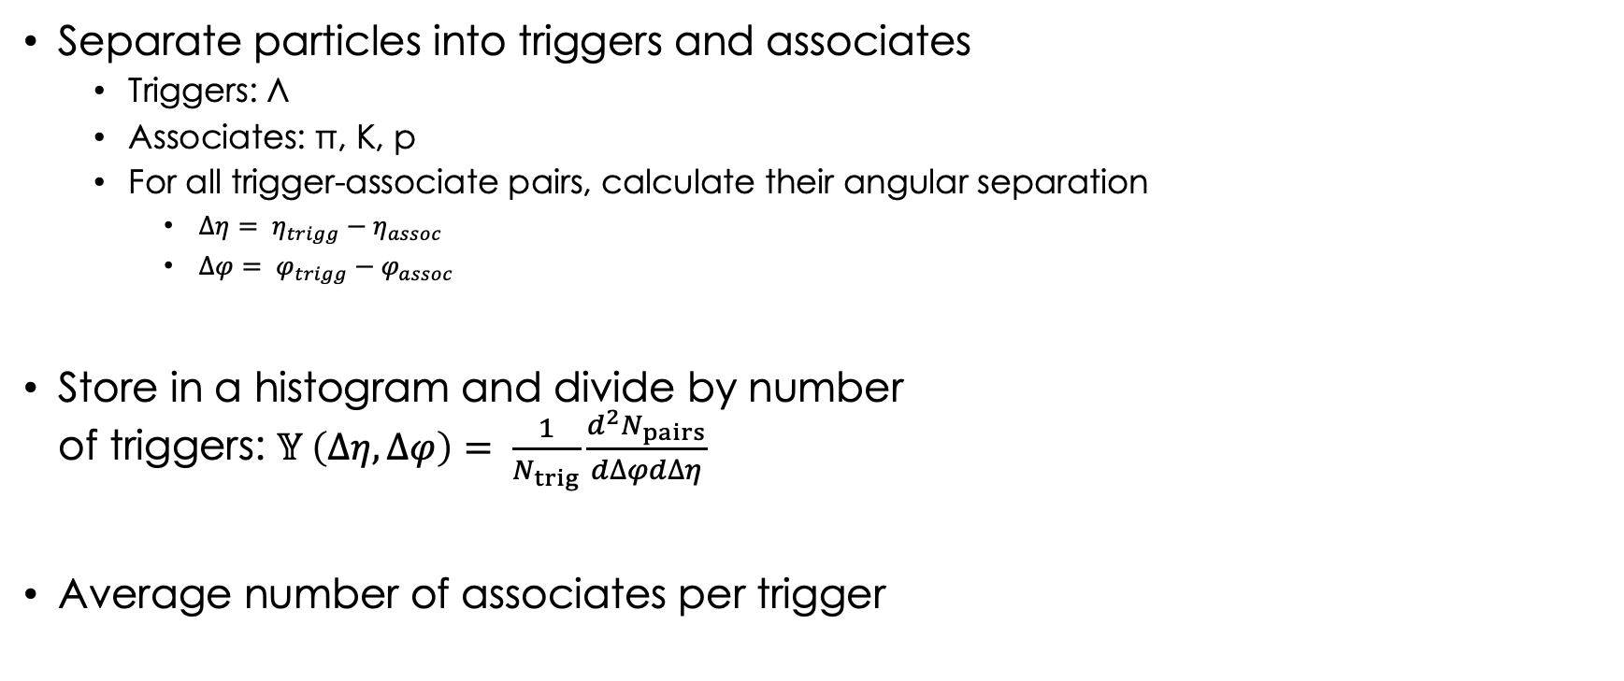
The Angular Correlation Function
Separate particles into triggers and associates
  Triggers: Λ
  Associates: π, K, p
  For all trigger-associate pairs, calculate their angular separation
    $Δη= η_{trigg}−η_{assoc}$
    $Δφ= φ_{trigg}−φ_{assoc}$
Store in a histogram and divide by number
of triggers: $𝕐 \left(∆η, ∆φ\right)= \frac{1}{N_{trig}}\frac{d^{2}N_{pairs}}{d∆φd∆η}$
Average number of associates per trigger

Slide 4
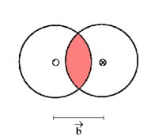
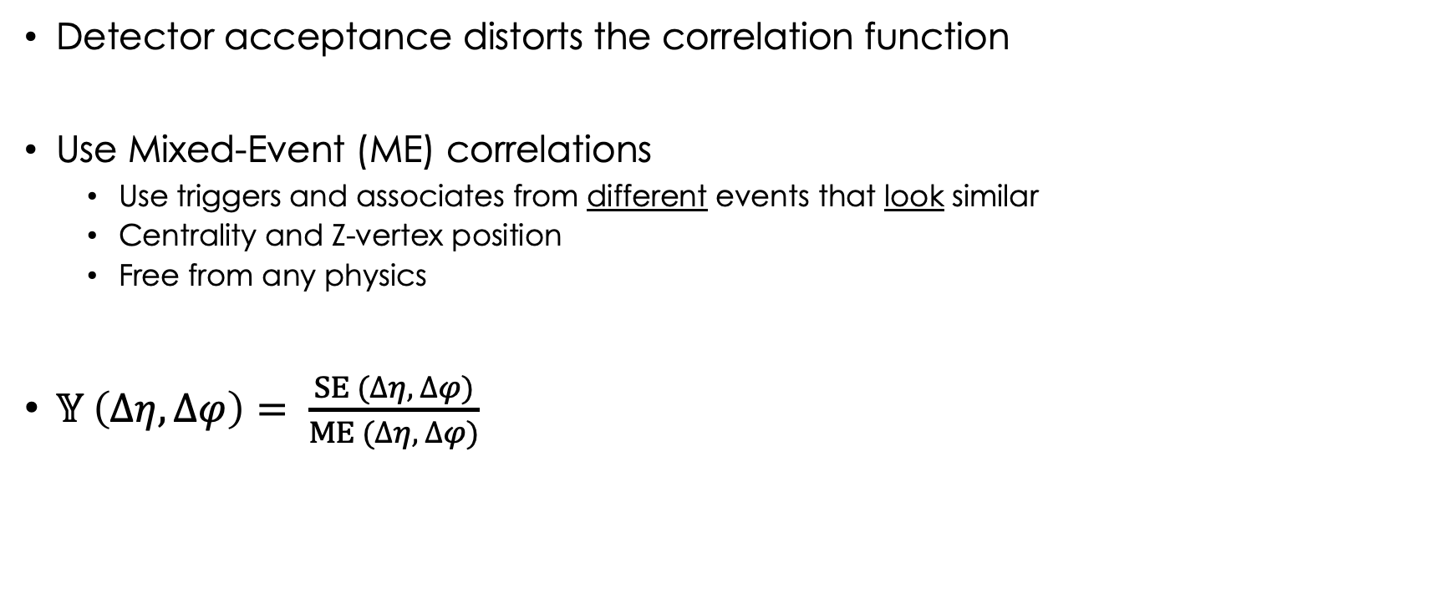
The Angular Correlation Function
Detector acceptance distorts the correlation function
Use Mixed-Event (ME) correlations
  Use triggers and associates from different events that look similar
  Centrality and Z-vertex position
  Free from any physics
$𝕐 \left(∆η, ∆φ\right)= \frac{SE (∆η, ∆φ)}{ME (∆η, ∆φ)}$

Slide 5
The Angular Correlation Function
Normalised such that (π, 0) = 1

Slide 6
Particle Identification - Associates
Make use of ALICE’s TPC & TOF detector
  For every associate, detectors calculate nσ^{π}, nσ^{K} and nσ^{p}
  “Inverse likelihood” that associate is a pion, kaon or proton
Initial guess: particle ID based on smallest nσ
Apply additional cuts to the smallest nσ
  Ensure the particle’s ID is correct
  Cuts are based on the full nσ^{i} distribution
  For a given p_{T}-range, apply a “hard” nσ cut
𝜋
K
p
𝜋
K
p

Slide 7
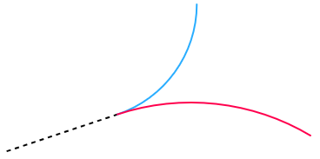
Particle Identification - Triggers
𝜋 ⁻
Λ-baryons are neutral, so invisible inside the
detector
Reconstruct Λ from the decay topology
  ”V0” shape, π ∓ and p±
  M_{inv} ≈ M_{Λ}
Use the full invariant mass distribution
  Apply a fit to identify a SGNL and SB region
  Make separate correlation functions for
  SGNL and SB
  Scale SB correlations to area underneath peak,
  then subtract from SGNL
Λ⁰
p

Slide 8
Balance Functions
Correlations are used to construct balance functions
Opposite-Sign (OS) minus Same-Sign (SS)
  Refers to the relevant quantum numbers between pairs
  Protons:
    OS = (Λ – p + Λ – p)/2
    SS = (Λ – p + Λ – p)/2
  Kaons:
    OS = (Λ – K⁺ + Λ – K⁻)/2
    SS = (Λ – K⁻ + Λ – K⁺)/2
OS and SS correlations should be nearly the same,
except for the charge balancing

Slide 9
Λ – p Balance Functions (OS – SS)
Balance function consists of a jet peak and a flat background
For protons, charge balancing is observed

Slide 10
Λ – p Balance Functions (OS – SS)
OS correlations are larger than SS correlations in the near side ($−\frac{π}{2}<Δφ<\frac{π}{2}$)
At the away side ($\frac{π}{2}<Δφ<\frac{3π}{2}$), correlations are approximately the same

Slide 11
Λ – p Balance Functions (OS – SS)
Charge balancing is observed at the near side
Balance remains flat at the away side

Slide 12
Λ – K Balance Functions (OS – SS)
Kaon correlations are much weaker compared to protons
Tiny difference at the near side for some centrality bins

Slide 13
Λ – K Balance Functions (OS – SS)
Balance appears shifted for some centrality bins
Very weak charge balancing is observed at the near side

Slide 14
Λ – π Balance Functions (OS – SS)
Pion correlations appear nearly identical
Very little difference between the near- and away side

Slide 15
Λ – π Balance Functions (OS – SS)
Balance is shifted downwards, but remains very flat
Little to no charge balancing

Slide 16
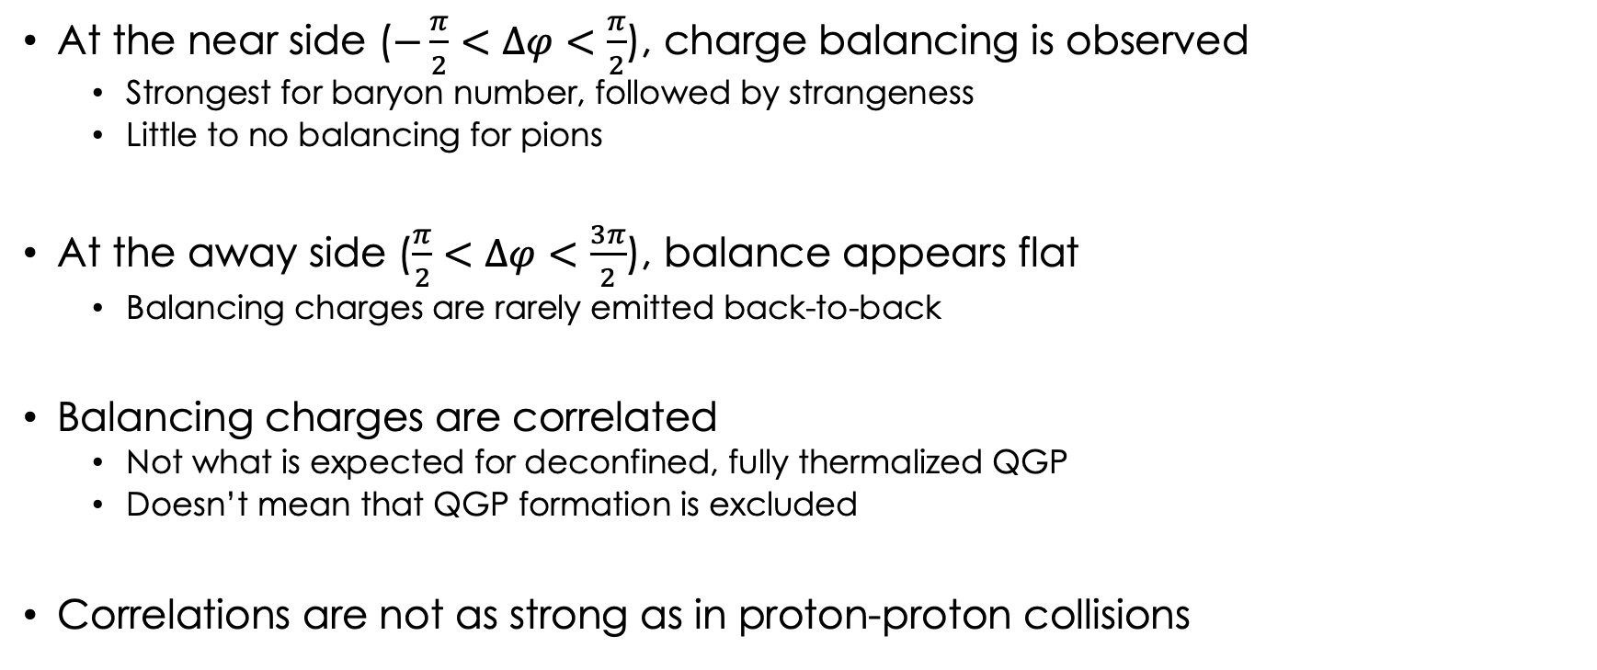
Conclusions
At the near side ($−\frac{π}{2}<Δφ<\frac{π}{2}$), charge balancing is observed
  Strongest for baryon number, followed by strangeness
  Little to no balancing for pions
At the away side ($\frac{π}{2}<Δφ<\frac{3π}{2}$), balance appears flat
  Balancing charges are rarely emitted back-to-back
Balancing charges are correlated
  Not what is expected for deconfined, fully thermalized QGP
  Doesn’t mean that QGP formation is excluded
Correlations are not as strong as in proton-proton collisions

Slide 17
Λ – K Balance Functions (OS – SS)

Slide 18
Λ – π Balance Functions (OS – SS)

