Slide 1
ARC: yearly summary report NG2017 Tromsø
Balázs Kónya, Lund University
NorduGrid Technical Coordinator

Slide 2

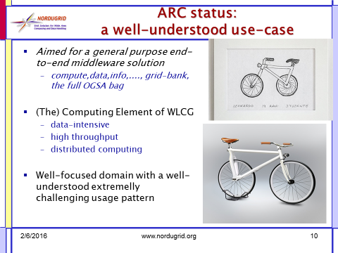
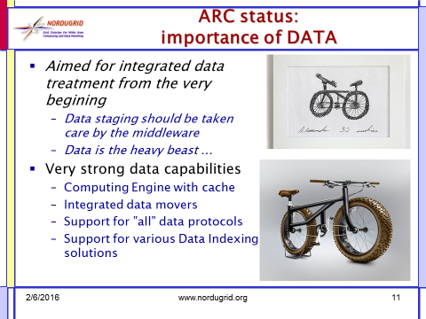
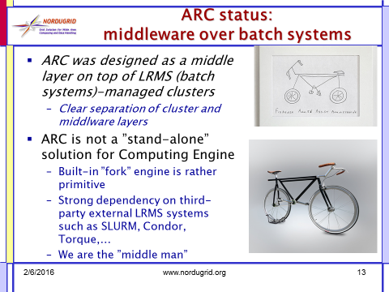
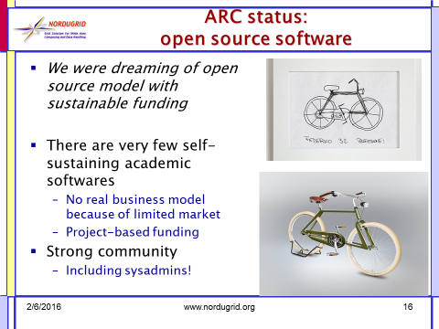
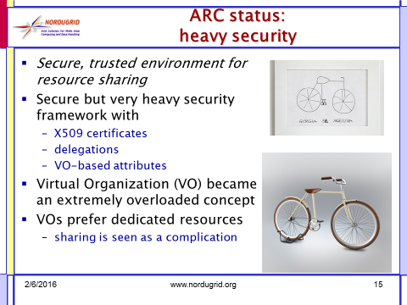
Follow up from Kosice
Conclusions from NG2016:
Design vs. Reality
Well-understood use-case
Importance of DATA
A middle layer over batch systems
Heavy security
Centralised and distributed
Overhead due to standard-compliance
Open source

Slide 3



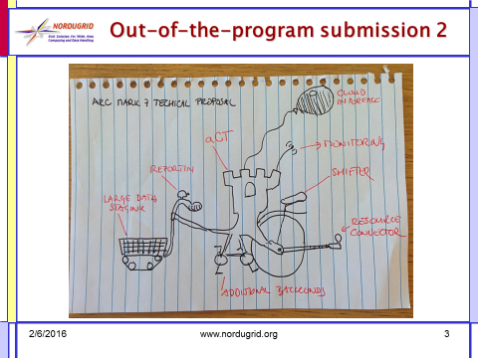
Follow up from Kosice

Slide 4
What happened since Kosice:
Overloaded and occupied by the usual fixes & improvements
nevertheless, for the first time since many years, we jumped on some major developments!
..thus ARC6 (the next major) is in the pipeline
…unfortunately, we can’t talk about a „BIG NEW THING” (yet)

Slide 5
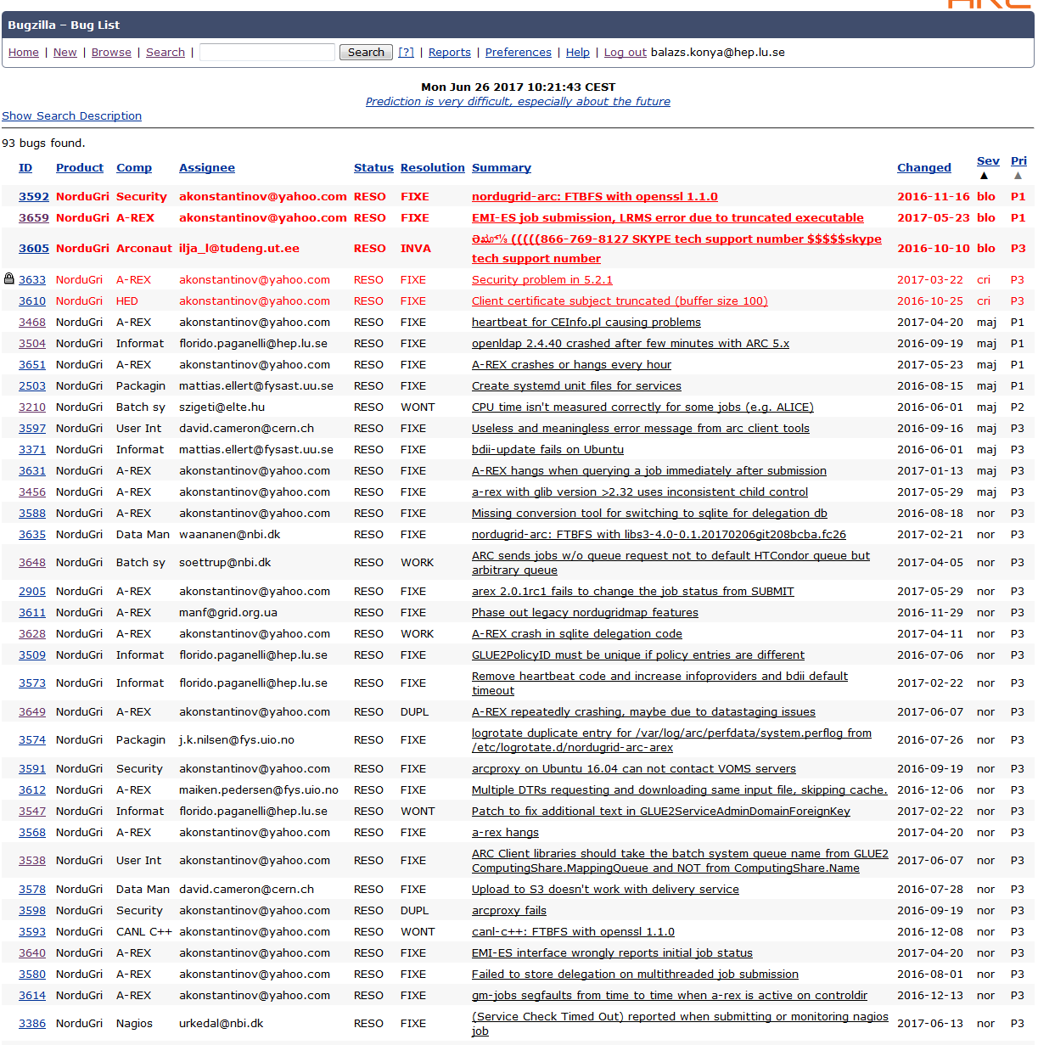
Business as usual: support & maintenance
Bugzilla, GGUS:
Openssl 1.1.0 migration
CEInfo.pl & heartbeat
Infosys/LDAP/bdii
EMI-ES interface issues
Arex stability issues
LRMS bugs
Most difficult: reproducing reported behaviour
And some topics from ng-discuss:
Jobstatus folder
Proposal for singularity RTE
Upgrade woes
AREX, JURA, LRMS problems
NorduGrid TCG monthly Digest

Slide 6
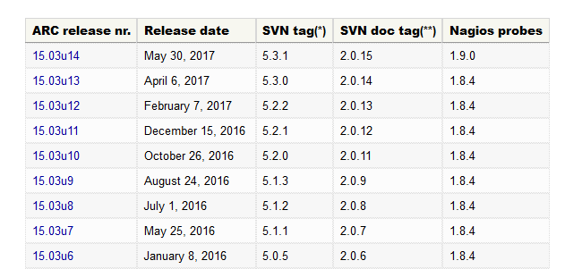
ARC Releases 2016-2017
http://www.nordugrid.org/arc/releases/
bugfix
minor

Slide 7
There was a bad release …
Serious A-REX stability issues in ARC 5.3.0
On April 6, 2017 an innocent looking minor release 15.03u13 (ARC 5.3.0) was announced:
As of Fedora 26 and Debian 9 and their migration to OpenSSL 1.1, ARC has undergone a lot of work in order to implement support for the new OpenSSL version
More support for sqlite as delegation database. To replace unstable BDB.
Various smaller enhancements and bugfixes in addition to code cleaning.
Sites upgrading to 5.3.0 started to report stability problems
One month long debugging campaign
Aleksandr: “I entered code review mode”
Skype calls, dedicated task force, long debugging sessions, …
On May 30, 2017 15.03u14 (ARC 5.3.1) came out
“In this release numerous fixes have been implemented in order to make ARC more reliable and stable.”

Slide 8
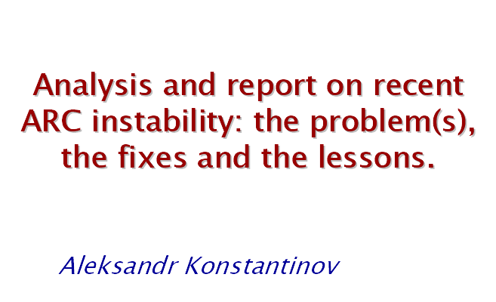
Post-mortem of 5.3.0
Superposition of problems:
New features introduced
Old but rarely used features became mainstream
Old problems for which no sufficient information was collected piled up
No testing in realistic environment
ACTIONS:
Continue hunting down leaks, strange code behaviours
Introduce heavy-load test on big site(s)
Access to logs, performance and monitoring data is critical
Mark 5.3.0 “DON’T USE IT”

Slide 9

NEW arc.conf: format FREEZE
Fixed structure!
Fixed syntax!
Fixed set of config parameters!
and also coded 80% of changes!
http://svn.nordugrid.org/trac/nordugrid/browser/arc1/branches/arcconf_restructuring/src/doc/arc.conf.reference

Slide 10

Cleaning up the configuration mess…
arc.conf is the server-side configuration file of an ARC CE.
Self-growing configuration since 2002 ...
Several failed redesign attempts (xml, modularize, ini...)
2015.07.02: [NG-disc] important community feedback: please send your arc.conf
January 2016: 3 days F2F meeting at Bodroki Kuria, reviewed the config line by line!
2016-2017: Continuous iterations, code camp, weekly calls
2017.06.15: the skype call where we resolved the last pending item and declared the ARC.CONF FREEZE

Slide 11

ARC.CONF blocks
OLD:
NEW:
#[common] #[vo] #[group] #[grid-manager] #[data-staging] #[gridftpd] #[gridftpd/filedir] #[gridftpd/jobs] #[infosys] #[infosys/glue12] #[infosys/site/sitename] #[infosys/admindomain] #[infosys/index/indexname] #[infosys/index/indexname/registration/registrationname] #[cluster] #[infosys/cluster/registration/registrationname] #[queue/gridlong] #[registration/emir] #[nordugridmap] #[acix/cacheserver] #[acix/indexserver]
#[common]
#[common/mapping]
#[userlist:biousers]
#[authgroup:allowedusers]
#[lrms]
#[lrms/ssh]
#[arex]
#[arex/cache]
#[arex/data-staging]
#[arex/ws]
#[arex/ws/emies]
#[arex/ws/cache]
#[arex/ws/candypond]
#[arex/ws/argus]
#[arex/jura]
#[arex/jura/archiving]
#[arex/jura/sgas:neic_sgas]
#[arex/jura/apel:prod_apel]
#[gridftpd]
#[gridftpd/jobs]
#[gridftpd/filedir]
#[infosys]
#[infosys/ldap]
#[infosys/ldap/bdii]
#[infosys/nordugrid]
#[infosys/glue2]
#[infosys/glue2/ldap]
#[infosys/glue1]
#[infosys/glue1/site:name]
#[cluster]
#[cluster/registration:name]
#[queue:gridlong]
#[datadelivery-service]
#[acix-scanner]
#[acix-index]
#[monitoring]
#[monitoring/perflog]
#[monitoring/ganglia]
#[nordugridmap]

Slide 12
Virtual Organizations (VO)
The main idea (concept):
Don’t work with individual users, instead “manage” a collection/self-organized group of those: the VO
VO is a (potentially large) dynamic group of individuals
Individual’s personal details become irrelevant (as long as credentials are valid)
Individuals should be still distinct, such as not to modify each other’s runtime environment
Authorization, accounting, environment setup, etc.. on a CE should be done per VOs
The problem:
VO-specific configurations are spread all over the various ARC service/component/feature modules.
The solution (yet to be found):
New configuration block(s) following a VO-centric view

Slide 13

Hidden treasures: Candypond
Cache and deliver your pilot on-demand data service:
It is an AREX Web-Service
https://hostname:443/arex/candypond
Re-discovered and rescued during arc.conf review
Was hidden under the name cacheservice, just next to the cacheserver of ACIX
Exposes various useful operations of the cache
link given URLs from the cache to the specified job directory on the worker node
query the cache service for the existence of the given URLs in the cache
Useful for the pilot job model where input data for jobs are not known until the job is running on the worker node

Slide 14
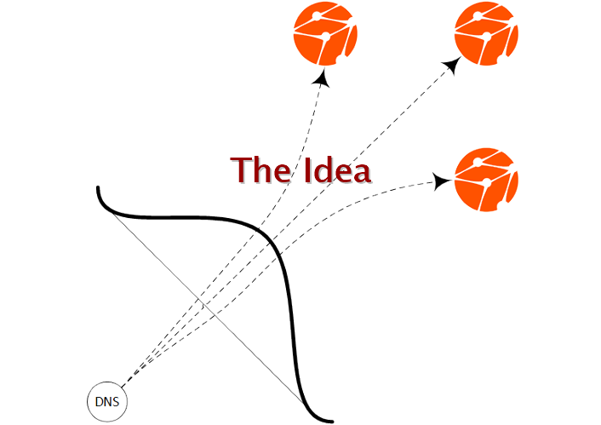
ARCHERY: ARC Hierarchical Endpoint Registry
Use DNS infrastructure
Organize service endpoints in a hierarchical list
Top-bottom management

Slide 15
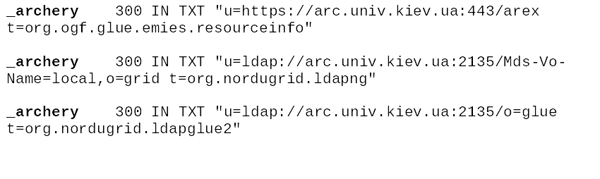
ARCHERY details
_archery TXT RR as an entry point
RR format for each endpoint is:
u=<uri> t=<type> [t=<type>...] [s=<status>]
Is it OK to use DNS used this way?
Yes! e-mail security is heavily rely on DNS RR
SFP [RFC 7208], DKIM [RFC 6376], DMARK [RFC 7489]

Slide 16
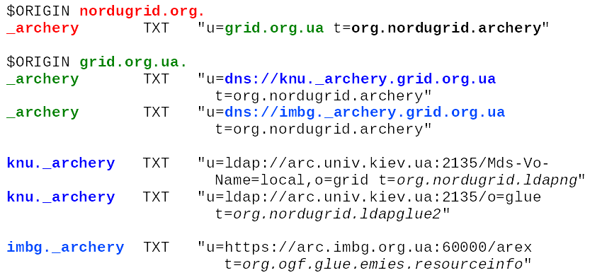
ARCHERY details

Slide 17
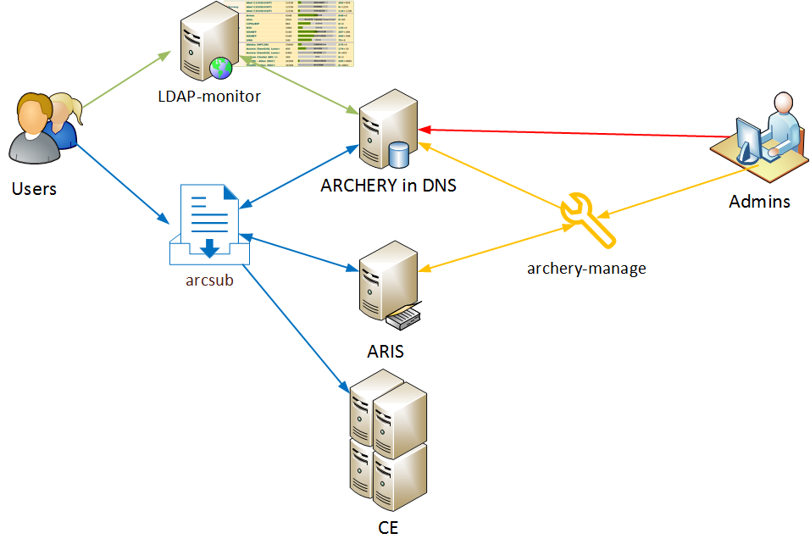
ARCHERY: overview
All the necessary coding is done!
Deployment details need to be agreed

Slide 18

server-side: rolling out EMI-ES
What is it?
A powerful Web Service interface for an ARC-CE
A kind of standard
http://svn.nordugrid.org/repos/nordugrid/doc/trunk/tech_doc/emi-es/EMI-ES-Specification_v1.16.pdf
Why is it useful?
Job management, state model, data staging, job & cluster information, delegation, job description, bulk job operations
Could replace LDAP and gridftp-job services
How much of it is supported in ARC?
Almost everything.
Why is it not used then?
It is already used: boinc ACT
scalability & stability tests are ongoing
discovered issues are quickly being fixed

Slide 19
few lines about the client side
set of commands to interact with ARC services from the command line
arcsub, arcget, arccp, arcproxy, ...
ARC SDK library for 3rd party developers
to write higher-level frameworks, utilities
or integrate ARC services into applications
set of c++ libraries: common, compute, credential, data, datastaging
also available in Python via Swig bindings
The arc* CLI and the aCT implemented on top of the SDK
disclaimer:
At the moment there are limited development resources
Focus is put on SDK

Slide 20
Security layer of ARC
Good news:
no security incident, no vulnerabilities
Bad news:
no ongoing or even planned developments in ARC security framework
we are not following trends (AARC blueprint)
a deserted area of ARC

Slide 21
The next MAJOR release (ARC 6)
Previous major releases:
V5 (15.03 Release):
arc-ur-logger got replaced by JURA, removed several components, modules (old data staging)
V4 (13.11 Release):
new client-side BDB job storage
ARC 6: major changes
Re-engineered server-side configuration
Event-driven internal A-REX job processing
NEW framework for RTE management
NEW Python-LRMS backends
NEW service endpoint registry: ARCHERY
OBSOLETED: EMIR, EGIS, CREAM, UNICORE, JAVA-SDK, …
Timeline: during autumn 2017

Slide 22
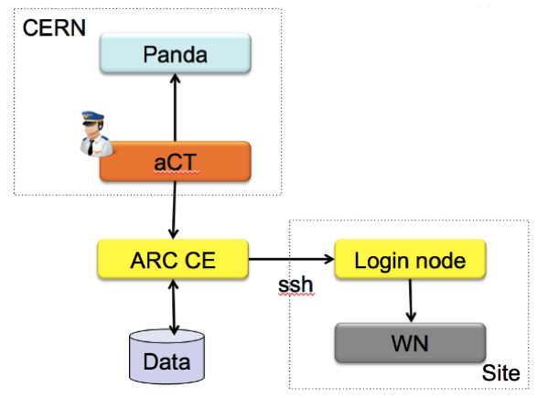
ARC on HPCs: remote-lrms
Some HPC sites are very restrictive allowing only ssh communication with outside world.
ARC jobs can still run on these sites e.g. with ARC-CE ssh-ing to site’s login-node (remote lrms feature of ARC)
23

Slide 23
ARC on HPCs: aCT@site
Some HPC sites are even more restrictive and don’t want any unusual service with open network interfaces
Solution: pull jobs/data to the HPC site: aCT@site:
Deploy a tightly integrated aCT and a networkless ARC CE on the HPC the site
aCT & ARC is closely coupled via the local filesystem
aCT takes care of pulling jobs to HPC
pull requests
HPC-Site
aCT
tight integration
ARC CE
WN

Slide 24

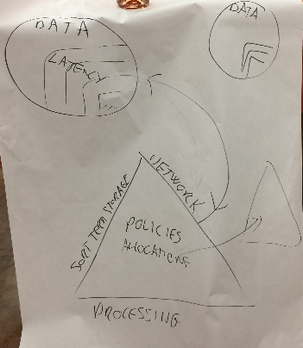
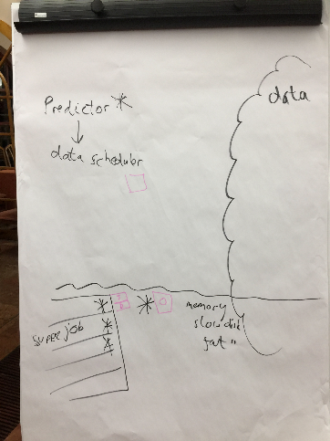
longer term future?
Move away being a middleman and focus on what is in the name:
Advanced
Resource
Connector
Have a vision of something great..
The brainstorming work started at the ABC f2f retreat in Monor, November 2016

Slide 25
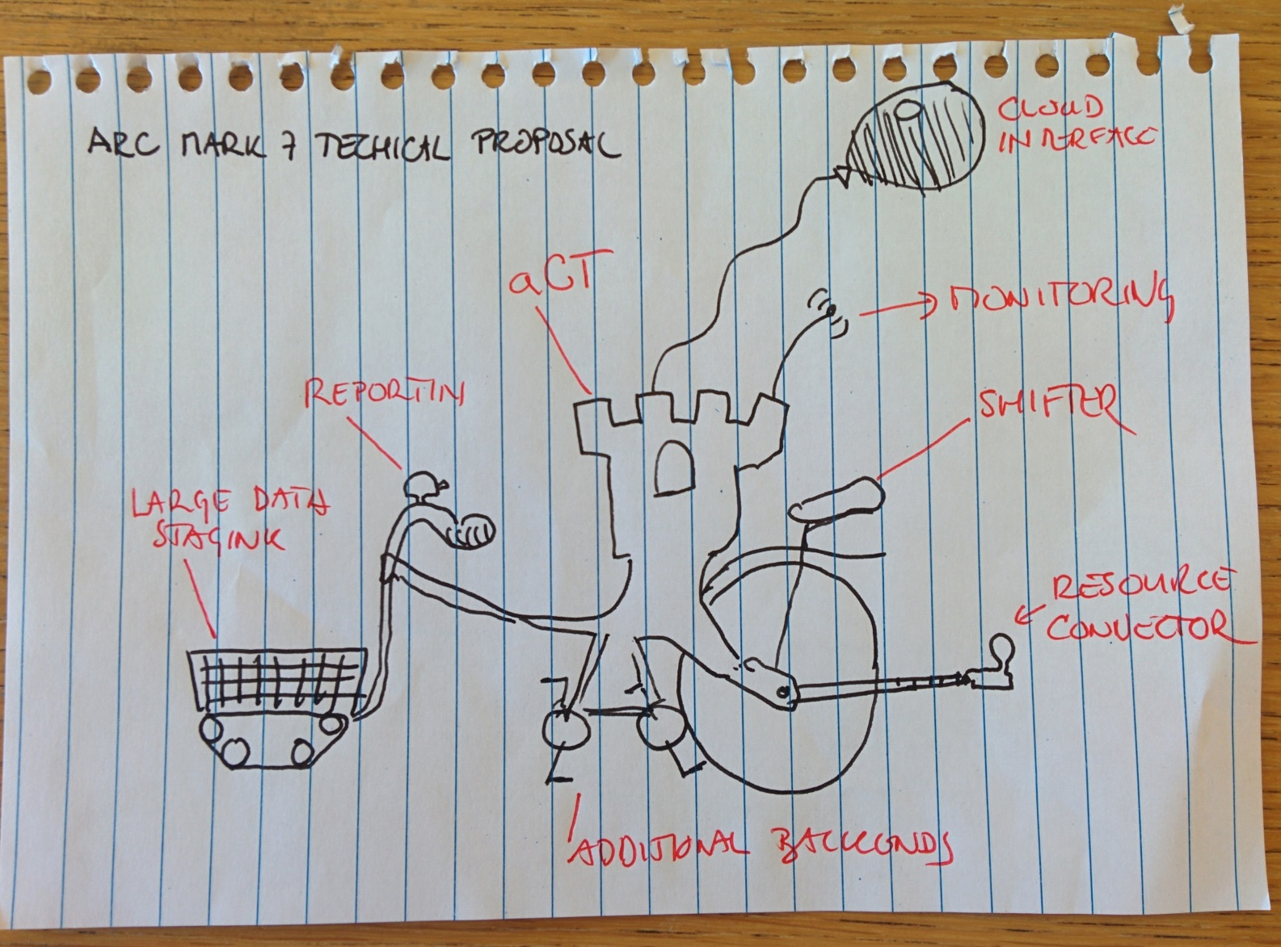

Summary of the past year
Not on the figure:
arc.conf
ARCHERY
EMI-ES

