Slide 1
Demos: ARC and ATLAS Event Service for HPC
David Cameron
NorduGrid Conference,
Tromsø, 29 June 2017

Slide 2
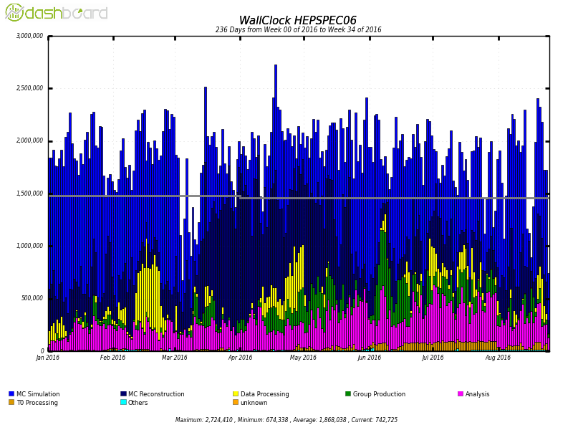
Opportunistic Resources
A vital contributor to ATLAS computing
  HPC backfilling, cloud spot market, volunteer computing, HLT farm
A common factor is that resources can disappear at any time, even in the middle of a job
Other potential issues:
  No network connectivity from worker nodes
  No root-mounted CVMFS for software
  No persistent edge services on eg login nodes
Unpledged
Pledged

Slide 3
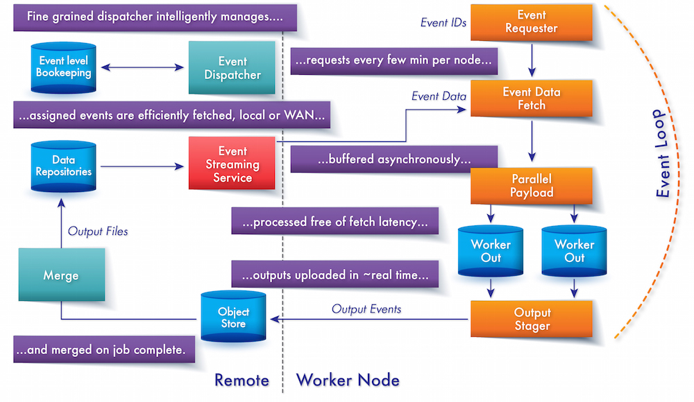
ATLAS Event Service
A regular ATLAS job processes a fixed number of events
The Event Service goes to event-level granularity
  As a job runs, it regularly saves events produced to an Object Store
  If a job is terminated it loses at most the last 10 mins of events
  Unfinished events are reassigned to another job
  Events are merged and stored on regular Grid storage

Slide 4
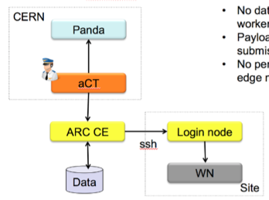
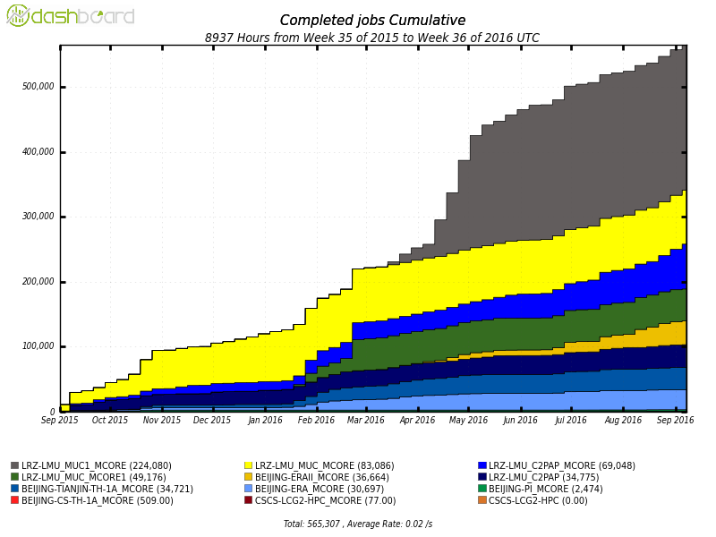
ARC CE and ARC Control Tower
ARC CE: Designed to be a lightweight non-intrusive resource connector
Performs staging in and out of data
ARC Control Tower (aCT) handles communication with Panda (ATLAS workload management system)
No Grid software or outbound connectivity needed from worker nodes
ssh mode for the more restrictive HPCs
Used to integrate HPCs in Europe and China (as well as many “regular” Grid sites)

Slide 5
Integration of ARC CE and Event Service
How to run jobs on a preemptable resource with no network connectivity?
  Run Event Service jobs and do asynchronous data staging with ARC CE
  The job writes each event + metadata to working directory
  Once finished, the names of events are put in a special file
  ARC CE detects the job finished in the batch system, and uploads the events listed in the file
  ARC Control Tower tells Panda which events succeeded
If preempted, a special ARC CE plugin runs
  It tells ARC CE that the job succeeded
  It finds the events that were produced and puts them in the special file

Slide 6
Challenges
The number of events to upload from one ARC CE quickly became a bottleneck
  10k cores, 5 mins per event = 30Hz upload
Led to zip functionality in Event Service
  After job finishes pilot creates a tarball of events
  Reduces data transfer rate by orders of magnitude
  Also makes merge job more efficient
Many extensions of aCT/ARC required

Slide 7
ARC Extensions
Object store support
  DMC for S3 protocol, uses S3 libraries available in standard repos
  Supports write, read, list, delete
  Requires setting S3_SECRET_KEY and S3_ACCESS_KEY in env
  > arcls -l s3://cs3.cern.ch:443/atlas-eventservice/panda.jeditest.HITS.d38f65a4-e996-4eb2-85d2-9d47d8bc9a27.000010.HITS.pool.root.1.11318977-3376091258-9453622235-3-10
  <Name> <Type> <Size> <Modified> <CheckSum> <Latency>
  panda.jeditest.HITS.d38f65a4-e996-4eb2-85d2-9d47d8bc9a27.000010.HITS.pool.root.1.11318977-3376091258-9453622235-3-10 file 20417 2017-05-12 05:35:32 (n/a) (n/a)
Passing event ranges back and forward
  After aCT pulls the job, it calls getEventRanges() from PanDA
  When job finishes, the list of done events is retrieved from ARC CE and aCT calls updateEventRanges()

Slide 8
unfail plugin
Plugin to emulate pilot functionality for preempted jobs - code
Runs before FINISHING state:
  authplugin="FINISHING 10 /path/to/unfail.py %u:%g %C %R %I wrong exit code”
Workflow:
  Check that job failed with specified error
  Check that events were produced (event metadata.xml exists)
  Remove job.id.failed
  Fix job.id.diag with batch system resource info if possible
  Make a log tarball with selected files
  Create output tarball of events if necessary
  Run outputfiles.py from the session dir to produce the output.list and PFC
  Make a minimal pilot pickle file if possible to get resource info
  Create jobSmallFiles.tgz

Slide 9

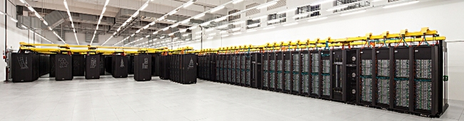
Test setup
The SuperMUC HPC in Munich is our test system
  Phase 1 (2011-13): 155000 cores, 3.2PFlops
  Phase 2 (2015): 86k cores, 3.6 PFlops
  #27 on Top500 (June 16)
Over a period of 3 days ran Event Service jobs on Phase 1
Each job attempted to run 500 events over 24 cores (~4h walltime)
All jobs could be preempted at any time

Slide 10
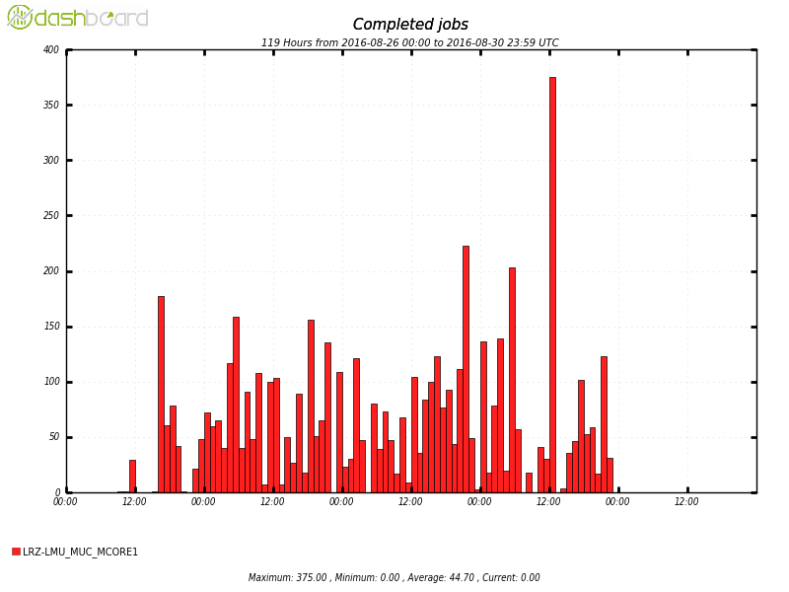
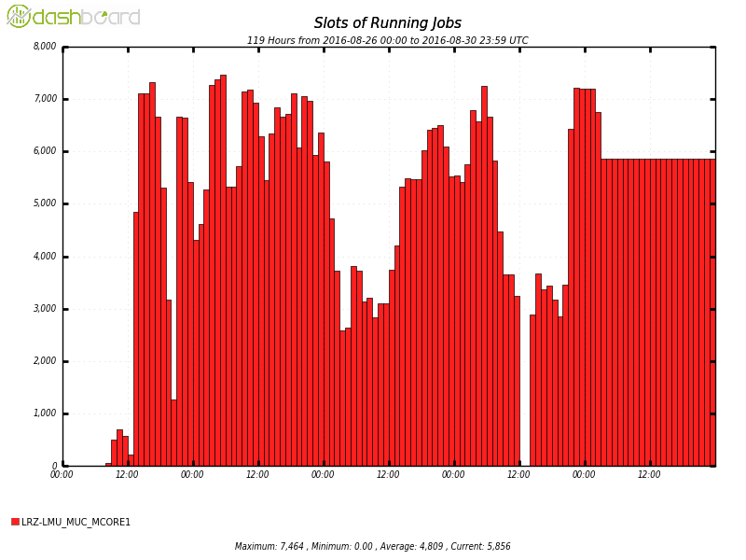
Results
 | Finished | Preempted | Total
Jobs | 3861 | 1014 | 4875
Events (M) | 1.93 | 0.23 | 2.16
CPU hours (k) | 196 | 24 | 220
Jobs used up to 7000 cores (24 each)
Out of a total of 4875 jobs 21% of jobs were preempted
10% of events were saved from preempted jobs

Slide 11
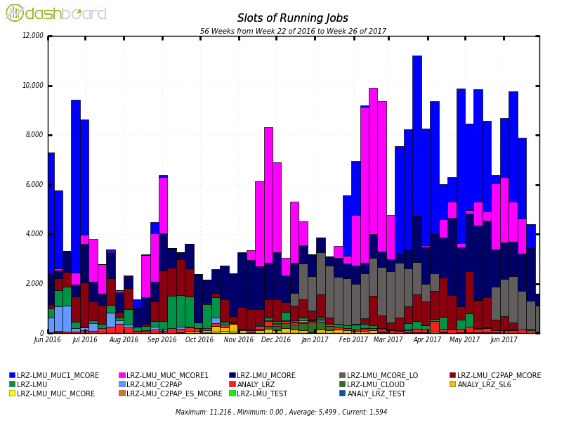
LRZ jobs
SuperMUC ES jobs
SuperMUC normal jobs
rest
T2 jobs

Slide 12
Conclusion
Integrating ARC and Event Service provides an effective solution for using opportunistic resources in restricted environments
  Specifically HPC but could be applicable in other areas eg volunteer computing, clouds
In a 3-day test on SuperMUC we used 1000 CPU days which would have otherwise been lost
Future directions:
  Scaling up
  Using on other HPC sites as Event Service usage grows
  Adapting to the Event Streaming Service

