Slide 1
Demos: ATLAS@Home
David Cameron
NorduGrid Conference,
Tromsø, 29 June 2017

Slide 2

Volunteer Computing
People volunteering their PC’s spare CPU cycles for science/mathematics/bitcoins…
The most commonly used software is BOINC
Why ATLAS@Home?
  Free resources in a time of flat funding
  Outreach and connecting to the public
ATLAS@Home is now part of LHC@Home
  https://lhcathome.web.cern.ch/projects/atlas

Slide 3
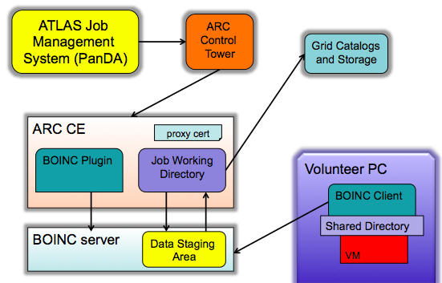
ATLAS@Home jobs
Volunteers run ATLAS MC simulation jobs inside a CERNVM Virtual Machine
  70% of our volunteers run Windows
Jobs are taken from the ATLAS job management system (Panda) and submitted to BOINC server through ARC CE
  No grid credentials distributed to volunteers

Slide 4
Current ATLAS@Home Setup
CERN
Panda Server
ARC Control Tower
Grid Catalogs and Storage
BOINC_MCORE PQ
ARC CE
arc-boinc-01.cern.ch
Shared NFS (2TB)
ARC cache
ARC sessiondir
BOINC stagingdir
ARC CE
arc-boinc-03.cern.ch
Volunteer PC
BOINC Plugin
BOINC Client
MySQL
(DB on demand)
BOINC server (LHC@Home)
boincai06.cern.ch
Shared Directory
VM

Slide 5
BOINC Plugin
*-boinc-job LRMS scripts
  submit: collect job requirements, filenames and pass to BOINC command create_work. Copy or link input files to BOINC server staging area
  scan: query DB for state of jobs
  cancel: run BOINC command cancel_jobs
Boinc.pm infoprovider
  Query DB for job state and total resources
arc.conf
  lrms=boinc
  Database connection parameters
Generic for any BOINC project
  Except some ATLAS-specific handling of input files in the submit script
echo "bin/create_work \
--appname $BOINC_APP \
--wu_name $wu \
--wu_template $WU_TEMPLATE \
--result_template $RESULT_TEMPLATE \
--rsc_memory_bound $memreq \
--rsc_fpops_est $maxcputime \
--remote_file $remote_url $fsize $md5 \
$priority \
$(basename $JobInput) \
$RTE_FILE \
$(basename $LRMS_JOB_SCRIPT)" >> $LRMS_JOB_BOINC
ATLAS-SITE RTE sets project parameters
  Path to BOINC project area
  App name
This will eventually go into arc.conf

Slide 6
Multicore support
The limiting factor for many volunteers is the memory ATLAS software consumes
  2.3GB for VM + overhead -> max 1 job per 4GB
In July 2016 a multicore version of ATLAS@Home was introduced
The app uses as many cores as available on the PC (up to 8)
The VM is started with this many cores and memory=2.5GB + 0.8GB * ncores
  2 cores need 4.1GB memory
  8 cores need 8.9GB memory
Before the job starts the ATLAS wrapper sets the number of cores for the job to use based on how many cores the VM has

Slide 7
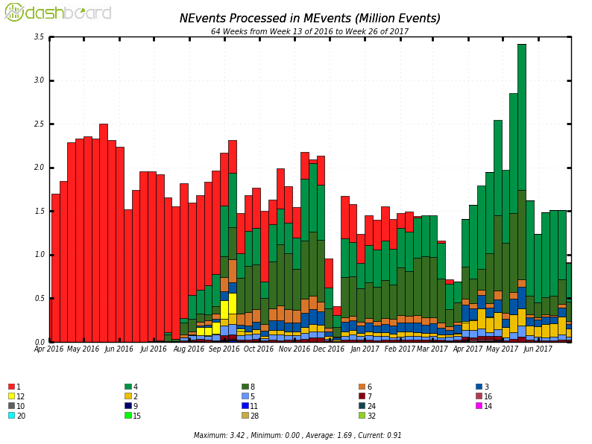
Multicore results
Different colours represent different core numbers

Slide 8
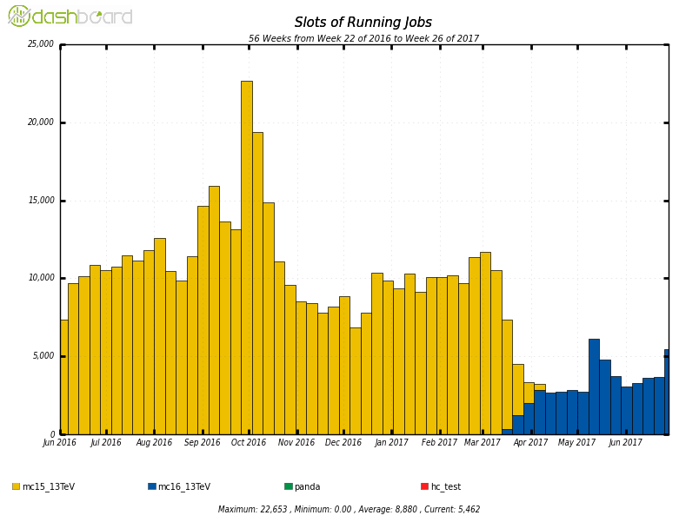
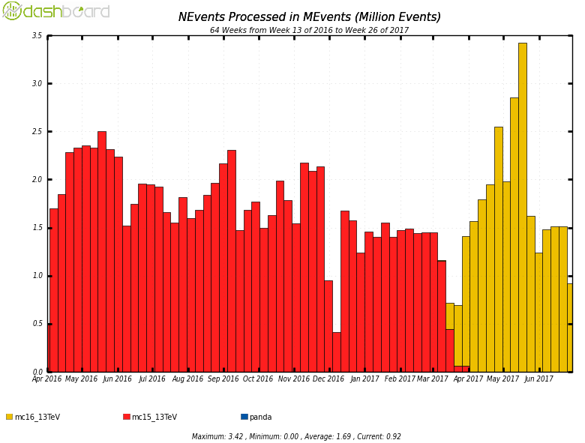
ATLAS@Home -> LHC@Home
LHC experiments independently started volunteer computing projects in last few years
  All now consolidated under one umbrella project: LHC@Home
  Single infrastructure to support
  Unified outreach effort
  Easier for volunteers to contribute to “CERN projects”
After transition: more work from fewer hosts

Slide 9

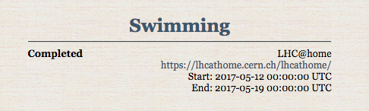
ATLAS@Home -> LHC@Home
LHC experiments independently started volunteer computing projects in last few years
  All now consolidated under one umbrella project: LHC@Home
  Single infrastructure to support
  Unified outreach effort
  Easier for volunteers to contribute to “CERN projects”
After transition: more work from fewer hosts
https://www.seti-germany.de/boinc_pentathlon/start.php?&lang=en

Slide 10
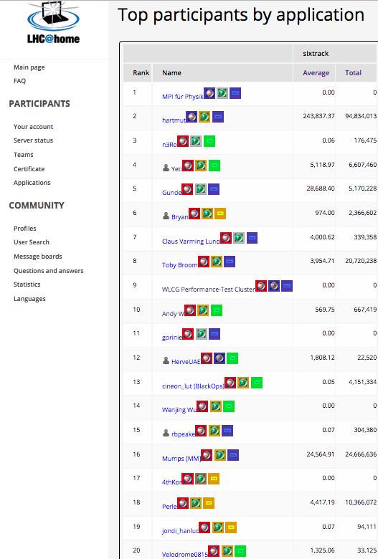
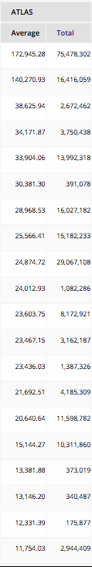
Volunteers
Credit is granted to volunteers after completing jobs
No monetary value but incentive for competition!
ATLAS@Home for idle desktops/worker nodes at ATLAS institutes
#1: Office desktops at MPI Munich
#9: ATLAS software performance testing cluster at CERN
ATLAS@Home is the most lightweight “Grid site” solution
No storage, no services, non-intrusive
https://lhcathome.cern.ch/lhcathome/per_app_list.php?appid=14&is_team=&is_total=0

Slide 11
On the Volunteer Side
Install BOINC Client and VirtualBox
  http://boinc.berkeley.edu/download.php
  One combined package for Windows
Choose LHC@Home
  Create an account from BOINC Manager or web pages
Select ATLAS app in project preferences
Start crunching!
  Note: initial 500MB download

Slide 12
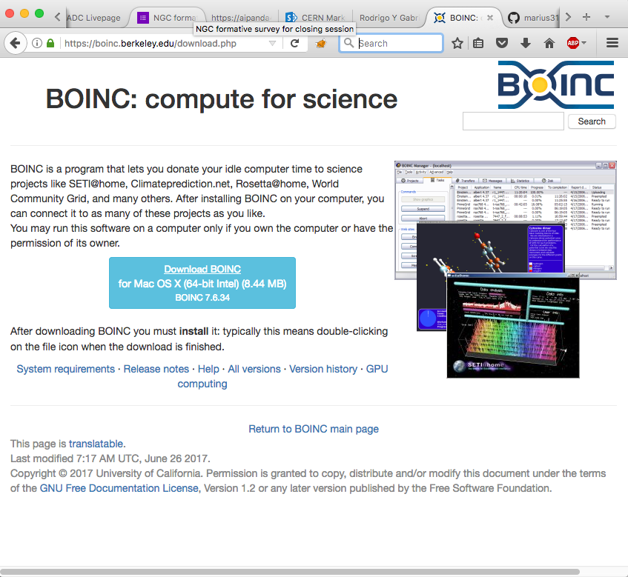
https://boinc.berkeley.edu/download.php
BOINC download page

Slide 13
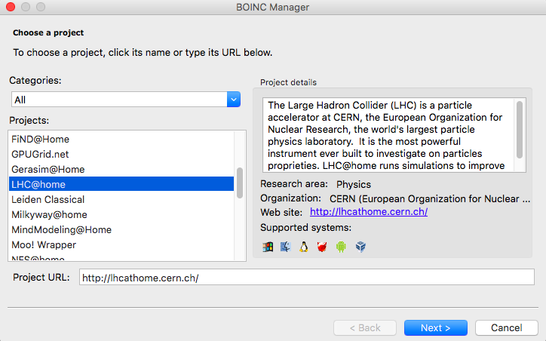

Slide 14
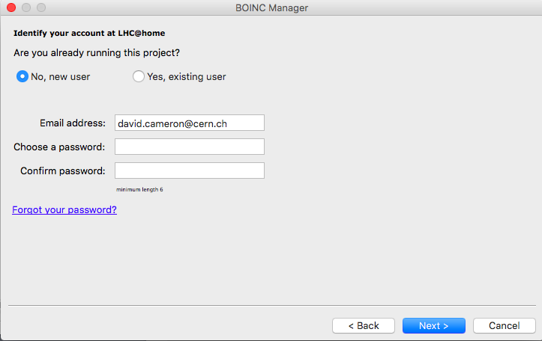

Slide 15
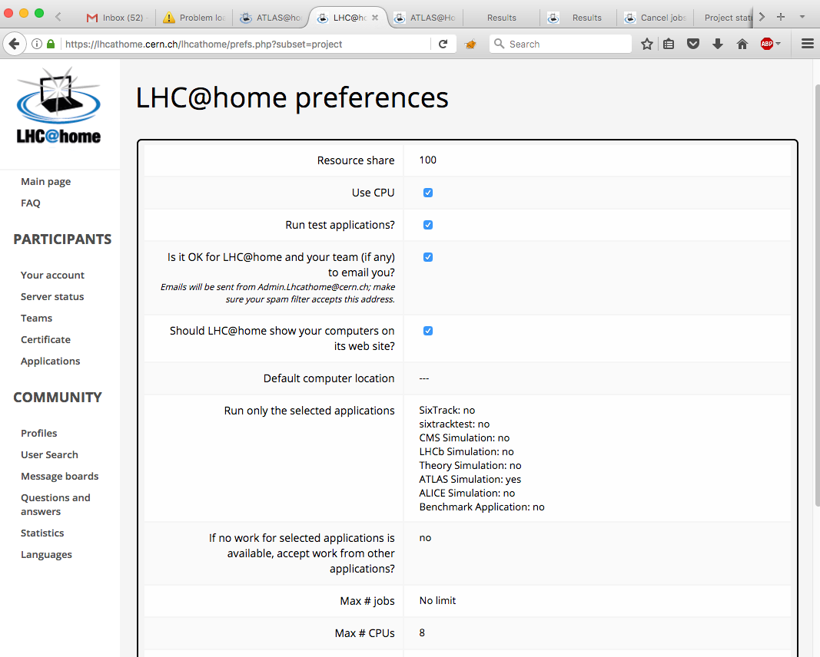

Slide 16
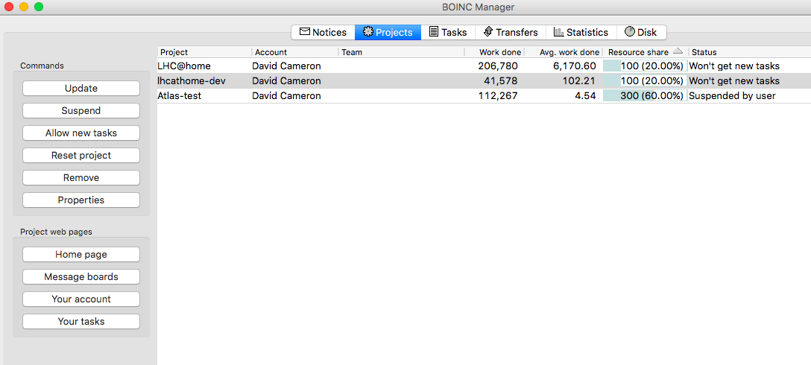

Slide 17
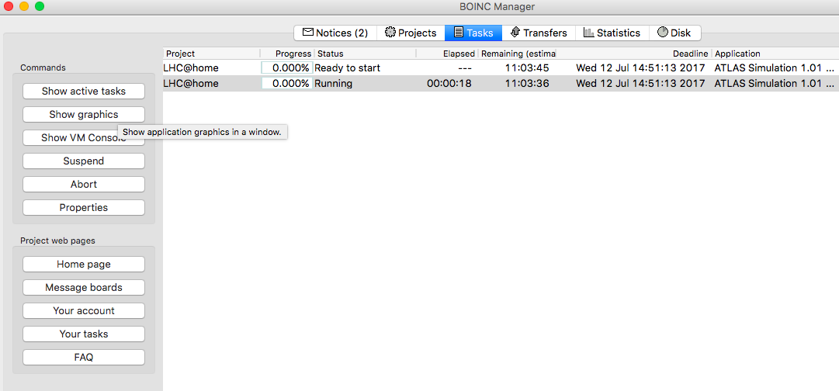
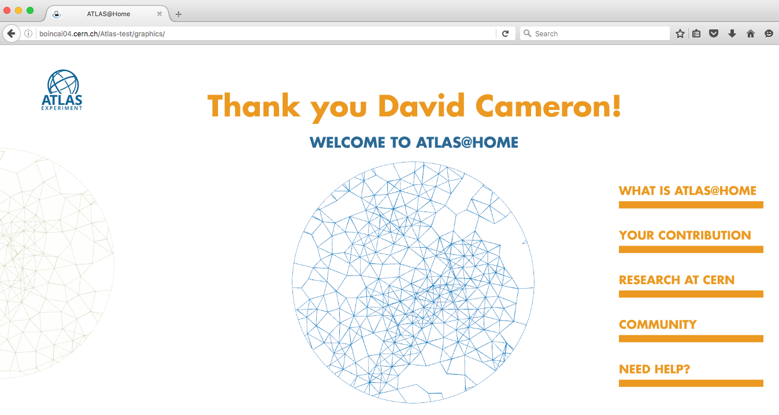
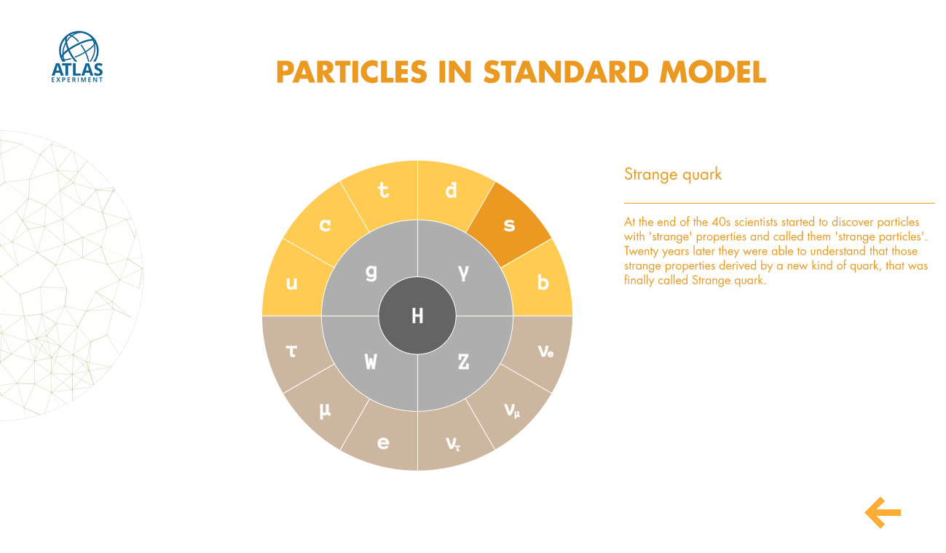
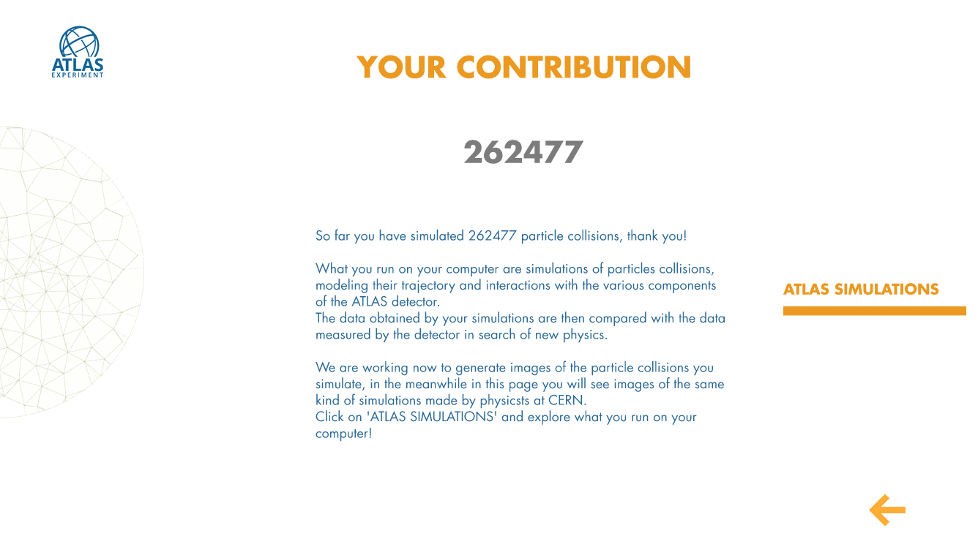
show graphics

Slide 18
Future Work
Many projects on-going at the moment
Integration with ATLAS Event Service, designed for opportunistic resources
  Volunteers prefer running a fixed length of time
  AES can allow this by uploading events as they are produced up to a fixed time limit after which the job is killed
A native version for Linux
  Just needs CVMFS and Singularity on the PC
Checkpointing
  Initialisation is a time (and not CPU-) consuming process – setting up software environment, reading conditions data over the network
  ATLAS@Home is the proof-of-concept platform for an effort to start jobs from a checkpointed image so they immediately use CPU
Other ATLAS workflows
  E.g. event generation (Bachelor student in Lund)
A great plaftorm for small projects and introduction to ATLAS/ARC distributed computing
Platform for other volunteer computing projects?

