Slide 1
Integrating the HPCs into the ATLAS production system via aCT+ARC-CE
ATLAS Qualification task
Maiken Pedersen
Andrej Filipcic, David Cameron

Slide 2


PanDA, ARC control Tower (aCT), and ARC Compute Element (ARC-CE)
CERN
PanDA uses pilot jobs that run directly on a sites worker nodes (left)
aCT is the layer between PanDA and NorduGrid, runs at CERN
aCT originally created for NorduGrid sites (and other HPC sites) that do not allow pilot jobs (right)
Panda
CERN
APF
Panda
aCT
pilot
Site
ARC CE
Data
Site
ARC CE
Data
WN
WN
Notes:
The PanDA Production ANd Distributed Analysis system
A “fake fat pilot” pulling jobs, sending them to ARC and dealing with communication with Panda
Started as ATLAS-specific project, now generic

Slide 3
ARC on an HPC (Abel@UiO as example)
CERN
Panda
ARC-CE is installed on a frontend that communicates with the outside world and with the underlying batch system
Grid functionality on frontend only. Batch cluster (worker nodes) non-gridified.
We use SLURM queuing system.
aCT
Data
Site
ARC CE
WN

Slide 4
ARC on an HPC (Abel@UiO as example)
CERN
Panda
ARC-CE is installed on a frontend that communicates with the outside world and with the underlying batch system
Grid functionality on frontend only. Batch cluster (worker nodes) non-gridified.
We use SLURM queuing system.
aCT distributes jobs to Nordugrid ARC-CE sites through gridftp
ARC picks up jobs (jobdescription) by listening to the designated ports for incoming jobs (2811 for gridftp, can also use 443 web-service, but aCT currently not set up for this)
ARC then takes care of all stages of the job-handling like
downloads necessary input files
translates the jobdescription to suit the local batch cluster
Once job is prepared, ARC submits the job directly to the computing clusters queuing system (SLURM, sbatch)
When job is finished ARC picks it up again and uploads any resulting files to predefined destination according to jobdescription
aCT keeps checking state of job (heartbeat), and reports back to PanDA.
aCT
Data
Site
ARC CE
WN

Slide 5
ARC on HPCs
Some HPC sites are very restrictive not allowing any communication with outside world.
Notes:
GridFTP is a high-performance, secure, reliable data transfer protocol optimized for high-bandwidth wide-area networks.
The GridFTP protocol is based on FTP, the highly-popular Internet file transfer protocol.
Any grid service needs to have a certificate issued by a trusted Certificate Authority (CA). A single machine, like a front-end running a CE, is identified by a host certificate.
EMI ES: EMI Execution Service
LDAP, Lightweight Directory Access Protocol, is an Internet protocol that email and other programs use to look up information from a server.

Slide 6
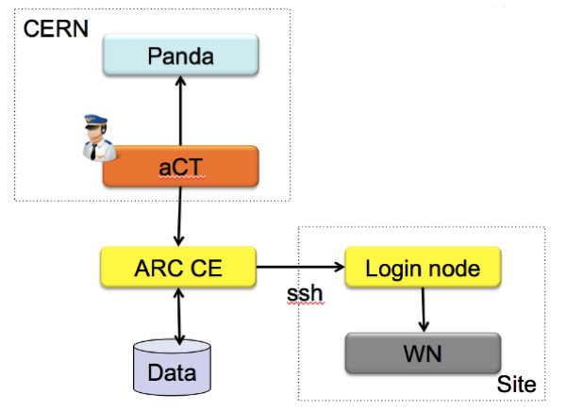
ARC on HPCs
Some HPC sites are very restrictive not allowing any communication with outside world.
Grid jobs can still run on these sites in various ways. E.g. with ARC-CE ssh-ing to sites login-node.
ARC through ssh
Notes:
GridFTP is a high-performance, secure, reliable data transfer protocol optimized for high-bandwidth wide-area networks.
The GridFTP protocol is based on FTP, the highly-popular Internet file transfer protocol.
Any grid service needs to have a certificate issued by a trusted Certificate Authority (CA). A single machine, like a front-end running a CE, is identified by a host certificate.
EMI ES: EMI Execution Service
LDAP, Lightweight Directory Access Protocol, is an Internet protocol that email and other programs use to look up information from a server.

Slide 7
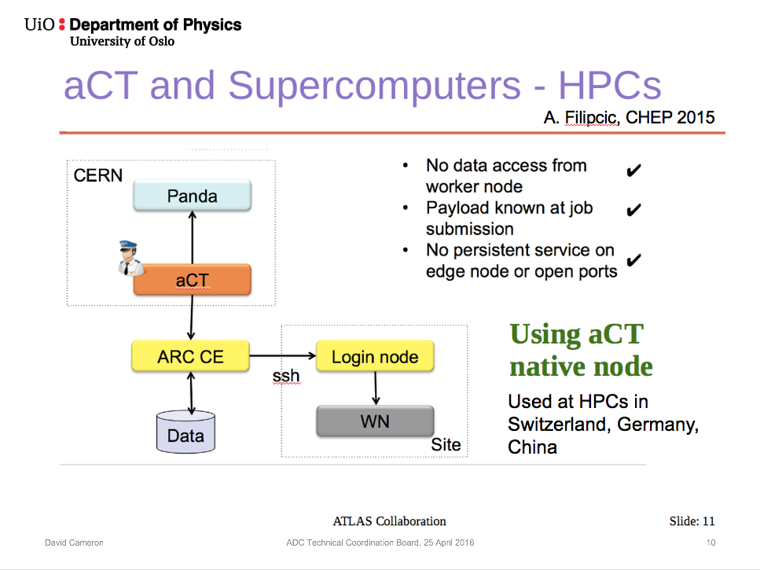
ARC and HPC: ssh connection to site
Several sites have ACT on server outside the cluster
ARC-CE connects to login-node through ssh

Slide 8
ARC and HPC: ssh connection to site
Several sites have ACT on server outside the cluster
ARC-CE connects to login-node through ssh
ARC and HPC: aCT @site
Qualification task implements a new way:
Installing an own instance of aCT on the site, with filesystem shared by ARC-CE.
Solution to same problem
Faster as everything will be direct
Given preliminary name: LOCAL plugin

Slide 9
Qualification task: Local aCT+ARC-CE
CERN
With aCT and ARC-CE installed at site, sharing filesystem
aCT grabs jobs from PanDA server, and locally feeds them to ARC-CE
no need to publish site information externally → ldap information system not needed
gridftp server not needed as jobs are fed from aCT to ARC internally
no need to require host certificate as aCT and ARC-CE are on the same host
Panda
Site
aCT
Data
ARC CE
WN
Notes:
GridFTP is a high-performance, secure, reliable data transfer protocol optimized for high-bandwidth wide-area networks.
The GridFTP protocol is based on FTP, the highly-popular Internet file transfer protocol.
Any grid service needs to have a certificate issued by a trusted Certificate Authority (CA). A single machine, like a front-end running a CE, is identified by a host certificate.
EMI ES: EMI Execution Service
LDAP, Lightweight Directory Access Protocol, is an Internet protocol that email and other programs use to look up information from a server.

Slide 10
Qualification task: Local aCT+ARC-CE
CERN
With aCT and ARC-CE installed at site, sharing filesystem
aCT grabs jobs from PanDA server, and locally feeds them to ARC-CE
no need to publish site information externally → ldap information system not needed
gridftp not needed as jobs are fed from aCT to ARC internally
no need to require host certificate as aCT and ARC-CE are on the same host
→minimal set of services → simplified job submission
→ no incoming connections
→ Lightweight aCT and ARC-CE beneficial for installation, configuration, maintenance
System administrator can run aCT and ARC-CE as own user (not root)
Panda
Site
aCT
Data
ARC CE
WN
Notes:
GridFTP is a high-performance, secure, reliable data transfer protocol optimized for high-bandwidth wide-area networks.
The GridFTP protocol is based on FTP, the highly-popular Internet file transfer protocol.
Any grid service needs to have a certificate issued by a trusted Certificate Authority (CA). A single machine, like a front-end running a CE, is identified by a host certificate.
EMI ES: EMI Execution Service
LDAP, Lightweight Directory Access Protocol, is an Internet protocol that email and other programs use to look up information from a server.

Slide 11
Qualification task: Local aCT+ARC-CE
CERN
With aCT and ARC-CE installed at site, sharing filesystem
aCT grabs jobs from PanDA server, and locally feeds them to ARC-CE
no need to publish site information externally → ldap information system not needed
gridftp not needed as jobs are fed from aCT to ARC internally
no need to require host certificate as aCT and ARC-CE are on the same host
→minimal set of services → simplified job submission
→ no incoming connections
→ Lightweight aCT and ARC-CE beneficial for installation, configuration, maintenance
System administrator can run aCT and ARC-CE as own user (not root)
→working on designing and implementing "local" job submission and management protocol in ARC client and server
→Given the working-title LOCAL-plugin
Panda
Site
aCT
Data
ARC CE
WN
Notes:
GridFTP is a high-performance, secure, reliable data transfer protocol optimized for high-bandwidth wide-area networks.
The GridFTP protocol is based on FTP, the highly-popular Internet file transfer protocol.
Any grid service needs to have a certificate issued by a trusted Certificate Authority (CA). A single machine, like a front-end running a CE, is identified by a host certificate.
EMI ES: EMI Execution Service
LDAP, Lightweight Directory Access Protocol, is an Internet protocol that email and other programs use to look up information from a server.

Slide 12
How are jobs handled? ARC-CE and A-REX (ARC Resource-coupled EXecution service)
The ARC Execution Service handles everything related to the execution of a job.
Once a job is picked up by A-REX it:
downloads necessary input-files according to jobdescription
submits job to the underlying batch system
uploads output files according to jobdescription

Slide 13
How are jobs handled? ARC-CE and A-REX (ARC Resource-coupled EXecution service)
The ARC Execution Service handles everything related to the execution of a job.
Once a job is picked up by A-REX it:
downloads necessary input-files according to jobdescription
submits job to the underlying batch system
uploads output files according to jobdescription
The job is picked up by A-REX once there exists a job.<jobid>.status file in the controldir
The controldir holds the metadata about a job (status, job description, list of input files and so on)
The new LOCAL plugin must therefore prepare the job up until the stage that A-REX picks it up

Slide 14
Submitting a job using the LOCAL submission interface
The job is submitted specifying the submissioninterface
org.nordugrid.local

Slide 15
Submitting a job using the LOCAL submission interface
The job is submitted specifying the submissioninterface
org.nordugrid.local
The LOCAL job-submission plugin (which is part of the ARC Client Components) receives the jobdescription passed on by the submission client
converts it to ARC readable format
creates a job-id
places the jobdescription directly onto the site’s controldir
creates the jobs sessiondir directly (sessiondir holds all input and outputfiles needed/produced by the job)
produces all other necessary files (.proxy, .local, .status) and places them directly in the controldir

Slide 16
Submitting a job using the LOCAL submission interface
The job is submitted specifying the submissioninterface
org.nordugrid.local
The LOCAL job-submission plugin (which is part of the ARC Client Components) receives the jobdescription passed on by the submission client
converts it to ARC readable format
creates a job-id
places the jobdescription directly onto the site’s controldir
creates the jobs sessiondir directly (sessiondir holds all input and outputfiles needed/produced by the job)
produces all other necessary files (.proxy, .local, .status) and places them directly in the controldir
From here on A-REX can pick up the job for execution

Slide 17
Extending ARC with LOCAL-plugin
Handles (or will handle) all expected job-manipulation requests
submission (e.g. from arcsub) → works
killing (arckill) → works partially
cleaning (arcclean) → works
information (arcstat) → works
getting finished job (arcget) → works

Slide 18
Extending ARC with LOCAL-plugin
Handles (or will handle) all expected job-manipulation requests
direct submission (e.g. from arcsub) → works
killing (arckill) → works
cleaning (arcclean) → works
information (arcstat) → works
getting finished job (arcget) → works
renewing proxy (arcrenew) → under construction
resuming (arcresume) → under construction
resubmitting (arcresub) → under construction
brokered submit – where resource must be matched with submission interface → under construction
→ However, not all of the “under construction” necessarily needed

Slide 19
User job-handling
Once the job is submitted, the full jobid is used for other job-manipulation like resubmit or kill
Jobid for local submission looks like:
local://arctest1.hpc.uio.no/78WNDm3iHSqnb4dOcqtdQWPmABFKDmABFKDmUtPKDmABFKDmb4DZEo
Instead of e.g for gridftp submission:
gsiftp://arctest1.hpc.uio.no:2811/jobs/jd8NDmEeHSqn7Up18nGEh2Sq9vMignABFKDmorGKDmABFKDmQUWvIn

Slide 20
aCT and the LOCAL plugin
Since aCT uses the ARC client, using local submission is transparent
the ARC client has a well defined API and plugins implement the API. This means a new plugin (e.g. the LOCAL-plugin) can be used without changing any aCT code
To-be-done: Implement changes in order for multiple aCTs to serve queues
Notes:
Not finished…

Slide 21
How to access computingresource information from the infoprovider?
computingresource info – xml-file from infoprovider has been made available in controldir/xml
used to be a hidden file in /tmp/ with random 6-char name, changed frequently (depending on site configuration and number of jobs)
now: info.xml in controldir
Should not need to be updated so frequently, as the computing resource is semi-stable (not as jobs that continuously change status)
LOCALPlugin will access the xml document created by infoprovider in order to check status of the site (like the sstat method in the EMI-ES plugin)
As the plugin is a client component, would like to avoid direct interaction with a-rex

Slide 22
Milestones
1. design and implement "local" job submission and management protocol in arc client and server 2. allow minimal aCT using sqlite and the local arc protocol 3. deployment on Oslo HPC/ARC-CE

