Slide 1
ATLAS Data Management:
Evolution & Impact on ARC
Vincent Garonne

Slide 2
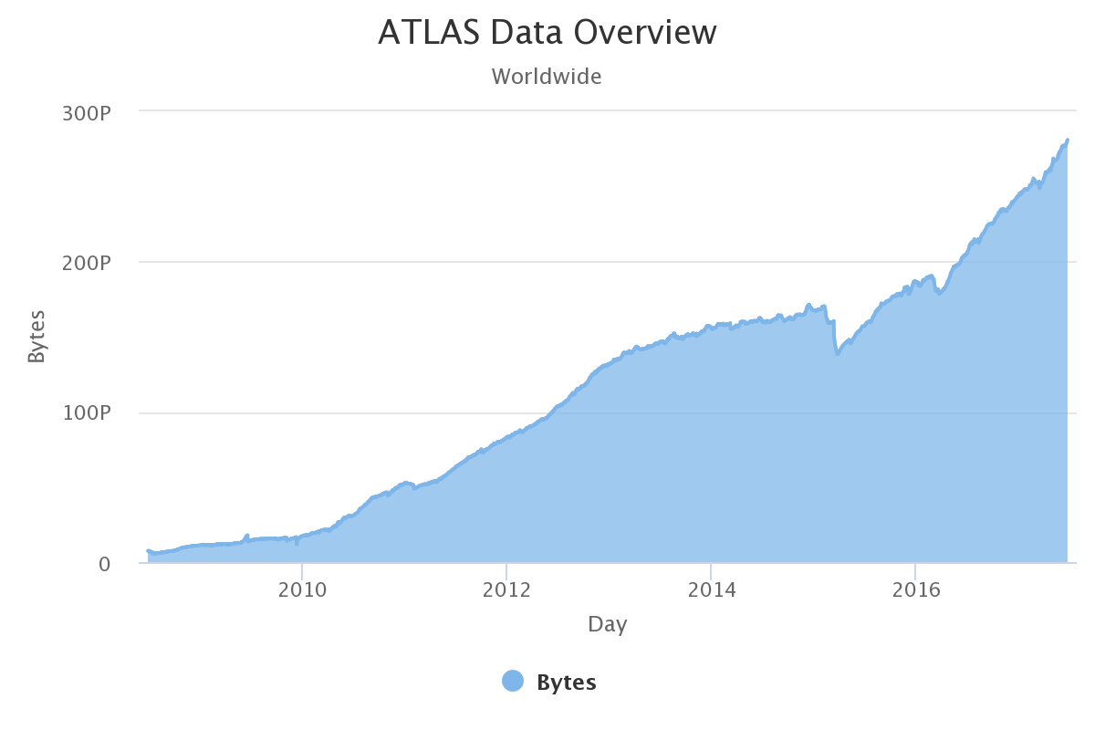
Current Scale
Almost 300 PB on 130 sites
1B file replicas
NDGF: 12 PB
  7,6 PB on DISK, 47M files
  4.3 PB on TAPE, 4 M files
40M file transfers/Month
20 PB data transfer/Month
100M deleted files/Month
30 PB deleted data /Month
Run-1
LS-1
Run-2

Slide 3
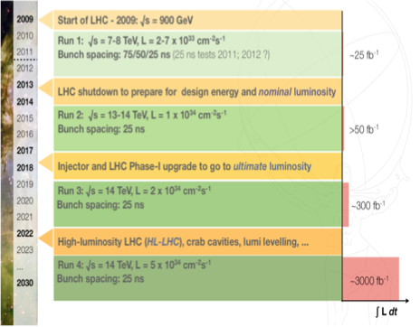
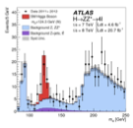



LHC Upgrade Timeline
Higgs discovery in Run-1
We are here: Run-2
High Luminosity:
the HL-LHC challenge

Slide 4
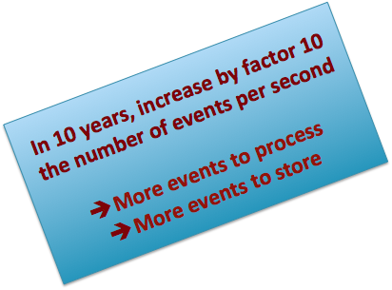
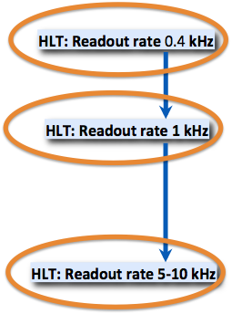
LHC Upgrade Timeline
Higgs discovery in Run-1
We are here: Run-2
High Luminosity:
the HL-LHC challenge

Slide 5
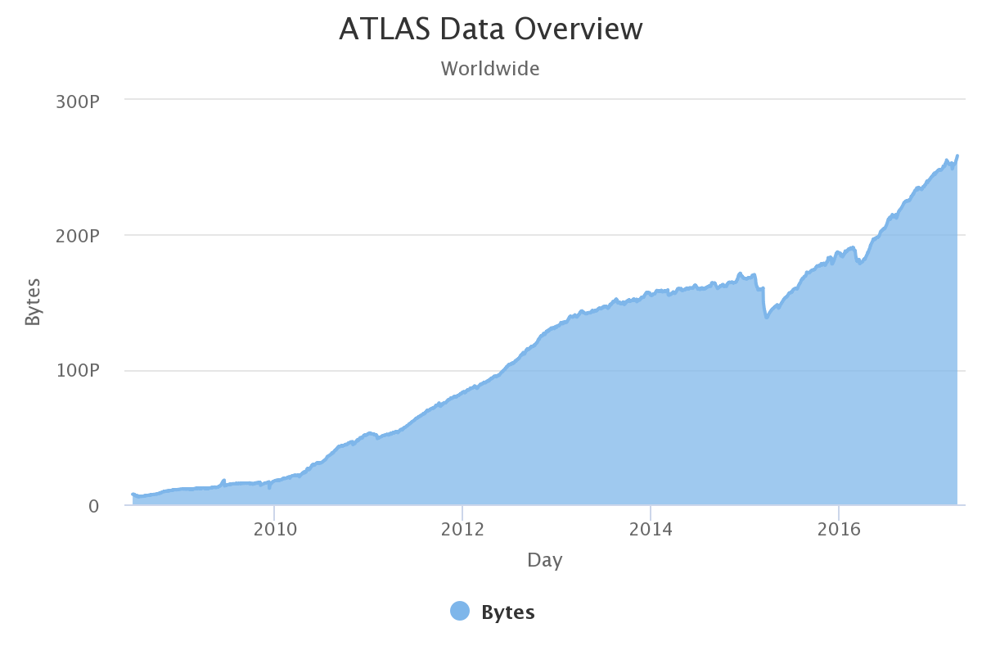
600P
500P
Exascale for Run-4 !
400P
300P
2018
2020
2022
2024
Run-1
Run-2
Run-3
Run-4

Slide 6
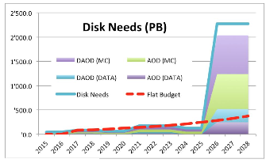
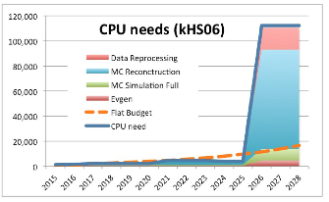
Will it scale ?
600P
Initial studies of computing for HL-LHC
500P
Exascale for Run-4 !
400P
300P
S.Campana
2018
2020
2022
2024
Run-1
Run-2
Run-3
Run-4

Slide 7
Future of Catalog ?
Most of DDM implementations for the LHC are based on catalog
  It’s convenient to have one global and fast index for job scheduling
  Easier to manage, few misses and availability > 99
  Flexible design with no dependence on particular implementation
  Follow the advances in databases, open and standard technologies
DDM has to scale with the (cumulative) number of data objects and operations
  Data object can be event(s), file(s), dataset(s), containers(s)
  Horizontal scalability as a strong requirement
  Today: 2.5 M transferred files/Day , Tomorrow: ? a factor 10 ?
I have observed a general trend to have more and more (physics) metadata in DDM to facilitate data selection, discovery and analytics

Slide 8
Third Party Transfer
The future of gsiftp is uncertain
  All ATLAS transfers are done with it !
The medium term goal is to do production transfers with alternative protocols
3rd party transfer tests with dav and xroot will be done in the next months
  Multi-sources transfers also coming
Is there a need to support natively third party transfer in ARC ?
  E.g., ACT & HPC use case

Slide 9
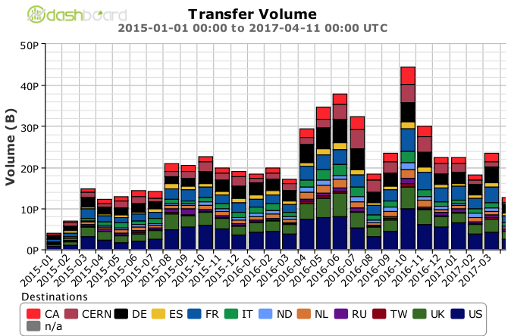
Network Evolution
Network Use in ATLAS
The biggest predictable gain will come from network and will strongly influence the experiments computing models
It’s coherent with our approach to use it more and more, e.g., remote i/o
By 2020, 800 Gbps waves should be possible but not from everywhere..
40 PB
40 PB/month ~= 14 GB/s (100Gbit+)
~X 4
12 PB

Slide 10
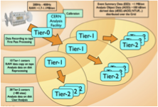
Future of DDM ?
Trends in data management
  Original model was based on network being the weak point
  But network has proven to be cheaper and better than expected
  Break the rigid hierarchical model of data flow and sending jobs to data
    Dynamic data placement
    Remote data access over wide area network
Need more disk but with flat budget
  Opportunistic resources, High Performance Computing (supercomputers)
  Cache, content delivery network, streaming

Slide 11
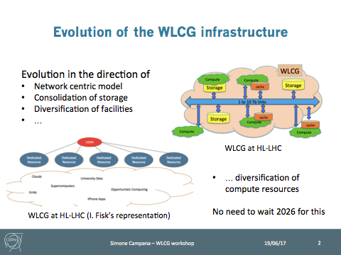

Slide 12
ARC & Cloud / Volatile Storage / Cache / Resources
Integration of new storage types is a constant need:
Objects store and cloud (volatile) storage to increase the total storage capacity
New protocols, e.g., swift
New authentication mechanisms, e.g., openID
Storage-less computing sites

Slide 13
ARC & ATLAS Event (Streaming) Service
Object-level (event) workflow instead of file-level
  In the future of ATLAS, the event should be the atomic information unit for information
  Dynamic data aggregation in data storage to best accommodate the specifics of the storage location and data transfer, i.e. the files are no longer static quantities
  Event-level granularity of event processing in heavily parallel computing environments
Today granular data handling at file level in ARC Cache
Direct (wan) I/O from jobs
  Impact on the brokering algorithm ?
  Possibility to expose cache content in Rucio
Can ARC cache be extended to cache events ? talk to the ATLAS Event Streaming Service ? move toward a Content Delivery Network model ?
  Event identifiers vs. hash(urls) ? AES →ARC Cache → Jobs ? AES + ARC Cache → Jobs ?

Slide 14


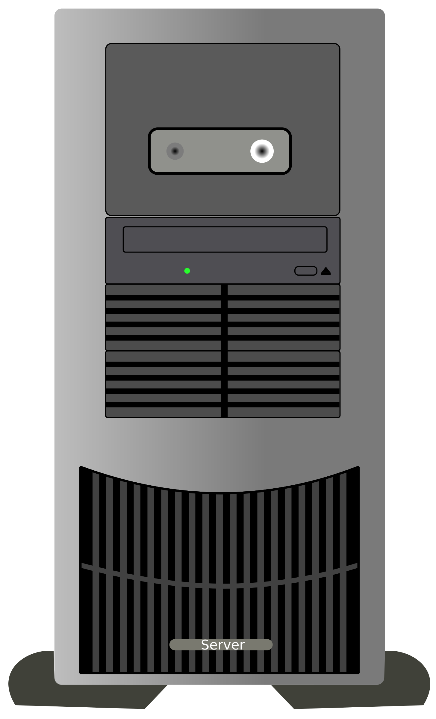
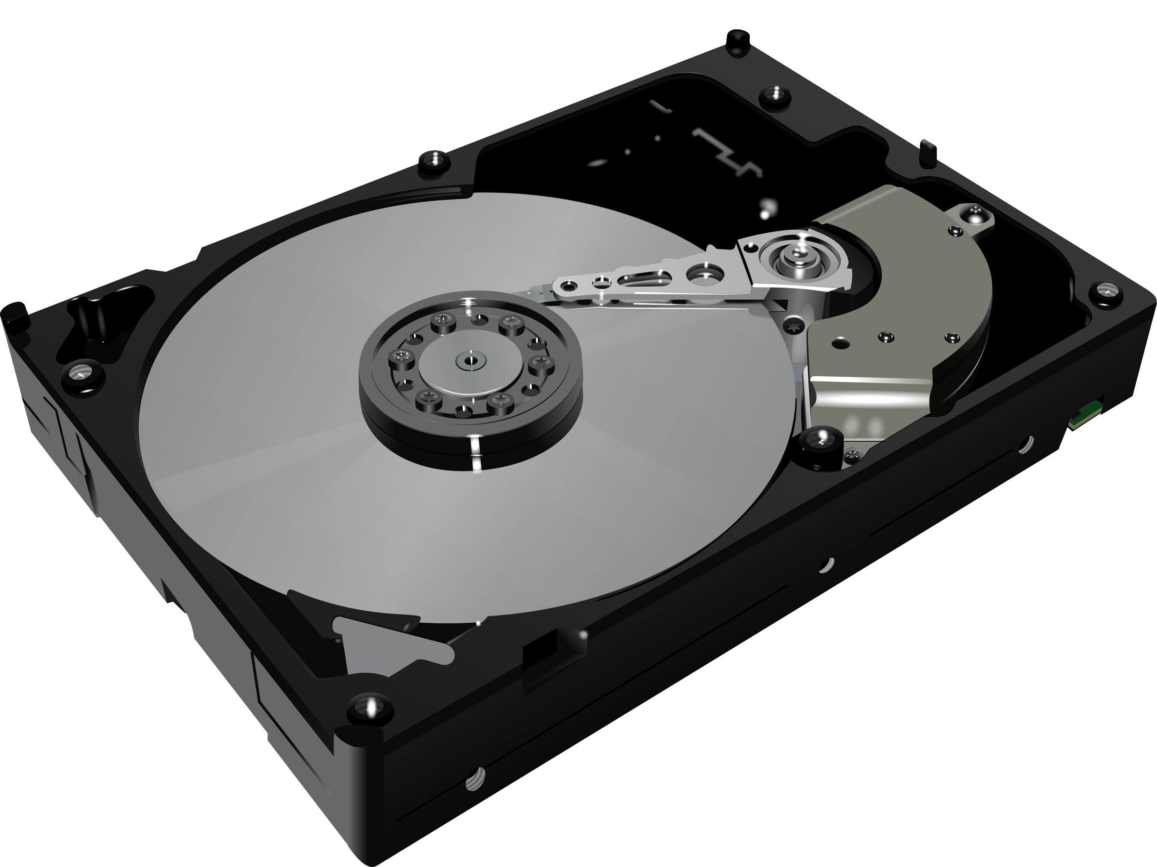
Xrootd Read-Only Cache: ARC ?
Unmanaged storage
Cache whole file /file blocks
SQUID-like:
xroot_proxy=”root://local.cache”
Optional
Update RUCIO:
add, delete files
root://local.cache//scope:file
root://RAL//dir1/scope/fa/6b/file
root://FZK//dir2/scope/fa/6b/file
MetaLink XML file:
<”1” root://RAL//dir1/scope/fa/6b/file>
<”2” root://FZK//dir2/scope/fa/6b/file>
RAL: /dir1/scope/fa/6b/file
FZK: /dir2/scope/fa/6b/file
↓
/scope/fa/6b/file

Slide 15
ARC & dCache ?
David: “Crazy idea some time ago about combining dcache disk pools and ARC cache at sites which have both. It’s related to having the knowledge of data locality in dcache”
…

