Slide 1
ARC release procedure migration to git next major release
Maiken Pedersen
Release manager

Slide 2
Current release procedure – when to release
A release-cycle is generally started once a sufficient amount or some sufficiently important fixes or features have been commited.
  Decision made in the nordugrid-core meeting (weekly)
A ”heads-up” email goes out in order for developers to finalize ongoing work they want included in this release
Bugfix release:
  Goal is to have bugfix release ca each month. Or at least bi-montly.
Minor release
  New features implemented
  Backward compatible
Major release
  Many new features
  Not backward compatible

Slide 3
Current release procedure
Procedure today
  Maiken
    makes overview of all commits to trunk in the so-called “svn-table”
    prompts developers to make a list of which of their commits are suitable for this release (based on the svn-table)
      Give a list of what commits belong together
      Write a summary slightly more informative than the commit messages to go to release notes
    merges the decided commits into a release-branch
    test-builds the release branch
  Anders
    makes a tag and fixes versioning
    resolves dependency problems if any
    makes the builds and tar-balls
  Mattias
    picks up tar-balls
    resolves dependency problems if any
    packages and distributes the rpms to EPEL
      Picks up the correct versions of the other packages such as nagios, ganglia etc to be distributed with the release
  Oxana
    Prepares new release-note template with updated version-numbers for Maiken to fill in
    Handles the translations (after all commits are done, the translation needs to be updated for correct page-references) and documentation
    Prepares the online release notes and links plus documentation

Slide 4
Testing procedure
Our testing procedure is not fully defined and operable.
After the problems with 5.3.0
  Need of test site: Andrej has a small cluster which can be used for testing
  Installation of release candidates on minimum 2 preferrably 3 sites
  Need rollback strategy if problem not quickly solved

Slide 5
Improvements could be
More automization
Quicker turn-around once new release is planned
More transparency
  Would like to be able to see what steps each responsible has done on a single progression page. E.g. jira-board
More stable build-service (rpm-production for all supported platforms)
GitLab hosted by Coderefinery will improve some of this
Testing (referring to previous slide)

Slide 6
Svn to git migration – GitLab @ Coderefinery
Made test-conversion with help from Martin and Radovan
  https://source.coderefinery.org/maikenp/arc
Suggest Fork-and-pullrequest workflow.
When developer works on e.g. a bugfix
  Forks the bugfix release-branch e.g. 5.3.1
  Implements fixes
  Sends pull-request to the bugfix release-branch 5.3.1
  Maintainer accepts pull-request and decides whether fix also should be implemented into the minor release-branch and the master
    If so merges the fix into minor and master branches
  Once all bugfixes are pulled to the bugfix branch, it is tagged for release

Slide 7
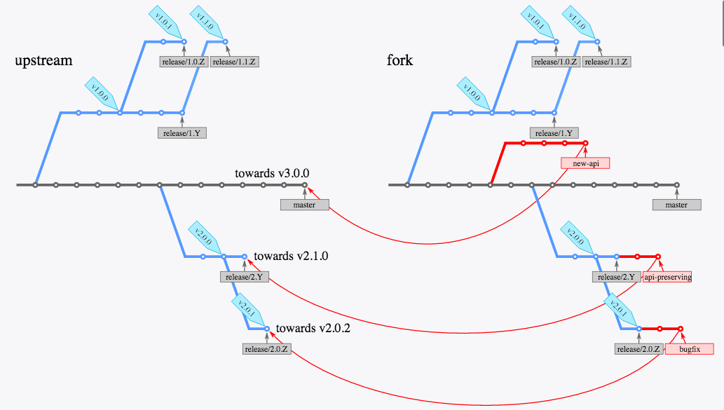
Semantic branching model https://dev-cafe.github.io/branching-model/

Slide 8
Benefits
Work-flow will now be to do a lot of forking, and to do coding towards designated branch rather than towards trunk as we have done previously.
Intent and scope of commits will be communicated by committing to the correct branch
  No manual ports later
  More code review possible before changes go into master(trunk)
The various commits relevant to a certain bugfix are pulled into the branch as one encapsulated ”package” after a pull-request
  With commit message that applies to the whole set of commits
  Changelog constructed at commit time
  Commit messages can be changed if more information is necessary or there is typo etc.
At release time, most of the work is already done, so turn-around will be much quicker
Notes:
https://git-scm.com/book/en/v2/Git-Branching-Rebasing

Slide 9


Slide 10
Next major release
ARC configuration restructuring
  Will help new deployments and also simplify the management of current sites.
  More streamlined block-naming, everything before a “:” are predefined block or subblock names – hereafter called options key. Everything after a “:” is considered a free name of the block, hereafter called option value(s).
  More details from Balazs
Python-lrms backend included
Event-driven job submission
ARCHERY
  See Andrii’s presentation
ARC 6.0 branch, branched off trunk
kept synchronized with trunk
once ready for deployment, the ARC 6.0 branch will be promoted to trunk
Notes:
release plans, release procedures, svn status. Content of the next major release. -- presentation by Maiken followed by discussions

Slide 11
Other release-related things
Confusing that we have (e.g.)
Nordugrid ARC 15.03u15 which contains
  ARC 5.3.2
  docs 2.0.16
  Nagios 1.9.1
  Gangliarc 1.0.2
docs should be moved into the main arc-repo and have same version number as the ARC code, since it is absolutely linked to the ARC code, and each version of the doc is related to the actual version of ARC, even if there are no changes in the doc
Could we change the name of the
  Nordugrid ARC 15.03u17 → Nordugrid GridSolution 15.03u17
  so a suitable word the scopes all the packages, and not only ARC?
  A better name is of course welcome!
Or if not, then I think that each of the other packages should be moved into the arc repository, but surely that is not practical or feasable
With the migration to git and new ARC major release we have the chance to rethink this!

