Slide 1
Introduction to ARC(6),
NG2018, Munich
Balázs Kónya, Lund University
NorduGrid Technical Coordinator

Slide 2
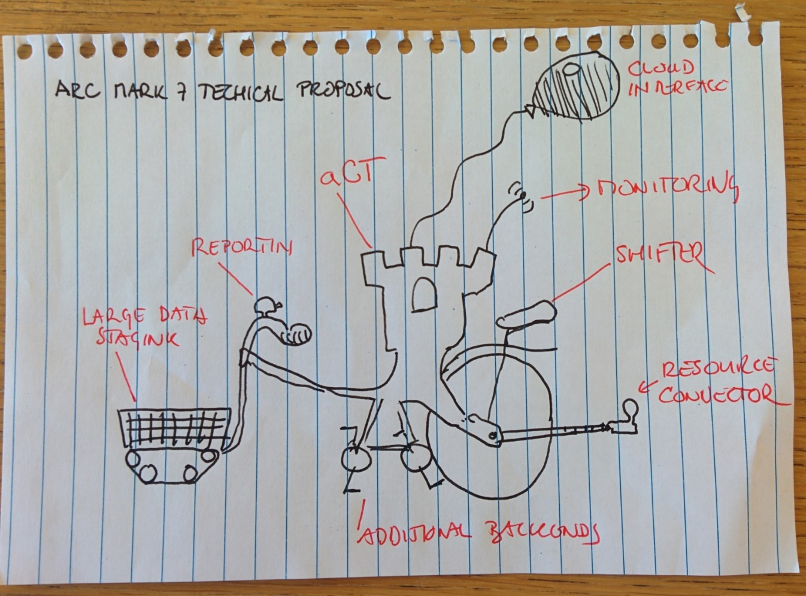
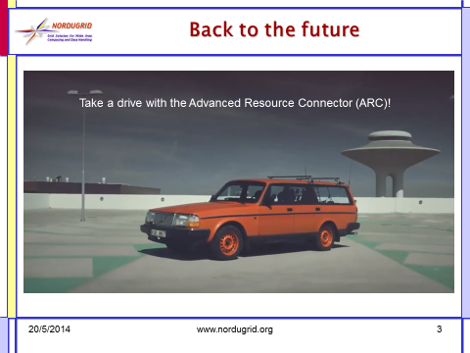

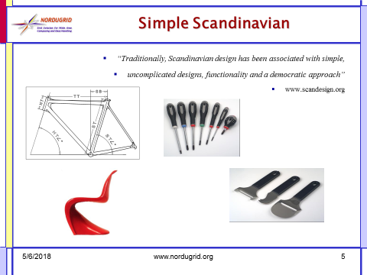
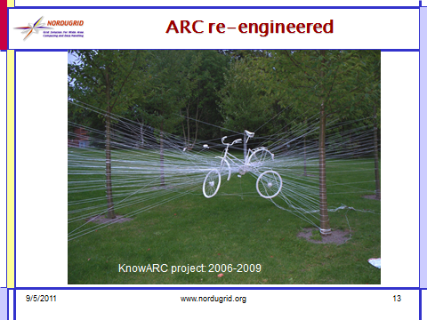

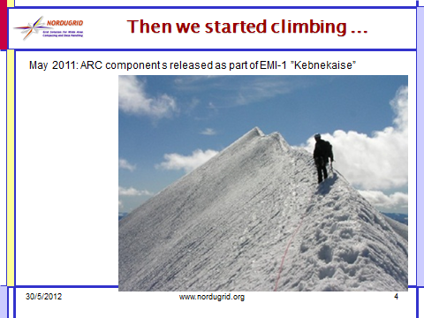
What is ARC?

Slide 3
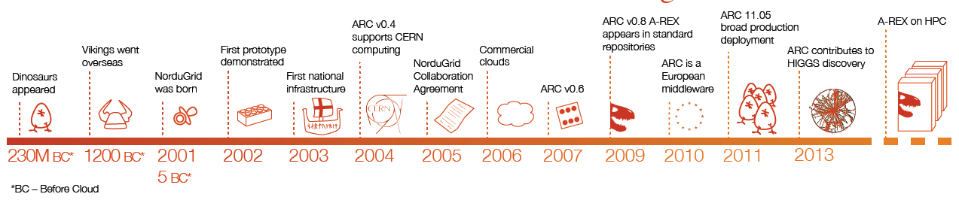
ARC history dates back 5 years BC

Slide 4

Original vision: utility computing
Develop a technology for utitilty computing
Large-scale distributed systems
General purpose, applicable for all areas

Slide 5
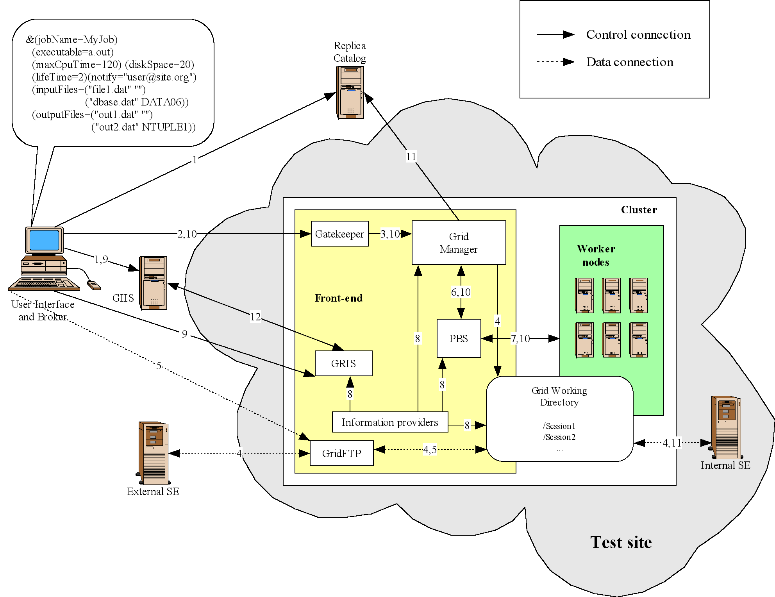
First prototype around 2002: reused what was available
Implementation strategy: start with something simple that works for users and add functionality gradually
Presented at 3rd NorduGrid project meeting, 23-24 May 2002, Helsinki
After two years of development and testing, the NorduGrid collaboration is pleased to announce
release 0.4 of its Grid middleware (also known as the Advanced Resource Connector),
the first official release of this software. April 13, 2004.

Slide 6
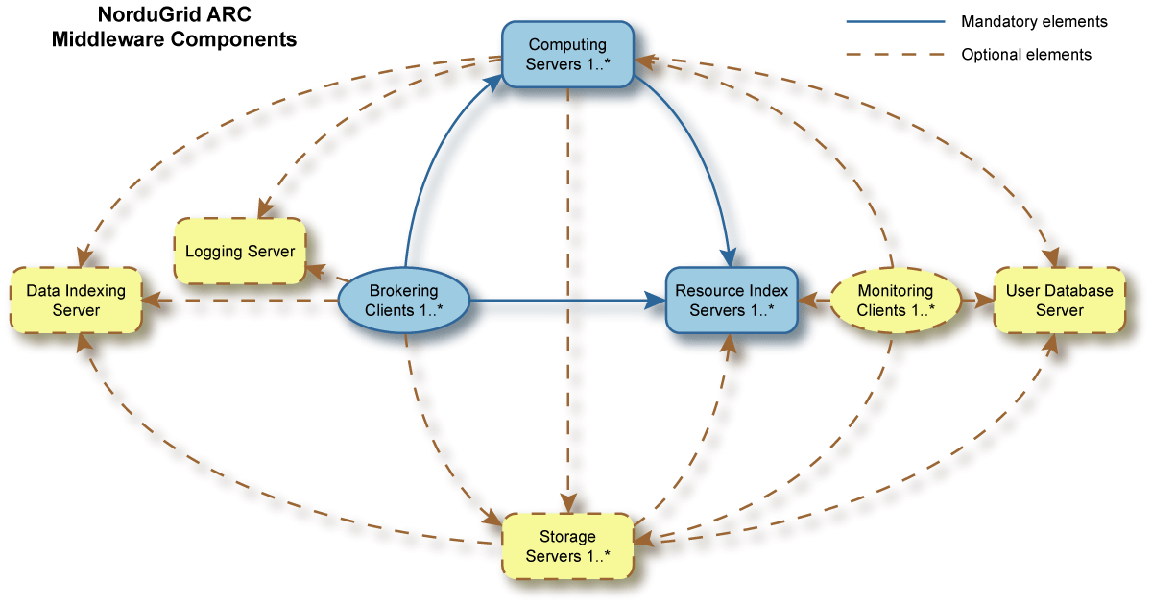
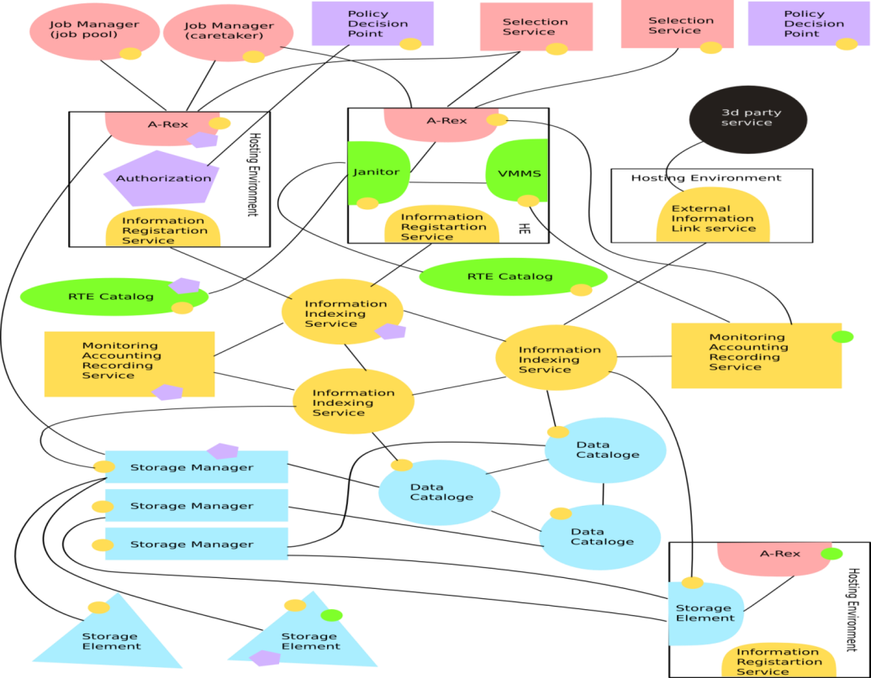
ARC re-engineered: SOA
May 22, 2007: Version 0.6, second stable release of ARC.
ARC v0.6 is not substantially different from version 0.4, the middleware is based on the same technology and consists of the same keonly minimal backwards compatibility with v0.4y components. Even if the underlying protocols are the same there is!
September 30, 2009: Version 0.8, third stable release of ARC with technology preview components.
May 10, 2011: The 11.05 release of the ARC software (version 1.0) represents a major change, for the first time in history of ARC introducing a very substantially re-written computing element (execution service), and for the second time - a re-written client component. Moreover, distribution and version conventions of ARC and its packages changed. Code repository underwent major changes as well.
HED
  Service container
  Modularity
  WS-layer
  Advanced Security

Slide 7
ARC as of Today
Middleware developed by Nordugrid Collaboration since 2002
  Open Source, mostly volunteer contributors
Key components:
  ARC Compute Element with support for most of the batch system
    Job control
    Resource and job information
    Data transfers and shared cache management
  Client tools (to interact with ARC CE and third-party services):
    Jobs submission
    Proxy management
    File copy
  API: (python) libraries providing interface to full software stack
    Custom services, Custom clients, eg arcControlTower

Slide 8
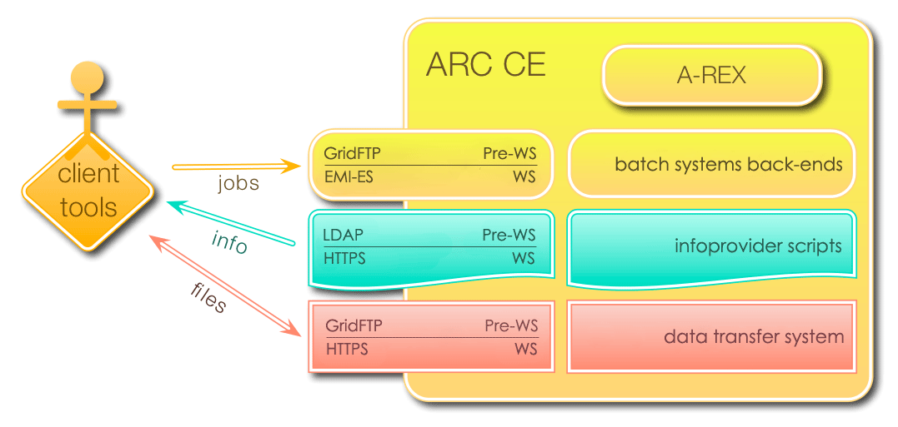
ARC CE as of Today

Slide 9
ARC major releases 2004-2018
http://www.nordugrid.org/arc/releases/
Release nr | Release Date | Major Change
Version 0.4 | April13, 2004 | First official release of ARC after two-year of development
Version 0.6 | May 22, 2007 | Same protocols nevertheless minimal backward compatibility with v04
Version 0.8 | Sept 30, 2009 | Contains technology preview of SOA ARC
NOX | Nov 30, 2009 | Separate release of SOA ARC
11.05 (v1.0) | May 10, 2011 | Very substantially re-enginered CE & clients
12.05 (v2.0) | May 21, 2012 | Further client-side changes, libarcclient
13.02 (v3.0) | February 28, 2013 | Several obsoleted components, numerous library name changes (libarcdata2 -> libarcdata)
13.11 (v4.0) | November 27, 2013 | new client-side job database
15.03 (v5.0) | March 27, 2015 | arc-ur-logger got replaced by JURA, removed several components, modules (old data staging)
VERSION 6.0 | 2018 (!) | see next slides

Slide 10

ARC 6: the motivation
Need for change:
  Internal scalability
  Configuration
  Interfaces
  Discontinued support
Major release allows:
  backward incompatible changes
  clean-up, consolidation, retirement
  substantial re-engineering

Slide 11
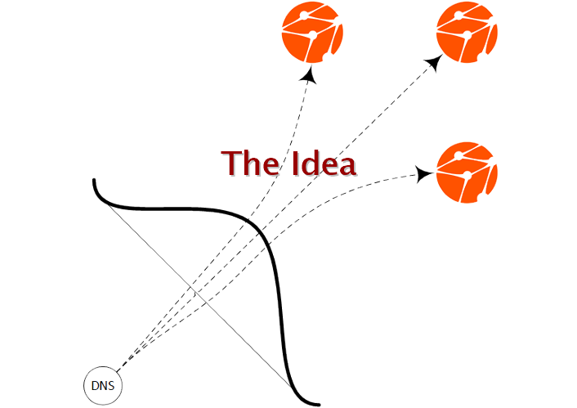
ARC 6 content: ARCHERY
ARC Hierarchical Endpoint Registry: a new service discovery
Use DNS infrastructure
Organize service endpoints in a hierarchical list
Top-bottom management

Slide 12
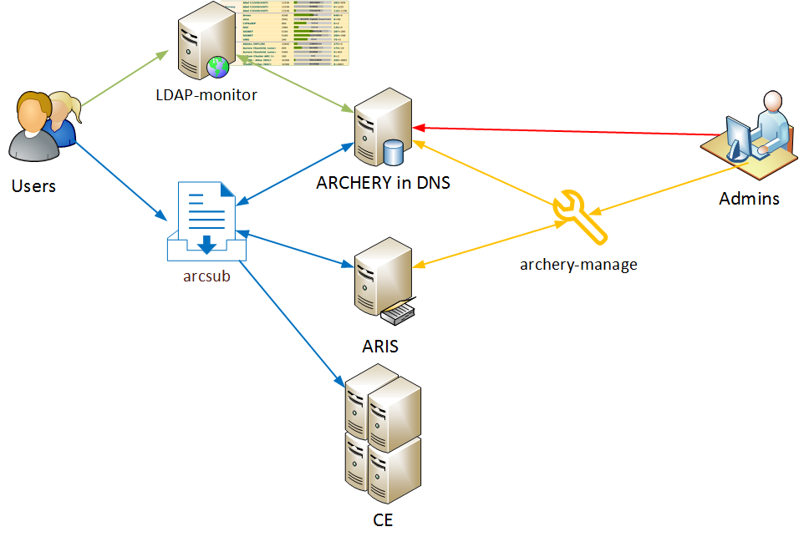
ARC 6 content: ARCHERY overview

Slide 13

ARC 6 content: new arc.conf
Self-growing configuration since 2002 ...
Several failed redesign attempts (xml, modularize, ini...)
  arc.conf.reference: 3334 lines
    Most of the new text is CHANGE description
  415 configuration objects of which 216 objects were changed
  74 objects tagged as DELETED
  configuration validator for ARC 6

Slide 14
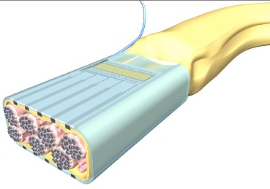
ARC 6 content: new server-side access methods
Production hardened EMI-ES CE interface
  A powerful Web Service interface for an ARC-CE, could replace LDAP & gridftp-job
  A kind of standard
    http://svn.nordugrid.org/repos/nordugrid/doc/trunk/tech_doc/emi-es/EMI-ES-Specification_v1.16.pdf
  Job management, state model, data staging, job & cluster information, delegation, job description, bulk job operations
  Could replace LDAP and gridftp-job services
Technology preview of a new REST CE interface
“local” job submission mode/interface

Slide 15

ARC 6 content: new internals
Event-driven job processing
new framework for RTE management
new Python-LRMS backends
Unfortunately no new security layer (yet)

Slide 16
ARC 6 content: few lines about the client side
set of commands to interact with ARC services from the command line
  arcsub, arcget, arccp, arcproxy, ...
ARC SDK library for 3rd party developers
  to write higher-level frameworks, utilities or integrate ARC services into applications
  set of c++ libraries: common, compute, credential, data, datastaging
  also available in Python via Swig bindings
  The arc* CLI and the aCT implemented on top of the SDK
ARC 6 Status:
  Very limited development
  Mostly code cleanup

Slide 17

ARC6: major cleanup
To be OBSOLETED with ARC 6:
EMIR, EGIS, CREAM, UNICORE, JAVA-SDK, Solaris & Windows ports, …

Slide 18

ARC 6: The new release
New source code management system: GIT
New package structure
New versioning scheme
  From now the release number will be identical with the git tag (like 6.0.0) of the core ARC
ARC 6 will consist of:
  core (server side)
  client & sdk
  metapackages
  release note
  …everything else will be distributed as a separate product

Slide 19
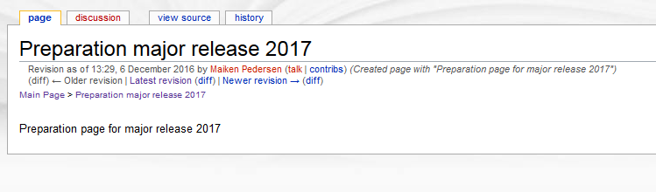
ARC 6 release timeline
ARC 6 preparation started in 2016
Then, we created a dedicated working area in wiki:
  http://wiki.nordugrid.org/wiki/Preparation_major_release_2017
As of NG2018, there is an ARC 6 code that builds ☺ and contains 89% of planned functionality
Test campaign during the Autumn with series of alpha/pre-6/rc-x releases
Target ARC 6 release date: not yet decided

Slide 20
Follow up from Tromsø
Conclusions from NG2017:
  Overloaded and occupied by the “business as usual” fixes & small improvements
  At the same time busy with major developments
  ..thus ARC6 (the next major) is in the pipeline
  …unfortunately, we can’t talk about a „BIG NEW THING” (yet)
  ARC has a well-understood use-case (LHC lockin)
  Importance of DATA
  A middle layer over batch systems
  With heavy security
  Overhead due to standard-compliance
  Open source community with no “big project” behind

Slide 21

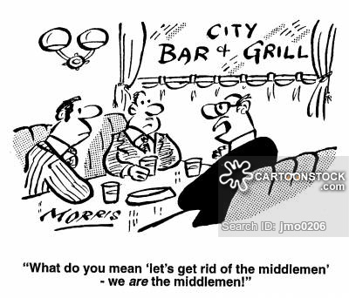
Post ARC6: howto modernize the dinosaur?
a) develop a vision of something great..
b) understand that ARC has always been a middleware..

Slide 22
Summary
ARC provides solid service and building blocks for WLCG computing
ARC 6, our next major new release is around the corner with focus on
  Scalability
  Simplification
  Stability
  Backward incompatibility
At the same time post ARC6 development ideas are appearing

